Slide 1
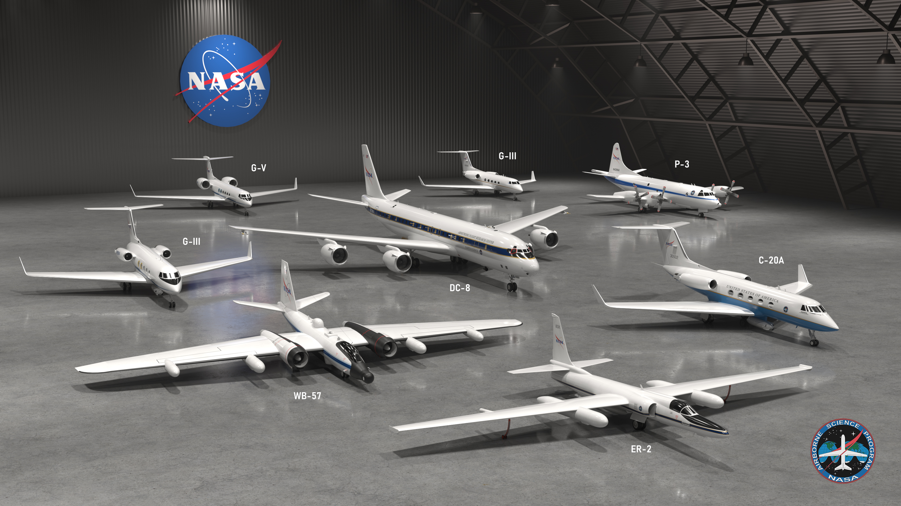
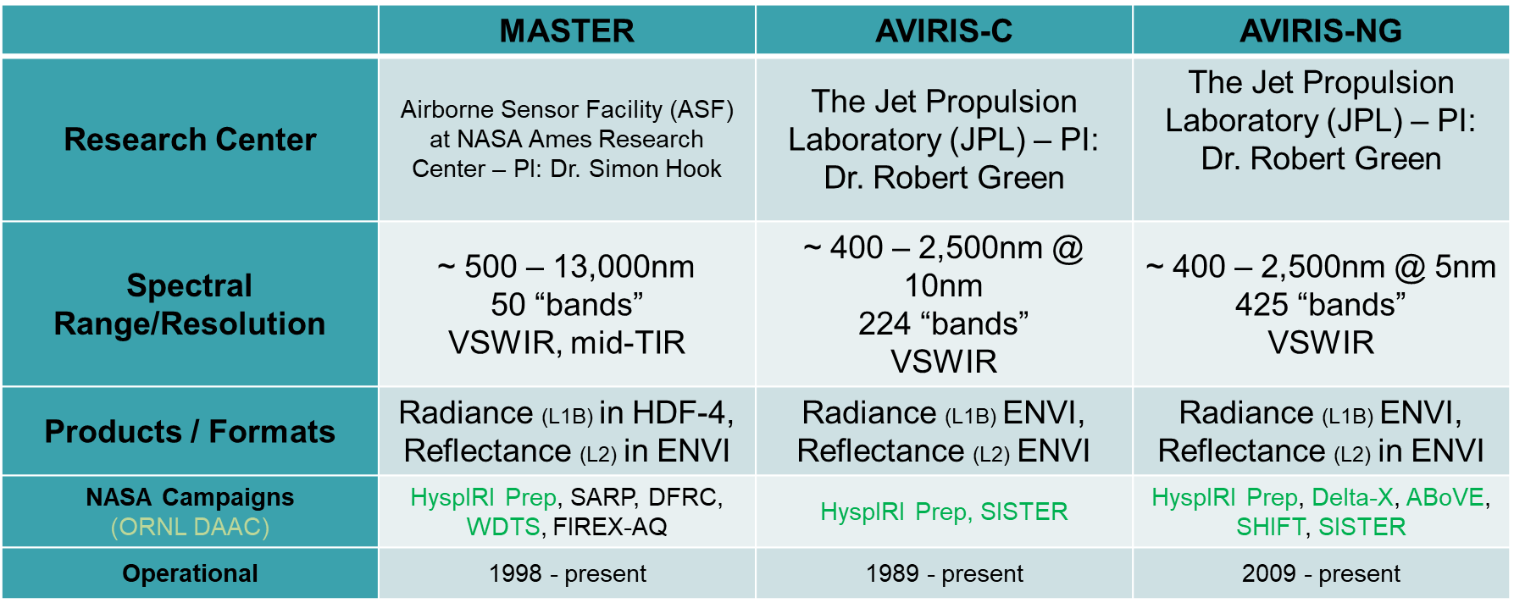
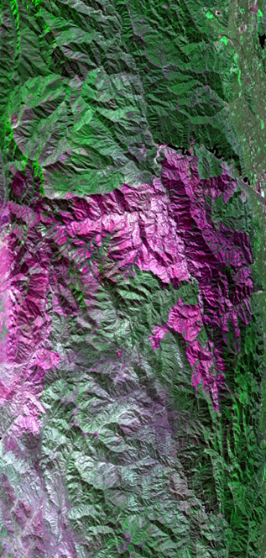
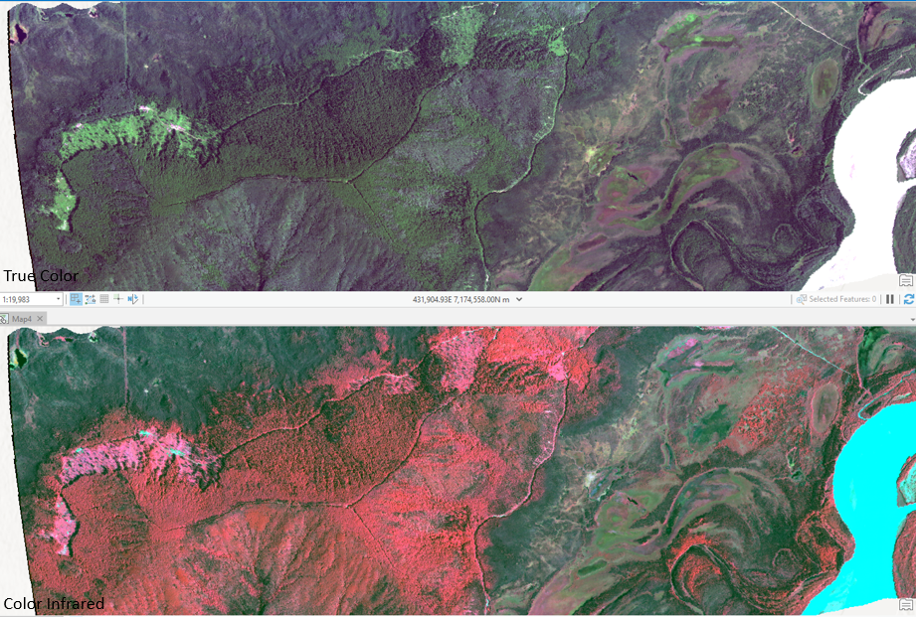
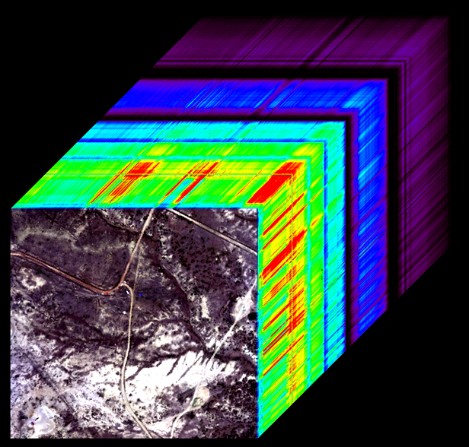
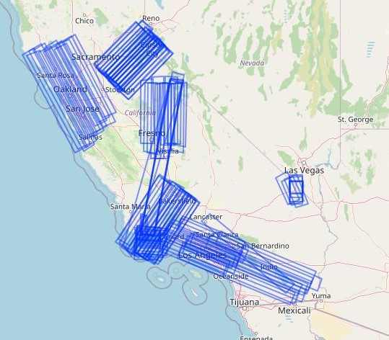
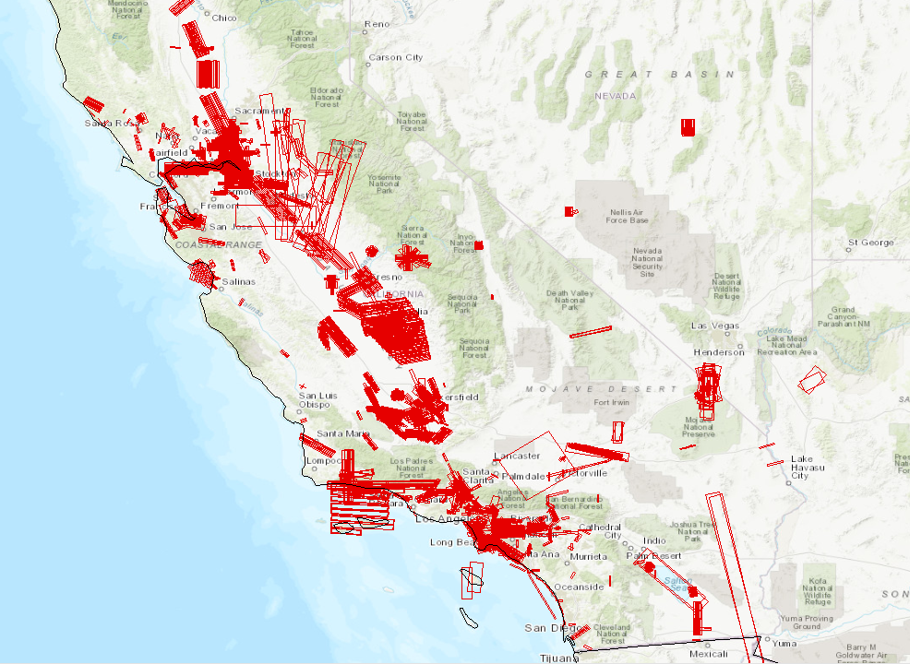
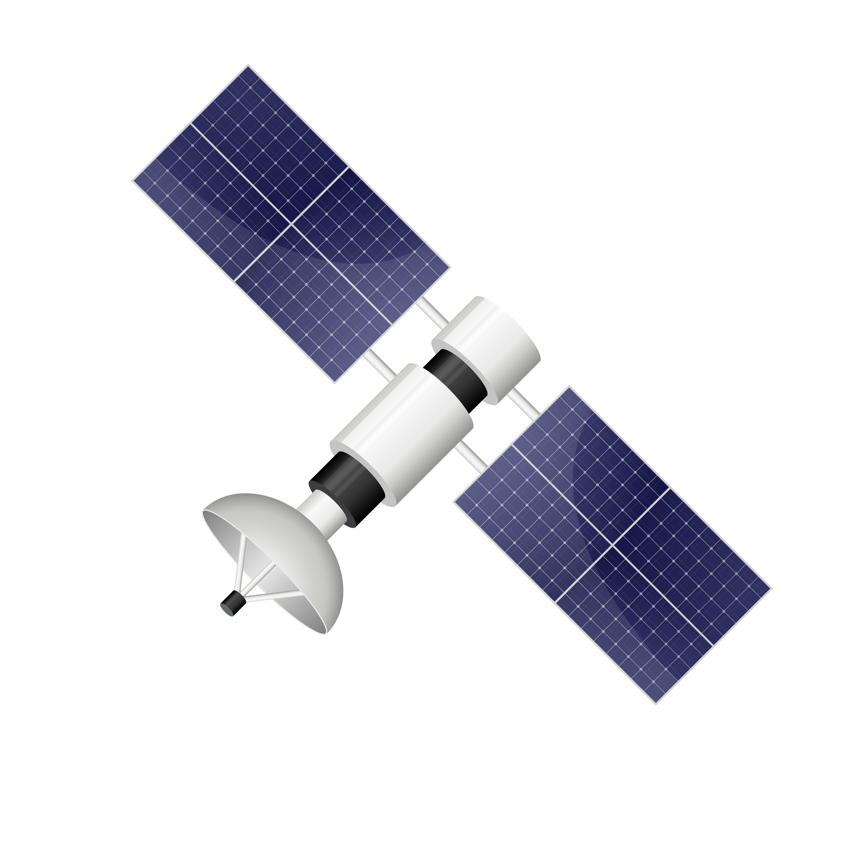
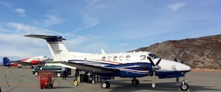
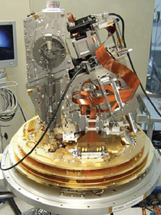
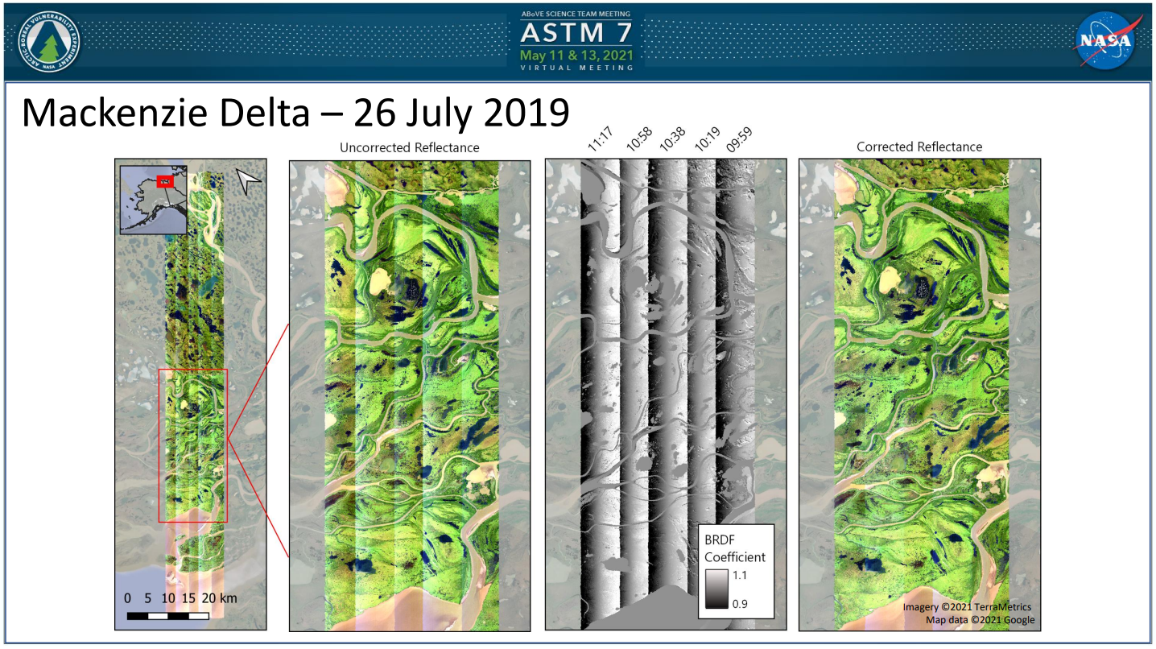
NASA Airborne Facility Instruments at the ORNL DAAC:
Opportunities for Open Access and Open Science
Michele M. Thornton*¹, Scott Pearson¹, Rupesh Shrestha¹, Yaxing Wei¹, Chris Lindsley², Bruce E. Wilson
Oak Ridge National Laboratory (ORNL²) Distributed Active Archive Center (DAAC¹), Oak Ridge, TN
*email: thorntonmm@ornl.gov
NASA Airborne Science Program
ORNL DAAC: NASA Airborne Facility Instruments
The ORNL DAAC is the DAAC of Record for 3 Imaging Spectrometer NASA Facility Instruments
MASTER
(MODIS/ASTER Airborne Simulator)
AVIRIS-Classic
(Airborne Visible/Infrared Imaging Spectrometer)
AVIRIS-Next Generation
https://airbornescience.nasa.gov/sites/default/files/pages/ASP_2022_HANGAR_001.jpg
NASA’s Airborne Science Program is responsible for providing aircraft systems that further science and advance the use of satellite data
Primary Objectives Include:
Satellite Calibration and Validation
Support New Sensor Development
Contribute to Process Studies
High-resolution measurements of complex systems
Coupled to global satellite observations
Develop the Next-Generation of Scientists and Engineers
MASTER Flight Paths: sample
AVIRIS-NG Flight Paths: sample
MASTER and AVIRIS Instrument data can be coincident with each other, satellite overpass, and relevant field measurements
https://avirisng.jpl.nasa.gov/science.html
NASA Earthdata Cloud Benefits for Airborne Data
NASA Airborne Facility Instruments (FI)
Historic Data
NASA Earthdata Archive long-term preservation
Data provenance
File and collection metadata / coincident data discoverability
S3 access and cloud compute capabilities
Airborne instruments or instrument/platform combinations
Operate out of a NASA research center
Support multiple science disciplines, field investigations, and NASA science objectives
NASA science research community via a request system
In many cases, all data from a facility instrument are archived together at one NASA DAAC
King Air B200
Cloud Optimized
Create cloud-optimized mirror-copy of historic data using Community Standards
Coordinate with and consider NASA ESDIS-wide tools and services
Develop or point to Notebook Tutorials for common cloud-optimized needs
User Community
Leverage NASA Facility Instrument and Science Teams to expose analysis and methods to the broader user community
Develop and provide opportunities to user community through workshops, webinars, and learning resources
CAD model of the AVIRIS-NG sensor
https://cce-datasharing.gsfc.nasa.gov/files/conference_presentations/Talk_Queally_35_27.pdf
Oak Ridge National Laboratory is managed by UT-Battelle for the US Department of Energy
The Oak Ridge National Laboratory Distributed Active Archive Center for Biogeochemical Dynamics operates under an interagency agreement between NASA and the U.S. Department of Energy

