Slide 1
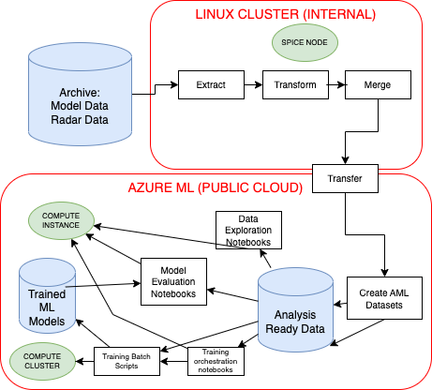
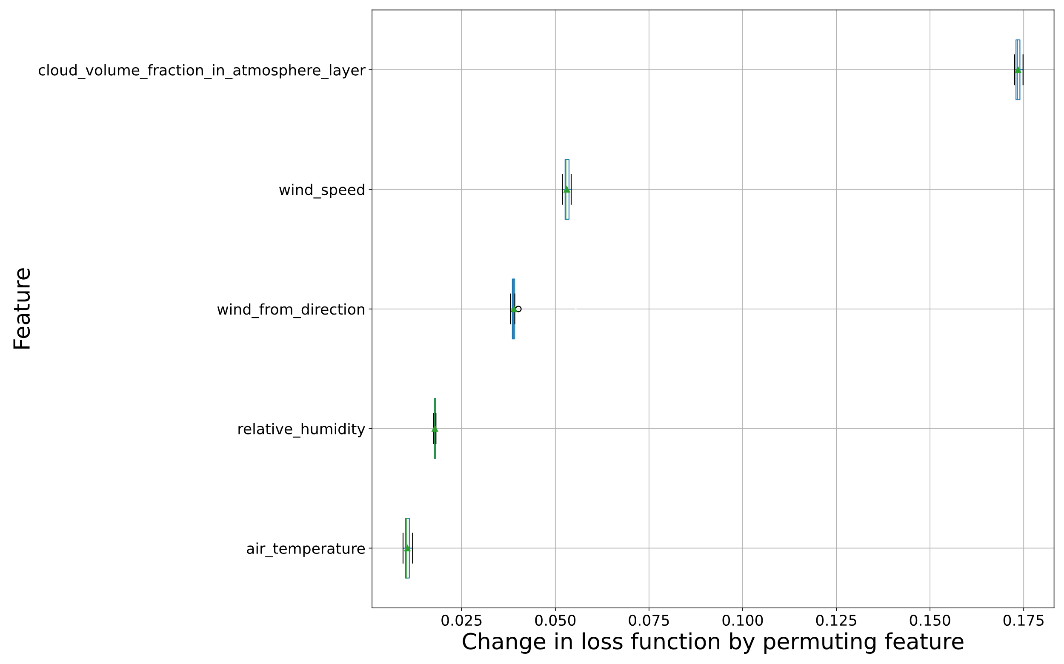
Precipitation Rediagnosis A Use Case for exploring MLOps for research machine learning projects in Weather & Climate Hannah Brown, Stephen Haddad, Peter Killick, Aaron Hopkinson, Nigel Roberts, Stephen Ramsdale
Idea & Aims
Creating Analysis-ready Datasets is Challenging
How to do open, reproducible ML research leading to reliable ML based products?
What additional tools and practices are needed for ML projects?
How do we build trust in model and results?
What is different about MLOps in an environmental research context?
How can we develop best practices?
Pick Use Case: improving precipitation forecasts using machine learning
Explore tools and techniques through Use Case to recommend for efficient, reproducible Data Engineering & MLOps
Data wrangling is significant time sink
How can this be made easier and faster to respond to science needs?
Input: Fields from coarse resolution global forecast
Target: Precipitation measured by radar
What were the challenges?
Reproducible, scalable workflow
Regridding / homogenizing data
Data and ML pipelines
MLOps Tools for W&C
Taking it forward
Initial processing done locally to reduce data transfer
Model training done on Azure ML (scalable hardware - GPU)
1: Data Workflows – Dagster
2: ML at scale – Azure ML Clusters
3: Data Sharing – Azure Datasets, Intake
4: Environments – Conda, Docker
5: Dashboards – Tensorboard, ML Flow, Azure ML and custom
Important for Explainable AI (XAI)
Create a publicly accessible dataset (ML competition?)
Best practice checklist with recommendations of tools & practices from experience
Create dashboards for sharing results, metrics, XAI
1
4,5
3
2,4

