Slide 1
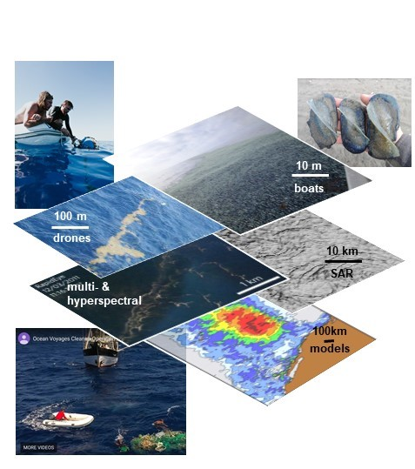
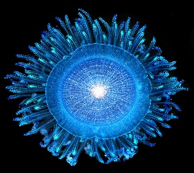
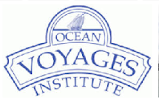
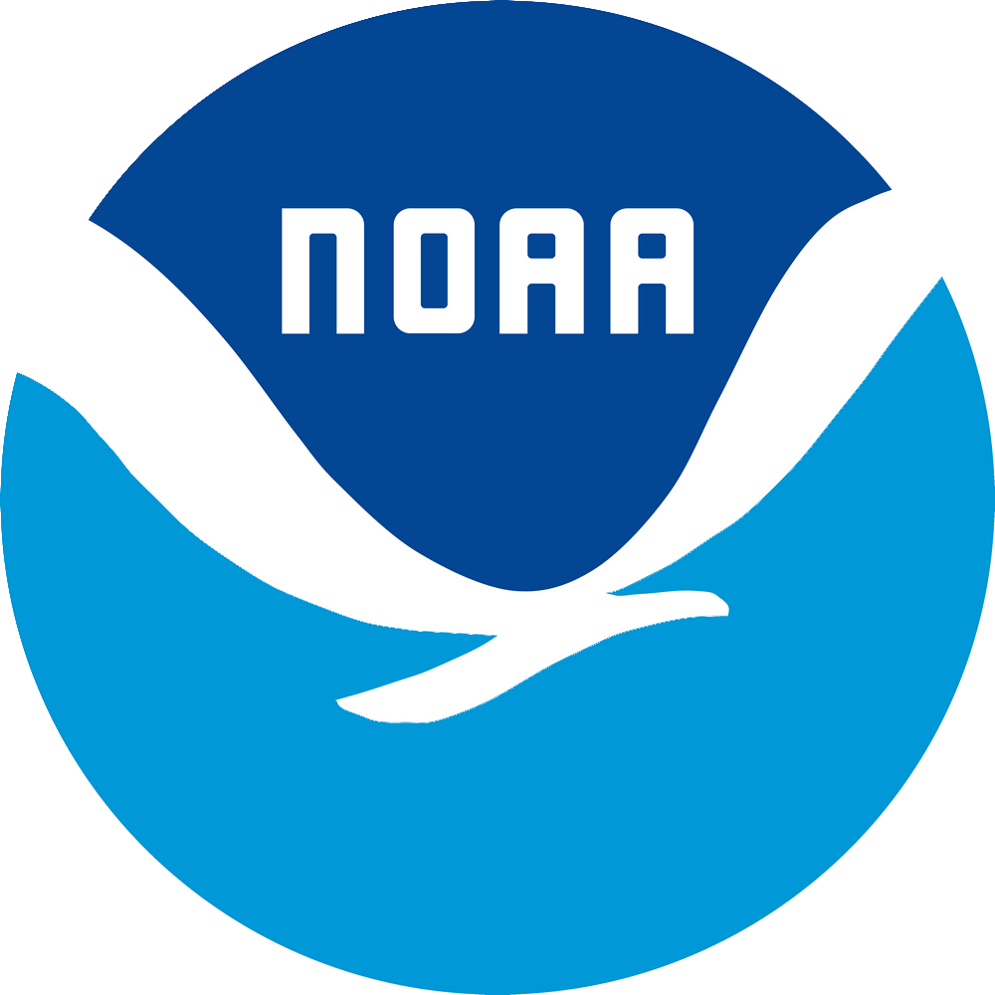
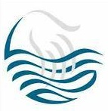
2022 ESDSWG Meeting
GO-SEA project
“Collaboration with citizen scientists
to enhance open ocean and coastal
observations and sampling and to augment
Impacts and utility of remote sensing for physical, biological, ecological, and environmental studies and applications”
Nikolai Maximenko, Rebecca Helm, Mary Crowley, Linsey Haram, Chela Zabin, Davida Streett, Justin Stopa, and Lauren Biermann
(marine physicists, biologists, and satellite and operations experts)
Our mission: 1) Train and equip curious and enthusiastic individuals who want to be part of furthering ocean research; 2) Engage them in cutting-edge research by collecting observations and samples in open ocean and shoreline habitats where scientific resources are scarce.
Scientific tasks include:
- Connect different spatiotemporal scales and different disciplines
- Connect in situ observations with remote sensing and models
- Observe and understand changes in pelagic ecosystems
- Observe and understand the dynamics of transient ocean features and their roles in transport of marine debris and biota
Status: active through webpage, Instagram, Twitter, Open Lab, etc.

Slide 2
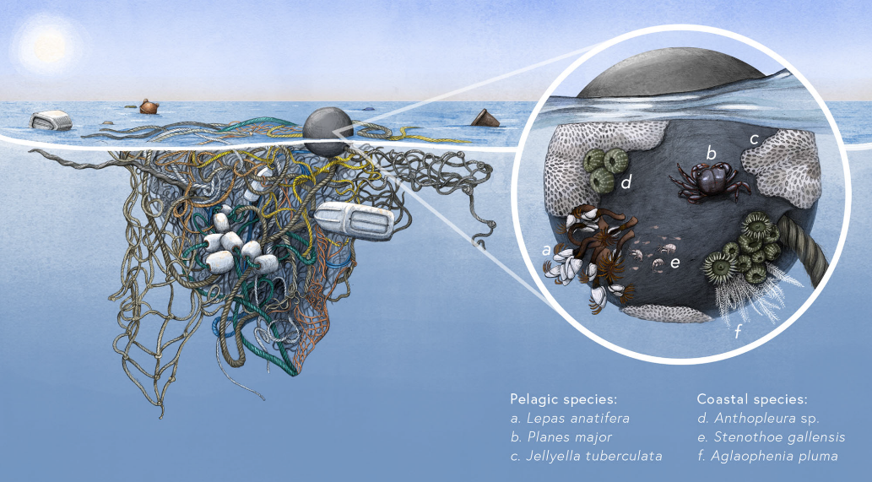
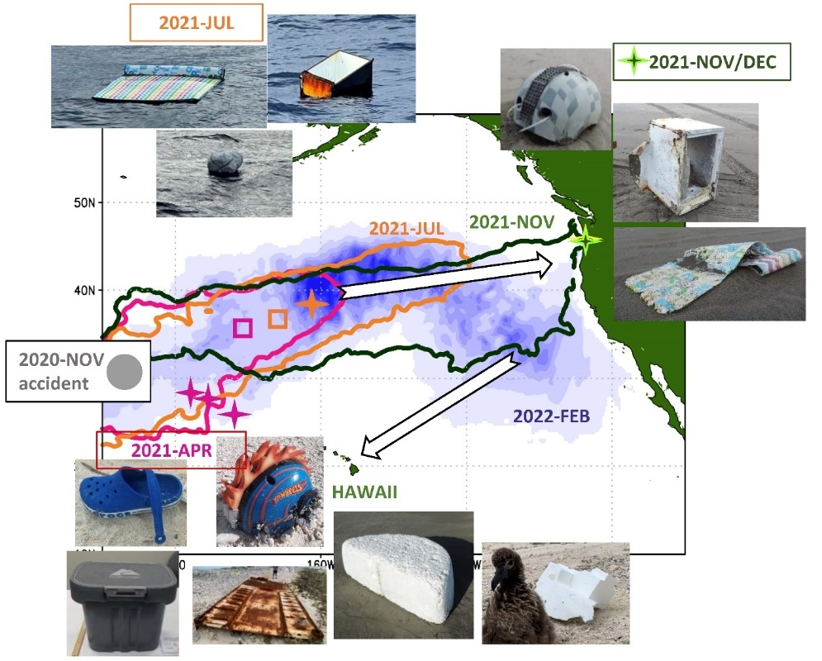
A successful NASA-funded scientific project based on collaboration with citizen scientists has
multiple criteria to satisfy and should include comprehensive communication and logistical plans.
Focus on actual scientific questions/problems prioritized by NASA and a broader scientific community.
Cross-ocean and ocean-shoreline connectivity via debris and neuston transport by currents.
Example A. Neopelagic ecosystem
Haram et al. (Nat. Comm., 2021) described a neopelagic ecosystem,
emerging in the North Pacific following accumulation of
anthropogenic debris in the “garbage patch”.
Example B. December 2020 ONE Apus Container spill
Synthesized with model, sparse observations allow to track
dispersion of plumes of unusual or dangerous debris and
warn ocean users.

Slide 3
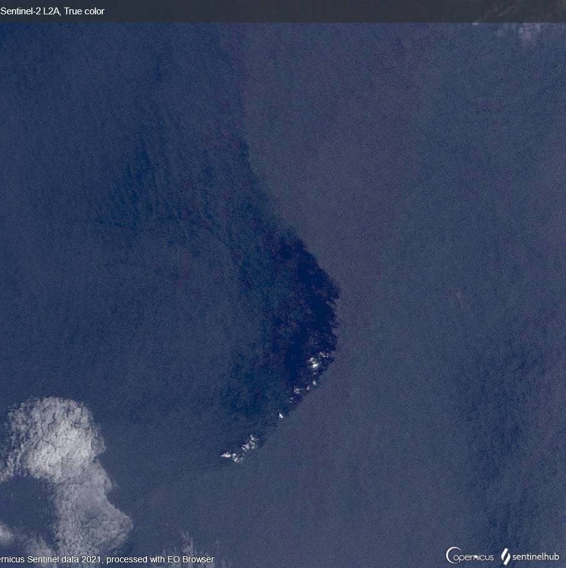
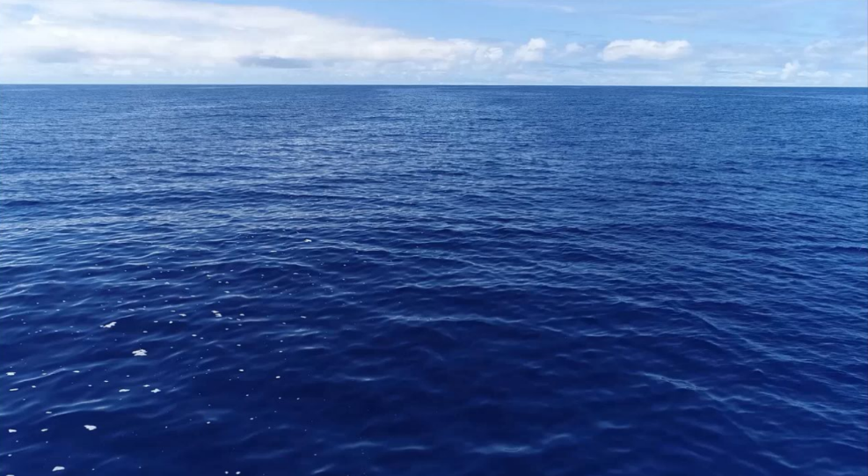
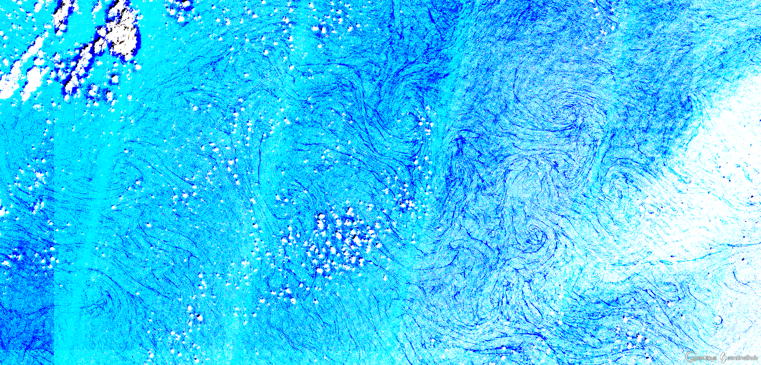
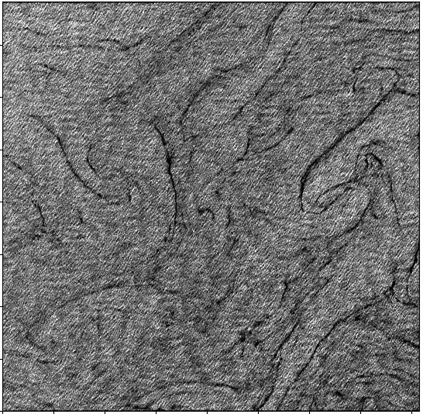
Open-ocean slicks and fronts as “hot spots” of pelagic ecosystems and crossroads for multiple dynamics
and observing systems.
Origin and dynamics of slicks outside of coastal regions are not well understood. They appear as glossy ”lines on the water”
and often accumulate high concentrations of surfactants, neuston, and debris providing unique sites for sampling
(e.g., Helm et al, PLOS Biology, under review).
Their scales (10-100 m in width and >10 km in length) make them visible both to optical satellites and naked eye of a boater,
offering unique opportunities for intercomparison/validation/calibration.
Sentinel-2, multispectral,
N.Pac garbage patch.
Reflectivity across the slick and
alignment of clouds hints on
SST differences and strong
air-sea interactions
slick axis
floating plastic
and foam
Algalita Research and
Education Foundation
Rare event of multiple slicks in
Sentinel-2 multi-spectral image,
false colors, “garbage patch” mission
Ocean slicks in Sentinel-1
SAR image (North Pacific
garbage patch)

Slide 4
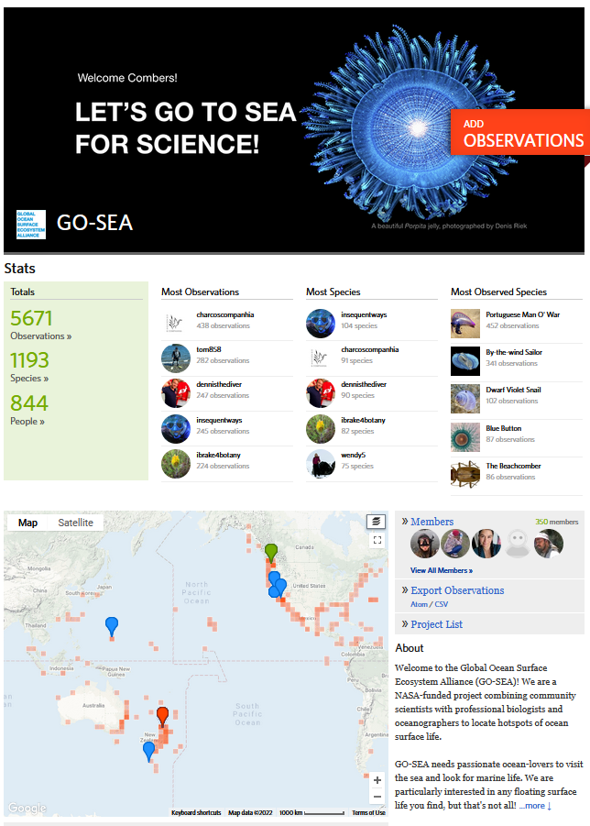
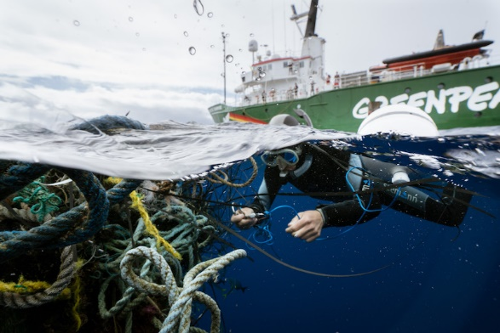
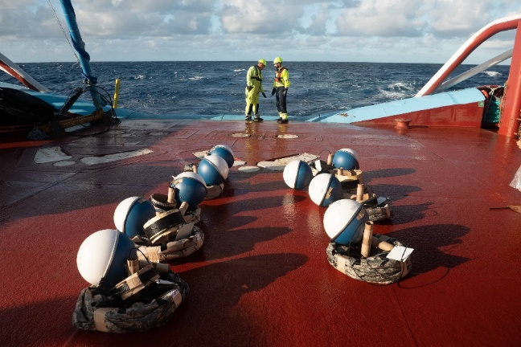
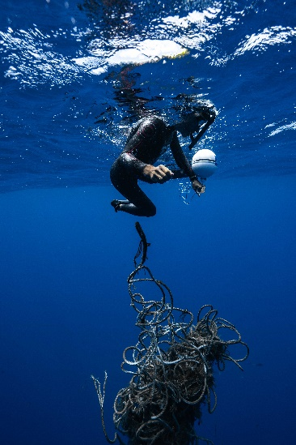
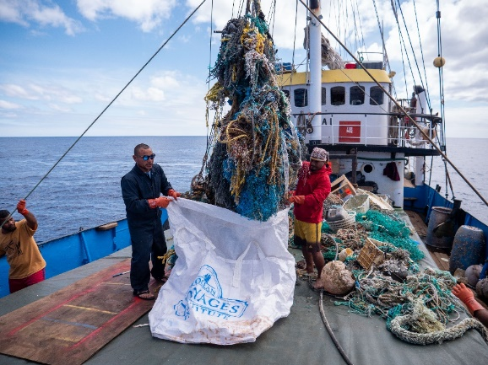
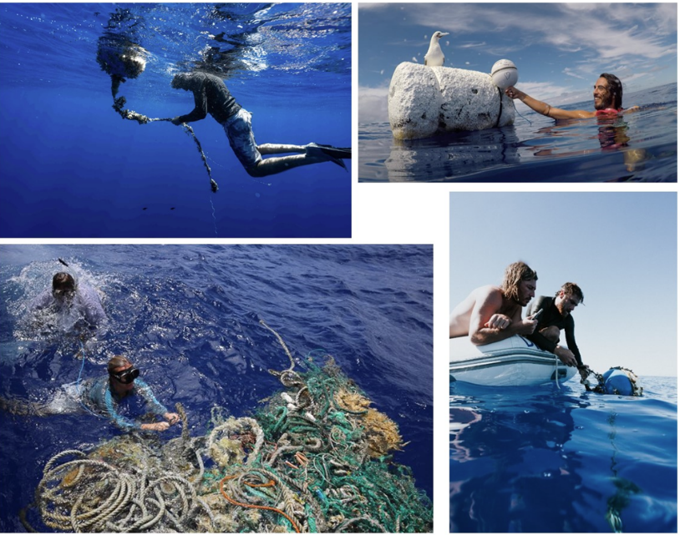
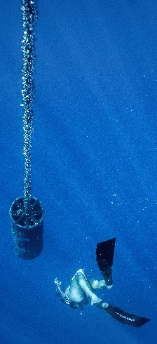
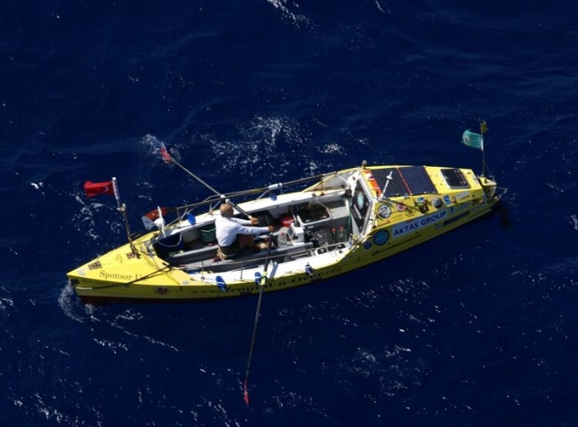
II. Creating project community
We engage with existing citizen science networks, such as iNaturalist and Zooniverse,
and projects, such as COASST and Project Odyssey.
Additionally, we use social media and collaborations with partners to recruit volunteers
operating in our study areas.

Slide 5
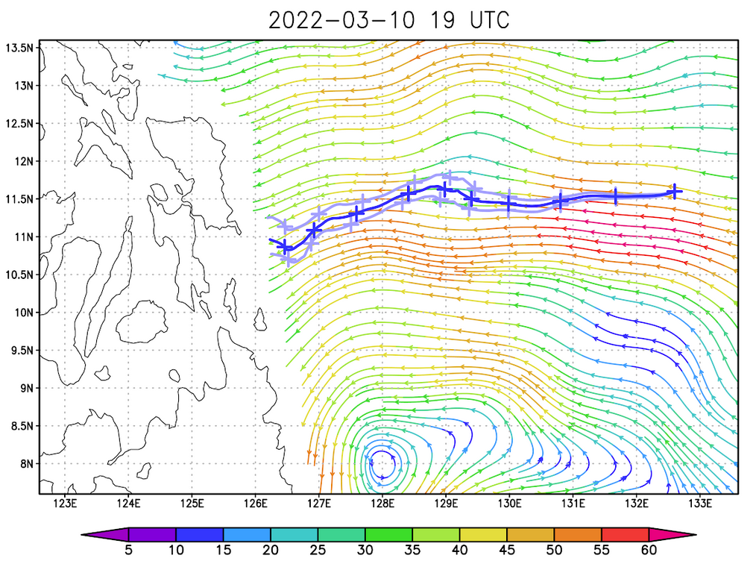
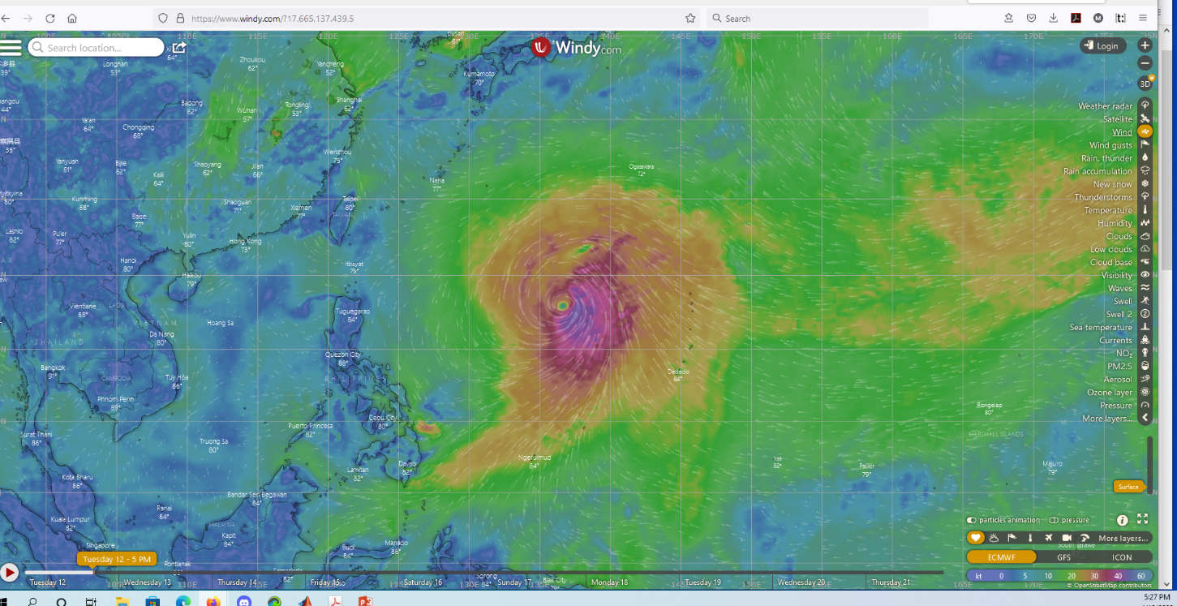
III. Interaction with citizen scientists
Careful assessment of feasibility of safe and informative observations by a specific citizen scientist.
Motivating through education.
Equipping with comprehensive protocols, tools, and supplies.
Near-real time coordination.
Rewards and compensations:
Operational weather and safety advice.
Fuel and time compensations for deviations from the volunteer’s
own plan.
Lending means for at-sea communication.
Acknowledging volunteer’s input in publications/presentations.
Optimization of route using a state-of-art model.
Wind map from windy.com

Slide 6
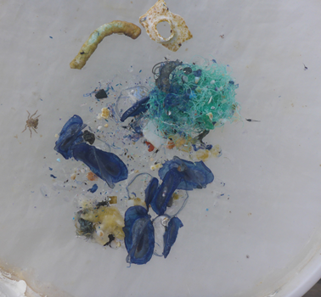
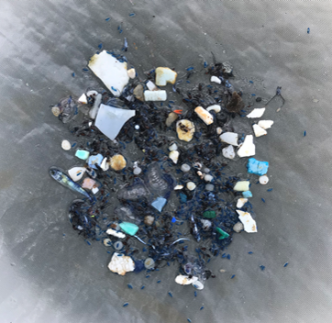
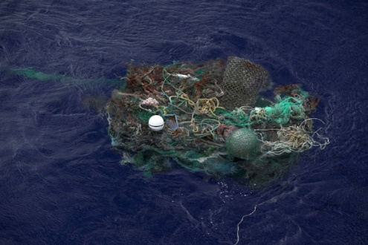
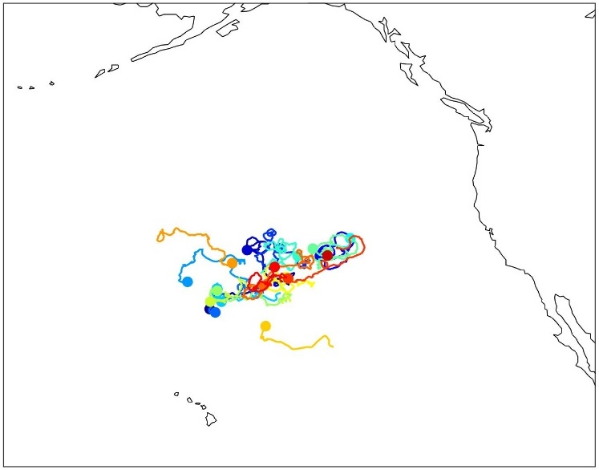
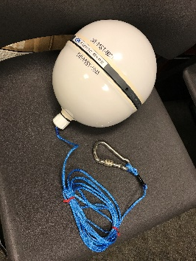
IV. Data collected or facilitated by citizen scientists
Visual/photo/video reports on debris, neuston, and other marine life from the ocean and coastline.
Characterization of ocean slicks (size, shape, temperature contrast, correlation with cloud pattern, interaction with wind and waves, presence and density of floating debris, neuston, and surfactants.
Sample collection, photographing, and preservation of neustonic, fouling species, marine debris and microbial biofilm.
Water sample collection for eDNA analysis.
Observations collocated with satellite flybys.
Tagging macro-debris items with GPS trackers.
Attaching biological settlement panels to debris.
Marking ocean features with drifters.
Inspection of previously deployed instruments and collection of settlement panels.
GPS tracker, tracker attached to derelict
fishing net, and six months of trajectories
of 19 trackers in 2021.
Photos of neuston and microplastics in samples collected during by The Vortex Swim voyage (Chong, Zabin, et al., 2022, submitted)

Slide 7
IV. Data quality control, formatting and archiving
Our exploratory, multi-disciplinary project will produce a broad variety of data, including:
geotagged reports on various types of marine debris and neustonic and fouling species,
timelines and geographic distributions of neuston stranded on the shoreline,
trajectories of debris items tagged with GPS trackers,
catalog of observed ocean slicks,
multi-spectral, hyperspectral, and SAR satellite images collocated with in situ measurements,
results of taxonomic, genetic, and spectral laboratory analyses of samples.
Consistency and complementarity of the datasets will be assessed in the framework of ocean drift model.
Project data will be deposited to corresponding NASA DAACs and/or published in supplements to scientific journals as well as in technical reports.

