Slide 1
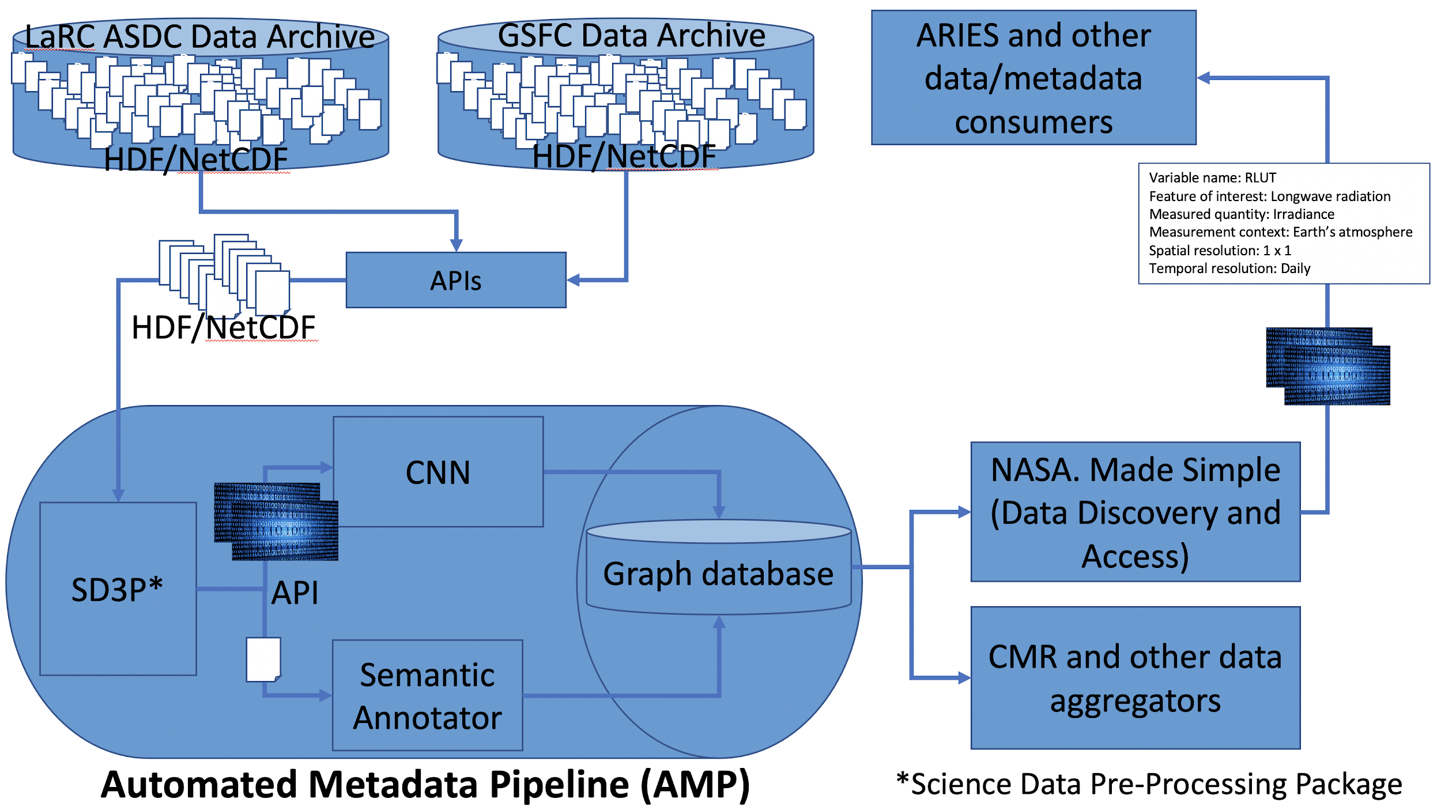
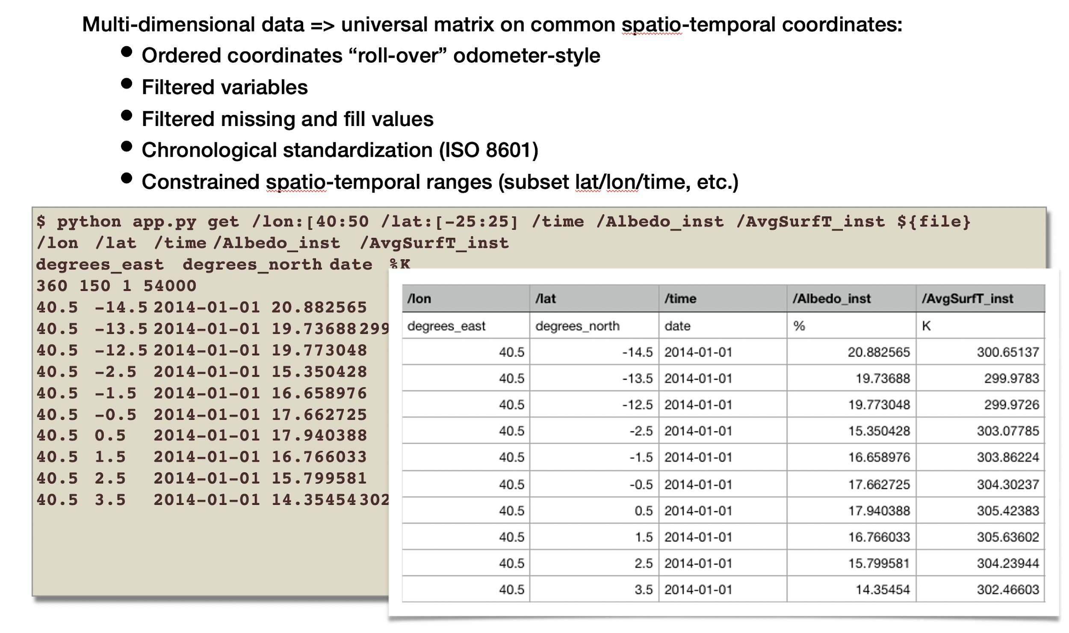
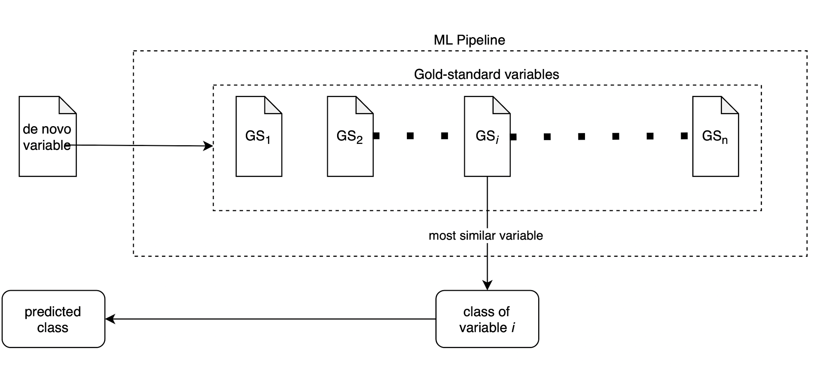
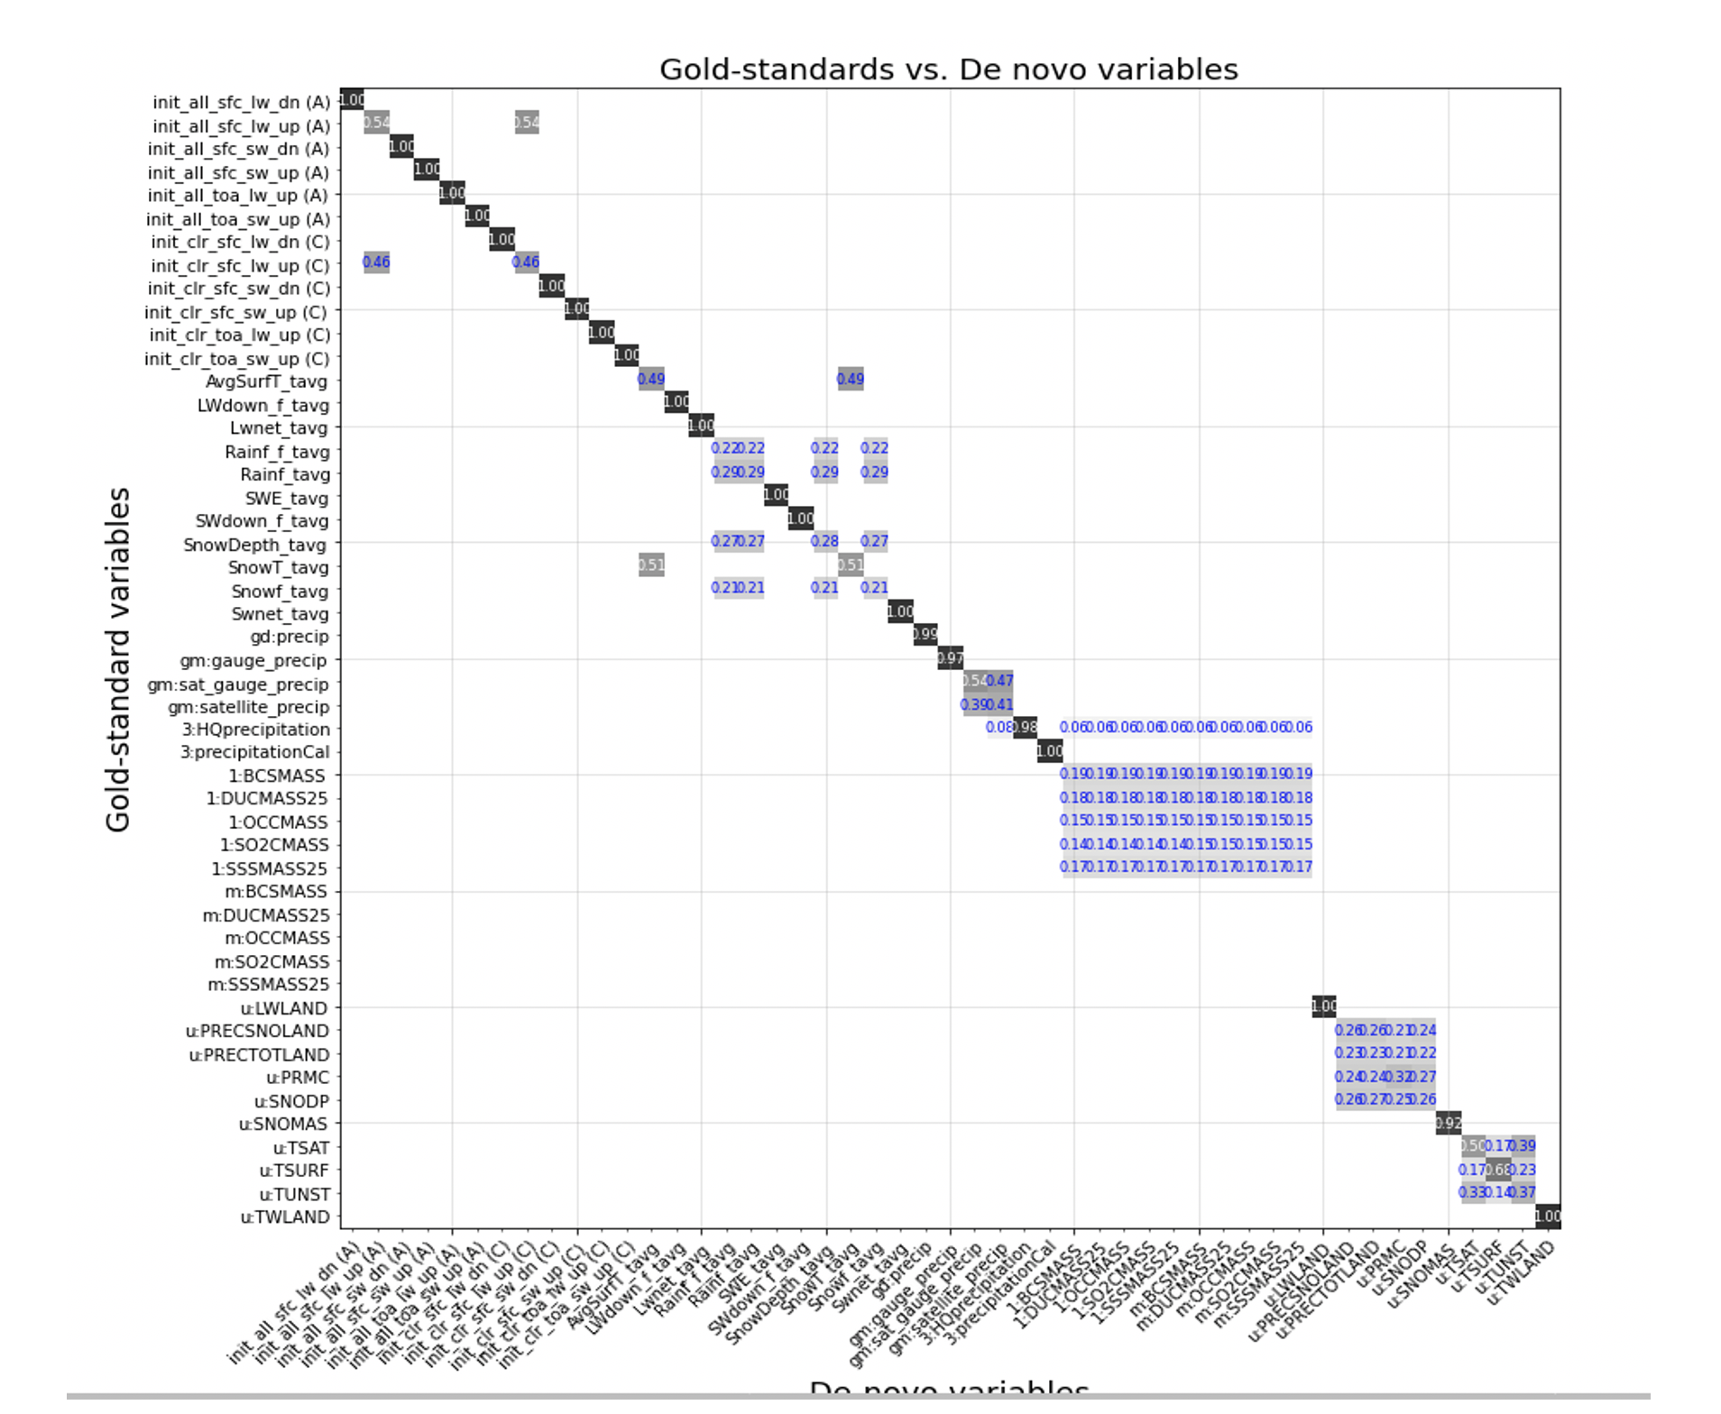
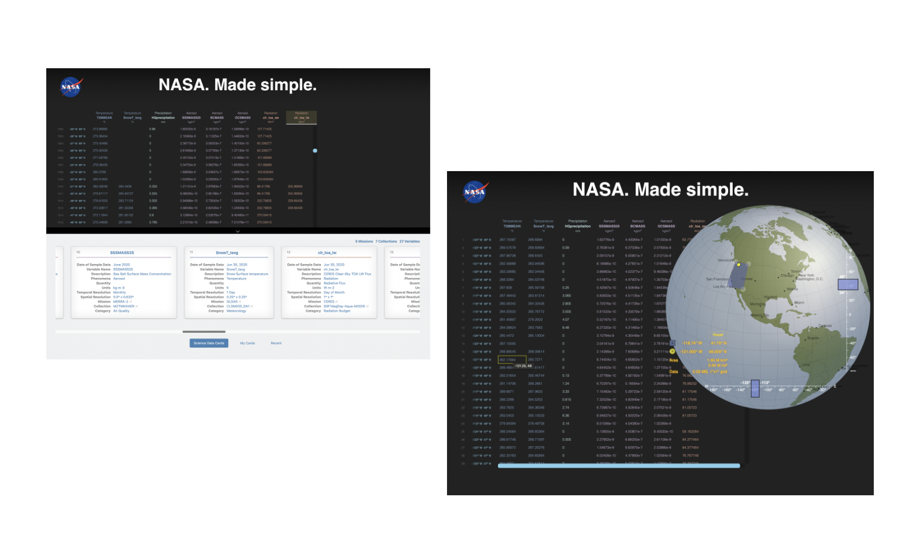
AMP: AN AUTOMATED METADATA PIPELINE
Beth Huffer¹, Damian Gessler¹, Simon Handley¹, Christina Babcock Gessler¹, Ken Bagstad², Ferdinando Villa³, Jennifer Wei⁴
¹Lingua Logica, ²USGS, ³Basque Center for Climate Change, ⁴NASA
Objectives
Develop an automated metadata pipeline (AMP) to create accurate, robust metadata that will facilitate data discovery and interoperability across Earth science data sources
Use Machine Learning (ML) techniques to classify datasets ontologically and find related data
Make NASA Earth science data easily discoverable and accessible
Integrate AMP with Goddard Earth Science Data and Information Services Center (GES DISC) data distribution services
Test usability of metadata and data services with the ARtificial Intelligence for Ecosystem Services (ARIES) modeling platform to demonstrate the value of semantics in improving usability
This work is supported by NASA’s Earth Science Technology Office, Advanced Information Technology Systems Program, Grant No. 80NSSC20K0209

