Slide 1
Community Guide Progress: Forum and Feedback
ESDSWG COMMUNITY DEVELOPMENT BEST PRACTICES WORKING GROUP
Jeff Siarto – NASA/EED2 UI/UX Lead
jeff@element84.com
ESIP Summer Meeting 2021

Slide 2
What is the Community Guide?
The Community Development Best Practices Working Group (CDBP) aims to promulgate best practices for fostering community for the development of open-source toolsets and packages especially within the NASA Earth Science community.
CDBP will continue and refine the work on the EOSDIS (Earth Observing System Data and Information System) General Open Source Software Collaboration and Contribution Process guide and add sections on community development best-practices
A repository of templates (pull requests, marketing copy, community contacts) to help ESDS (Earth Science Data Systems) open-source projects engage with (and develop a community around) their project.

Slide 3
References and Prior Art
Orbit: A tactical guide to kickstarting your community
GitHub: Building a Strong Community
Open Source Guides: Building Welcoming Communities
Apache Incubator: Guide to Successful Community Building
Mozilla Open Leadership Training Series: Building Communities
Contributor Covenant: A Code of Conduct for Open Source Communities
rOpenSci: Community Contribution Guide
https://ropenscilabs.github.io/statistical-software-review-book/index.html
https://devguide.ropensci.org
Get Together Book
https://gettogether.world
The Cathedral and the Bazaar

Slide 4
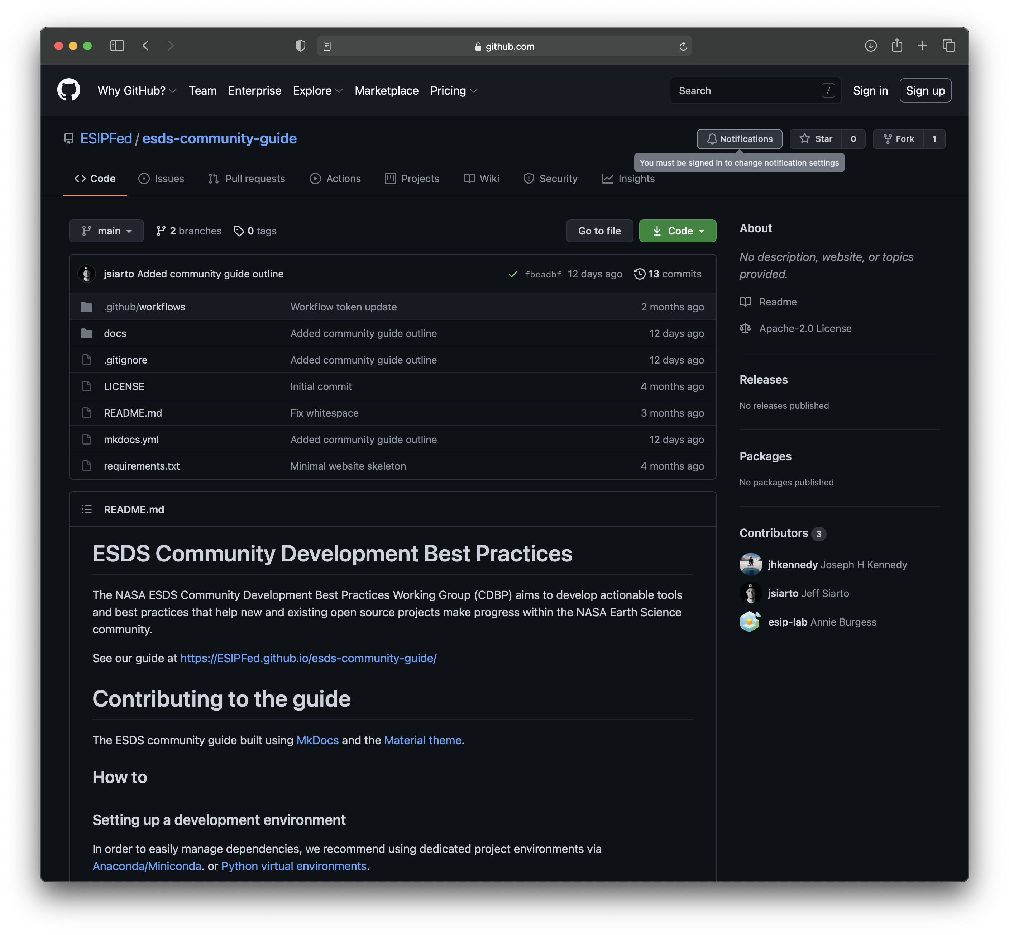
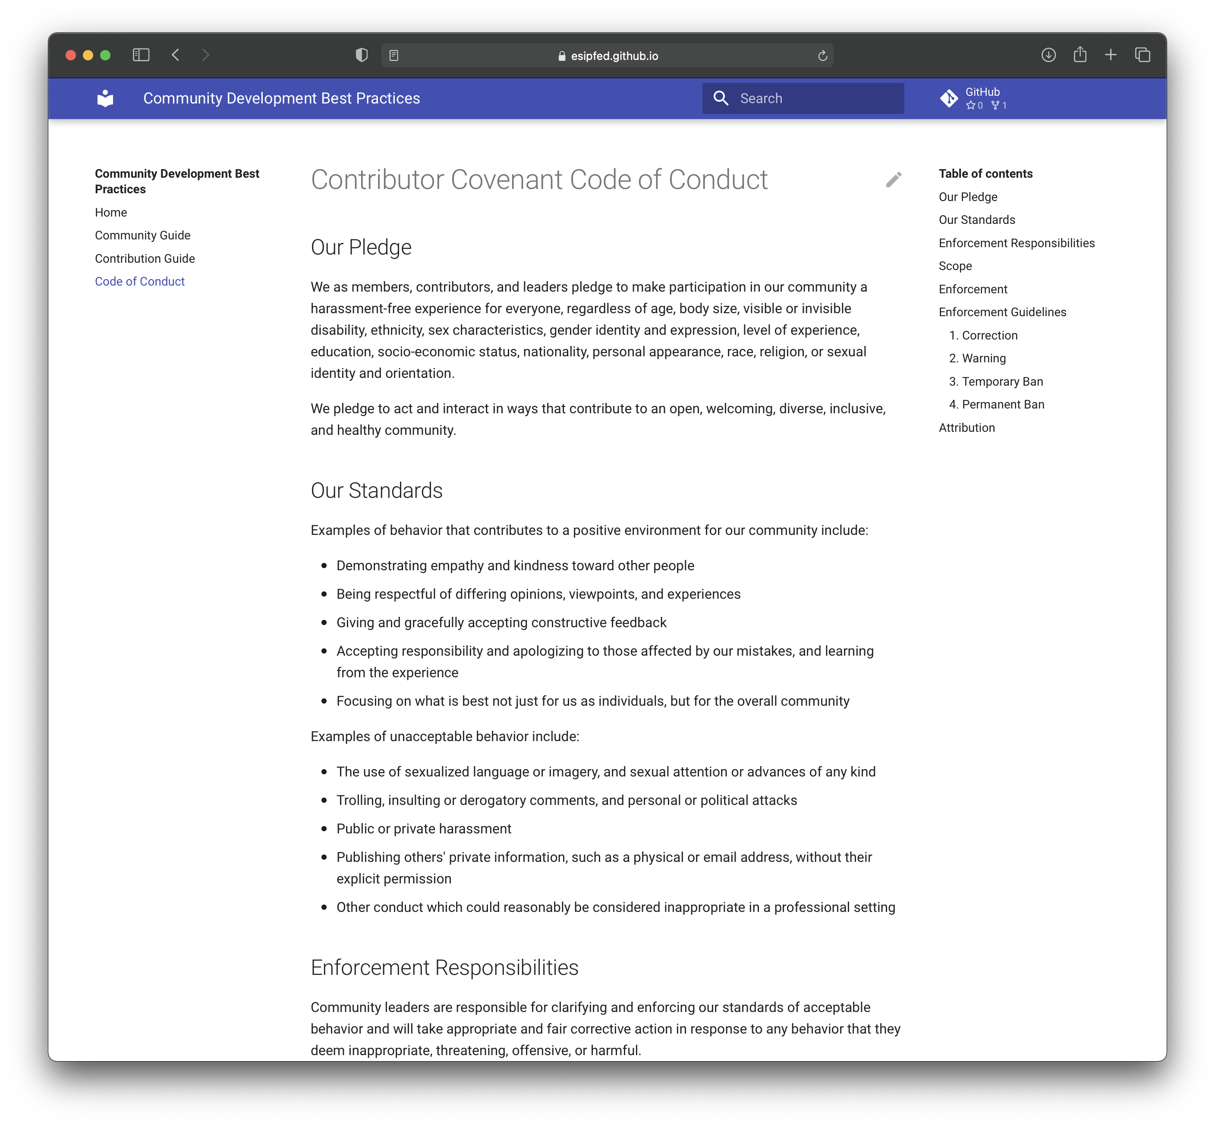
https://github.com/ESIPFed/esds-community-guide
https://esipfed.github.io/esds-community-guide/CODE_OF_CONDUCT

Slide 5
Where does it live?
https://github.com/ESIPFed/esds-community-guide/
https://esipfed.github.io/esds-community-guide

Slide 6
Contributing
esdswg-community-guide@lists.nasa.gov
https://wiki.earthdata.nasa.gov/display/ESDSWG/Community+Development+Best+Practices+Working+Group
Monthly Meetings (Last Friday at 2pm ET)

Slide 7
Proposed Sections and Topics
Community Flywheel (Getting started)
Events and Rituals
Leadership and Mentoring
Resolving Conflicts
Metrics
Tools
Templates

Slide 8
Open DISCUSSION and Q&A
Community Guide

