Slide 1
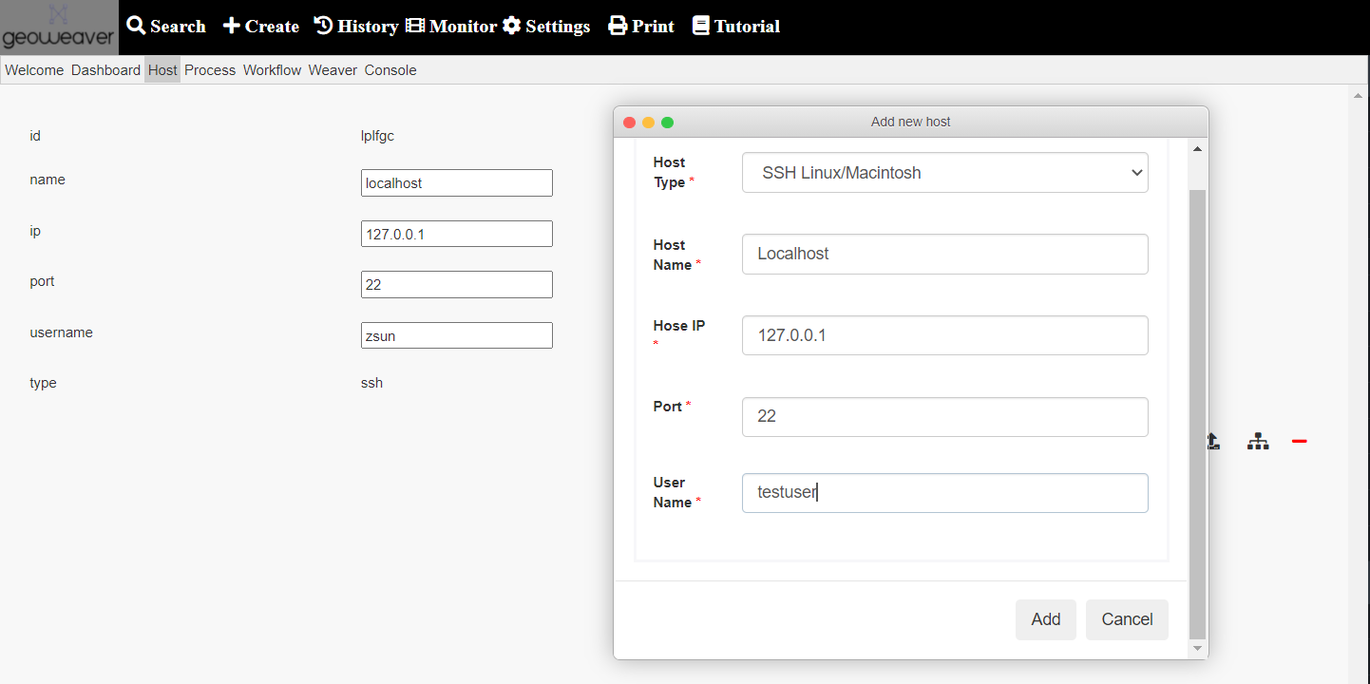
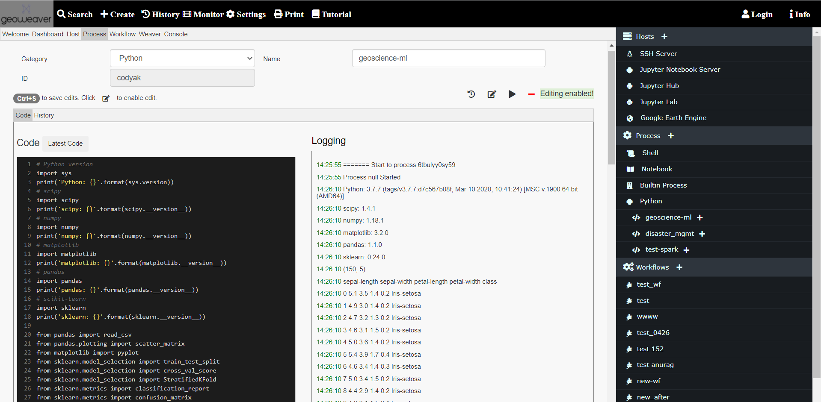
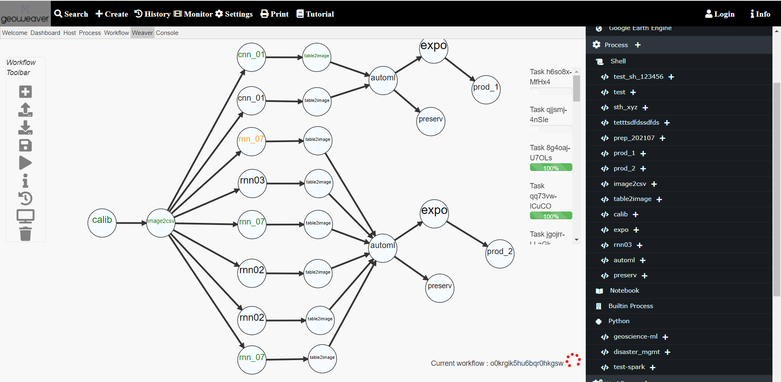
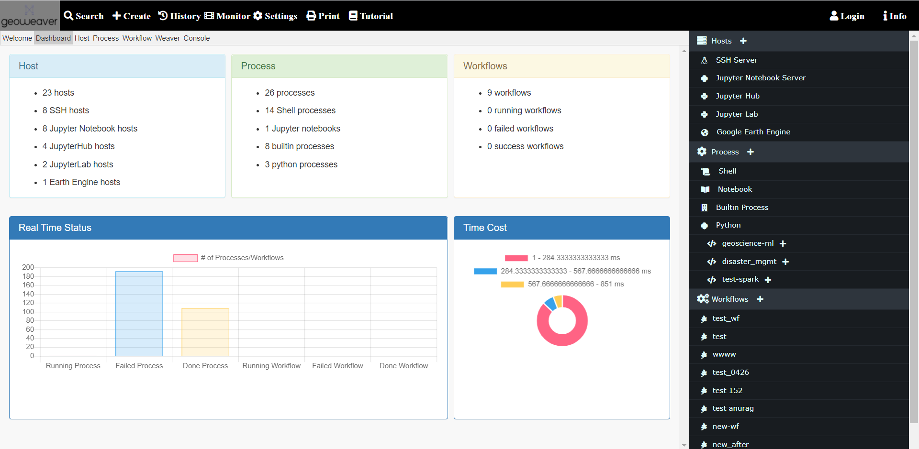
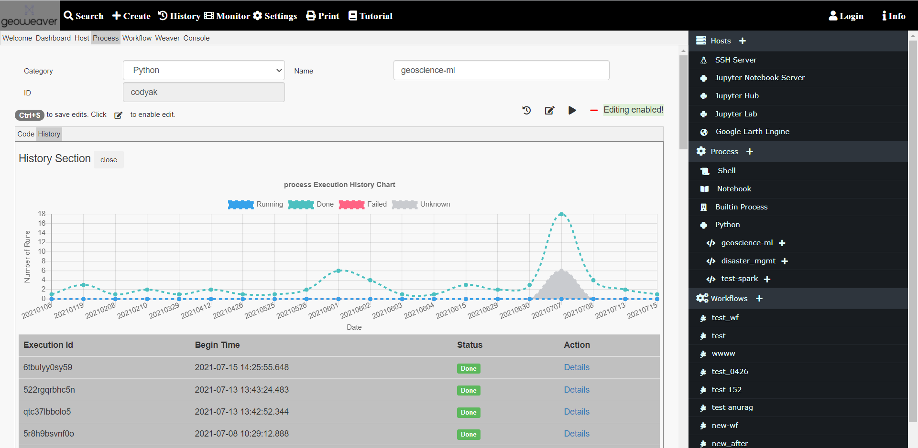
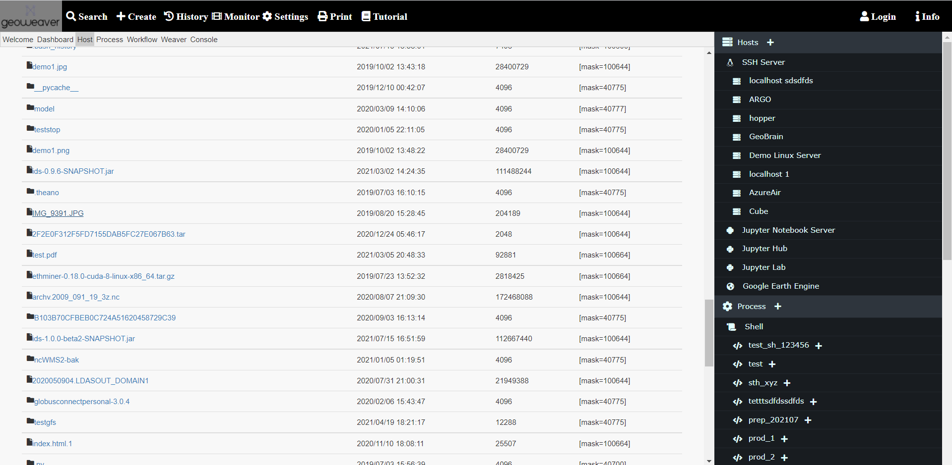
Geoweaver Tutorial: Resilient Workflow Management in One Place
Ziheng Sun¹, Annie Burgess², Nicoleta Cristea³, Daniel Tong¹, Marshall Ma⁴, Ahmed Alnaim¹
1 George Mason University; 2 ESIP; 3 University of Washington; 4 University of Idaho
Step 1: Create a host (where you want to run workflow)
Step 2: Create process (what you want to run, python/shell/notebook/builtin)
Step 3: Create workflow and Run (how you want to run, Directed Acyclic Graph)
Step 4: Monitor Status (trace progress)
Step 5: Check history (find out the results)
Step 6: Download Result Files (retrieve the results)
3 Aug 2016
Geoweaver is an open-source project on Github: http://github.com/ESIPFed/Geoweaver
Work on Windows, Linux, and Mac.
This work is funded by NASA ACCESS#80NSSC21M0028; NSF EAR#1947875, #1947893, ESIPLab Geoweaver project.
Contact: Dr. Ziheng Sun (zsun@gmu.edu)

