Slide 1
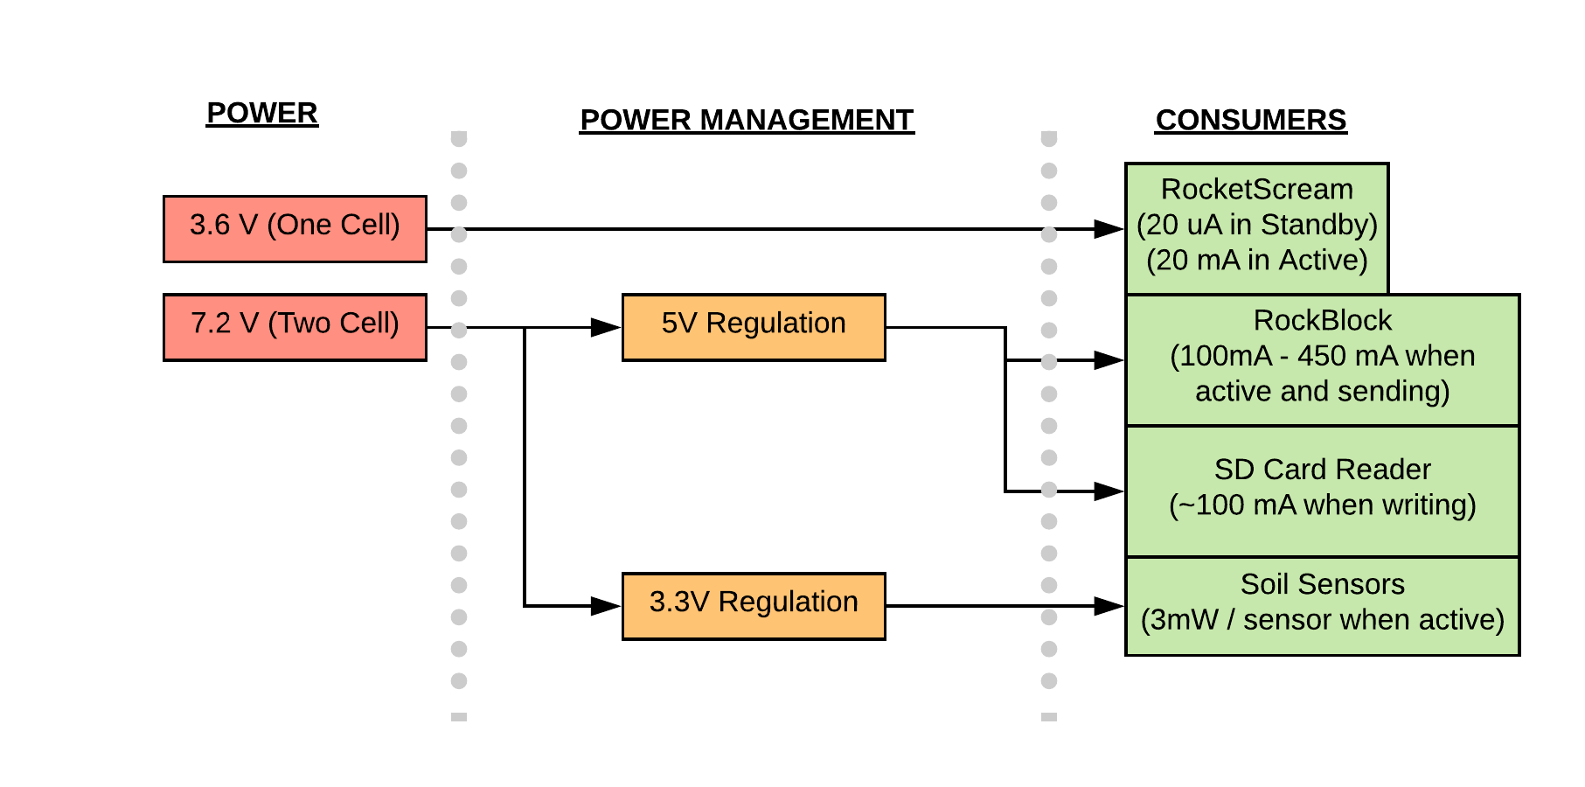
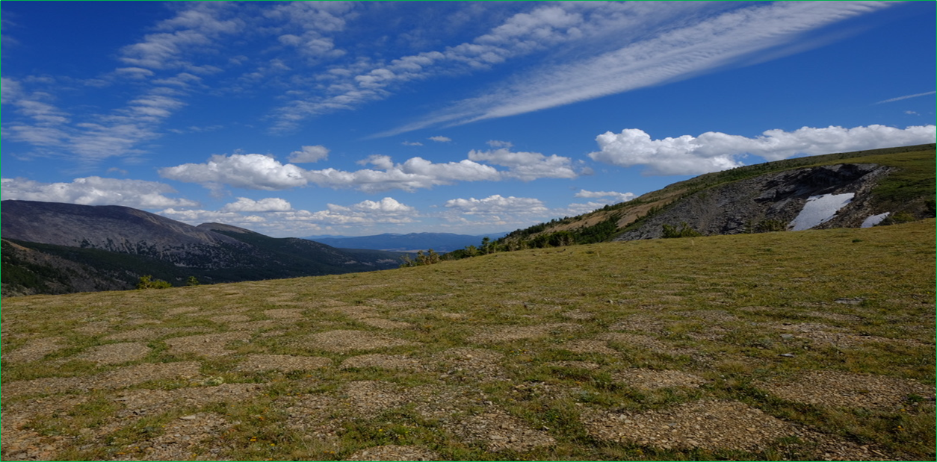
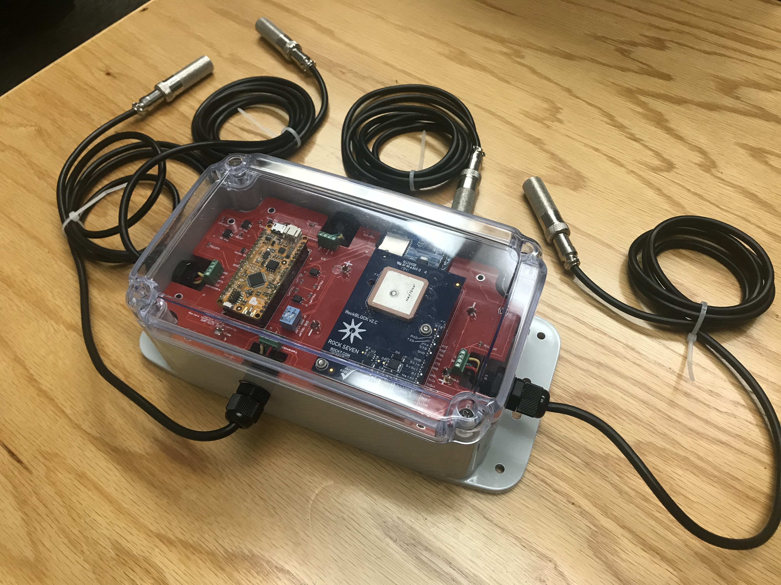
High Altitude Soil Testing: Increasing Accessibility of Data from Remote Locations
Justin Rubalcaba, Undergraduate Student¹; Martha Apple, PhD²; Kevin Negus, PhD¹
1: Montana Technological University, Electrical Engineering
2: Montana Technological University, Biological Science
Abstract
Conclusions
Continuation of a project initially developed by Jamison Ehlers, Graduate Student at Montana Technological University.
Refined prototype HAST device capable of measuring soil temperature and humidity in remote, difficult to access areas, over long periods of time. Data is logged on the device and sent via Iridium satellite system to web host.
Focus has been put on debugging the software and attempting to find and fix any physical issues in the system.
Current issues that need to be addressed:
No physical connection between microcontroller and satellite modem’s sleep pin.
Power comsumption too high according to data sheets for components being used.
Data needs to be compressed to increase amount of data transferred per message sent.
The HAST device will need to have PCB revised to have a connection to the Rockblock sleep pin, as well as implementing optocouplers to prevent current leaking between components.
Device will be brought to a high-altitude area of interest and set up for a short-term field test once the area is accessible.
Figure 2 - Power Usage: Flow Diagram
Components
For our system, we’ve implemented a RocketScream Mini-Ultra Pro v3, SD Card reader, industrial rated SD card, Iridium RockBlock Mk2 satellite modem, an SHT10 soil sensor, three 3.6V lithium-thionyl chloride (Li/SOCl₂) batteries, one IP68 rated NEMA case and IP68 rated cable glands.
The RocketScream controls the rest of the system, providing power management, a real-time clock and the Arduino coding libraries to operate each of the other components. The usual operating mode (standby) of the microcontroller will draw around 20 uA, increasing to 20 mA when active.
The RockBlock is a satellite modem, able to connect to a moving satellite in orbit around Earth, and can send an email containing a “Twitter length” string of data
The SD card reader is there to store data onto a temperature rated SD card, if the RockBlock is unable to establish a satellite connection.
The SHT10 sensor is able to read temperature and humidity. For the final system, multiple sensors will be implemented.
The lithium-thionyl batteries were chosen for their constant voltage performance over time, as well as their projected battery life. They are non rechargeable.
The IP68 rated cable glands and NEMA case were chosen for their safety rating of dust ingress and moisture incursion protection.
Figure 3 - Periglacial Patterned Ground, Goat Flat, Pintler Mountains, SW Montana.
Acknowledgments
This work is based on funding provided by the ESIP Community with support from the National Aeronautics and Space Administration (NASA), National Oceanic and Atmospheric Administration (NOAA) and the United States Geologic Survey (USGS). We’d also like to acknowledge the Electrical Engineering and Biological Science departments at Montana Tech for their contributions as well.
Figure 1 – Current System Prototype

