Slide 1









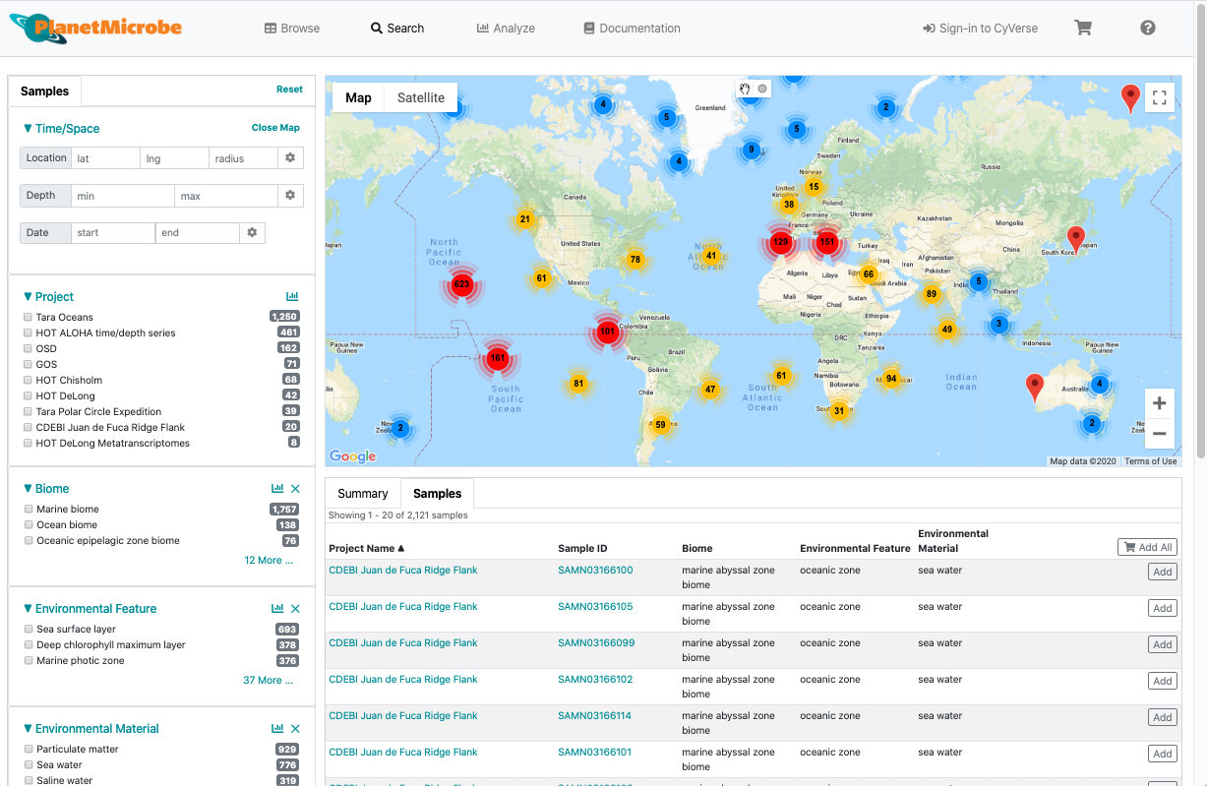









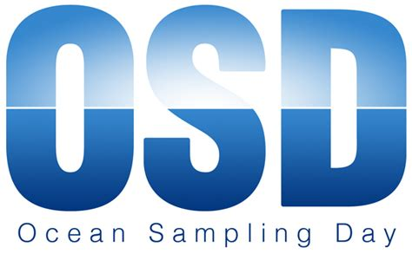


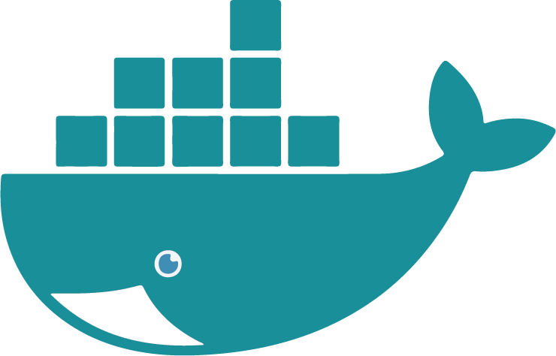


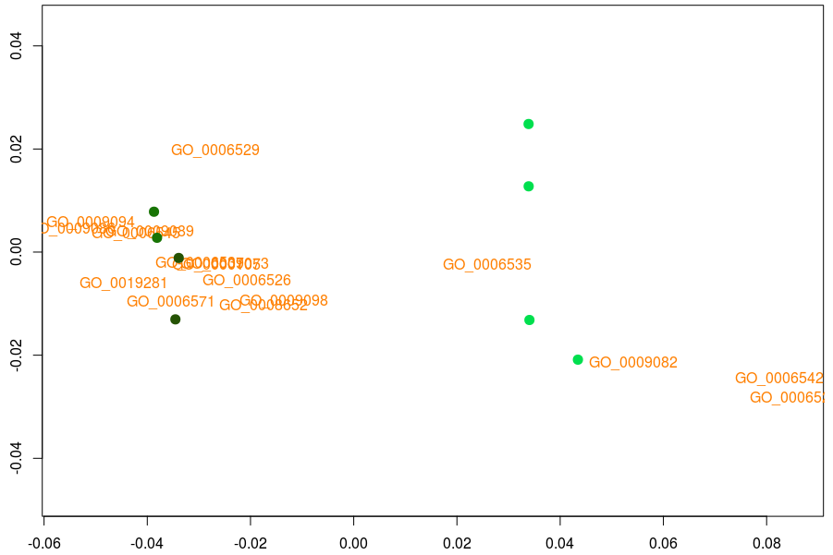
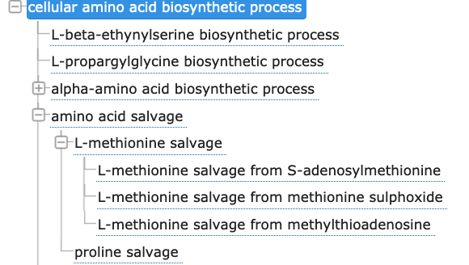


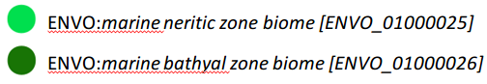

Try it out: planetmicrobe.org
Planet Microbe: An Ontology-Enriched Cyberinfrastructure System for FAIR Marine ‘Omics Data
Kai Blumberg¹, Alise Ponsero¹, Matthew Bomhoff¹, Pier Luigi Buttigieg² , Elisha Wood-Charlson³, Bonnie Hurwitz¹
¹Department of Biosystems Engineering, University of Arizona, Tucson, Arizona
²Alfred Wegener Institute Helmholtz Centre for Polar and Marine Research Bremerhaven Germany
³KBase Division, Lawrence Berkeley National Laboratory, 94720 Berkeley, CA, USA.
Context
Reintegrating ‘omics data in their environmental context
Semantic standardization for data interoperability
Marine ‘omics platform
Like a pirate's “buried treasure”, oceanographic data are incredibly valuable allowing us to deepen our knowledge of ocean systems at a higher spatiotemporal resolution. Unfortunately, such heterogeneous data are often separated upon collection and are rarely fully re-united. Despite careful curation, data are sometimes shared only with specific collaborators preventing complete dataset reassembly. Additionally, data are often used only to a address specific questions, limiting their reuse.
Currently, no unifying systematic framework exists for the integration of newer ‘omics data with traditional physical, geological, geochemical, and biological data sets commonly generated by the broader oceanographic community.
Here, we present here a new web-based cyberinfrastructure platform, Planet Microbe, tailored for the reintegration and analysis of marine ‘omics datasets with their environmental contextual metadata.
Planet Microbe aims to re-unite taxonomic and functional microbial information from historic ‘omics datasets with their environmental context.
‘OMIC DATA
‘Omic dataset functional and taxonomic annotations
Planet Microbe makes use of and extends standardized semantics provided by the Open Biological and Biomedical Ontology (OBO) Foundry and Library.
SAMPLE
Biological and physiochemical measurments on water samples
In order to ensure for well-represented, interoperable metadata Planet Microbe combines semantics from a variety of OBO Foundry ontologies including the Environment Ontology (ENVO) to represent metadata types, the Ontology of Units (UO) to represent units, as well as the Ontology for Biomedical Investigations (OBI) to represent measurement devices.
SAMPLING EVENT
CTD profiles
Meteorological data
Station descriptions
Type semantic
ENVO: concentration of nitrate in water
EXPEDITION
Cruise tracks
Expedition instrumentation and protocols
Metadata :
[NO3]- : 50 µg/ml
Environmental context can be provided by biological and physio-chemical measurements performed directly on a water sample. At a larger scale, environmental context can be provided by metadata from the sampling event and the sampling station. Finally, cruise protocols and instrumentation can provide users with a better understanding of the metadata.
Unit semantic
UO: microgram per mililiter
Currently Planet Microbe includes 9 projects, with over 2100 marine metagenomic and transcriptomic samples. Additionally, dataset metadata is searchable using ontology terms for 80 metadata parameters; including the including the Biome, Environmental Feature, and Environmental Material hierarchies from ENVO, annotated by data producers in compliance with the Minimum Information about any (x) Sequence (MIxS) standard.
‘omics data
Public repositories (NCBI, EBI…)
Measurement device semantic
OBI: fluormeter
Geochemical measures
Public repositories (BCO-DMO, Pangea…)
Study-specific measurements
Published papers
Community-driven tools and visualizations
Marine ‘omics datasets
Data containers for dataset interoperability
We aim to integrate major oceanographic datasets for which abundant environmental metadata were collected.
The project includes time-series such as the Hawaii Ocean Time-series and Bermuda Atlantic Time-series, as well as large-scale projects such as the Global Ocean Sampling expedition, Center for Dark Energy Biosphere Investigations, Tara oceans expeditions, and Ocean Sampling Day.
Metadata stored in public repositories like BCO-DMO, Rolling Deck repository, CCHDO, Pangea, or published in research papers will be reintegrated with their respective publicly available ‘omics datasets.
Planet Microbe makes use of Frictionless Data packages to make datasets interoperable, as well as shareable between systems.
Planet Microbe is a cyberinfrastructure system that provides users with a set of tools and apps for metagenomic analysis and visualization. Compute time and storage is available freely for Planet Microbe users through CyVerse and XSEDE resources.
Aims
Data Package
Frictionless Data package can be used to containerize tabular data and associate columns in the csv metadata file to OBO type, unit, and measurement source semantics.
Tool containers for reproducibility
CSV
environmental metadata from selected samples
JSON
type, unit and source information about the metadata
Apps and tools deployed in Planet microbe rely on community-developed docker/singularity containers.
Containers ensure the reproducibility of tools and analytical results in Planet Microbe by preserving the code, configurations, and dependencies.
Reintegration of ‘omics data with their environmental context
Standardization of semantics for increased data interoperability
Future directions
1) Browse GO for specific information.
2) Look up specified GO terms in pre-computed functional genomic annotations from Planet Microbe data.
3) Deliver ontology-refined data into multivariate statistical analysis and machine-learning workflows for analysis. Such as Principal Coordinate Analysis (PCoA).
Figure Modified from Kai Blumberg’s M.Sc. thesis
This work is supported by the NSF EarthCube Planet Microbe Building Blocks award #1639588 to Dr. Bonnie Hurwitz, and does not necessarily reflect the views of the NSF.
Leverage Ontologies to “learn more” from ‘omics datasets
ENVO:bathyal
ENVO:neritic
Use the Gene Ontology (GO), which represents information about gene products, to select specific information relevant to a biological question such as:
GO:cysteine biosynthetic process from serine
Use the Gene Ontology (GO), which represents information about gene products, to select specific information relevant to a biological question such as:
Providing community driven analysis and visualizations tools
“What cellular amino acid biosynthetic processes differentiate marine benthic biomes?”

