Slide 1
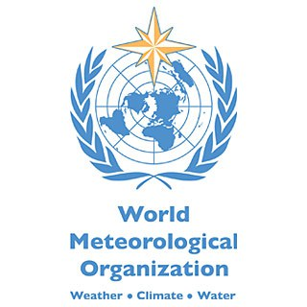
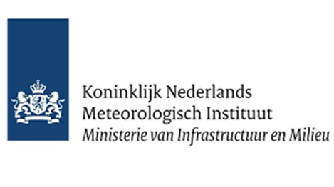
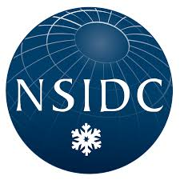
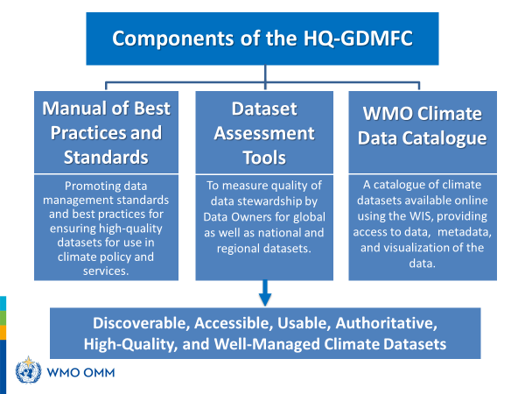
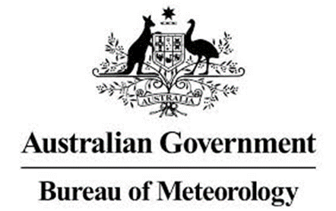
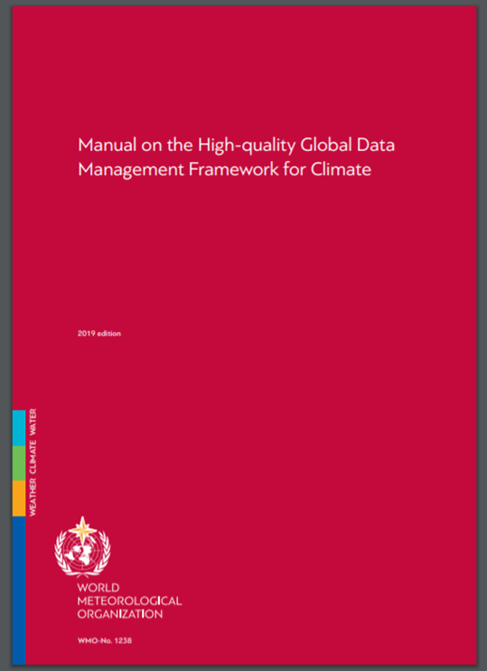
WMO High Quality Global Data Management Framework for Climate (HQ-GDMFC)
Improving the Quality of Climate Data Management to Attain Better Climate Monitoring
Christina Lief (WMO/EIG-CDM)* , Ge Peng (NOAA/NCEI, NCICS/NCSU), Omar Baddour (WMO) , William Wright (WMO/IEG-CDM)
HQ-GDMFC Goal
HQ-GDMFC three Components:
Aims at making use of high-quality climate data needed for developing climate services for policy and decision making in a variety of applications.
Manual Provides definitions, best practices, standards and tool to manage climate data for optimal quality.
2. Datasets self-assessment tool Stewardship Maturity Matrix for Climate Data (SMM-CD) provides a consistent way to identify gaps, and allow improvements in, quality of data management and documentation.
3. WMO Climate Data Catalogue (https://climatedata-catalogue.wmo.int/) Includes assessments of some well-known global datasets
and links to the manual and assessment tool.
* Christina Lief, WMO International Expert Group on Climate Data Modernization (IEG-CDM), Lead; Christina.lief@gmail.com

