Slide 1
Making Drones Interesting Again
Daniel R. Fuka, James Gallagher, Roberto Rodriguez, Amy S. Collick, Peter JA Kleinman, Zach M Easton
Virginia Tech, OPeNDAP, UMES,
USDA-ARS
zeaston@vt.edu

Slide 2
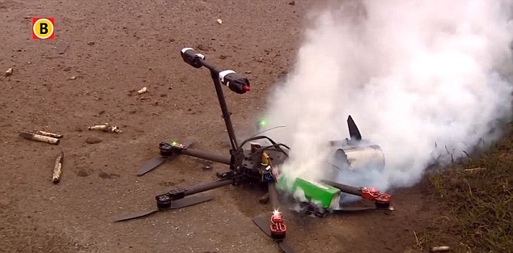
Use Case Driven
Design and Printing of water quality project drones to fill spatial surface data gaps
New sensor development
Two orders of magnitude cheaper than traditional methods
Something we can give to our students

Slide 3
Use Case Overview
Finding Saturation/Infiltration Excess Nexus
Saturation Excess
Precip Rate << Saturated Conductivity/Infiltration Rate
Field Scale Managed Phosphorous can stay in field
Infiltration Excess
Precip Rate >> Saturated Conductivity/Infiltration Rate
Phosphorous runs off into streams/rivers
Nexus Research exists where:
PPT_{rate} / K_{sat} ≈ 1

Slide 4
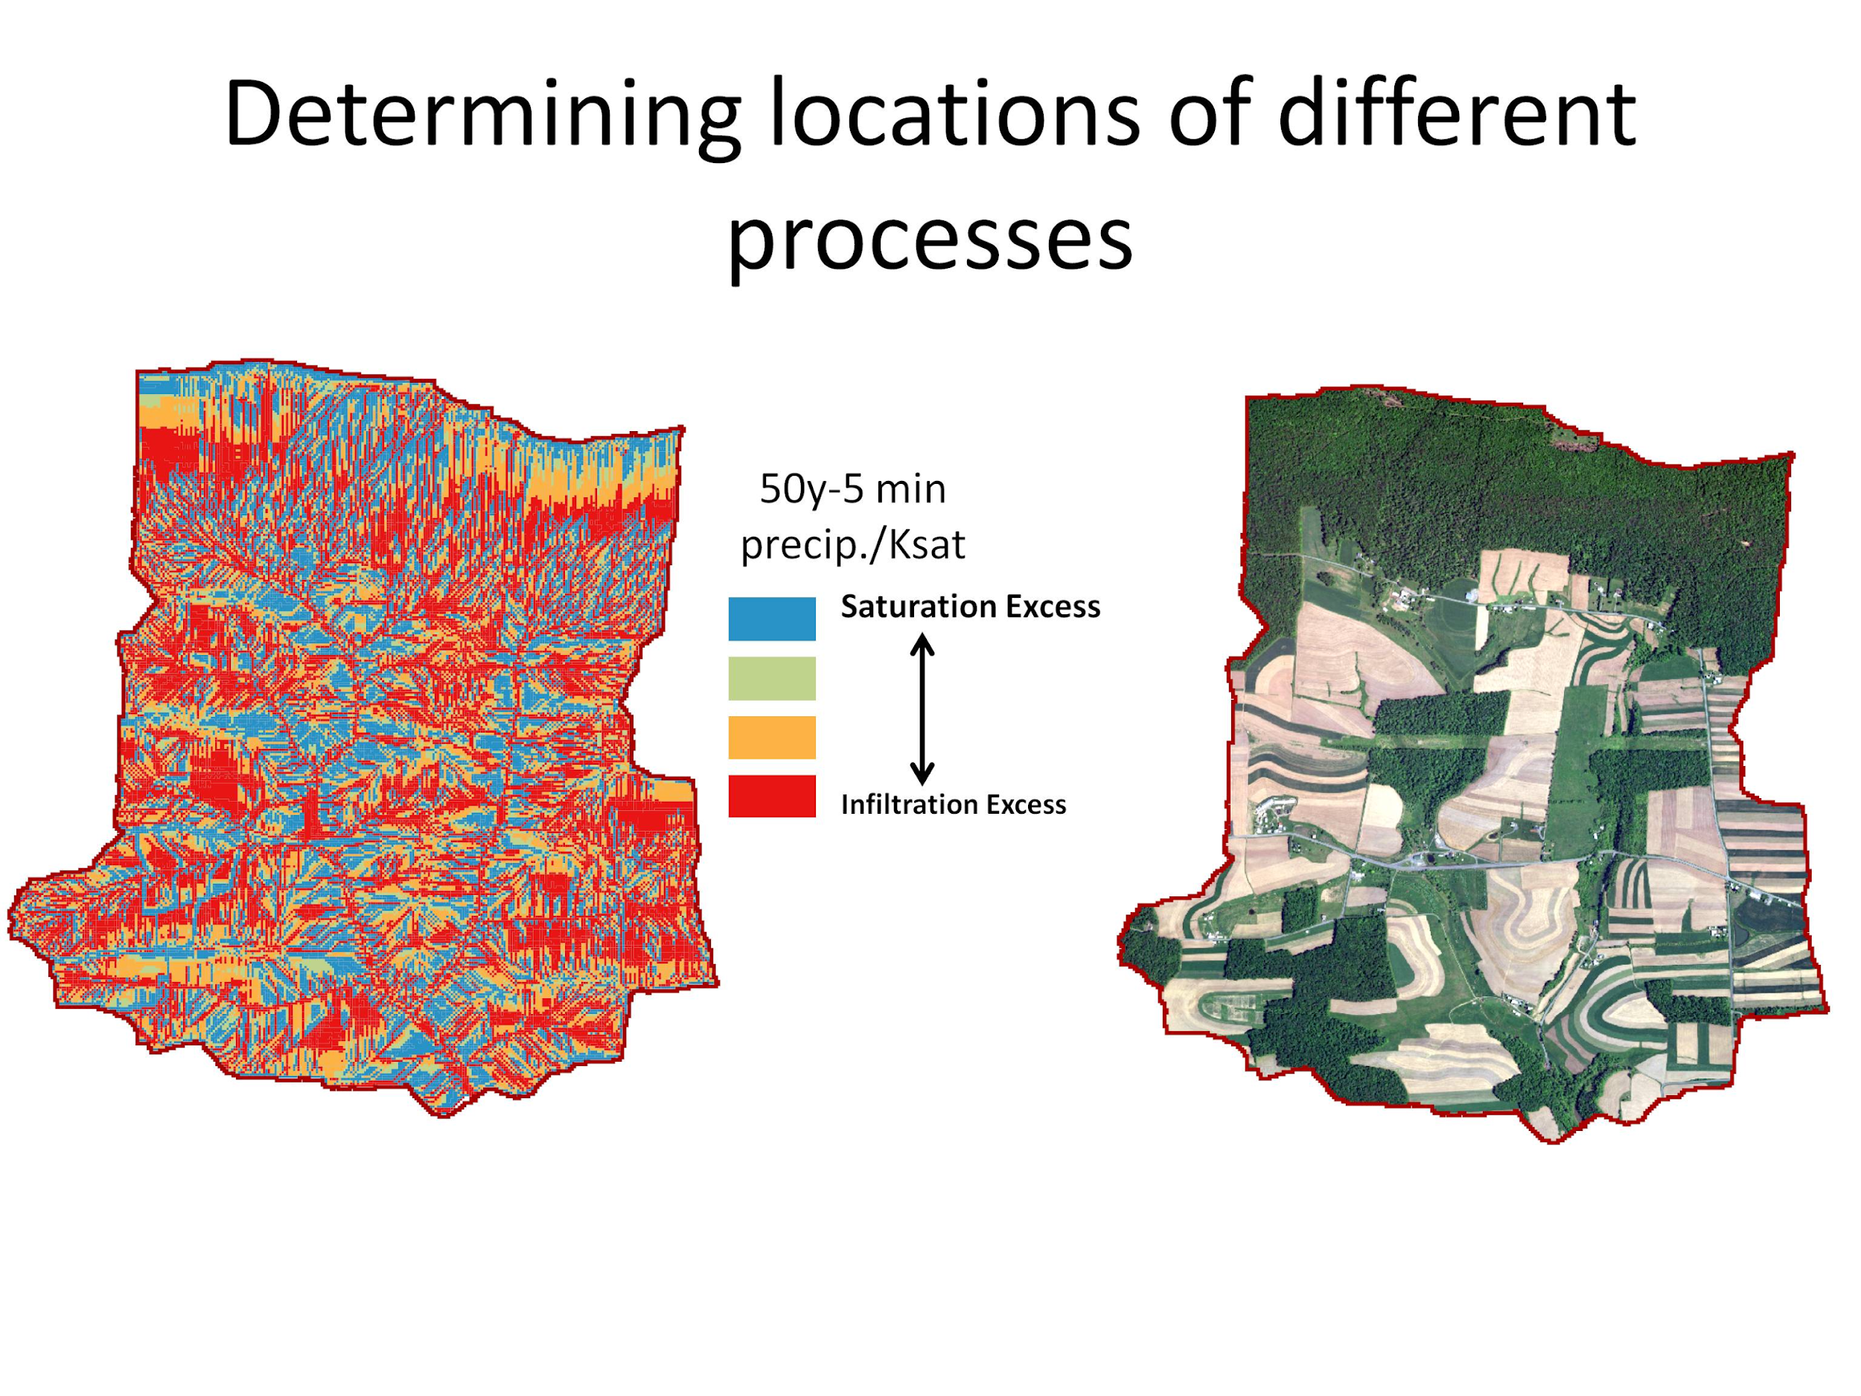
Notes:
If manure is placed in the blue/green areas, P is less likely to make it into streams and water bodies

Slide 5
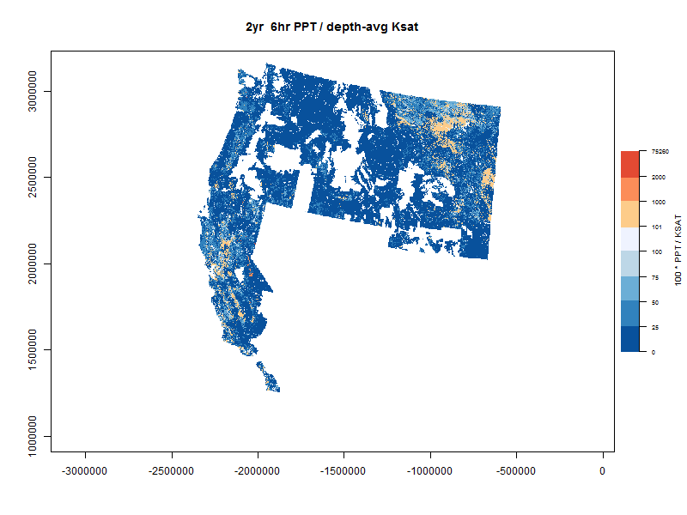
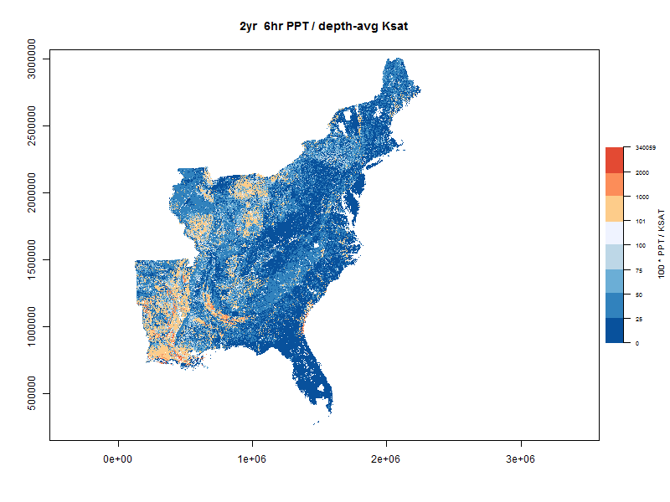
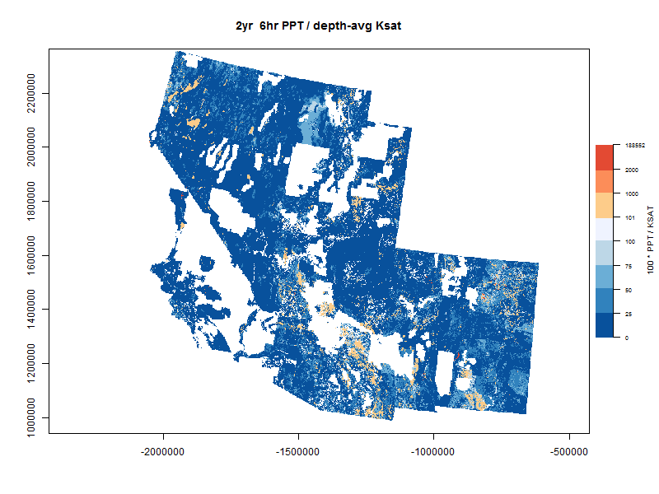
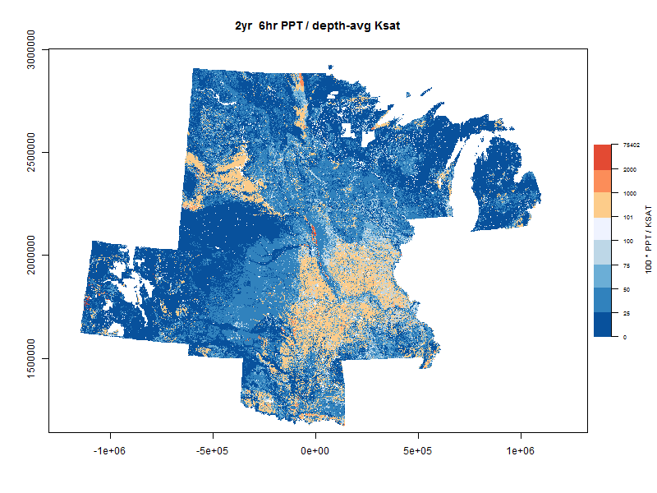
Saturation Excess
Infiltration Excess
Thank you Daniel Auerbach & Brian Buchanan

Slide 6
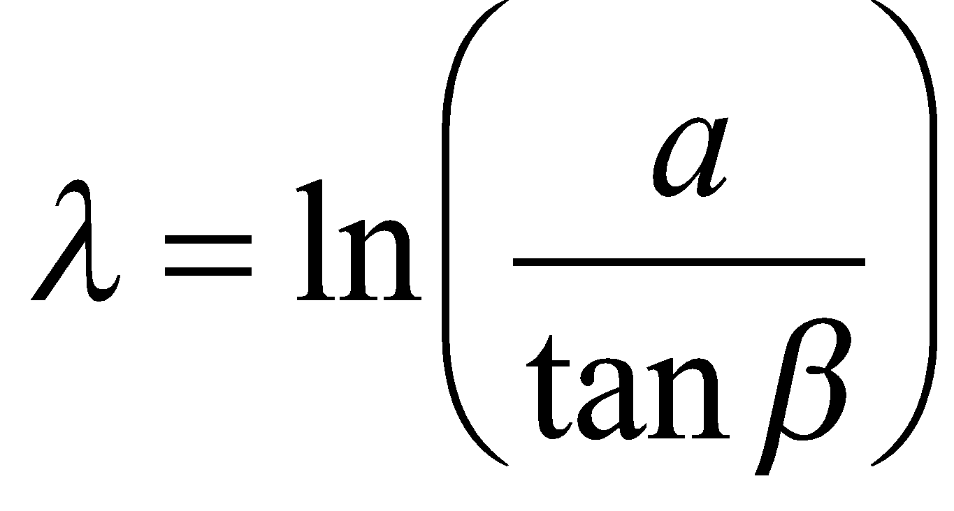
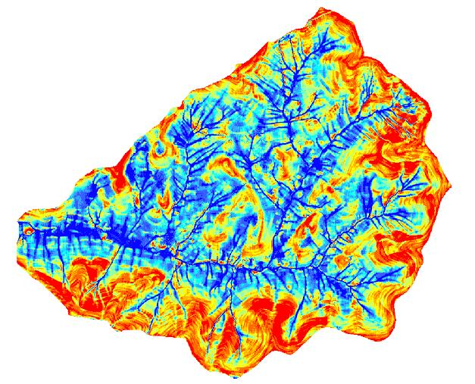
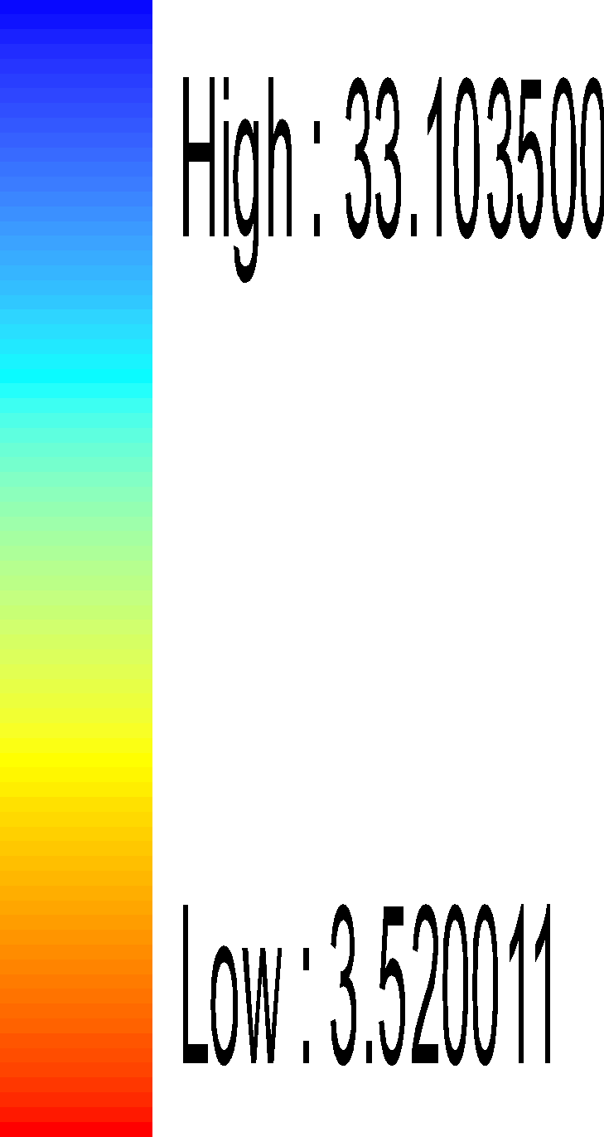
Soil genesis as explained by Topography
Topographic
Index
Wetness Index
Classes
33.10
3.52
10
Z₁₀= 130 cm
1
Z_{i} = local soil depth
Z₂= 80 cm
Z₆=100 cm
Easton et al. 2008 J. Hydrol
Collick et al. 2015. Hydrol Proc
Fuka et al. 2015. Hydrol Proc

Slide 7
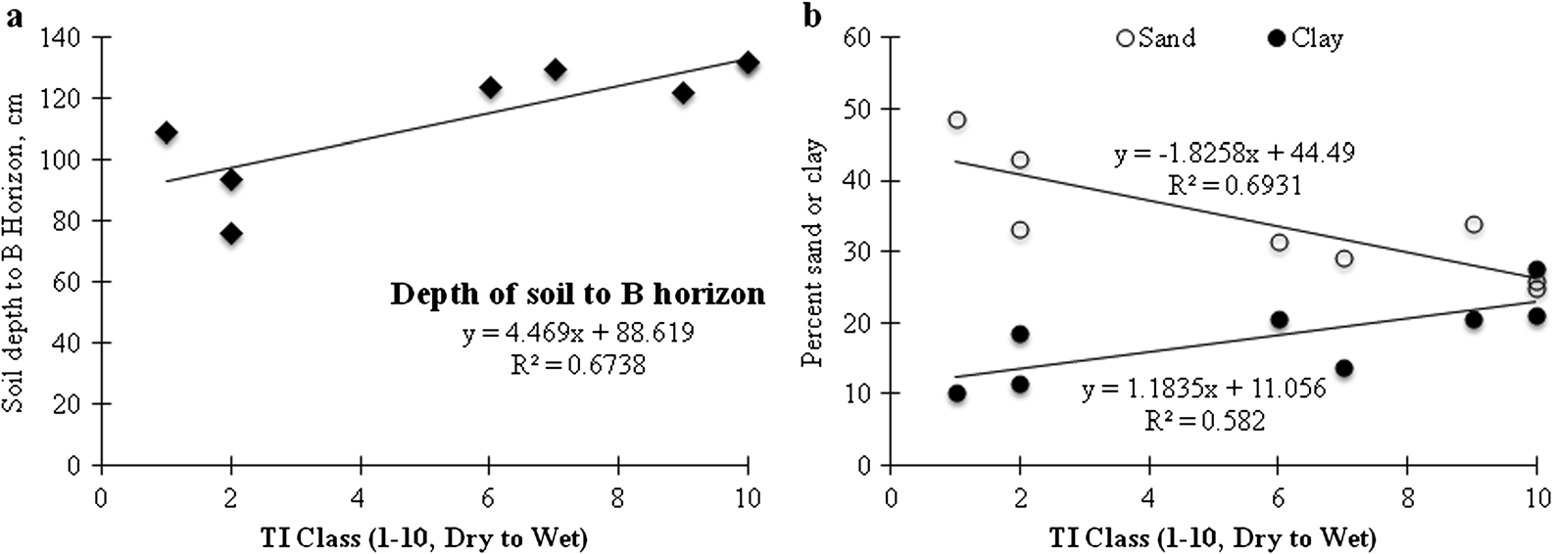
Topography explains soil depth and texture distributions (gravity appears to work)
Soil Depth (cm)
Sand or Clay (%)
TI Class (Dry to Wet)
TI Class (Dry to Wet)
Using measured pedon data from ARS long term watershed
Collick et al. 2015. Hydrol Proc

Slide 8
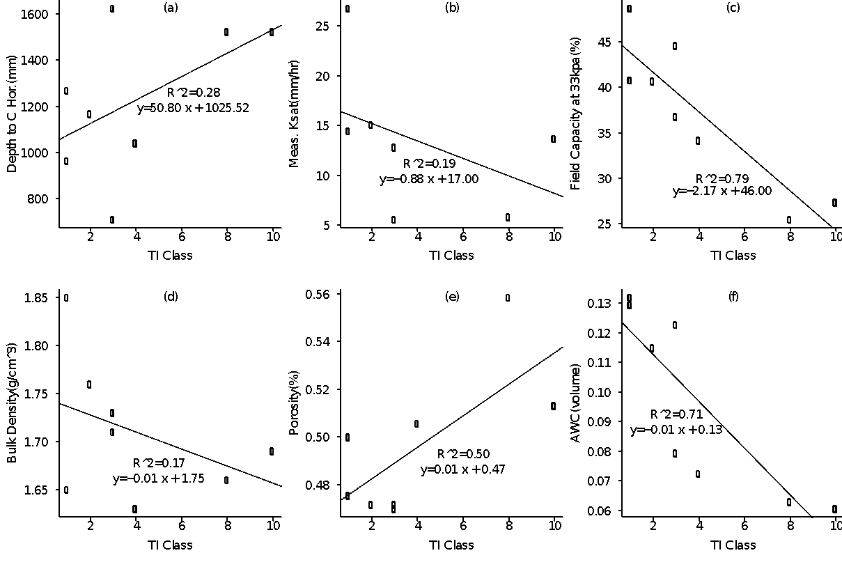
Soil Depth
Ksat
Field Capacity
Soil Depth (cm)
Ksat (mm/hr)
Field capacity (33kpa %)
TI Class
TI Class
TI Class
Bulk Density
Porosity
AWC
Bulk Density (g cm⁻³)
Porosity (%)
AWC (cm³ cm⁻³)
TI Class
TI Class
TI Class
Fuka et al. 2015 Hydrol Proc
Notes:
If we can "scan" a field with GPR prior for several time steps after a precipitation event, simple soil physics can give us much higher resolution soils maps.

Slide 9
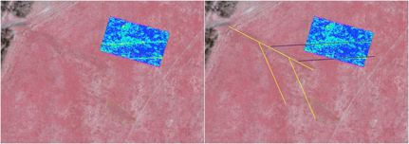
Water Quality/Spatial Soils
VSA Hydrology Use Case
GPR is Very Useful
Thank you: Helen Dahlke (UC Davis) and Tuna Easton (RIP)

Slide 10
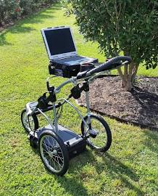
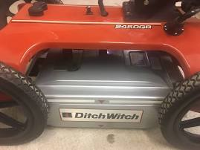
But Expensive, Slow, Bulky and hard to use right after storms
Ground Penetrating Radar Unit 500mhz High Resolution Fcc Certified $4,495.00 from eBay
Ditch Witch Ground Penetrating Radar $17,800.00 used from eBay

Slide 11
Can We Improve on 2003?
Huisman, J. A., S. S. Hubbard, J. D. Redman, and A. P. Annan. 2003. Measuring Soil Water Content with Ground Penetrating Radar . Vadose Zone J. 2:476-491. doi:10.2136/vzj2003.4760

Slide 12
Workflow Should Be Trivial
Buy Cheap Drone parts
Buy Cheap Sensors
Print Body
Give to Students to get data from field

Slide 13
Cheap Drone Parts ✅
Notes:
Same payload as Dual GPS, Flight Following, Can “SNIFF” and replace serial GPS,

Slide 14
Buy Cheap GPR Sensors ?
Tauqeer & Islam landmine detection study
$5 sensor can detect landmine to 4cm
Found that soil wetness decreases amplitude of reflected waves in soil because of attenuation
We assume that repeated measurements of the same area over time before and after rainfall events might collectively tell us something about Ksat
Tauqeer, Tauseef, Maira Islam, and A. K. Aziz. 2014. “Short Range Continuous Wave Radar for Target Detection in Various Mediums.” Microwave and Optical Technology Letters 56 (11):2484–89.

Slide 15
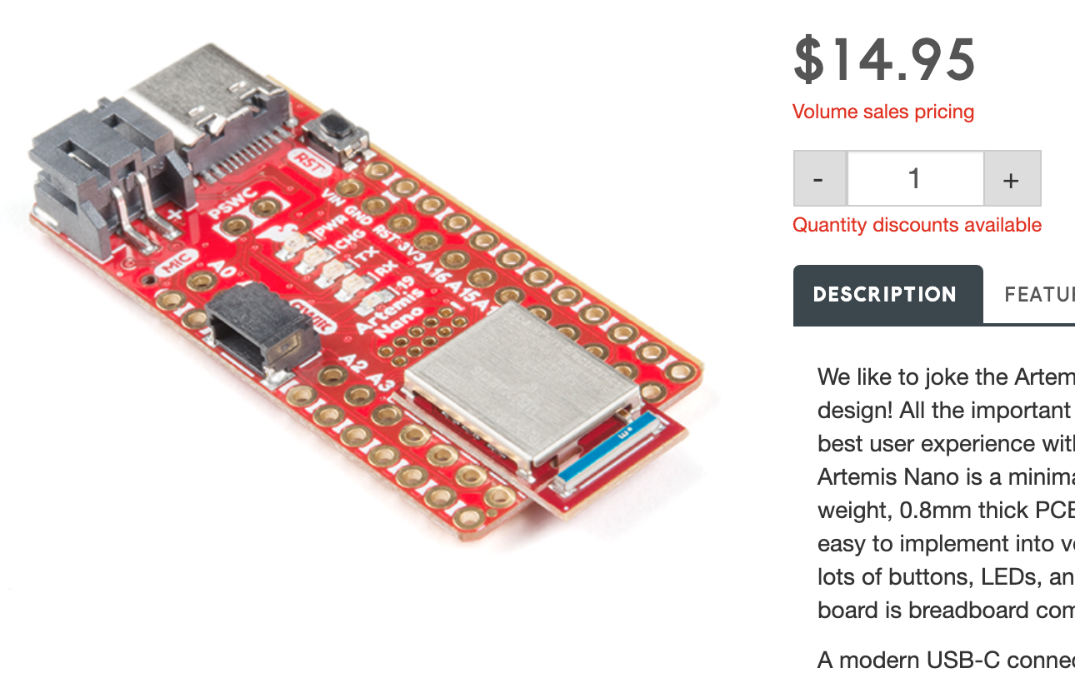
Build Sensors ✅
Edge Processing/Communication
1M Flash / 384k RAM
48MHz / 96MHz turbo available
2 UARTs
Built in BLE radio
Sensing
8 ADC channels with 14-bit precision
2 I2C buses
1 SPI bus
PDM Digital Microphone (Yondu Joke?)
I2S Interface
Qwiic Connector
21 GPIO Pins - all interrupt capable
21 PWM Channels

Slide 16
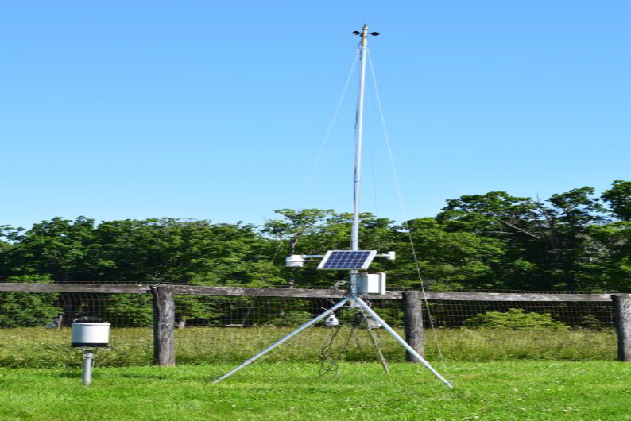
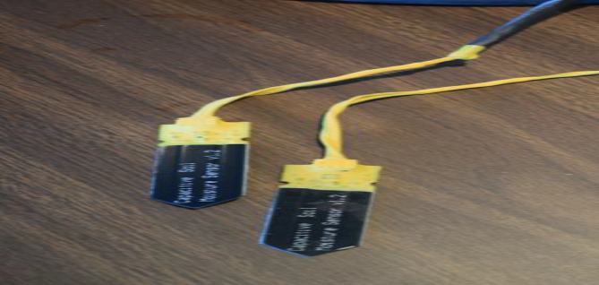
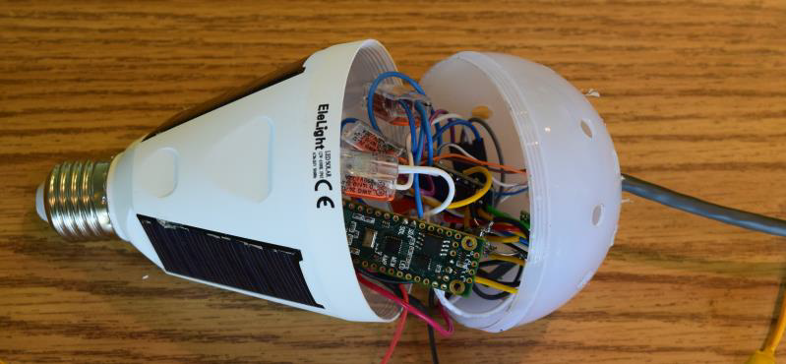
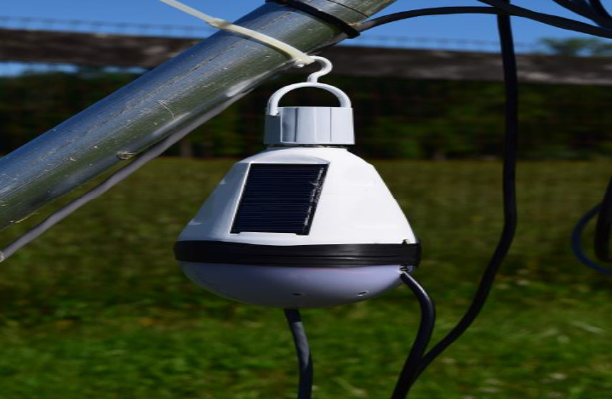
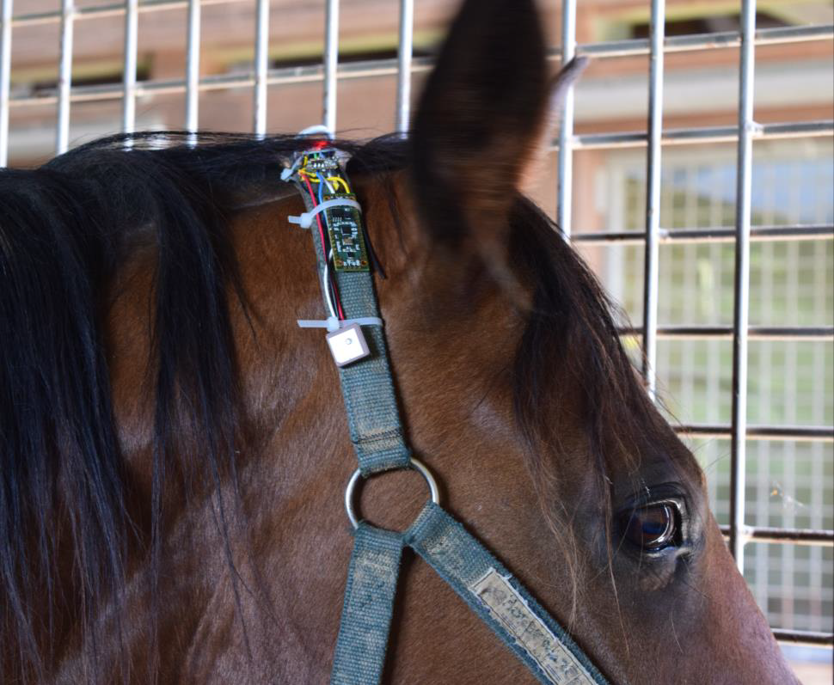
Data Handling
through
Brokering Alignment of Long-Tail Data
(NSF BALTO)
$25 Multi-Science Station
WX
Solar
Soil
Battery
Power Reg.
Arduino
LoRa
10DF Motion
GPS

Slide 17
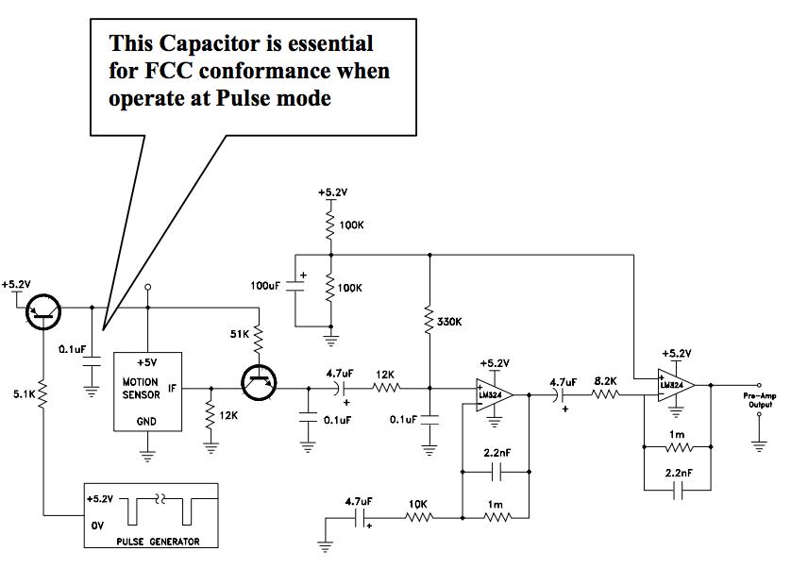
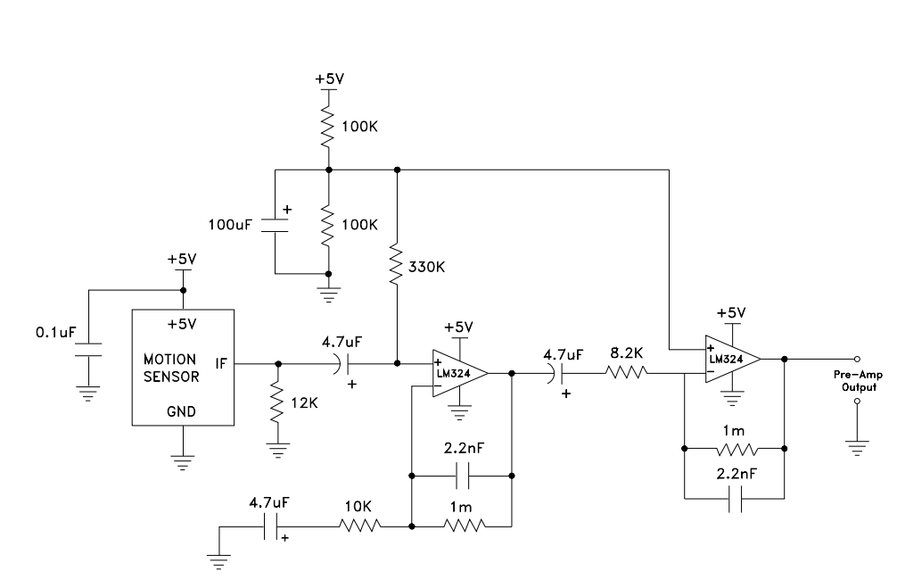
Slight Changes can
Add $15/35 Question Exam
Notes:
Difference is a

Slide 18
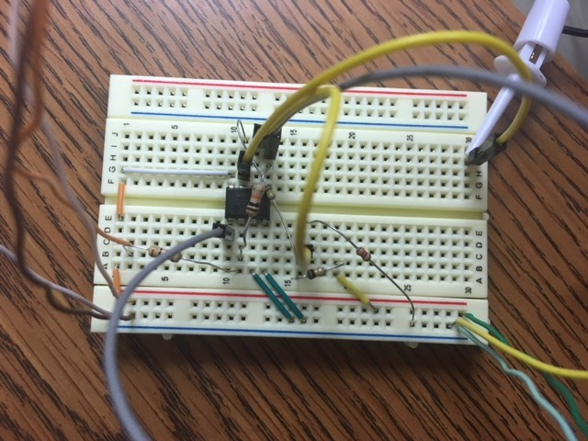
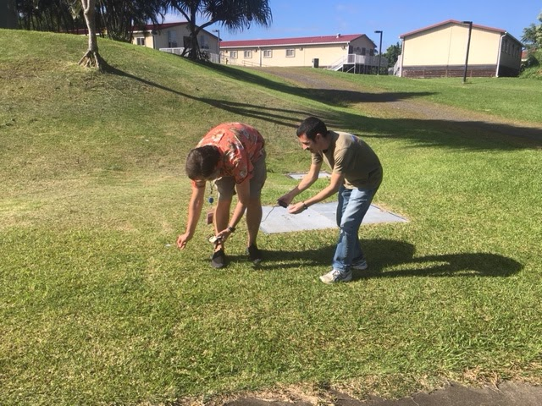
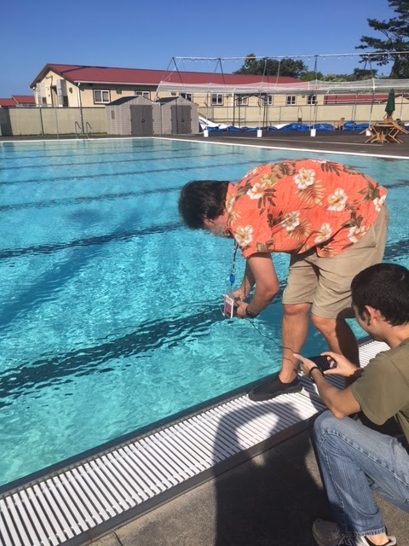

Slide 19
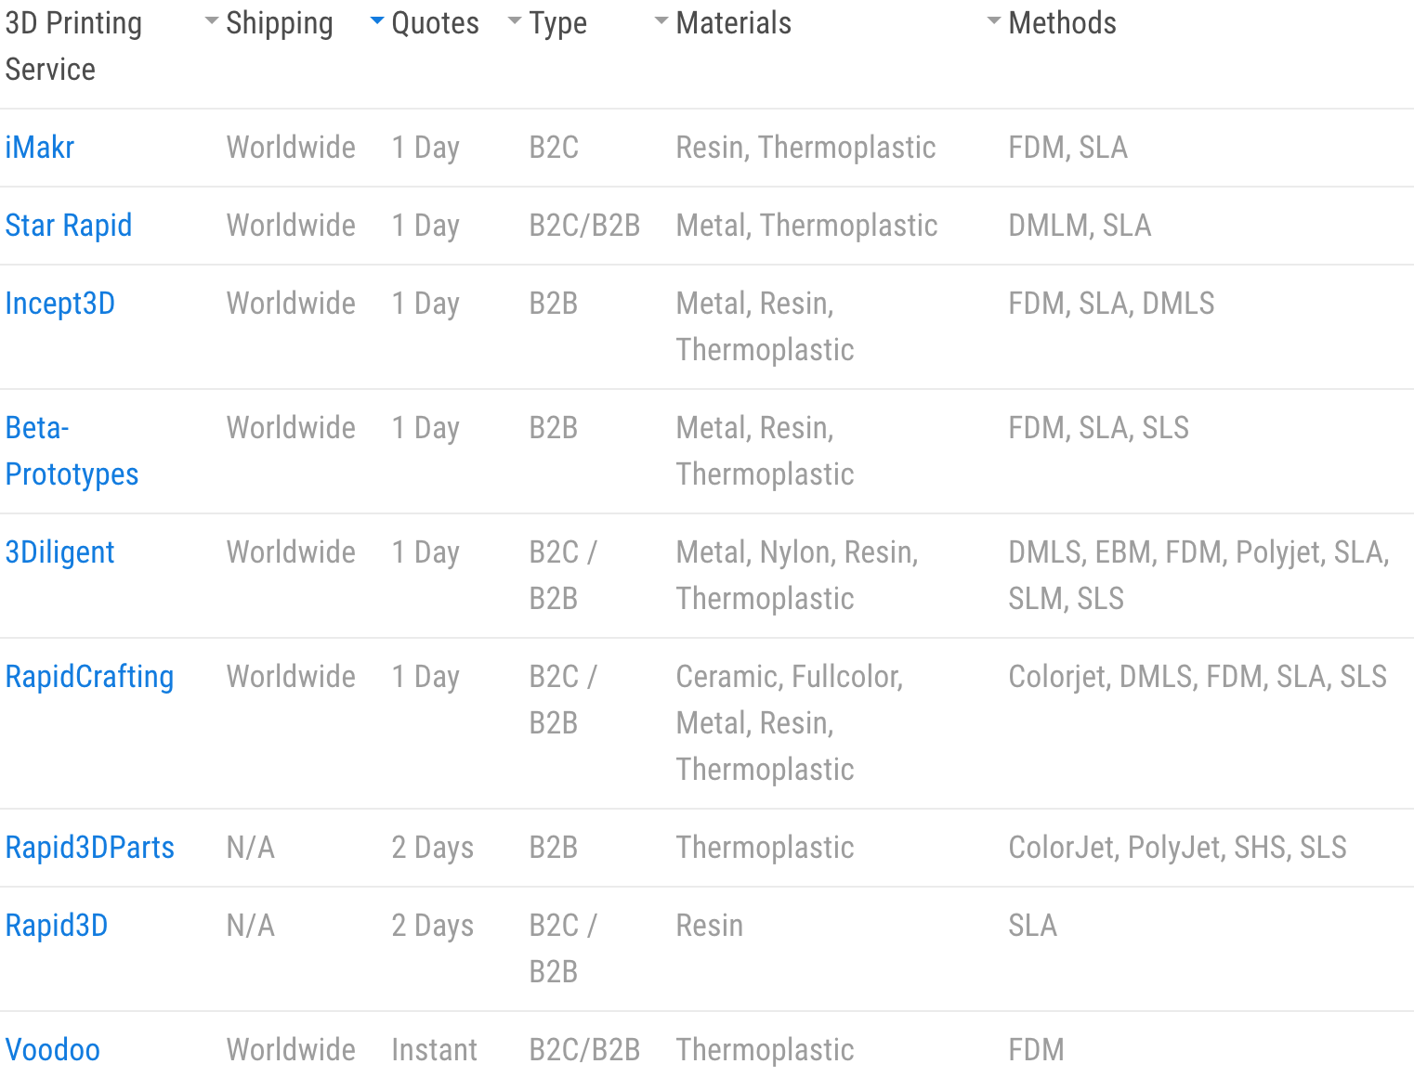
Print Body ✅

Slide 20
Sec. 1092. (d) reinstates the registration and marking requirements for sUAS, including model aircraft (i.e., hobby/recreational), that were vacated by the United States Court of Appeals for the District of Columbia Circuit in Taylor v. Huerta.

Slide 21
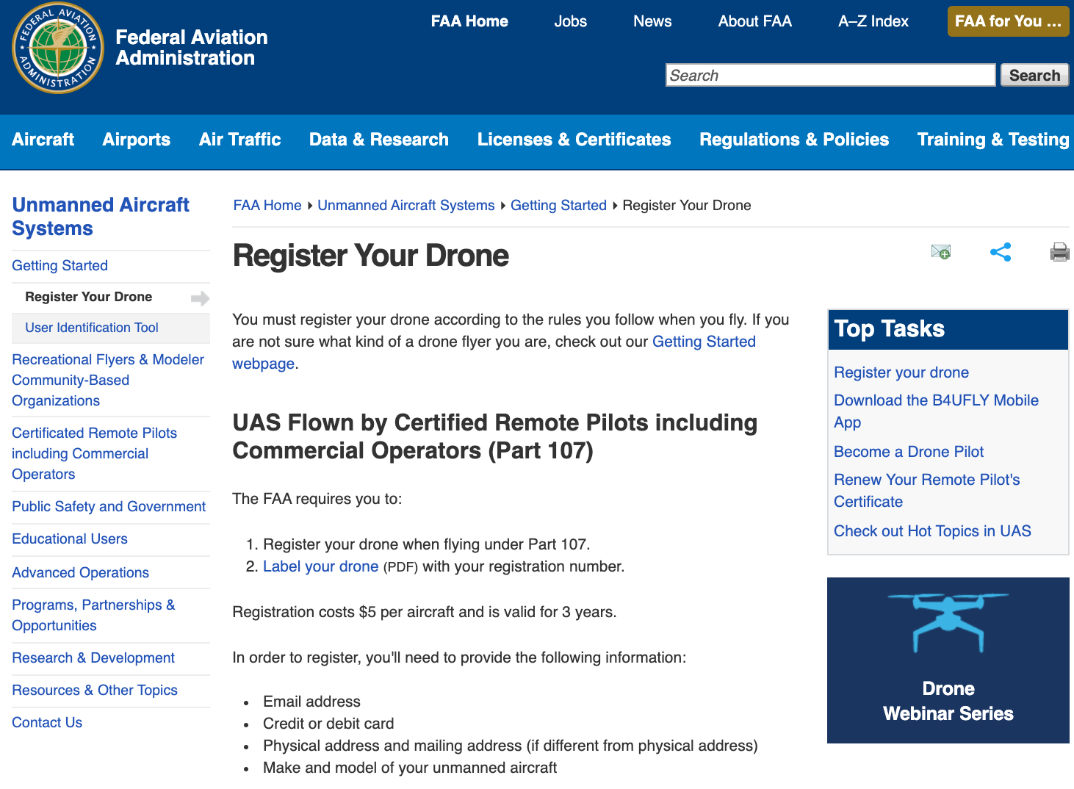

Slide 22
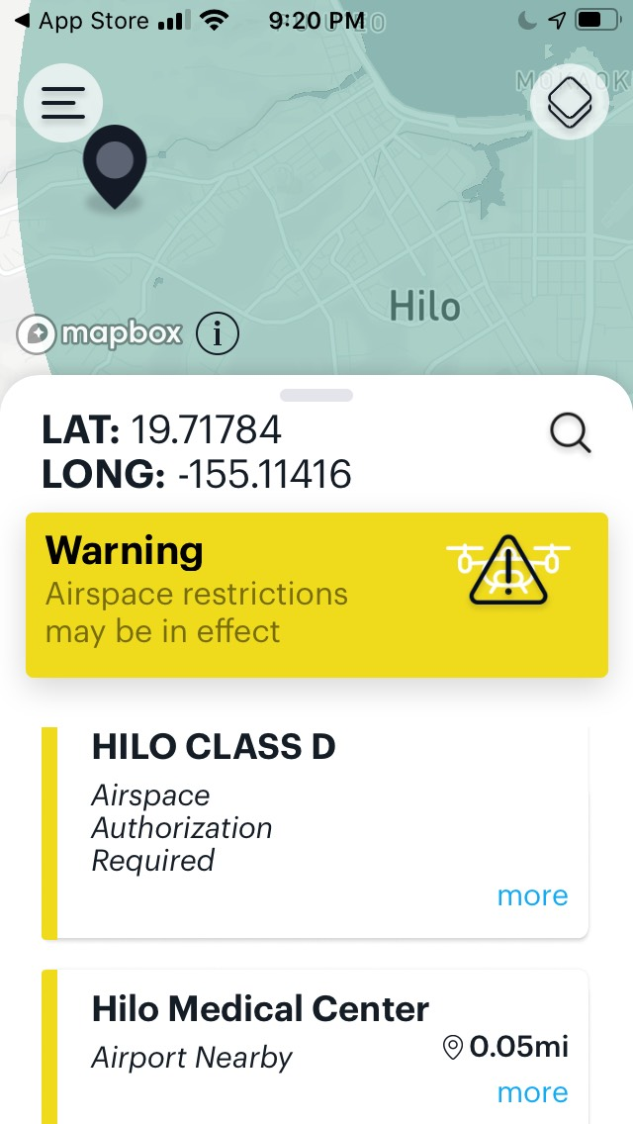
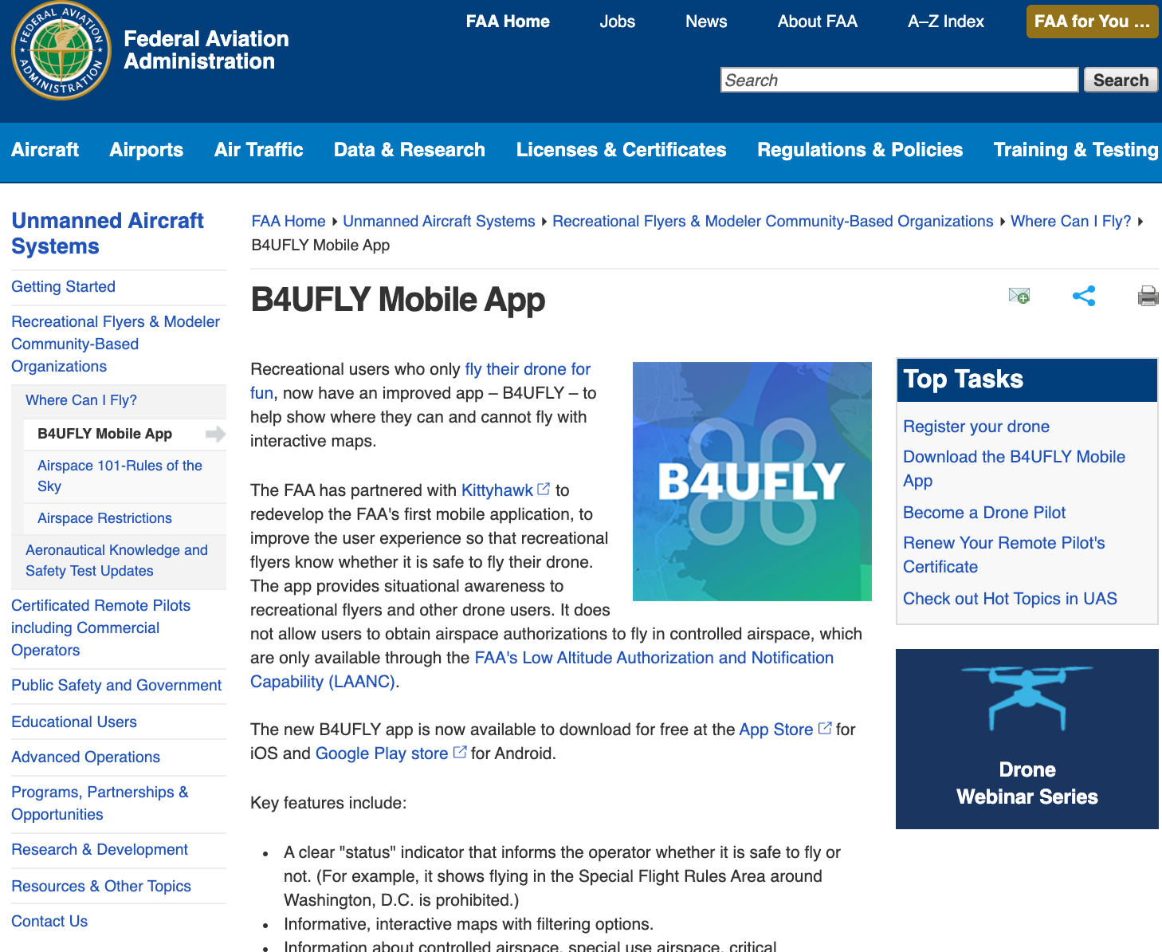
FAA is Making Legal Flying Easy

Slide 23
Give to Students?
Flying commercial sUAS operations without a remote pilot certificate (14CFR§107.12)
Flying an unregistered sUAS in the National Airspace System (14CFR§107.13)
Operating in a careless or reckless manner so as to endanger the life or property of another (14CFR§107.23)
Operation under the influence of drugs or alcohol (14CFR§107.27)
Operating beyond line of sight (14CFR§107.31)
Failure to yield right of way, i.e., close proximity to another aircraft (14CFR§107.37)
Operating over non-participants (14CFR§107.39)
Operation in controlled airspace (14CFR§107.41)
Operation in the vicinity of an airport, heliport, or seaplane base (14CFR§107.43)
Operation in prohibited or restricted airspace (14CFR§107.45)
Operation in a restricted area designated by notice to airmen (14CFR§107.47)
Failure to conduct preflight actions (14CFR§107.49)
Exceeding operational limits, e.g., altitude above 400 ft AGL, visibility below 3 SM (14CFR§107.51)
Notes:
Potential Violations of Aviation Regulations

Slide 24
Give to Students ✅
Need FAA Pilot’s License (Part 107)
FAA $150 test (First group Dec 2017 )
HAM License $15
$150 Drone
$50 in Sensors
Solder/Printer

