Slide 1
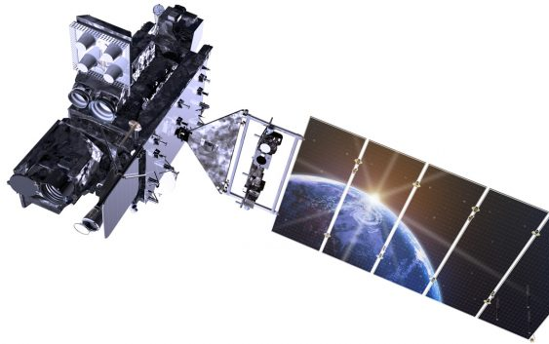
Connecting Value
ESIP Winter Meeting
January 9, 2020
Finding Societal Benefit in NOAA Satellite Data using USGEO Satellite Needs Working Group and the
2016 Earth Observation Assessment
Joseph Conran
National Oceanic and Atmospheric Administration
Technology, Planning and Integration for Observation
Riverside Technology, Inc

Slide 2
Context: NOAA Analysis of USGEO Satellite Needs Working Group
SNWG Collects agency satellite observation needs for NASA to consider as part of its satellite systems engineering and budgeting processes
NOAA Review for Round 2 of NASA’s Satellite Needs Working Group (SNWG) Surveys
Assessed 78 submissions to NASA to Identify NOAA’s Capability to Fulfill Needs
Identified environmental parameters and whether NOAA satellites could support need
Compared SNWG data requirements to NOAA capabilities using WMO OSCAR*
NOAA can potentially contribute to 29 of 67 non-NOAA federal agency needs
Desire to identify data needs by federal civil agency and other organizations
Realizing the external use of NOAA satellite data by application area can improve understanding of the benefit of NOAA data beyond its direct products and services
Cross-referenced SNWG with OSTP’s 2016 Earth Observation Assessment (EOA)
Focus on MODIS users potential transition to VIIRS and Sentinel Imagers (SAR, MSI, OLCI)
Confirm SNWG identified all agency satellite needs (especially for NOAA)
Value Chain: Satellite Instrument to Product to Agency to Societal Benefit Area
*WMO Observing System Capability Analysis and Review Tool

Slide 3
Value Chain: OSTP 2016 Earth Observation Assessment
Congress: “Establish a mechanism to ensure greater coordination of the research, operations, and activities relating to civilian Earth observation.”
EOA provides a relational framework of observing systems relied upon to meet key Earth observing objectives
Connects observing systems to agencies to benefit and application areas
EOA Value Chain:
Data Source – Product/Service/Outcome – Agency Owner – Objective – Societal Benefit Area – Sub Area
EOA Societal Benefit Areas:
Agriculture Biodiversity Climate Disasters Terrestrial & Freshwater Ecosystems Energy and Mineral Resources Human Health | Ocean & Coastal Resources and Ecosystems Space Weather Transportation Water Resources Weather Reference Measurements

Slide 4
Example of EOA Value Chain Connections
Instrument | Organization | Service/Outcome | Societal Benefit Area | SBA Sub Area | Key Objective
AQUA(MODIS) | DOI/USGS/CLUMsnArea | Data and Observations | Water Resources | Water availability | Ensure water availability for societal and ecosystem needs
AQUA(MODIS) | DOI/USGS/CLUMsnArea | Forecasts and Models | Water Resources | Water use | Develop a better understanding of the essential components of the water budget associated with agricultural use
AQUA(MODIS) | DOI/USGS | Fossil Fuels: Models to understand fate and transport of spilled oil in the marine environment | Energy and Mineral Resources | Understand and mitigate environmental impacts | Improve the understanding of the fate of fossil fuel resources released into the environment
AQUA(MODIS) | DOI/USGS/EcosysMsnArea | Coastal inundation research | Ecosystems | Role of ecosystems in mitigating natural hazards | Research and understand how ecosystem's species impact the ability for an area to mitigate natural hazards
AQUA(MODIS) | DOI/USGS/EnrgyMinMsnArea | Renewables: Geothermal resource development | Energy and Mineral Resources | Evaluate and enhance sustainability | Promote the development of new technologies to ensure sustainable supply of geothermal resources for electric power generation
AQUA(MODIS) | DOI/USGS/EcosysMsnArea | Coastal inundation and shoreline change hazards | Ocean and Coastal Ecosystems and Resources | Resilient coastal ecosystems | Ensure resilience of coastal ecosystems to key challenges and threats
AQUA(MODIS) | DOI/USGS | Water quality threats | Ocean and Coastal Ecosystems and Resources | Resilient coastal ecosystems | Ensure resilience of coastal ecosystems to key challenges and threats
Earth Observation Assessment 2016

Slide 5
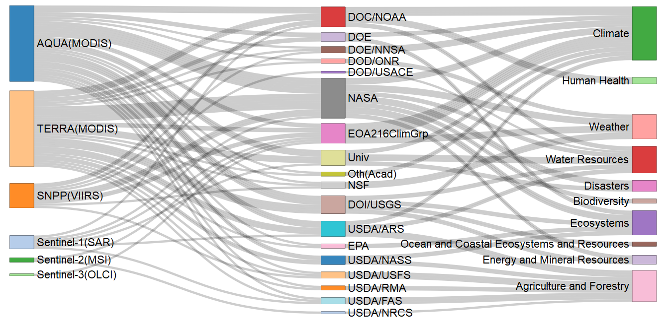
Visualizing the Connections
NOAA Satellite Instrument Dept/Agency Societal Benefit Area
Earth Observation Assessment 2016

Slide 6
So What?
Example of cross-agency collaboration and analysis (NOAA, NASA, OSTP, USGS) using a graph approach
EOA value chain provides cross-agency view of the impact of NOAA satellite data
NOAA Efforts: NOAA Observing System Integrated Analysis (NOSIA) Value Tree
NOAA-centric view connecting Observing Systems to Products to NOAA Missions and Goals
Not only satellites, but all observations (radar, dropsondes, ships, drones, human surveys, etc)
Next Steps in identifying societal value for Earth observations
Identify end users of data and their socioeconomic decisions
Initial step to identify monetary value of improved Earth observations
Observing System – Agency – Application Area – Policy Objective – End User

Slide 7
2020 Efforts
NOAA Observing System Integrate Analysis (NOSIA)
NOAA Internal Value Chain
Similar Methodology to Earth Observation Assessment
Observing System - NOAA Line Office - Mission - Product/Service
Current project to update NOSIA with new observing systems/products
Capture NOAA public-facing products and external/end users
Obsys - NOAA Office - Mission - NOAA Product - Public-Facing Product - End User(s)
US Group on Earth Observations
December 2019: National Plan for Civil Earth Observations
Satellite Needs Working Group Round 3
NOAA to again identify how agency can support civil agency needs
Potential Update to 2016 Earth Observation Assessment??

Slide 8
More Information
2019 National Plan for Civil Earth Observations
https://www.whitehouse.gov/wp-content/uploads/2019/12/Natl-Plan-for-Civil-Earth-Obs.pdf
USGEO Satellite Needs Working Group and Process:
https://www.ofcm.gov/groups/COES/Meetings/COES%2020160629/02%20SNWG_for_COES.pdf
Historical Information on USGEO and 2016 Earth Observation Assessment
https://obamawhitehouse.archives.gov/administration/eop/ostp/nstc/committees/cenrs/usgeo
NOAA Technology, Planning, and Integration for Observation division
https://nosc.noaa.gov/tpio/
NOAA Observing System Integrated Analysis
https://nosc.noaa.gov/tpio/main/nosia_main.html
WMO Observing Systems Capability Analysis and Review Tool
https://www.wmo-sat.info/oscar/instruments/view/296
Contact:
David Helms
TPIO Analytical Team Lead
NOAA/NESDIS/OPPA/TPIO
david.helms@noaa.gov
Joseph Conran
joseph.conran@noaa.gov

