Slide 1
Assessing the Impact of Land Imaging
January 9, 2020
ESIP Winter Meeting
Emily Sylak-Glassman | NASA
Jason Gallo | IDA Science & Technology Policy Institute
Presented by William E. J. Doane | IDA Science & Technology Policy Institute

Slide 2
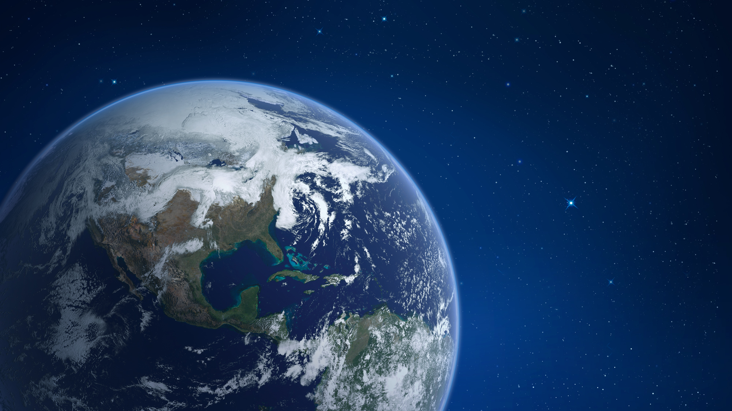
NASA EARTH FLEET
LANDSAT-9
NISAR
TROPICS (6)
SENTINEL-6A/B
OPERATING & FUTURE THROUGH 2023
LAND IMAGING SATELLITES ARE HIGHLIGHTED
TSIS-2
SWOT
PREFIRE (2)
MAIA
GEOCARB
PACE
INVEST/CUBESATS
RAVAN
RainCube
CSIM
CubeRRT
TEMPEST-D
CIRiS
HARP
CTIM
HyTI
SNoOPI
NACHOS
TEMPO
GLIMR
ICESAT-2
GRACE-FO (2)
CYGNSS (8)
NISTAR, EPIC (DSCOVR/NOAA)
ISS INSTRUMENTS
EMIT
CLARREO-PF
GEDI
SAGE III
OCO-3
TSIS-1
ECOSTRESS
LIS
SORCE
CLOUDSAT
TERRA
AQUA
AURA
CALIPSO
GPM
LANDSAT 7 (USGS)
JPSS-2, 3 & 4 INSTRUMENTS
OMPS-Limb
LANDSAT 8 (USGS)
OCO-2
(PRE) FORMULATION
IMPLEMENTATON
PRIMARY OPS
EXTENDED OPS
OSTM/JASON 2 (NOAA)
SMAP
09.10.19
SUOMI NPP (NOAA)
Notes:
NOTE: Land imaging satellites are highlighted. GLIMR might also qualify since it will be imaging coastal regions.
NASA Earth Science uses a fleet of satellites, the ISS, airborne sensors, ground networks and models to capture long term records of the earth as a system. This includes decades of Landsat data, seasonal to near real time records of snow, soil, storm and water with instruments such as SMAP characterizations of soil, MODIS imagery of storms and VIIRS imagery of power grids.
GLIMR: imaging/coastal regions
GEOCARB: will collect 10 million daily observations of the concentrations of carbon dioxide, methane, carbon monoxide and solar-induced fluorescence (SIF) at a spatial resolution of about 3 to 6 miles (5 to 10 kilometers).
PREFIRE: Far-IR measurements, esp. in the Arctic
TSIS: will provide absolute measurements of the total solar irradiance (TSI) and spectral solar irradiance (SSI), important for accurate scientific models of climate change and solar variability
LANDSAT: Land imaging
NISAR: SAR imagery
TROPICS: will provide rapid-refresh microwave measurements over the tropics that can be used to observe the thermodynamics of the troposphere and precipitation structure for storm systems at the mesoscale and synoptic scale over the entire storm lifecycle
SENTINEL -6A/B: will carry the record of sea level change – used by agencies, oceanographers, climate scientists, and many more – into its fourth decade. (JASON series)
SWOT: will make the first global survey of Earth's surface water, observe the fine details of the ocean's surface topography, and measure how water bodies change over time
MAIA: will make radiometric and polarimetric measurements needed to characterize the sizes, compositions and quantities of particulate matter in air pollution
PACE: will be NASA's most advanced global ocean color and aerosol mission to date. will be capable of measuring the color of the ocean from ultraviolet to shortwave infrared.
TEMPO: will monitor major air pollutants across the North American continent every daylight hour at high spatial resolution.
ICESAT-2: uses lasers and a very precise detection instrument to measure the elevation of Earth’s surface. By timing how long it takes laser beams to travel from the satellite to Earth and back, scientists can calculate the height of glaciers, sea ice, forests, lakes and more – including the changing ice sheets of Greenland and Antarctica.
GRACE-FO: will continue the work of tracking Earth's water movement to monitor changes in underground water storage, the amount of water in large lakes and rivers, soil moisture, ice sheets and glaciers, and sea level caused by the addition of water to the ocean.
CYGNSS: will use eight micro-satellites to measure wind speeds over Earth's oceans, increasing the ability of scientists to understand and predict hurricanes. Each satellite will take information based on the signals from four GPS satellites.
NISTAR, EPIC: NISTAR is an instrument that measures the outgoing radiation from the Earth. EPIC captures a color image of the sunlit side of Earth at least once every two hours.
SORCE: measures x-ray, ultraviolet, visible, near infra-red, and total solar radiation to study long-term climate change, natural variability and enhanced climate prediction, and atmospheric ozone and UV-B radiation.
CLOUDSAT: provides observations necessary to advance our understanding of cloud abundance, distribution, structure, and radiative properties
TERRA: Land imaging
AQUA: Land imaging
AURA: obtains measurements of ozone, aerosols and key gases throughout the atmosphere using technologically innovative space instrumentation
CALIPSO: measures aerosol forcing and uncertainty, surface and atmospheric fluxes, and cloud-climate feedbacks
GPM: is an international network of satellites that provide the next-generation global observations of rain and snow
Landsat 7: Land imaging
Landsat 8: Land imaging
OCO-2: designed to collect space-based global measurements of atmospheric CO₂ with the precision, resolution, and coverage needed to characterize sources and sinks (fluxes) on regional scales (≥1000km)
OSTM/JASON 2: measures ocean surface topography from space
SMAP: measures the amount of water in the top 5 cm (2 inches) of soil everywhere on Earth’s surface
SUOMI NPP: collects data on long-term climate change and short-term weather conditions
EMIT: will map the surface mineralogy of arid dust source regions via imaging spectroscopy in the visible and short-wave infrared (VSWIR). The maps of the source regions will be used to improve forecasts of the role of mineral dust in the radiative forcing (warming or cooling) of the atmosphere.
CLARREO-PF:
GEDI: provides high resolution laser ranging of Earth’s forests and topography from the International Space Station (ISS). GEDI will provide answers to how deforestation has contributed to atmospheric CO₂ concentrations, how much carbon forests will absorb in the future, and how habitat degradation will affect global biodiversity.
SAGE III: uses a technique known as occultation, which involves looking at the light from the Sun or Moon as it passes through Earth’s atmosphere at the edge, or limb, of the planet to provide long-term monitoring of ozone vertical profiles of the stratosphere and mesosphere.
OCO-3: will investigate important questions about the distribution of carbon dioxide on Earth as it relates to growing urban populations and changing patterns of fossil fuel combustion.
TSIS-1: measures the total amount of sunlight that falls on Earth, and how that light is distributed among the ultraviolet, visible and infrared wavelengths.
ECOSTRESS: collects the most detailed temperature images of the surface ever acquired from space and can be used to measure the temperature of an individual farmers field.
LIS: s a space-based lightning sensor aboard the International Space Station (ISS). The ISS LIS instrument records the time of occurrence of a lightning event, measures the radiant energy and estimates the location during both day and night conditions with high detection efficiency.
OMPS-Limb: collects total column and vertical profile ozone data and continues the daily global data produced by current ozone monitoring systems—the Solar Backscatter Ultraviolet Radiometer (SBUV/2) and Total Ozone Mapping Spectrometer (TOMS)—but with higher fidelity and larger swaths.
RAVAN: tests new technologies that help to measure Earth’s radiation imbalance, which is the difference between the amount of energy from the Sun that reaches Earth and the amount that is reflected and emitted back into space.
RainCube: is a technology demonstration mission to enable Ka-band precipitation radar technologies on a low-cost, quick-turnaround platform.
CSIM: will be measuring the wavelengths from the sun from the near-ultraviolet to the near infrared – a wavelength range encompassing 96% of the total output of the sun
CubeRRT: will demonstrate on-board, real-time Radio Frequency Interference (RFI) processing
TEMPEST-D: is a technology demonstration mission to enable millimeter wave radiometer technologies on a low-cost, short development schedule.
CIRiS: is designed to match the temperature and water vapor profile measurements in the lower troposphere of the Atmospheric Infrared Sounder, or AIRS, instrument on NASA's Aqua satellite and the Cross Track Infrared Sounder, or CrIS, instrument on the NASA/NOAA Joint Polar Satellite System to improve the timeliness and resolution of critical infrared sounding data to improve weather forecasting and support research in the areas of severe weather and climate.
HARP: is a comprehensive atmospheric radiation suite to measure spectrally resolved actinic flux and horizontally stabilized irradiance.
CTIM: is a technology demonstration mission of a next-generation Compact Total Irradiance Monitor that will help to provide an understanding of Earth’s climate change. Total solar irradiance has been measured from space by a 40-year, uninterrupted sequence of instruments. CTIM will allow measurements to be made with the same accuracy and long-term stability while using a much smaller instrument.
HyTI: will demonstrate how high spatial resolution (60 m ground resolution element), high spectral resolution (25 bands) and long-wave infrared image data can be acquired to monitor water resources using a 6U CubeSat. HyTI will map irrigated and rainfed cropland, determine crop water use and establish crop water productivity of major world crops.
SNoOPI: will demonstrate the measurement of the complex reflection coefficient over various land surface conditions for use in future CubeSat constellations. The technology will measure snow and soil moisture, which are vital data for applications like food security and water resources management.
NACHOS: Compact high-resolution tracegas hyperspectral imagers, with agile on-board processing

Slide 3
NASA Earth Science | Applied Sciences Program
The Applied Sciences Program within NASA’s Earth Science Division provides funding, resources, technical and analytical expertise and other support to experts to use data from NASA’s Earth-observing satellites and airborne missions to tackle tough challenges and develop solutions that improve our daily lives.
We provide three types of decision-support:
Enhancing existing decision support tools or processes together with the partner organizations;
Developing new applications and decision support tools or processes together with the partner organizations; and
Developing information products, maps, and tools used by partner organizations to serve their customers, clients, and public.
Notes:
I work in the Applied Sciences Program, which is the part of NASA’s Earth Science Division that works to take all of the data that NASA collects and apply it for decision support. We fund projects that use NASA’s satellite and airborne data often in combination with Earth observations collected by other partners within the Earth observation Enterprise, and in many cases, socio-economic data to fill knowledge gaps, build awareness, and develop meaningful solutions to difficult problems.
The land imaging satellites and sensors are used in a wide range of the applications that we support, and so today, I’d like to talk through a few specific examples of ways that we see those satellites and sensors being used.

Slide 4
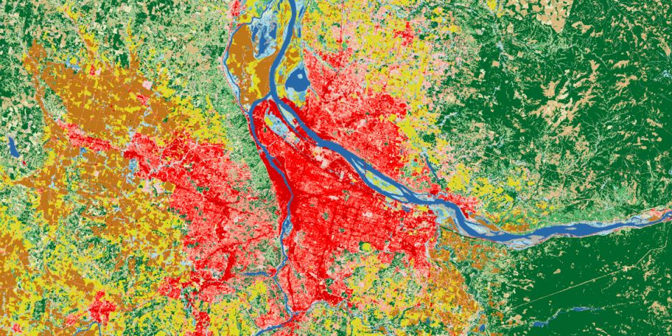
Landsat and MODIS Data for Land Classification: Training and Applications
Landsat and MODIS imagery can be used to develop land cover classifications, transformations of pixels with similar spectral characteristics into other meaningful categories of interest.
Classification of land imagery is an initial analysis step for a wide range of projects funded by the Applied Sciences Program, from developing field-scale crop-type maps and agricultural yield estimations in the U.S. to developing regional land cover maps for countries in the Lower Mekong Region.
The Applied Remote Sensing Training (ARSET) Program offers webinars that show users how to use Landsat data for land classification.
Source: https://arset.gsfc.nasa.gov/land/webinars/advanced-land-classification
Notes:
In many different applications that we support, Landsat and MODIS data is being used for land classification, in which researchers train algorithms to map between pixels with certain spectral characteristics and categories that are meaningful to the research.

Slide 5
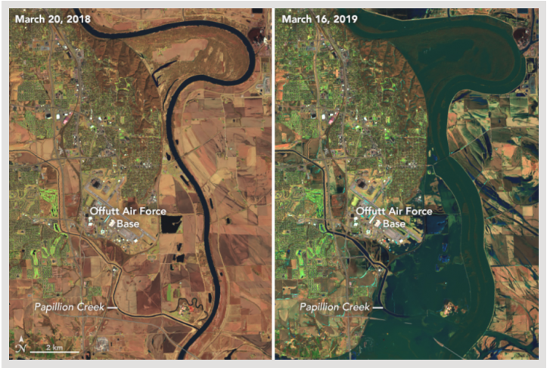
Landsat and MODIS for Disaster Response: Flood Mapping and Monitoring
In the mid-western floods in Spring, 2019, many individuals turned to NASA for the data to drive decisions and the information products needed to enable preparedness, stage response and assist in resilient recovery.
FEMA, the National Guard Bureau, the State of Missouri Emergency Management Agency, and the US Department of Agriculture used flood risk products developed by NASA and partners including those developed from MODIS optical imagery and Landsat optical imagery to predict and characterize flood extent.
NASA supports users by providing near-real time (3-5 hour lag) MODIS data for flood mapping and many other tools on the Land, Atmosphere Near real-time Capability of Earth observing systems, known as LANCE and fully GIS-enabled information on the Disasters Program’s Portal.
Landsat’s long record, simple access, and intuitive imagery allow for widespread use for disaster preparedness, mitigation, response, and recovery.
Comparison of before (March 20th, 2018) and after (March 16th, 2019) the flooding event at Offutt Air Force Base, Nebraska, using data from Landsat 8's OLI instrument. Credit: NASA Earth Observatory

Slide 6
Use of Land Imaging Satellites
The land imaging satellites are used in a wide-range of applications, both because of their long longitudinal record (47 years for Landsat, 20 years for TERRA, and 17 years for AQUA) and their broad utility.
Understanding the diversity of applications that a given satellite has can inspire new data products, tools, partnerships, and missions.
How do we look systematically across the different applications of Landsat, MODIS, and other satellites, sensors, networks, and surveys, to identify key uses across the Federal Government?

Slide 7
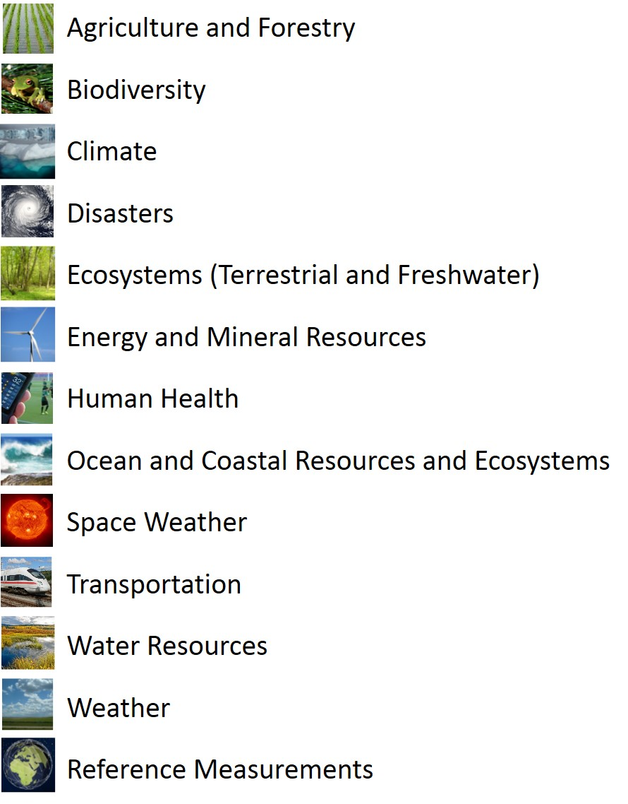
Earth Observation Assessment 2016 (EOA 2016)
NASA Authorization Act of 2010 (Section 702) instructed the Director of the White House Office of Science and Technology Policy (OSTP) to “establish a mechanism to ensure greater coordination of the research, operations, and activities relating to civilian Earth observation of those Agencies.”
In response, an interagency group led by OSTP, NASA, NOAA, and USGS conducted assessments (2012 and 2016) of the Earth observation portfolio that the Federal Government relies on to meet its civil objectives.
Federal Participation
USGEO Assessment Working Group (AWG), Co-Chaired by NASA, NOAA, and USGS
300 federal research scientists and managers on 13 Societal Benefit Area (SBA) teams
1,000 subject matter experts involved in the data elicitation process
3,000 elicitation interviews with subject matter experts
Assessment General Statistics
217 unique key federal objectives identified
1,722 unique Earth observation products surveyed
1,323 total Earth observation inputs (systems, sensors, networks, databases, and surveys)
53,720 nodes in the resulting Assessment network model

Slide 8
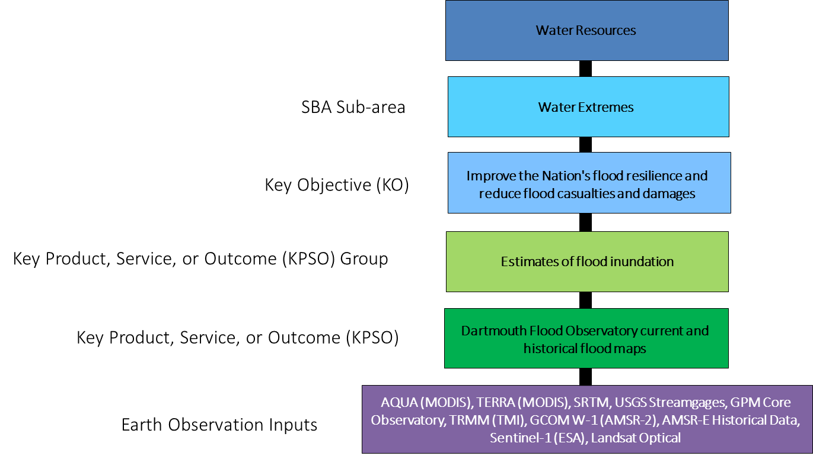
EOA 2016 Data is Organized Hierarchically

Slide 9
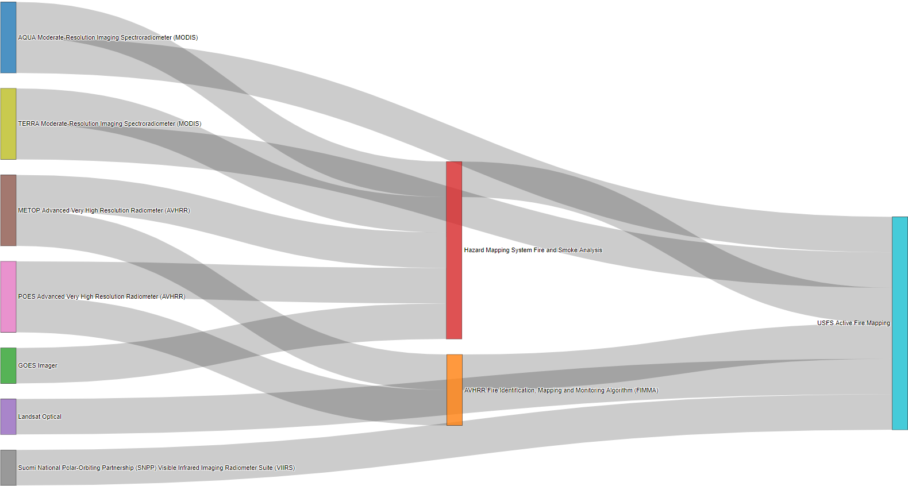
Combination of Satellite Observations to Support Active Fire Mapping

Slide 10
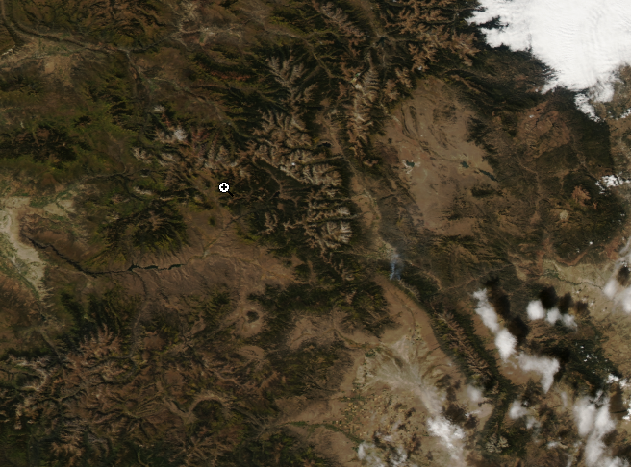
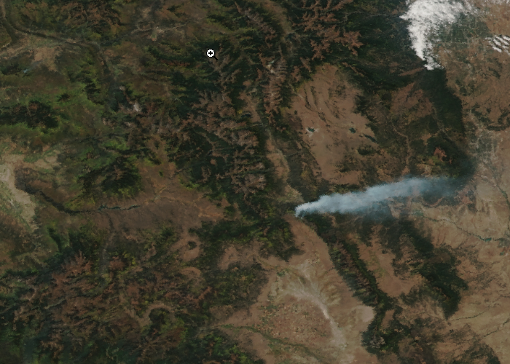
MODIS and VIIRS Fire Imagery
Colorado 10/01/2019 19:54:24 GMT Satellite: Aqua, Sensor: MODIS, Bands: 1/4/3, True Color
Colorado 10/02/2019 18:52:21 GMT Satellite: SNPP, Sensor: VIIRS, Bands 5/4/3, True Color

Slide 11
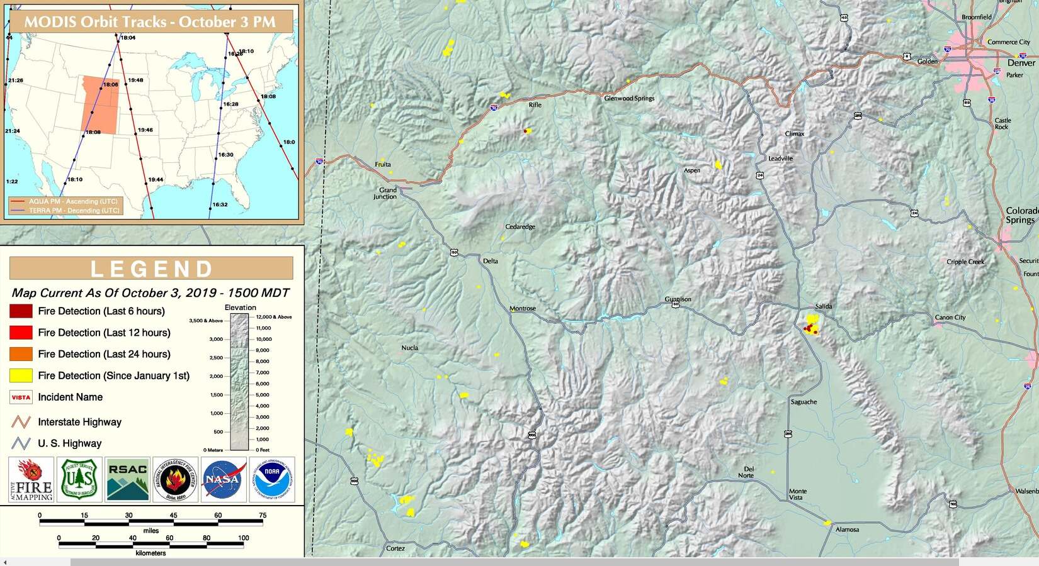
Active Fire Mapping

Slide 12
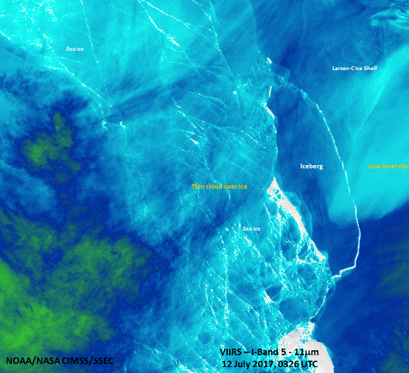
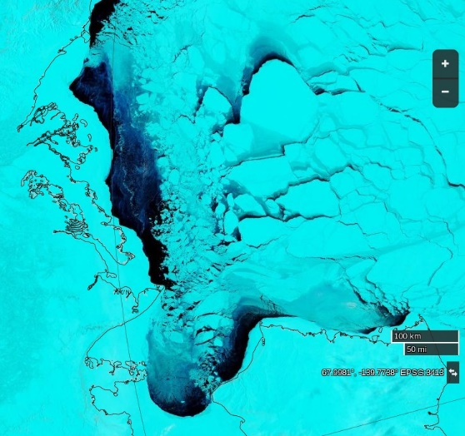
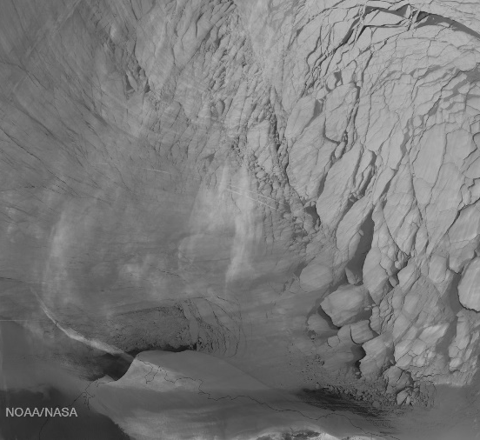
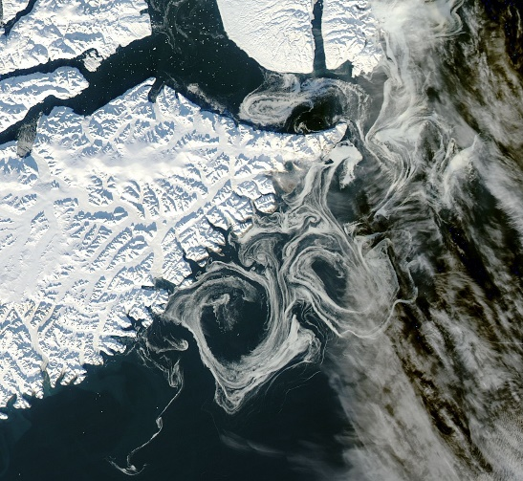
Diverse Uses of Observations: MODIS and VIIRS
In this example we identified sea ice products that used imagery from both VIIRS and MODIS to demonstrate the impact of both sensors on research and operations specifically in the Climate and Transportation SBAs.
We identified all of the key products that a combination of Suomi NPP VIIRS, Aqua MODIS, and Terra MODIS imagery directly connect to then visualized that information flow through the EOA 2016 network.
VIIRS
MODIS

Slide 13
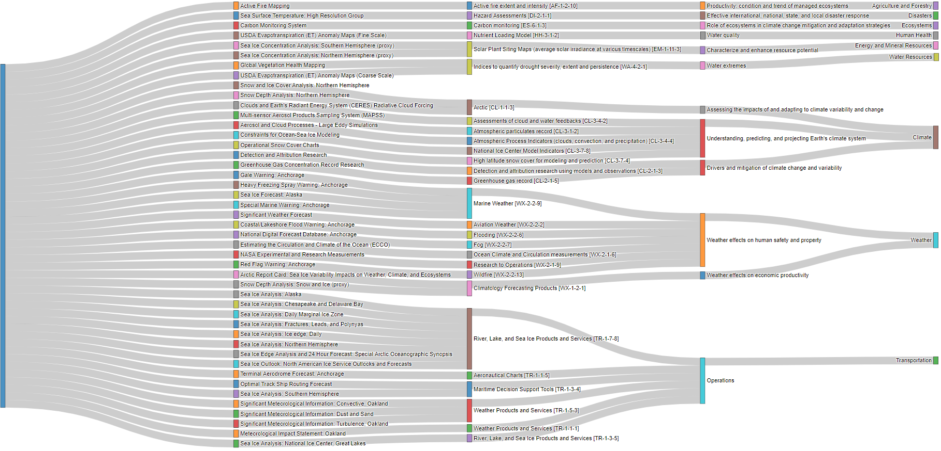
Network of Combined MODIS and VIIRS Imagery (Direct Links)
KPSO
KPSO GROUP
SUB-AREA
SBA
Snow and Ice Observations for Research
SUOMI NPP VIIRS, AQUA MODIS, TERRA MODIS Combination
Ice Observations for Operations

Slide 14
Next Steps
Understanding non-Federal user needs
What data and information products do non-Federal users rely on?
What data and information products do non-Federal users wish they had?
How do non-Federal users access current data and information products?
What data and information services and tools do non-Federal users use?
What data and information product format(s) do non-Federal users currently use?
What data and information product format(s) would non-Federal like to use?
Do non-Federal users encounter discoverability, accessibility, or usability issues?

