Slide 1
Connecting Data with Data Usage: a Graph Approach
Winter ESIP, 10:15am, Thursday, January 9th 2020
Doug Newman
NASA EED-2 Data Use Architect
douglas.j.newman@nasa.gov
Dr. Christopher Lynnes
NASA EOSDIS System Architect
christopher.s.lynnes@nasa.gov
This work was supported by NASA/GSFC under Raytheon Co. contract number NNG15HZ39C.
This document does not contain technology or Technical Data controlled under either the U.S. International Traffic in Arms Regulations or the U.S. Export Administration Regulations.

Slide 2
EOSDIS KNOWLEDGE GRAPH

Slide 3
Overview
Effective technologies
Sources of knowledge
NASA EOSDIS Common Metadata Repository
World meteorological organization
The CEOS database
Notes:
A prototypical approach.
Evaluate various technologies.
Test against ‘in-house’ entities and associations and then branch out to entities we do not house.
Missions, instruments etc in the CEOS database.
Essential Climate Variables from the WMO.

Slide 4
Graph Technologies
Implementations
AWS Neptune
Neo4J
APIs
SPARQL
Gremlin
Cypher – soon to be GQL
Amazon Web Services and the “Powered by AWS” logo are trademarks of Amazon.com, Inc. or its affiliates in the United States and/or other countries
Neo4j is a registered trademark of Neo4j
Apache Gremlin are either registered trademarks or trademarks of the Apache Software Foundation
Notes:
We looked at two implementations
Neo4J – generally, the first port of call for graph. Free community edition, rather expensive enterprise edition
Neptune - AWS’s managed graph database solution
We looked at three APIS for graph population and querying.
SPARQL – well known in this community
Gremlin – apache project
Cypher/GQL – Neo4J’s default API

Slide 5
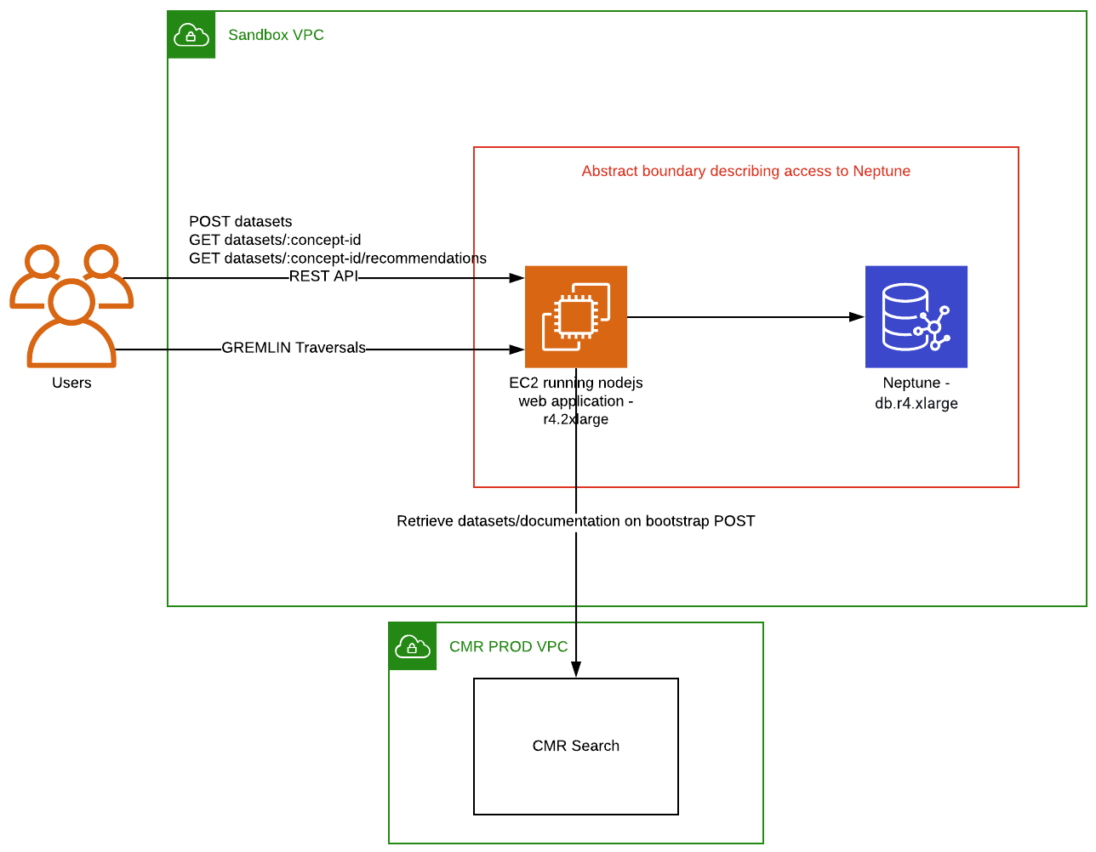
AWS Neptune + Gremlin
Amazon Web Services and the “Powered by AWS” logo are trademarks of Amazon.com, Inc. or its affiliates in the United States and/or other countries
Apache Gremlin are either registered trademarks or trademarks of the Apache Software Foundation
Notes:
What did we choose?
Graph engine: Neptune – supported two widely accepted standards (Gremlin and SPARQL) out of the box. Fits nicely into our existing AWS ecosystem. Note: Neo4J have recently announced their Cypher query language as a standard (GQL).
Neo4J does not have Gremlin or SPARQL support out of the box. Third party plugins for that support did not yield results.
Graph API: Gremlin – imho the most intuitive graph API of those evaluated and is implemented in a large number of programming languages.

Slide 6
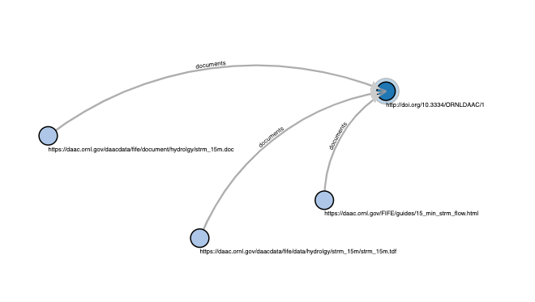
Within NASA Earthdata
The common metadata repository contains dataset metadata records and references to their respective documentation. We used this inventory to create a graph of datasets and documentation vertices and ‘documents’ edges, originally to serve as a stepping stone towards scientific literature.
Notes:
Starting point: create graph from CMR entities. Datasets + documentation
Why documentation? Scientific literature may cite the documentation of a dataset rather than the dataset itself. It’s a stepping stone to linking datasets to scientific literature.

Slide 7
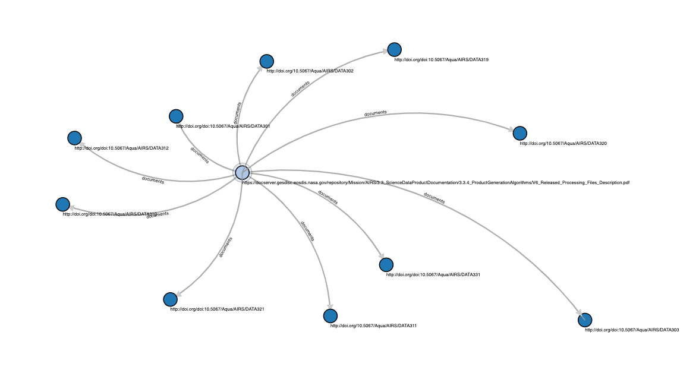
Side trip to recommendations
g.V().hasLabel('dataset')
.has('conceptid',conceptId)
.inE('documents')
.outV()
.hasLabel('documentation')
.outE('documents')
.inV()
.hasLabel('dataset')
AIRS3STM
Notes:
After building that graph I was ready to move on to the scientific literature step but I noticed something.
Lightbulb moment!
Datasets share documentation. Shared documentation == possible recommendation.
The visualization is a manifestation of this Gremlin query (describe query)
So I built a recommendation engine based on that assumption. And it was trivial.
Graph provides a very intuitive and efficient means of extracting that information.
Because we can assign properties to the associations, we could imagine reinforcing these links with weightings based on how often they are travelled. If a user acquires data based on a recommendation above we can increase the weight of that association.

Slide 8
Essential Climate Variables (1)
A good starting point for discovery: ‘I want total ozone data’
Total Ozone is one of 496 well-defined products, spread across 30 variables in 3 domains
Notes:
Another test case:
Essential Climate Variables.
WMO curates a collection of ECVs wrt domains, variables and products.
It seems likely that a user might use one of these ECVs as a starting point for discovery. I want TOTAL OZONE data.

Slide 9
Essential Climate Variables (2)
425 datasets have been mapped to those products in our graph implementation
Notes:
We have mapped 425 datasets resident in CMR to ECV products. We put those relationships into a graph.

Slide 10
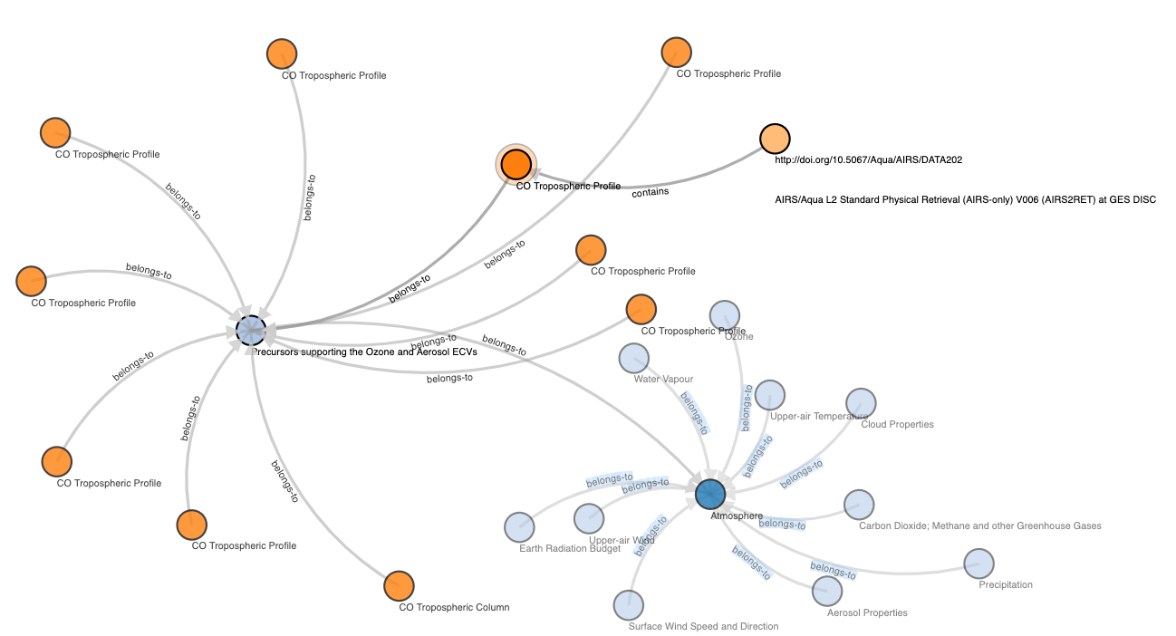
Essential Climate Variables (2)
Notes:
Let’s walk the graph…
Atmospheric ECVs?
Precursors supporting the Ozone and Aerosol ECVs?
CO tropospheric profile?
You’ll be wanting AIRS2RET then?

Slide 11
Missions and instruments
The CEOS database contains extensive information about missions and instruments and their linkage.
CMR contains linkage information between datasets and mission/instruments.
Notes:
Another dimension we assessed was the relationship between missions, instruments and datasets.
We have the linkage between these three entities within CMR but we don’t have the canonical representation of instruments and missions. CEOS does though.

Slide 12
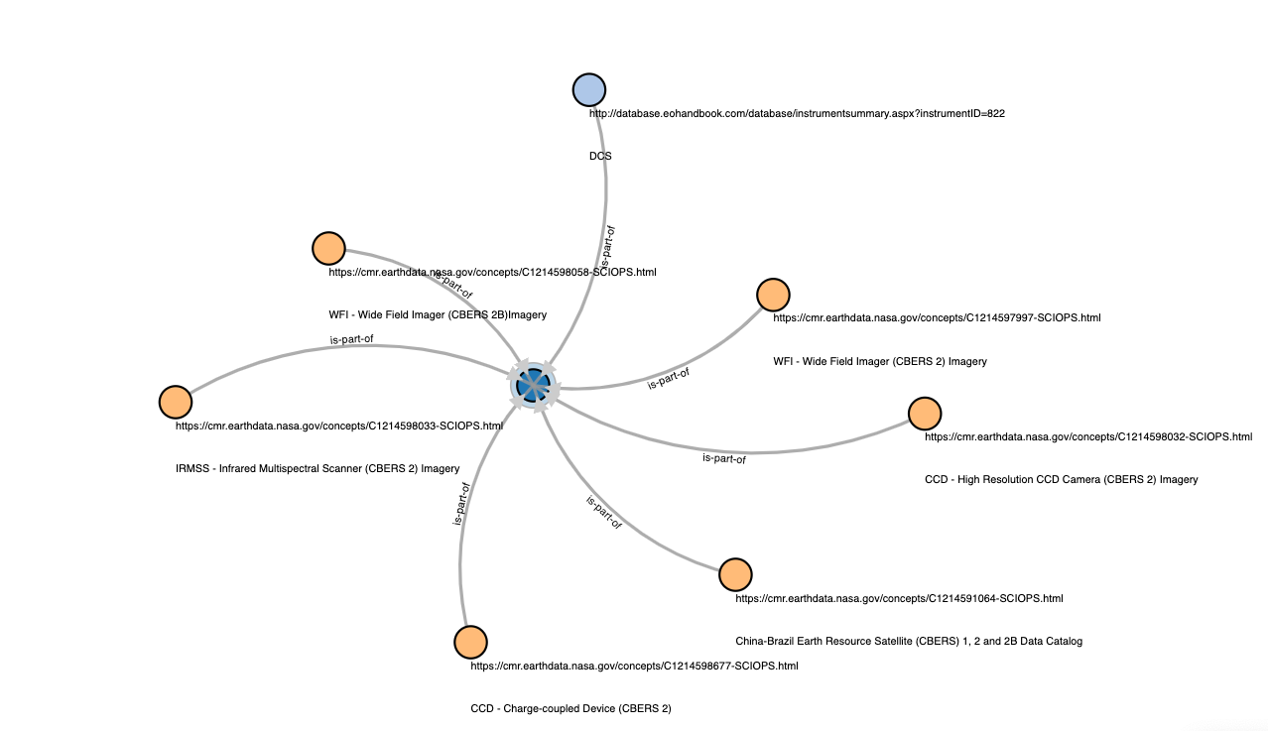
Missions and instruments
Notes:
Let’s walk the graph
Mission CBERS-2?
Here’s a canonical representation of the mission in the center~
Here are the collections associated with that mission (some of their canonical representations are DOIs!)
Here are the instruments. Their canonical representations are at the end of this URL!

Slide 13
Keywords
The hierarchy of science keywords and their associations with datasets
Science keywords - GCMD
Datasets - CMR
Notes:
And finally, Science keywords seems like a natural fit for graph. EOSDIS has the keywords (GCMD) it has the datasets and it has the associations between them.

Slide 14
CONCLUSIONS
Notes:
In conclusion

Slide 15
If you build it...
10 minutes looking at a visualization of the associations between two CMR concepts gave me the inspiration for the recommendation engine. Imagine what an expert could do?
Providing a traversal API over a knowledge base containing more concepts could open the floodgates for novel discovery techniques
Notes:
Visualization of relationships can give both new insight and more efficient/intuitive means of solving problems. 10 minute!
Exposing a means to do that to the world at large may encourage new discovery techniques
If we are to provide associations to external entities, they need to be permanent (DOIs etc.)
Those external entities need to provide both human-readable and machine-readable representations

Slide 16
NEXT STEPS
Notes:
In conclusion

Slide 17
Link all the things
With help from each other we can scale up these connections to facilitate data discovery
Notes:
The canonical source of truth of the entities we want to link belong to a variety of organizations. If we want to exploit these relationships we need to collaborate.

Slide 18
QUESTIONS?
Approved for Public Release
Notes:
Thank you for your time. Questions?

Slide 19
This work was supported by NASA/GSFC under Raytheon Co. contract number NNG15HZ39C.
in partnership with

