Slide 1
Applying the RDF DataCube model to power data exploration dashboards for the Irish Wave and Weather Buoy Networks
Rob Thomas and Adam Leadbetter
Marine Institute, Ireland

Slide 2
Background – OpenCube project
OpenCube aimed at developing software tools that facilitate
Linked Statistical Data publishing
reusing distributed Linked Statistical Data
Notes:
The work covered by this presentation has been carried out under an EU Horizon 2020 funded project called OpenGovIntelligence (or OGI for short).
The OGI project builds on work carried out under the EU FP7 funded OpenCube project, which developed tools to help the publishing and re-use of Linked Open Statistical Data.

Slide 3
Motivation – Open Government Data
Public administration publishes Open Data in an ad-hoc manner.
Society expects data-driven public services, not raw data.
As a result, society should be involved in service co-production to ensure that public services address their needs.
Notes:
Key message is that despite a large variety of data the public expects data driven services not just raw data.

Slide 4
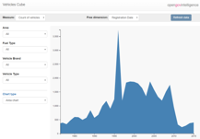
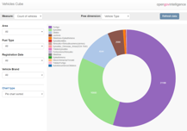
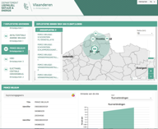
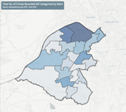
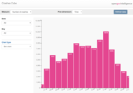
OpenGovIntelligence Pilots
Managing government vehicles in Greece
Business planning in Lithuania
Environmental planning in Belgium
Worklessness in Trafford
Renewable Energy in Ireland
Real estate in Estonia
Notes:
The OGI pilot used 6 pilot user cases to drive and assess the development of tools for Linked Open Statistical Data (LOSD) publishing.
Only 2 of the 6 pilots related to environmental data.
The pilots were to develop data dashboards to provide information (derived from data) not just data to the users.
The Marine Institute pilot use case related to marine renewable energy.

Slide 5
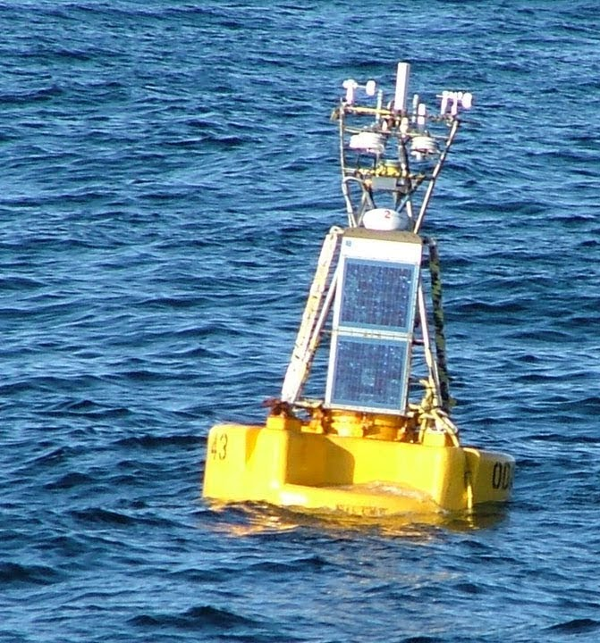
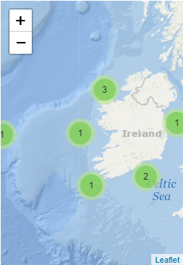
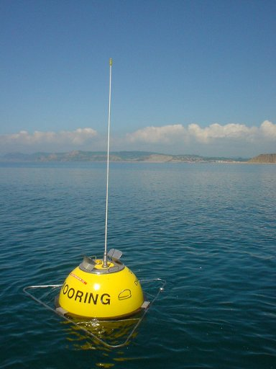
Irish Data Buoy Network
https://erddap.marine.ie/erddap/tabledap/IWaveBNetwork.html
https://erddap.marine.ie/erddap/tabledap/IWBNetwork.html
Notes:
The Irish Data Buoy Network consists of weather buoys and wave buoys returning meteorological and hydrographic measurements from around Ireland.
Some of the measurements go back to the early 2000s.
The wave buoys return data on the environmental conditions at 2 licenced wave energy test sites. A ¼ scale site in Galway Bay and a full scale test site off the NW coast near Belmullet in Co. Mayo.

Slide 6
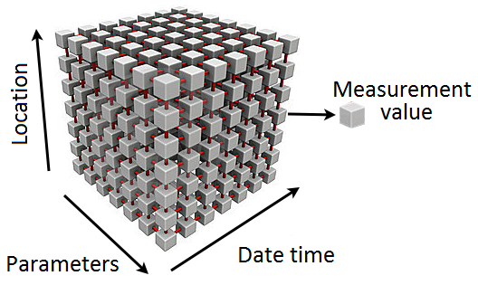
Building the data cube
https://github.com/IrishMarineInstitute/OGI_MIPilot/blob/master/cube_construct_stats.ipynb
https://erddap.marine.ie/
https://linked.marine.ie/sparql
https://github.com/IrishMarineInstitute/OGI_MIPilot/blob/master/cube_triple_generator.ipynb
Notes:
How did we go about building the Data Cube?
Weather and wave buoy data returned every 60 and 30 minutes respectively in real-time.
Python script calls the data from ERDDAP and calculates daily statistics (max, min, mean standard deviation).
Direction statistics are calculated on a unit circle and we do not generate min and max values for each day as these would be a nonsense.
These daily statistics are then represented as RDF Data Cubes following the RDF Data Cube Vocabulary. The RDF is then served through a Virtuoso SPARQL endpoint.

Slide 7
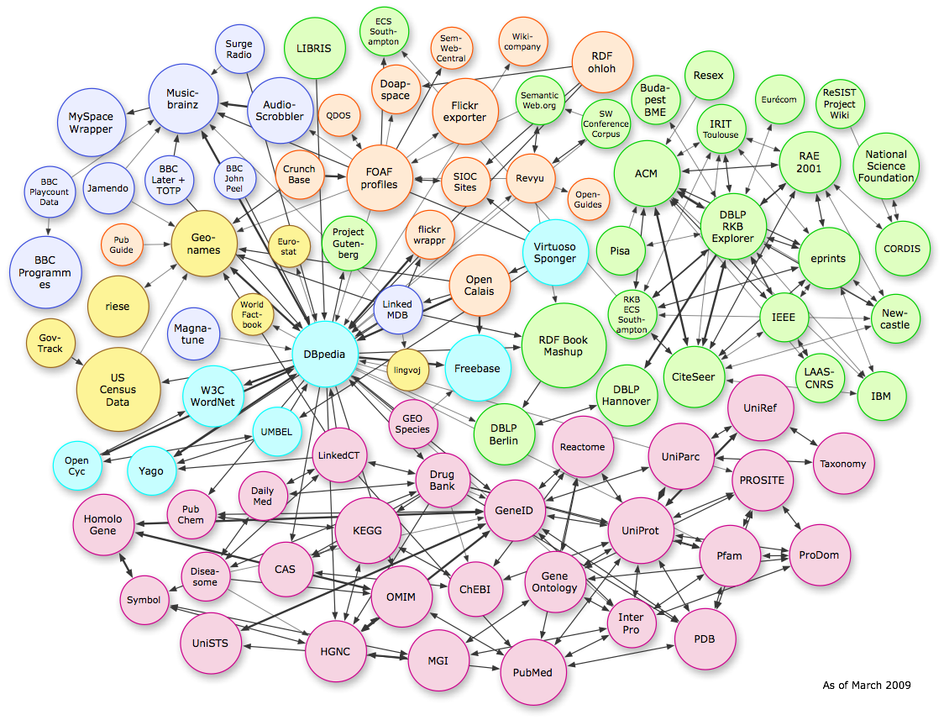
Linking to the semantic web
EDMO EDMED EDIOS
NVS
Notes:
Within European the SeaDataNet projext has developed metadata catalogues for Marine Organisations, Datasets and Observing Systems. These are now being published as Linked Data.
The RDF Data Cubes we are serving link to these metadata catalogues and use community vocabularies, such as the CF standard names as served by the NERC Vocabulary Server.
Makes marine data part of the semantic web… next step on from where we currently are within the marine data community where Linked Data should really be Linked “Metadata”.

Slide 8
Data – spreadsheet view
Dimensions
Measures
Station_ID | Statistic | Date | Havg [m] | Hmax [m] | HmaxPeriod [s] | Tavg [s]
SmartBay | mean | 01/01/2009 | … | … | … | …
SmartBay | std | 01/01/2009 | … | … | … | …
SmartBay | min | 01/01/2009 | … | … | … | …
SmartBay | max | 01/01/2009 | 0.3821 | 1.37 | 4.97 | 3.11
Attribute
Observation

Slide 9
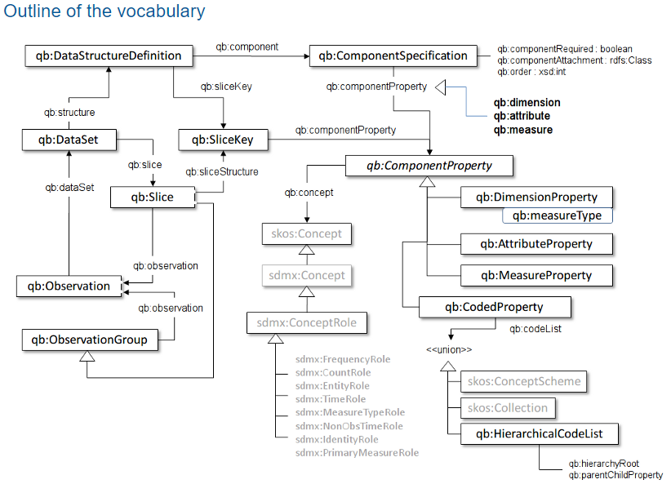
RDF Data Cube Vocabulary

Slide 10
Describing Dimensions
eg:station_id a rdf:Property, qb:DimensionProperty ;
rdfs:label "station_id"@en ;
rdfs:subPropertyOf sdmx-dimension:refArea ;
rdfs:range mi-vcb:station_id ;
qb:concept sdmx-concept:refArea ;
.
eg:Date a rdf:Property, qb:DimensionProperty ;
rdfs:label "Date"@en ;
rdfs:subPropertyOf sdmx-dimension:refPeriod ;
rdfs:range xsd:date ;
qb:concept sdmx-concept:refPeriod ;
.

Slide 11
Describing Measurements
eg:Havg a rdf:Property, qb:MeasureProperty;
rdfs:label "Havg"@en ;
rdfs:seeAlso <http://vocab.nerc.ac.uk/collection/P07/current/IRPTM00V/> ;
rdfs:comment "Average wave height of all the upcrossing waves measured during the period of observation."@en ;
rdfs:subPropertyOf sdmx-measure:obsValue ;
sdmx-attribute:unitMeasure <http://vocab.nerc.ac.uk/collection/P06/current/ULAA/> ;
rdfs:range xsd:decimal ;
.

Slide 12
Defining the Data Structure
eg:dsd-IWaveBN_zero_daily a qb:DataStructureDefinition;
# The dimensions
qb:component [ a qb:ComponentSpecification ; qb:componentProperty eg:station_id ; qb:dimension eg:station_id; qb:order 1; qb:componentAttachment qb:Slice ],
[ a qb:ComponentSpecification ; qb:componentProperty eg:Date ; qb:dimension eg:Date; qb:order 2 ],
[ a qb:ComponentSpecification ; qb:componentProperty eg:statistic ; qb:dimension eg:statistic; qb:order 3; qb:componentAttachment qb:Slice ];
# The measure(s)
qb:component [ a qb:ComponentSpecification ; qb:componentProperty eg:Havg ; qb:measure eg:Havg];
qb:component [ a qb:ComponentSpecification ; qb:componentProperty eg:Hmax ; qb:measure eg:Hmax];
qb:component [ a qb:ComponentSpecification ; qb:componentProperty eg:HmaxPeriod ; qb:measure eg:HmaxPeriod];
qb:component [ a qb:ComponentSpecification ; qb:componentProperty eg:Tavg ; qb:measure eg:Tavg];
# The attributes
qb:component [ a qb:ComponentSpecification ; qb:componentProperty sdmx-attribute:unitMeasure ; qb:attribute sdmx-attribute:unitMeasure ; qb:componentAttachment qb:MeasureProperty; ] ;
# The slices
qb:sliceKey eg:sliceByStationID_statistic ;

Slide 13
Describing a Slice
eg:IWaveBN_zero_daily_slice12 a qb:Slice;
qb:sliceStructure eg:sliceByStationID_statistic ;
eg:station_id mi-vcb:smartbay_wave ;
eg:statistic mi-vcb:daily_max ;
qb:observation eg:IWaveBN_zero_daily_o22409, …. , … , …

Slide 14
Describing an Observation
eg:IWaveBN_zero_daily_o22552 a qb:Observation;
qb:dataSet eg:IWaveBN_zero_daily ;
eg:Date '2009-01-01'^^xsd:date ;
eg:station_id mi-vcb:smartbay_wave ;
eg:statistic mi-vcb:daily_max ;
eg:Havg 0.3821 ;
eg:Hmax 1.37 ;
eg:HmaxPeriod 4.97 ;
eg:Tavg 3.11 ;
.
Dimensions
Measures

Slide 15
Data Buoy dashboard - https://vis.marine.ie/dashboards
Notes:
Pilot dashboard to visualise the wave and weather buoy data…
Built on Open Data APIs… anyone can build their own flavour of dashboard from exactly the same resources…
Standards are friendly to developers without domain knowledge…
Demonstration or interactive data dashboards can provide an entry point for the uninitiated to dig deeper into large data sets of interest….

Slide 16
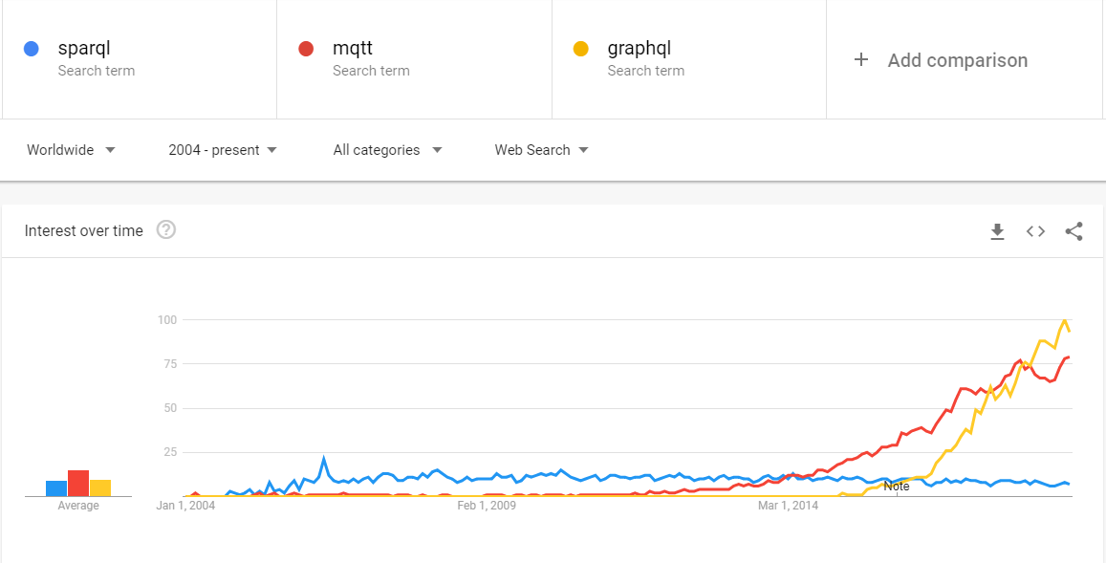
Notes:
The JSON query language implemented by Facebook and released for other developers to use more widely has increased in the last 3-4 years.

Slide 17
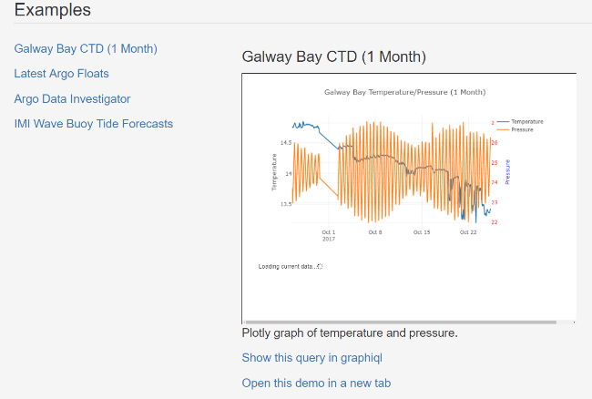
GraphQL example- https://api.digitalocean.ie
Notes:
We have deployed a GraphQL layer over our ERDDAP instance.
Examples can be found at the link given in the slide.
Taking one example using this plot….

Slide 18
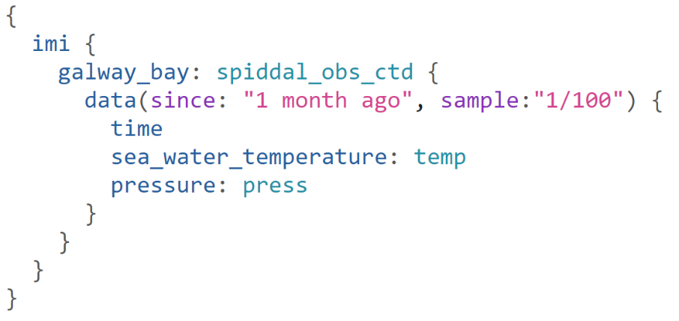
API call comparison
https://erddap.marine.ie/erddap/tabledap/spiddal_obs_ctd.htmlTable?instrument_id%2Ctime%2Cpress%2Ctemp&time%3E=2018-11-14T00%3A00%3A00Z
Notes:
Compare the query required to get these results using the ERDDAP URL and GraphQL.
The GraphQL is more readable and results are returned to the user in the same shape as the query. A useful feature for developers.

Slide 19
OGI - JSON-qb API Specification
Aims to exploit the advantages of LOSD (e.g. easy data integration)
Support web developers use statistical data stored in the form of an RDF Data Cube
Assume minimal knowledge of Linked Data
Notes:
The OGI project set out to implement and JDON-qb API to help web developers access Linked Open Statistical Data without needing to learn SPARQL.

Slide 20
OGI - CubiQL
Aimed at developers
Make it easier to retrieve LOSD for analysis, visualisations
Don’t require understanding of SPARQL
Use GraphQL framework
https://github.com/Swirrl/cubiql
Notes:
The result is an API called CubiQL which uses the GraphQL framework.
On the assumption that this is more familiar to web developers it should therefore be easier for them to interact with the data published through SPARQL endpoints in Data Cubes.
This was more successfully linked to the publishing workflow of government statistics data cubes (e.g. the Trafford Council pilot on worklessness). Possibly due to the multi-measure nature of the environmental data.

Slide 21
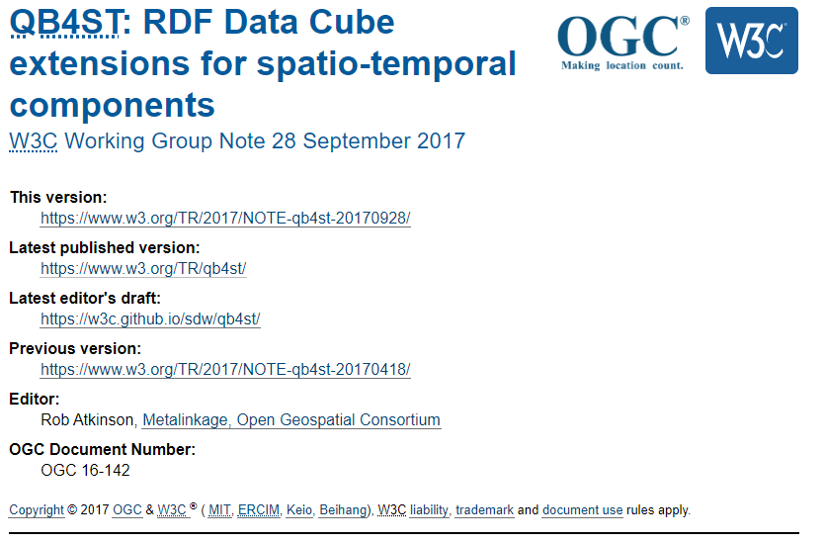
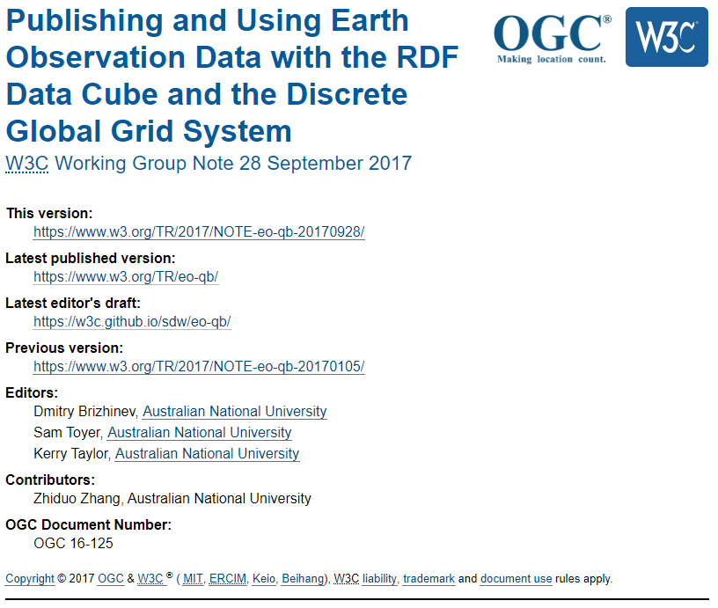
RDF Data Cube extensions of interest

