Slide 1
John Porter
University of Virginia

Slide 2
Python according to Wikipedia

Slide 3
Where Does Python Fit In?
C++
FORTRAN
BASIC
PERL
Python
JAVA
R
PHP
JavaScript

Slide 4
“Hello World”
JAVA:
public class MyClass {
public static void main(String[] args) {
System.out.println("Hello World");
}
}
C++:
#include<iostream>
using namespace std;
int main()
{
cout<<"Hello World";
return 0;
}
https://www.w3schools.com/java/showjava_file.asp?filename=demo_helloworld
https://www.programiz.com/cpp-programming/examples/print-sentence
Python:
print(“Hello World”)

Slide 5
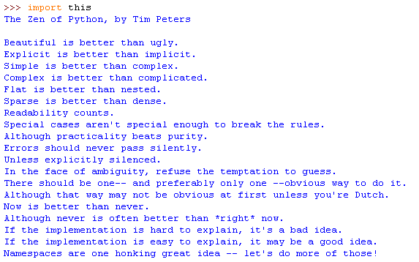
The Zen of Python
import this
will generate the list in the Python interpreter

Slide 6
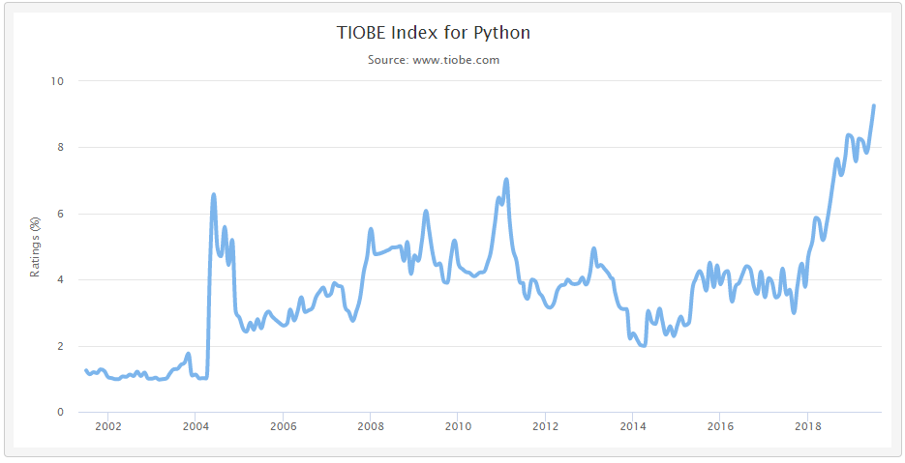
Python is Also Widely Used
Probably reflective of the diversity of users
Peak R
Usage

Slide 7
Python Strengths
Python is a language that is designed to be easy to write and read, so it’s a good place to start!
Easy ways to:
Interact with the Internet (e.g., web services)
Do Pattern matching – text processing
Some specialized software supports Python extensions
E.g., The “arcpy” site package contains the tools that let you use Python to write programs that interact with ArcGIS data structures

Slide 8
Python Modules
Specialized Python functions are contained in “modules” (similar to “packages” in R)
A single function, or multiple functions can be extracted
Examples:
SQLAlchemy (allow communication with databases)
lxml (read and write XML documents)
pandas (R-like data structures and capabilities)
json (encoder and decoder for JSON messages)

Slide 9
Python Objects
The Python Idle editor automatically lists the methods associated with an object if you type the period (.) then wait…
In Python, everything is an object, so it has methods associated with it
strA= "A sample String“ creates an object of class “string” named “strA” with the value “A sample String”
These methods are available for all strings

Slide 10
Basic Elements
Assignment – assigns a value to a variable
varA=10 or strB=“A string in quotes”
Expression – calculation etc.
varC=varA+10 or strD= strB+”!”
Function() – applies a function to an argument
len(strD) reports how many characters in strD
math.sqrt(varC) (sqrt is defined in the math package. You must import math before you can use it)
strD.upper() – Since strD is a “string” certain functions are automatically available for it. Upper() converts it entirely to upper case….

Slide 11
Sample Loop
x=5
while (x > 0):
print("x ="+str(x))
x=x-1
print("Done")
Output
x =5
x =4
x =3
x =2
x =1
Done
FOR loops are also available

Slide 12
Lists
Lists – lists of values that can be edited or changed
mylist=['a','b','c‘] # note [ ]
print(mylist)
['a', 'b', 'c‘]
print(mylist[2]) # numbers start at 0
c
‘a’ is element 0, ‘b’ is element 1 and ‘c’ is element 2
So mylist[2] is ‘c’

Slide 13
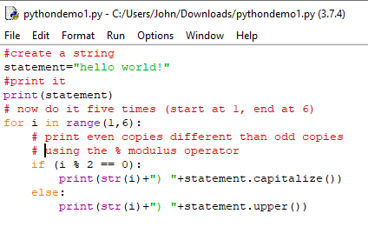
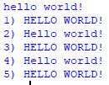
Sample
Concatenate Strings to Produce Output using +
Use built-in String functions of the “statement” object

Slide 14
How do I use Python?
Programs where complex input needs to be parsed
e.g., extract the serial number from a sensor header file
Creation and use of web services
Tally dataset downloads using PASTA audit services
XML processing
Ingest and Style XML
Create XML
GIS programming
ArcGIS ArcPy module exposes all ArcGIS functions
Automating Database activities
e.g., calculate checksums for all data packages and save them in a MySQL database

Slide 15
How do Others use Python?
Creation of large, complex systems with sophisticated graphical user interfaces
e.g., Open Science Framework – osf.io
Numerical and Statistical Analyses
Numpy module – matrix analysis capabilities
Pandas module – simulates many R data structures and analysis capabilities
SciPy module – math, engineering & scientific functions

Slide 16
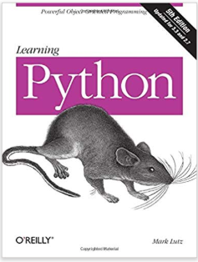
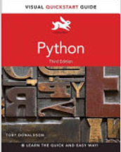
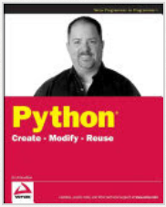
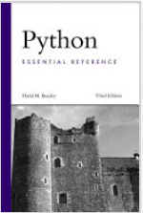
How to Learn Python
Tutorials
Books
Read-a-little-write-a-little
Google solutions to your problems – lots out there!

Slide 17
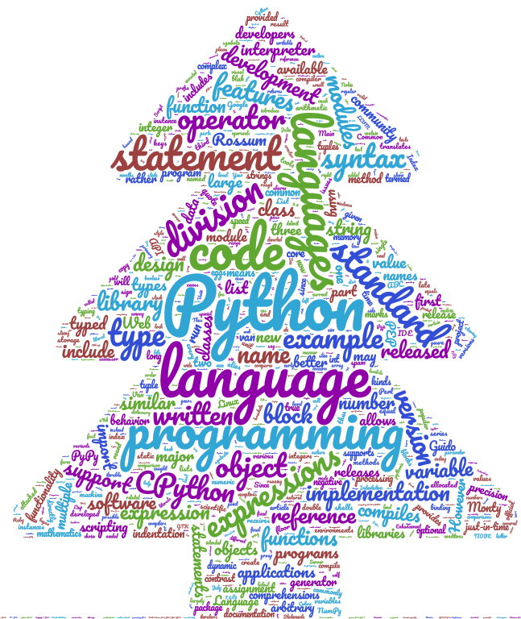
R
Python

Slide 18
Python vs R
Python
The things you can do with Python and R overlap broadly
Differences:
Ease for a particular task
Readability of code
R

Slide 19
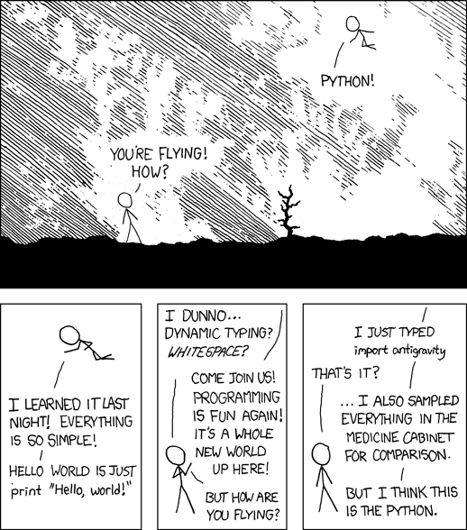
https://xkcd.com/353/

Slide 20
Warning- Programming can get to be addictive!
http://xkcd.com/1319/

Slide 21
Basic Elements
Logical expressions allow a program to make choices based on some comparison
IF X==Y :
print(“X and Y Match!”)
Logical operators are often doubled to allow things like <=, >=, != but >, < are just singles
Logical expressions can be connected by ‘and’ and ‘or’ or logically reversed by ‘not’

Slide 22
Learning to Program
The best way to learn to program, IS to program!
Sources of information
Tutorials – good for getting started
Books - ditto
Language reference manuals – for getting the nitty gritty on how things work
Example code – never program what someone else has already done. Learn from them!

Slide 23
A Sample Program
Variables are “containers” that hold numbers or text
You can use whatever names you choose as long as they start with a letter!
varA=10
varB=15
varC=varA+varB
print("The sum of "+str(varA)+" and "+str(varB)+" is "+str(varC))
Result:
The sum of 10 and 15 is 25
An expression manipulates the values in the variables, then saves the result in another variable
The str() function converts numbers into text so they can be added to other text strings

Slide 24
Learning to Program
Once you have looked at the elements of a language, you can start to write some simple programs
After they work, you can start adding more and more complex elements to make the programs more powerful
Ultimately, programming is an art, not a science – there are an infinite number of programs that can perform the same task

Slide 25
Python Input and Output
print(“Hello world”)
Creates output:
Hello world
a=raw_input(“What is your name? “)
print(a)
Prints out whatever you type in at the prompt

Slide 26
Common Variable Types
Boolean (true or false – 1 or 0)
Integer (e.g., 15)
Floating point or Real (e.g., 15.2)
String (e.g., “This is a test” or ‘This is a test’)

Slide 27
Type Conversion Functions
str(10) – gives the string representation of 10 (’10’)
int(5.5) – gives the integer value (5)
float(5) – gives the floating point value (5.0)

Slide 28
Lists and Arrays
Languages typically have ways of creating variables that can contain more than one value, often called a LIST or ARRAY
MyListB=[10,20,30]
and also allow you to extract a specific value from that variable later
Print(MyListB[1]) would print out “20”
Note numbering usually begins at 0, not 1!

Slide 29
Learning to Program
Flow Control Statements allow the program to perform loops
WHILE and FOR statements are common ways of performing loops
They work well with LISTS and other array structures to automate repeated tasks

Slide 30
Program Logic
The power of programming lies in the ability to write programs that make decisions and do repetitive tasks
Loops
WHILE
FOR
Decisions
IF-THEN-ELSE
TRY (other languages=Case, Switch)

Slide 31
Logical Operators
> - greater than
< - less than
== - equals (note double =)
<> or != - Not equals
<= - less than or equal to
>= - greater than or equal to

Slide 32
Using Character Strings
name = " "
while name <> 'John':
name=raw_input("what is your name? ")
print("At last! Someone named John")
Obviously <, >, <=,>= don’t work with string data!

Slide 33
Using IF
a=2
b=3
print("a=“+str(a)+" b=“+str(b))
answer=raw_input("What is a times b? ")
correctanswer= a*b
if (int(answer) == correctanswer):
print("You are correct!")
print(“Very Smart!")
else:
print("You are Wrong!")
print("done")

Slide 34
Your program
Alter the previous program so that it keeps asking you until you give the right answer!

Slide 35
Python Mathematics – Differs between Python 2.x and 3.x
a= 10
b= 20
c= 20.0
print (“a/b is: ”)
print(a/b)
print (“but a/c is:”)
print(a/c)

Slide 36
Program Results
Note: in Python 3, a/b=0.5
a/b is:
0
but a/c is:
0.5
Why are these different when b and c both are equal to 20?
b was 20 as an integer number
c was 20.0 as a real number
Rule: in Python 2.x operations containing only integers yield integer results, but operations with one or more real numbers yield real number results!

Slide 37
Hint
To avoid odd problems in mathematical operations, in Python 2.x use real numbers! ☺
In all languages variables have “types” – in some languages they must be formally specified (e.g., C, Java)
Python tries to “guess” the appropriate type

Slide 38
Structures
Each type of variable has a way of being stored that is unique to its type
Integer variables require 4 bytes
Float variables require 8 bytes
String variables require a variable number of bytes depending on the string in question
More Complex Structures are Possible
Lists
Tuples
Objects

Slide 39
Lists
Lists – lists of values that can be edited or changed
mylist=['a','b','c‘] # note [ ]
print mylist
['a', 'b', 'c‘]
print mylist[2] # numbers start at 0
c

Slide 40
Some more complex types for Python
Tuples – lists of values that can’t be edited or changed
mytuple=('a','b','c') # note ( )
print mytuple
('a', 'b', 'c')
print mytuple[1]
b
Anything after a # is a comment – not part of the program
Tuple elements are numbered starting with 0, so element [1] is b, not a

Slide 41
Learning to Program
Objects are a way of creating new structures for data that go beyond simple numbers or groups of the same type of data
For example, a “Coordinate” class might include 3 numbers for the X, Y and Z coordinates.
Each variable will typically have an Identity (its name), a Type (that defines its class) and a Value (what is stored inside the variable)

Slide 42
Looping and Lists
Sample code for printing the contents of a list
myList=["one","two","three"]
for number in myList:
print(number)
RESULT >>>
one
two
three

Slide 43
Built-in Functions
Python has built-in functions that are always available. They take the form:
functionname(argument1,argument2..)
Sample:
a=raw_input(“what is your name? “)
Yournamelength= len(a)
len() is a function that gives the length of a string

Slide 44
Using functions from modules
Functions are often stored in “modules” to use them you must first import the appropriate module
import math
Functions have the format:
module.functionname(arguments)
To get a square root
a= math.sqrt(10.0)

Slide 45
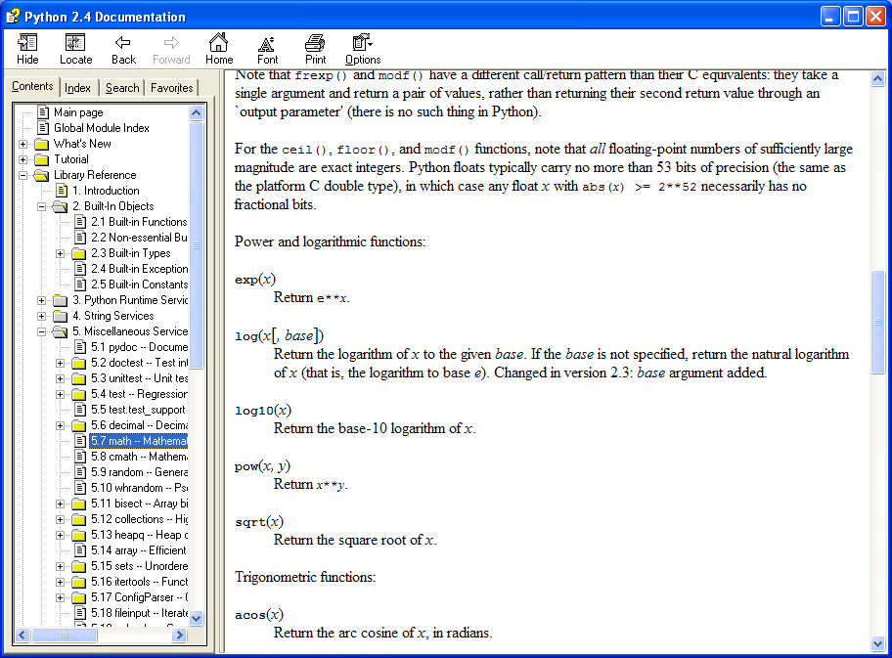
To learn about what functions are available and what the arguments are, you need to look them up in the documentation

Slide 46
Documentation /Help
Tutorial – sample programs and instructions (not comprehensive)
Language Reference – Language details – variable types, expressions, statements – the rules!
Library Reference – list of functions and common modules – the tools!

Slide 47
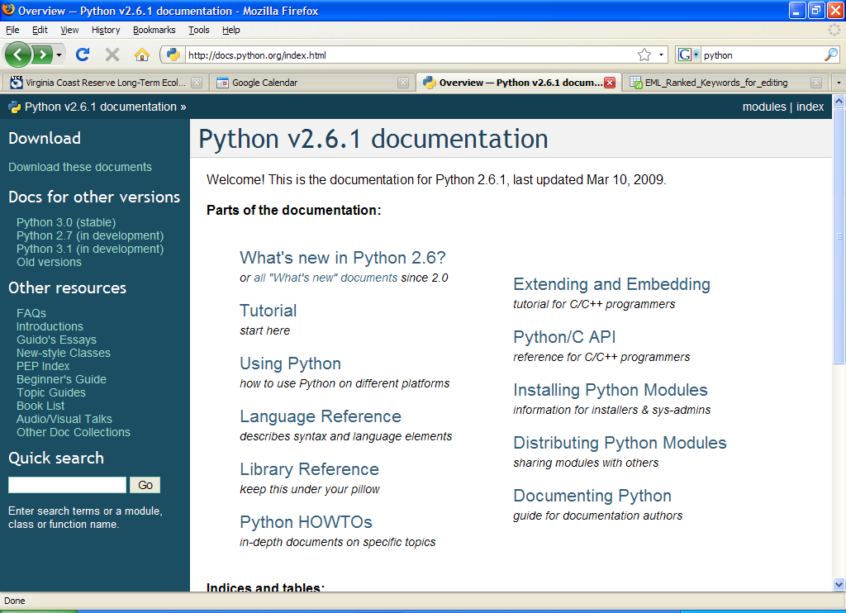

Slide 48
What to Expect when you Start to Program?
The computer will only do what you tell it to do, not what you want it to do!
The learning curve is steepest at the beginning
As you get familiar with the jargon things get easier to understand
“Playing around” – experimentation is key to developing understanding
Writing a program takes 80% of the time. Testing and debugging take the other 80%.
Programming can be FUN! ☺

Slide 49
ArcGIS Objects
You’re probably suitably amazed that all the software you use was created by programmers, given your experience with getting Python to do relatively simple tasks
How is it that you can do complex GIS tasks given the relatively simple tools?

Slide 50
ArcGIS Objects
There are several answers. The big one is that you don’t need to do everything yourself
Modules containing additional functions for working with GIS
Object-oriented programming
Allows programs to be reused and altered without potentially “breaking” other parts of the program
ArcGIS has a large number of “objects” that can be accessed by programs

Slide 51
Object-Oriented Programming
Object oriented programming is a way of developing programs that can be more easily re-used
Often used for graphical interfaces
Common object oriented languages are:
JAVA
C++
Python
Visual Basic

Slide 52
Principles of Object-Oriented Programming
CLASSes include:
PROPERTIES
The data communicated to and from the class
METHODS
Actions that can be taken these include:
Getting or setting Properties
Performing actions on data based on the properties
Classes are a GENERIC description of a type of object, not any individual object

Slide 53
Python Objects
The Python Idle editor automatically lists the methods associated with an object if you type the period (.) then wait…
In Python, everything is an object, so it has methods associated with it
strA= "A sample String“ creates an object of class “string” named “strA” with the value “A sample String”
These methods are available for all strings

Slide 54
Objects
A CLASS defines what characteristics an object has, in general
An INSTANCE of a CLASS is a particular object of a class
In Python an assignment statement is used to create an “instance” of a “class”
pArea = IArea();
Where PArea is an instance, and IArea is a class
The METHODS and PROPERTIES defined by the class are available in an INSTANCE of that class

Slide 55
Writing Scripts – The Easy Way
Modelbuilder can be used to generate basic scripts that can be customized for more general uses

Slide 56
Start
ModelBuilder

Slide 57
Set properties for projection

Slide 58
Save Model to Script File

Slide 59
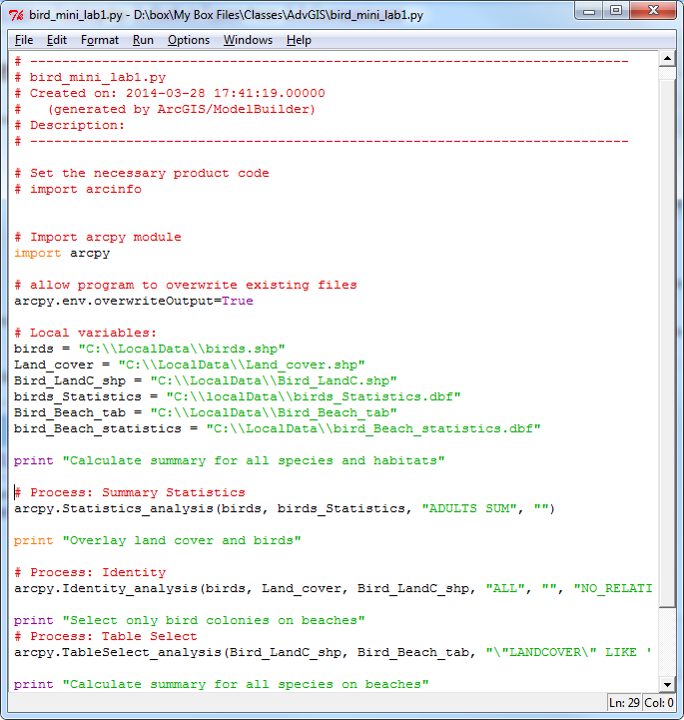
Edit the Model in Idle

Slide 60
A Line-by-Line look at a Script
# --------------------------------------------#
# ProjectDefineBatch.py
# Created on: 2012-01-24 16:16:01.00000
# (generated by ArcGIS/ModelBuilder)
# Description:
# ---------------------------------------------
# Import arcpy module
import arcpy
filelist=["250m_tank","bambi","bill“]

Slide 61
Things to Note
# defines the start of a comment. Anything following a # on a line will be ignored by the program
Each command begins on a new line except:
When a “\” (backslash) is used at the end of a line, the next line is treated as a continuation of the previous line

Slide 62
Loop to set file name
for shapefile in filelist:
shpfilename = "C:\\Users\\jhp7e\\Dropbox\\SynthVol\\my_arcview\\workding_dir\\"+shapefile+".shp"

Slide 63
# Process: Define Projection
arcpy.DefineProjection_management(shpfilename, "PROJCS['WGS_1984_UTM_Zone_18N',GEOGCS['GCS_WGS_1984',DATUM['D_WGS_1984',SPHEROID['WGS_1984',6378137.0,298.257223563]],PRIMEM['Greenwich',0.0],UNIT['Degree',0.0174532925199433]],PROJECTION['Transverse_Mercator'],PARAMETER['False_Easting',500000.0],PARAMETER['False_Northing',0.0],PARAMETER['Central_Meridian',-75.0],PARAMETER['Scale_Factor',0.9996],PARAMETER['Latitude_Of_Origin',0.0],UNIT['Meter',1.0]]")

Slide 64
Things to Note
In file paths, “/” not “\” is used – even on Windows computers that normally use “\” as separators
If “\” is used, it must be doubled “\\”
Names of variables are NOT in quotes, but string values are. E.g.:
test_out_shp = "C:\\Temp\\test_out.shp"
A variable named
test_out_shp
A string (or group of characters)
Containing C:\\Temp\\ .....

Slide 65
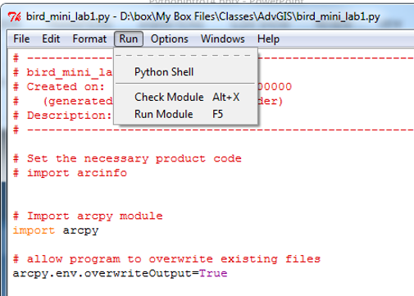
Click Here to “Run” the Script

Slide 66
Some tools in the ArcToolbox are python programs. You can open them for editing in the PYTHON interface to customize them for YOUR purpose. Be sure to save them with a new name, however!

Slide 67
ArcGIS 10
Python Tool

Slide 68
Running ArcPy outside ArcGIS
You can run your Python programs that use arcpy outside of the ArcGIS environment but you may need to add some additional lines of code to deal with accessing the licenses needed

Slide 69
Licensing, including Spatial Analyst
Gets the main license for using ArcGIS with all the features
import arcinfo
import arcpy
from arcpy import env
from arcpy.sa import *
print("Spatial Analyst is:”+arcpy.CheckExtension("Spatial"))
Gets the main license for using Spatial Analyst, along with the functions
Tests that the license is available and prints the result

Slide 70
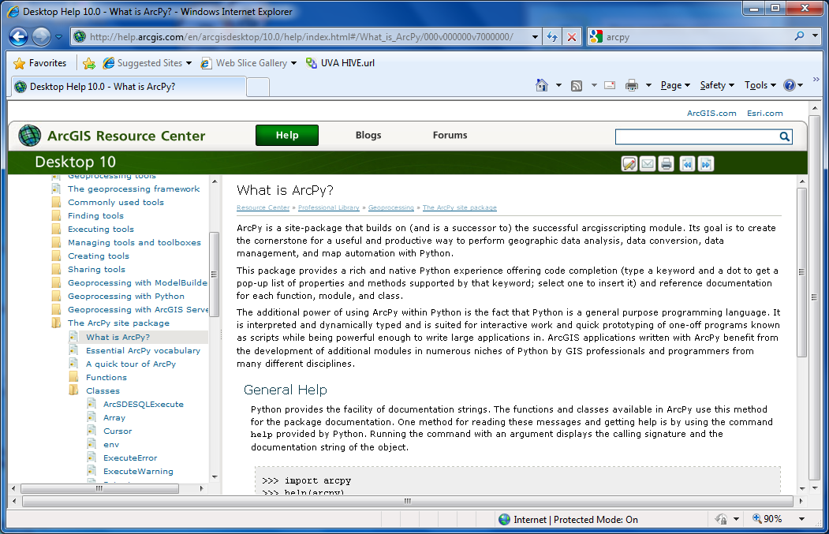
ArcPY – Functions and Classes
ArcPy (new in ArcGIS 10) has built in Functions and Classes for doing all sorts of GIS analyses

Slide 71
Using ArcPy
The good news is that there are a large number of functions and classes defined by ESRI in ArcPy
Manipulate shapefiles etc.
Manipulate geometry etc. of points, lines and polygons
Using these only requires you to know what the functions are and what their parameters are

Slide 72
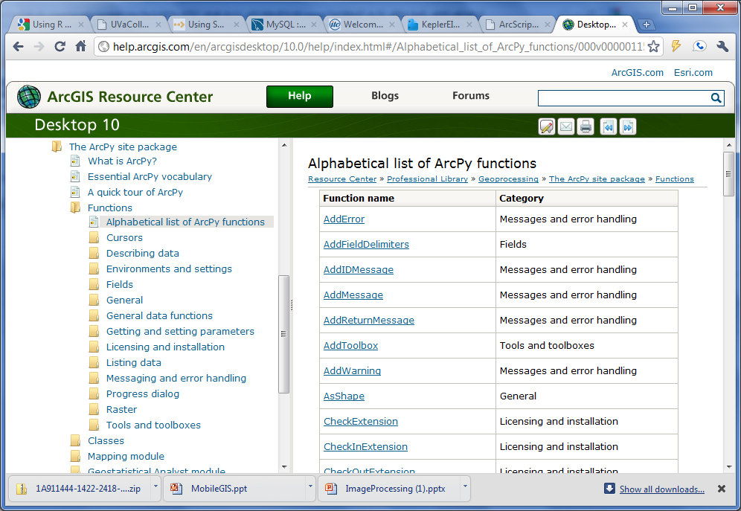

Slide 73
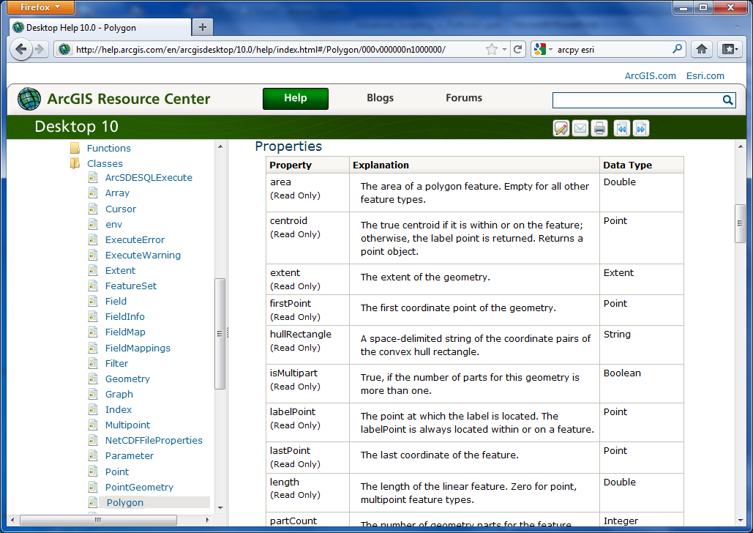
Documentation for the “Polygon” object for ArcPy

Slide 74
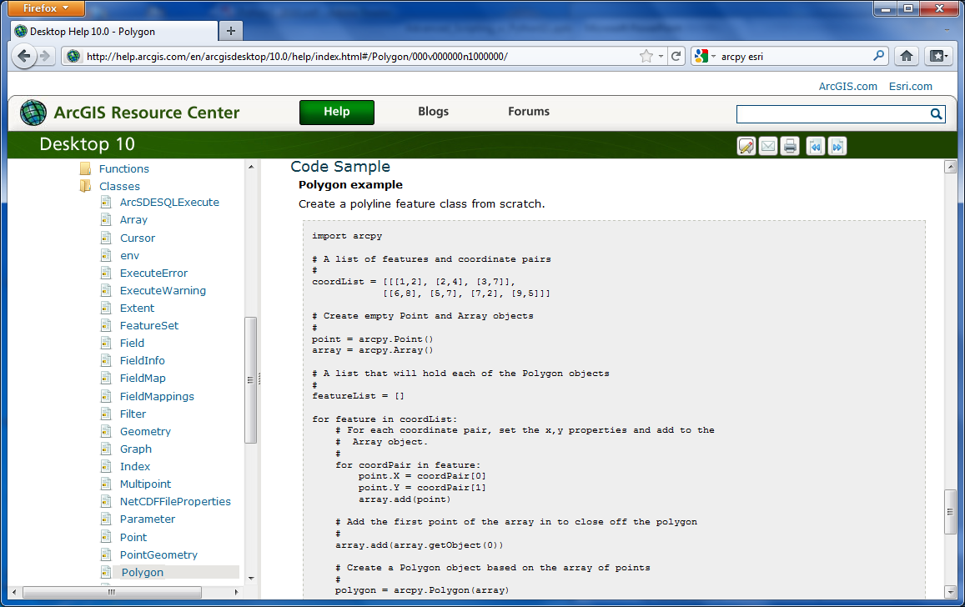
Sample Code Using “Polygon”

Slide 75
Challenges in Using ArcPy
Some basic understanding of Python is expected
The large (huge?) number of functions and objects available makes it difficult to locate the function you need
The functions allow you to do EVERYTHING you can do in ARCGIS and more!

