Slide 1
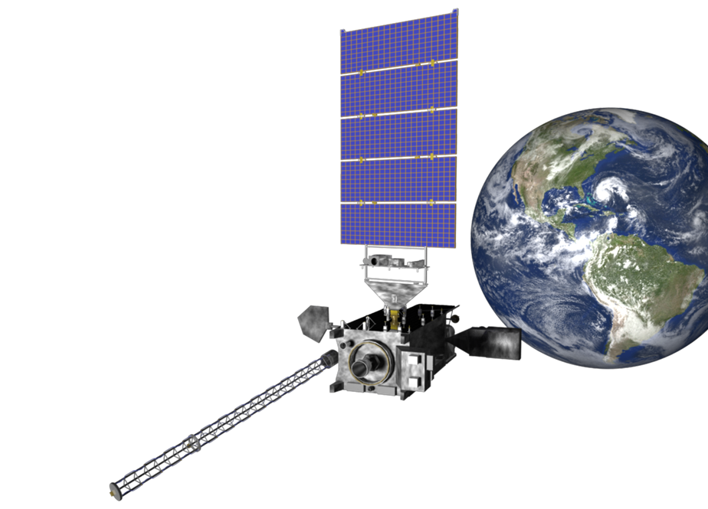
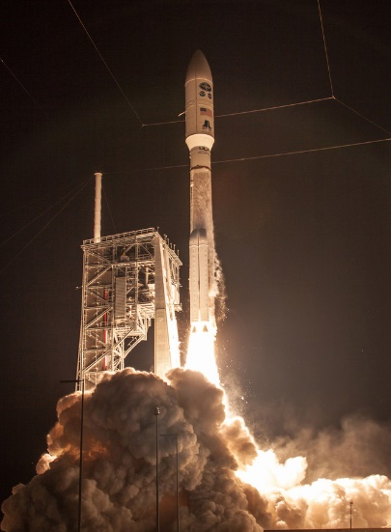
GOES-16/17 RGB Activity
Margaret Mooney
Cooperative Institute for Meteorological Satellite Studies (CIMSS)
University of Wisconsin-Madison
ESIP Education 2019

Slide 2
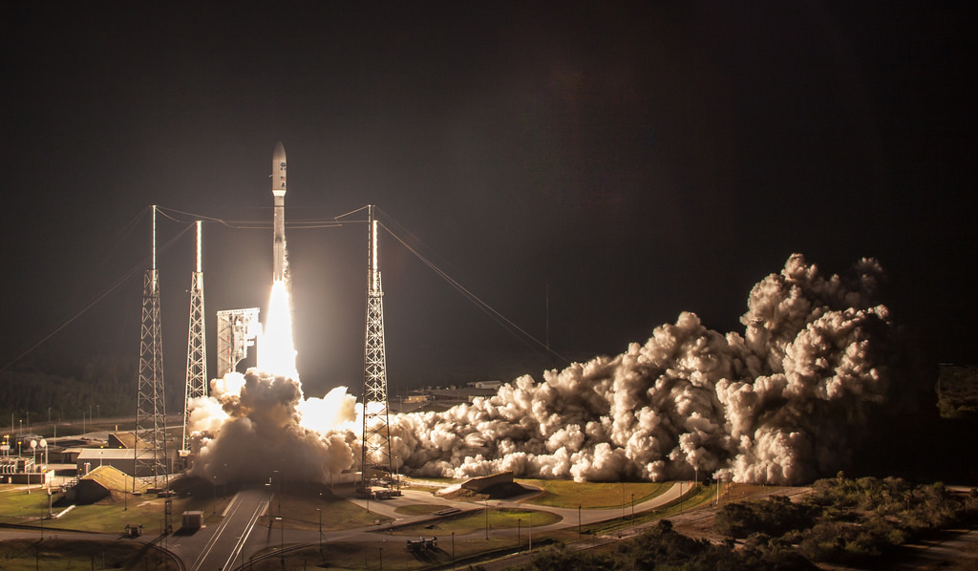
GOES-R launched in November 2016, was renamed
GOES-16 when it reached geostationary orbit, & became the operational GOES-East satellite in November 2017.
Photo credit: NOAA

Slide 3
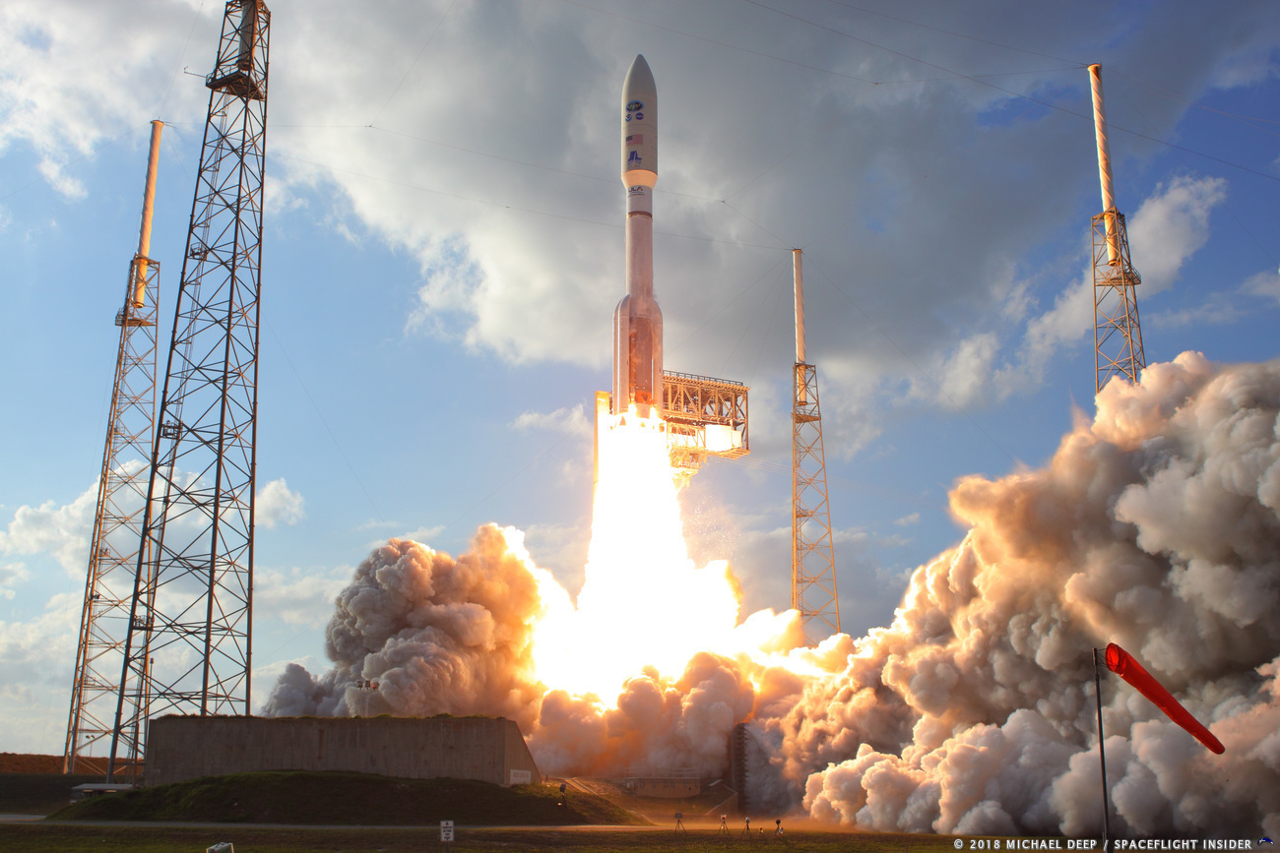
GOES-S launched on March 1st 2018!
Was renamed GOES-17 soon after and became our operational GOES-West satellite late fall 2018.

Slide 4
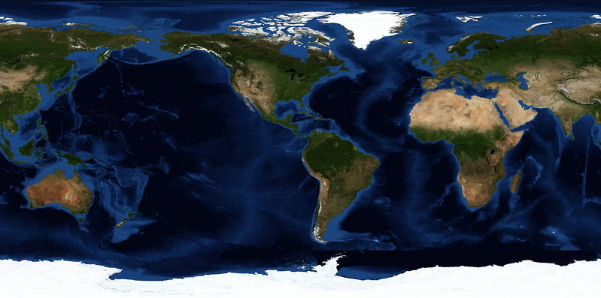

U.S. GOES Constellation
Geostationary Operational Environmental Satellites
GOES-West
GOES-17
GOES-East
GOES-16
Standby
GOES-14
105° West
2 operational satellites
1 standby

Slide 5
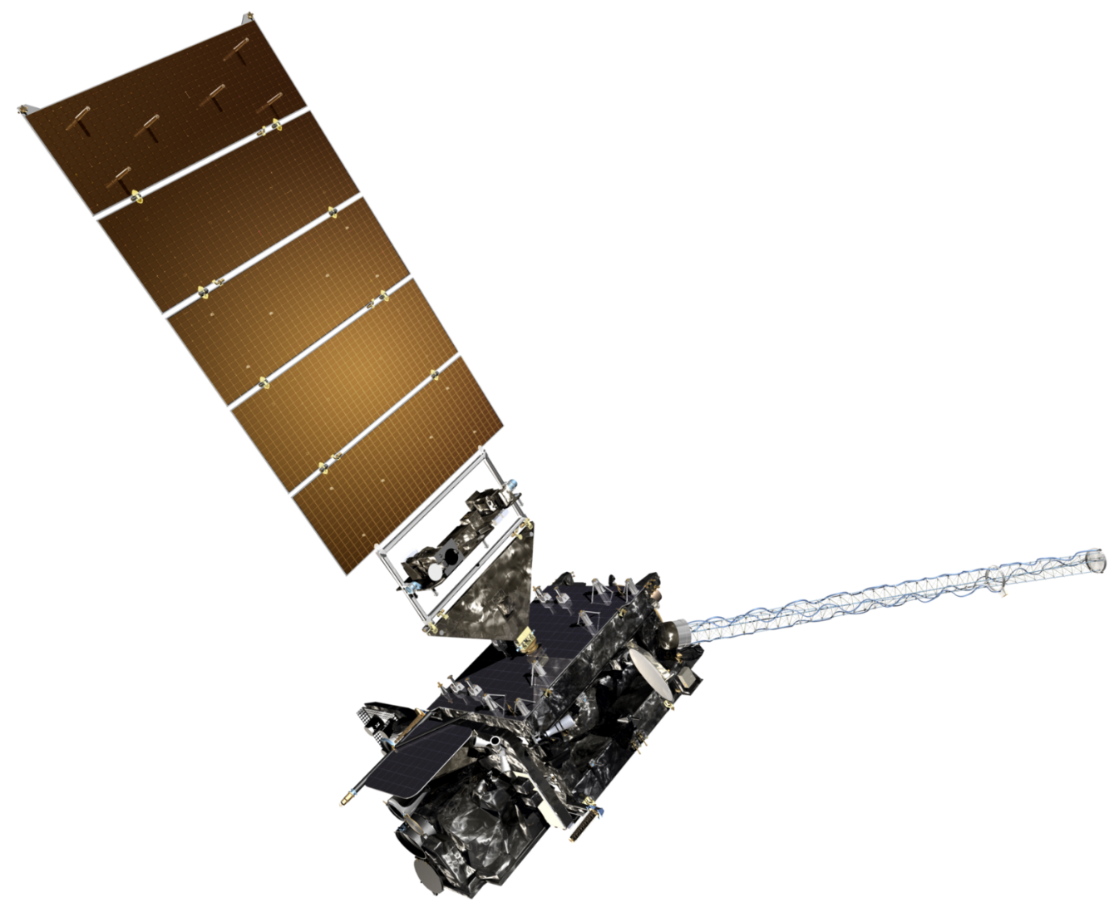
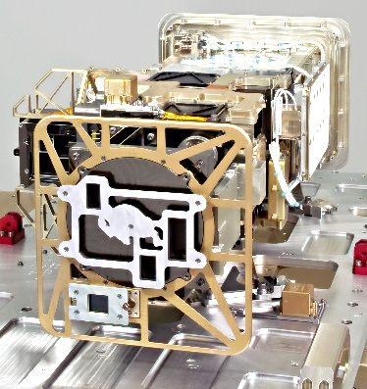
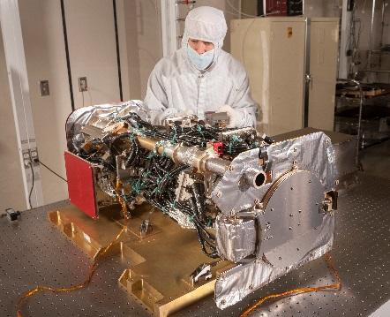
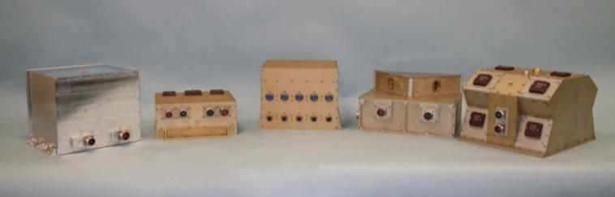
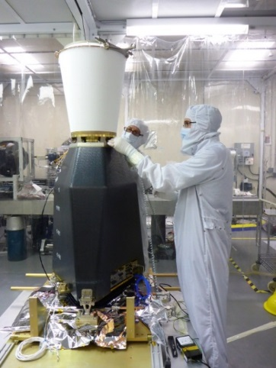
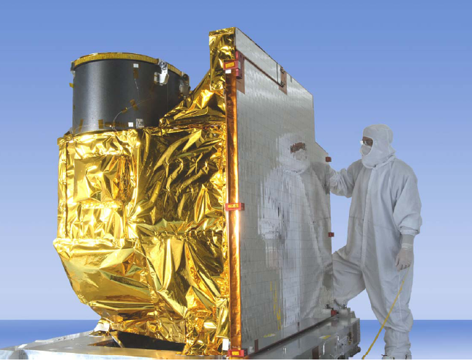
GOES-R Series Spacecraft
Extreme Ultraviolet and X-Ray Irradiance Sensor (EXIS)
Space Environment In Situ Suite (SEISS)
Solar Ultraviolet Imager (SUVI)
Magnetometer
Geostationary Lightning Mapper (GLM)
Advanced Baseline Imager (ABI)

Slide 6
GOES-R Series Spacecraft
Geostationary Lightning Mapper (GLM)
Advanced Baseline Imager (ABI)

Slide 7

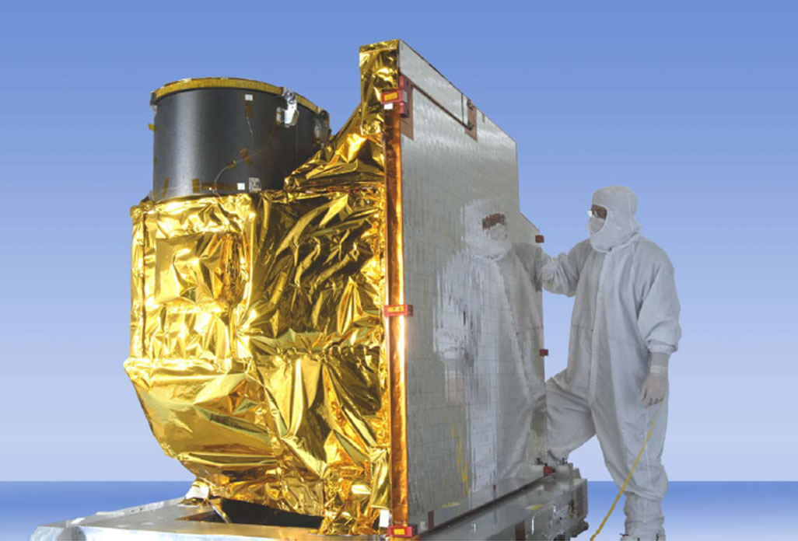
Advanced Baseline Imager (ABI)
5
4
3
X
Faster coverage
(5-minute full disk vs. 25-minute)
X
Improved spatial
resolution
(2 km IR vs. 4 km)
X
More spectral bands (16 on ABI vs. 5 on the current imager)
Notes:
Slide from J. Gerth, CIMSS.

Slide 8
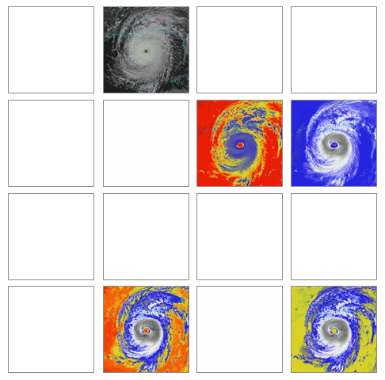
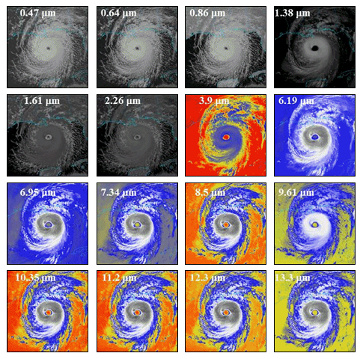
Advanced Baseline Imager - ABI
3 times the spectral data!
GOES-13/14/15 Spectral Bands
GOES-R Series Spectral Bands

Slide 9
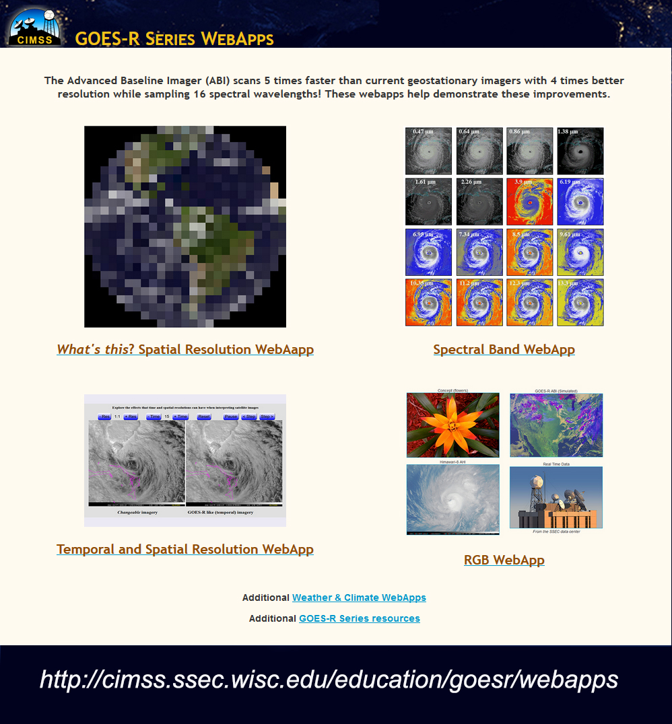
New HTML5 WebApps!

Slide 10
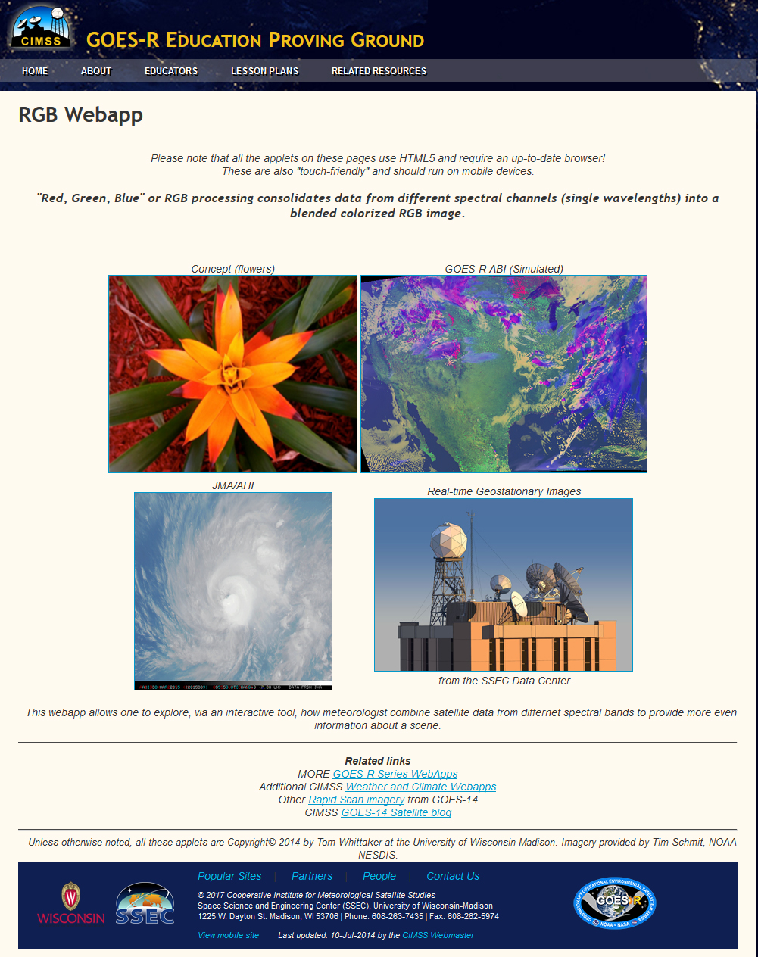

Slide 11

GOES-16/17 Virtual Science Fair
Spring 2020: Student teams conduct research using GOES- 16 or GOES-17 ABI data
There will be three winning teams: middle school, high school & grades 13/14 (community college or university). Students from the winning teams will receive $25 Amazon gift cards AND a GOES-T launch viewing invitations (but no travel support).
The coaches/teachers of the winning teams (3 total) will have their travel & conference registration paid
to the American Meteorology Society (AMS)
Centennial meeting in Boston in January 2020
to present in the education symposium

Slide 12
GOES16/17 Science Fair Specifics
Accepting entries starting April 1st, 2020
Details and updates on-line at
http://cimss.ssec.wisc.edu/education/goesr/
All entries must be submitted by May 22nd, 2020
3-5 students allowed on each submission
1 teacher/coach per entry

Slide 13


SUMMARY -
- GOES R Education Proving Ground
http://cimss.ssec.wisc.edu/education/goesr/
- Virtual Science Fair! http://cimss.ssec.wisc.edu/education/goesr/vsf
Follow us on twitter at @UWCIMSS
Follow us on Facebook at CIMSS.UW.Madison
Contact me at margaret.mooney@ssec.wisc.edu

