Slide 1
The Critical Zones: Supporting place-based research
Data management for the NSF Critical Zone Observatories program
• | Moderator introduction | Ben Galewsky (NCSA)
1 | CZO Cyberinfrastructure history | Collin Bode (CZO, UC Berkeley)
2 | Eel River CZO & Dendra | Collin
3 | IML CZO & Clowder+Geodashboard | Luigi Marini (CZO, NCSA)
4 | CUAHSI & HydroShare | Martin Seul (CUAHSI)
5 | Migrating CZO (meta)data to HydroShare | David Lubinski (CZO, CU-Boulder)
6 | “CZ Collaborative Network” NSF RFP | Luigi
• | Discussion | Ben
SUMMER MEETING 2019
Notes:
This session focuses on the history of data management for the CZO program… through 6 mini talks and a discussion. Please ask interrupt us and ask questions at any point; let’s make these presentations conversational.

Slide 2
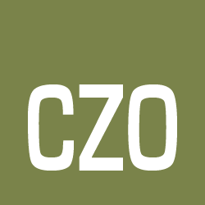
The Critical Zones: Supporting place-based research
Data management for the NSF Critical Zone Observatories program
Themes
Partners
Approaches taken
Tools used
Lessons learned
CRITICAL ZONE OBSERVATORIES
Supported by
National Science Foundation

Slide 3
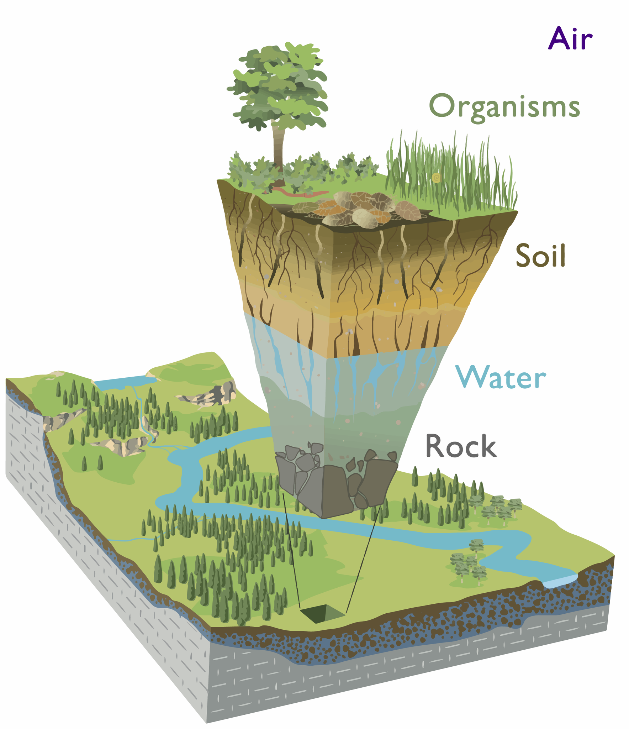
What is the Critical Zone?
It is the Earth's permeable near-surface layer...
from the tops of the trees to the bottom of the groundwater.
Why do we care?
Almost all terrestrial life exists within and depends on the Critical Zone
What do we study?
CZ structure (vegetation, soil, saprolite, weathered rock)
Processes that evolve that structure
Fluxes mediated by CZ structure (water, solutes, sediment, biota)
Notes:
The CZ extends from the tops of trees to the bottom of groundwater.

Slide 4
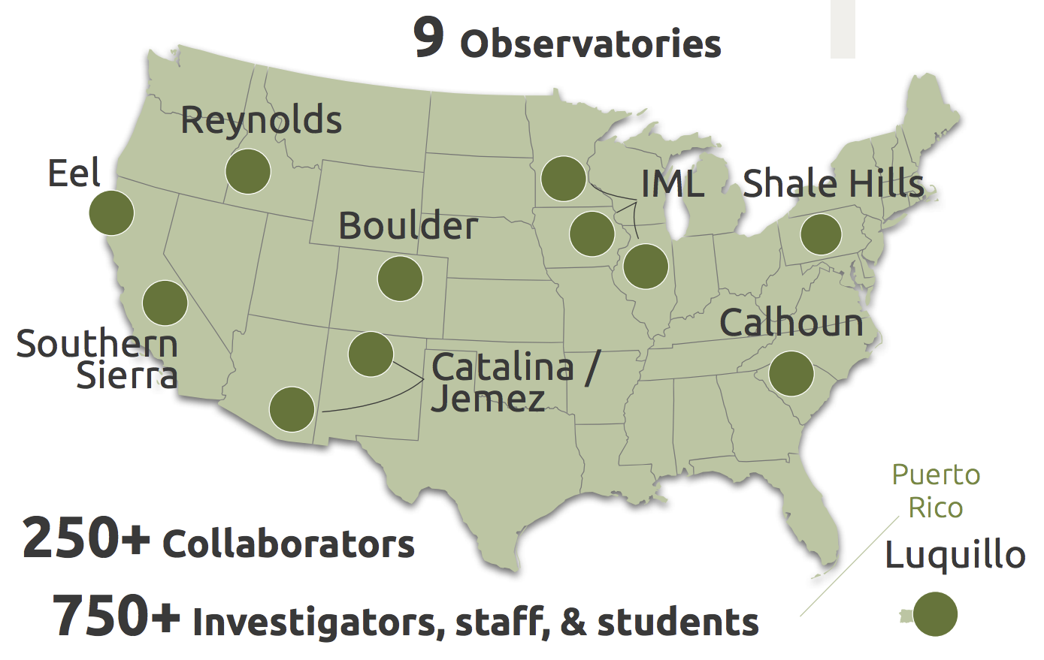
What are the Critical Zone Observatories?
Observatory Design
Place-based research
Cross-disciplinary teams
Data manager required
Episodic growth
2007 3 CZOs
2009 6 CZOs
2014 9 CZOs & Natl Office
Supported by
National Science Foundation

Slide 5
A Brief History of CZO CyberInfrastructure
From the perspective of several CZO data managers
Three Eras of development
2007 – 2012 Loose Federation
2012 – 2016 All-in-one Databasing
2017 - 2020 HydroShare Centralization
Actors
Principle Investigators
Data Managers
Infrastructure Developers

Slide 6
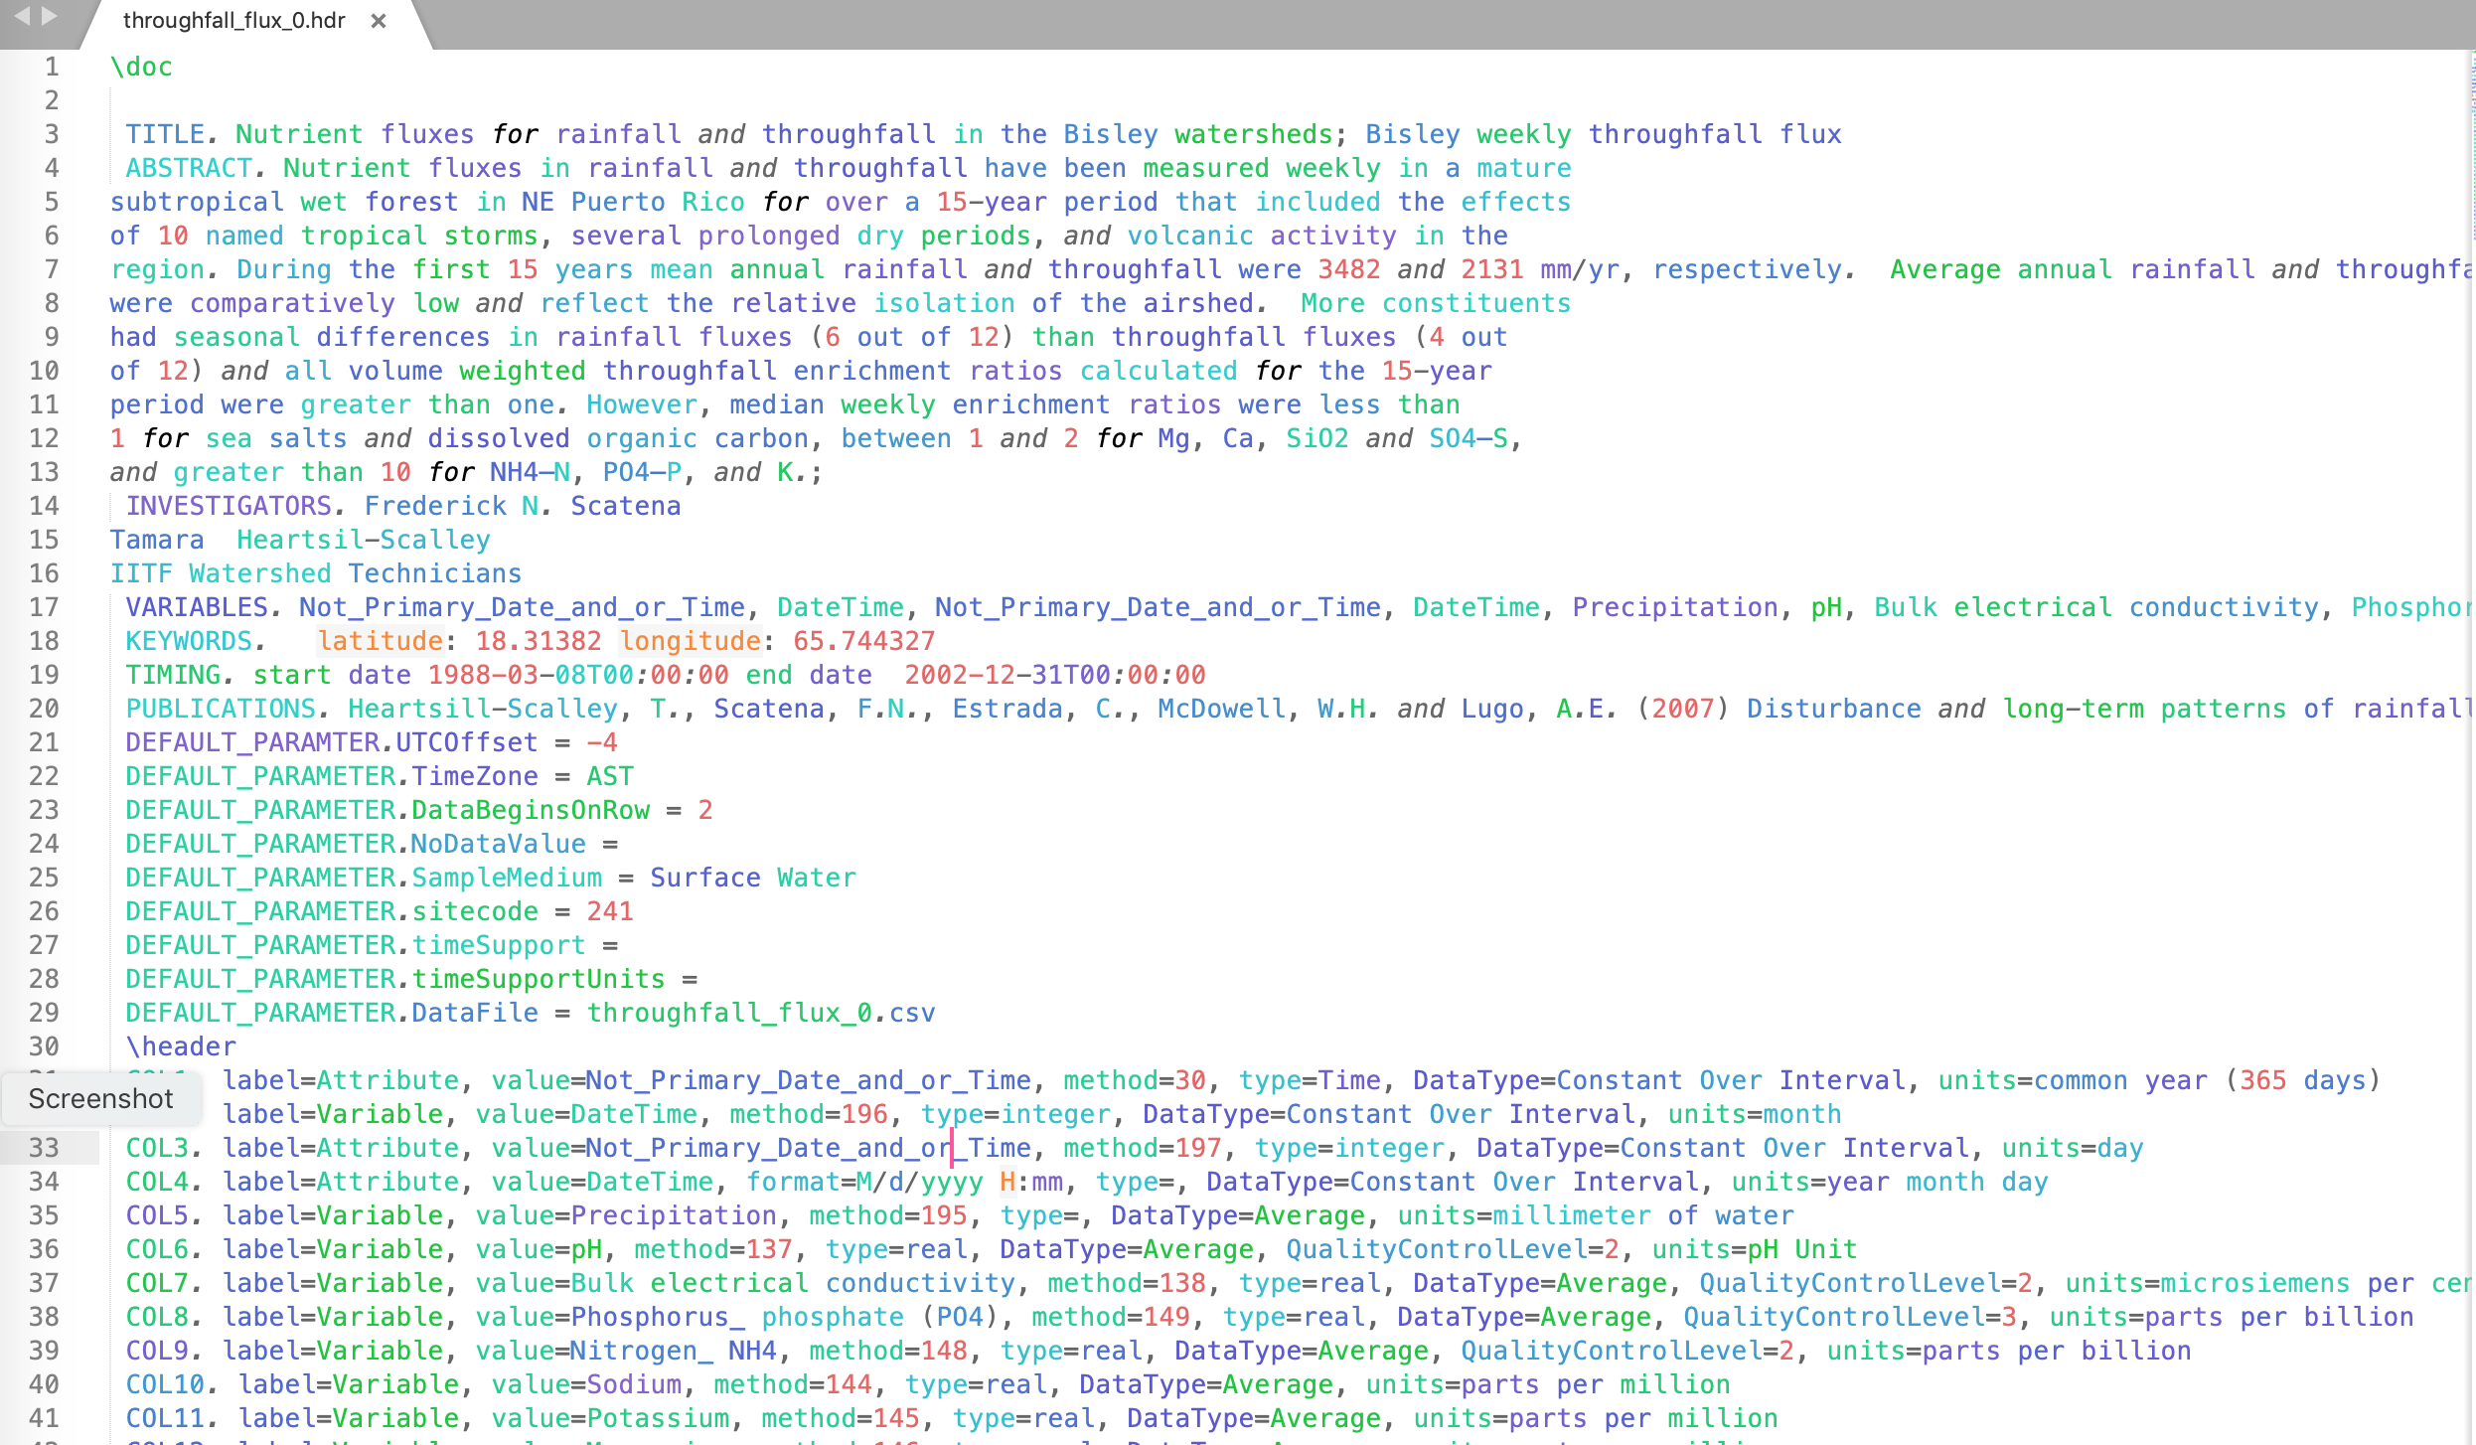
Era 1: Loose Federation (2007-2012)
Approaches
Loose federation mentality
CZOs were standalone sites
Local management of data
Standardization of some basic metadata
Tools
ODM 1.0
Display Files
Basic metadata standardization
No format language, e.g. XML,JSON
“CZO Central”, SDSC using ODM1, Display Files
Lessons Learned
ODM1 was good for time-series, but too rigid for generalized data
Display files were not standardized enough to parse reliably
CZO website used as a central catalog instead

Slide 7
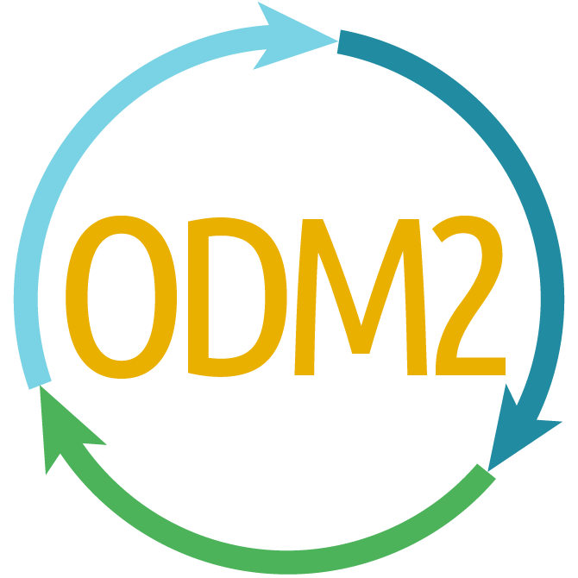
Era 2: All-in-one Databasing (2013-2016)
Approaches
CZOs refocused as a network by NSF
Lesson from Era 1: increase flexibility of system
Data interoperability emphasized
Desire for granular data combination
Tools
CZO National Office & website formed
NSF grants: BigCZ & CZOData
YODA
BigCZ Portal
ODM 2.0
CZ Manager (formerly ODM2 Admin)
Lessons Learned
Scope of effort too broad, very difficult to implement
National Office website remains central catalog
Mismatch between grant priorities and CZO local data manager needs
Vendor lock-in
Notes:
YODA: Display file replacement, YAML, unfinished
User-engagement: example, Miguel helped make WaterOneFlow work with his data
Vendor licensing prevented adoption of tools

Slide 8
Era 3: HydroShare Centralization (2017-Current)
Approaches
NSF: CZO system will be changing
Repository systems have matured
Deliberately narrow in scope
Adopt a central repository
Searchable metadata
No requirement for dynamic data combination(bag & tag)
Small budget
Lessons Learned
A single controlled vocabulary is insufficient (ODM2 variables)
A semantic taxonomy is required
Data managers need to be closely involved in development
Partnering brings more benefit than building on our own
Tools
CUAHSI HydroShare
ODM2 Controlled Vocabulary: Variable Names
NCSA Clowder
Notes:
YODA: Display file replacement, YAML, unfinished
User-engagement: example, Miguel helped make WaterOneFlow work with his data
Vendor licensing prevented adoption of tools

Slide 9
The Critical Zones: Supporting place-based research
Data management for the NSF Critical Zone Observatories program
• | Moderator introduction | Ben Galewsky (NCSA)
1 | CZO Cyberinfrastructure history | Collin Bode (CZO, UC Berkeley)
2 | Eel River CZO & Dendra | Collin
3 | IML CZO & Clowder+Geodashboard | Luigi Marini (CZO, NCSA)
4 | CUAHSI & HydroShare | Martin Seul (CUAHSI)
5 | Migrating CZO (meta)data to HydroShare | David Lubinski (CZO, CU-Boulder)
6 | “CZ Collaborative Network” NSF RFP | Luigi
• | Discussion | Ben
SUMMER MEETING 2019
Notes:
Transition from CZO-wide infrastructure to two Data Managers giving their perspective from the ground

