Slide 1
Increasing the impact of the Smithsonian’s geoscience collections
Adam Mansur
Department of Mineral Sciences
National Museum of Natural History
0000-0002-7512-4206
mansura@si.edu
Notes:
Thank you for the introduction, and thank you to ESIP for inviting me. As Kerstin said, I work as the data manager in the Department of Mineral Sciences at the National Museum of Natural History, and I'm going to talk to you today about the Smithsonian's geoscience collections. My background is in petrology and geochemistry, but I know this audience extends well beyond the community that is primarily concerned with physical samples, so I'll do my best to provide context as I go.

Slide 2
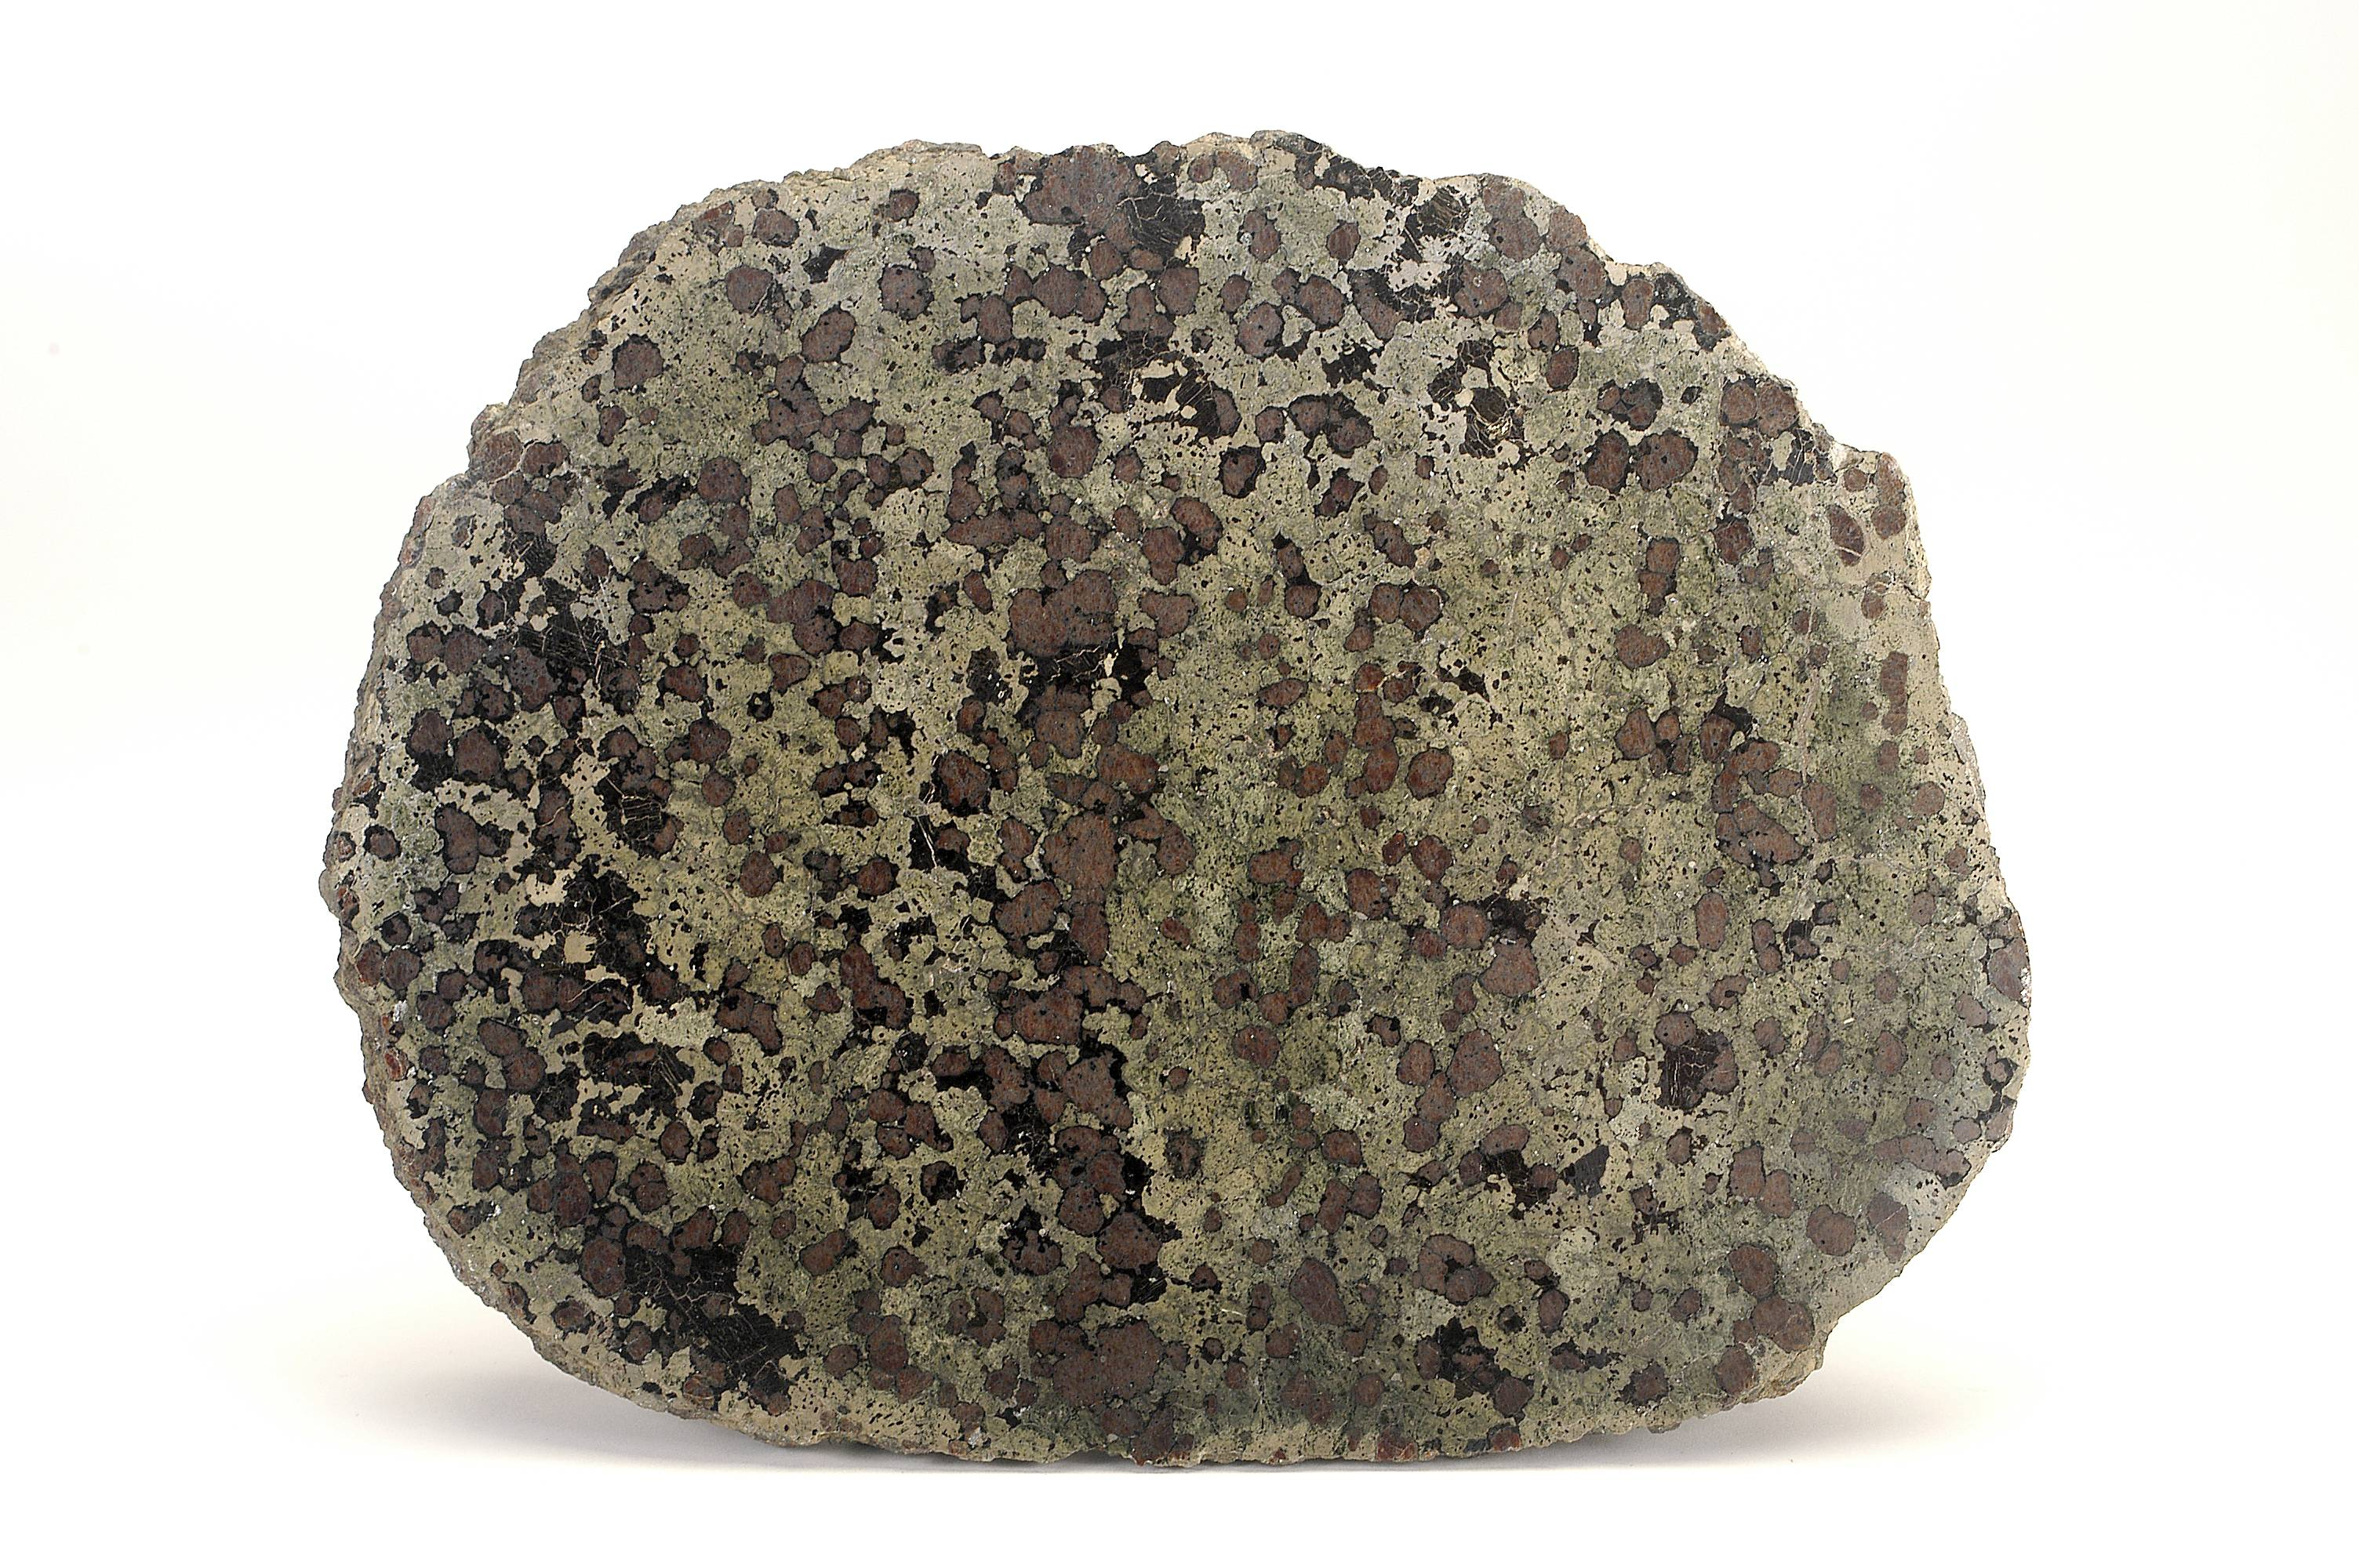
Value of physical samples
Notes:
In these days of models and drones and world-spanning satellite imagery, it's easy to forget the humble rock, but specimen-based research is still going strong. It is there to provide constraints for your models and ground-truth your remote-sensing observations. It’s there to yield new insights about the ancient history of the Earth. And as analytical instruments and laboratory methods get more and more sensitive, even carefully studied samples can still yield new information…

Slide 3
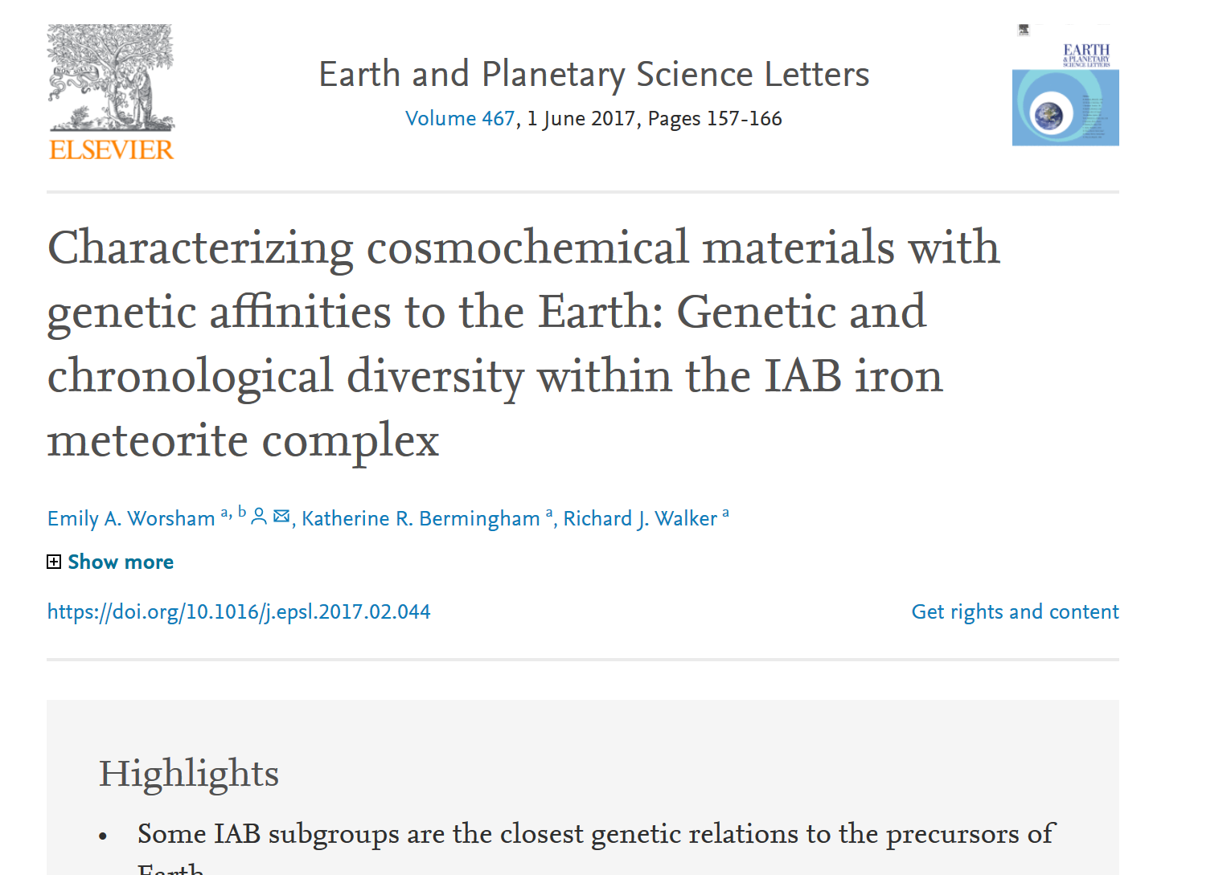
A publication from the collection
Notes:
As in this paper from 2015 about meteorites borrowed primarily from the Smithsonian’s collection. But a historical collection has its own challenges in terms of data, so I’m going to talk to you today about what we’re doing to make sure that our specimens are putting their best face forward.

Slide 4
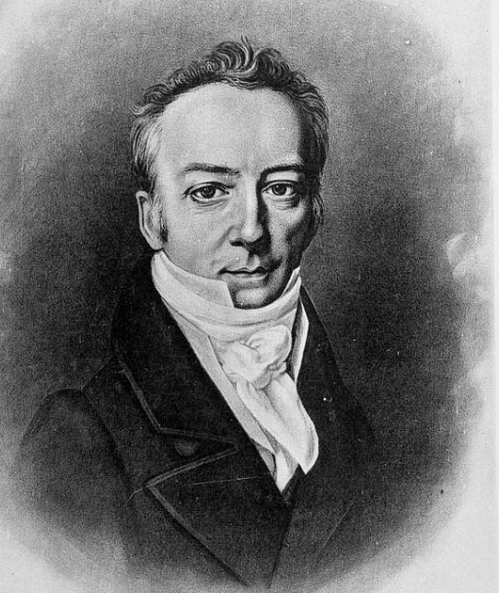
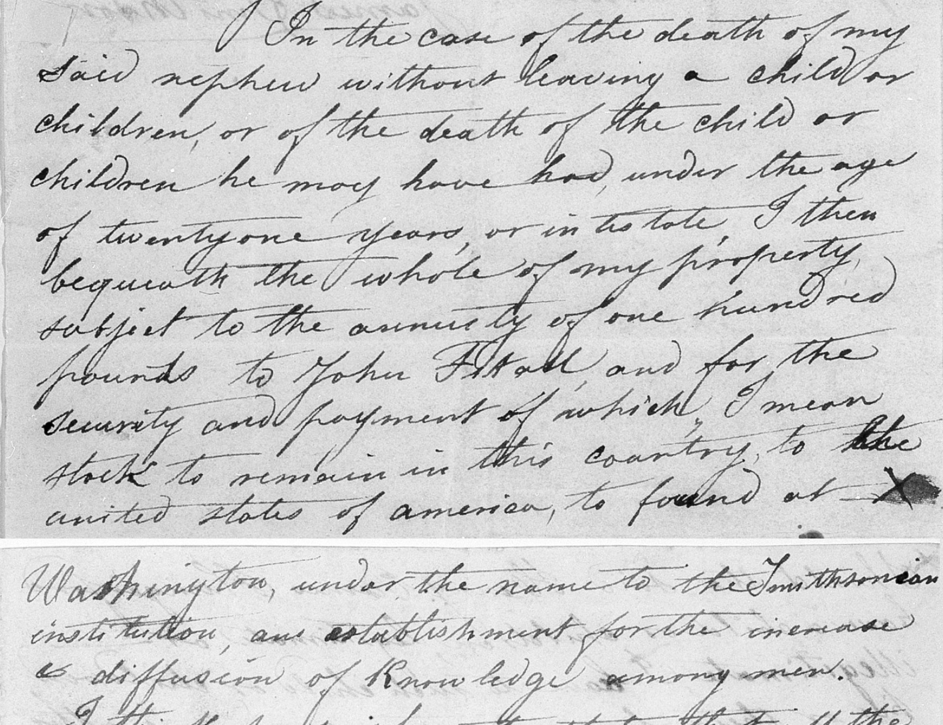
The founding of the Smithsonian
SIA 72-3960 and 72-3960A
“…for the increase and diffusion of knowledge…”
James Smithson, SIA
Notes:
I'll begin with a whirlwind tour of the Smithsonian Institution. The Smithsonian was founded in 1846 following a bequest from a British scientist, James Smithson, pictured here, who provided not only the name and the seed money for the institution but also its mission statement: the increase and diffusion of knowledge.

Slide 5
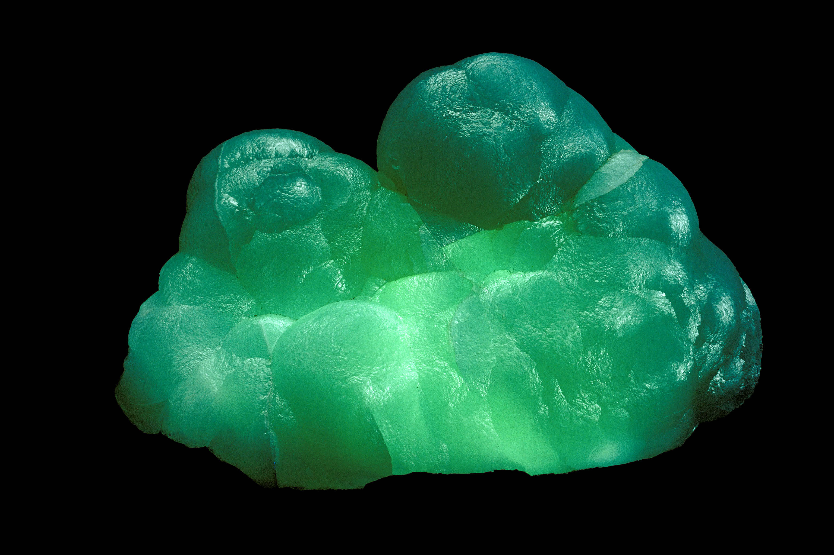
Smithson the mineralogist
NMNH 143509. Photo by Chip Clark.
James Smithson, SIA
Notes:
Smithson was among other things a mineralogist--the mineral smithsonite, pictured here, is named after him--and naturally he had his own mineral collection, including several thousand specimens, which he left to the Smithsonian...

Slide 6
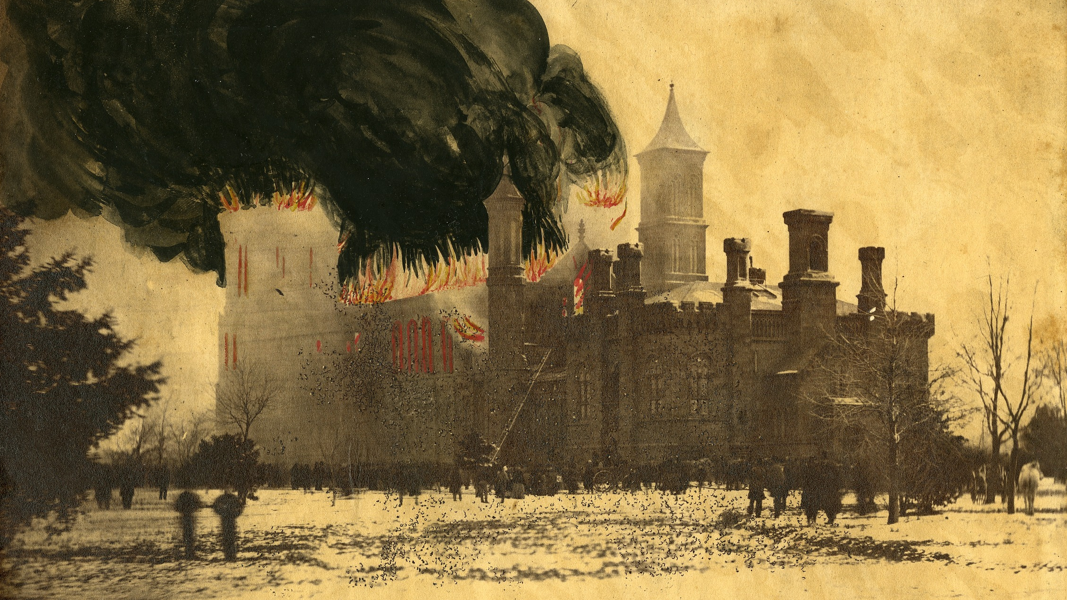
The Smithsonian castle in flames
1865 fire at the Smithsonian castle by A. Gardener (SIA2013-08351)
Notes:
...but which unfortunately was lost, along with most of the Smithsonian's original collection, in a fire in 1865.

Slide 7
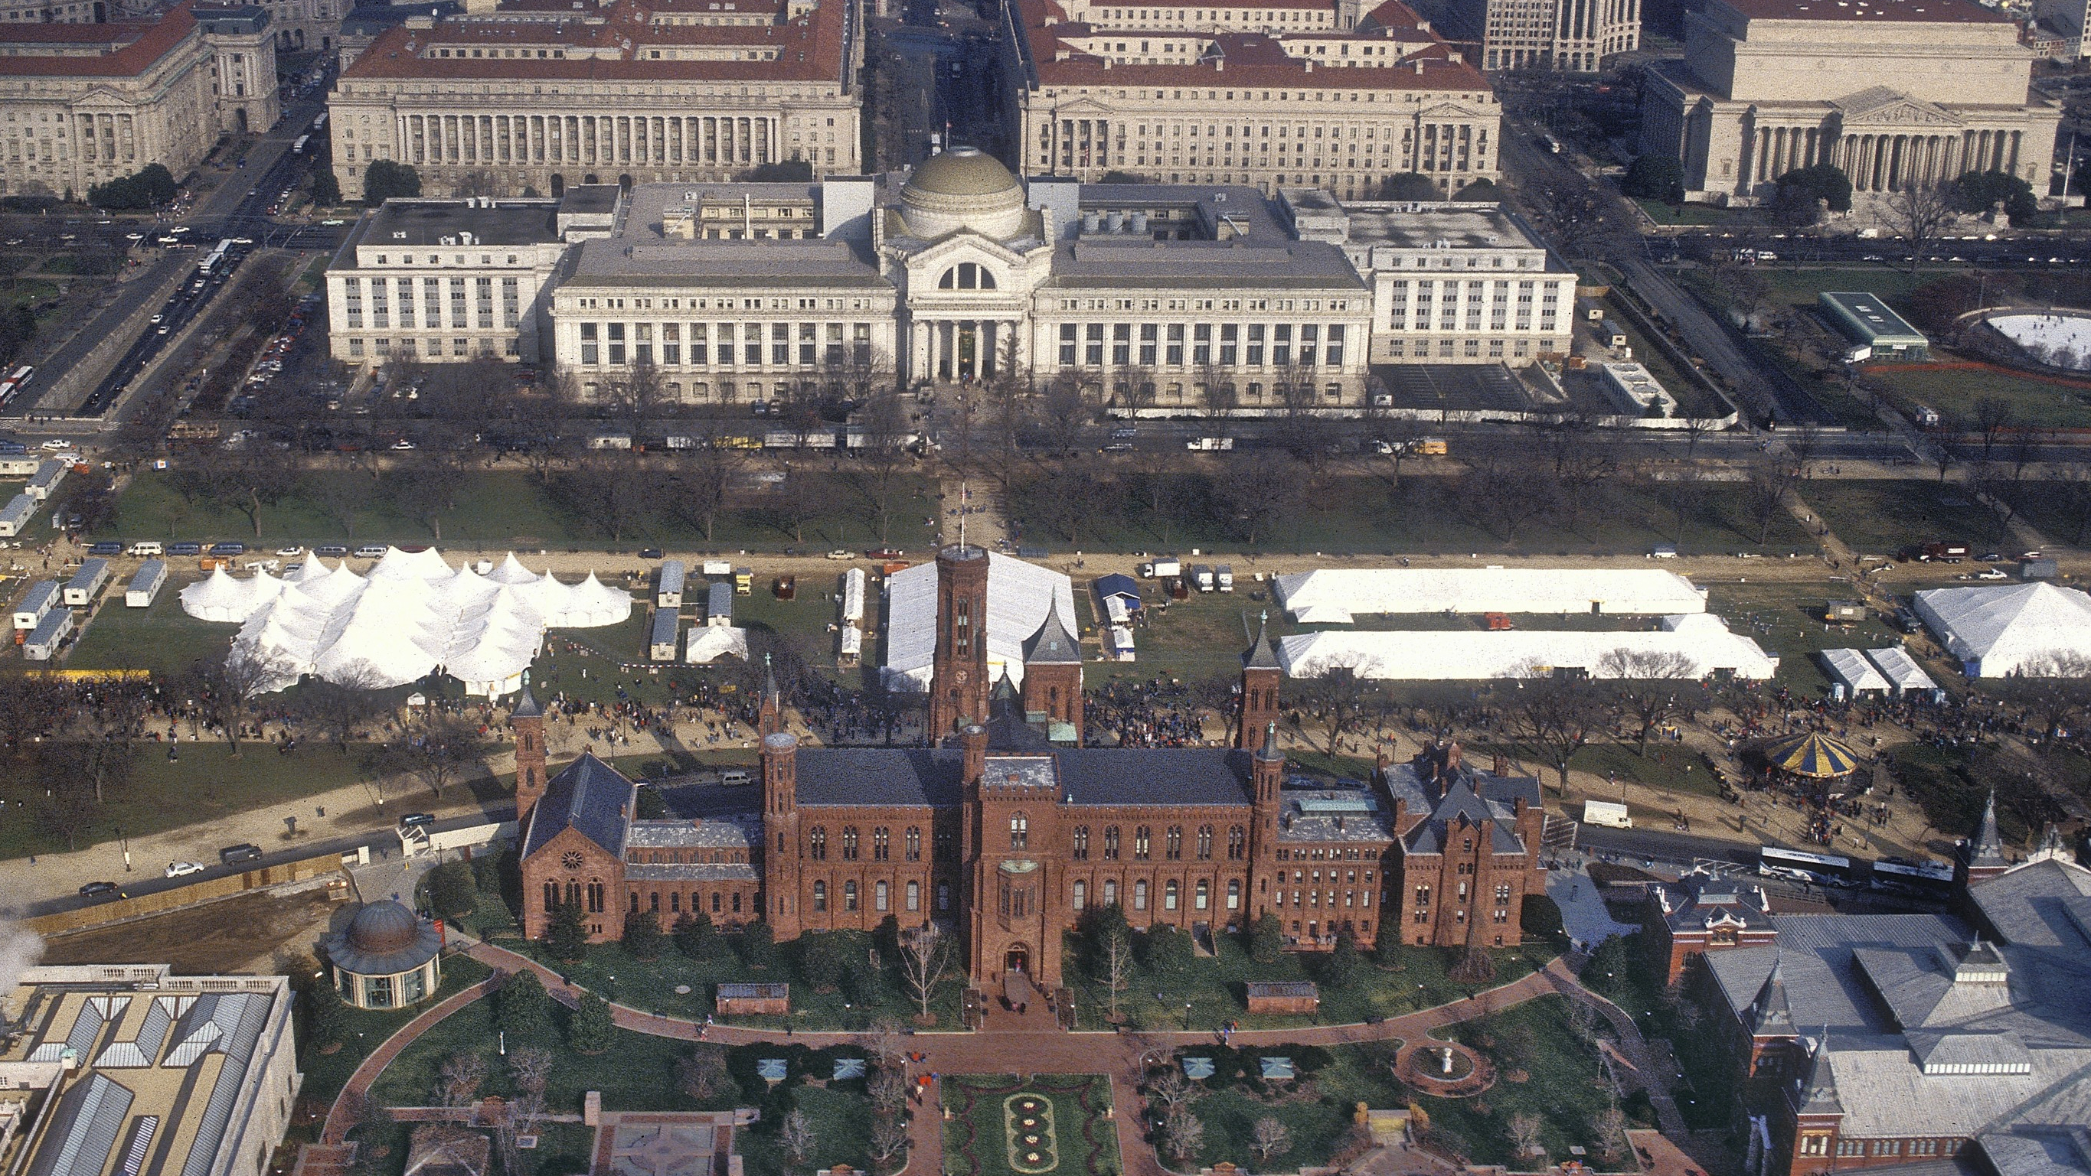
The modern Smithsonian
SIA-2003-0102-000004
Notes:
But the institution recovered, and the Smithsonian expanded from a single building--the Castle, back in one piece here at the bottom of this picture--to 19 museums and a zoo today, which combined welcome more than 28 million visitors a year. The building I work in has been known by a couple different names over its life, but currently is known as the National Museum of Natural History, or NMNH, and is located right across the National Mall from the Castle. I was originally supposed to give this talk in January at the winter meeting in Bethesda—I couldn’t make it—but I was going to encourage you to stop by. It's a really lovely museum, and if you're ever in DC it's worth the visit.

Slide 8
Research at the Smithsonian
Photos from SIA
Notes:
But the Smithsonian is also and has ever been an active research center, both in terms of performing its own research and supporting research elsewhere. A fundamental part of its research activity is its collections, the scale of which can sometimes surprise people.

Slide 9
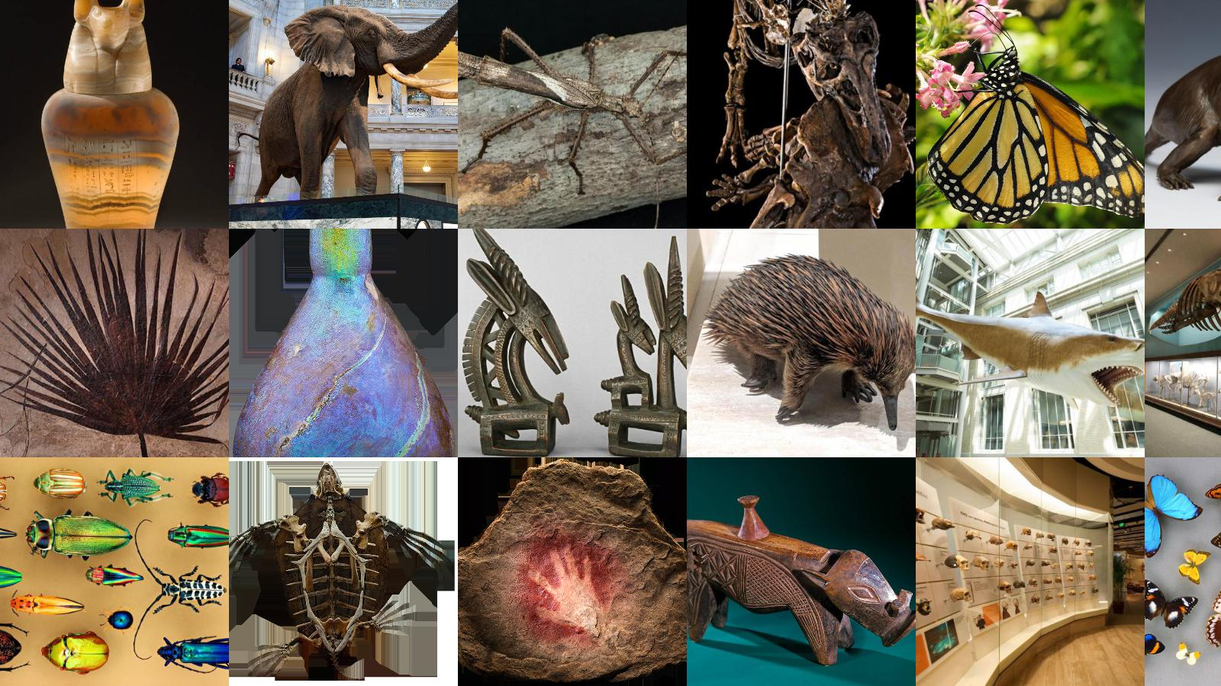
Collections at the Smithsonian
Photos from naturalhistory.si.edu
Notes:
As a whole, the Smithsonian manages more than 155 million objects, 146 million of which belong to NMNH. It is perhaps the most extensive natural history collection in the world, with literally millions of striking natural objects, far more than the exhibits could hold but a few of which you can see here.

Slide 10
Introduction to the collections
Rocks, minerals, and meteorites (and a little bit about fossils)

Slide 11
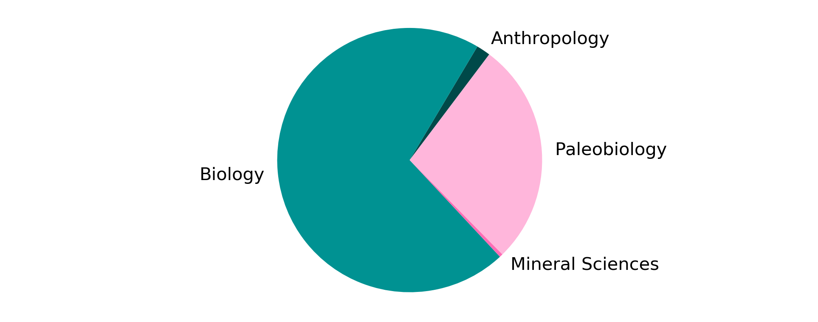
NMNH collections info
Notes:
The NMNH collections include specimens from the fields of biology, geology, and anthropology in roughly the proportions depicted here.

Slide 12
NMNH collections info
~2 million
specimens
~40 million
specimens
~130 million
specimens
~500,000 specimens
Notes:
The extant biology collections--including plants, vertebrates, invertebrates, and insects--make up roughly 70% of the total collection, while the geoscience collections, including Paleobiology and Mineral Sciences, make up most of the last 30%, with most of those specimens belonging to Paleobiology.

Slide 13
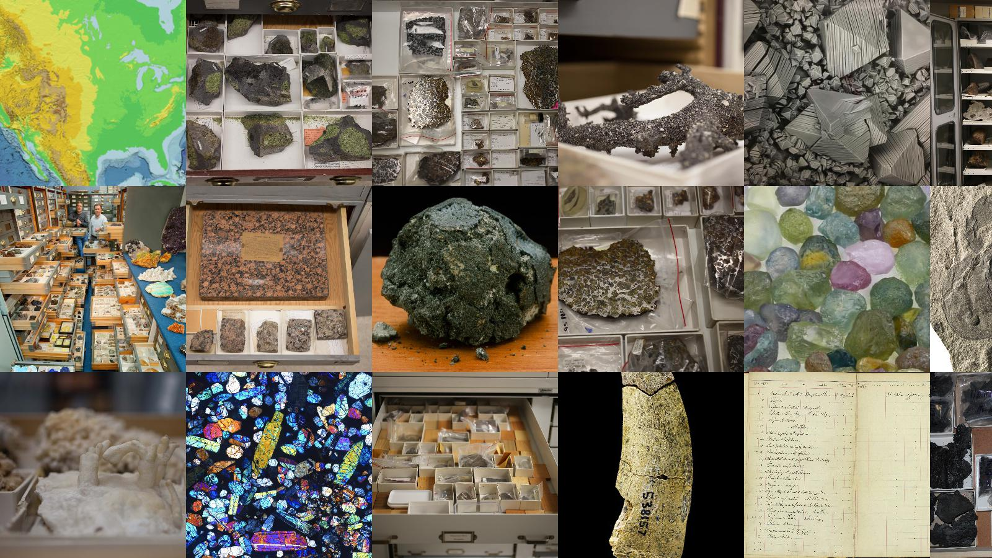
Geoscience collections at NMNH
Photos courtesy NMNH
Notes:
But I'm not here to talk about Paleobiology. I'm here to talk about the Mineral Sciences collections, which, yes, make up a pretty small piece of the whole, but 500,000 specimens is still quite large for an earth science collection with no fossil component. The Mineral Sciences collections are divided into three main areas: the rock collection, managed by the Division of Petrology & Volcanology; the gem and mineral collection, managed by the Division of Mineralogy; and the meteorite collection, managed by the Division of Meteorites.

Slide 14
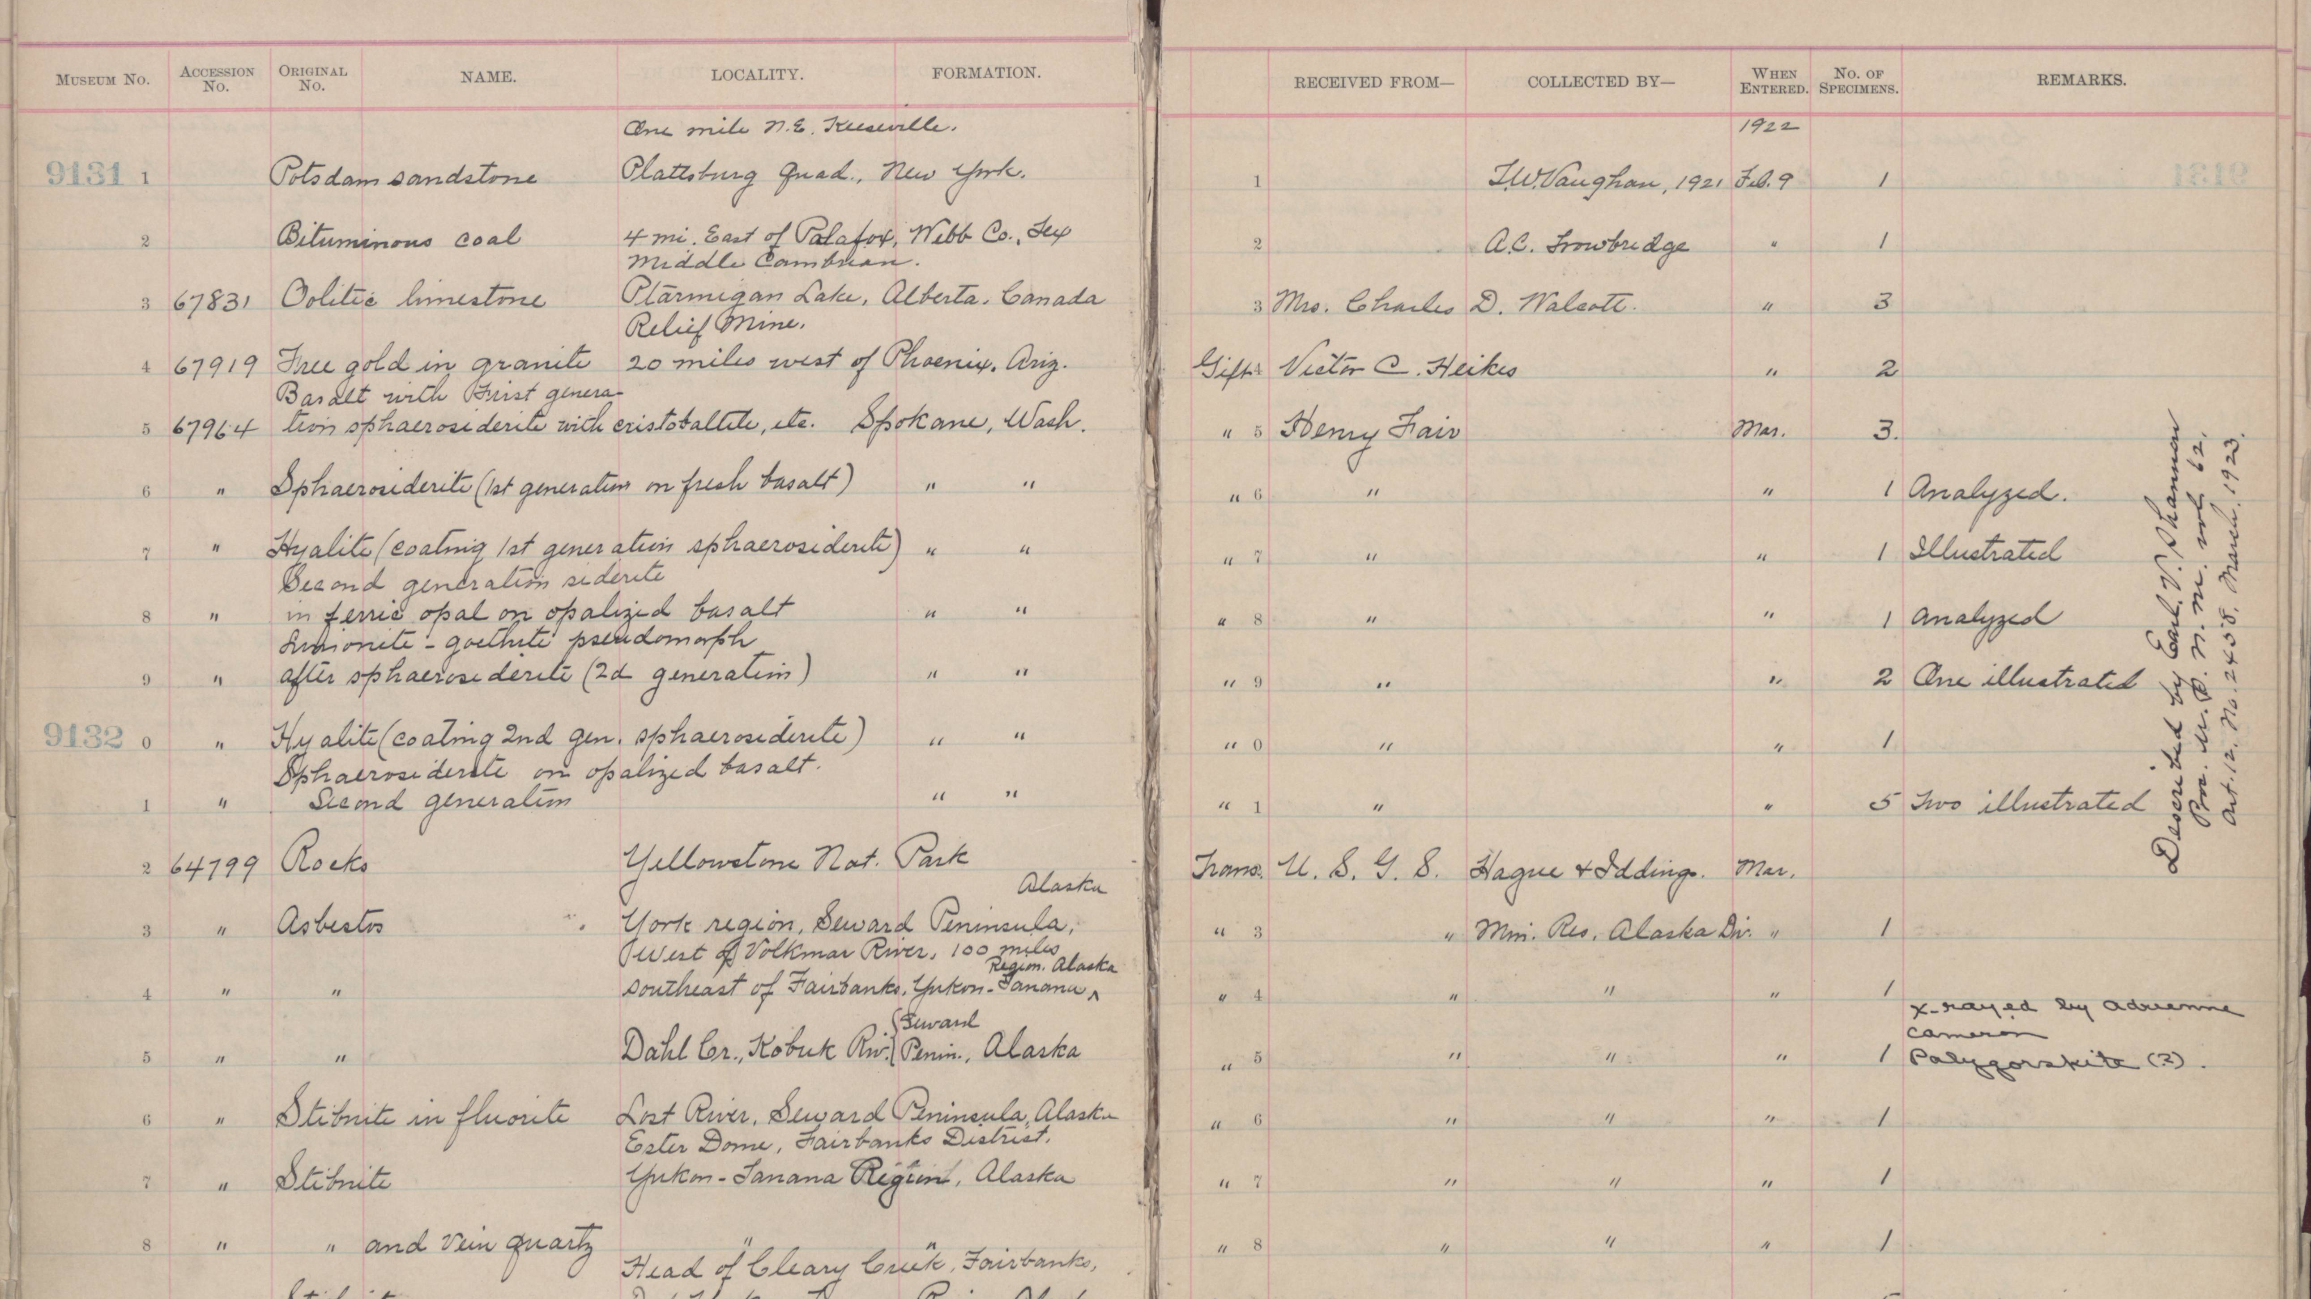
History and growth of the collection
Scan by Julie Hoskin, NMNH
Notes:
The current collection is almost 150 years old. Most of it was originally cataloged in handwritten ledgers like this one. In addition to material collected by Smithsonian scientists, it grows mainly through transfers from other government agencies, like the United States Geological Survey, and donations of collections held by scientists or private collectors. Growth of the collection needs to strike a balance between historical interest, current research interest, and future research interest, which is a difficult balance to find, especially when so many universities and agencies are looking to get rid of their earth science collections.

Slide 15
Measuring impact
Setting a baseline for understanding use of the collection
Notes:
The theme of this meeting is value--how to measure it, how to increase it, how to convey it to stakeholders and funding agencies--so I'd like to talk a little about how we construe the value of a collection. A natural history collection has two major functions. One is to educate the public about the natural world. The other, more important for my purposes here, is to support original research.

Slide 16
Why maintain collections?
Retain specimens underpinning significant findings
Provide access to unique or difficult-to-collect specimens
Allow researchers to build on existing work
Notes:
Here are three key reasons why you’d maintain a collection to support research: [summarize slide]
To support research, the department provides loans of specimens from the collection, typically free of charge, to qualified scientists around the world. In exchange, researchers are required to cite our specimens where they appear in the literature and to share their results with the museum once their research is complete.

Slide 17
Why maintain collections?
Retain specimens underpinning significant findings
Provide access to unique or difficult-to-collect specimens
Allow researchers to build on existing work
Value = Use
Notes:
So value is use, but the value proposition only holds if the collection is being actively used. That means that scientists are requesting material from the collection, and it means that they are using that material to perform novel research, ideally resulting in publications.

Slide 18
Goals for impact
Increase loans and publications using the collection
Increase use of collections data
Refine metrics used to understand impact
Notes:
Based on that idea, here are some general goals for the collection: [summarize slide]

Slide 19
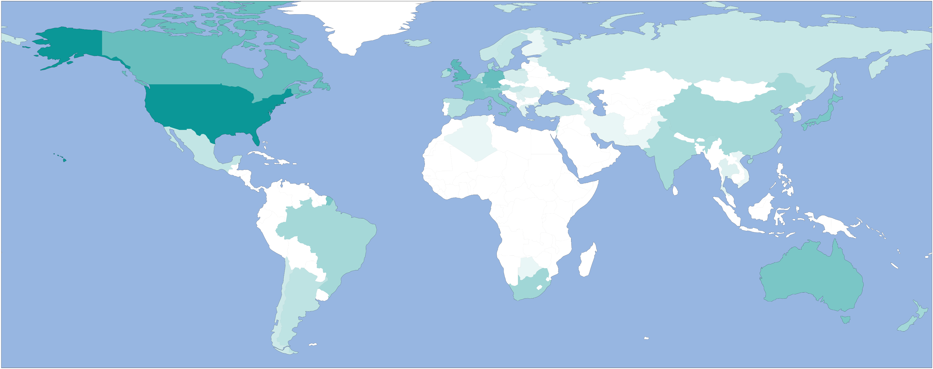
Loans by country (2000-2019)
Notes:
I'll start with an overview of our audience. Here is a map of where the approximately 3,500 loans intended for scientific study that the department has sent out over the last twenty years have gone based on data from our internal collections database. Darker colors mean more loans, with colors scaling logarithmically. Our audience is primarily in the United States, which receives 70-80% of loans. Most of the rest go to Canada, Australia, or western Europe.

Slide 20
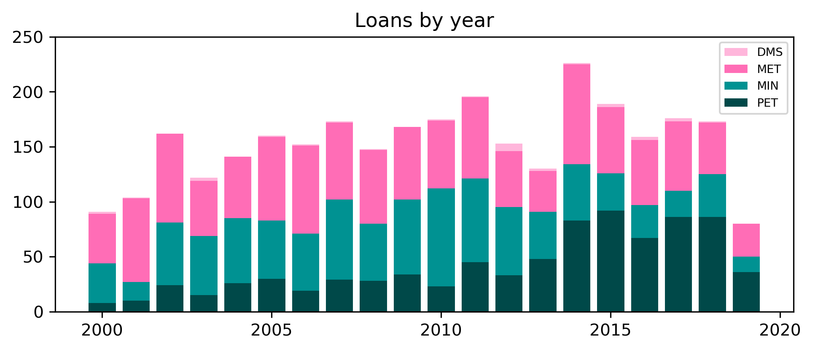
Loans by year (2000-2019)
Color palette for plots from http://mkweb.bcgsc.ca/biovis2012/color-blindness-palette.png
Notes:
This is the same time period plotted as number of loans per year. Loans per year is plotted on the y-axis, with the different colors corresponding to the different divisions within Mineral Sciences: Dark green for Petrology & Volcanology, light green for Mineralogy, dark pink for Meteorites, light pink for loans that could not be assigned to a specific collection. So we generally process 100-200 loans per year.

Slide 21
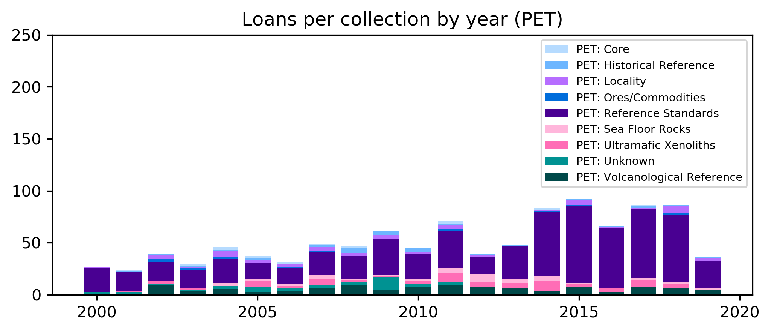
Loans per collection per year (Petrology) (2000-2019)
Notes:
There's one aspect of these loans that I want to point out. This is basically the same plot, now showing only loans from the rock collection. I want to highlight the large fraction of loans from the rock collection that are from the Reference Standard collection, which is this purple bar. Those loans are primarily of specimens from the Smithsonian Microbeam Standards, which are a widely used set of reference materials for calibrating electron microprobes. This is an important collection for us and a big need for the community, but it's also quite different from the samples that we send out to be the subject of original research.

Slide 22
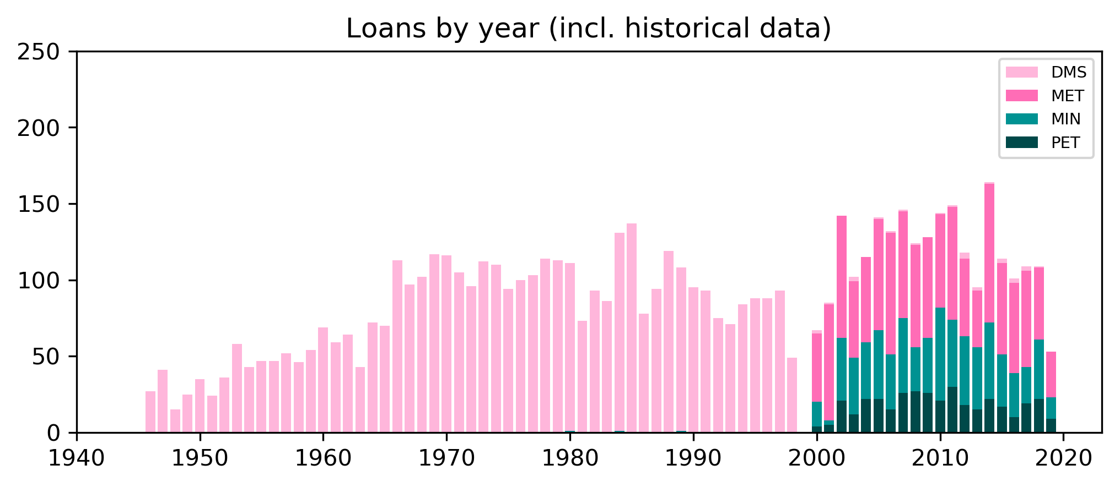
Loans by year (1945-2019)
Pre-1998 transaction data compiled by Anna Weitzman, NMNH Informatics
Notes:
For what it's worth, these numbers are broadly consistent and even a little higher than historical numbers back to 1960 or so, which were compiled based on recently digitized loan paperwork. There are some differences between the pre- and post-1998 datasets that make a straight comparison tricky, so I'm not inclined to take the uptick after 2000 too seriously, but in general modern use of the collection is in line with what we've seen in the past.

Slide 23
What about publications?
Notes:
Getting a grip on the publication history of the collection is trickier. As I mentioned, researchers that request material from the collection are required to cite our specimens by their museum number and to return a copy of any data or publications to the museum. Would you believe me if I told you that they do not always do this? As a result, we haven't had the best understanding of how our loans are translating into publications.

Slide 24
Basic catalog number mining
GeoDeepDive
https://geodeepdive.org/
Biodiversity Heritage Library
https://www.biodiversitylibrary.org/
10 million documents
Mine but not view documents
Geoscience focus
150,000 documents
View and mine documents
Biology focus
Includes Smithsonian publications
GitHub: https://github.com/adamancer/speciminer
Notes:
To try to get some sense of those numbers, I've turned to GeoDeepDive, which is an NSF-funded application based at the University of Wisconsin that allows users to mine data from the scientific literature, up to and including research that has been published this year. GeoDeepDive is also very strong on geology journals, thanks in part to its partnership with AGU, and includes more than 10 million articles. NMNH also uses a fairly standard, fairly recognizable catalog number format, which helps when it comes to text mining like this.

Slide 25
Basic catalog number mining
Search GeoDeepDive for snippets containing USNM or NMNH
Parse out substrings that look like catalog numbers
Verify catalog numbers against collections database using context from the snippet and publication
...er with polished billets of Gore Mountain garnet (USNM 107144) and San Carlos olivine (USNM 136718) evacuated a...
Source: McCoy, T. et al. Geochimica et Cosmochimica Acta (2011) 75: 22. https://doi.org/10.1016/j.gca.2011.09.006 (via GeoDeepDive)
Notes:
So the script starts by looking for documents in the GeoDeepDive corpus that contain either USNM or NMNH...

Slide 26
Basic catalog number mining
Search GeoDeepDive for snippets containing USNM or NMNH
Parse out substrings that look like catalog numbers
Verify catalog numbers against collections database using context from the snippet and publication
...er with polished billets of Gore Mountain garnet (USNM 107144) and San Carlos olivine (USNM 136718) evacuated a...
Source: McCoy, T. et al. Geochimica et Cosmochimica Acta (2011) 75: 22. https://doi.org/10.1016/j.gca.2011.09.006 (via GeoDeepDive)
Notes:
Then finds snippets containing strings that look like catalog numbers...

Slide 27
Basic catalog number mining
Search GeoDeepDive for snippets containing USNM or NMNH
Parse out substrings that look like catalog numbers
Verify catalog numbers against collections database using context from the snippet and publication
...er with polished billets of Gore Mountain garnet (USNM 107144) and San Carlos olivine (USNM 136718) evacuated a...
Source: McCoy, T. et al. Geochimica et Cosmochimica Acta (2011) 75: 22. https://doi.org/10.1016/j.gca.2011.09.006 (via GeoDeepDive)
Notes:
Then tries to match those strings to records in the NMNH collections database based on context from the snippet or publication. In this case, the script has matched the catalog number strings to specific samples based on the terms *garnet* and *olivine*. This step is key. It helps both to filter out strings that look like catalog numbers but aren’t and to distinguish Mineral Sciences specimens from those of other departments within NMNH.

Slide 28
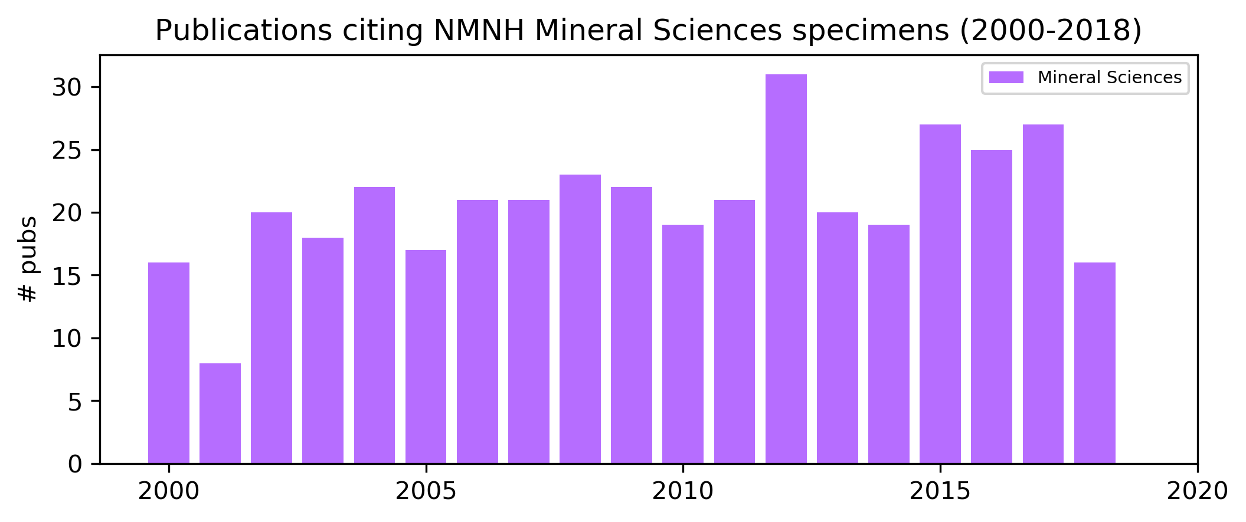
Publications citing Mineral Sciences specimens (2000-2018)
Data compiled from GeoDeepDive
Notes:
Here is a plot of papers including specimens from the Mineral Sciences collections since 2000. The number of publications hovers between 15 and 30 per year and, like the loan plot, is relatively flat. These numbers will underestimate the true number of publications, because the GeoDeepDive corpus, while extensive, is not exhaustive and in particular does not have good coverage of certain journals--like *American Mineralogist* and *Meteoritics and Planetary Science*--where NMNH specimens would be likely to show up. But this gives us a place to start, and I think that we will be able to generate a more complete picture in days to come.
References:
1. Adams, T.D. et al. Geochemistry, Geophysics, Geosystems (2011) 12: 12. https://doi.org/10.1029/2011GC003778
2. Airieau, S. et al. Geochimica et Cosmochimica Acta (2005) 69: 16. https://doi.org/10.1016/j.gca.2005.01.029
3. Akram, W. et al. Geochimica et Cosmochimica Acta (2015). https://doi.org/10.1016/j.gca.2015.02.013
4. Akridge, G.D. Journal of Geophysical Research (2004) 109: E7. https://doi.org/10.1029/2003JE002198
5. Al-Aasm, S.I. et al. Marine and Petroleum Geology (2002) 19: 3. https://doi.org/10.1016/S0264-8172(02)00013-2
6. Alwmark, C. & Schmitz, B. Earth and Planetary Science Letters (2007) 253: 1-2. https://doi.org/10.1016/j.epsl.2006.10.034
7. Alwmark, C. & Schmitz, B. Geochimica et Cosmochimica Acta (2009) 73: 5. https://doi.org/10.1016/j.gca.2008.12.006
8. Alwmark, C. & Schmitz, B. Meteoritics & Planetary Science (2009) 44: 1. https://doi.org/10.1111/j.1945-5100.2009.tb00720.x
9. Alwmark, C. et al. Geological Society of America Bulletin (2010) 122: 7-8. https://doi.org/10.1130/b30040.1
10. Aléon, J. Earth and Planetary Science Letters (2018) 482. https://doi.org/10.1016/j.epsl.2017.11.027
11. Andronico, D. et al. Journal of Volcanology and Geothermal Research (2008) 176: 4. https://doi.org/10.1016/j.jvolgeores.2008.05.011
12. Aponte, C.J. et al. Geochimica et Cosmochimica Acta (2014). https://doi.org/10.1016/j.gca.2014.01.035
13. Aponte, C.J. et al. Geochimica et Cosmochimica Acta (2014). https://doi.org/10.1016/j.gca.2014.06.035
14. Argast, A. Canadian Journal of Earth Sciences (2002) 39: 4. https://doi.org/10.1139/e01-086
15. Auer, A. et al. New Zealand Journal of Geology and Geophysics (2015) 58: 4. https://doi.org/10.1080/00288306.2015.1089913
16. Ayers, J. et al. Geochimica et Cosmochimica Acta (2012). https://doi.org/10.1016/j.gca.2012.08.027
17. Barnes, D.J. & Straub, M.S. Chemical Geology (2010) 1-4. https://doi.org/10.1016/j.chemgeo.2010.02.005
18. Barrat, J. et al. Geochimica et Cosmochimica Acta (2012). https://doi.org/10.1016/j.gca.2011.12.011
19. Barrat, J. et al. Geochimica et Cosmochimica Acta (2014). https://doi.org/10.1016/j.gca.2013.11.042
20. Barrat, J. et al. Geochimica et Cosmochimica Acta (2015). https://doi.org/10.1016/j.gca.2015.12.004
21. Barrat, J. et al. Geochimica et Cosmochimica Acta (2016). https://doi.org/10.1016/j.gca.2016.07.025
22. Barrat, J. et al. Geochimica et Cosmochimica Acta (2016). https://doi.org/10.1016/j.gca.2016.08.042
23. Batanova, G.V. et al. Chemical Geology (2015). https://doi.org/10.1016/j.chemgeo.2015.10.042
24. Becker, H. & Walker, J.R. Chemical Geology (2003) 196: 1-4. https://doi.org/10.1016/S0009-2541(02)00406-0
25. Bell, J. et al. Icarus (2002) 158: 1. https://doi.org/10.1006/icar.2002.6865
26. Benedix, K.G. et al. Geochimica et Cosmochimica Acta (2005) 69: 21. https://doi.org/10.1016/j.gca.2005.03.048
27. Benedix, K.G. et al. Meteoritics & Planetary Science (2000) 35: 6. https://doi.org/10.1111/j.1945-5100.2000.tb01502.x
28. Berlin, J. et al. Meteoritics & Planetary Science (2011) 46: 4. https://doi.org/10.1111/j.1945-5100.2011.01171.x
29. Berlo, K. et al. Earth and Planetary Science Letters (2006) 249: 3-4. https://doi.org/10.1016/j.epsl.2006.07.018
30. Bermingham, K. et al. Geochimica et Cosmochimica Acta (2015). https://doi.org/10.1016/j.gca.2015.11.006
31. Bertoldi, C. et al. Lithos (2004) 78: 4. https://doi.org/10.1016/j.lithos.2004.07.003
32. Bindeman, I. et al. Geochimica et Cosmochimica Acta (2008) 72: 17. https://doi.org/10.1016/j.gca.2008.06.010
33. Boesenberg, S.J. & Hewins, H.R. Geochimica et Cosmochimica Acta (2010) 74: 6. https://doi.org/10.1016/j.gca.2009.12.008
34. Boesenberg, S.J. et al. Geochimica et Cosmochimica Acta (2012). https://doi.org/10.1016/j.gca.2012.04.037
35. Bogard, D.D. et al. Geochimica et Cosmochimica Acta (2000) 64: 12. https://doi.org/10.1016/S0016-7037(00)00355-0
36. Bombardieri, J.D. et al. Meteoritics & Planetary Science (2005) 40: 5. https://doi.org/10.1111/j.1945-5100.2005.tb00973.x
37. Bonal, L. et al. Geochimica et Cosmochimica Acta (2013). https://doi.org/10.1016/j.gca.2012.12.009
38. Borisova, Y.A. et al. Journal of Geophysical Research (2012) 117: B5. https://doi.org/10.1029/2012JB009213
39. Boschi, S. et al. Geochimica et Cosmochimica Acta (2017). https://doi.org/10.1016/j.gca.2017.01.028
40. Botta, O. et al. Meteoritics & Planetary Science (2007) 42: 1. https://doi.org/10.1111/j.1945-5100.2007.tb00219.x
41. Bowles, A.J. et al. Journal of Geophysical Research: Solid Earth (2012) 117: B3. https://doi.org/10.1029/2011JB008867
42. Brachfeld, S. et al. Meteoritics & Planetary Science (2015) 50: 10. https://doi.org/10.1111/maps.12505
43. Brandl, A.P. et al. Lithos (2018) 312. https://doi.org/10.1016/j.lithos.2018.05.011
44. Brandon, D.A. et al. Geochimica et Cosmochimica Acta (2005) 69: 6. https://doi.org/10.1016/j.gca.2004.10.005
45. Breen, P.J. et al. Meteoritics & Planetary Science (2016). https://doi.org/10.1111/maps.12685
46. Briani, G. et al. Meteoritics & Planetary Science (2012) 47: 5. https://doi.org/10.1111/j.1945-5100.2012.01367.x
47. Brinckerhoff, W. Planetary and Space Science (2005) 53: 8. https://doi.org/10.1016/j.pss.2005.04.005
48. Bryce, G.J. & Depaolo, J.D. Geochimica et Cosmochimica Acta (2004) 68: 21. https://doi.org/10.1016/j.gca.2004.01.016
49. Burbine, H.T. et al. Meteoritics & Planetary Science (2002) 37: 9. https://doi.org/10.1111/j.1945-5100.2002.tb00892.x
50. Burkhardt, C. et al. Geochimica et Cosmochimica Acta (2008) 72: 24. https://doi.org/10.1016/j.gca.2008.10.023
51. Burton, S.A. et al. Meteoritics & Planetary Science (2014) 49: 11. https://doi.org/10.1111/maps.12281
52. Carlson, W.R. & Hauri, H.E. Geochimica et Cosmochimica Acta (2001) 65: 11. https://doi.org/10.1016/S0016-7037(01)00559-2
53. Chaumard, N. et al. Geochimica et Cosmochimica Acta (2018) 228. https://doi.org/10.1016/j.gca.2018.02.040
54. Chaussidon, M. et al. Geochimica et Cosmochimica Acta (2006) 70: 1. https://doi.org/10.1016/j.gca.2005.08.016
55. Chaussidon, M. et al. Geochimica et Cosmochimica Acta (2008) 72: 7. https://doi.org/10.1016/j.gca.2008.01.015
56. Cherniak, D. Chemical Geology (2003) 193: 1-2. https://doi.org/10.1016/S0009-2541(02)00246-2
57. Cherniak, D. Geochimica et Cosmochimica Acta (2002) 66: 9. https://doi.org/10.1016/S0016-7037(01)00866-3
58. Cherniak, D. et al. Geochimica et Cosmochimica Acta (2015). https://doi.org/10.1016/j.gca.2015.06.033
59. Clifford, H.J. Rocks & Minerals (2011) 86: 3. https://doi.org/10.1080/00357529.2011.568351
60. Connolly, C.H. et al. Geochimica et Cosmochimica Acta (2001) 65: 24. https://doi.org/10.1016/S0016-7037(01)00749-9
61. Cook, D. et al. Geochimica et Cosmochimica Acta (2004) 68: 6. https://doi.org/10.1016/j.gca.2003.09.017
62. Cook, L.D. et al. Meteoritics & Planetary Science (2007) 42: 12. https://doi.org/10.1111/j.1945-5100.2007.tb01008.x
63. Coombs, L.M. et al. Journal of Volcanology and Geothermal Research (2006) 151: 1-3. https://doi.org/10.1016/j.jvolgeores.2005.07.037
64. Corsaro, A.R. & Miraglia, L. Journal of Volcanology and Geothermal Research (2014). https://doi.org/10.1016/j.jvolgeores.2014.02.009
65. Corsaro, A.R. et al. Journal of Geophysical Research (2009) 114: B7. https://doi.org/10.1029/2008JB006013
66. Craddock, R.P. & Dauphas, N. Geostandards and Geoanalytical Research (2011) 35: 1. https://doi.org/10.1111/j.1751-908X.2010.00085.x
67. Croat, K.T. et al. Meteoritics & Planetary Science (2008) 43: 9. https://doi.org/10.1111/j.1945-5100.2008.tb01024.x
68. Croat, K.T. et al. Meteoritics & Planetary Science (2013) 48: 4. https://doi.org/10.1111/maps.12093
69. Croat, T. et al. Geochimica et Cosmochimica Acta (2003) 67: 24. https://doi.org/10.1016/S0016-7037(03)00463-0
70. Cronberger, K. & Neal, R.C. Meteoritics & Planetary Science (2017). https://doi.org/10.1111/maps.12837
71. Cronholm, A. & Schmitz, B. Meteoritics & Planetary Science (2007) 42: 12. https://doi.org/10.1111/j.1945-5100.2007.tb01010.x
72. Dare, S.M. et al. Earth and Planetary Science Letters (2016). https://doi.org/10.1016/j.epsl.2016.05.009
73. Daubar, J.I. et al. Meteoritics & Planetary Science (2002) 37: 12. https://doi.org/10.1111/j.1945-5100.2002.tb01164.x
74. Dauphas, N. & Pourmand, A. Geochimica et Cosmochimica Acta (2015). https://doi.org/10.1016/j.gca.2015.03.037
75. Dauphas, N. et al. Earth and Planetary Science Letters (2009) 288: 1-2. https://doi.org/10.1016/j.epsl.2009.09.029
76. De Hoog, C.J. et al. Chemical Geology (2010) 1-4. https://doi.org/10.1016/j.chemgeo.2009.11.017
77. De Hoog, J. et al. Geochimica et Cosmochimica Acta (2001) 65: 18. https://doi.org/10.1016/S0016-7037(01)00634-2
78. De Hoog, J. et al. Journal of Volcanology and Geothermal Research (2001) 108: 1-4. https://doi.org/10.1016/S0377-0273(00)00278-X
79. Deegan, M.F. et al. Chemical Geology (2016). https://doi.org/10.1016/j.chemgeo.2016.10.018
80. Del Carlo, P. et al. Journal of Volcanology and Geothermal Research (2012). https://doi.org/10.1016/j.jvolgeores.2012.05.021
81. Diaz-Bravo, A.B. et al. Geosphere (2014) 10: 2. https://doi.org/10.1130/ges00976.1
82. Ding, S. et al. Geochimica et Cosmochimica Acta (2014). https://doi.org/10.1016/j.gca.2014.02.003
83. Ding, S. et al. Geochimica et Cosmochimica Acta (2018) 222. https://doi.org/10.1016/j.gca.2017.10.025
84. Douglas, G.J. & Chase, T.W. Studies in Conservation (2001) 46: 1. https://doi.org/10.1179/sic.2001.46.1.35
85. Edwards, R.B. et al. Journal of Volcanology and Geothermal Research (2009) 185: 4. https://doi.org/10.1016/j.jvolgeores.2008.11.015
86. El Goresy, A. et al. Geochimica et Cosmochimica Acta (2002) 66: 8. https://doi.org/10.1016/S0016-7037(01)00854-7
87. Elburg, A.M. et al. Chemical Geology (2007) 240: 3-4. https://doi.org/10.1016/j.chemgeo.2007.02.015
88. Elburg, A.M. et al. Gondwana Research (2013) 24: 2. https://doi.org/10.1016/j.gr.2012.12.017
89. Elsila, E.J. et al. Geochimica et Cosmochimica Acta (2005) 69: 11. https://doi.org/10.1016/j.gca.2004.11.023
90. Elsila, E.J. et al. Meteoritics & Planetary Science (2012) 47: 9. https://doi.org/10.1111/j.1945-5100.2012.01415.x
91. Emerson, R.N. et al. Palaeogeography, Palaeoclimatology, Palaeoecology (2004) 210: 2-4. https://doi.org/10.1016/j.palaeo.2004.02.042
92. Fagan, T. et al. Geochimica et Cosmochimica Acta (2004) 68: 11. https://doi.org/10.1016/j.gca.2003.10.033
93. Falloon, J.T. et al. Chemical Geology (2007) 241: 3-4. https://doi.org/10.1016/j.chemgeo.2007.01.015
94. Falloon, J.T. et al. Geochemistry, Geophysics, Geosystems (2007) 8: 9. https://doi.org/10.1029/2007GC001619
95. Fazio, A. et al. Geochimica et Cosmochimica Acta (2016). https://doi.org/10.1016/j.gca.2016.02.003
96. Fazio, A. et al. Meteoritics & Planetary Science (2014) 49: 12. https://doi.org/10.1111/maps.12385
97. Fehr, A.M. et al. Geochimica et Cosmochimica Acta (2005) 69: 21. https://doi.org/10.1016/j.gca.2005.04.020
98. Fehr, A.M. et al. Geochimica et Cosmochimica Acta (2006) 70: 13. https://doi.org/10.1016/j.gca.2006.04.019
99. Fehr, A.M. et al. Meteoritics & Planetary Science (2009) 44: 7. https://doi.org/10.1111/j.1945-5100.2009.tb00782.x
100. Fioretti, M.A. & Zipfel, J. Meteoritics & Planetary Science (2004) 39: S8. https://doi.org/10.1111/j.1945-5100.2004.tb00350.x
101. First, E. & Hammer, J. Meteoritics & Planetary Science (2016) 51: 7. https://doi.org/10.1111/maps.12659
102. Fischer-Gödde, M. & Becker, H. Geochimica et Cosmochimica Acta (2012). https://doi.org/10.1016/j.gca.2011.11.014
103. Fischer-Gödde, M. et al. Geochimica et Cosmochimica Acta (2010) 74: 1. https://doi.org/10.1016/j.gca.2009.09.024
104. Floss, C. Meteoritics & Planetary Science (2002) 37: 8. https://doi.org/10.1111/j.1945-5100.2002.tb00882.x
105. Floss, C. et al. Meteoritics & Planetary Science (2008) 43: 4. https://doi.org/10.1111/j.1945-5100.2008.tb00676.x
106. Folco, L. et al. Meteoritics & Planetary Science (2007) 42: 3. https://doi.org/10.1111/j.1945-5100.2007.tb00236.x
107. Ford, L.R. et al. Meteoritics & Planetary Science (2008) 43: 8. https://doi.org/10.1111/j.1945-5100.2008.tb00705.x
108. Frahm, E. Archaeometry (2012) 54: 4. https://doi.org/10.1111/j.1475-4754.2011.00648.x
109. Francalanci, L. et al. Journal of Volcanology and Geothermal Research (2004) 131: 1-2. https://doi.org/10.1016/S0377-0273(03)00362-7
110. Friedrich, M.J. et al. Geochimica et Cosmochimica Acta (2003) 67: 13. https://doi.org/10.1016/S0016-7037(03)00024-3
111. Friedrich, M.J. et al. Geochimica et Cosmochimica Acta (2004) 68: 13. https://doi.org/10.1016/j.gca.2004.01.010
112. Friedrich, M.J. et al. Geochimica et Cosmochimica Acta (2013). https://doi.org/10.1016/j.gca.2013.01.009
113. Friedrich, M.J. et al. Meteoritics & Planetary Science (2002) 37: 5. https://doi.org/10.1111/j.1945-5100.2002.tb00847.x
114. Friedrich, M.J. et al. Meteoritics & Planetary Science (2016) 51: 2. https://doi.org/10.1111/maps.12595
115. Fujii, T. et al. Earth and Planetary Science Letters (2006) 247: 1-2. https://doi.org/10.1016/j.epsl.2006.04.034
116. Füri, E. et al. Icarus (2014). https://doi.org/10.1016/j.icarus.2013.10.029
117. Gall, Q. & Donaldson, A.J. Canadian Journal of Earth Sciences (2006) 43: 5. https://doi.org/10.1139/e06-011
118. Garcia, O.M. et al. Geochimica et Cosmochimica Acta (2016). https://doi.org/10.1016/j.gca.2016.03.025
119. Geiger, H. et al. Geochemistry, Geophysics, Geosystems (2016). https://doi.org/10.1002/2016GC006317
120. Geochimica et Cosmochimica Acta (2010) 74: 12. https://doi.org/10.1016/j.gca.2010.04.037
121. Gietzen, M.K. et al. Meteoritics & Planetary Science (2012) 47: 11. https://doi.org/10.1111/maps.12013
122. Glaubrecht, M. & Von Rintelen, T. Zoologica Scripta (2003) 32: 5. https://doi.org/10.1046/j.1463-6409.2003.00127.x
123. Glavin, P.D. et al. Meteoritics & Planetary Science (2006) 41: 6. https://doi.org/10.1111/j.1945-5100.2006.tb00493.x
124. Glavin, P.D. et al. Meteoritics & Planetary Science (2010) 45: 12. https://doi.org/10.1111/j.1945-5100.2010.01132.x
125. Goldstein, I.J. et al. Meteoritics & Planetary Science (2009) 44: 3. https://doi.org/10.1111/j.1945-5100.2009.tb00737.x
126. González-Jiménez, Lithosphere (2018). https://doi.org/10.1130/l1030.1
127. Goodrich, A.C. et al. Meteoritics & Planetary Science (2010) 45: 12. https://doi.org/10.1111/j.1945-5100.2010.01130.x
128. Graf, T. et al. Icarus (2001) 150: 1. https://doi.org/10.1006/icar.2000.6560
129. Grant, J. et al. Canadian Journal of Fisheries and Aquatic Sciences (2010) 67: 9. https://doi.org/10.1139/F10-073
130. Griffin, L.W. et al. Geological Society of America Bulletin (2011) 123: 9-10. https://doi.org/10.1130/b30253.1
131. Grossman, N.J. & Brearley, J.A. Meteoritics & Planetary Science (2005) 40: 1. https://doi.org/10.1111/j.1945-5100.2005.tb00366.x
132. Grossman, N.J. et al. Meteoritics & Planetary Science (2000) 35: 3. https://doi.org/10.1111/j.1945-5100.2000.tb01429.x
133. Grossman, N.J. et al. Meteoritics & Planetary Science (2002) 37: 1. https://doi.org/10.1111/j.1945-5100.2002.tb00795.x
134. Gudbrandsson, S. et al. Geochimica et Cosmochimica Acta (2014). https://doi.org/10.1016/j.gca.2014.04.028
135. Gudmundsdóttir, R.E. et al. Journal of Quaternary Science (2011) 26: 6. https://doi.org/10.1002/jqs.1474
136. Gurenko, A. et al. Journal of Volcanology and Geothermal Research (2005) 147: 3-4. https://doi.org/10.1016/j.jvolgeores.2005.04.002
137. Gurenko, A.A. & Kamenetsky, S.V. Earth and Planetary Science Letters (2011) 1-2. https://doi.org/10.1016/j.epsl.2011.09.033
138. Gurenko, A.A. et al. Earth and Planetary Science Letters (2009) 277: 3-4. https://doi.org/10.1016/j.epsl.2008.11.013
139. Gurenko, A.A. et al. Lithos (2013). https://doi.org/10.1016/j.lithos.2013.03.002
140. Gómez-Ulla, A. et al. Chemical Geology (2017). https://doi.org/10.1016/j.chemgeo.2016.11.021
141. Hagerty, J.J. & Newsom, E.H. Meteoritics & Planetary Science (2003) 38: 3. https://doi.org/10.1111/j.1945-5100.2003.tb00272.x
142. Hallis, J.L. & Taylor, J.G. Meteoritics & Planetary Science (2011) 46: 12. https://doi.org/10.1111/j.1945-5100.2011.01293.x
143. Hallis, J.L. Meteoritics & Planetary Science (2013) 48: 2. https://doi.org/10.1111/maps.12049
144. Hallis, L. et al. Geochimica et Cosmochimica Acta (2012). https://doi.org/10.1016/j.gca.2012.08.017
145. Hallis, L. et al. Geochimica et Cosmochimica Acta (2014). https://doi.org/10.1016/j.gca.2014.02.007
146. Hamilton, E.V. & Ruff, W.S. Icarus (2012) 218: 2. https://doi.org/10.1016/j.icarus.2012.01.011
147. Hamilton, E.V. Journal of Geophysical Research (2003) 108: E8. https://doi.org/10.1029/2003JE002052
148. Hanna, D.K. & Sprague, L.A. Meteoritics & Planetary Science (2009) 44: 11. https://doi.org/10.1111/j.1945-5100.2009.tb01205.x
149. Hanna, D.R. & Ketcham, A.R. Earth and Planetary Science Letters (2018) 481. https://doi.org/10.1016/j.epsl.2017.10.029
150. Hanna, D.R. et al. Geochimica et Cosmochimica Acta (2015). https://doi.org/10.1016/j.gca.2015.09.005
151. Hansen, T.C. et al. Geochimica et Cosmochimica Acta (2017) 217. https://doi.org/10.1016/j.gca.2017.08.014
152. Harries, D. Chemie der Erde - Geochemistry (2014) 74: 3. https://doi.org/10.1016/j.chemer.2014.01.001
153. Head, E. et al. Geochimica et Cosmochimica Acta (2018) 226. https://doi.org/10.1016/j.gca.2018.01.033
154. Heck, R.P. et al. Geochimica et Cosmochimica Acta (2010) 74: 2. https://doi.org/10.1016/j.gca.2009.10.027
155. Heirwegh, M.C. et al. X-Ray Spectrometry (2015) 44: 2. https://doi.org/10.1002/xrs.2583
156. Herzberg, C. et al. Earth and Planetary Science Letters (2014). https://doi.org/10.1016/j.epsl.2014.03.065
157. Hetzinger, S. et al. PALAIOS (2009) 24: 6. https://doi.org/10.2110/palo.2008.p08-116r
158. Hidas, K. et al. Lithos (2018) 316. https://doi.org/10.1016/j.lithos.2018.07.004
159. Hietpas, J. et al. Journal of Sedimentary Research (2014) 83: 12. https://doi.org/10.2110/jsr.2013.83
160. Hips, K. et al. Sedimentary Geology (2015). https://doi.org/10.1016/j.sedgeo.2014.12.002
161. Hoffmann, P. et al. X-Ray Spectrometry (2010) 39: 1. https://doi.org/10.1002/xrs.1218
162. Hofmeister, M.A. et al. Geochimica et Cosmochimica Acta (2004) 68: 21. https://doi.org/10.1016/j.gca.2004.03.011
163. Hopp, T. & Vollmer, C. Meteoritics & Planetary Science (2017). https://doi.org/10.1111/maps.12991
164. Horan, M. et al. Chemical Geology (2003) 196: 1-4. https://doi.org/10.1016/S0009-2541(02)00405-9
165. Huang, Y. et al. Earth and Planetary Science Letters (2015). https://doi.org/10.1016/j.epsl.2015.06.027
166. Huberty, M.J. et al. Chemical Geology (2010) 3-4. https://doi.org/10.1016/j.chemgeo.2010.06.012
167. Humayun, M. & Campbell, J.A. Earth and Planetary Science Letters (2002) 198: 1-2. https://doi.org/10.1016/S0012-821X(02)00500-9
168. Hurt, M.S. et al. Meteoritics & Planetary Science (2012) 47: 6. https://doi.org/10.1111/j.1945-5100.2012.01372.x
169. Husen, A. et al. Geochemistry, Geophysics, Geosystems (2013) 14: 10. https://doi.org/10.1002/ggge.20231
170. Hushur, A. et al. Journal of Geophysical Research (2011) 116: B6. https://doi.org/10.1029/2010JB008087
171. Icenhower, P.J. et al. Geochimica et Cosmochimica Acta (2008) 72: 12. https://doi.org/10.1016/j.gca.2008.02.026
172. Isa, J. et al. Chemical Geology (2017) 458. https://doi.org/10.1016/j.chemgeo.2017.03.020
173. Ishiguro, M. et al. Meteoritics & Planetary Science (2007) 42: 10. https://doi.org/10.1111/j.1945-5100.2007.tb00538.x
174. Izawa, M. et al. Icarus (2018) 300. https://doi.org/10.1016/j.icarus.2017.09.005
175. Izawa, R.M. et al. Canadian Journal of Earth Sciences (2012) 49: 9. https://doi.org/10.1139/e2012-040
176. Jackson, A.W. et al. Earth and Planetary Science Letters (2015). https://doi.org/10.1016/j.epsl.2015.09.003
177. Jacobson, I.M. Rocks & Minerals (2015) 90: 4. https://doi.org/10.1080/00357529.2015.1034487
178. Jamieson, A.R. et al. Earth and Planetary Science Letters (2015). https://doi.org/10.1016/j.epsl.2015.06.014
179. Jaret, J.S. et al. Journal of Geophysical Research: Planets (2015) 120: 3. https://doi.org/10.1002/2014JE004764
180. Jensen, J.B. et al. Quaternary Science Reviews (2008) 27: 3-4. https://doi.org/10.1016/j.quascirev.2007.10.010
181. Jilly, E.C. et al. Meteoritics & Planetary Science (2014) 49: 11. https://doi.org/10.1111/maps.12305
182. Jégo, S. & Dasgupta, R. Geochimica et Cosmochimica Acta (2013). https://doi.org/10.1016/j.gca.2013.02.011
183. Kadlag, Y. & Becker, H. Chemie der Erde - Geochemistry (2017) 77: 1. https://doi.org/10.1016/j.chemer.2017.01.004
184. Kadlag, Y. & Becker, H. Geochimica et Cosmochimica Acta (2015). https://doi.org/10.1016/j.gca.2015.04.022
185. Kadlag, Y. & Becker, H. Geochimica et Cosmochimica Acta (2016). https://doi.org/10.1016/j.gca.2015.09.026
186. Kadlag, Y. & Becker, H. Meteoritics & Planetary Science (2016) 51: 6. https://doi.org/10.1111/maps.12653
187. Kamenetsky, S.V. et al. Chemical Geology (2013). https://doi.org/10.1016/j.chemgeo.2012.09.022
188. Kessel, R. et al. Geochimica et Cosmochimica Acta (2007) 71: 7. https://doi.org/10.1016/j.gca.2006.12.017
189. Kettrup, B. et al. Geochimica et Cosmochimica Acta (2003) 67: 4. https://doi.org/10.1016/S0016-7037(02)01143-2
190. Kettrup, B. et al. Meteoritics & Planetary Science (2000) 35: 6. https://doi.org/10.1111/j.1945-5100.2000.tb01511.x
191. Kita, T.N. et al. Geochimica et Cosmochimica Acta (2000) 64: 22. https://doi.org/10.1016/S0016-7037(00)00488-9
192. Kita, T.N. et al. Geochimica et Cosmochimica Acta (2010) 74: 22. https://doi.org/10.1016/j.gca.2010.08.011
193. Kita, T.N. et al. Geochimica et Cosmochimica Acta (2012). https://doi.org/10.1016/j.gca.2012.02.015
194. Koepke, J. et al. Lithos (2018) 323. https://doi.org/10.1016/j.lithos.2018.09.017
195. Kogarko, L. et al. Russian Geology and Geophysics (2012) 53: 11. https://doi.org/10.1016/j.rgg.2012.09.007
196. Korolyuk, N.V. & Pokhilenko, N.L. X-Ray Spectrometry (2014) 43: 6. https://doi.org/10.1002/xrs.2562
197. Korolyuk, V. & Pokhilenko, L. Russian Geology and Geophysics (2016) 57: 12. https://doi.org/10.1016/j.rgg.2016.04.011
198. Kring, A.D. et al. Meteoritics & Planetary Science (2004) 39: 6. https://doi.org/10.1111/j.1945-5100.2004.tb00936.x
199. Krivolutskaya, N. et al. Chemical Geology (2012). https://doi.org/10.1016/j.chemgeo.2011.11.022
200. Krot, N.A. et al. Meteoritics & Planetary Science (2000) 35: 4. https://doi.org/10.1111/j.1945-5100.2000.tb01465.x
201. Kuehn, S. et al. Quaternary International (2011) 246: 1. https://doi.org/10.1016/j.quaint.2011.08.022
202. Kula, J. & Baldwin, L.S. Earth and Planetary Science Letters (2011) 3-4. https://doi.org/10.1016/j.epsl.2011.08.006
203. Landi, P. et al. Journal of Volcanology and Geothermal Research (2009) 182: 3-4. https://doi.org/10.1016/j.jvolgeores.2008.11.010
204. Larrea, P. et al. Journal of Volcanology and Geothermal Research (2017) 348. https://doi.org/10.1016/j.jvolgeores.2017.10.016
205. Lasue, J. et al. Meteoritics & Planetary Science (2010) 45: 5. https://doi.org/10.1111/j.1945-5100.2010.01059.x
206. Leitner, J. et al. Meteoritics & Planetary Science (2008) 43: 1-2. https://doi.org/10.1111/j.1945-5100.2008.tb00616.x
207. Li, C. et al. Chemical Geology (2002) 188: 3. https://doi.org/10.1016/S0009-2541(02)00098-0
208. Li, C. et al. Chemical Geology (2003) 201: 3-4. https://doi.org/10.1016/j.chemgeo.2003.08.008
209. Li, C. et al. Chemical Geology (2013). https://doi.org/10.1016/j.chemgeo.2013.05.007
210. Li, C. et al. Geochimica et Cosmochimica Acta (2008) 72: 6. https://doi.org/10.1016/j.gca.2008.01.016
211. Li, C. et al. Lithos (2016). https://doi.org/10.1016/j.lithos.2015.12.027
212. Libourel, G. & Chaussidon, M. Earth and Planetary Science Letters (2011) 1-2. https://doi.org/10.1016/j.epsl.2010.11.009
213. Libourel, G. & Krot, N.A. Earth and Planetary Science Letters (2007) 254: 1-2. https://doi.org/10.1016/j.epsl.2006.11.013
214. Lin, S. et al. Journal of Experimental Marine Biology and Ecology (2007) 341: 2. https://doi.org/10.1016/j.jembe.2006.10.025
215. Lin, Y. & Kimura, M. Geochimica et Cosmochimica Acta (2000) 64: 23. https://doi.org/10.1016/S0016-7037(00)00479-8
216. Lindskog, A. et al. Meteoritics & Planetary Science (2012) 47: 8. https://doi.org/10.1111/j.1945-5100.2012.01383.x
217. Liu, R. et al. Meteoritics & Planetary Science (2016). https://doi.org/10.1111/maps.12803
218. Logan, Amelia V.M. & Wise, A.M. Geostandards and Geoanalytical Research (2009) 33: 1. https://doi.org/10.1111/j.1751-908X.2009.00855.x
219. Lowe, J.D. Quaternary Geochronology (2011) 6: 2. https://doi.org/10.1016/j.quageo.2010.08.003
220. Ložys, L. et al. Estuarine, Coastal and Shelf Science (2017) 198. https://doi.org/10.1016/j.ecss.2017.08.020
221. Lu, Y. et al. Chemical Geology (2007) 236: 1-2. https://doi.org/10.1016/j.chemgeo.2006.08.007
222. Luais, B. Chemical Geology (2012). https://doi.org/10.1016/j.chemgeo.2012.10.017
223. Luhmann, J.A. et al. Geochimica et Cosmochimica Acta (2017) 214. https://doi.org/10.1016/j.gca.2017.07.020
224. Luhr, F.J. & Logan, V.M. Geochimica et Cosmochimica Acta (2002) 66: 18. https://doi.org/10.1016/S0016-7037(02)00931-6
225. Lunning, G.N. et al. Geochimica et Cosmochimica Acta (2017) 214. https://doi.org/10.1016/j.gca.2017.07.004
226. Lynton, J.S. et al. Geochimica et Cosmochimica Acta (2005) 69: 13. https://doi.org/10.1016/j.gca.2005.02.009
227. Ma, H. & Overstreet, M.R. The Journal of Eukaryotic Microbiology (2006) 53: 2. https://doi.org/10.1111/j.1550-7408.2005.00080.x
228. Macintyre, G.I. et al. Geol (2000) 28: 5. https://doi.org/10.1130/0091-7613(2000)28<455:pvoepb>2.0.co;2
229. Macke, J.R. et al. Meteoritics & Planetary Science (2011) 46: 12. https://doi.org/10.1111/j.1945-5100.2011.01298.x
230. Macpherson, G. et al. Earth and Planetary Science Letters (2012). https://doi.org/10.1016/j.epsl.2012.03.010
231. Macpherson, G. et al. Earth and Planetary Science Letters (2018) 491. https://doi.org/10.1016/j.epsl.2018.03.039
232. Macpherson, J.G. et al. Geochimica et Cosmochimica Acta (2003) 67: 17. https://doi.org/10.1016/S0016-7037(02)01298-X
233. Macpherson, J.G. et al. Geochimica et Cosmochimica Acta (2017). https://doi.org/10.1016/j.gca.2016.09.032
234. Mairin Hynes, K. et al. Meteoritics & Planetary Science (2010) 45: 4. https://doi.org/10.1111/j.1945-5100.2010.01045.x
235. Makishima, A. & Nakamura, E. Geostandards and Geoanalytical Research (2006) 30: 3. https://doi.org/10.1111/j.1751-908X.2006.tb01066.x
236. Marcucci, C.E. et al. Journal of Geophysical Research: Planets (2013) 118: 10. https://doi.org/10.1002/jgre.20159
237. Mariga, J. et al. Earth and Planetary Science Letters (2006) 248: 1-2. https://doi.org/10.1016/j.epsl.2006.05.031
238. Martins, Z. et al. Meteoritics & Planetary Science (2007) 42: 9. https://doi.org/10.1111/j.1945-5100.2007.tb00592.x
239. Mccanta, C.M. et al. Meteoritics & Planetary Science (2016) 51: 3. https://doi.org/10.1111/maps.12604
240. Mcdowell, L.M. & Hamilton, E.V. Journal of Geophysical Research (2009) 114: E6. https://doi.org/10.1029/2008JE003317
241. Mchenry, J.L. et al. Quaternary Research (2016) 85: 1. https://doi.org/10.1016/j.yqres.2015.10.005
242. Medas, D. et al. Geochimica et Cosmochimica Acta (2014). https://doi.org/10.1016/j.gca.2014.05.019
243. Melson, G.W. et al. Geochemistry, Geophysics, Geosystems (2002) 3: 4. https://doi.org/10.1029/2001GC000249
244. Meteoritics & Planetary Science (2003) 38: S7. https://doi.org/10.1111/j.1945-5100.2003.tb00333.x
245. Meteoritics & Planetary Science (2004) 39: S8. https://doi.org/10.1111/j.1945-5100.2004.tb00346.x
246. Meyer, R. et al. Systematics and Biodiversity (2013) 11: 3. https://doi.org/10.1080/14772000.2013.833143
247. Mittlefehldt, W.D. Meteoritics & Planetary Science (2002) 37: 5. https://doi.org/10.1111/j.1945-5100.2002.tb00850.x
248. Mojzsis, J.S. et al. Geochimica et Cosmochimica Acta (2014). https://doi.org/10.1016/j.gca.2014.02.019
249. Moriarty, M.G. et al. Chemie der Erde - Geochemistry (2009) 69: 2. https://doi.org/10.1016/j.chemer.2008.12.002
250. Moynier, F. et al. Geochimica et Cosmochimica Acta (2006) 70: 16. https://doi.org/10.1016/j.gca.2006.06.1371
251. Nagahara, H. et al. Geochimica et Cosmochimica Acta (2008) 72: 5. https://doi.org/10.1016/j.gca.2007.12.020
252. Neave, A.D. et al. Geochimica et Cosmochimica Acta (2017). https://doi.org/10.1016/j.gca.2017.02.009
253. Ngwa, N.C. et al. Lithos (2017) 288–289. https://doi.org/10.1016/j.lithos.2017.06.028
254. Nichols, R.L.A. et al. Geochemistry, Geophysics, Geosystems (2012) 13: 9. https://doi.org/10.1029/2012GC004222
255. Nielsen, G.S. et al. Geochimica et Cosmochimica Acta (2006) 70: 10. https://doi.org/10.1016/j.gca.2006.02.012
256. Nielsen, L.R. Geochemistry, Geophysics, Geosystems (2011) 12: 10. https://doi.org/10.1029/2011GC003822
257. Nielsen, L.R. et al. Geochemistry, Geophysics, Geosystems (2000) 1: 5. https://doi.org/10.1029/1999GC000017
258. Nielsen, L.R. et al. Geochemistry, Geophysics, Geosystems (2017) 18: 9. https://doi.org/10.1002/2017GC007080
259. Nikolaev, G. et al. Russian Geology and Geophysics (2018) 59: 5. https://doi.org/10.1016/j.rgg.2018.04.001
260. Nikolaeva, A.N. et al. Quaternary International (2016) 425. https://doi.org/10.1016/j.quaint.2016.07.004
261. Noe Dobrea, Z.E. et al. Journal of Geophysical Research (2010) 115. https://doi.org/10.1029/2009JE003351
262. Ottolini, L. et al. Earth and Planetary Science Letters (2004) 228: 1-2. https://doi.org/10.1016/j.epsl.2004.09.027
263. Paque, M.J. et al. Meteoritics & Planetary Science (2009) 44: 5. https://doi.org/10.1111/j.1945-5100.2009.tb00762.x
264. Patel, C.S. et al. Lithos (2019) 324. https://doi.org/10.1016/j.lithos.2018.11.026
265. Patterson, T.R. et al. Palaeogeography, Palaeoclimatology, Palaeoecology (2017) 477. https://doi.org/10.1016/j.palaeo.2017.03.031
266. Paul, D. et al. Journal of Volcanology and Geothermal Research (2007) 164: 1-2. https://doi.org/10.1016/j.jvolgeores.2007.04.004
267. Peters, J.B. et al. Earth and Planetary Science Letters (2017) 478. https://doi.org/10.1016/j.epsl.2017.08.042
268. Pickersgill, E.A. et al. Meteoritics & Planetary Science (2015) 50: 9. https://doi.org/10.1111/maps.12495
269. Plotkin, H. et al. Meteoritics & Planetary Science (2012) 47: 5. https://doi.org/10.1111/j.1945-5100.2012.01348.x
270. Pohwat, W.P. Rocks & Minerals (2011) 86: 4. https://doi.org/10.1080/00357529.2011.583601
271. Portnyagin, M. et al. Earth and Planetary Science Letters (2008) 272: 3-4. https://doi.org/10.1016/j.epsl.2008.05.020
272. Portnyagin, M. et al. Earth and Planetary Science Letters (2012). https://doi.org/10.1016/j.epsl.2012.09.047
273. Portnyagin, M. et al. Lithos (2018) 310. https://doi.org/10.1016/j.lithos.2018.04.011
274. Portnyagin, V.M. et al. Lithos (2018) 322. https://doi.org/10.1016/j.lithos.2018.10.011
275. Pourkhorsandi, H. et al. Geochimica et Cosmochimica Acta (2017) 218. https://doi.org/10.1016/j.gca.2017.09.013
276. Pourkhorsandi, H. et al. Meteoritics & Planetary Science (2017). https://doi.org/10.1111/maps.12894
277. Prasad, S.M. et al. Journal of Geophysical Research: Planets (2013) 118: 11. https://doi.org/10.1002/2013JE004460
278. Prasad, S.M. et al. Meteoritics & Planetary Science (2003) 38: 9. https://doi.org/10.1111/j.1945-5100.2003.tb00320.x
279. Pratesi, G. et al. Meteoritics & Planetary Science (2005) 40: 11. https://doi.org/10.1111/j.1945-5100.2005.tb00137.x
280. Pravdivtseva, V.O. et al. Meteoritics & Planetary Science (2009) 44: 11. https://doi.org/10.1111/j.1945-5100.2009.tb01207.x
281. Qin, L. & Humayun, M. Geochimica et Cosmochimica Acta (2008) 72: 6. https://doi.org/10.1016/j.gca.2008.01.012
282. Quitté, G. et al. Geochimica et Cosmochimica Acta (2011) 75: 23. https://doi.org/10.1016/j.gca.2011.09.037
283. Raines, E. Rocks & Minerals (2001) 76: 5. https://doi.org/10.1080/00357520109603235
284. Ren, M. et al. Lithos (2006) 91: 1-4. https://doi.org/10.1016/j.lithos.2006.03.011
285. Righter, K. et al. Geochimica et Cosmochimica Acta (2009) 73: 5. https://doi.org/10.1016/j.gca.2008.11.042
286. Roeder, P. et al. Journal of Volcanology and Geothermal Research (2003) 123: 3-4. https://doi.org/10.1016/S0377-0273(02)00508-5
287. Rooney, O.T. et al. Chemical Geology (2016). https://doi.org/10.1016/j.chemgeo.2016.09.011
288. Rowe, C.M. et al. Chemical Geology (2007) 3-4. https://doi.org/10.1016/j.chemgeo.2006.10.007
289. Rowe, M. et al. Journal of Volcanology and Geothermal Research (2008) 178: 4. https://doi.org/10.1016/j.jvolgeores.2008.01.012
290. Rubin, E.A. Geochimica et Cosmochimica Acta (2005) 69: 20. https://doi.org/10.1016/j.gca.2005.06.017
291. Rubin, E.A. Geochimica et Cosmochimica Acta (2010) 74: 16. https://doi.org/10.1016/j.gca.2010.05.018
292. Rubin, E.A. Meteoritics & Planetary Science (2007) 42: 10. https://doi.org/10.1111/j.1945-5100.2007.tb00532.x
293. Rubin, E.A. Meteoritics & Planetary Science (2012) 47: 6. https://doi.org/10.1111/j.1945-5100.2012.01374.x
294. Rumble, D. et al. Geochimica et Cosmochimica Acta (2002) 66: 12. https://doi.org/10.1016/S0016-7037(02)00844-X
295. Russell, S.S. et al. Earth and Planetary Science Letters (2000) 184: 1. https://doi.org/10.1016/S0012-821X(00)00309-5
296. Sahijpal, S. et al. Geochimica et Cosmochimica Acta (2000) 64: 11. https://doi.org/10.1016/S0016-7037(00)00343-4
297. Sanborn, E.M. et al. Geochimica et Cosmochimica Acta (2015). https://doi.org/10.1016/j.gca.2015.08.026
298. Savelieva, G. et al. Russian Geology and Geophysics (2016) 57: 10. https://doi.org/10.1016/j.rgg.2015.12.001
299. Schatz, J.O. et al. Chemical Geology (2004) 210: 1-4. https://doi.org/10.1016/j.chemgeo.2004.06.007
300. Schiffman, P. et al. Geochemistry, Geophysics, Geosystems (2010) 11: 4. https://doi.org/10.1029/2009GC003009
301. Schmitz, B. & Häggström, T. Meteoritics & Planetary Science (2006) 41: 3. https://doi.org/10.1111/j.1945-5100.2006.tb00473.x
302. Schmitz, B. et al. Earth and Planetary Science Letters (2001) 1-2. https://doi.org/10.1016/S0012-821X(01)00559-3
303. Schrader, L.D. & Davidson, J. Geochimica et Cosmochimica Acta (2017) 214. https://doi.org/10.1016/j.gca.2017.07.031
304. Schrader, L.D. et al. Geochimica et Cosmochimica Acta (2008) 72: 24. https://doi.org/10.1016/j.gca.2008.09.011
305. Schrader, L.D. et al. Geochimica et Cosmochimica Acta (2016). https://doi.org/10.1016/j.gca.2016.06.012
306. Schrader, L.D. et al. Geochimica et Cosmochimica Acta (2017) 205. https://doi.org/10.1016/j.gca.2017.02.012
307. Schrader, L.D. et al. Meteoritics & Planetary Science (2015) 50: 1. https://doi.org/10.1111/maps.12402
308. Schönbächler, M. et al. Earth and Planetary Science Letters (2003) 216: 4. https://doi.org/10.1016/S0012-821X(03)00547-8
309. Scott, J. et al. New Zealand Journal of Geology and Geophysics (2015) 58: 4. https://doi.org/10.1080/00288306.2015.1093005
310. Shahar, A. & Young, D.E. Earth and Planetary Science Letters (2007) 257: 3-4. https://doi.org/10.1016/j.epsl.2007.03.012
311. Shaikh, M.A. et al. Chemical Geology (2017) 455. https://doi.org/10.1016/j.chemgeo.2016.10.030
312. Sharma, K. et al. Journal of Volcanology and Geothermal Research (2008) 178: 4. https://doi.org/10.1016/j.jvolgeores.2008.08.003
313. Shiao, C.J. et al. Journal of Fish Biology (2006) 69: 3. https://doi.org/10.1111/j.1095-8649.2006.01147.x
314. Shorttle, O. et al. Earth and Planetary Science Letters (2015). https://doi.org/10.1016/j.epsl.2015.07.017
315. Simon, B.S. & Grossman, L. Meteoritics & Planetary Science (2011) 46: 8. https://doi.org/10.1111/j.1945-5100.2011.01224.x
316. Simon, B.S. et al. Meteoritics & Planetary Science (2005) 40: 3. https://doi.org/10.1111/j.1945-5100.2005.tb00394.x
317. Simon, C.A. & Pettke, T. Geochimica et Cosmochimica Acta (2009) 73: 2. https://doi.org/10.1016/j.gca.2008.10.020
318. Simon, C.A. et al. Geochimica et Cosmochimica Acta (2004) 68: 23. https://doi.org/10.1016/j.gca.2004.05.033
319. Simon, C.A. et al. Geochimica et Cosmochimica Acta (2005) 69: 13. https://doi.org/10.1016/j.gca.2005.01.028
320. Simon, C.A. et al. Geochimica et Cosmochimica Acta (2006) 70: 22. https://doi.org/10.1016/j.gca.2006.08.045
321. Simon, C.A. et al. Geochimica et Cosmochimica Acta (2007) 71: 7. https://doi.org/10.1016/j.gca.2007.01.005
322. Simon, C.A. et al. Geochimica et Cosmochimica Acta (2008) 72: 6. https://doi.org/10.1016/j.gca.2008.01.003
323. Simon, I.J. et al. Earth and Planetary Science Letters (2005) 238: 3. https://doi.org/10.1016/j.epsl.2005.08.004
324. Simon, J. et al. Earth and Planetary Science Letters (2017) 472. https://doi.org/10.1016/j.epsl.2017.05.002
325. Smyth, R.J. et al. Physics of the Earth and Planetary Interiors (2012). https://doi.org/10.1016/j.pepi.2012.04.003
326. Sobolev, A. et al. Russian Geology and Geophysics (2009) 50: 12. https://doi.org/10.1016/j.rgg.2009.11.002
327. Sobolev, N. et al. Lithos (2009) 112. https://doi.org/10.1016/j.lithos.2009.06.038
328. Sobolev, N. et al. Russian Geology and Geophysics (2015) 56: 1. https://doi.org/10.1016/j.rgg.2015.01.019
329. Sokol, G.A. et al. Geochimica et Cosmochimica Acta (2013). https://doi.org/10.1016/j.gca.2012.10.018
330. Sours-Page, R. et al. Chemical Geology (2002) 183: 1-4. https://doi.org/10.1016/S0009-2541(01)00384-9
331. Southwood, M. & Robison, J. Rocks & Minerals (2016) 91: 4. https://doi.org/10.1080/00357529.2016.1172174
332. Southwood, M. et al. Rocks & Minerals (2018) 93: 6. https://doi.org/10.1080/00357529.2018.1502582
333. Stead, V.C. et al. Chemical Geology (2017) 475. https://doi.org/10.1016/j.chemgeo.2017.10.020
334. Stead, V.C. et al. Geostandards and Geoanalytical Research (2016). https://doi.org/10.1111/ggr.12157
335. Stoll, B. et al. Geostandards and Geoanalytical Research (2008) 32: 1. https://doi.org/10.1111/j.1751-908X.2007.00871.x
336. Straub, M.S. & Layne, D.G. Geochimica et Cosmochimica Acta (2003) 67: 21. https://doi.org/10.1016/S0016-7037(03)00307-7
337. Straub, M.S. et al. Geochemistry, Geophysics, Geosystems (2008) 9: 3. https://doi.org/10.1029/2007GC001583
338. Streck, J.M. & Wacaster, S. Journal of Volcanology and Geothermal Research (2006) 157: 1-3. https://doi.org/10.1016/j.jvolgeores.2006.03.040
339. Sun, W. et al. Geochimica et Cosmochimica Acta (2007) 71: 6. https://doi.org/10.1016/j.gca.2006.12.003
340. Sundberg, A.F. & Mccollum, B.L. Journal of Paleontology (2003) 77: 02. https://doi.org/10.1017/S0022336000043687
341. Szymanowski, D. et al. Earth and Planetary Science Letters (2015). https://doi.org/10.1016/j.epsl.2015.01.041
342. Tachibana, S. & Huss, R.G. Geochimica et Cosmochimica Acta (2005) 69: 12. https://doi.org/10.1016/j.gca.2004.06.025
343. Theis, K. et al. Earth and Planetary Science Letters (2013). https://doi.org/10.1016/j.epsl.2012.11.004
344. Thorpe, N.A. et al. Meteoritics & Planetary Science (2002) 37: 5. https://doi.org/10.1111/j.1945-5100.2002.tb00853.x
345. Tomeoka, K. & Tanimura, I. Geochimica et Cosmochimica Acta (2000) 64: 11. https://doi.org/10.1016/S0016-7037(00)00332-X
346. Trigo-Rodriguez, M.J. et al. Geochimica et Cosmochimica Acta (2006) 70: 5. https://doi.org/10.1016/j.gca.2005.11.009
347. Troiano, J. et al. Geochimica et Cosmochimica Acta (2011) 75: 21. https://doi.org/10.1016/j.gca.2011.08.033
348. Tryon, A.C. et al. Quaternary International (2011) 246: 1. https://doi.org/10.1016/j.quaint.2011.05.039
349. Tuchscherer, G.M. et al. Meteoritics & Planetary Science (2004) 39: 6. https://doi.org/10.1111/j.1945-5100.2004.tb00937.x
350. Ushikubo, T. et al. Geochimica et Cosmochimica Acta (2012). https://doi.org/10.1016/j.gca.2012.05.010
351. Ushikubo, T. et al. Geochimica et Cosmochimica Acta (2013). https://doi.org/10.1016/j.gca.2013.01.045
352. Ustunisik, G. et al. Geochemistry, Geophysics, Geosystems (2016). https://doi.org/10.1002/2016GC006297
353. Van Den Bogaard, C. & Schmincke, H. Journal of Quaternary Science (2002) 17: 1. https://doi.org/10.1002/jqs.636
354. Van Hoose, E.A. et al. Journal of Volcanology and Geothermal Research (2013). https://doi.org/10.1016/j.jvolgeores.2013.03.007
355. Viney, M. et al. Rocks & Minerals (2016) 91: 3. https://doi.org/10.1080/00357529.2016.1138429
356. Voelker, H.A. & Haflidason, H. Global and Planetary Change (2015). https://doi.org/10.1016/j.gloplacha.2015.05.001
357. Vogel, N. et al. Meteoritics & Planetary Science (2003) 38: 9. https://doi.org/10.1111/j.1945-5100.2003.tb00322.x
358. Walker, J.R. et al. Geochimica et Cosmochimica Acta (2008) 72: 8. https://doi.org/10.1016/j.gca.2008.01.021
359. Walker, R. et al. Earth and Planetary Science Letters (2004) 3-4. https://doi.org/10.1016/j.epsl.2004.05.036
360. Wang, K. et al. Geochimica et Cosmochimica Acta (2012). https://doi.org/10.1016/j.gca.2012.04.050
361. Wang, P. et al. Geochimica et Cosmochimica Acta (2004) 68: 5. https://doi.org/10.1016/j.gca.2003.08.016
362. Wang, Z. & Becker, H. Geochimica et Cosmochimica Acta (2017) 216. https://doi.org/10.1016/j.gca.2017.05.024
363. Wasson, T.J. et al. Geochimica et Cosmochimica Acta (2006) 70: 12. https://doi.org/10.1016/j.gca.2006.03.023
364. Wasson, T.J. et al. Geochimica et Cosmochimica Acta (2007) 71: 3. https://doi.org/10.1016/j.gca.2006.09.032
365. Weber, S. & Bucher, K. Lithos (2015). https://doi.org/10.1016/j.lithos.2015.07.010
366. Weller, D. & Stern, C. Lithos (2018) 296–299. https://doi.org/10.1016/j.lithos.2017.11.009
367. Welten, C.K. et al. Meteoritics & Planetary Science (2008) 43: 8. https://doi.org/10.1111/j.1945-5100.2008.tb00700.x
368. Wendler, E.J. et al. Journal of Paleontology (2013) 87: 06. https://doi.org/10.1666/12-121
369. White, C.J. et al. Journal of Volcanology and Geothermal Research (2009) 179: 1-2. https://doi.org/10.1016/j.jvolgeores.2008.10.007
370. Wiedenbeck, M. et al. Geostandards and Geoanalytical Research (2004) 28: 1. https://doi.org/10.1111/j.1751-908X.2004.tb01041.x
371. Wilkison, L.S. & Robinson, S.M. Meteoritics & Planetary Science (2000) 35: 6. https://doi.org/10.1111/j.1945-5100.2000.tb01509.x
372. Wittmann, A. et al. Meteoritics & Planetary Science (2004) 39: 6. https://doi.org/10.1111/j.1945-5100.2004.tb00938.x
373. Woodland, S. et al. Geochimica et Cosmochimica Acta (2005) 69: 8. https://doi.org/10.1016/j.gca.2004.10.012
374. Yancey, E.T. & Guillemette, N.R. Geological Society of America Bulletin (2008) 120: 9-10. https://doi.org/10.1130/b26146.1
375. Yang, J. & Goldstein, I.J. Geochimica et Cosmochimica Acta (2006) 70: 12. https://doi.org/10.1016/j.gca.2006.04.007
376. Yang, J. et al. Geochimica et Cosmochimica Acta (2010) 74: 15. https://doi.org/10.1016/j.gca.2010.04.011
377. Yang, J. et al. Geochimica et Cosmochimica Acta (2014). https://doi.org/10.1016/j.gca.2013.09.023
378. Yang, J. et al. Meteoritics & Planetary Science (2011) 46: 9. https://doi.org/10.1111/j.1945-5100.2011.01210.x
379. Yang, Q. et al. Geostandards and Geoanalytical Research (2012) 36: 3. https://doi.org/10.1111/j.1751-908X.2012.00171.x
380. Yokoyama, T. et al. Earth and Planetary Science Letters (2009) 279: 3-4. https://doi.org/10.1016/j.epsl.2008.12.046
381. Yokoyama, T. et al. Earth and Planetary Science Letters (2013). https://doi.org/10.1016/j.epsl.2013.01.037
382. Yokoyama, T. et al. Earth and Planetary Science Letters (2017). https://doi.org/10.1016/j.epsl.2016.10.037
383. Young, D.E. et al. Geochimica et Cosmochimica Acta (2002) 66: 4. https://doi.org/10.1016/S0016-7037(01)00796-7
384. Yu, S. et al. Geochimica et Cosmochimica Acta (2017) 215. https://doi.org/10.1016/j.gca.2017.08.007
385. Zajacz, Z. et al. Geochimica et Cosmochimica Acta (2012). https://doi.org/10.1016/j.gca.2012.04.039
386. Zajacz, Z. et al. Geochimica et Cosmochimica Acta (2012). https://doi.org/10.1016/j.gca.2012.05.033
387. Zappettini, O.E. et al. Lithos (2013). https://doi.org/10.1016/j.lithos.2012.11.016
388. Zega, J.T. et al. Earth and Planetary Science Letters (2004) 223: 1-2. https://doi.org/10.1016/j.epsl.2004.04.005
389. Zhang, C. et al. Geostandards and Geoanalytical Research (2015). https://doi.org/10.1111/j.1751-908X.2015.00390.x
390. Zieg, J.M. & Lofgren, E.G. Journal of Volcanology and Geothermal Research (2006) 154: 1-2. https://doi.org/10.1016/j.jvolgeores.2005.09.020
391. Zimmerman, E.C. & Reeves, H.G. Canadian Journal of Fisheries and Aquatic Sciences (2000) 57: 10. https://doi.org/10.1139/f00-192
392. Zürcher, L. & Kring, A.D. Meteoritics & Planetary Science (2004) 39: 7. https://doi.org/10.1111/j.1945-5100.2004.tb01137.x

Slide 29
Summary of current impact
Researchers in the US receive 70-80% of loans
International audience is primarily in Canada, Australia, and western Europe
Publications and loans appear steady over time (but the publication data especially could be refined)
Reference materials are a major need in the community
Notes:
[summarize slide]

Slide 30
Increasing impact
Using external initiatives to make the collection easier to find and use
Notes:
All right, that's some kind of baseline. Now let's talk about increasing impact.
I'm going to be talking primarily about data stuff, but that is not the only approach the department is pursuing. For example, the rock collection is stepping up its outreach to the petrology community in order to better understand what researchers want from a collection and to hopefully do better hearing about geoscience collections that are on the chopping block. And the meteorites collection has always had a very strong relationship with its research community.
But on the technical side, the idea will be to publish the highest quality data we can in places where it is likely to be found by our audience. These are essentially steps towards making our specimen information FAIR, a concept that most of you are probably familiar with on day 2 of this conference unless you’ve been specifically avoiding it.

Slide 31
Geoscience specimen data initiatives
Mineral Sciences
Collection Database
Publications
Global Volcanism Program
http://volcano.si.edu/
IGSN
EZID
NMNH Collection Search
https://collections.nmnh.si.edu/search/ms/
EarthChem
http://www.earthchem.org/
TDWG standards
Smithsonian programs
Darwin Core
Publications & data
EFG
Smithsonian Collections Search Center
http://collections.si.edu
Meteoritical Bulletin Database
https://www.lpi.usra.edu/meteor/metbull.php
SESAR Catalog Search
http://www.geosamples.org/catalogsearch
GeoCASe
http://geocase.eu/
internal
external
Geoscience specimen catalogs
Notes:
This diagram shows some of the organizations and tools from both the geoscience and museum communities that could help us increase use of the collection. On the right we have Smithsonian geoscience initiatives that include data from the collection, and on the left we have publications and utilities like EarthChem that collate data about samples. In the middle are some data standards maintained by TDWG which are widely used in the museum world. Here at the bottom we have specimen catalogs, including GeoCASe, which is run out of the Natural History Museum in Berlin, and SESAR, which I’ll talk about in a little bit.

Slide 32
Current Mineral Sciences activity
Mineral Sciences
Collection Database
Publications
Global Volcanism Program
http://volcano.si.edu/
IGSN
EZID
NMNH Collection Search
https://collections.nmnh.si.edu/search/ms/
EarthChem
http://www.earthchem.org/
TDWG standards
Smithsonian programs
Darwin Core
Publications & data
IGSN
EFG
Smithsonian Collections Search Center
http://collections.si.edu
Meteoritical Bulletin Database
https://www.lpi.usra.edu/meteor/metbull.php
SESAR Catalog Search
http://www.geosamples.org/catalogsearch
GeoCASe
http://geocase.eu/
internal
external
Geoscience specimen catalogs
Notes:
This is the same chart, modified to show what we are currently doing. With the exception of registering the rock and mineral collections with SESAR, most of the work we've been doing is concentrated on projects run by the Smithsonian. That makes sense, but it also means we're limiting out audience: Anyone who doesn't already know to look to the Smithsonian for physical samples could easily miss us entirely.

Slide 33
Into the biology collections!
~98% of NMNH collections are biological
Notes:
The work undertaken by the museum so far has largely focused on the biology collections. This makes sense! The extant biology collections make up 70% of NMNH's total collections. Throw Paleobiology in there, which you usually can, and that number increases to something like 98%. If you're trying to get bang for your buck, biology collections are where you'd start, and that's true in natural history collections worldwide.

Slide 34
NMNH museum-wide data initiatives
Assigns persistent identifiers to collection records (EZIDs)
Publishes biocollections data in widely used data standards
Darwin Core (TDWG)
Shares biocollections data through biodiversity aggregators
Global Biodiversity Information Facility (GBIF)
Integrated Digitized Biocollections (iDigBio)
Notes:
The museum does a lot of things, but in general it is very interested in sharing its data widely and sustainably: [summarize slide]
The museum has placed special emphasis on biodiversity and genomics, which are domains where a large, old collection can be particularly useful. Take biodiversity. It's topical, it's pressing, you can get pretty far with large amounts of fairly basic specimen information.

Slide 35
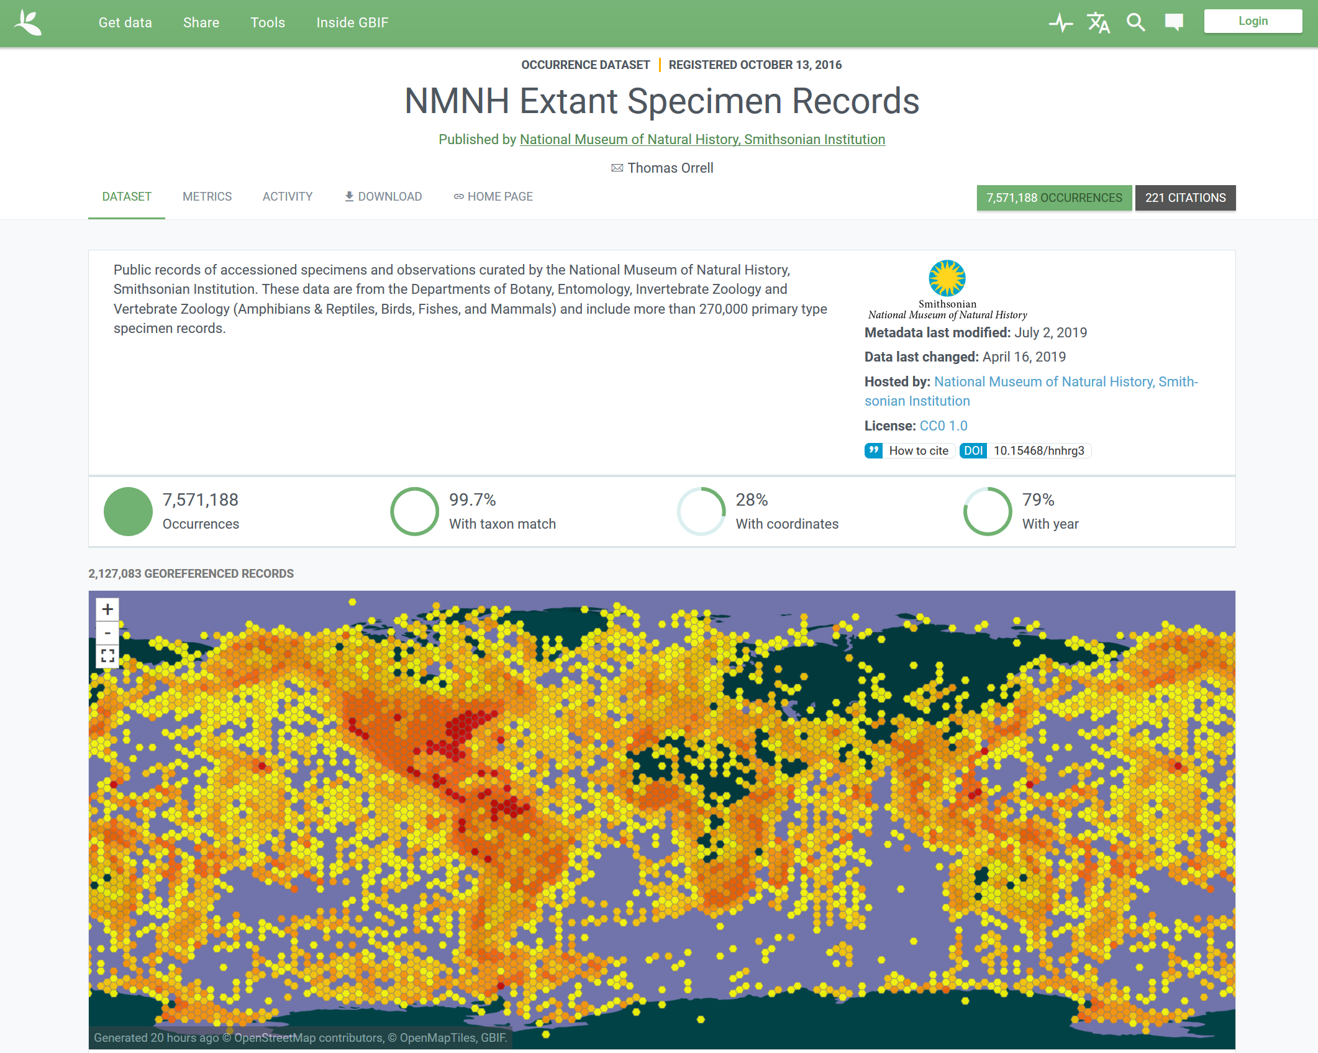
Global Biodiversity Information Facility
NMNH Extant Specimen Records: https://www.gbif.org/dataset/821cc27a-e3bb-4bc5-ac34-89ada245069d
NMNH Paleobiology Specimen Records: https://www.gbif.org/dataset/c8681cc2-9d0a-4c5f-b620-5c753abfe2bc
Notes:
Aggregators like GBIF, pictured here, pool data from a large number sources and then make it available through their website and an API, so that researchers can combine data from multiple places, and they increasingly allow institutions to see where and how that data is being used.
This is as good a use for basic specimen data as you'll ever find, and while there are analogues to these kind of aggregators for geoscience collections--GeoCASe is one--it would be hard to argue that there's the same demand for basic specimen information in the rock-mineral-meteorite world.

Slide 36
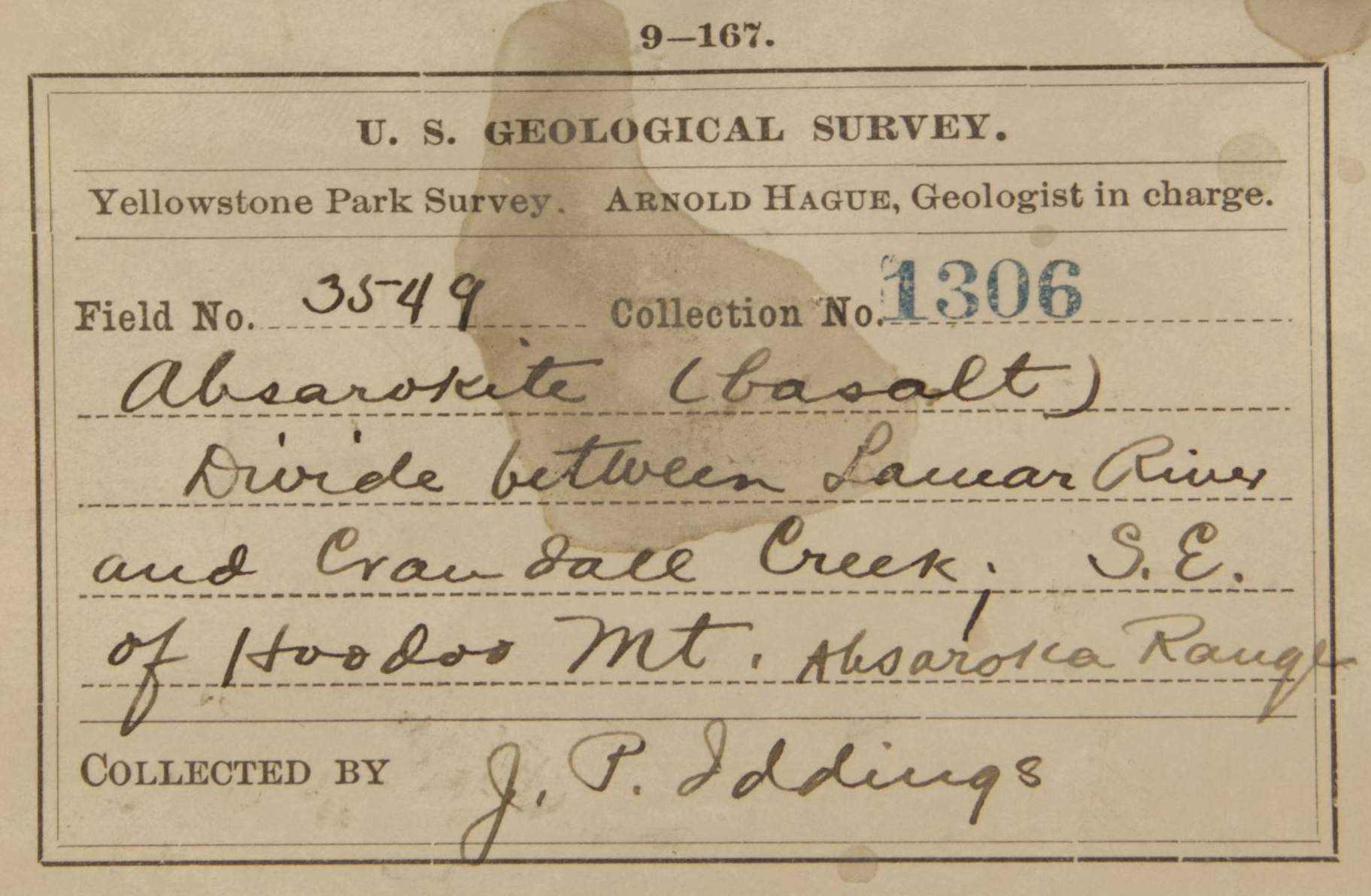
Limits of historical specimen data
Photo by Greg Polley, NMNH
Notes:
Consider this specimen label. This is a sample picked out of the National Rock Collection, not entirely at random but representative. It was collected during the original survey of Yellowstone National Park by the USGS in the late 19th century, and the information on this label is more or less typical of what you'd expect for a historical specimen.

Slide 37
Limits of historical collection data
Sample identifiers
Rock or
mineral name
Collection locality ± unit name
Photo by Greg Polley, NMNH
Notes:
You have some kind of specimen number, a classification, a collection locality as a string that you might be able to estimate within a few kilometers. You might know the unit name, you might know the collector, you might not. And that's really the best we can do even if the catalog process goes perfectly, if there are no misreadings, omissions, or misunderstandings on the part of the cataloger. The collection is 150 years old, it's been compiled from the work of hundreds of different people, and as a result the quality and extent of specimen data varies enormously.
Is this enough for a modern researcher? It depends, but often enough the answer is likely to be no. The research value of many geological specimens--this is especially true of rocks--requires a precise understanding of context that the older parts of the collection often do not provide.
But there are ways to mitigate this, the best one being to strengthen connections between the collection and the scientific literature. The specimen from this label, for example, has both been analyzed and is cited frequently in the originally USGS monograph about Yellowstone. That’s useful information to have. This goes back to one of the reasons why we bother with collections in the first place: They allow researchers to build on previous work.

Slide 38
Value of citation histories
“Citation histories enhance credibility and importance to well-organized, often-used data and collections.”
∾
Geoscience Data and Collections: National Resources in Peril (National Academies Press, 2002)
Notes:
This is a quick quote from what is still probably the best publication on the value of geoscience collections to borrow some credibility on that point.
It’s all well and good to say that we’d like to make these connections—how might we go about actually doing it?

Slide 39
International Geo Sample Number
Notes:
So this is where the IGSN can really be helpful. IGSN stands for International Geo Sample Number. It is a persistent sample identifier resolvable at the igsn.org domain. Mineral Sciences obtained IGSNs for the National Rock and Mineral Collections in 2015 using the System for Earth Sample Registration, or SESAR, which provides webservices for both registering samples and updating sample data, as well as a catalog search that can be used to find samples that have been registered using their application. Because the Mineral Sciences collection data is already managed in a central database and the developers working on SESAR are very helpful, the sample registration was straightforward, and now the rock and mineral collections are now duly IGSNed.

Slide 40
International Geo Sample Number
Unambiguously identifies a specimen
Allows publications and databases to link directly to specimens, e.g., igsn.org/NHB000001
Notes:
IGSNs offer several advantages over normal sample identifiers, among them: [summarize slide]

Slide 41
International Geo Sample Number
Unambiguously identifies a specimen
Allows publications and databases to link directly to specimens, e.g., igsn.org/NHB000001
Bonus features
Registering through SESAR adds samples to the SESAR Catalog Search
Simplifies adding new samples to the collection
Notes:
There are also some side benefits largely for a large collection: [summarize second half of slide]
The IGSN itself has been recommended by the American Geophysical Union, and linking samples has been implemented in at least some journals by publishers like Elsevier and Copernicus. As far as I know, no NMNH specimen has yet been linked via its IGSN, but researchers have requested lists of IGSNs for samples they've borrowed, so I expect that to happen sooner rather than later, and going forward, use of the IGSN can give us a much better idea of how and where NMNH specimens are being used, both before and after specimens are added to the collection.

Slide 42
Return of the humble rock
Notes:
So essentially we’ve taken our samples…

Slide 43
The humble rock identified
NHB005DWO
Smithsonian Institution
Notes:
And marked them up a bit…

Slide 44
The humble rock interconnected
NHB005DWO
Smithsonian Institution
Notes:
And as a consequence they will now be easier to identify when they are cited in the future.

Slide 45
Current Mineral Sciences activity
Mineral Sciences
Collection Database
Publications
Global Volcanism Program
http://volcano.si.edu/
IGSN
EZID
NMNH Collection Search
https://collections.nmnh.si.edu/search/ms/
EarthChem
http://www.earthchem.org/
TDWG standards
Smithsonian programs
Darwin Core
Publications & data
IGSN
EFG
Smithsonian Collections Search Center
http://collections.si.edu
Meteoritical Bulletin Database
https://www.lpi.usra.edu/meteor/metbull.php
SESAR Catalog Search
http://www.geosamples.org/catalogsearch
GeoCASe
http://geocase.eu/
internal
external
Geoscience specimen catalogs
Notes:
Or in other words, implementation of the IGSN offers a way to activate a couple of more of the connections in the geoscience data world…

Slide 46
Future Mineral Sciences activity enabled by the IGSN
Mineral Sciences
Collection Database
Publications
Global Volcanism Program
http://volcano.si.edu/
IGSN
IGSN
EZID
NMNH Collection Search
https://collections.nmnh.si.edu/search/ms/
EarthChem
http://www.earthchem.org/
IGSN
TDWG standards
Smithsonian programs
Darwin Core
Publications & data
IGSN
EFG
Smithsonian Collections Search Center
http://collections.si.edu
Meteoritical Bulletin Database
https://www.lpi.usra.edu/meteor/metbull.php
SESAR Catalog Search
http://www.geosamples.org/catalogsearch
GeoCASe
http://geocase.eu/
internal
external
Geoscience specimen catalogs
Notes:
Without only a bit of work on our end now that the initial registrations are complete.
That’s great! And with the IGSN2040 project underway, it really looks like the IGSN will have a chance to fulfill its promise.
But I’d hate to end on too optimistic a note, so I have to wonder: what about the older body of literature? This is still largely a pre-IGSN world, and even if all the researchers and all the journals covering physical samples adopted persistent ids tomorrow, there would still be a large body of existing literature that predates them. This is a significant issue for an old collection!

Slide 47
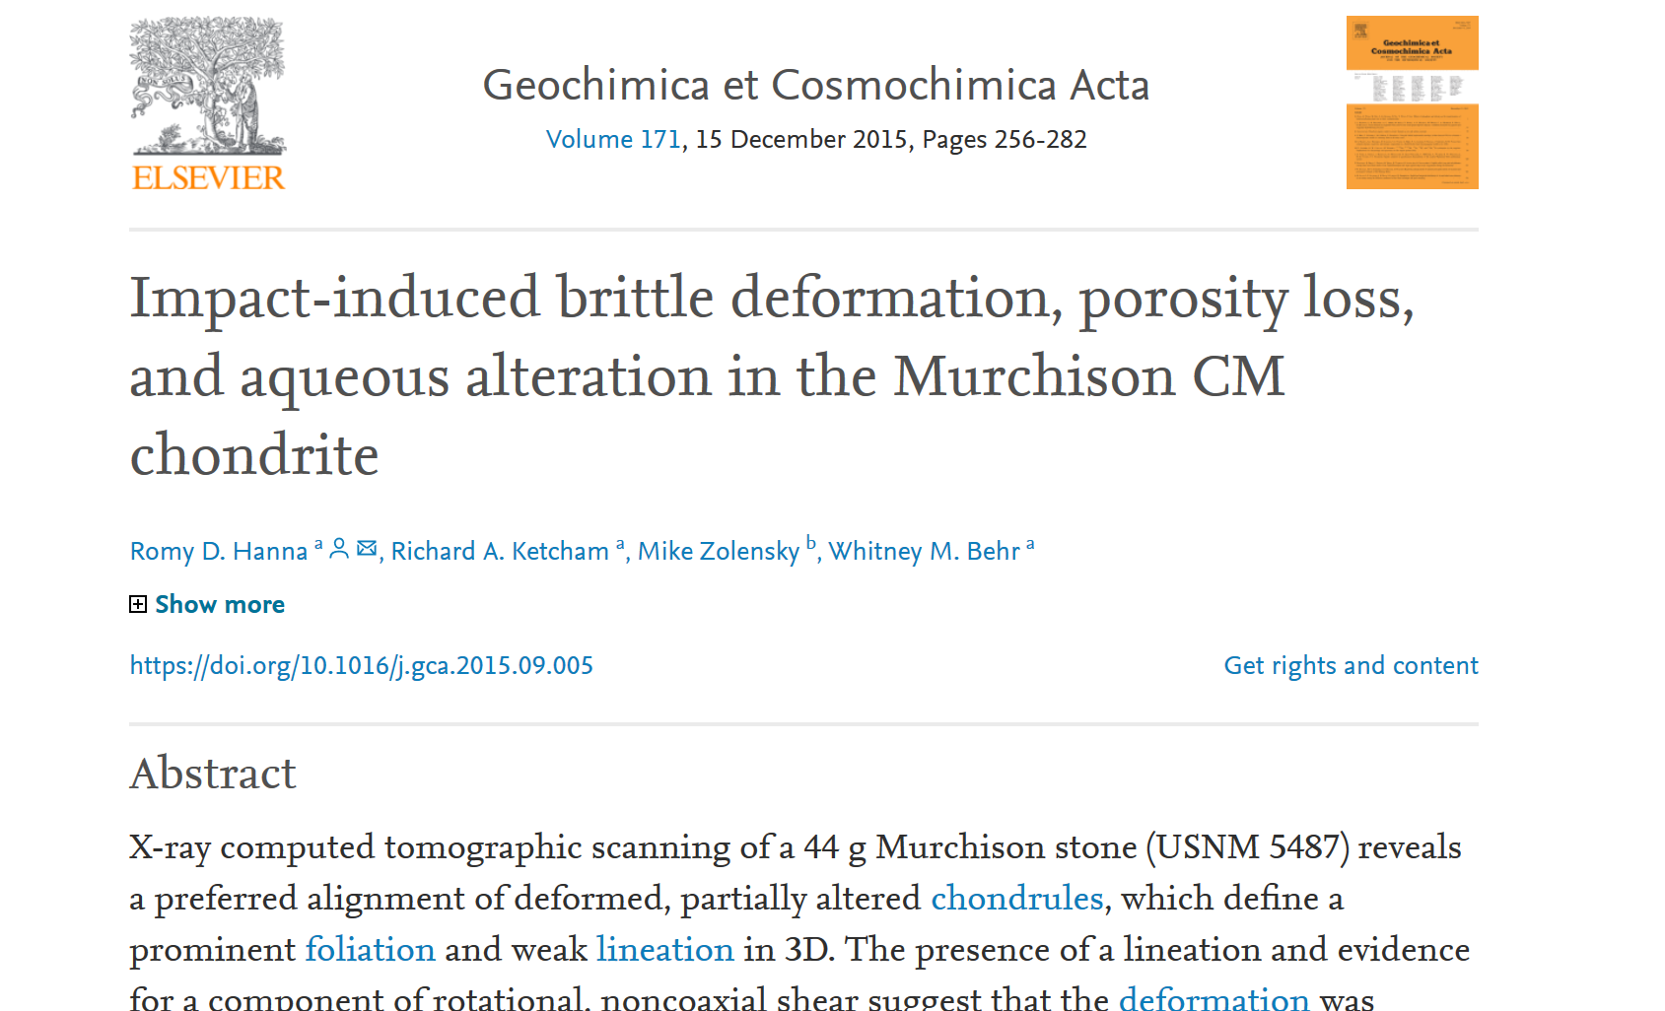
Specimen citations in the pre-IGSN world
Notes:
This paper, for example, links to a meteorite in the meteorite collection…

Slide 48
Specimen citations in the pre-IGSN world
Notes:
…but only by catalog number.

Slide 49
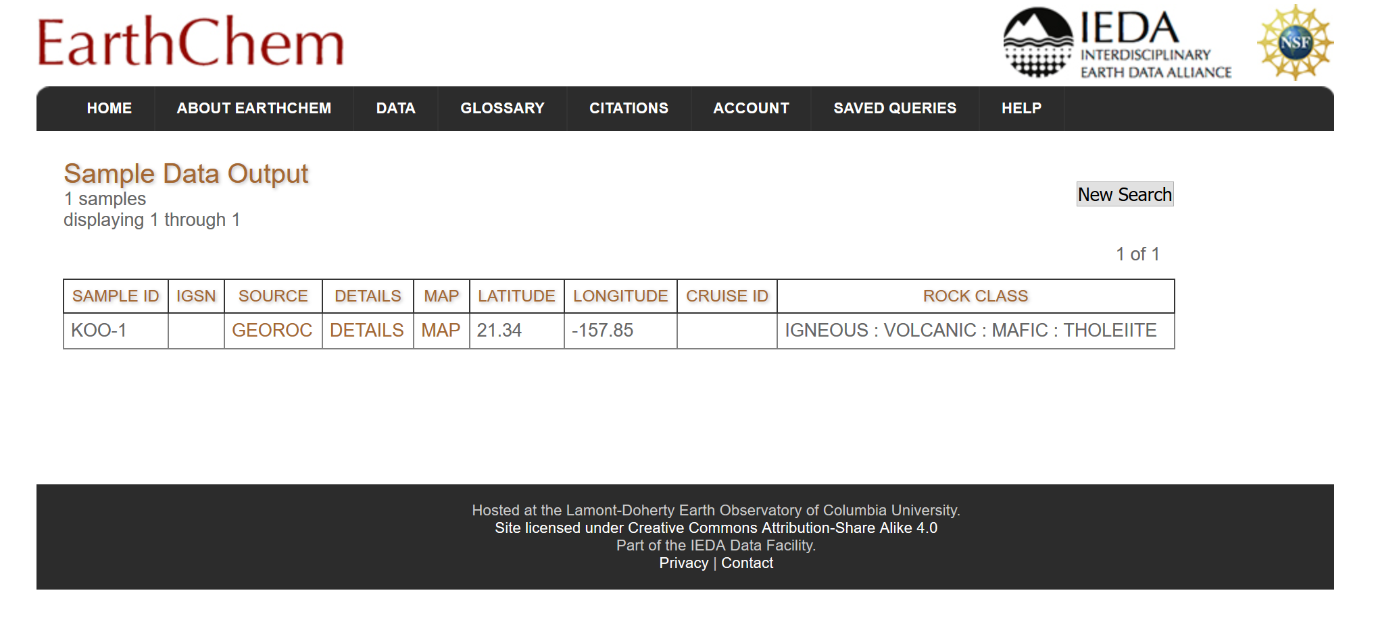
Specimen citations in pre-IGSN data
Notes:
Analyses added to EarthChem have the same issue. The Smithsonian now owns the sample depicted here, but EarthChem has no way of knowing that. I only found this sample because I was looking for an example where a specimen was assigned an IGSN after analyses were published. This is a huge problem. Field numbers are much more diverse and less distinctive than NMNH’s own catalog numbers, making them harder to find and match automatically. Basically, all of the things that make the IGSN necessary make it difficult to apply retroactively.

Slide 50
Return of basic catalog number mining
GeoDeepDive
https://geodeepdive.org/
Biodiversity Heritage Library
https://www.biodiversitylibrary.org/
10 million documents
Mine but not view documents
Geoscience focus
150,000 documents
View and mine documents
Biology focus
Includes Smithsonian publications
GitHub: https://github.com/adamancer/speciminer
Notes:
Difficult but not impossible. We can use the same sort of text mining I discussed earlier on when describing the publication history of the collection to get some handle on this. NMNH catalog numbers are a good place to start for the same reasons I mentioned earlier: They are easy to recognize, and they are part of a database that can provide context that can be used to verify citations. The script that I used to generate the data about publications uses this context to ensure that the catalog numbers it finds correspond to actual specimens.

Slide 51
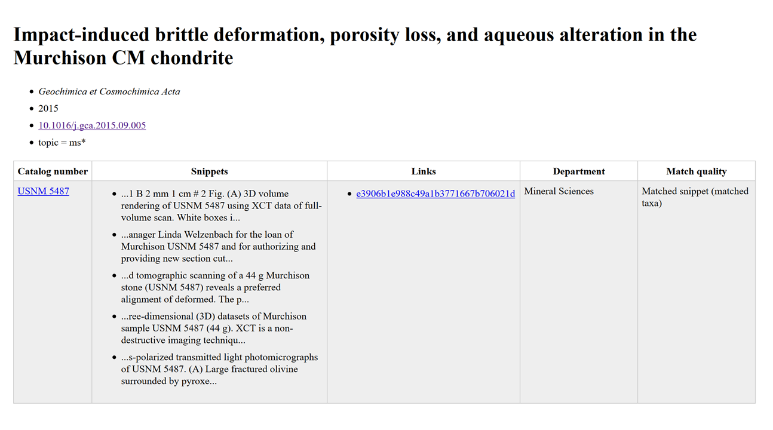
Catalog number mining results
Notes:
Which means that the publication dataset can also be used to track how samples have been used since they were added to the collection. Here is a screenshot from that dataset showing citations of a sample of the Murchison meteorite in the paper I showed a few slides ago, including brief snippets of exactly where it was mentioned in the text. The snippets are short, which limits their usefulness in many cases, but they sometimes contain information missing from the catalog record. At a minimum, we should be able to compile a record of associated publications for many specimens. Not comprehensive, and not for every specimen, but we can make some headway. I’m optimistic that this approach can be extended to field numbers as well, although the complexity of formatting and the similarity of field numbers from different sources make that a thornier problem.

Slide 52
Summary
Developed a baseline for collections use based on internal transaction data and data about NMNH specimens mined from the literature
Strategies used by NMNH to share its biocollections data could be useful to apply to the Mineral Sciences collections
Implementation of the IGSN will improve tracking and visibility of the collection going forward
Filling in complete citation histories for the collection is impossible, but partial histories can be compiled using services like GeoDeepDive
Notes:
[summarize slide]

Slide 53
Acknowledgments
Anna Weitzman (NMNH) for compiling old transaction data
Ian Ross (GeoDeepDive) for helping run the specimen mining script
Adam Mansur
Department of Mineral Sciences
National Museum of Natural History
0000-0002-7512-4206
mansura@si.edu
Notes:
Questions?

