Slide 1
Advanced Geospatial Cyberinfrastructure for Deep Learning
Moderator: Annie Burgess
Speakers: Ziheng Sun, Eugene Yu
ESIP Summer Meeting
Tacoma, MA
7/18/2019

Slide 2
Geoweaver for Better Deep Learning A review of cyberinfrastructure
Ziheng Sun¹, Liping Di¹, Annie Burgess²
1 George Mason University
2 ESIP

Slide 3
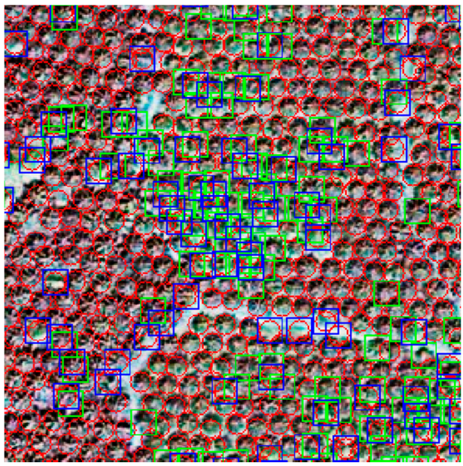
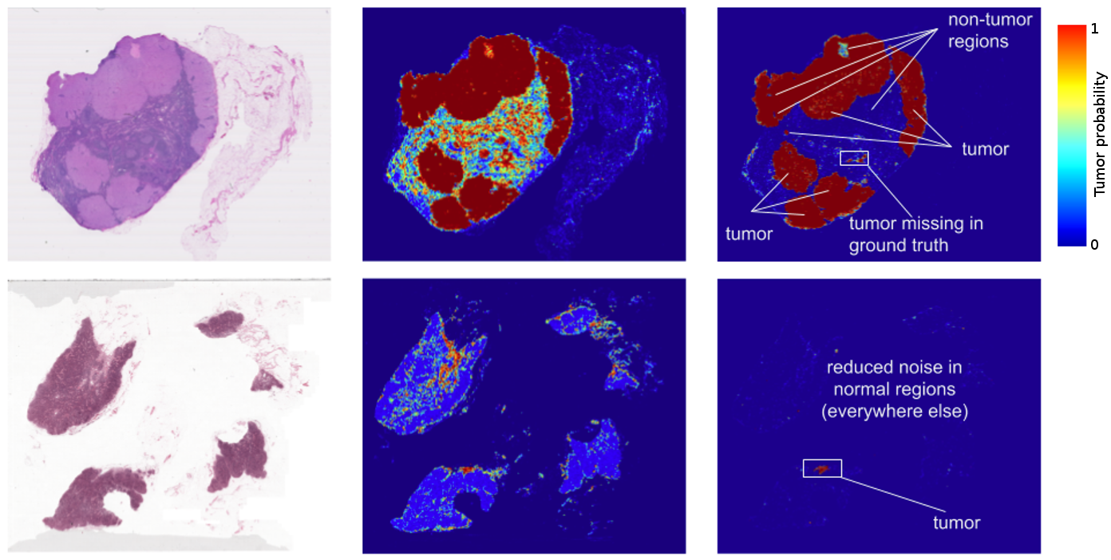
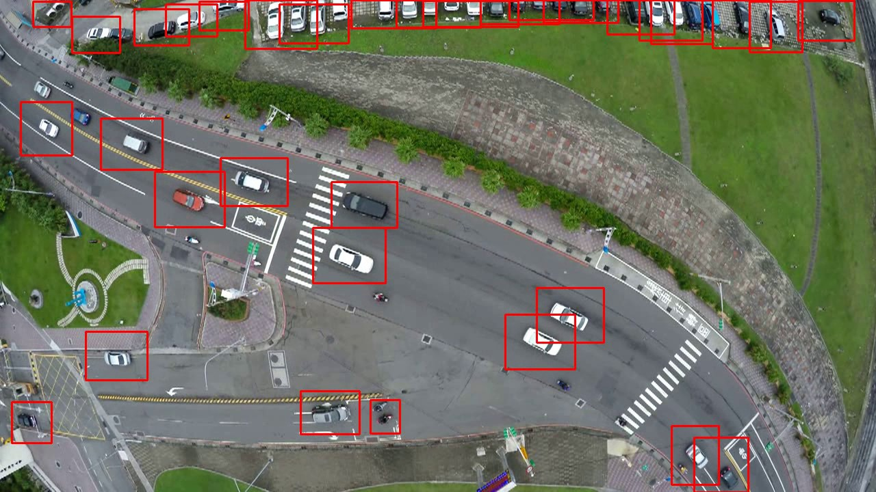
Next Step: AI
Deep learning is a powerful universal solution
Oil Palm Tree Detection
Car Detection
Notes:
Images come from:
Deep Learning Based Oil Palm Tree Detection and Counting for High-Resolution Remote Sensing Images
https://2.bp.blogspot.com/-gSIgoqSR1sY/WLjHshWv0eI/AAAAAAAABnY/jEMd9ybBnawy3yVuc5loR9-Zl01zM_RtQCLcB/s1600/image01.png
Deep Learning Approach for Car Detection in UAV Imagery

Slide 4
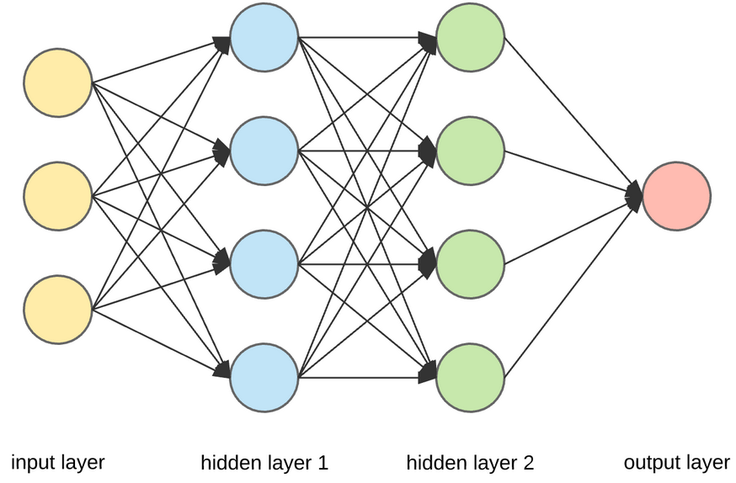
Deep Learning Models for Geoscience
Feedforward – image analysis
Recurrent – time series analysis
More are coming..
SegNet, U-Net, DeepLab, VGG, LinkNet, FCN, …
LSTM, GRU, etc
Notes:
Image source: https://miro.medium.com/max/1400/1*Gh5PS4R_A5drl5ebd_gNrg@2x.png

Slide 5
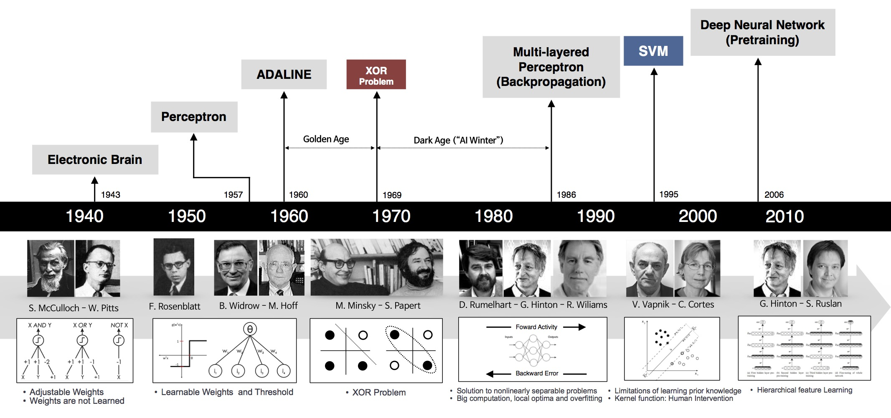
What’s new? Cyberinfrastructure
More computational power
Most disk storage
More open source libraries and tools
Image source: https://arisahpc.com/wp-content/uploads/2018/09/nn_timeline.jpg
Notes:
Image source: https://arisahpc.com/wp-content/uploads/2018/09/nn_timeline.jpg

Slide 6
It is not easy..
Deep learning is full of uncertainties.
Many processes are repeated hundreds of times to get good results.
Scientists are tired of managing code, files, servers, history, etc.
Pre-Processing
> 60% time
Collect Datasets
Create Training Dataset
Train Deep Neural Network
Generate Predictions
Convert to Products
Create/Read Neural Network
Test Trained Model
Post-Processing
Most scientists just reuse the existing neural networks!

Slide 7
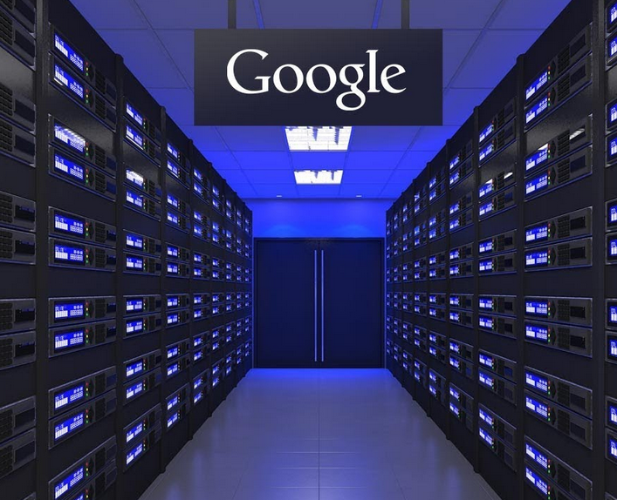
How people do it now?
Professional
DIY
Notes:
Image source: https://i.ytimg.com/vi/j_kVZ6t8yuo/maxresdefault.jpg

Slide 8
CI for Geoscientific Deep Learning
Google Earth Engine & Colab
AWS & Amazon SageMaker
Apache Spark-ML
Pangeo? – pre-/post- processing

Slide 9
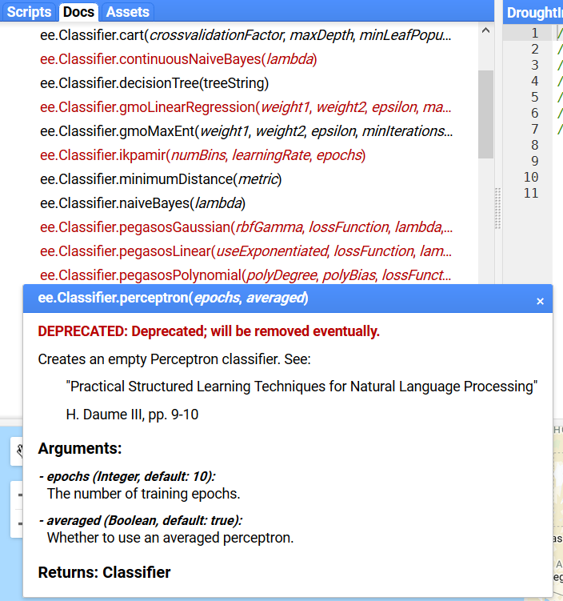
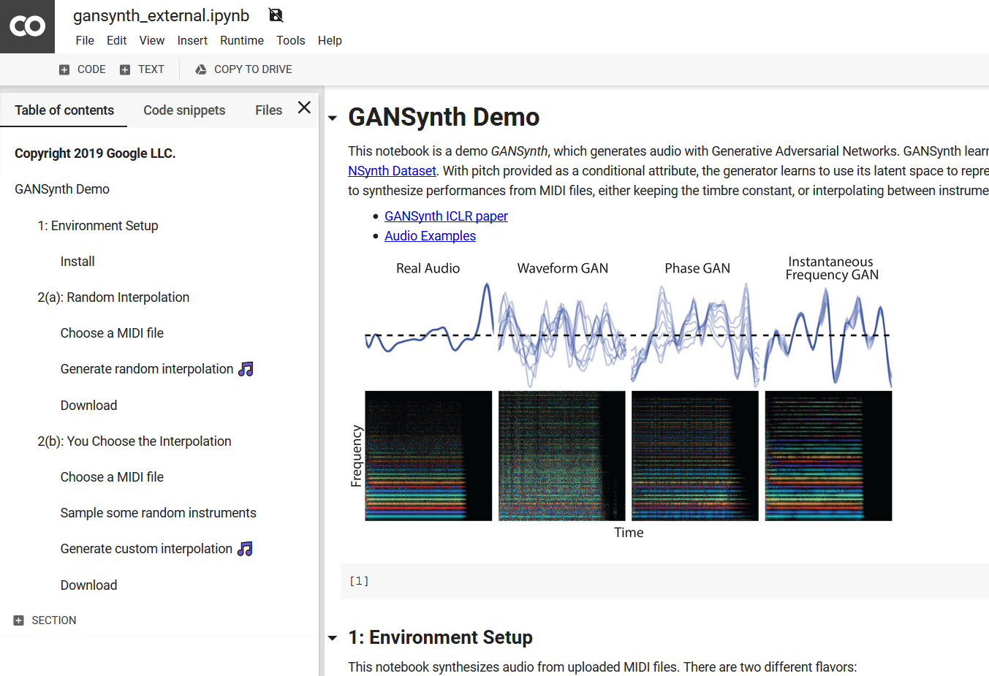
Google Earth Engine & Colab

Slide 10
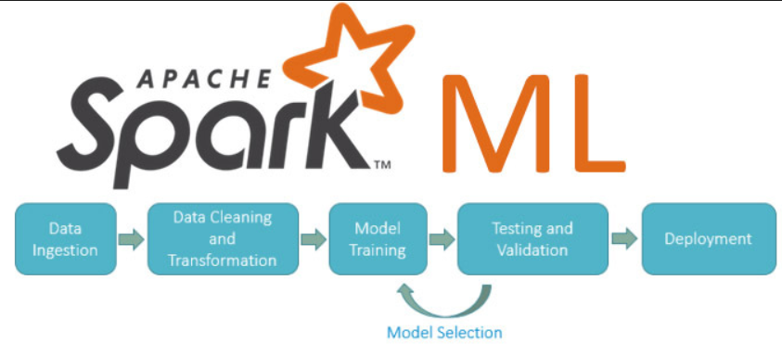
Apache Spark-ML
Spark-ML aims to provide a uniform set of high-level APIs that help users create and tune practical machine learning pipelines.
It is currently an alpha component.

Slide 11
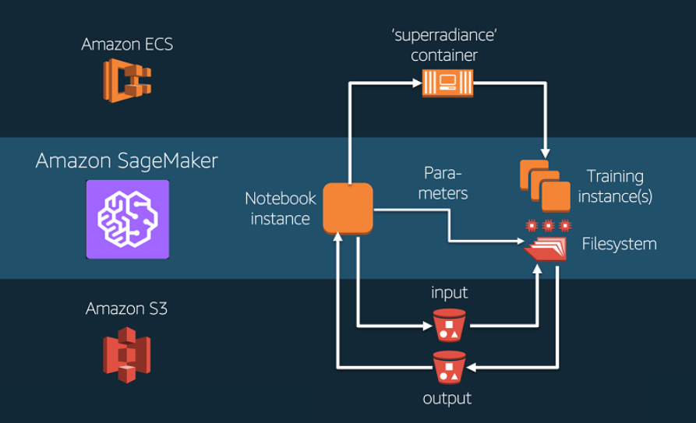
Amazon SageMaker
Fixed workflow
Built-in algorithms

Slide 12
Pangeo? Probably
We need more discussion and efforts

Slide 13
Overall..
Most deep learning practitioners depend on hybrid platforms.
They use everything to get job done.
Lesson: With poor management, you will still get nothing even after numerous hours of training attempts.
Deep learning is a monster who takes your time as his food!
Notes:
Image source: https://images-na.ssl-images-amazon.com/images/I/413mNs0IefL._SX425_.jpg

Slide 14
Our Proposed Solution..

Slide 15
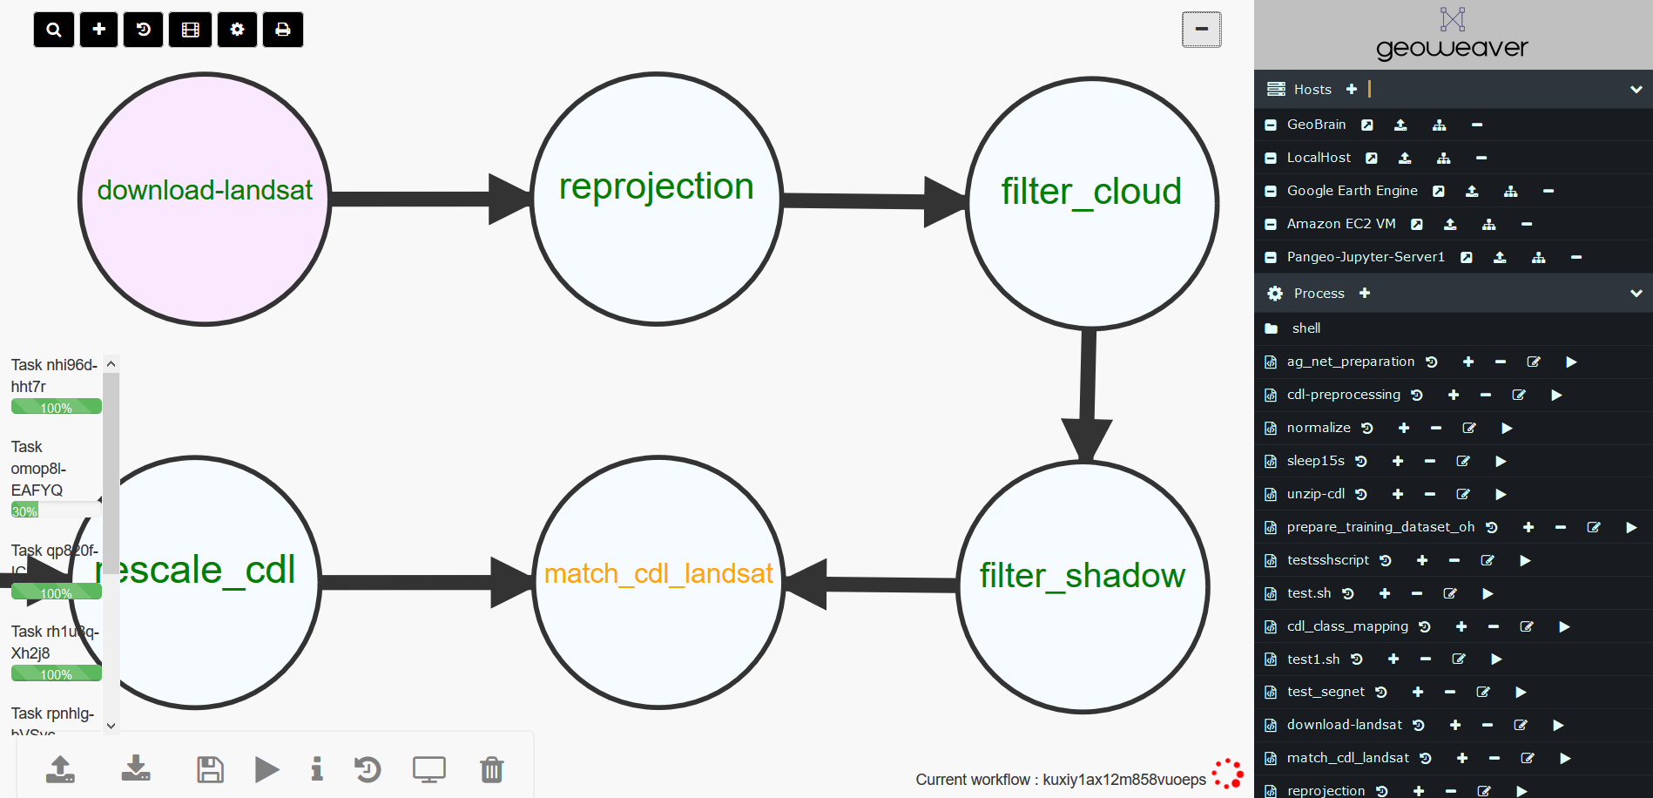
Navigation Toolbar
Log Window
User Added Hosts
Status Indicator
User Created Process
Workflow Toolbar

Slide 16
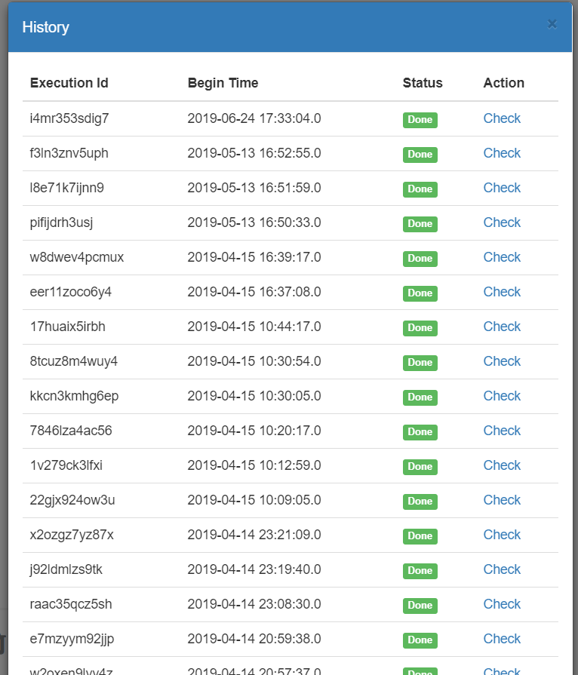
Geoweaver can:
Avoid reckless attempts
Effortlessly managing multiple servers
Upload/download files directly
Record code and logs of every execution of any script
(Science replicability has no excuse!!!)

Slide 17
Working Topic
How will deep learning boost “data to action”?
What unsolved science problems can deep learning solve?
What is missing in data facilities to support deep learning researches?
What should cyberinfrastructure and Geoweaver improve to attract more Earth scientists?

Slide 18
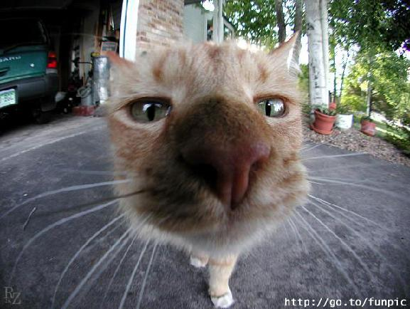
Thank you so much!!!
Enjoy your day!

