Slide 1
New examples of encoding satellite geolocation information
Edward Armstrong¹, Sasha Ignatov², Matt Pennybaker², and Wen-Hao Li¹
1. Jet Propulsion Laboratory, California Institute of Technology
2. NOAA STAR.
California Institute of Technology. Government sponsorship acknowledged.
© 2019. All rights reserved.

Slide 2
Implementations of novel geolocation encoding for Level 1and 2 satellite data
Implementation #1
Encoding geolocation for the geostationary GOES-16 (aka “GOES R”) platform
GOES ABI (sensor) for atmospheric and oceanographic observation
New technique leveraging CF projection information for the NOAA GHRSST L2P SST dataset
https://podaac.jpl.nasa.gov/dataset/ABI_G16-STAR-L2P-v2.70
Implementation #2
Encoding geolocation for polar orbiting NPP VIIRS sensor
Multispectral VIIRS used for all manner of earth atmosphere, land and ocean observation. MODIS follow-on.
Eumetsat has developed pixel level interpolation technique to retrieve subsampled L1 geolocation points

Slide 3
Leveraging CF for geostationary SST datasets
The Group for High Resolution SST (GHRSST) has a specific data model for encoding Level 2 geolocation latitude and longitude
Every pixel is assigned its unique lat/lon
lat/lon information stored as floats; “heaviest” variables in the granule suite
See the GDS reference documentation
https://podaac-tools.jpl.nasa.gov/drive/files/allData/ghrsst/docs/GDS20r5.pdf
The geostationary view of the observation “disk”, essentially a unprojected grid, lends itself to encoding using a map projection which is possible using the “grid_mapping” CF metadata attribute referencing
grid_mapping_name = "geostationary" ;
How does this look like and perform? …….

Slide 4
Existing L2P GHRSST encoding
Example NetCDF CDL from previous version of the GOES-16 dataset
dimensions:
ni = 5424 ;
nj = 5424 ;
time = 1 ;
float lat(nj, ni) ;
lat:standard_name = "latitude" ;
lat:units = "degrees_north" ;
lat:valid_max = 90.f ;
lat:valid_min = -90.f ;
float lon(nj, ni) ;
lon:standard_name = "longitude" ;
lon:units = "degrees_east" ;
lon:valid_max = 180.f ;
lon:valid_min = -180.f ;
short sea_surface_temperature(time, nj, ni) ;
sea_surface_temperature:add_offset = 273.15f ;
sea_surface_temperature:coordinates = "lon lat" ;
sea_surface_temperature:scale_factor = 0.01f ;
sea_surface_temperature:standard_name = "sea surface sub-skin temperature" ;
sea_surface_temperature:units = "kelvin" ;

Slide 5
New L2P GHRSST encoding
Example NetCDF CDL from new version of the GOES-16 dataset
dimensions:
time = 1 ;
nj = 5424 ;
ni = 5424 ;
float nj(nj) ;
nj:axis = "Y" ;
nj:units = "radians" ;
nj:standard_name = "projection_y_coordinate" ;
float ni(ni) ;
ni:axis = "X" ;
ni:units = "radians" ;
ni:standard_name = "projection_x_coordinate" ;
short sea_surface_temperature(time, nj, ni) ;
sea_surface_temperature:add_offset = 273.15f ;
sea_surface_temperature:coordinates = "nj ni" ;
sea_surface_temperature:scale_factor = 0.01f ;
sea_surface_temperature:standard_name = "sea surface sub-skin temperature" ;
sea_surface_temperature:units = "kelvin" ;
sea_surface_temperature:grid_mapping = "geostationary" ;

Slide 6
CF projection information
NetCDF CDL from new version of the GOES-16 dataset
int geostationary ;
geostationary:grid_mapping_name = "geostationary" ;
geostationary:semi_major_axis = 6378137. ;
geostationary:semi_minor_axis = 6356752.314245 ;
geostationary:inverse_flattening = 298.257223563 ;
geostationary:latitude_of_projection_origin = 0. ;
geostationary:longitude_of_projection_origin = -75. ;
geostationary:false_easting = 0. ;
geostationary:false_northing = 0. ;
geostationary:horizontal_datum_name = "WGS_1984" ;
geostationary:reference_ellipsoid_name = "WGS 84" ;
geostationary:prime_meridian_name = "Greenwich" ;
geostationary:geographic_crs_name = "WGS 84" ;
geostationary:sweep_angle_axis = "x" ;
geostationary:perspective_point_height =

Slide 7
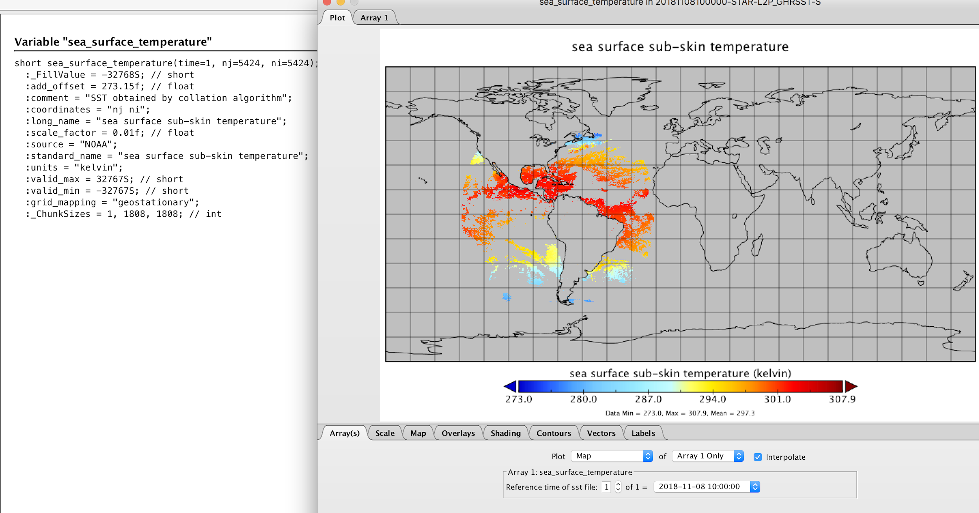
Plotting with Panoply

Slide 8
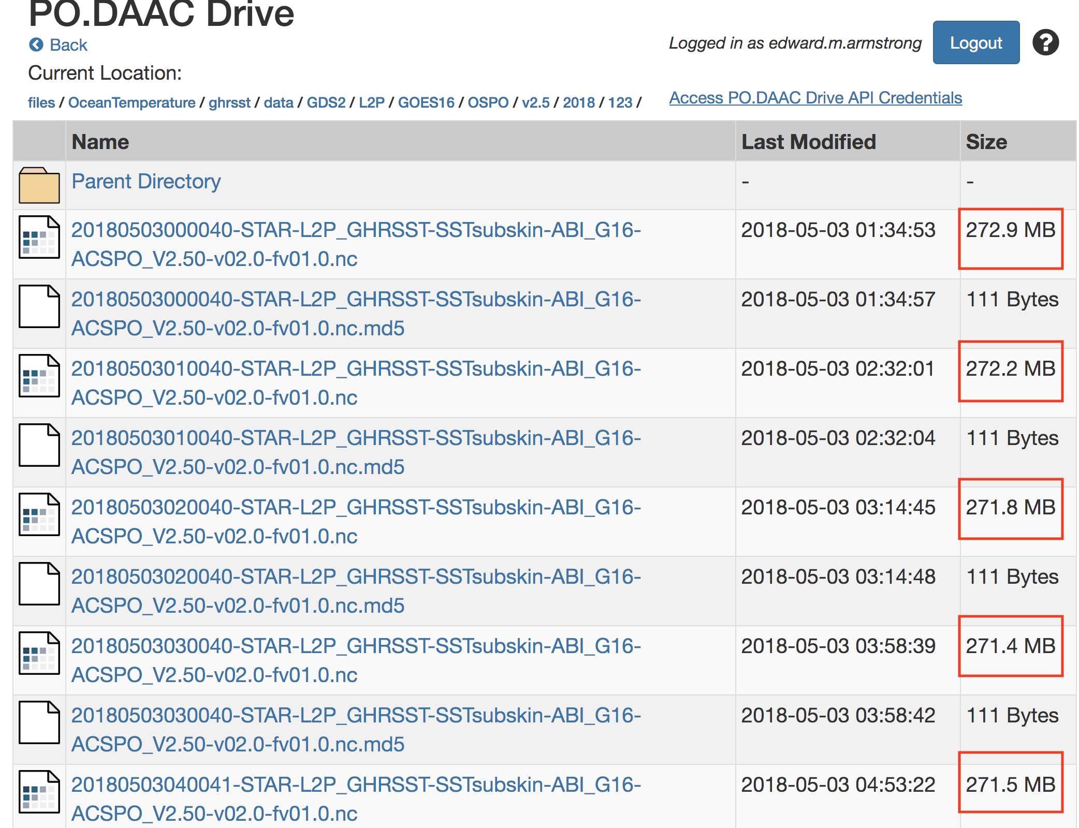
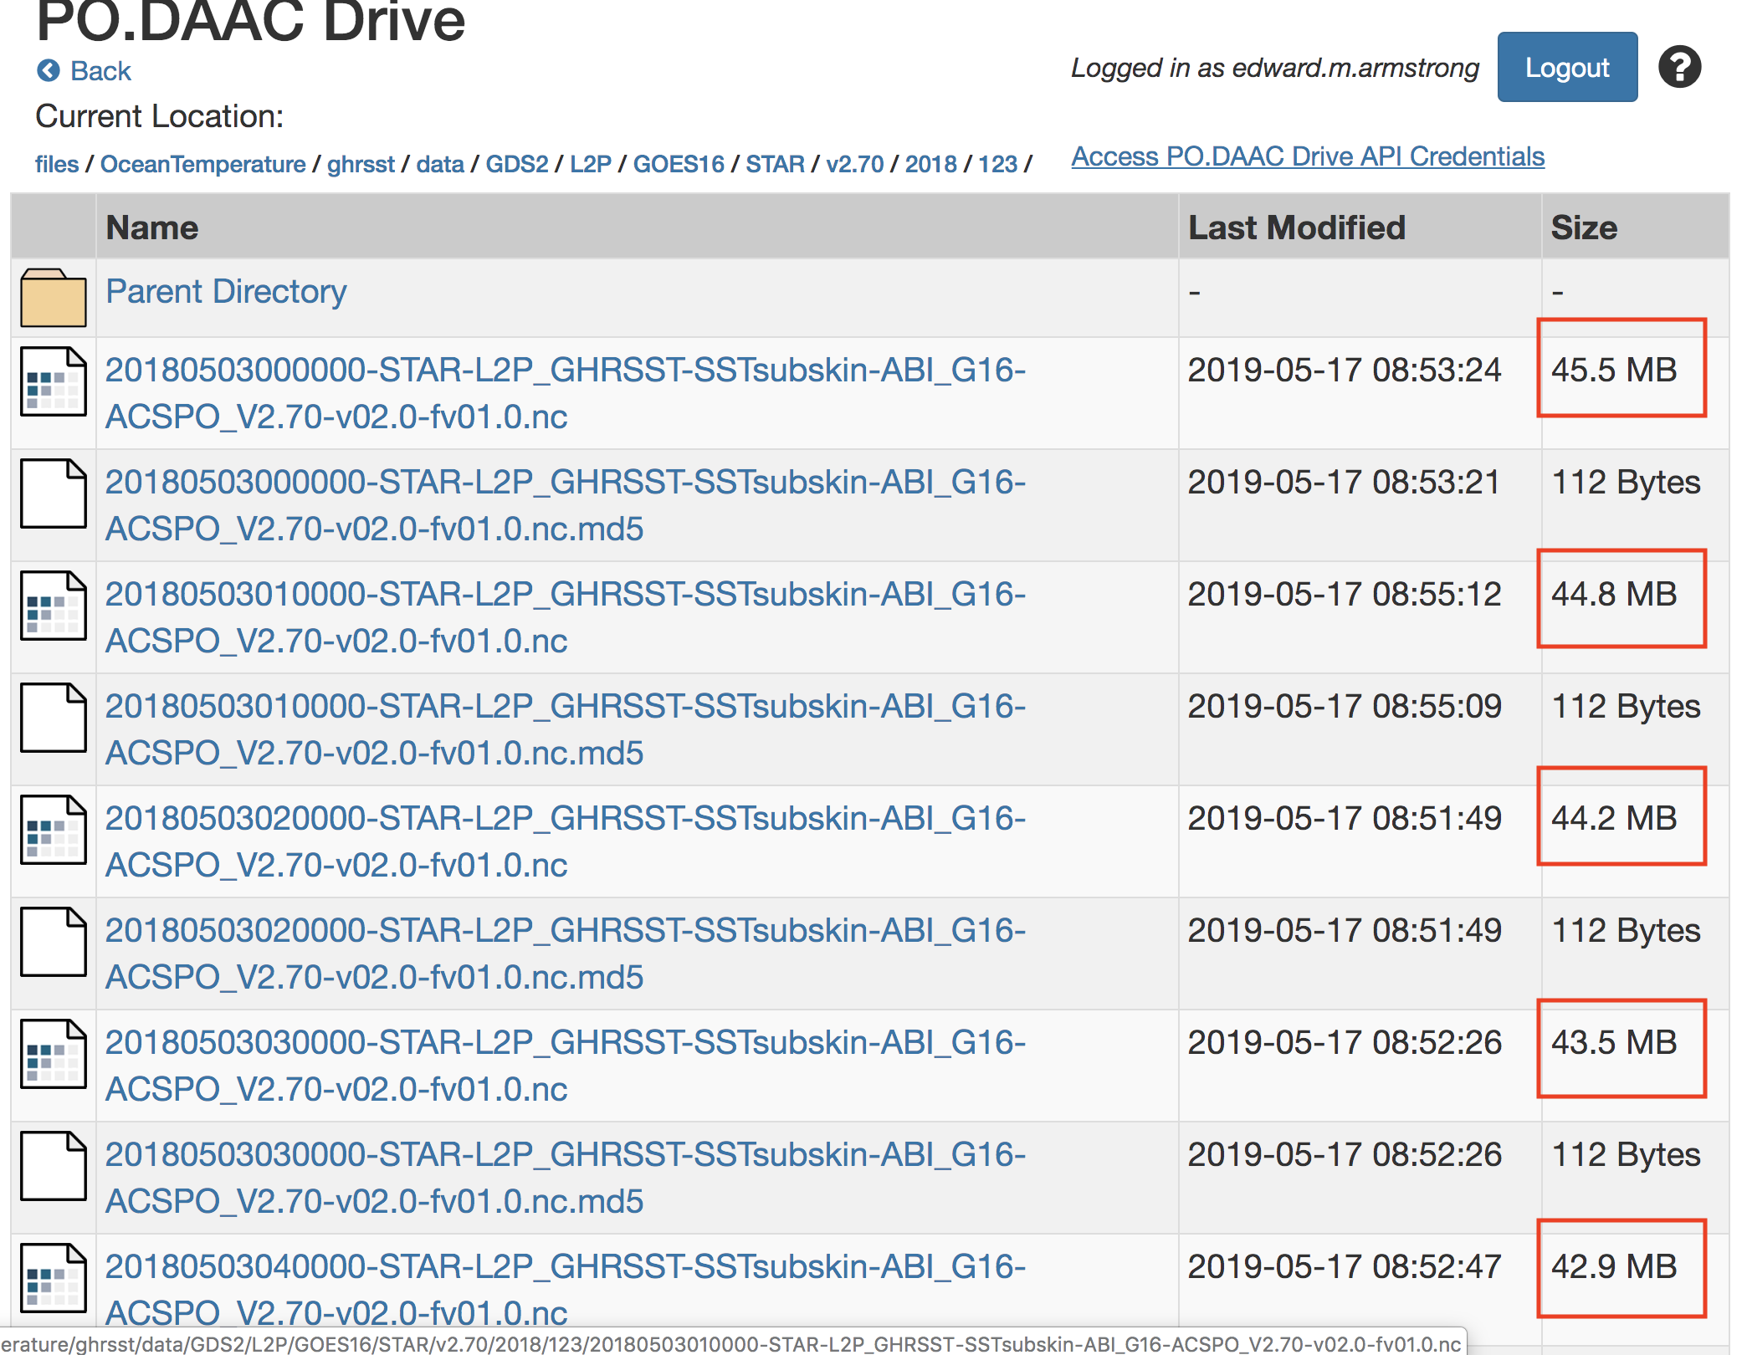
Granule data reduction → greater than 80% !!
Average: 272 MB → 44 MB

Slide 9
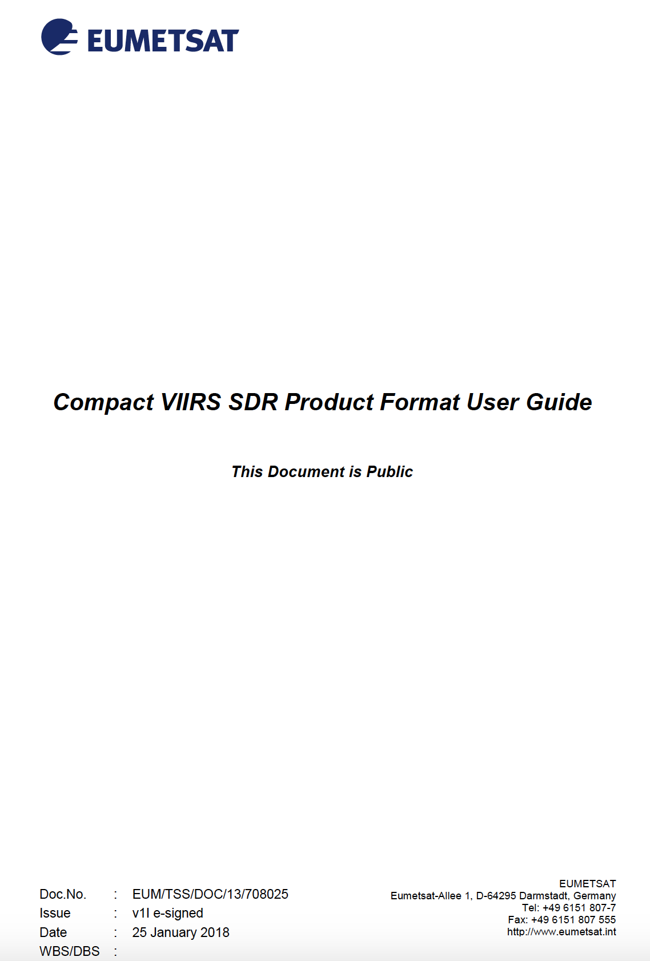
Eumetsat L2 VIIRS compact data model

Slide 10
VIIRS Compact data model
1 INTRODUCTION
1.1 Purpose
During the implementation of the EUMETSAT provided VIIRS Regional Service (EARS-VIIRS) a need was identified to develop a Compact VIIRS SDR Product Format (Level 1) to achieve a cost efficient distribution of the VIIRS data via EUMETCast, EUMETSAT’s satellite based data distribution system.
This document specifies the Compact VIIRS SDR Product Format and how it relates to the Original VIIRS SDR Product Format developed as part of the Suomi-NPP and JPSS Programmes. It provides guidelines on how to construct the Compact product format from the Original product format and on how to reconstruct the Original product format from the Compact product format.

Slide 11
VIIRS Compact data model
In the Compact VIIRS SDR format, geolocation data is stored only for the corner points, i.e. the Tie-Points, of each Tie-Point Zone. Interpolation functions are defined for re-constructing the geolocation data for all pixels within the Tie-Point Zone.

Slide 12
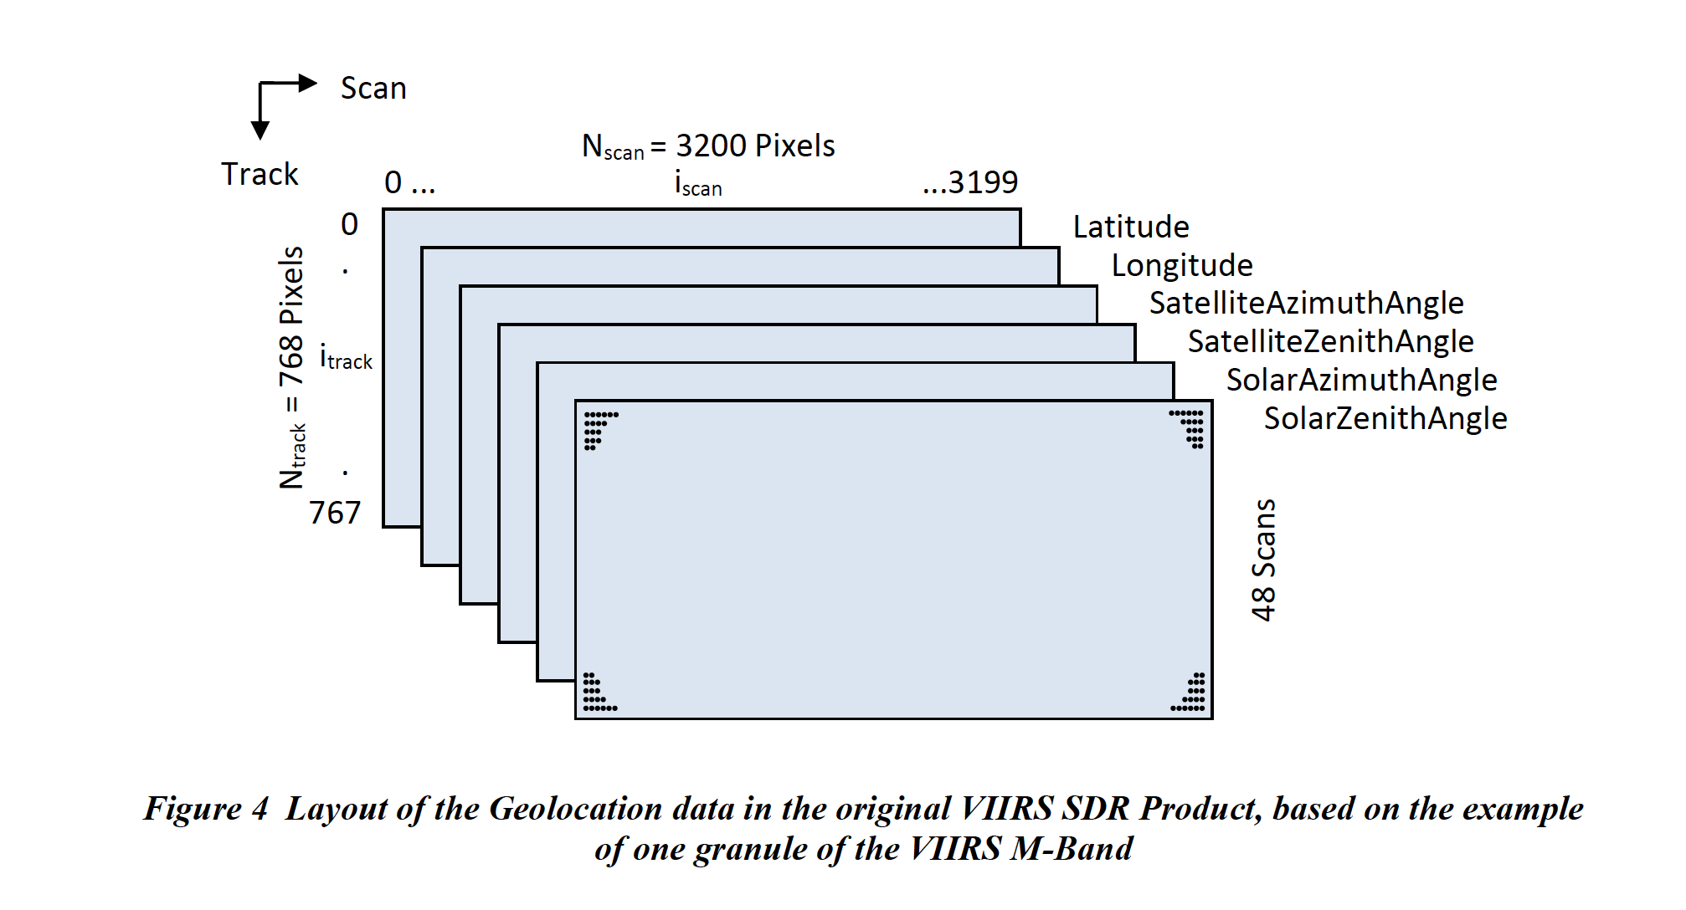
Original layout

Slide 13
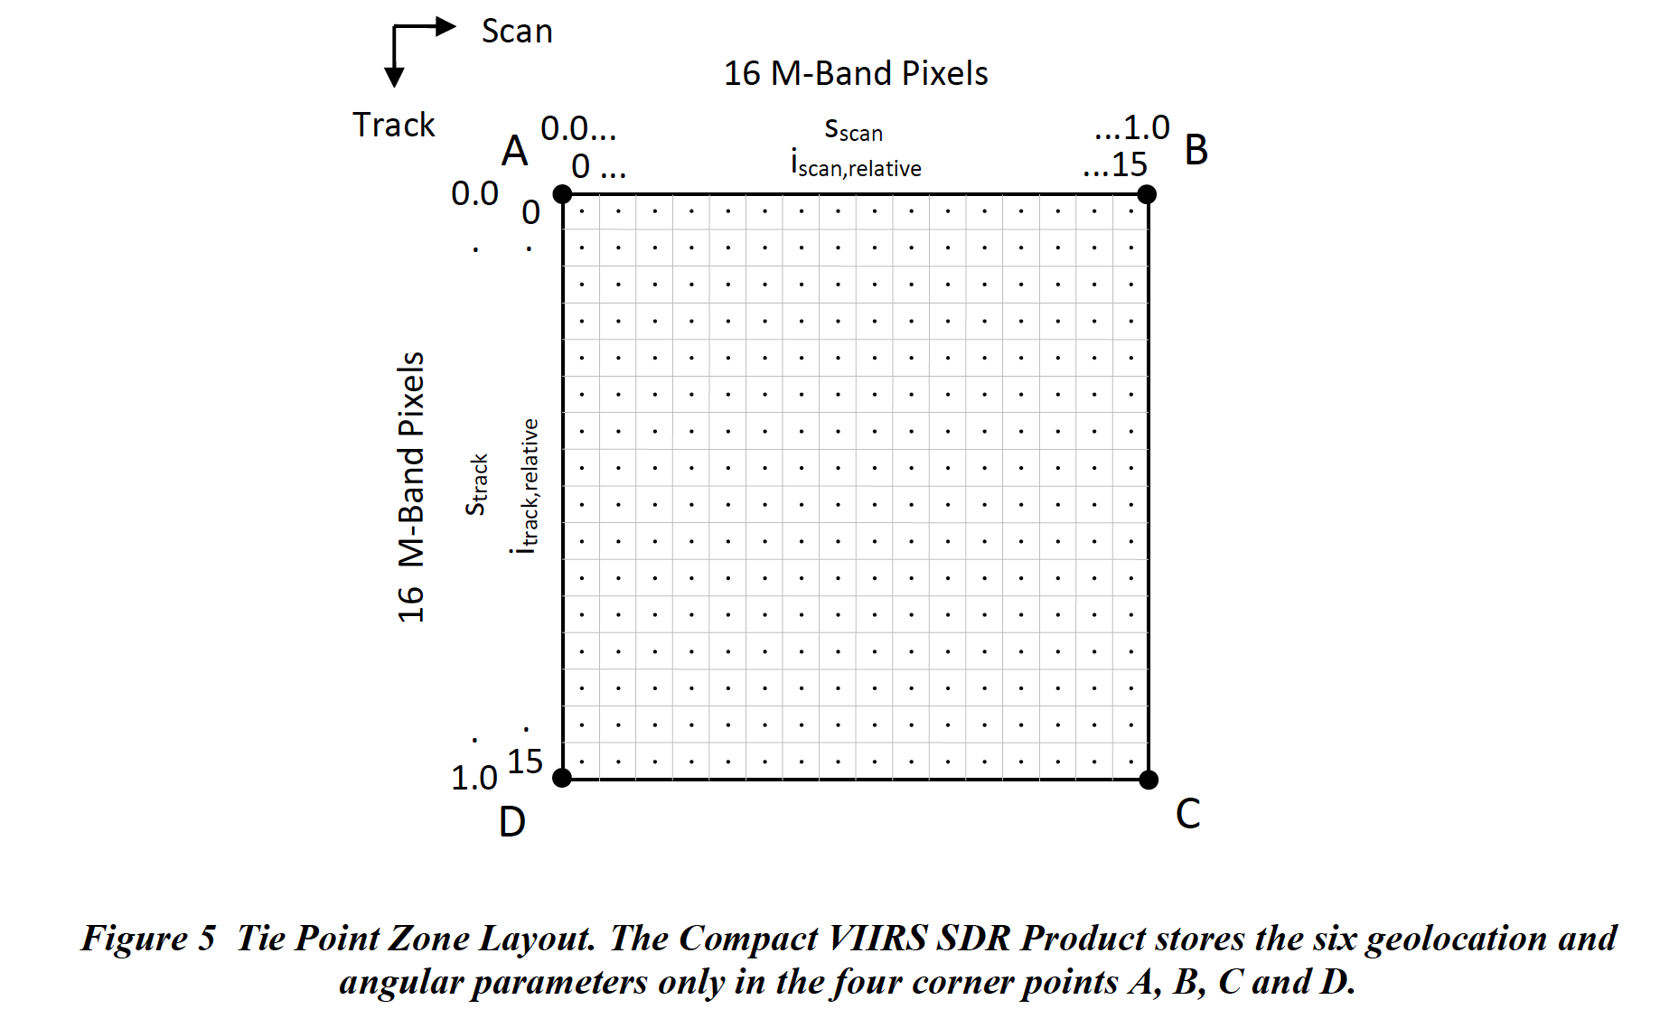
Tie point example

Slide 14
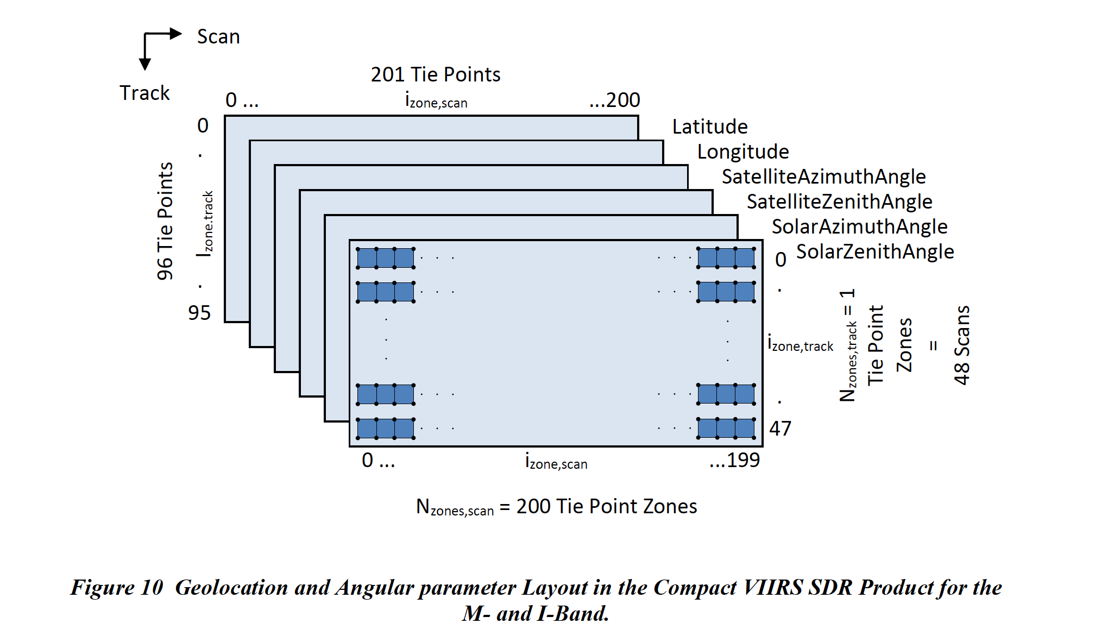
The Tie Point grid

Slide 15
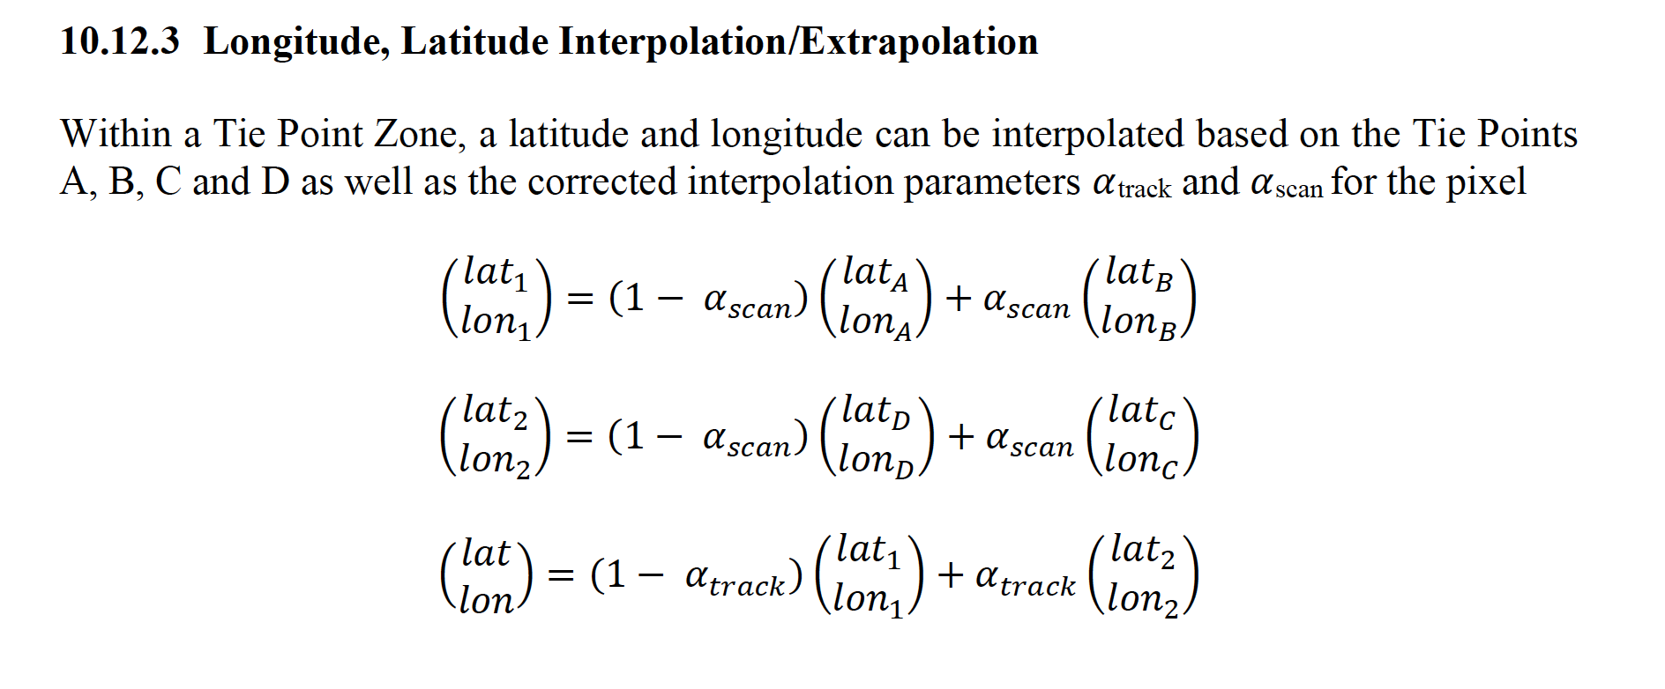
Reconstruction of Original Longitude and Latitude
Each Tie Point set, with lon/lat for corners A,B,C,D and alpha representing satellite zenith angle

Slide 16
Summary
CF provides an elegant roadmap for encoded geolocation geostationary L1 and L2 observations by leveraging projection information similar to an L3 grid
80% data reduction
But coordinates in original radians format
Eumetsat has developed a data model to decimate original obs keeping a subset of tie points and then interpolate back the geolocation information for L1 polar orbiting satellites
Substantial size reduction. Probably an order of magnitude
But interpolation needed to retrieve original geolocation values
Have any software developers tackled this ?
What else is on the horizon ?
Disclaimer: Reference herein to any specific commercial product, process, or service by trade name, trademark, manufacturer, or otherwise, does not constitute or imply its endorsement by the United States Government or the Jet Propulsion Laboratory, California Institute of Technology.

