Slide 1

The Energy Infrastructure of the Future
A multi-disciplinary collaborative project across the campus of the University of Texas at Austin
Dr. Fred Beach,
University of Texas at Austin
18 July, 2019 ESIP, Tacoma, WA

Slide 2




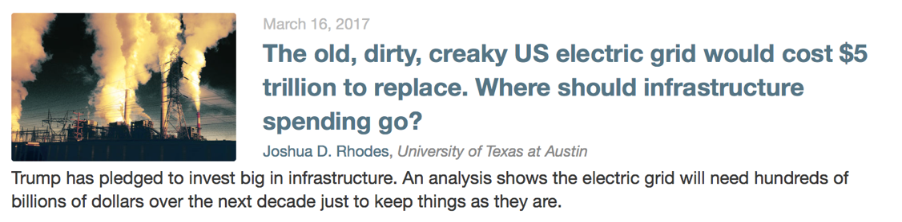
Energy infrastructure is in the news

Slide 3
This project will develop an extensive understanding of energy infrastructure requirements and opportunities
The Problem
Despite imminent changes, society is underprepared to respond to $Trillions in changing energy infrastructure needs
Major investments are being made without clear understanding of future market needs
Significant policy decisions are being made without anticipation of the impacts on affordability, resiliency, and the environment
The Solution/Goal
  Develop an extensive understanding of existing infrastructure, and the technical requirements and financial opportunities of future energy scenarios
  to inform stakeholders, public debate and policy process with quantitative, transparent, comprehensive and objective analysis
Stakeholders
Upstream, Midstream, Downstream
Manufacturers
Utilities
Financial Institutions
Energy Consumers
Policymakers

Slide 4
The United States is facing significant changes
Energy Transitions Driving Change
1) Decarbonization
  Nuclear vs Natural gas vs Coal
  Renewables with low operating costs
  Centralized vs Distributed generation
  Energy storage
2) Electrification
  Electrification of things
  Internal combustion vs Electric Vehicles
3) Information Technology & Automation
  Demand response & Automated loads
  Digitization
  Automated vehicles
4) Energy Market Structures
  Electricity: Restructuring & Modularity
  O&G: Abundant Resources
Energy Infrastructure includes all infrastructure associated with extracting and processing of traditional primary fuels (e.g., oil, gas, coal, uranium), primary-to-energy carrier conversions (e.g., wind turbines, power plants), transmission and distribution of energy (e.g., pipelines, electric grid), and end-use devices (e.g., electric vehicles).
Trillions of dollars will be spent on energy infrastructure within the next 30 years*.
*Based on initial estimates from the Energy Institute of UT Austin

Slide 5
This project has three objectives
Develop an extensive understanding of existing domestic energy infrastructure
  Policy history & Inventory and valuation of infrastructure, including: Asset type, Purpose, Ownership, & Vintage/Depreciated state
Develop methods to model how different energy transitions might impact infrastructure requirements
Assessment Criteria
Create decision support tools that assist policy formulation, investors and planning based on a 2050 horizon
Energy Sources
Investment Requirements
Economics for Customers, Operators, and Public Coffers (both Affordability & Profitability)
Access
Resilience
Environmental Stewardship
Domestic Energy Resources

Slide 6
We’ve begun cataloging the value of our energy infrastructure
Replacement: $5 trillion
Depreciated: $2 trillion
The Electricity Sector Value*:
56%
9%
35%
The electricity sector alone with require $Trillions in investment within 30 years*.
*Based on initial estimates from the Energy Institute of UT Austin

Slide 7
Our current electricity infrastructure has a replacement value of about $5T
© Joshua D. Rhodes, UT Austin
Avg. Age
Capacity

Slide 8
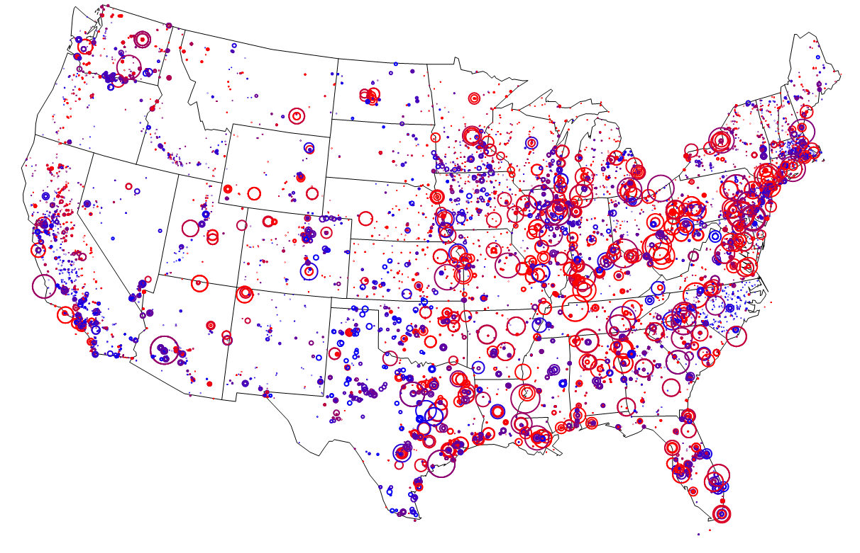
The majority of power plants are in the east and they are also the oldest; new power plants tend to be smaller
Larger Plant
Smaller Plant
More Depreciated
© Joshua D. Rhodes, UT Austin
Less Depreciated

Slide 9

Our current natural gas infrastructure has a replacement value of about $8T
© Joshua D. Rhodes, UT Austin
?

Slide 10
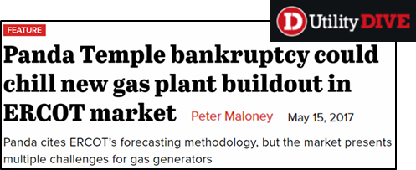
Significant investments will need to be made in the face of uncertainty
Critical Questions
How will decisions be made by companies, policy makers, and customers; and what are the best investment opportunities?
How can society balance our economic, environmental, and safety concerns to deliver the best energy system for our country?

Slide 11
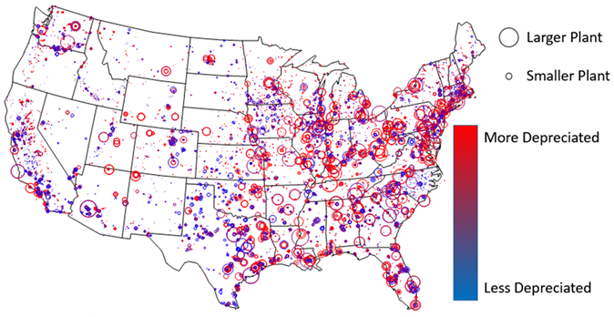
The project deliverables will help answer critical questions
Deliverables
Characterization of existing infrastructure
Analysis of how different energy transitions
(e.g. vehicle electrification) might impact
the adaptation needs of existing
stakeholders (e.g. O&G companies)
Analysis of economic constraints and impacts of future scenarios
  CAPEX vs OPEX
  Timeline of asset retirements / stranded assets
Description of how different energy transitions will impact the U.S. energy mix
Interactive tools to allow stakeholders to model future scenarios
  Interactive Sankey diagram
  Infrastructure “knowledge maps”

Slide 12
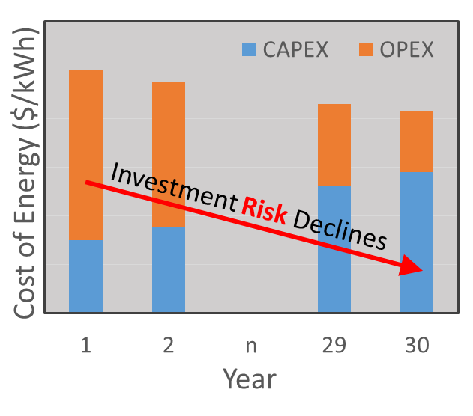
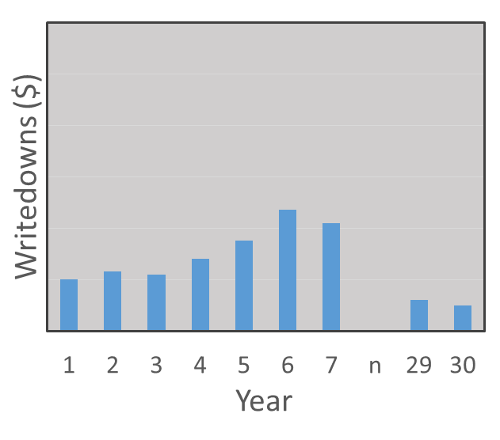
Example Results: The financial structure of energy assets will change – but how?
CAPEX could increase
OPEX could decrease
Assets might be retired before
the end of their expected life
What will the rate and magnitude of change be?
Notes:
Will the total cost change over the years?
Will yearly expenditures shift from OpEx for fuels to increased spending on CapEx?
Will remaining “firming fuel” be more expensive & offset savings?
Will existing assets be retired before the end of their useful life?

Slide 13
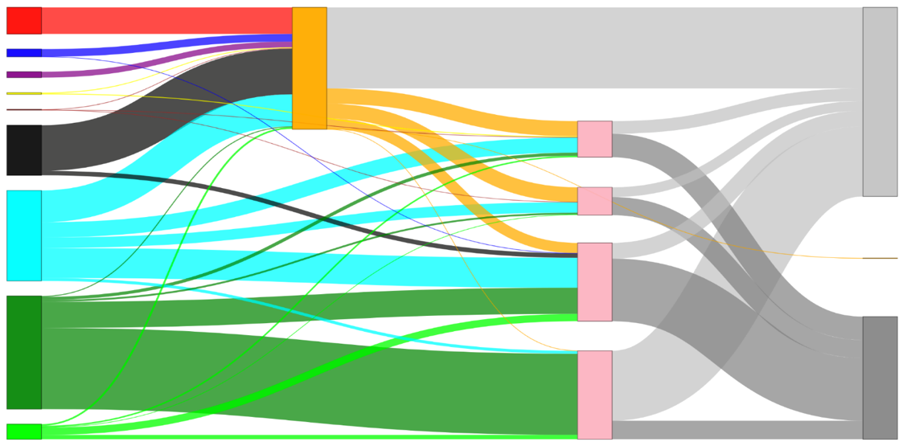
Develop Interactive Tools to Model Future Scenarios
An interactive Sankey diagram will provide an effective way to visualize the impact of future scenarios and energy transitions (e.g. how do changes in energy sources impact the delivery of energy services?)
Remake of Lawrence Livermore National Laboratory 2015 Sankey diagram
Nuclear
Electricity
Hydro
Wind
Electricity: 38 Quads
Rejected Energy
Solar
Geo
Residential
Coal
Commercial
Natural Gas
Natural Gas: 28 Quads
Industrial
Exports
Petroleum
Transport
Energy Services
Biomass

Slide 14

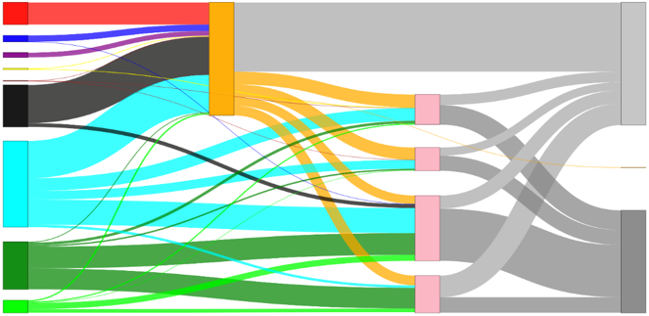
Electric Vehicle Case Study
Scenario 1: Baseline
Equivalent to LLNL 2015 Sankey diagram
Scenario 2: Increased Elec. Vehicles
All light-duty vehicles are replaced by EV’s, and increased electricity demand is met by NGCC plants
38
Electricity
59
47
Electricity
52
Rejected Energy
Rejected Energy
28 Quads
37
Natural Gas
Petroleum
Petroleum
17
Transportation
28
Transportation
More efficient transportation
12% lower rejected energy
https://dennis1du.shinyapps.io/Shiny_State/

Slide 15
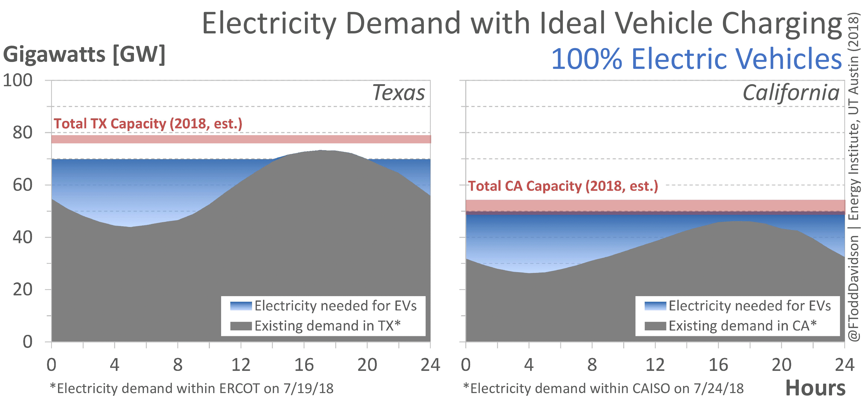
When and where we consume that energy will matter

Slide 16
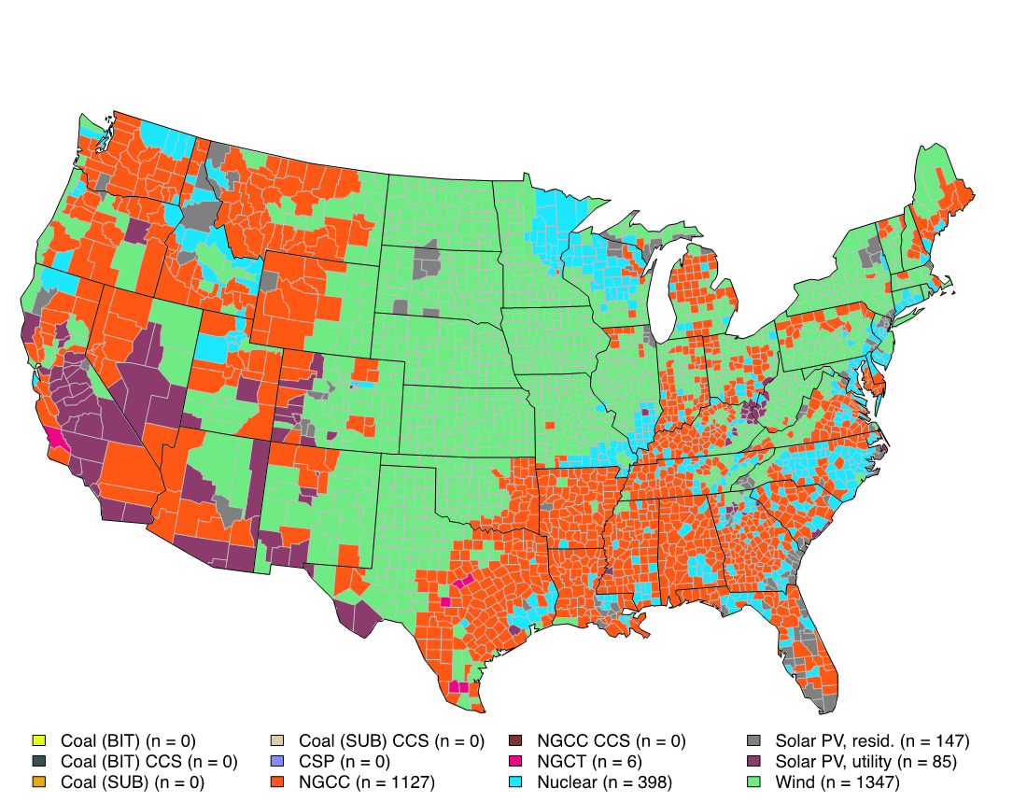

Develop interactive maps that provide localized knowledge for stakeholders
Previous Energy Institute Study: “Full Cost of Electricity”
Developed methods and tools to determine the least-cost electricity generation technology in every county of the US.
Tools Developed for FCe- Study:
http://calculators.energy.utexas.edu/
© Joshua D. Rhodes, UT Austin

Slide 17
Our interactive tool converts user’s future energy mix into economic and environmental indicators
Nuclear
Electricity
Hydro
Wind
Rejected Energy
Solar
Geo
Residential
Coal
Commercial
Natural Gas
Industrial
Exports
Petroleum
Transport
Energy Services
Biomass
Notes:
Demonstrate how we envision the interactive tool to work.
Intro: (10-20 seconds)

Slide 18
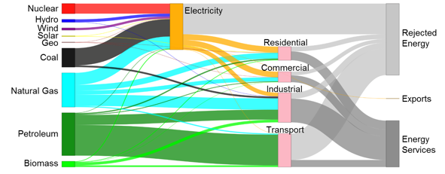
User chooses 2050 annual mix of energy and technologies
Notes:
Demonstrate how we envision the interactive tool to work.
User only chooses annual energy mix at a high level. (5-10 seconds)

Slide 19
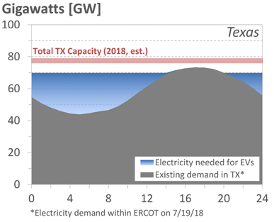
User chooses 2050 annual mix of energy and technologies
Hourly Energy Flows
Notes:
Demonstrate how we envision the interactive tool to work.
We have to go from annual energy to hourly demand and supply: (5-15 seconds)

Slide 20
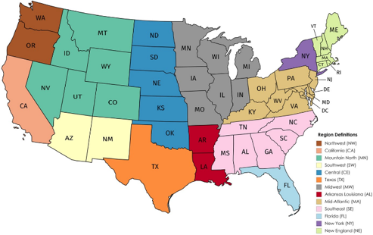
User chooses 2050 annual mix of energy and technologies
Hourly Energy Flows
Regional Energy & Infrastructure
Notes:
Demonstrate how we envision the interactive tool to work.
The annual energy to hourly demand and supply must be broken down geographically: (5-15 seconds)

Slide 21
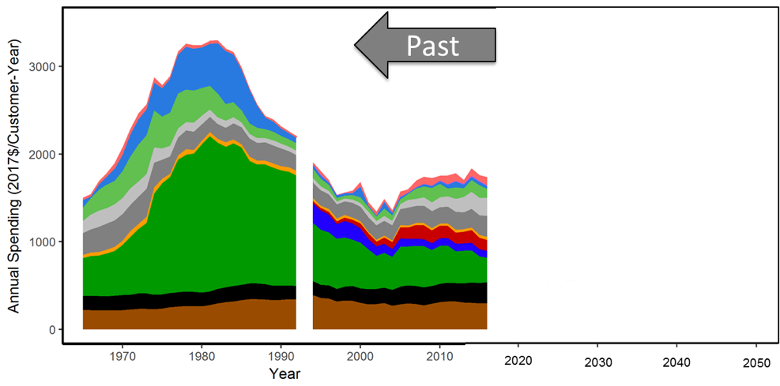
Users see cost implications of their choices
Hourly Energy Flows
Regional Energy & Infrastructure
Notes:
Demonstrate how we envision the interactive tool to work.
Each geographic region has an existing set of infrastructure that has evolved over time, and the future energy system evolves from this initial condition. This needs to be put into perspective for the user.
1. History: (5-10 seconds)

Slide 22
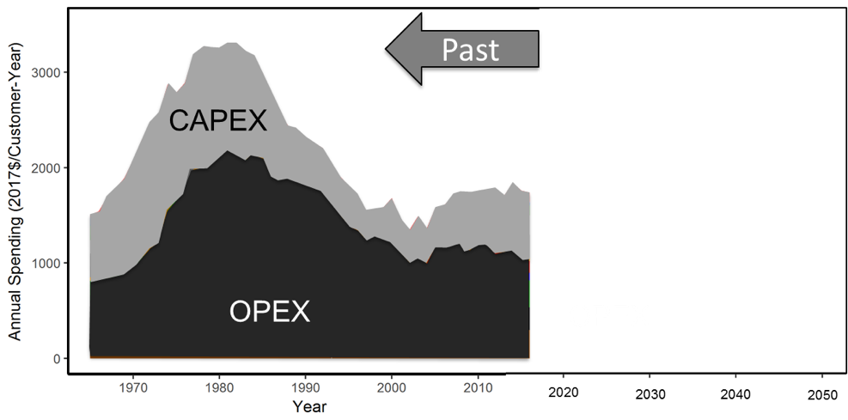
Users see cost implications of their choices
Hourly Energy Flows
Regional Energy & Infrastructure
Notes:
Demonstrate how we envision the interactive tool to work.
Each geographic region has an existing set of infrastructure that has evolved over time, and the future energy system evolves from this initial condition. This needs to be put into perspective for the user.
2. History in broad categories of capital and O&M: (5-10 seconds)

Slide 23
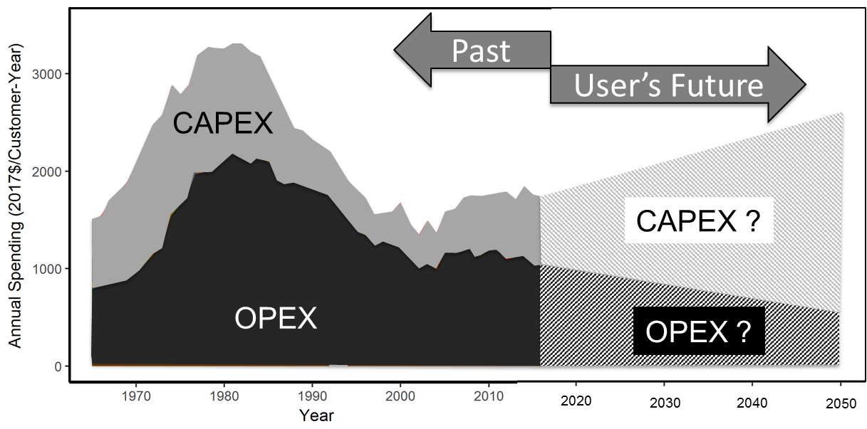
Users see cost implications of their choices
Hourly Energy Flows
Regional Energy & Infrastructure
Notes:
Demonstrate how we envision the interactive tool to work.
Each geographic region has an existing set of infrastructure that has evolved over time, and the future energy system evolves from this initial condition. This needs to be put into perspective for the user.
3. The user’s chosen future in broad categories of capital and O&M: (5-10 seconds)

Slide 24
Users see cost implications of their choices
User Feedback
Hourly Energy Flows
Regional Energy & Infrastructure
Capital and O&M Spending
Notes:
Demonstrate how we envision the interactive tool to work.
Each geographic region has an existing set of infrastructure that has evolved over time, and the future energy system evolves from this initial condition. This needs to be put into perspective for the user.
4. The user’s sees the impact of his/her choices, and can change the energy mix again: (5-10 seconds)

Slide 25
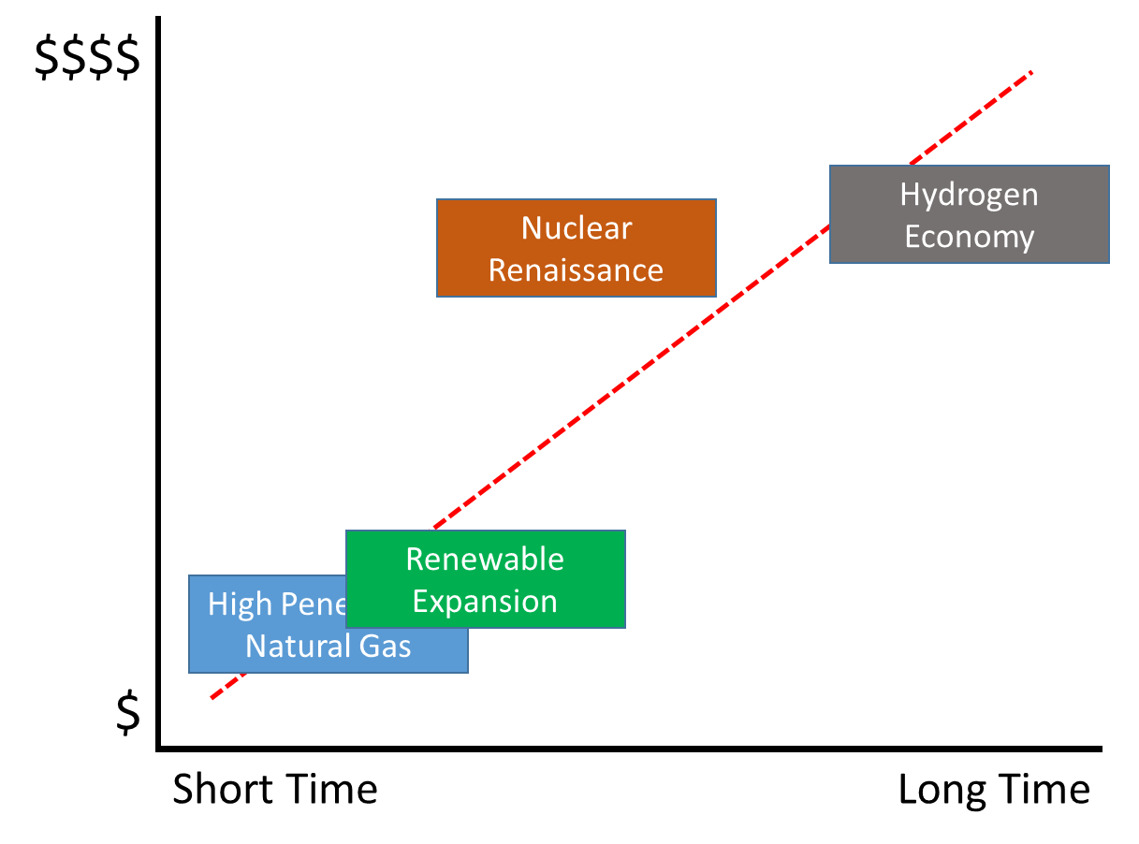
Candidate Scenarios that Could be Studied to Illustrate Different Energy Futures
1) High Penetration Natural Gas
  Expansion of pipeline infrastructure
  Replacement of coal power plants with gas
  Use of CNG for transportation
  Replacement of heating oil with gas
2) Nuclear Renaissance
  Replacement of coal with nuclear
  Electrified transportation
  Leverage existing wires and poles
3) Renewable Expansion
  Expansion of wires and poles
  Biofuels for transportation
4) Hydrogen Economy
  Expand wires and poles for electrolysis
  Fueling stations for fuel cell vehicles
  Increase infrastructure for storage/movement

Slide 26


Thank you
energy.utexas.edu

