Slide 1
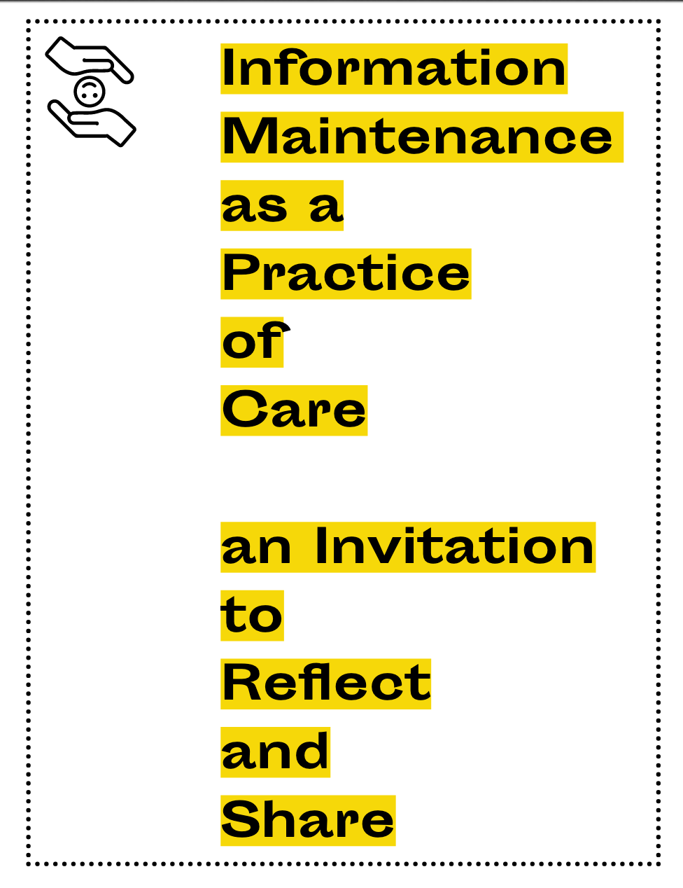
Culture, Kindness, and Care:
Commoning for Earth Knowledge Sustainability
thanks for
support from
the:
The Maintainers, 2019

Slide 2
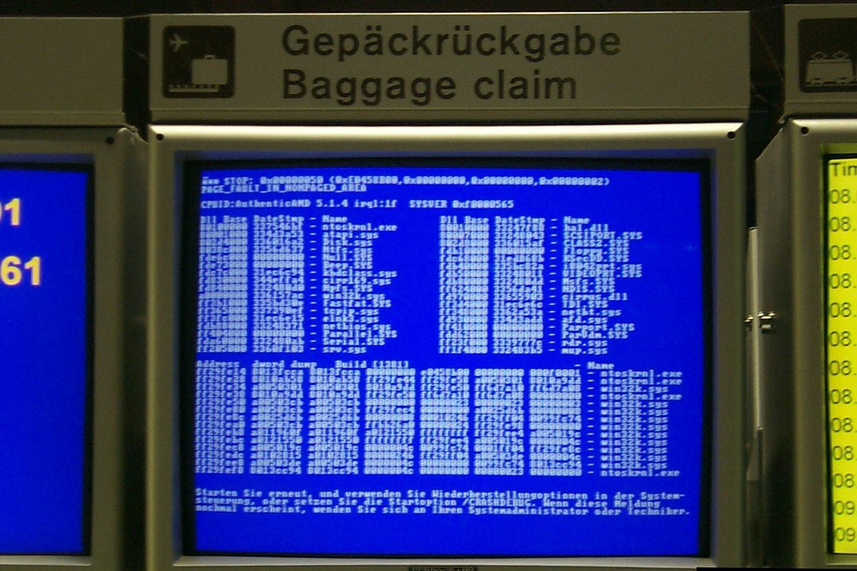
By Jeh - I took this photo while waiting for my bags in the baggage claim area of GVA. The subject was in public view., CC BY-SA 3.0, https://en.wikipedia.org/w/index.php?curid=42004999

Slide 3
We care for our communities by working to facilitate the cohesion and sustained engagement of their members. We believe the communities …will be most successful if they combine the perspectives, experiences, and resources of their members in a thoughtful and caring way.…
The Maintainers, et al, 2019

Slide 4
So it’s kind of like if your house catches on fire.
The bad news is there is no fire brigade.
The good news is random people apparate from nowhere,
put out the fire and leave without expecting payment or praise. …
And it turns out this model is everywhere,
once you start looking for it.
Jonathan Zittrain

Slide 5
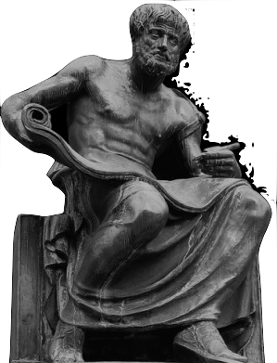
Maintainers use Phronesis to shepherd resources
Aristotle’s practical wisdom … Game of Phrones?

Slide 6
In our view, the work of information maintenance is future-oriented, with the goal of making the systems in and on which it is performed open themselves up to community-driven brands of creativity, adaptation, and transformation that are respectful
and deeply rooted in care.
The Maintainers, et al, 2019

Slide 7
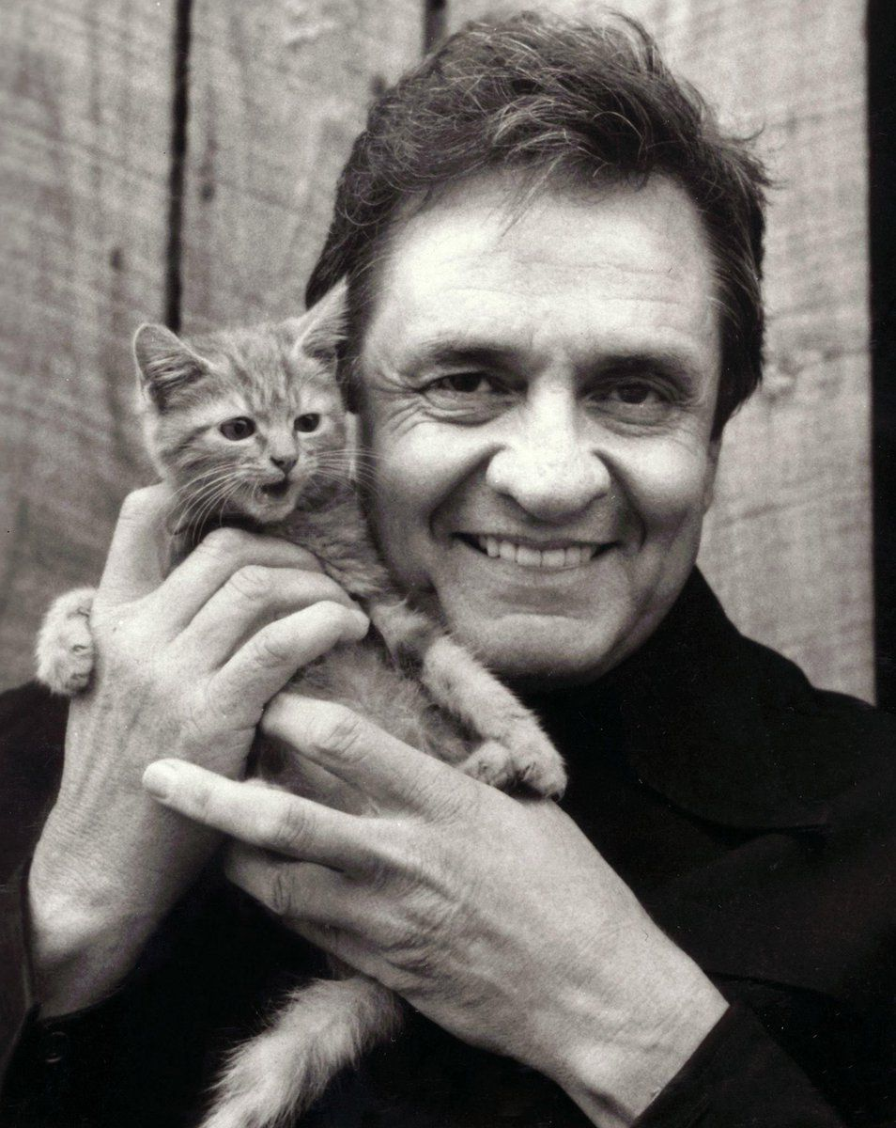
Obligatory Kitten Slide

Slide 8
Putting the
CARE
back

Slide 9
in your
CARE
ER

Slide 10
I have learnt silence from the talkative,
tolerance from the intolerant
and kindness from the unkind.
Khalil Ghibran, Sand and Foam.

Slide 11
As he was dying, someone asked
Aldous Huxley if he could say
what he had learned … on his own spiritual journey.
Huxley’s answer was,
“It is embarrassing to tell you this, but it seems to come down mostly to just learning to be kind.”

Slide 12
ESIP is….
Too Nice
response to post-meeting survey…
Tough… that’s how we like it…
bruce caron bruce@tnms.org

