Slide 1




Toward Interoperable Microbiome Data
https://github.com/environmentontology/envo
Bridging Earth-Systems and Life-Science Semantics
Kai Blumberg, Chris Mungall, Bonnie Hurwitz, Pier Luigi Buttigieg

Slide 2
Outline
FAIR principles
Ontology
  SWEET Semantic Web for Earth and Environment Technology Ontology
  ENVO Environment Ontology
Metagenomics
Linking SWEET & ENVO
Accessing genomic potential from SWEET terms

Slide 3
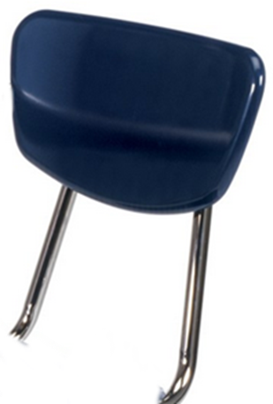

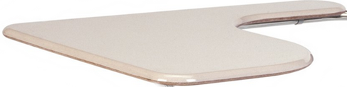
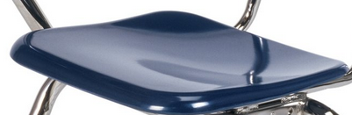
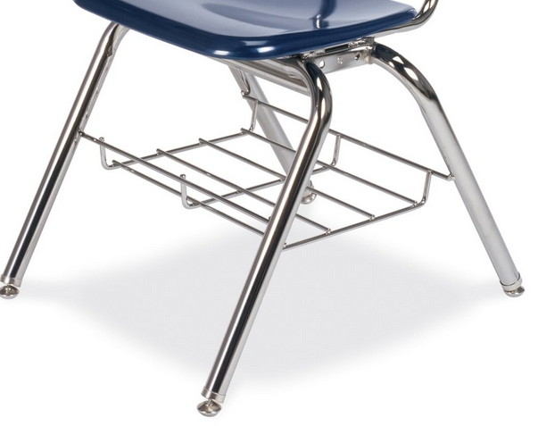

FAIR
Findable Accessible Interoperable Reusable
To BE INTEROPERABLE:
  I1. (meta)data use a formal, accessible, shared, and broadly applicable language for knowledge representation.
  I2. (meta)data use vocabularies that follow FAIR principles.
  I3. (meta)data include qualified references to other (meta)data.
Wilkinson et al. 2016 Scientific Data

Slide 4
Ontology
concept
transportation
~ def. A human- and machine-readable, logical representation of expert knowledge about
real-world entities
personal
transportation
device
sub concept
bicycle
car
https://purl/namespace/identifier
type
different type
PURL: Permanent Uniform Resource Locator
Notes:
4
Knowledge graphs aren’t just picture, engineered with controlled axioms, controlled by another ontology RO -> bring in AI angle, there are AI agents reasoners which check graphs, RO thoroughly checked by logicians,
Take opportunity to show the guts of these to engineer this knowledge have a view diagram (simple first), then simple diagram, then zoom out diagram more complexities, -> semantic science research seeing if our captures of human knowledge withstand AI checks, run test see if
After 3 versions repeat the envo/go /data slide, take a step back we talked about the first two , now we’ll talk about the 3rd part the data that’s been linked.

Slide 5
Ontology
A knowledge graph by which machine agents can put data into context.
Notes:
5
Knowledge graphs aren’t just picture, engineered with controlled axioms, controlled by another ontology RO -> bring in AI angle, there are AI agents reasoners which check graphs, RO thoroughly checked by logicians,
Take opportunity to show the guts of these to engineer this knowledge have a view diagram (simple first), then simple diagram, then zoom out diagram more complexities, -> semantic science research seeing if our captures of human knowledge withstand AI checks, run test see if
After 3 versions repeat the envo/go /data slide, take a step back we talked about the first two , now we’ll talk about the 3rd part the data that’s been linked.

Slide 6

Ontologies
Stronger semantics
A rough illustration of the semantic gradient
Taxonomies
I3 include qualified references to other (meta)data
Controlled
vocabularies
Data models
Thesauri
Glossaries
Modified from McCreary D (2006)
Patterns of Semantic Integration. CC 2.5
Weaker semantics
https://creativecommons.org/licenses/by/2.0/legalcode
https://www.slideshare.net/dmccreary/semantic-integrationpatterns

Slide 7




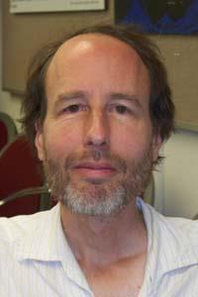




Semantic Web for Earth and Environment Technology (SWEET)
Foundational Earth Science Ontology
More than 6000 terms
  200 ontologies
Developed by Dr. Robert Raskin
  NASA Jet Propulsion Labs
Governed by ESIP
Raskin R, Pan M. 2003 Proc of the Workshop on Semantic Web Technologies for Searching and Retrieving Scientific Data
(1957-2012)
http://mappingideas.sdsu.edu/mashup/Robert/robert.html

Slide 8

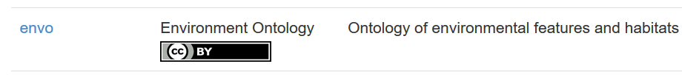

The OBO: Foundry
Open Biological and Biomedical Ontology
  Collection of domain-specific Interoperable Ontologies
Notes:
8
Knowledge graphs aren’t just picture, engineered with controlled axioms, controlled by another ontology RO -> bring in AI angle, there are AI agents reasoners which check graphs, RO thoroughly checked by logicians,
Take opportunity to show the guts of these to engineer this knowledge have a view diagram (simple first), then simple diagram, then zoom out diagram more complexities, -> semantic science research seeing if our captures of human knowledge withstand AI checks, run test see if
After 3 versions repeat the envo/go /data slide, take a step back we talked about the first two , now we’ll talk about the 3rd part the data that’s been linked.

Slide 9
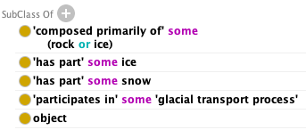
Environment Ontology
Buttigieg et al. 2013 Journal of Biomedical Semantics
astronomical body part
'glacier’ [ ENVO_00000133]
water body
ocean
An ice mass which is of sufficient mass that the action of gravity upon it overcomes the frictional forces holding it in place, causing it to deform and flow towards lower elevation.
material entity
environmental material
air
sediment
Axioms help make data Interoperable
marine sediment
soil
object
glacier
Notes:
9
Knowledge graphs aren’t just picture, engineered with controlled axioms, controlled by another ontology RO -> bring in AI angle, there are AI agents reasoners which check graphs, RO thoroughly checked by logicians,
Take opportunity to show the guts of these to engineer this knowledge have a view diagram (simple first), then simple diagram, then zoom out diagram more complexities, -> semantic science research seeing if our captures of human knowledge withstand AI checks, run test see if
After 3 versions repeat the envo/go /data slide, take a step back we talked about the first two , now we’ll talk about the 3rd part the data that’s been linked.

Slide 10
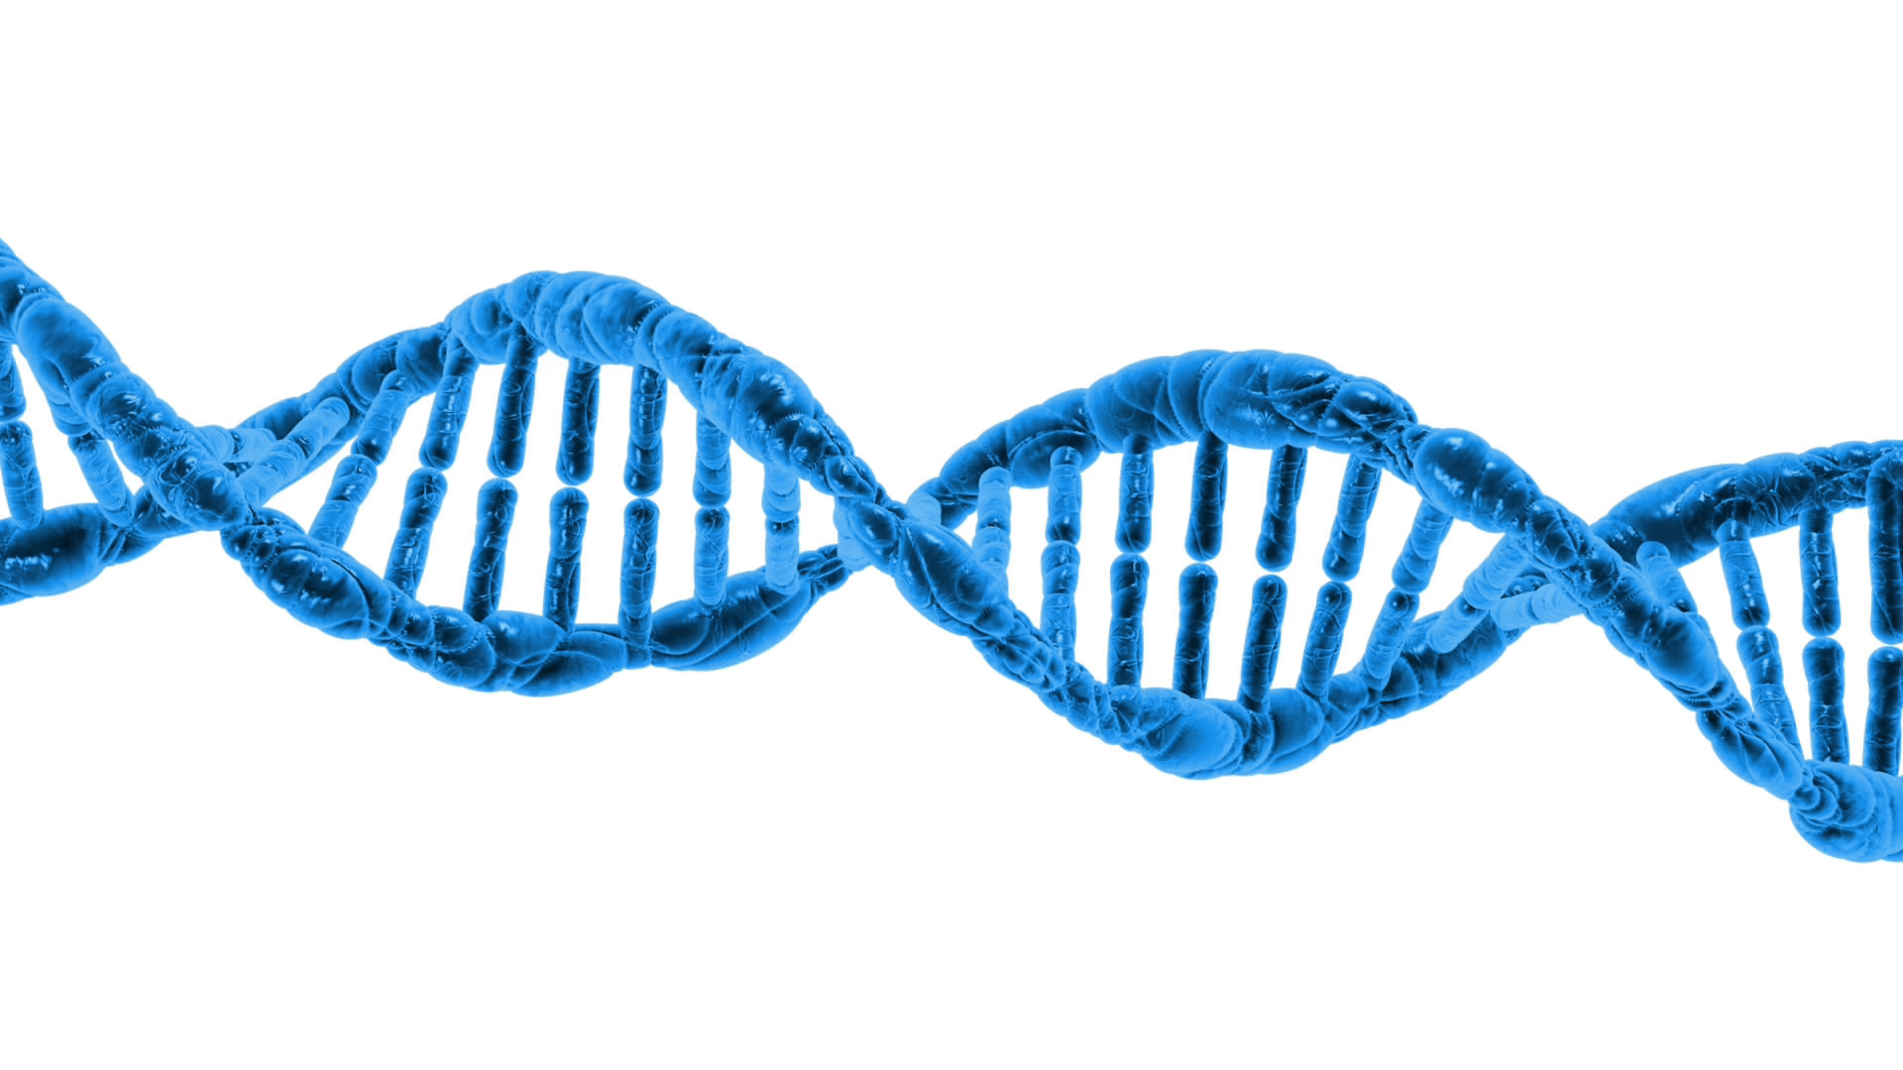



Metagenomics
Microbiome
Cultivation-independent genome-level characterization of microbial communities.
Gilbert et al. 2010 Standards in Genomic Sciences
Turnbaugh et al. 2017 Nature
https://yokoent.com/images/dna-png-transparent-6.png

Slide 11







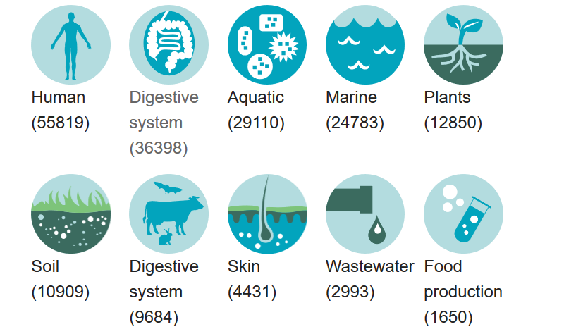
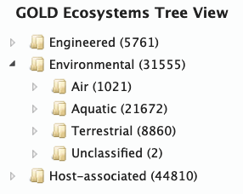

European Molecular Biology Laboratory
European Bioinformatics Institute
11

Slide 12

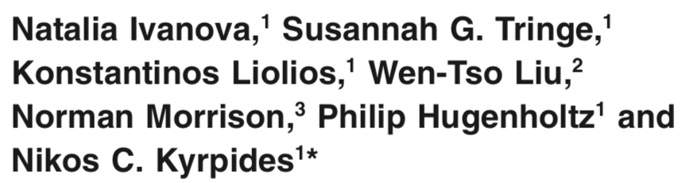
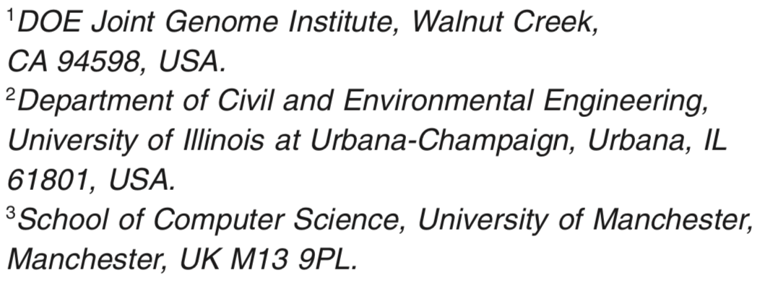
Ivanova et al. 2010 Environmental microbiology
Created a five-tiered schema:
Ecosystem
> Ecosystem category
> Ecosystem type
> Ecosystem subtype
> Specific ecosystem
12

Slide 13
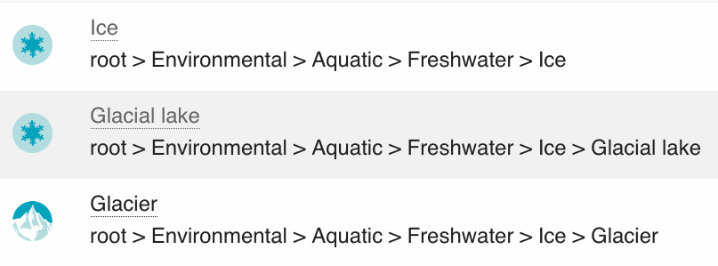
'glacial ecosystem’ [ _3300104]
13

Slide 14


glacial feature
brine channel*
Definition: An ecosystem which is determined by a glacier.
frazil ice*
Axioms:
‘ecosystem’
‘determined by’ some
‘determined by’ some
water ice layer
slush ice layer*
grease ice layer*
'glacier’ [ENVO_00000133]
'glacial feature’ [ENVO_00000131]
*envoPolar contributions
14

Slide 15
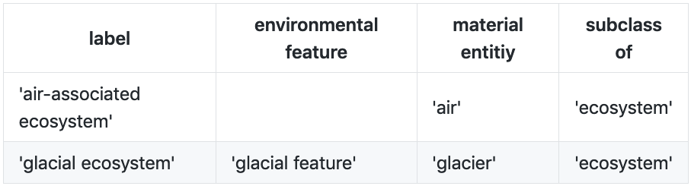
Automated Term Generation
ROBOT Template
  generate ontology terms from csv files
.csv
.owl
‘air-associated ecosystem’:
‘ecosystem’ and
(‘determined by’ some ‘air’)
‘glacial ecosystem’:
‘ecosystem’ and
(‘determined by’ some ‘glacier’ and
(‘determined by’ some glacial feature))
MIxS: Minimum information about any X Sequence
annotation triplet: feature, material, biome
15

Slide 16
astronomical body part
water body
'ocean' [ENVO_00000015]
material entity
environmental material
'air' [ENVO_00002005]
sediment
'marine sediment' [ENVO_03000033]
'soil' [ENVO_00001998]
object
'glacier' [ENVO_00000133]

Slide 17
'ocean' [ENVO_00000015]
cross_reference
'air' [ENVO_00002005]
cross_reference
'marine sediment' [ENVO_03000033]
cross_reference
'soil' [ENVO_00001998]
cross_reference
'glacier' [ENVO_00000133]
cross_reference

Slide 18
'ocean biome' [ENVO_01000048]
determines
'ocean' [ENVO_00000015]
'air-associated ecosystem' [ENVO_3300084]
cross_reference
determines
'air' [ENVO_00002005]
cross_reference
'marine sediment ecosystem' [ENVO_3300172]
determines
'marine sediment' [ENVO_03000033]
cross_reference
'soil ecosystem' [ENVO_3300172]
'soil' [ENVO_00001998]
determines
cross_reference
'glacial ecosystem' [ENVO_3300104]
'glacier' [ENVO_00000133]
determines
cross_reference
https://yokoent.com/images/dna-png-transparent-6.png

Slide 19
'ocean biome' [ENVO_01000048]
determines
'ocean' [ENVO_00000015]
'air-associated ecosystem' [ENVO_3300084]
cross_reference
determines
'air' [ENVO_00002005]
cross_reference
'marine sediment ecosystem' [ENVO_3300172]
determines
'marine sediment' [ENVO_03000033]
cross_reference
'soil ecosystem' [ENVO_3300172]
'soil' [ENVO_00001998]
determines
cross_reference
'glacial ecosystem' [ENVO_3300104]
'glacier' [ENVO_00000133]
determines
cross_reference
https://yokoent.com/images/dna-png-transparent-6.png

Slide 20


Results:
http://www.ontobee.org/sparql
?x:
'glacial ecosystem' [ENVO_3300104]
SELECT ?x ?y ?z
FROM <http://purl.obolibrary.org/obo/merged/ENVO>
WHERE {
?x a owl:Class .
owl:equivalentClass/owl:intersectionOf/rdf:rest/rdf:first/owl:onProperty obo-term:RO_0002507;
owl:equivalentClass/owl:intersectionOf/rdf:rest/rdf:first/owl:someValuesFrom ?y .
?y rdfs:label ?label.
rdfs:subClassOf*/oboInOwl:hasDbXref> "SWEETRealm:Glacier" .
rdfs:label ?label .
?x rdfs:subClassOf*/oboInOwl:hasDbXref > ?z .
}
determines
?y:
'glacier' [ENVO_00000133]
cross_reference
?z:
https://www.ebi.ac.uk/metagenomics/api/v1/biomes/root:Environmental:Aquatic:Freshwater:Ice:Glacier

Slide 21
Summary
Ontologies help make data Interoperable
  Enable FAIR data
Link earth and life science ontologies
  SWEET & ENVO
ENVO
  Annotation of metagenomic data
    Working toward comprehensive term set
    Employ strategies to automate ontology term creation
  Access microbiome data
    European Bioinformatics Institute (EBI)
    Join Genome Institute (JGI)
determines
'glacial ecosystem' [ENVO_3300104]
'glacier' [ENVO_00000133]
cross_reference

Slide 22
References
Buttigieg, Pier Luigi, Norman Morrison, Barry Smith, Christopher J. Mungall, Suzanna E. Lewis, and ENVO Consortium. 2013. “The Environment Ontology: Contextualising Biological and Biomedical Entities.” Journal of Biomedical Semantics 4 (1): 43.
Gilbert, Jack A., Folker Meyer, Dion Antonopoulos, Pavan Balaji, C. Titus Brown, Christopher T. Brown, Narayan Desai, et al. 2010. “Meeting Report: The Terabase Metagenomics Workshop and the Vision of an Earth Microbiome Project.” Standards in Genomic Sciences 3 (3): 243–48.
Ivanova, Natalia, Susannah G. Tringe, Konstantinos Liolios, Wen-Tso Liu, Norman Morrison, Philip Hugenholtz, and Nikos C. Kyrpides. 2010. “A Call for Standardized Classification of Metagenome Projects.” Environmental Microbiology 12 (7): 1803–5.
National Research Council (US) Committee on Metagenomics: Challenges and Functional Applications. 2011. The New Science of Metagenomics: Revealing the Secrets of Our Microbial Planet. Washington (DC): National Academies Press (US).
Optum. 2010. “Semantic Integration Patterns.” August 9, 2010. https://www.slideshare.net/dmccreary/semantic-integrationpatterns.
Raskin, Rob, and Michael Pan. 2003. “Semantic Web for Earth and Environmental Terminology (sweet).” In Proc. of the Workshop on Semantic Web Technologies for Searching and Retrieving Scientific Data. Vol. 25.
Turnbaugh, Peter J., Ruth E. Ley, Micah Hamady, Claire M. Fraser-Liggett, Rob Knight, and Jeffrey I. Gordon. 2007. “The Human Microbiome Project.” Nature 449 (7164): 804–10.
Wilkinson, Mark D., Michel Dumontier, I. Jsbrand Jan Aalbersberg, Gabrielle Appleton, Myles Axton, Arie Baak, Niklas Blomberg, et al. 2016. “The FAIR Guiding Principles for Scientific Data Management and Stewardship.” Scientific Data 3 (March): 160018.

Slide 23
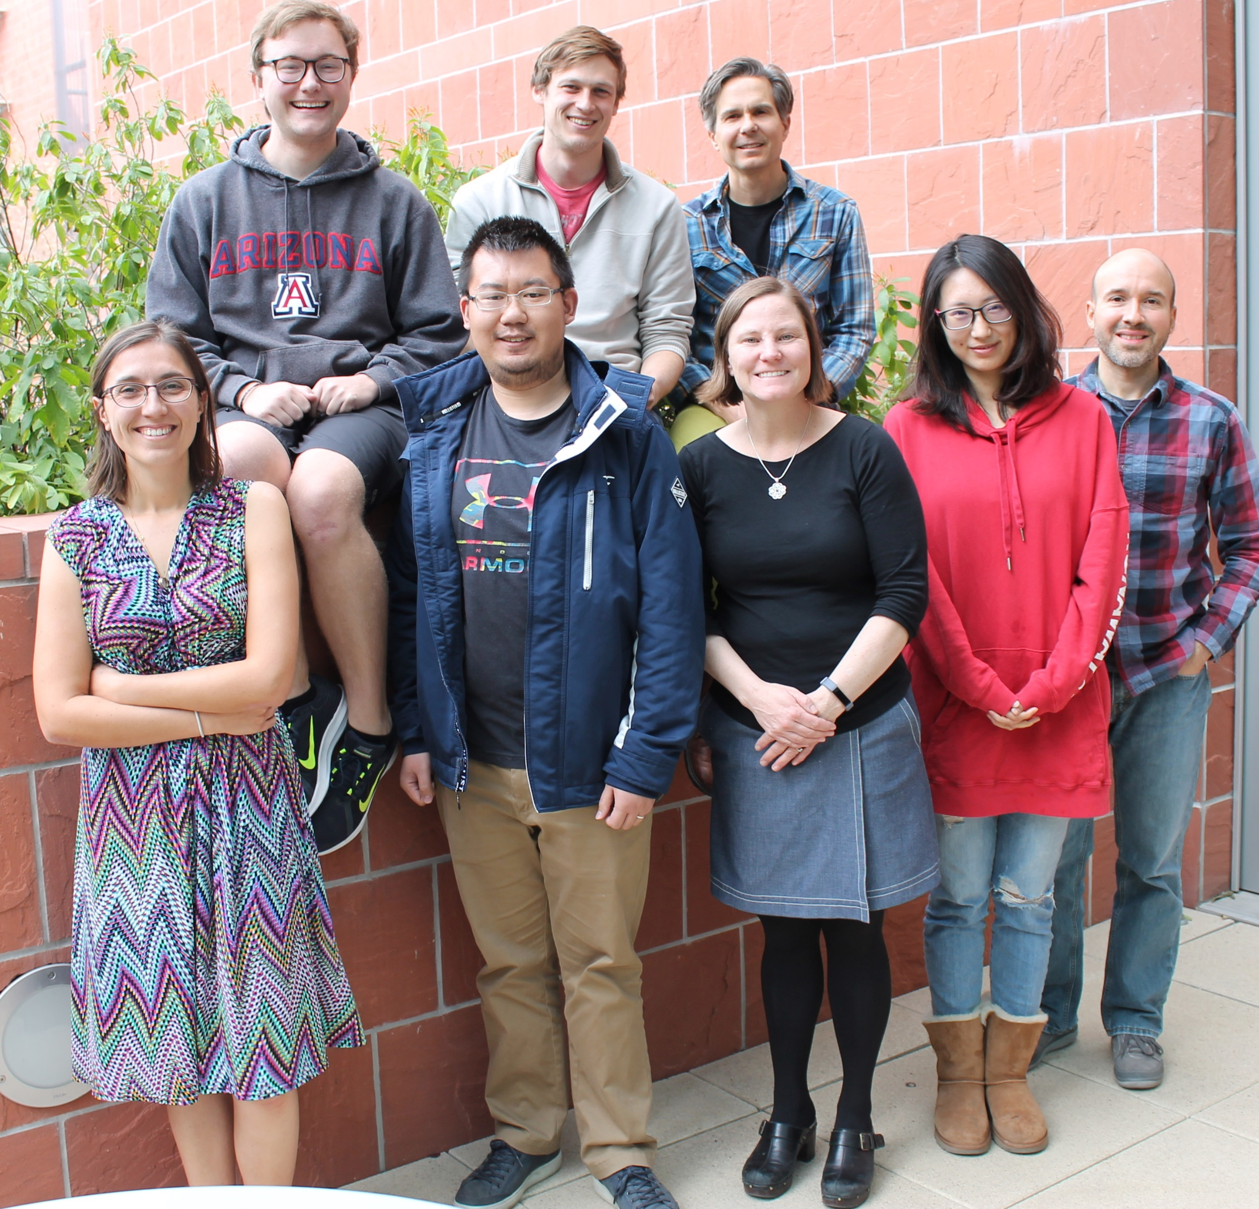
Acknowledgments
Special Thanks
ESIP Raskin Scholarship Committee
Megan Carter
Erin Robinson
Dr. Robert Raskin
Collaborators
Dr. Pier Luigi Buttigieg (Alfred Wegener Institute)
Dr. Chris Mungall (Berkeley Lab)
Dr. Ramona Walls (CYVERSE, University of Arizona)
Hurwitz Lab
Dr. Bonnie Hurwitz (University of Arizona)

Slide 24
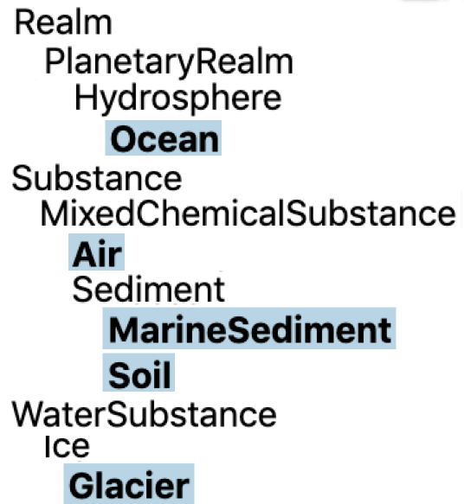
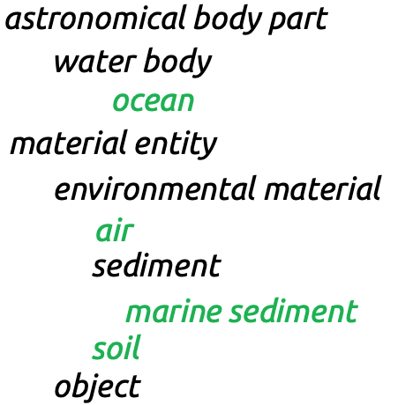
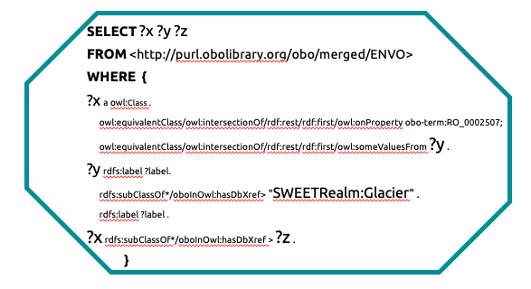
Questions?
?z:
https://www.ebi.ac.uk/metagenomics/api/v1/biomes/root:Environmental:Aquatic:Freshwater:Ice:Glacier
'glacial ecosystem' [ENVO_3300104]
'glacier' [ENVO_00000133]
MIxS: Minimum information about any X Sequence
determines
?x:
cross_reference
?y:
FAIR
http://www.ontobee.org/sparql

Slide 26
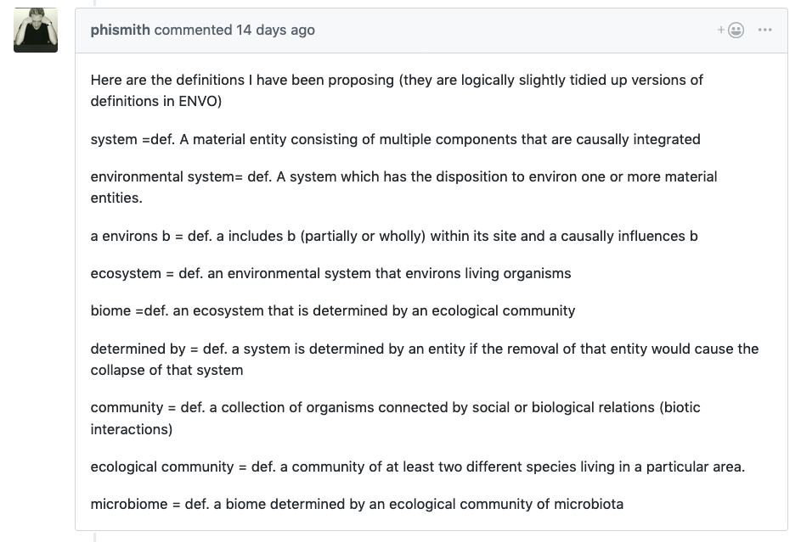

Slide 27

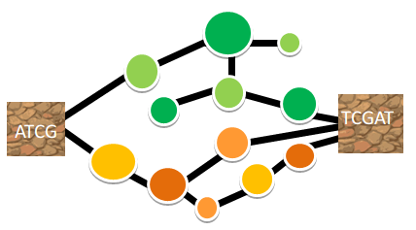
“What cellular amino acid biosynthetic processes differentiate marine benthic biomes?”
?
27
Notes:
27
*note this applies only for marine benthic biomes for which we have examples present in the dataholdings

Slide 28
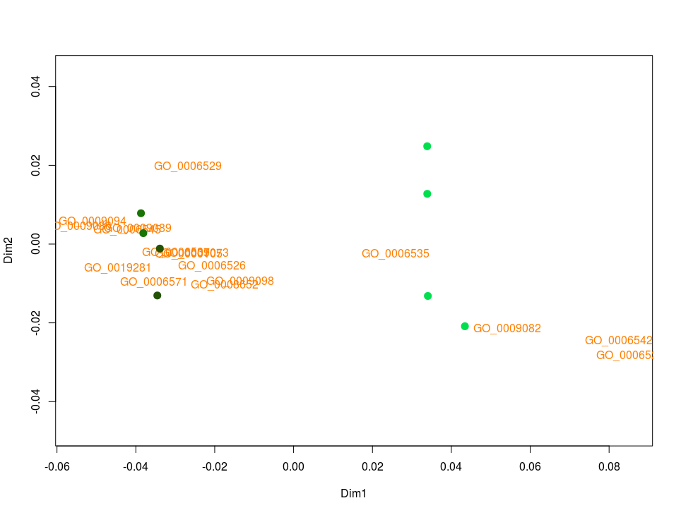
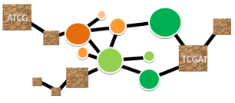
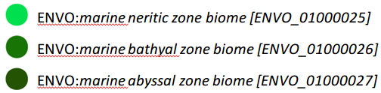
“What cellular amino acid biosynthetic processes differentiate marine benthic biomes?”
?
ENVO:marine neritic zone biome
GO:cysteine biosynthetic process from serine [GO_0006535]
GO:branched-chain amino acid biosynthetic process [GO_0009082]
GO:leucine biosynthetic process [GO_0009098]
28
Notes:
28

Slide 29
“What cellular amino acid biosynthetic processes differentiate marine benthic biomes?”
?
ENVO: marine abyssal zone biome and ENVO: marine bathyal zone biome
GO:lysine biosynthetic process via diaminopimelate [GO_0009089]
GO:glutamate biosynthetic process [GO_0006537]
GO:glycine biosynthetic process [GO_0006545]
29
Notes:
29

