Slide 1
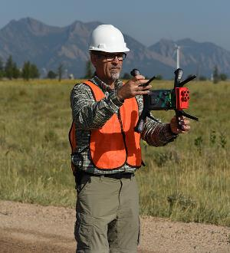
USGS UAS Tech Stack
LANDRS Design Hackathon1
Joe Adams
USGS National Unmanned Aircraft Systems Project Office
uas.usgs.gov
jdadams@usgs.gov
303-236-2906 (office)
2019 ESIP Summer Meeting Tacoma, WA

Slide 2
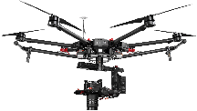
USGS – Current UAS Platforms
Pulse Vapor 55 ……………..…... 1
DJI Matrice 600 ……………...... 11
FireFly 6 ……………………..…..... 8
3DR Solo …………………..……..107
3DR Solo (Site Scan)……..…….. 9
Parrot Anafi…………………..……. 4
Total UAS @ USGS…………151
Pulse Vapor 55
DJI Matrice 600
(Testing)
BirdsEyeView
FireFly 6
End of 2018:
DOI owns 531 UAS
DOI - 359 trained operators
3DR Solo
DJI Mavic
(Testing)
Parrot - Anafi

Slide 3
UAS Sensors Approved for DOI Use
3DR Solo
High Definition Video
Point & Shoot Cameras
DSLR Cameras
Thermal Sensors (FLIR)
MultiSpectral (MicaSense)
Doppler RADAR
Hero 3, 4
Ricoh GRII
Sony UMC-R10C
Sequoia
Pixpro SP360 4K
RedEdge 3, MX
FLIR VUE Pro/Pro R/Dual Pro
MAPIR
DJI
Zenmuse XT2, X5, Z30
Ronin – MX Gimbal
BirdsEyeView FireFly6
Sony A6000, A7R, RXIRII
Slantrange 3P
MicaSense RedEdge M
GoPro Hero4

Slide 4
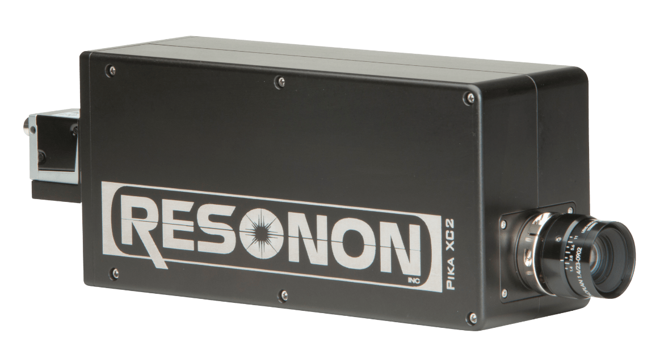
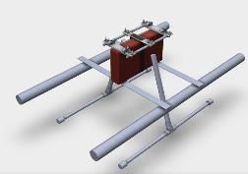
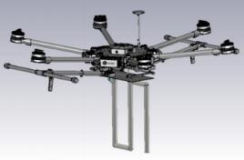
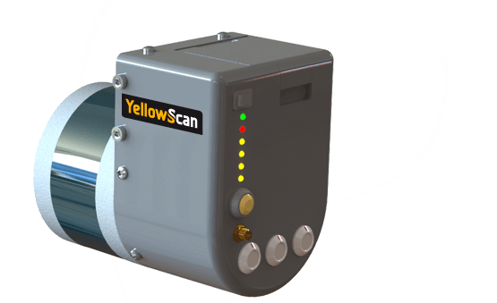
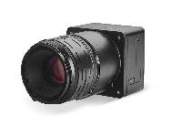
UAS Sensors Currently Being Integrated
Gas Sensors
Ground Penetrating
RADAR
LiDAR
Metric Cameras
Hyperspectral
MultiSpectral
Telemetry
Methane Sensor

Slide 5
Phases of Data Workflow
Plan
Collect
Process
Publish
Google Earth
Mission Planner
Global Mapper
ArcGIS
SkyVector
AirMap
Tower App
DJI Pilot PE App
Pix4DCapture App
Mission Planner
Windows Explorer
WinSCP
IrfanView
AgiSoft
Locus Map
Avenza Maps
ExifTool
GeoSetter
Mission Planner
AgiSoft
POSPac LiDAR
GlobalMapper
Cloud Compare
Camtasia Video
Metadata Wizard 2.x
IPDS
Trusted Repository
EDC LTA
EarthExplorer.usgs.gov
ScienceBase.gov
Science Data Catalog
Data.gov
OAS-2U

Slide 6
Phases of Data Workflow
Plan
Google Earth
Mission Planner
Global Mapper
ArcGIS
SkyVector
AirMap

Slide 7
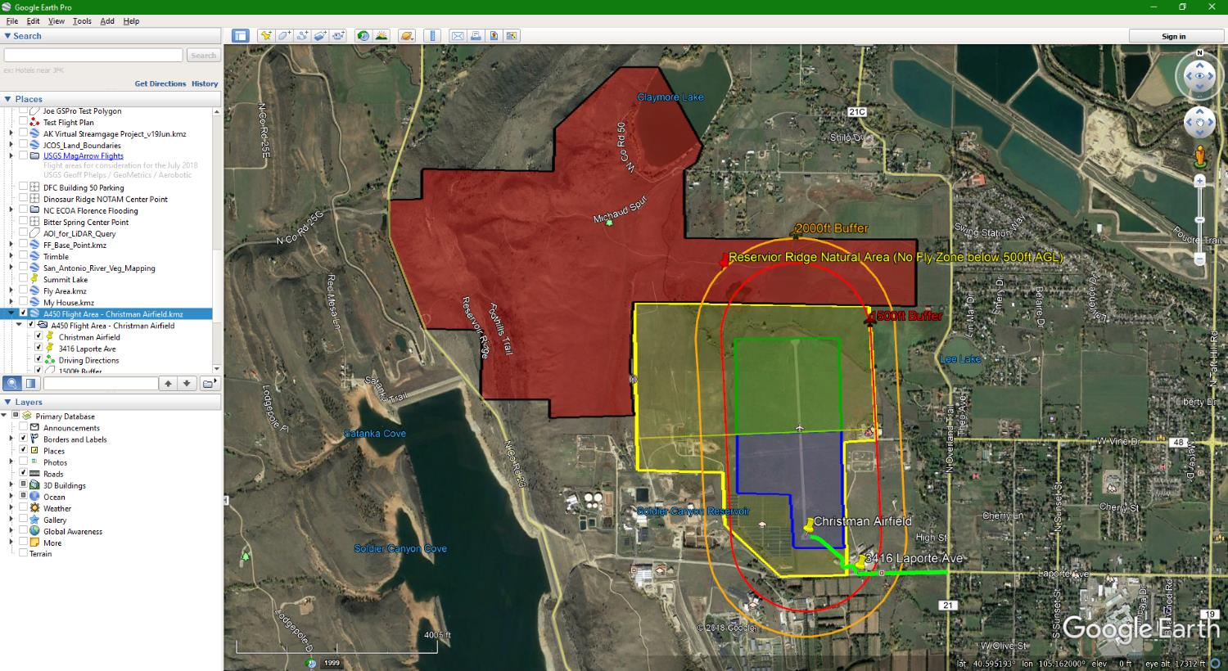
Plan
Wait … There’s More

Slide 8
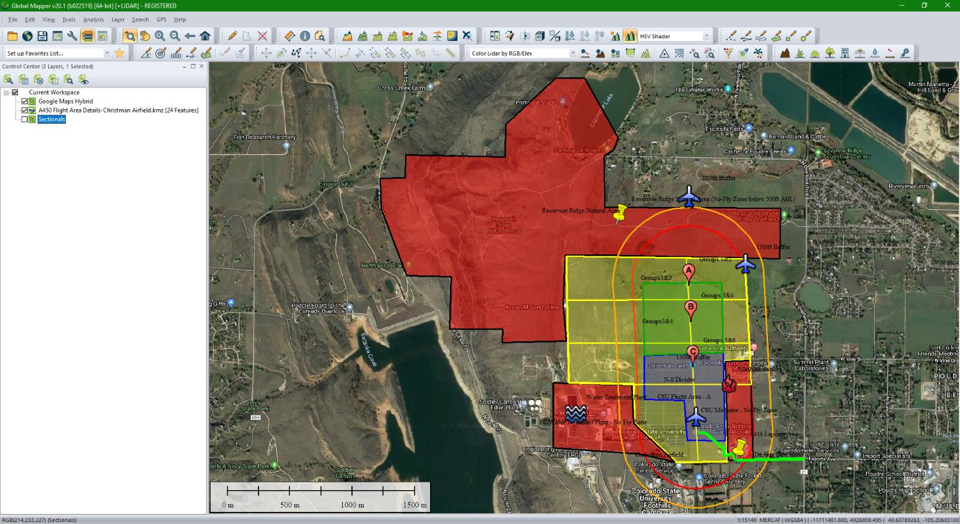

Slide 9
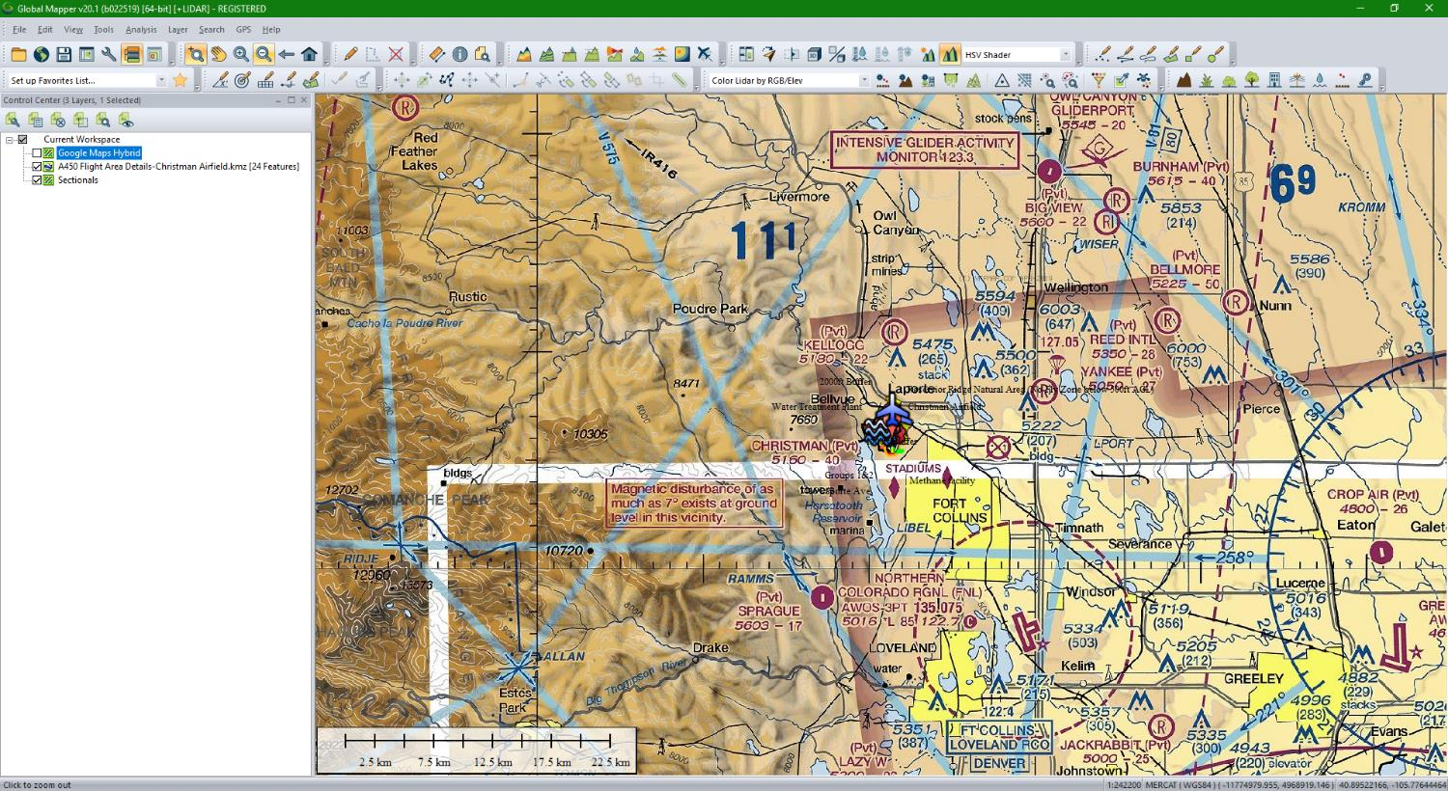

Slide 10
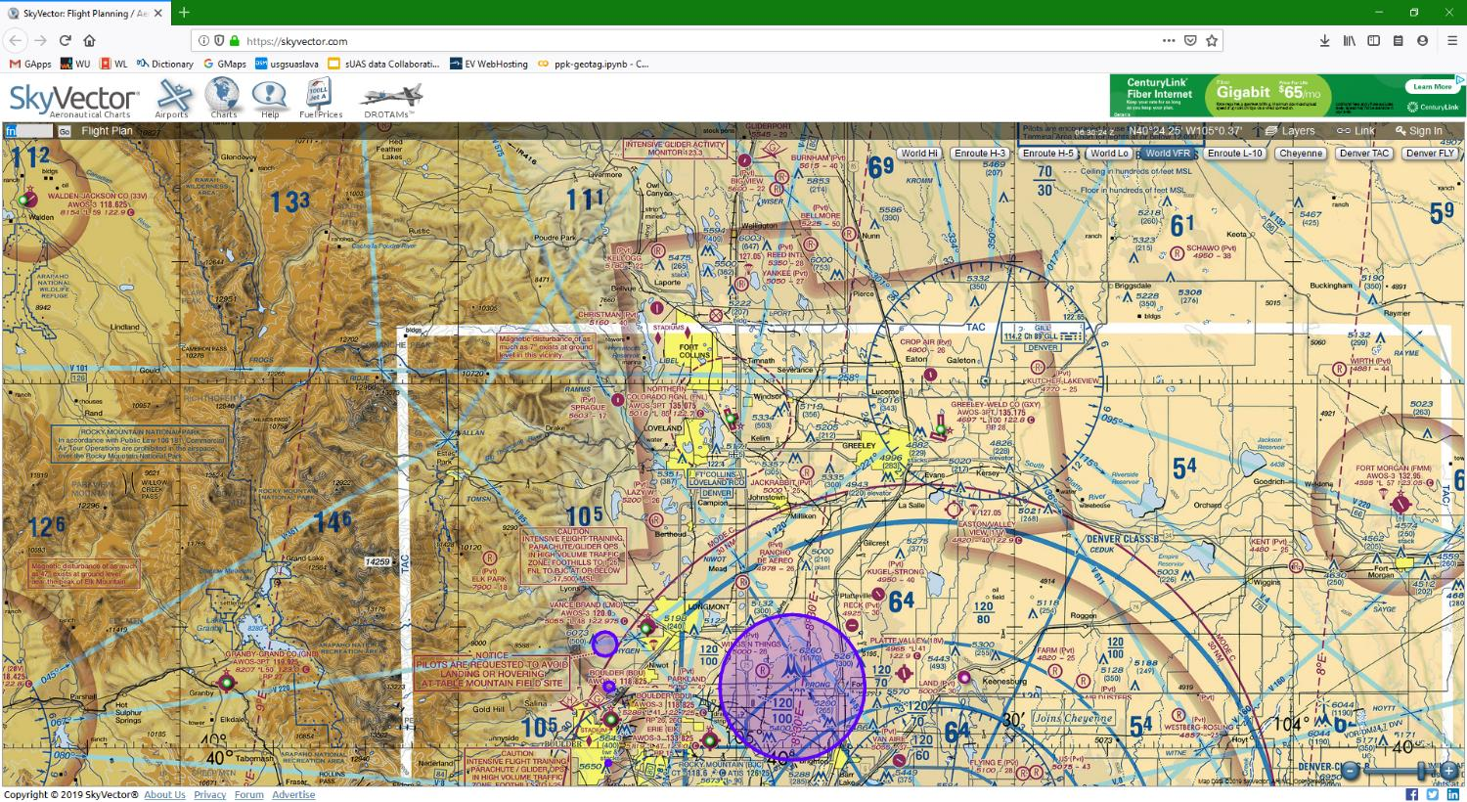

Slide 11
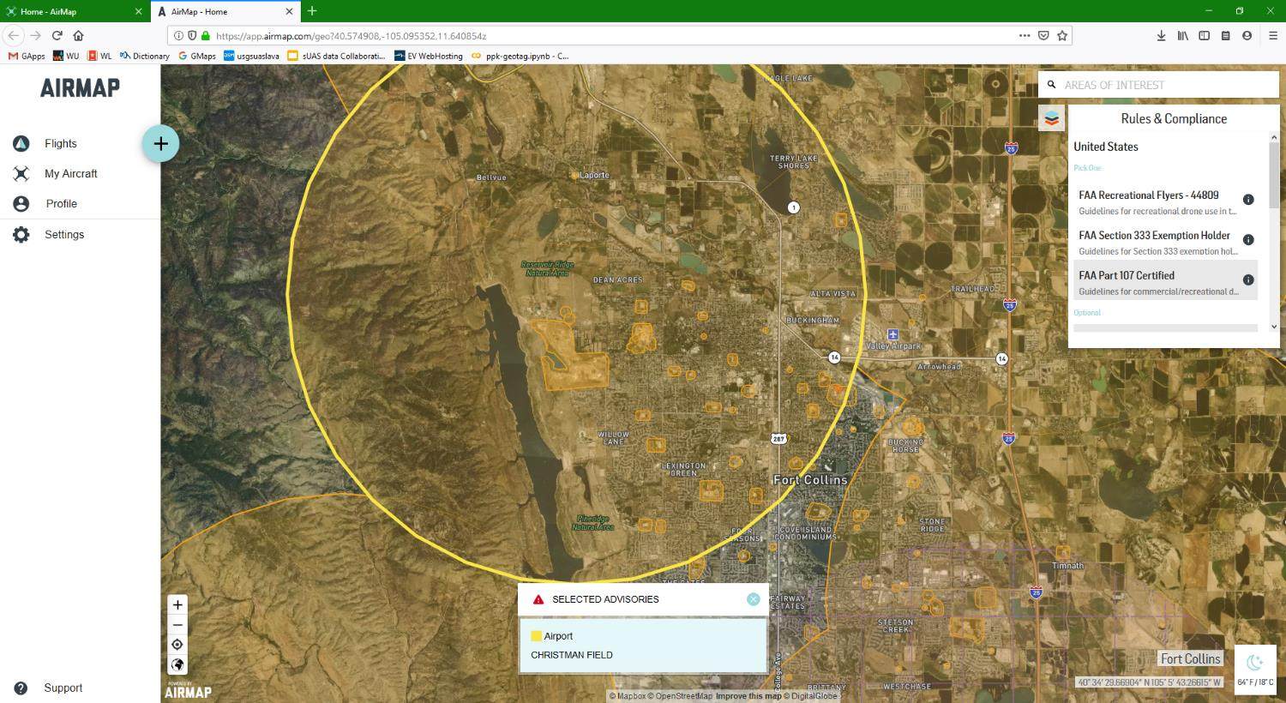

Slide 12
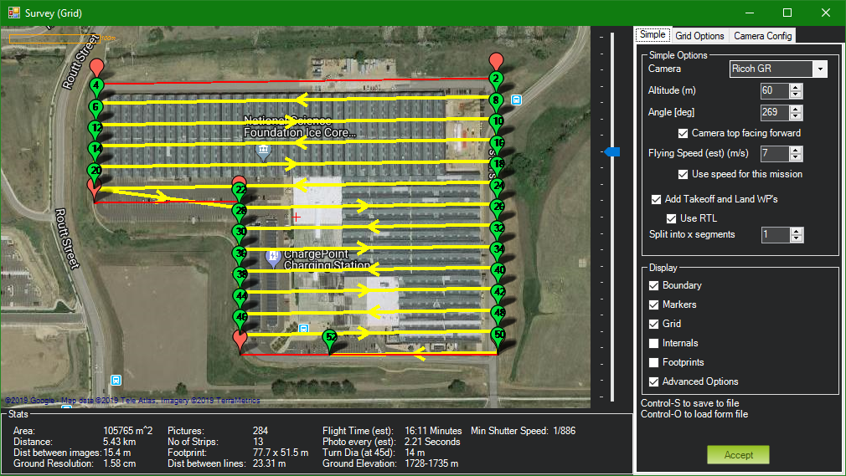

Slide 13
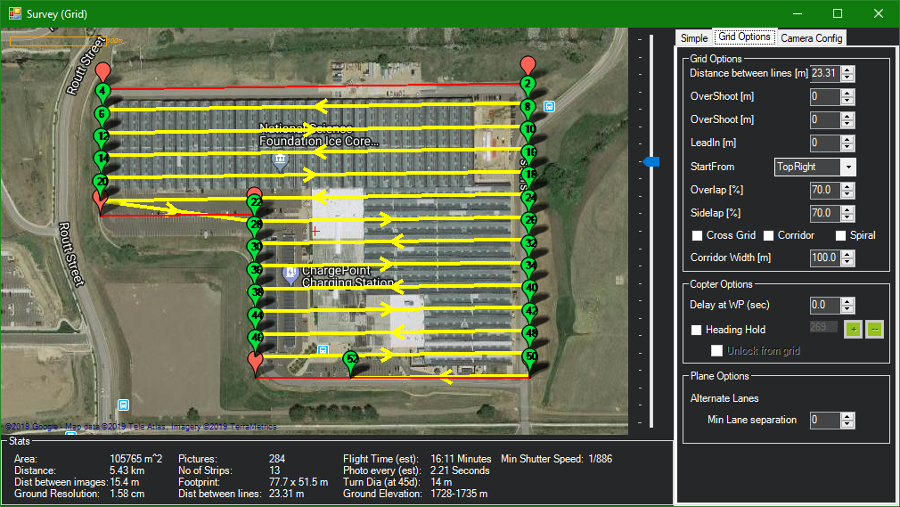

Slide 14
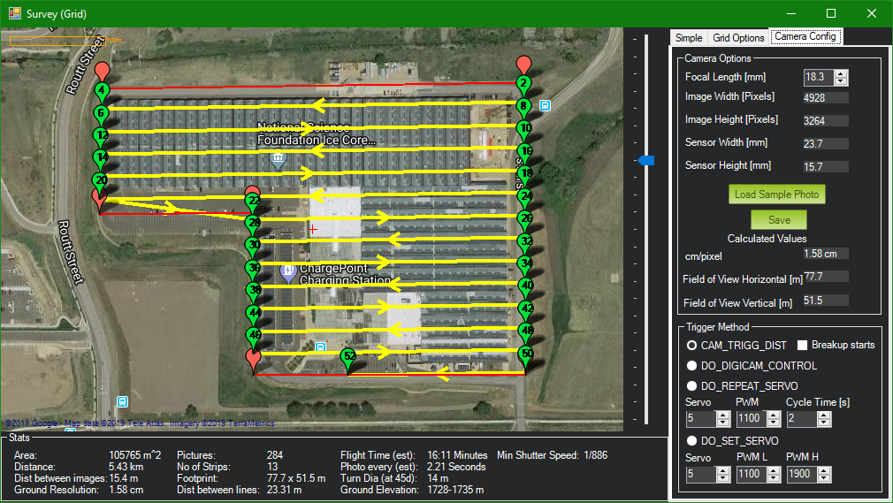

Slide 15
Phases of Data Workflow
Collect
Tower App
DJI Pilot PE App
Pix4DCapture App
Mission Planner
Windows Explorer
WinSCP
IrfanView
AgiSoft
Locus Map
Avenza Maps

Slide 16
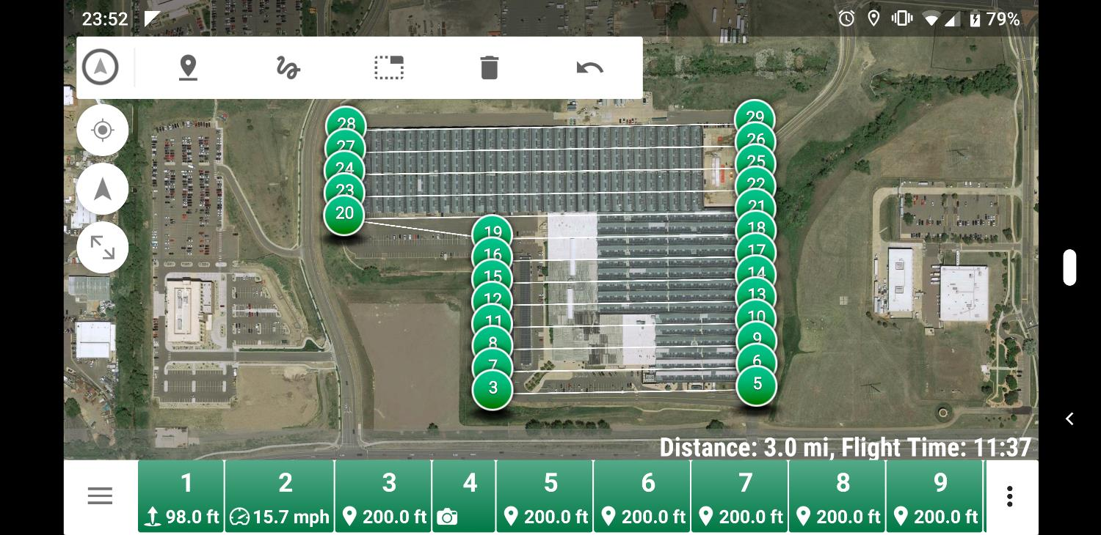

Slide 17
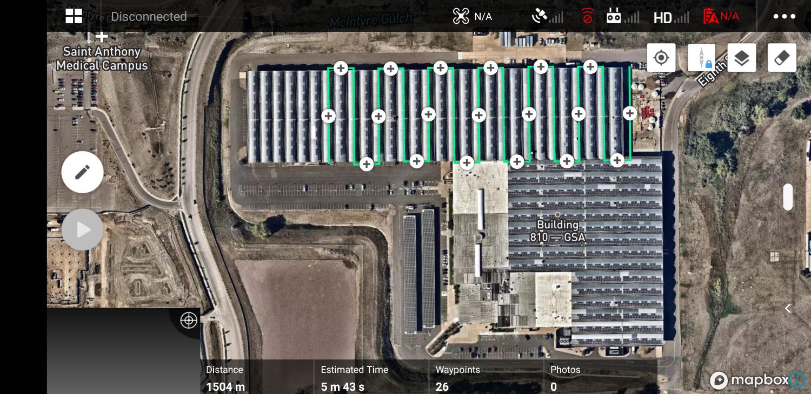

Slide 18
Phases of Data Workflow
Collect
Tower App
DJI Pilot PE App
Pix4DCapture App
Mission Planner
Windows Explorer
WinSCP
IrfanView
AgiSoft
Locus Map
Avenza Maps

Slide 19
Phases of Data Workflow
Process
ExifTool
GeoSetter
Mission Planner
AgiSoft
POSPac LiDAR
GlobalMapper
Cloud Compare
Camtasia Video

Slide 20
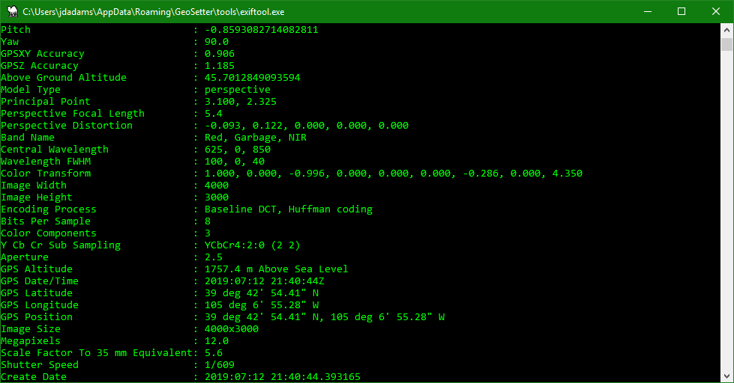

Slide 21
Tweak Images with ExifTool
Remove Orientation Tag
%USERPROFILE%\AppData\Roaming\GeoSetter\tools\exiftool.exe -Orientation= *.JPG -overwrite_original -preserve
Remove GPS Tags from FLIR TIFF images with bad GPS
%USERPROFILE%\AppData\Roaming\GeoSetter\tools\exiftool.exe -gps:all= *.tiff -overwrite_original -preserve

Slide 22
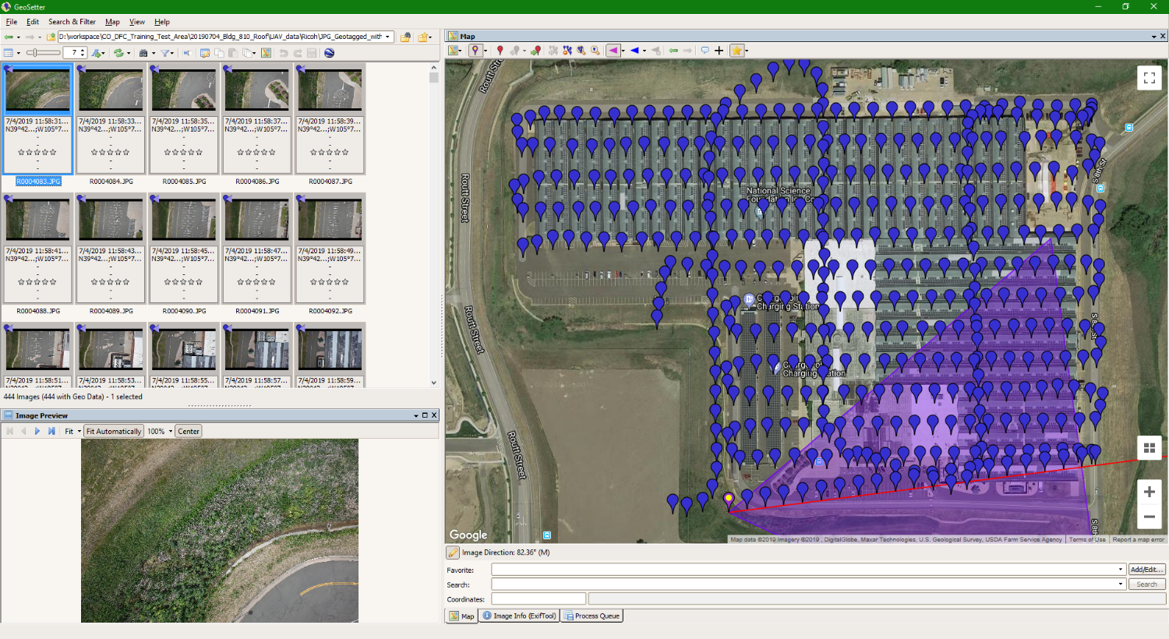

Slide 23
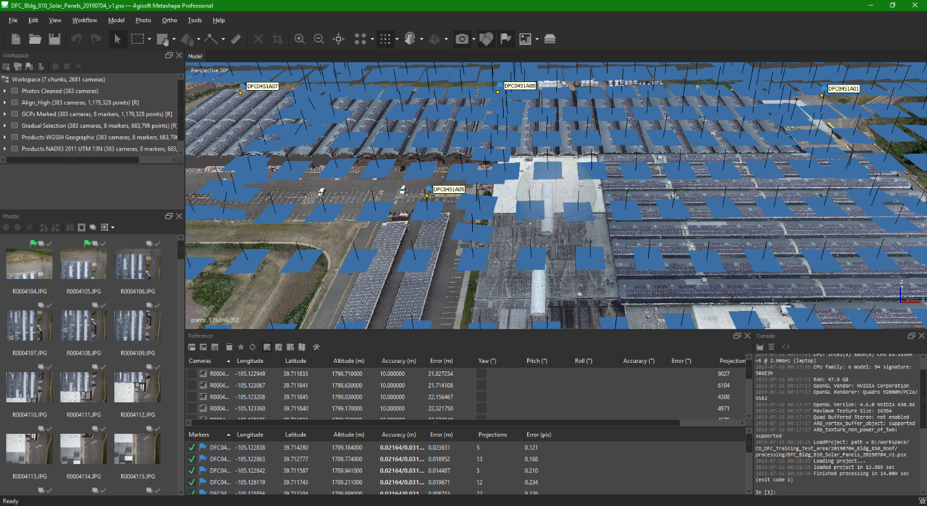

Slide 24
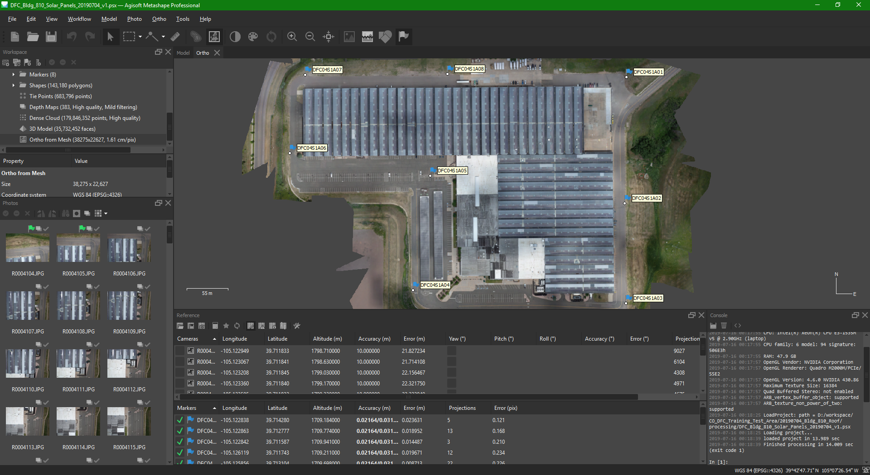

Slide 25
Phases of Data Workflow
Process
ExifTool
GeoSetter
Mission Planner
AgiSoft
POSPac LiDAR
GlobalMapper
Cloud Compare
Camtasia Video

Slide 26
Phases of Data Workflow
Publish
Metadata Wizard 2.x
IPDS
Trusted Repository
EDC LTA
EarthExplorer.usgs.gov
ScienceBase.gov
Science Data Catalog
Data.gov
OAS-2U

Slide 27
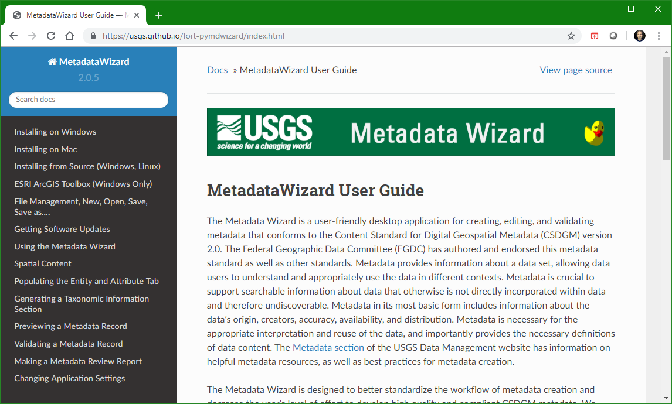

Slide 28
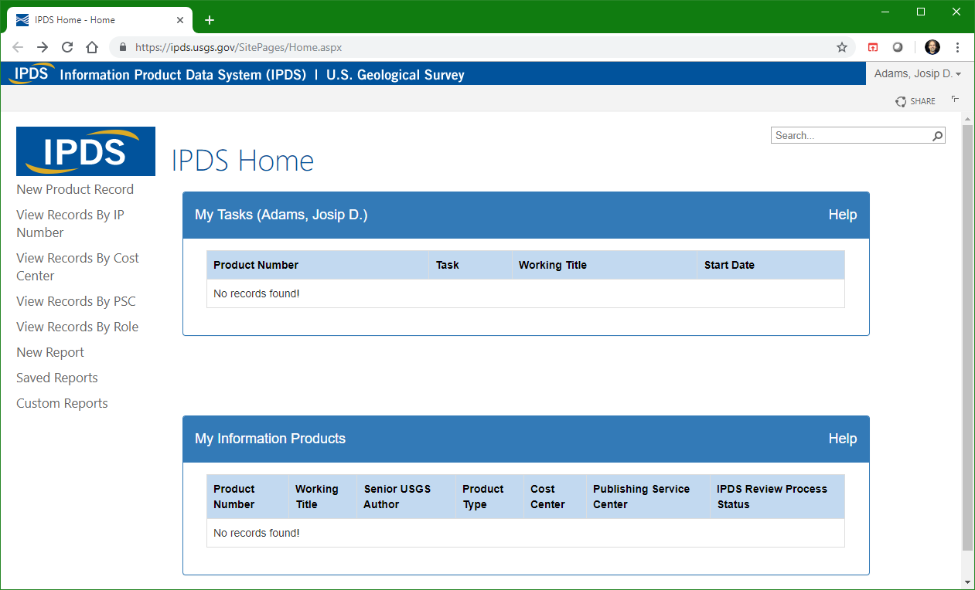

Slide 29
USGS EROS Data Center – Long Term Archive
Trusted Data Repository
Data Management and Information Delivery (DMID) project in Sioux Falls, SD
DMID is responsible for providing ingest, archive and distribution for USGS National Land Imaging (NLI) collections and other government entities.
Currently, the project manages over 14 Petabytes of data covering over 300 data collections.

Slide 30
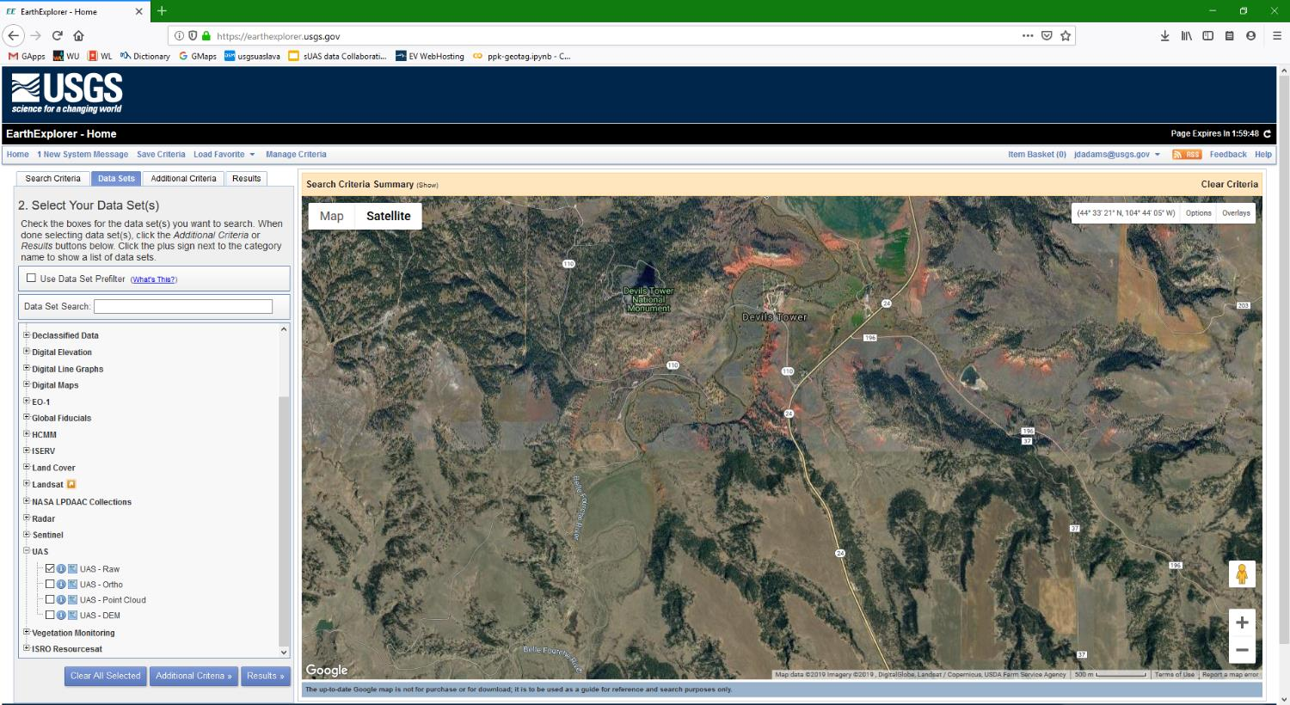

Slide 31
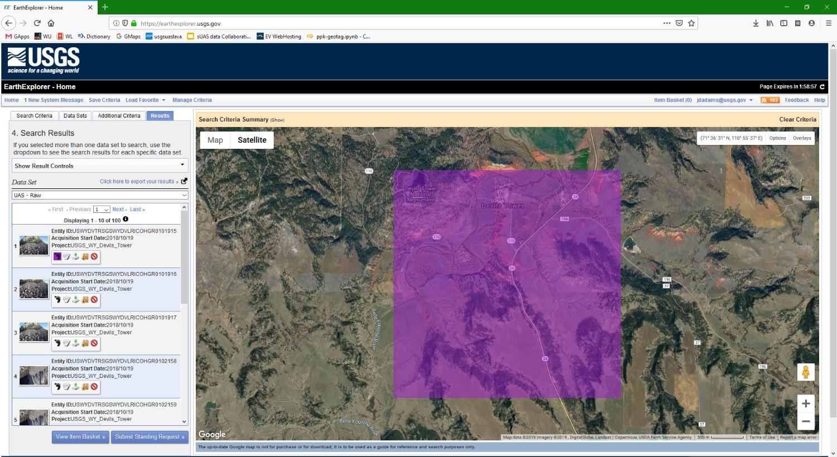

Slide 32
Woods Hole Examples in ScienceBase
https://www.sciencebase.gov/catalog/item/5c0fe16de4b0c53ecb2d1bc3
https://www.sciencebase.gov/catalog/item/5c75a7b4e4b0fe48cb4a55ad
https://www.sciencebase.gov/catalog/item/5c0009b8e4b0815414cb3d30

Slide 33
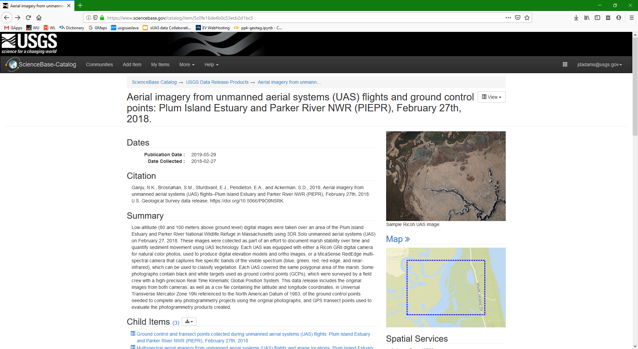

Slide 34
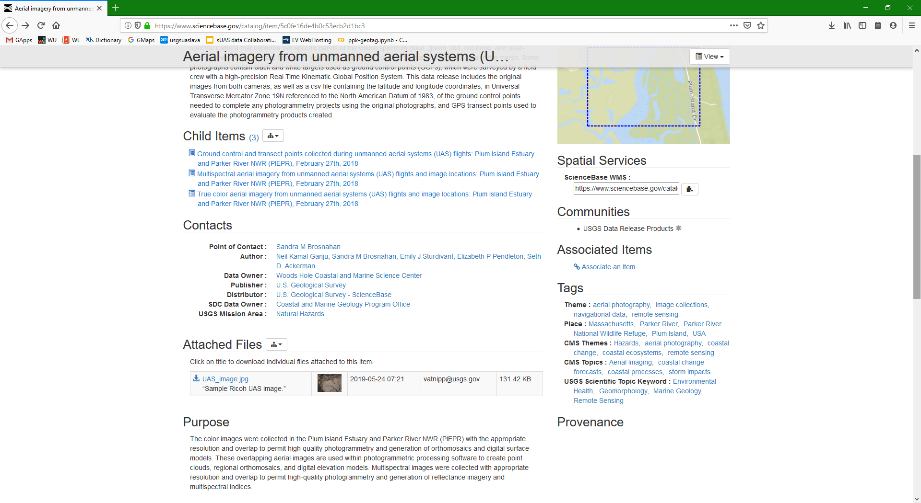

Slide 35
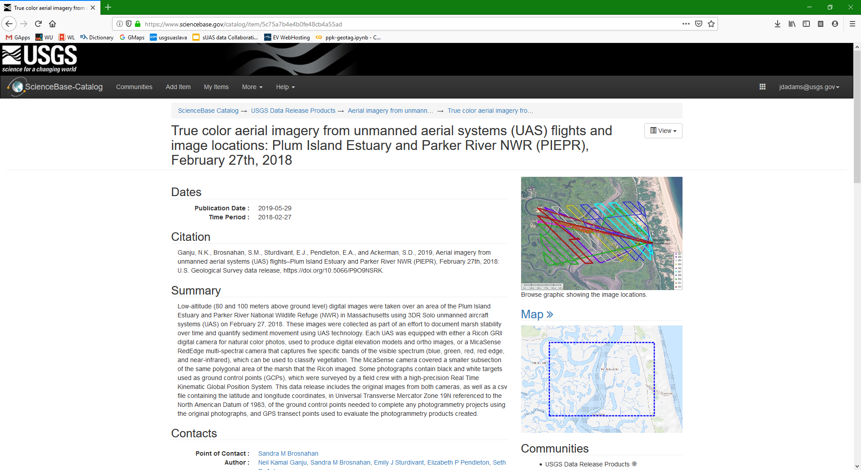

Slide 36
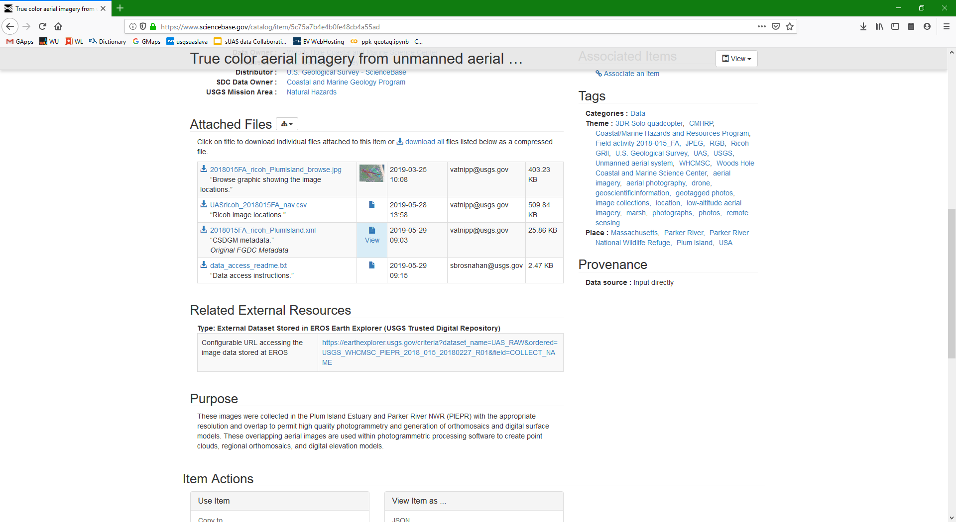

Slide 37
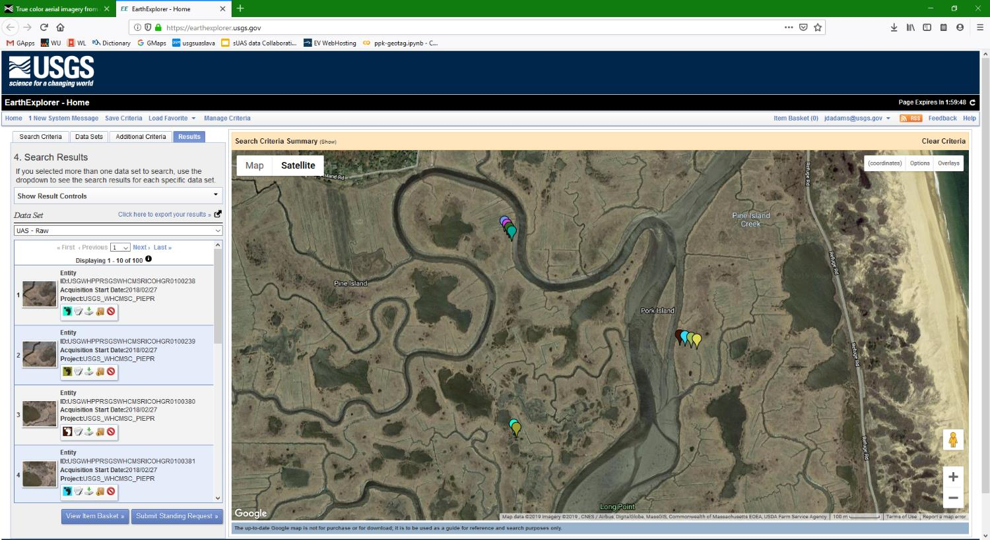

Slide 38
data.gov
USGS Catalog and Metadata Flow
Harvest
data.doi.gov
dataone.org
Harvest
Member Node
USGS Science Data Catalog (SDC)
data.usgs.gov
Once a Week
Push
Harvest
Harvest
sciencebase.gov
earthexplorer.usgs.gov
Other.gov

Slide 40
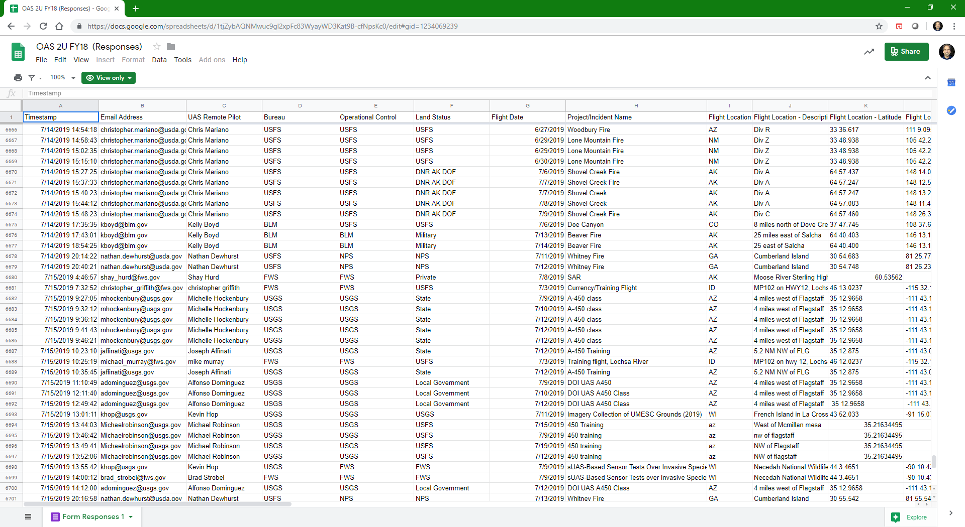

Slide 41
Phases of Data Workflow
Publish
Metadata Wizard 2.x
IPDS
Trusted Repository
EDC LTA
EarthExplorer.usgs.gov
ScienceBase.gov
Science Data Catalog
Data.gov
OAS-2U

Slide 42
Phases of Data Workflow
Plan
Collect
Process
Publish
Google Earth
Mission Planner
Global Mapper
ArcGIS
SkyVector
AirMap
Tower App
DJI Pilot PE App
Pix4DCapture App
Mission Planner
Windows Explorer
WinSCP
IrfanView
AgiSoft
Locus Map
Avenza Maps
ExifTool
GeoSetter
Mission Planner
AgiSoft
POSPac LiDAR
GlobalMapper
Cloud Compare
Camtasia Video
Metadata Wizard 2.x
IPDS
Trusted Repository
EDC LTA
EarthExplorer.usgs.gov
ScienceBase.gov
Science Data Catalog
Data.gov
OAS-2U
Knowledge
Nuggets
Automation
Joe’s Vision – Data Buddy

Slide 43
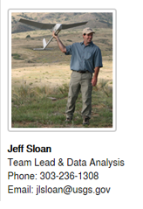
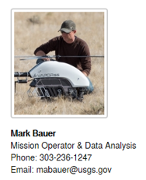
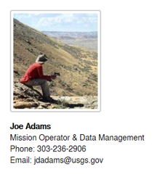
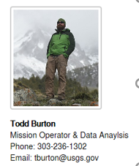
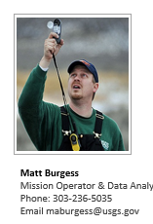
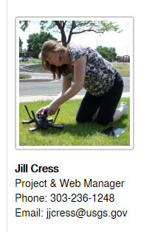
USGS National UAS Project Office
Bruce Quirk
RPAS Liaison
Phone: 703-648-5736
Email : quirk@usgs.gov

