Slide 1
Data Sharing and Management for Community Resilience: Insights from Community Science
Natasha Udu-gama, Ph.D.
15 January 2019
She/her/hers
@ThrivingEarth
Notes:
Good morning, ladies and gentlemen. I’m pleased to present to you all on Data Sharing and Management for Community Resilience: Insights from Community Science from the perspective of Thriving Earth Exchange. I am Natasha Udu-gama, a senior specialist with the team.
If you’re into social media, feel free to tweet @ThrivingEarth.

Slide 2
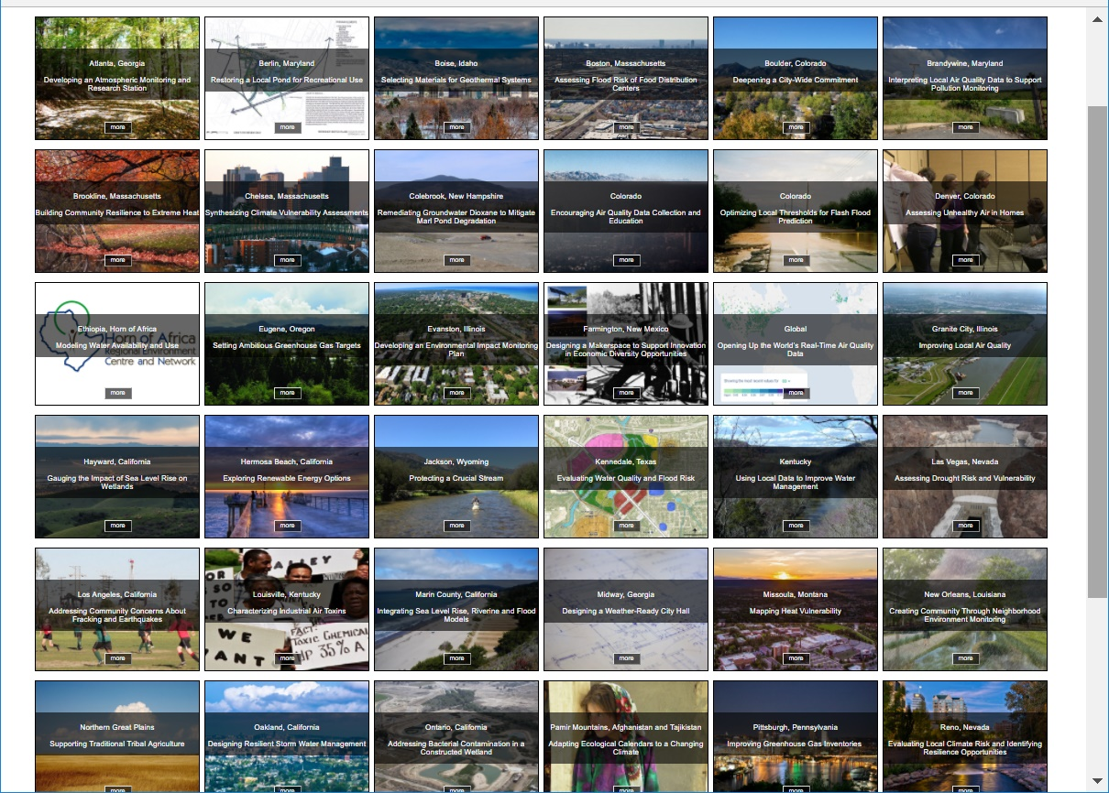
Communities and scientists working together advances diversity, equity, and inclusion
Notes:
This slide shows a portion of our all projects page.

Slide 3
Frame
Questions
Global
Reach
communities
Develop
Methods
Share
Results
scientists
Collect
Data
Local
Impact
Apply
Results
Analyze
Data
Community Science
Draw
Conclusions
Notes:
Thus,
This slide shows a circular diagram with each of these key steps in community science.

Slide 4
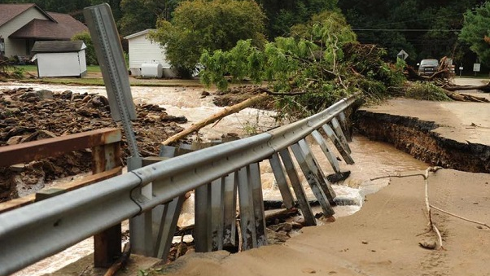
Connellsville and Bullskin Township, PA
Notes:
Background
Located 50 miles southeast of Pittsburgh in one Pennsylvania’s poorest counties
Long-time residents are hesitant to move away from the area – even in highly flood prone/repetitive loss areas due to intergenerational ties to neighborhoods and “homestead mentality”
Problem:
Increased precipitation and frequency of more extreme storms causes devastating floods
Culverts are undersize and too small for such extreme events; culverts get clogged and cause major backups
Data Challenge:
University of Pittsburgh team had trouble obtaining parcel GIS data for the county – had to have the community leader put in a number of requests to receive the data. The data helped the U of Pitt team evaluate the number of structures in Fayette Co. that are: 1) located in “geomorphic” floodplains (derived from elevation data) and 2) in watersheds smaller than 1 square mile. One-hundred year floodplains are not mapped by FEMA for this size watershed. Damage to these locations are not within the floodplain, so following intense flooding events like the 2017 events in Connellsville/Bullskin Township, these areas not eligible for federal programs.
They did end up receiving the data:
-A GIS coverage showing the locations of structures in Fayette County
-The year the structures were built in a form that can be associated with the structures.

Slide 5
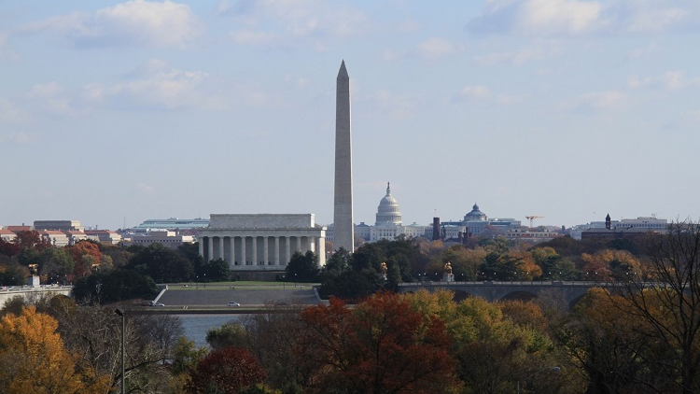
Washington, DC
Notes:
Problem:
Increased urban population and more days in summer when temperatures exceed the threshold of 95F
Low income population increasingly adversely affected by high temps.
Needed to figure out where UHI was greatest to help city plan more green spaces.
Data Challenges:
Other agencies not informed of project until after project commenced.
Scattered source data for heat vulnerability maps
Discussions centered around how to obtain heat-related data from 911 and 311 calls.
Difficult to obtain this data because it was held by a different agency and there were protocols around obtaining previous years’ 911/311 heat-related data (misunderstanding/miscommunication of the purpose)
Didn’t think about other sources of heat-related information like hospitals, nursing homes and the like, providing review of heat-related recommendations to the DC Climate Adaptation Plan.
In regards to UHI, 911 calls don’t provide information as to whether incidents are heat-related or not nor do they record key demographic information like: age, race, sex, zip code.
Moreover, source data to develop the needed heat vulnerability maps had been done by different university groups and agencies, making it difficult to obtain that data.
Outcomes and Impacts:
Goal of this project is to have a memo/white paper that will take 911 data and will overlay this on a heat sensitivity map for inclusion in the city's climate action plan. The city will then identify the top 3 areas based on 911 data, lack of green space and prevalence of vulnerable populations. This information will help the city inform grants they’d like to go after for greening and reduce overall heat in those top 3 areas.

Slide 6
Atlanta, GA
Notes:
Background
The City of Atlanta, GA is known for southern gentility,
a world-class music scene
–and 21,000 tons of environmental waste.
Problem:
Urban sprawl and the ensuing greater number of cars on the road are affecting the health of Atlanta’s citizens.
The City has collected data on emissions for the and completes an annual greenhouse gas inventory.
but no comprehensive written report on its GHG inventories that can provide analysis of the data collected for the inventory that can be used support policy decisions to reduce greenhouse gas (GHG) emissions, as well as to provide updates to the public on the status of the City in working to achieve its emissions reductions targets.
Data Challenge:
The community lead has consistently had trouble accessing GHG inventory data from other departments. There is no data sharing protocol in place and it has been exceedingly difficult to obtain any consistent data beyond that of 1 year and only in a handful of areas needed.

Slide 7
Top 5 Data Issues
Data exists, but isn't easy for decision-makers to find.
Data is findable, but hard to use because its not easy to understand and use
Whoever owns the data doesn't want to share it
Data wasn't designed to answer users primary questions, and so is interesting but not super-relevant.
No time/energy/experience with data
Notes:
Data exists, but isn't easy for decision-makers to find.
Data is findable, but hard to use because its not easy to understand and use (weird formats, lack of metadata).
Whoever owns the data doesn't want to share it (worried about loosing it, not time to respond, sharing doesn't help them).
Data wasn't designed to answer users primary questions, and so is interesting but not super-relevent.
No time/energy/experience with data

Slide 8
Thank you!
www.thrivingearthexchange.org
@ThrivingEarth
Nudu-gama@agu.org

Slide 9
Improving Science’s Use and Practice through Community Science Partnerships
For scientists:
Working with people, on shared priorities, in the places they live work and play.
Offering our science with humility and honoring what others bring.
Community Science Values
Community context & local knowledge
Trust & partnership
Collaborative planning and action
People, process, results
Community impact
Notes:
Start with partners – can they recommend communities that would be best suited to work with scientists? Do they have the point of contact, time and resources to devote to working with a pro bono scientist?
What are the community’s issues? What are the priorities? Do they relate to climate change, natural hazards and/or natural resources?
Are there any ongoing funding streams/deadlines/requirements that make one issue more of a priority?
Scoping conversations – having a series of conversations to determine the structure of the project with community leaders and others that might have a stake in the project’s impact.
Finding scientists willing to work the community scope.
Community leaders and selected scientist(s) are willing to work together to re-scope the project a little to suit selected scientist(s) expertise and availability.
Encourage teams to meet each other soon after matching to learn about each other’s communications styles and hash out a way to develop a project plan.

