Slide 1
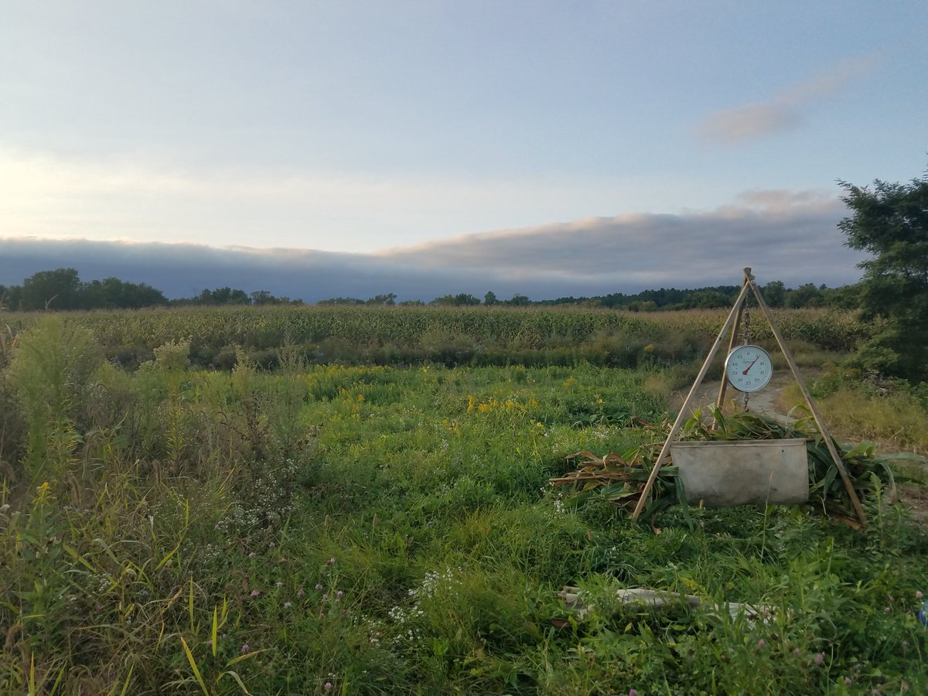
Soil Data:
Earth Science Data Analytics (ESDA Cluster)
&
Connections
&
Discussion
Lindsay Barbieri
Gund Institute, University of Vermont
@barbieriiv
lindsay.barbieri@uvm.edu
Agricultural Research
Emerging Technologies & Analytics
Soil Data & Information
for Climate
Change

Slide 2
Agriculture & Soil Data:
Scaling Up Knowledge
& Multiple Uses
Food
Production and Adaptation
Food and livelihood security
Increasing yields, improving adaptability
Water
Mitigate
Eutrophication of waterbodies
Overuse of water
Terrestrial
Mitigate
Land use and land cover change
Biodiversity loss
Climate
Mitigate
Greenhouse gas emissions
Carbon sequestration

Slide 3
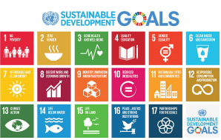
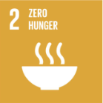
Agriculture & Soil Data:
Scaling Up Knowledge
& Multiple Uses
Food
Production and Adaptation
Food and livelihood security
Increasing yields, improving adaptability
Water
Mitigate
Eutrophication of waterbodies
Overuse of water
Terrestrial
Mitigate
Land use and land cover change
Biodiversity loss
Climate
Mitigate
Greenhouse gas emissions
Carbon sequestration

Slide 4
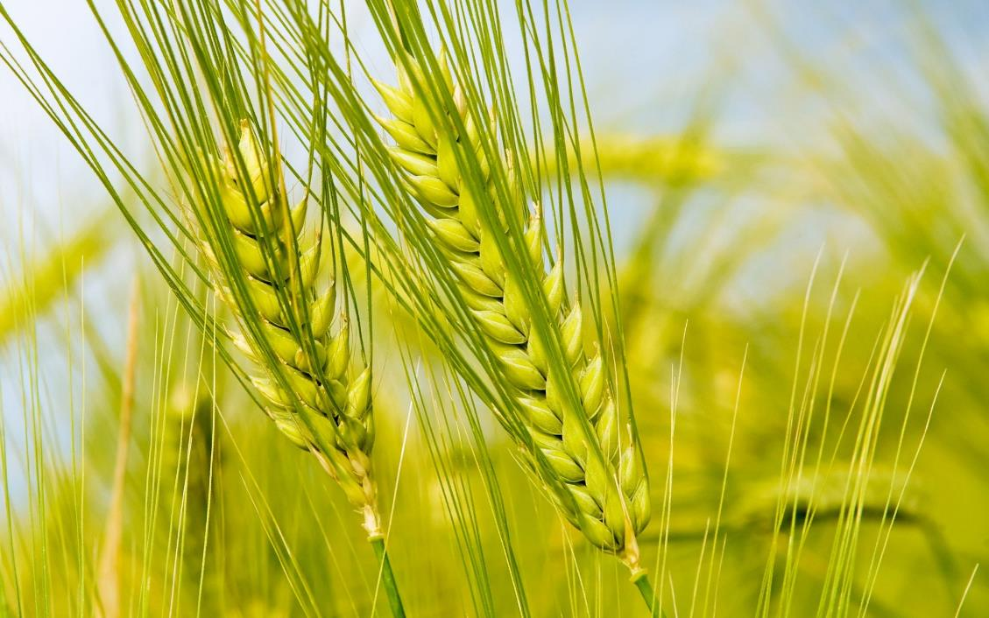
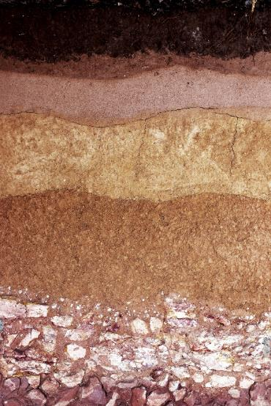
Advancing interoperable soil data exchange for global soil data information systems
Fenny van Egmond, Bas Kempen, Niels Batjes, Luis de Sousa, Eloi Ribeiro
Wageningen, 2018

Slide 5
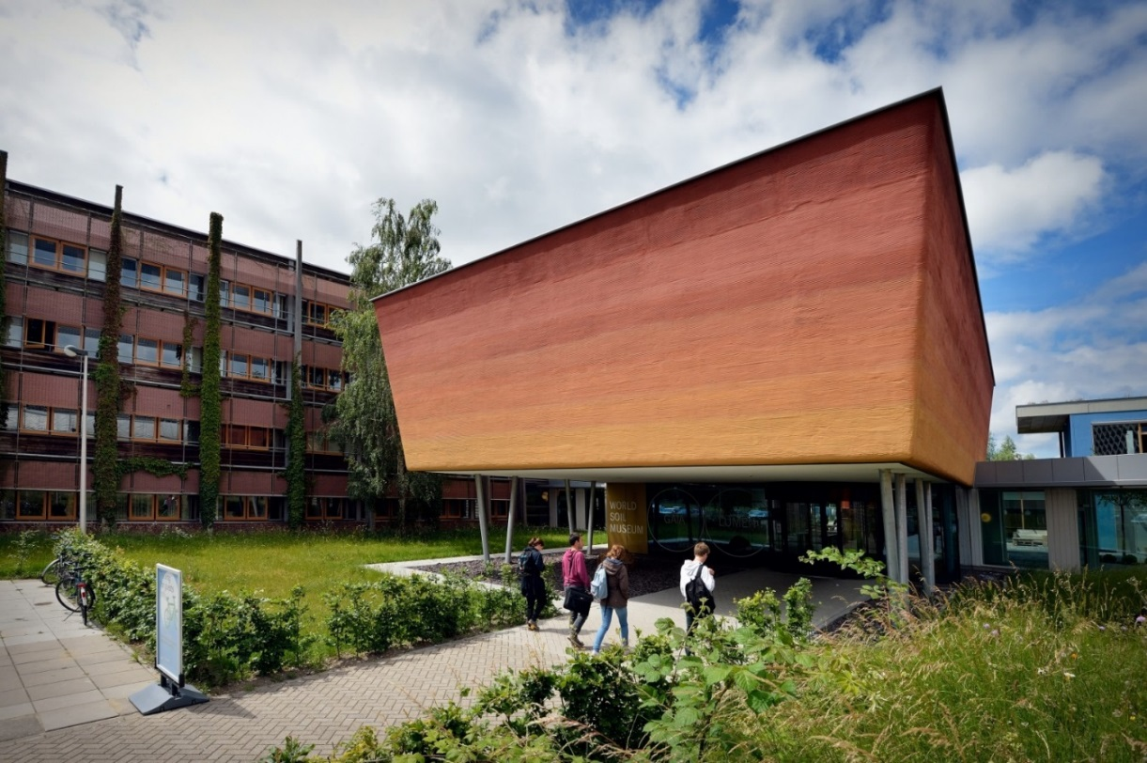
ISRIC – World Soil Information
Founded in 1966, upon recommendation of UNESCO, FAO and IUSS
Independent foundation based in Wageningen, Netherlands
Cooperation agreement with Wageningen University.
Accredited as the World Data Centre for Soils (WDC – Soils) by the International Council for Science
Participating Organisation of the Intergovernmental Group on Earth Observations (GEO)
Global Soil Partnership, hosting the Soil Data Facility (pillar 4, 5)
Vision: A world where reliable and relevant soil information is freely-available and properly used to address global environmental and social challenges.

Slide 6
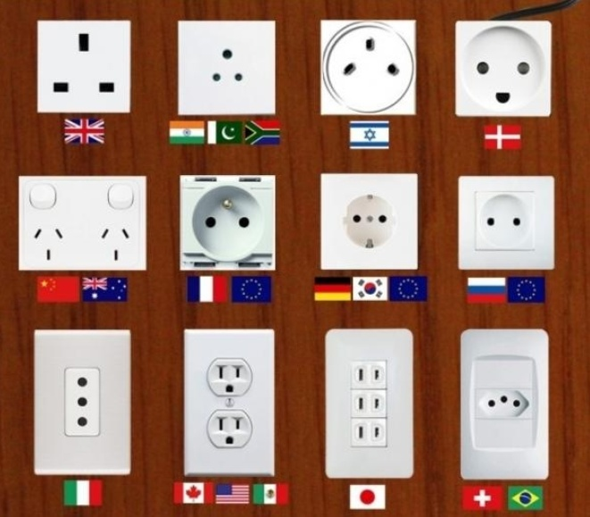
Problem space
Standardisation and harmonisation in collection, storage and exchange is needed

Slide 7
Therefore are we working on:
ISRIC has a centralized soil information system and infrastructure (WoSIS (points), Soilgrids, global ref. collection, scanned soil maps)
Global Soil Partnership is building a federated SIS (GloSIS)
Work on soil data interoperability is done in several communities.
Local institutes are collating their own SIS
This is a challenge at national scales as well as on a global scale
But one organisation can never do this alone aiming at:
Standardised and harmonised soil data and information
to increase the impact of (global) soil information

Slide 8
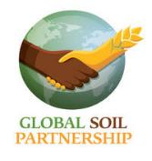
Towards a Global Soil Information System
Global Soil Partnership - Country level (INSII) - institutional:
Pillar 4 - soil information
Pillar 5 - harmonisation
National support: country driven
Global network and agenda setting
Global Soil Information System GLOSIS (to be build)
GSP Soil Data Facility hosted by ISRIC needs and will build tools for distributed systems
Wants to use formats/structures that are internationally accepted
http://www.fao.org/global-soil-partnership/pillars-action/

Slide 9
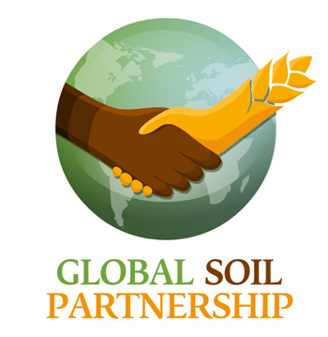
The Global Soil Partnership
GloSIS:
Soil profile databases (Tier 1, Tier 2)
Global polygon coverage, as replacement of FAO/UNESCO SMotW, 1:5M
Global Grids:
Harmonized World Soil Database, version 2
Fine-resolution grid of soil properties, version 0 (collation of grids, 1km)
Fine resolution grid of soil properties, version 1 (harmonized, <1km)
Guidelines and capacity development for implementation.
SoilSTAT:
Foreseen system for monitoring, forecasting and status reporting of the soil resource.
Addition to the FAOSTAT family of reporting systems.

Slide 10
GloSIS Guiding Principles
Infrastructure bringing together soil information collected by (national) institutions in a de-centralized way.
GloSIS is to be a federation of soil information systems.
Source institutions retain their data and control access.
Data sharing according to data policy of data providers.
Implementation that is lightweight, cheap to deploy, “simple”.
Based on open source software.
Should empower countries (and other data providers) to develop their national soil information system as a centre for national soil information.

Slide 11
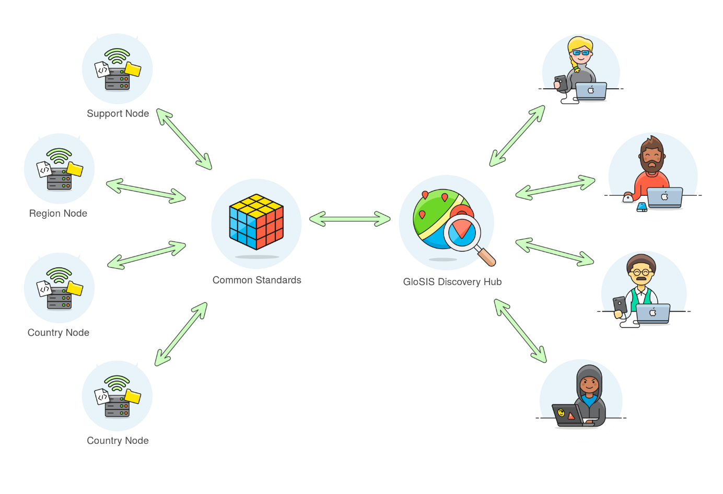
GSP Soil Data Facility
Recent developments

Slide 12
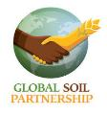
Initiatives on soil data standards
Ag domain WG
Pillar 5 WG
Soil data WG
ISO 28258
IUSS WG - SIS

Slide 13
IUSS WG on Soil Information Standards
To develop, promote and maintain internationally recognized and adopted standards for the exchange and collation of consistent harmonized soils data and information worldwide.
Vocabularies for SoilML
Use cases
Capacity building
https://www.iuss.org/
Scientific soil science community

Slide 14
GODAN Working Group on Soil Data
GODAN Soil data working group:
Since April 2017
70 subscribers,46 organisations
10 international presentations
Advocacy for SoilML
Use cases
Capacity building
Public private agriculture and nutrition community
http://www.godan.info/working-groups/soil-data

Slide 15
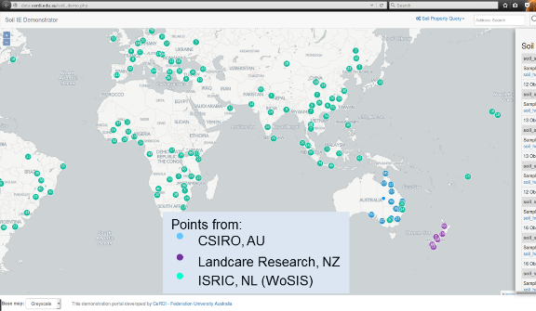
Use case: OGC IE
Three organizations providing data using the same standard (Soil-IE-ML) in an interoperable manner
Global studies need data from multiple data sources in 1 format, currently that’s hardly available:
SoilML enables that by proposing a new core model (including GML/XML schema);
The IE experiment
proves that it works:
Next step is v2.0

Slide 16
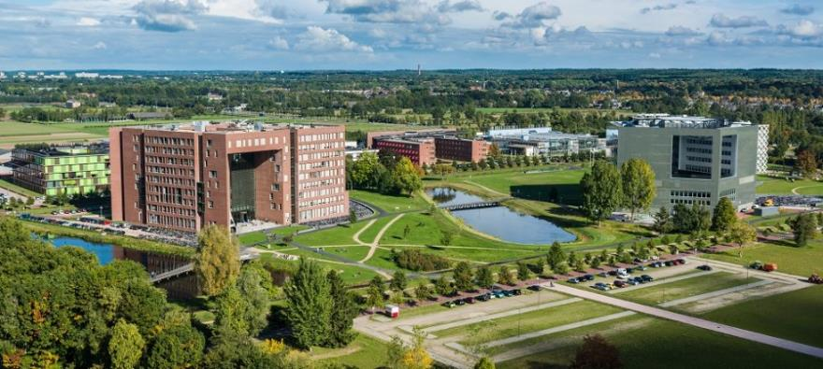
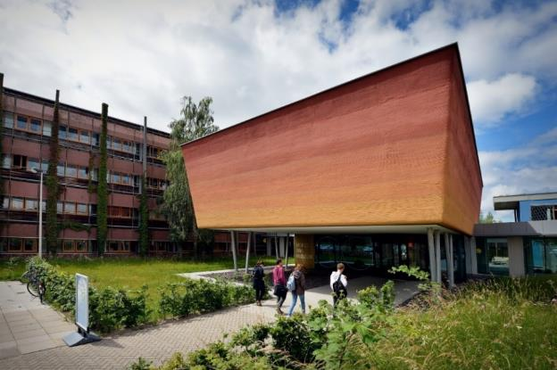
The aim is to be able to provide FAIR Linked Open Soil Data for regional and global studies without spending half of the budget on data preparation and harmonisation within each project.
More information:
fenny.vanegmond@wur.nl
www.isric.org

Slide 17
Soil Data: Discussion
- Challenging stages in Soil Data “lifecycle” or infrastructure (e.g. Data formats, Data standards, Metadata, Computational tools, Repositories)
- New Initiatives for Soil Data Integration (e.g. Communities of Practice, Technologies, Analytics, Databases & Information Systems)
- Future Directions (Research Data Alliance, ESIP Summer & beyond!)
Lindsay.Barbieri@uvm.edu @barbieriiv

