Slide 1
ESIP Working Session Some basics of deep learning in Agriculture
Ziheng Sun
Jan 17 2019 11:00am-12:30pm
ESIP Winter
Notes:
Some images come from Internet. No responsibility claimed.

Slide 2
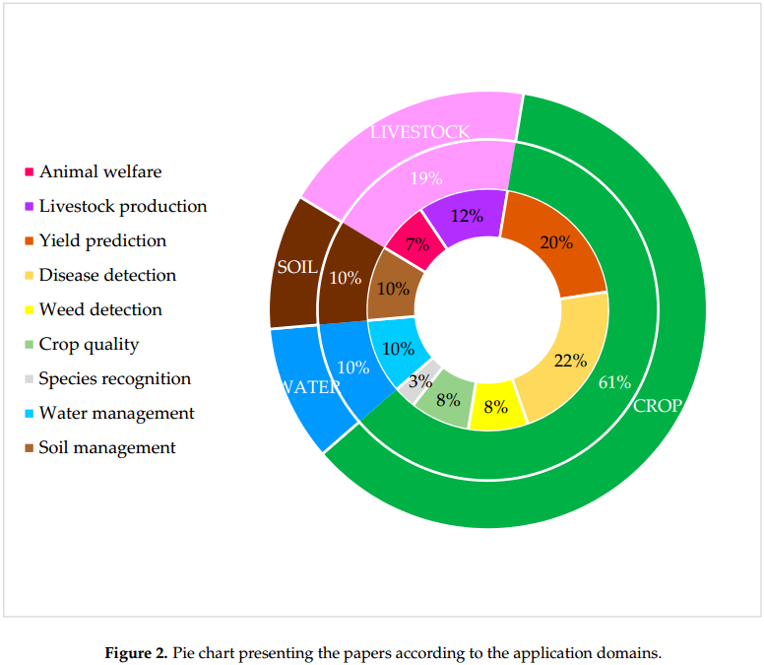
What can deep learning help with in agriculture?
Konstantinos G. Liakos et al, Machine Learning in Agriculture: A Review

Slide 3
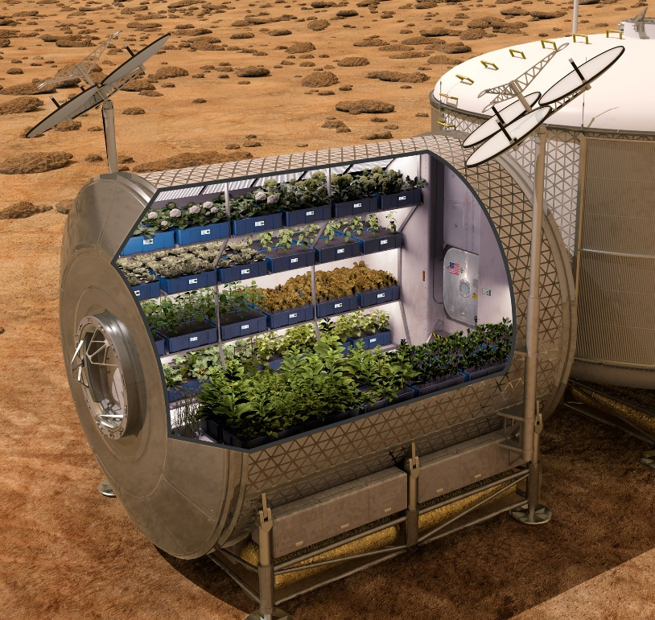
What future will agriculture be led to?
Precise Agriculture
Intelligent Agriculture
Smart Agriculture
Space Agriculture
Notes:
Image source: https://www.bouldercounty.org/open-space/management/agriculture/
https://www.agriculture.com/technology/crop-management/farming-in-space

Slide 4
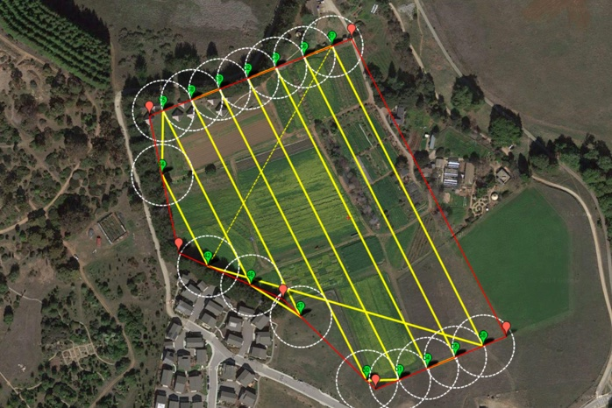
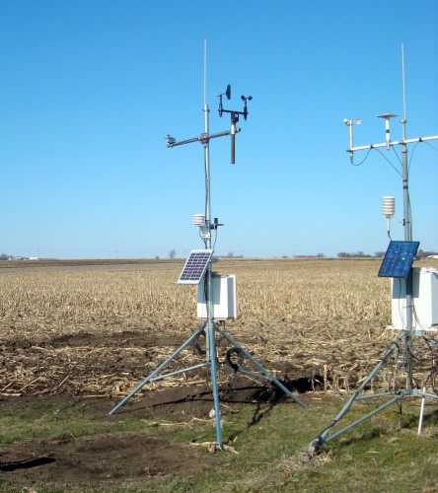
What datasets are available?
Landsat 5, 7, 8 TM, OLI
Sentinel 1, 2
MODIS Aqua & Terra
National Land Cover Database
USDA NASS
CubeSat
Farmer Reports
UAV
Weather/Soil Moisture Station
Field Survey
Notes:
Image source: https://bestdroneforthejob.com/drone-buying-guides/agriculture-drone-buyers-guide/
https://www.cals.iastate.edu/news/releases/new-iowa-state-university-weather-stations-monitor-soil-moisture

Slide 5
What deep learning methods can we use?
Method
Convolutional Neural Network (CNN)
Recurrent Neural Network (RNN)
Segnet CNN
U-net CNN
Resnet CNN
Yolo CNN
Mask R-CNN
DeepLabv3
GRU RNN
LSTM RNN
LSTM RCNN

Slide 6
Deep learning libraries
Theano
Mxnet
Chainer
CNTK
Deeplearning4j
PyTorch
Torch
Keras
Tensorflow
Caffe/Caffe2

Slide 7
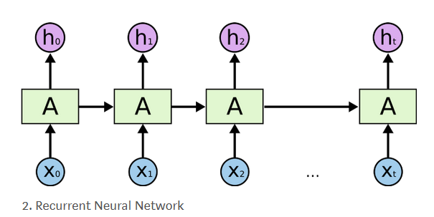
Choose your network type
Feedforward Neural Network
Image Recognition
Classification
Recurrent Neural Network
Speech recognition
Text translation
Time series prediction.

Slide 8
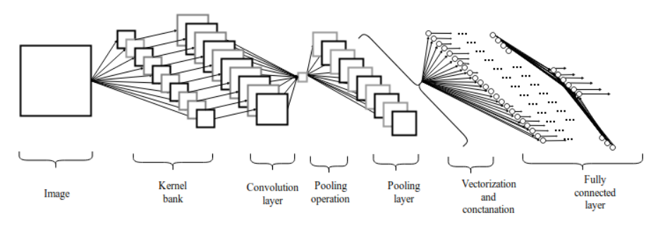
Feedforward Convolutional NN (ConvNet)
A simple ConvNet is a sequence of layers, and every layer of a ConvNet transforms one volume of activations to another through a differentiable function. We use three main types of layers to build ConvNet architectures: Convolutional Layer, Pooling Layer, and Fully-Connected Layer (exactly as seen in regular Neural Networks). We will stack these layers to form a full ConvNet architecture. – Stanford CS231n

Slide 9
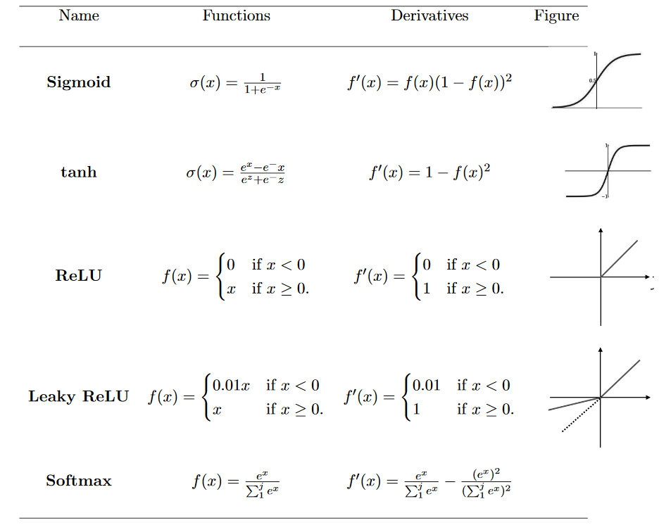
Activation

Slide 10
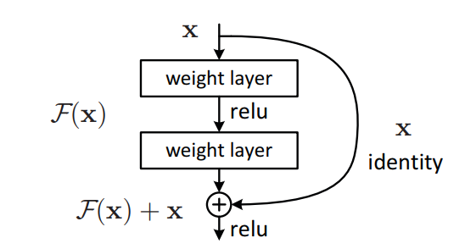
ResNet
Kaiming He, Deep Residual Learning for Image Recognition

Slide 11
Mask R-CNN
Kaiming He, et al, Mask R-CNN

Slide 12
Segnet
Vijay Badrinarayanan et al, SegNet: A Deep Convolutional Encoder-Decoder Architecture for Robust Semantic Pixel-Wise Labelling

Slide 13
U-net
Olaf Ronneberge et al, U-Net: Convolutional Networks for Biomedical Image Segmentation

Slide 14
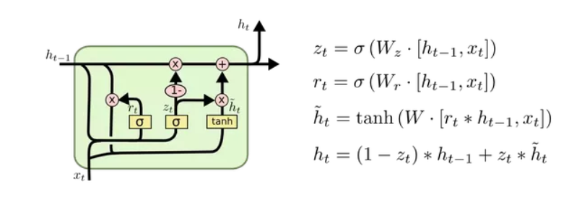
GRU RNN
GRU: Gated Recurrent Unit
Notes:
https://medium.com/@saurabh.rathor092/simple-rnn-vs-gru-vs-lstm-difference-lies-in-more-flexible-control-5f33e07b1e57

Slide 15
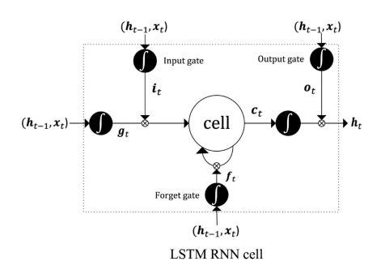
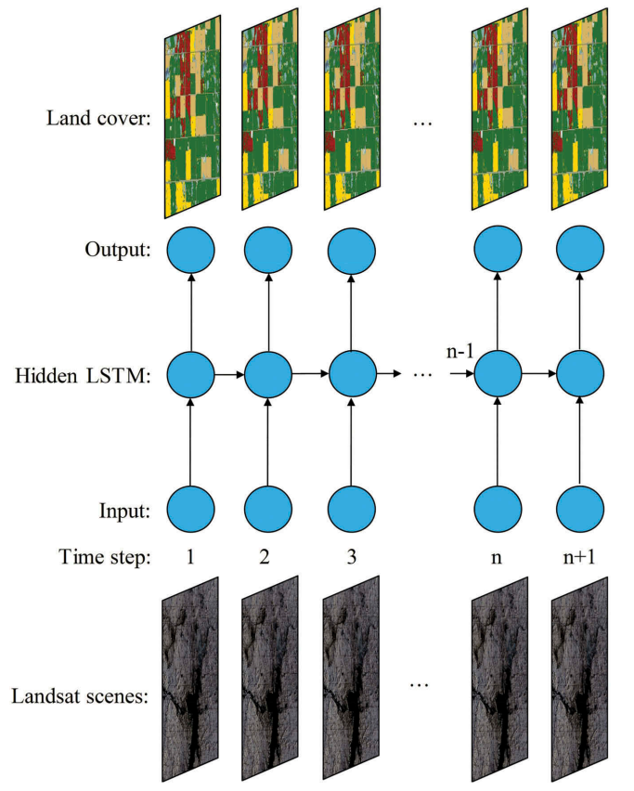
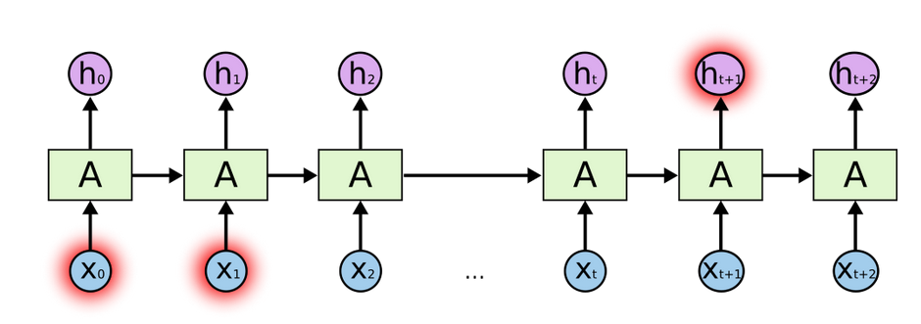
LSTM RNN
LSTM: Long Short Term Memory
Notes:
https://towardsdatascience.com/introduction-to-sequence-models-rnn-bidirectional-rnn-lstm-gru-73927ec9df15
Sun et al, Using long short-term memory recurrent neural network in land cover classification on Landsat and Cropland data layer time series, International Journal of Remote Sensing

Slide 16
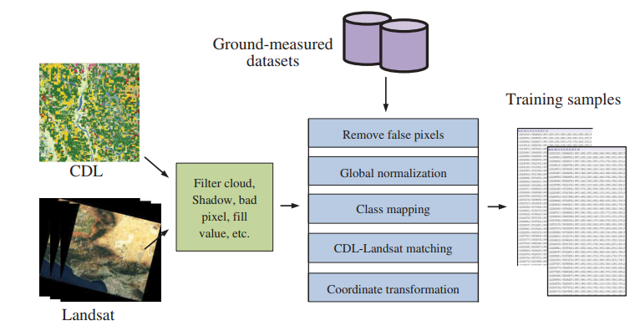
Data Preprocessing
Take ~70% of the time

Slide 17
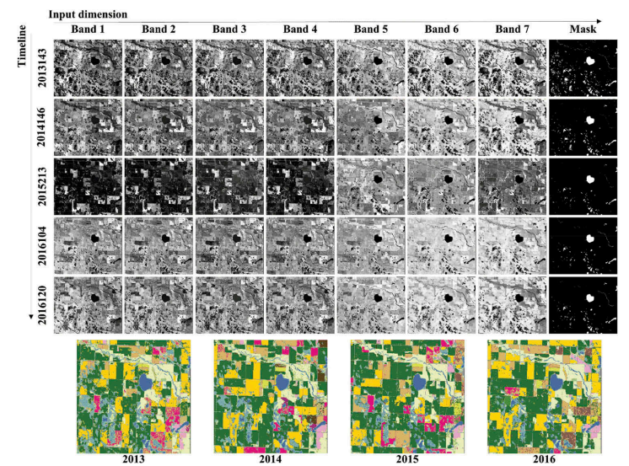
Training Dataset

Slide 18
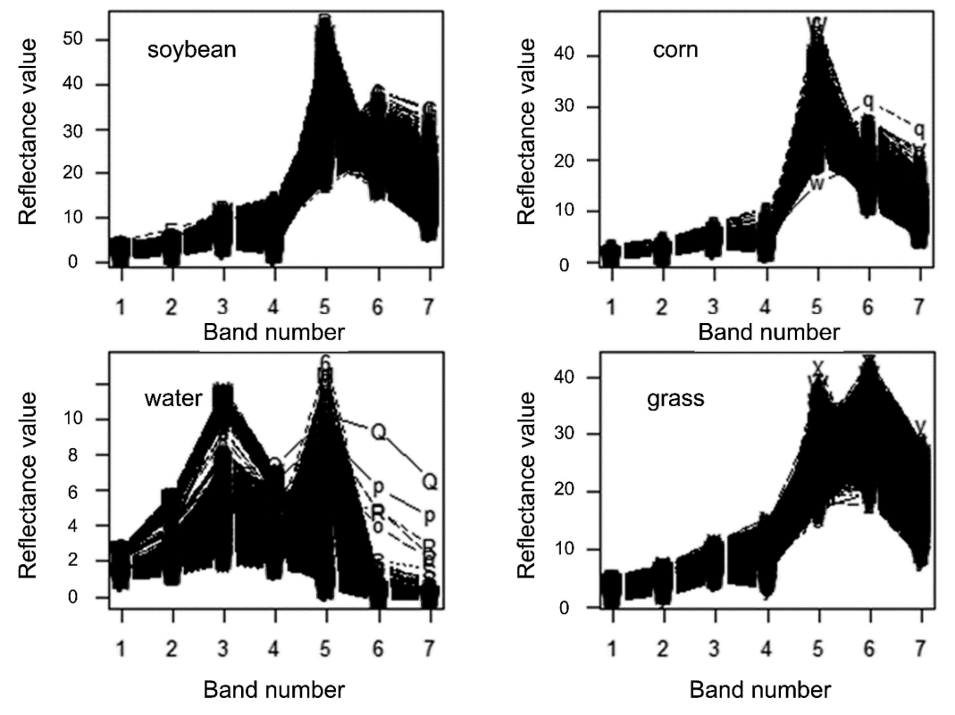
Landsat Spectral Characteristics

Slide 19
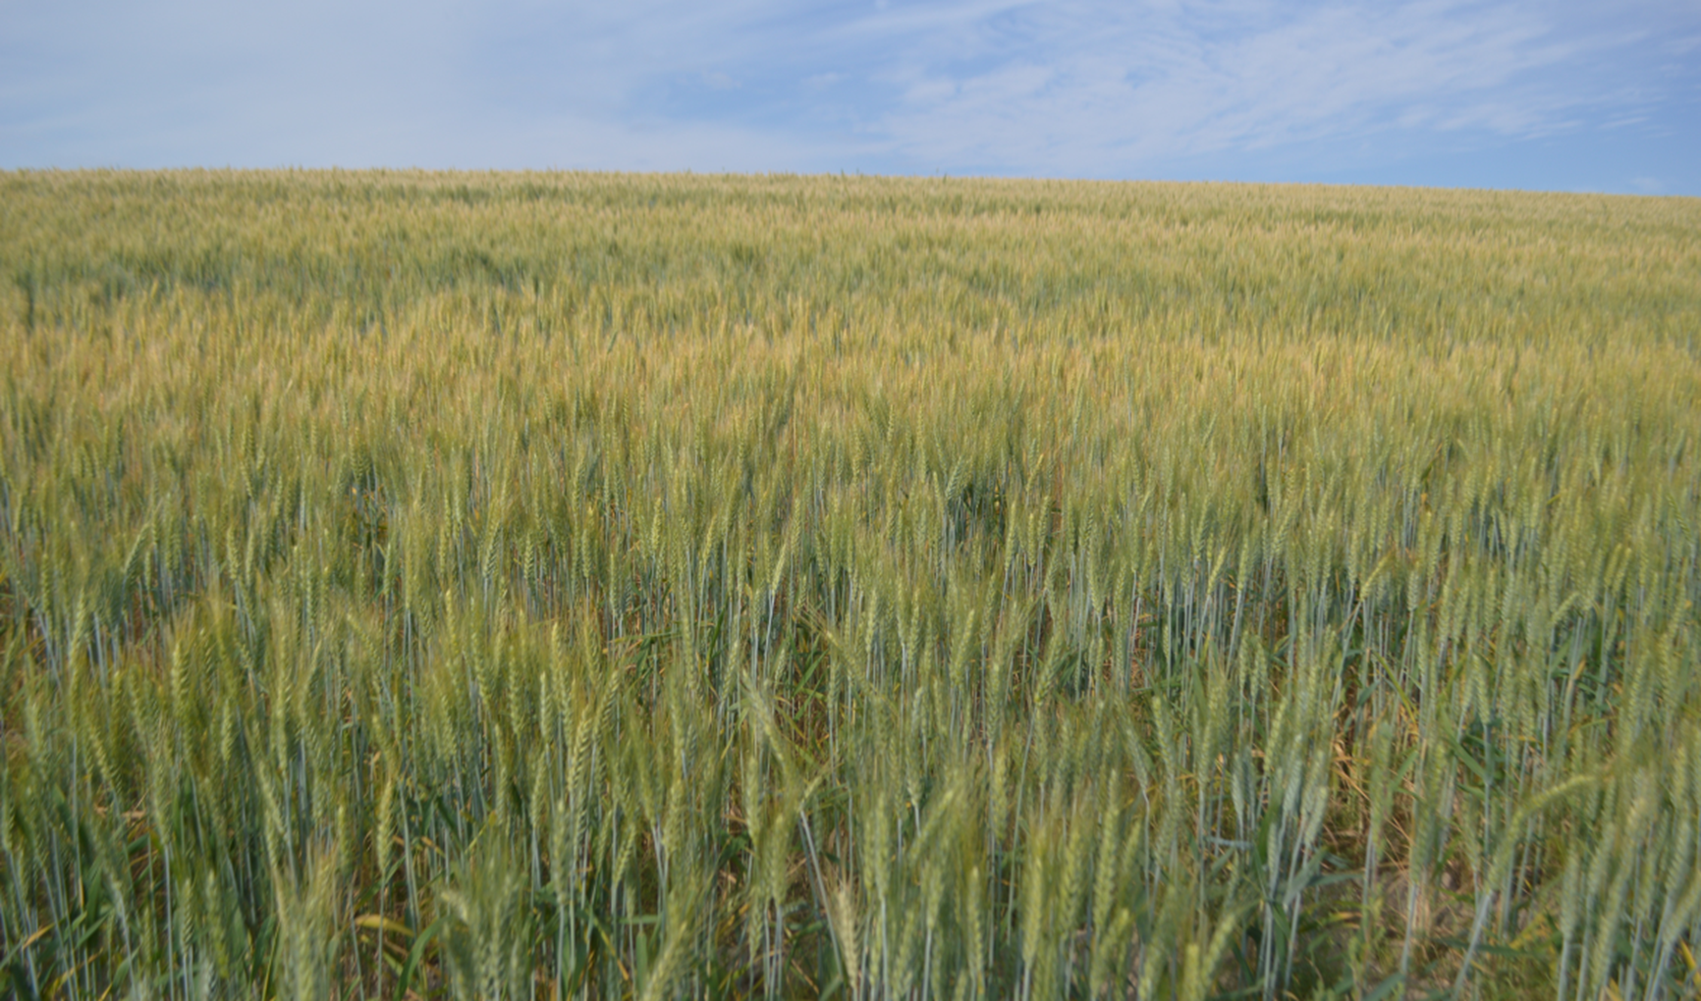
Field Survey
Take geotagged photos
Get samples
Fill record forms
Measure dynamics

Slide 20
Training
Hardware
HPC Cluster
GPU: P100, K80, Google TPU
Cloud
Terminology
Time Step: one run of network
Batch: the number of samples used during one iteration
Epoch: one pass over the full training dataset

Slide 21
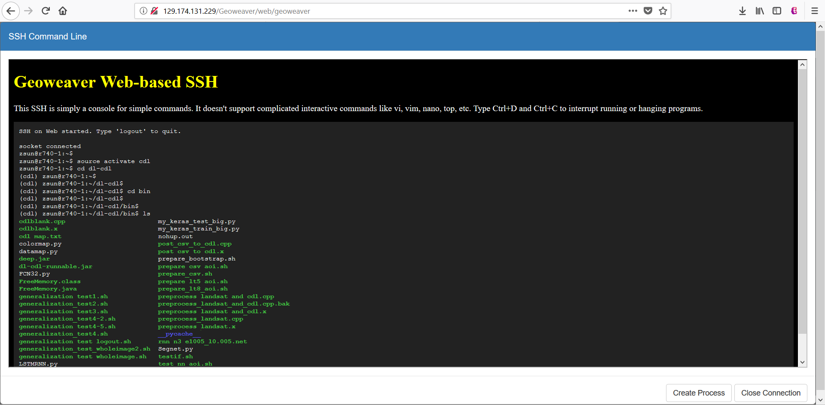
Training on Geoweaver

Slide 22
Training & Watching

Slide 23
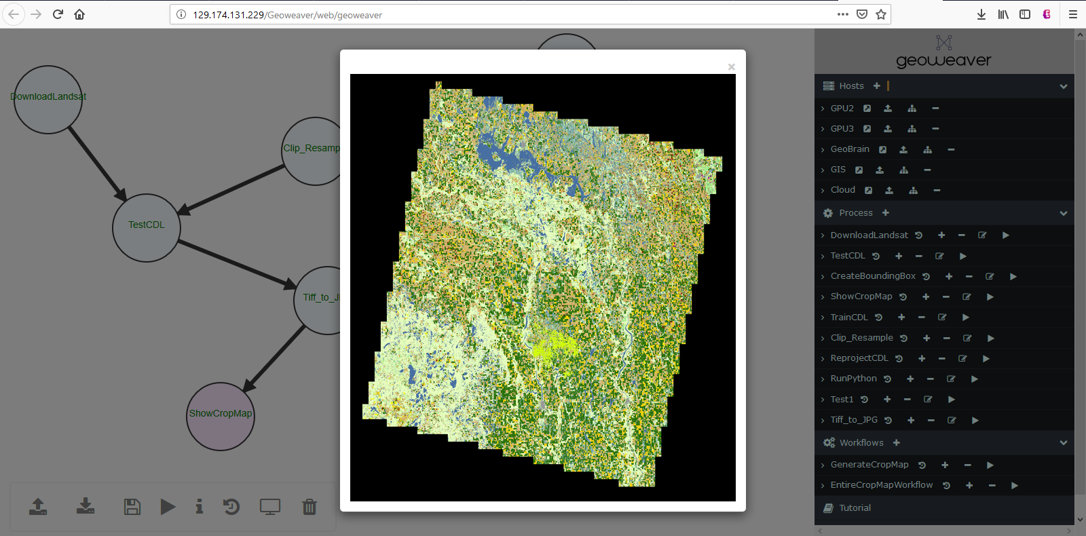
Testing on Geoweaver

Slide 24
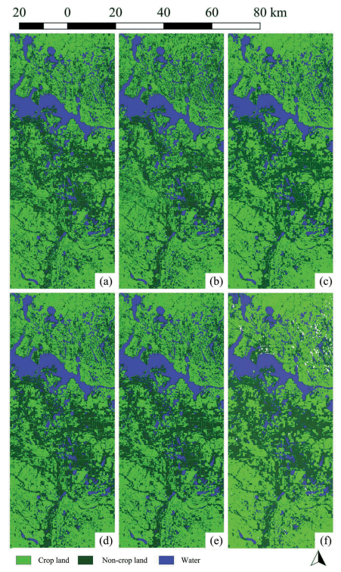
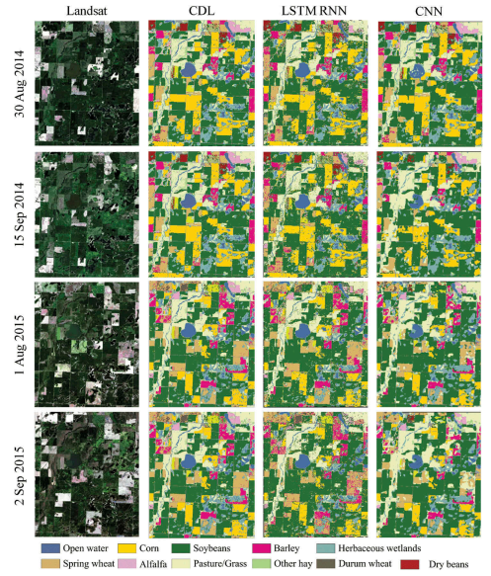
Classification Result
>97%
>88%

Slide 25
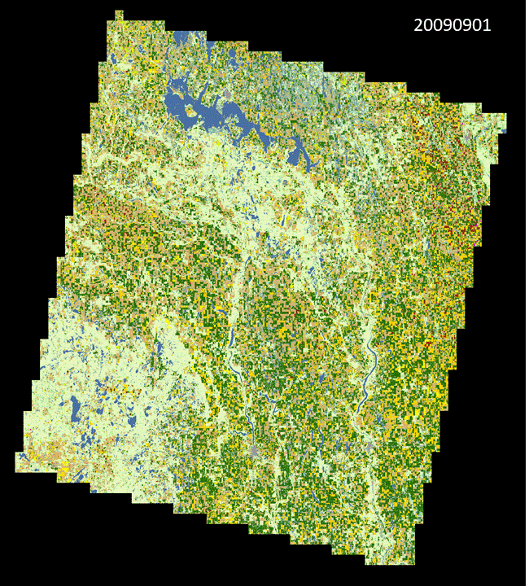
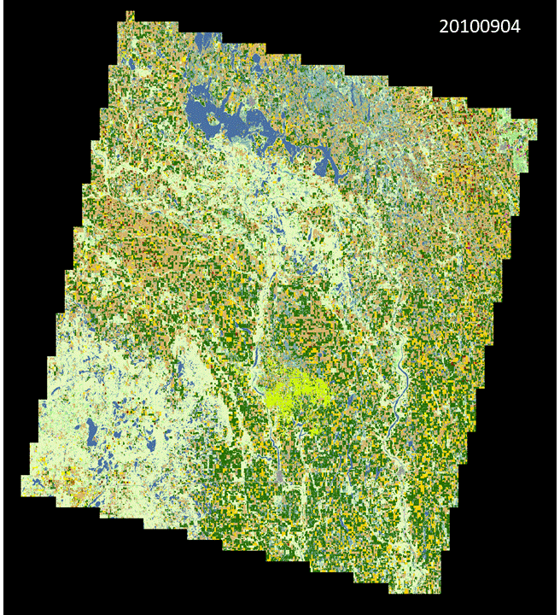
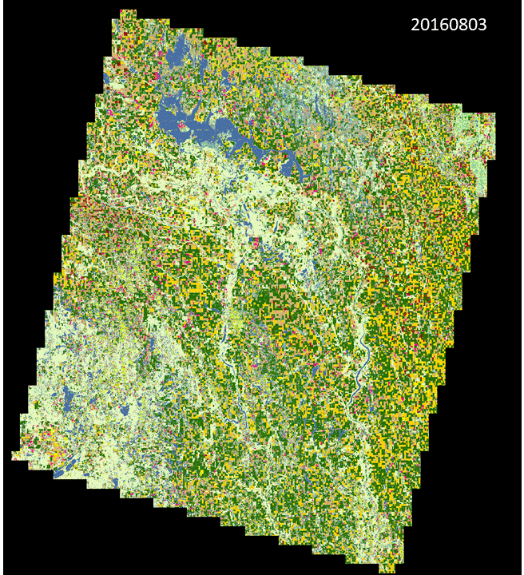
Crop Rotation Pattern By DNN

Slide 26
Lessons Learned
Don’t use September network on July data!
The difference per season is huge
Location matters!
Overfitting is very hard to avoid
Training dataset is the key to success
Training takes longer than your plan
Version control and provenance tracing of deep learning model and results are headache without tool

Slide 27
What we will cover today?
Group discussion
How can agriculture benefit from deep learning?
Any ideas on using deep learning in your research?
How can ESIP community collaborate and contribute to this effort?

Slide 28
Thank you!!!
End
Contact: Ziheng Sun zsun@gmu.edu; Liping Di ldi@gmu.edu; Annie Burgess annieburgess@esipfed.org

