Slide 1
SCIENTIFIC COMMUNITY CURATED EXTRACTORS
Presented by Ben Galewsky (bengal1@Illinois.edu)

Slide 2
National Center for Supercomputing Applications
Technology behind significant scientific research in:
  Astrophysics
  Earth Science
  High Energy Physics
  Cosmology
  Materials Science
  Agriculture
  Bioinformatics

Slide 3

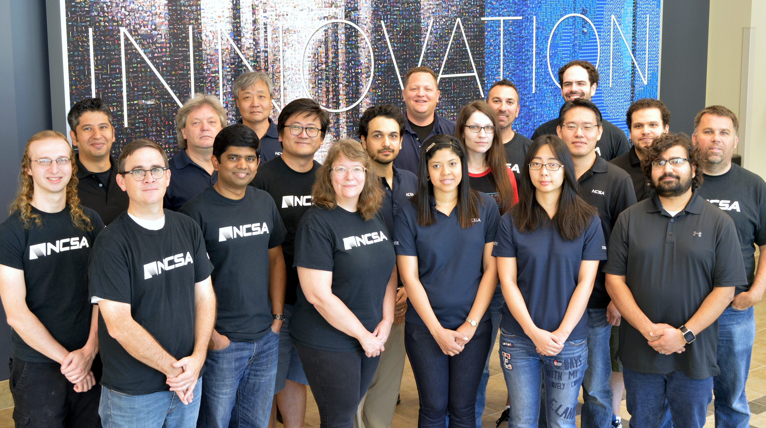
Research & Development
Reusable software tools & frameworks for data analysis
Bridging and amplifying efforts across different projects
New custom software tools & frameworks

Slide 4
Overview
What do we mean by extractors?
What are some examples?
How can they be shared?
What would scientific community curation look like?
A call to action!

Slide 5
“Metadata”
Information that can be extracted from a datafile that might be useful for:
  Searches
  Additional computation steps
  Repurposing of data
Examples:
  OCR an Image
  Compute the sinuosity of a river valley
  Convert temperature readings to Celsius

Slide 6
Real-World Examples
David LeBauer
  Director of Data Science, Arizona Experiment Station
Kunxuan Wang
  PhD student, University of Illinois, Civil and Environmental Engineering
Bob Dattore
  NCAR Research Data Archive

Slide 7
How Can Extractors be Shared?
Python Libraries
Web Services?
A Global Data Transformation Service!

Slide 8
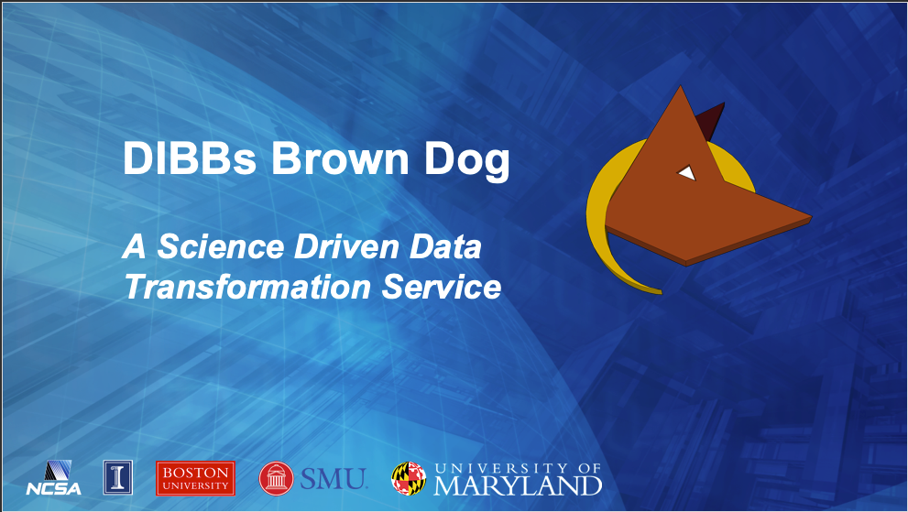
How Can Extractors be Shared?
Python Libraries
Web Services?
A Global Data Transformation Service!

Slide 9

NSF Data Infrastructure Building Blocks
National Science Foundation in 2012 Sought Proposals that:
  “develop robust, scalable, well-designed cyberinfrastructure contributing to future discovery and innovation across disciplines”

Slide 10
Cyberinfrastructure Process Model
Data Acquired
Data Enriched
Data Curated
Problem Space Explored
Hypothesis Tested
Research Reviewed
Research Published
Community Educated
Research Discovered
Scientific process described as a series of outcomes

Slide 11
Data Enriched
Data Acquired
Data Enriched
Data Curated
Problem Space Explored
Hypothesis Tested
Research Reviewed
Research Published
Community Educated
Research Discovered
Derived data is extracted from files
Data cleaning processes are executed
Machine learning models assign clusters to data
Machine learning models detect features
Popular Technologies:
  Brown Dog
  Clowder

Slide 12
Many Ways to Transform Files
Command Line Interface
Python SDK
Box Skill
Windows Client
Excel Plugin

Slide 13






Architecture
Web Browser (BDFiddle)
Clients
(e.g. BDCLI, …)
HTTP/HTTPS
RabbitMQ (Event Bus)
HTTP/HTTPS
Fence (API Gateway)
NGINX (Load balancer)
NGINX (Load balancer)
Polyglot
…
Polyglot
Clowder
Clowder
…
MongoDB
MongoDB (Data, Metadata)
Converter (Software Server)
Converter (Software Server)
Extractor
Extractor
…
…
Conversions
Extractions

Slide 14
How Extractors are Deployed
Dockerized tools
Deployed into Docker Swarm
RabbitMQ distributes extract requests
Global Brown Dog Service
Locally hosted instance
Hybrid routing

Slide 15
Community Curation
Follow a GitHub Open Source Workflow
  Open Source Repository for Extractor
  Community reports issues
  Community submits pull requests
  Committers decide what receives official publication
  Extractor releases should receive a DOI
  Community members always have the freedom to fork

Slide 16
Curation Workflow
Fan, Qiang & Yu, Yue & Yin, Gang & Wang, Tao & Wang, Huaimin. (2017). Where Is the Road for Issue Reports Classification Based on Text Mining?.
121-130. 10.1109/ESEM.2017.19.

Slide 17
bengal1@Illinois.edu

