Slide 1
ESIPHub
Services and infrastructure to support computational geosciences
education, research and collaboration
with JupyterHub
Winter 2019 Incubator Project Update

Slide 2
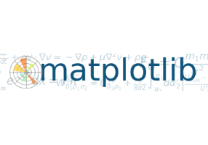
ESIPHub | Project Goals
BROAD PROJECT GOALS
1
provide ESIP community with shared resources based on current tools, platforms and workflows to support computational geoscience inquiry for experimentation, collaboration, education and research
2
develop skill and capacity for workshop support and expansion of platform at 2018 ESIP summer meeting and beyond
3
sustain stable long-term platform for continued use in varied ESIP projects and communities

Slide 3
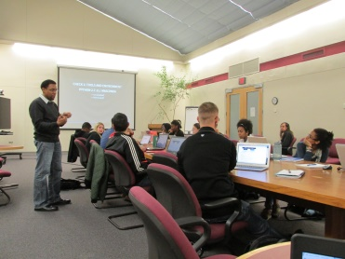
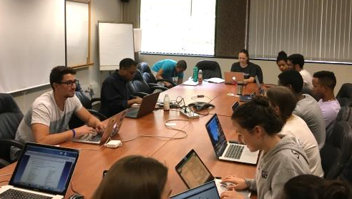
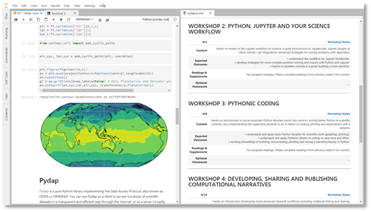
ESIPHub | Project initialization
Summer 2018
ESIPHub Pilot with UCAR SOARS
ESIPHub piloted at UCAR summer research programs
Computational thinking and data science workshops
OUTCOMES
Refined operating environment
Developed experience with infrastructure scaling

Slide 4
ESIPHub | Project initialization
Summer 2018
Metadata Evaluation Lab at ESIP: Assessing if community metadata is ready for Schema.org (Sean Gordon • John Relph)
Custom Built Jupyter Widgets for Earth Science (Tyler Erickson • Sean Gordon)
Interactive Data Analysis on Cloud Environment (Frank Greguska • Thomas Huang • Joe Jacob • Rich Signell)

Slide 5
ESIPHub | Lessons learned
Scalability should be a principal concern
Platform more compelling in directed contexts (workshops)
Sharing and collaboration model still needs refinement (e.g. /shared, etc.)
Ongoing support necessary to guarantee service quality
Hub visibility requires more marketing and promotion
More work needs to go into understanding supportable use cases

Slide 6
ESIPHub | Refinement Iteration
Winter 2019
ESIP Education Cluster taking interest in using the Hub in middle and high school geoscience
Cluster working session (yesterday 1/15) provided feedback for summer 2019 meeting goals for Hub

Slide 7
ESIP Hub | Next Steps
Hub sustainability is a priority:
What is the operating model?
How will it be paid for?
How can ongoing operational budget develop to support a broad array of needs?
Hub service model needs development:
Who can you the Hub within the community (and for what)?
Will education/training be the primary role of the Hub?
When will access requests be rejected or suspended?

Slide 8
Thanks!
ESIPHub Team
Ben Galewsky (UIUC)
Sean Gordon (HDF Group)
Keith Maull (NCAR)
Matt Mayernik (NCAR)
Craig Willis (UIUC)

