Slide 1
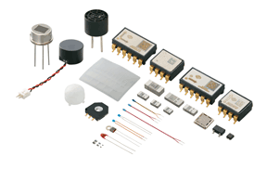
SensorDat: a testbed for improving real-time sensor data quality and provenance
Mike Daniels (NCAR), Matt Bartos (UMich),
Connor Scully-Allison (UNR), Scotty Strachan (UNR),
Renée Brown (UNM), Aaron Botnick (NCAR), Charlie Martin (NCAR)

Slide 2
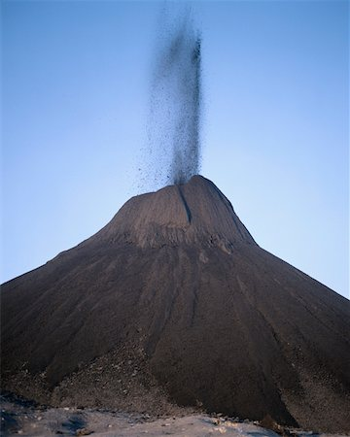
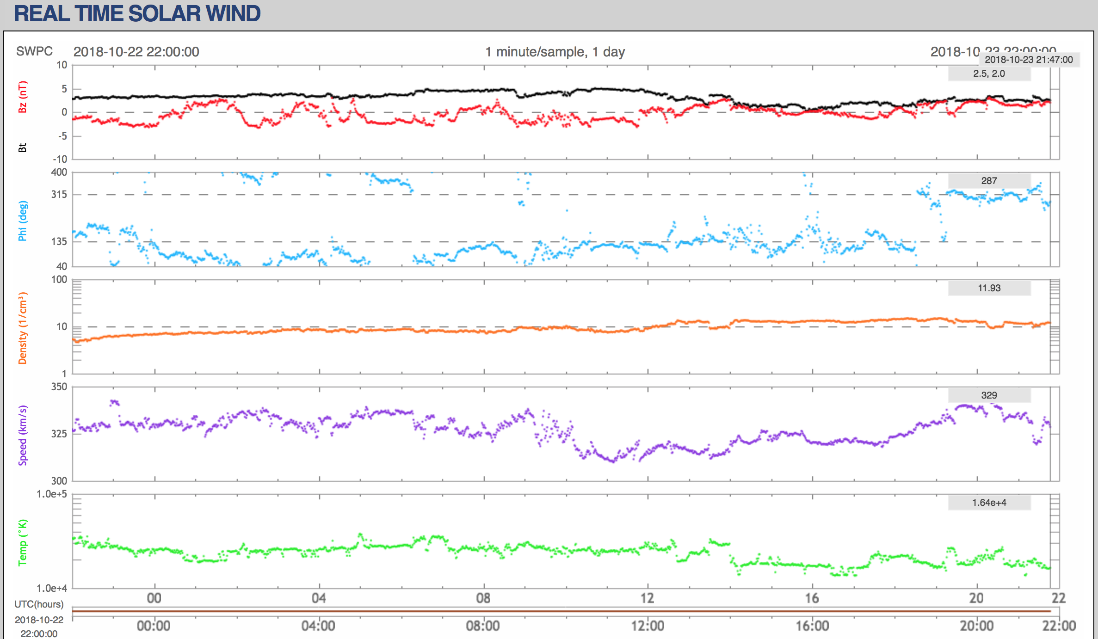
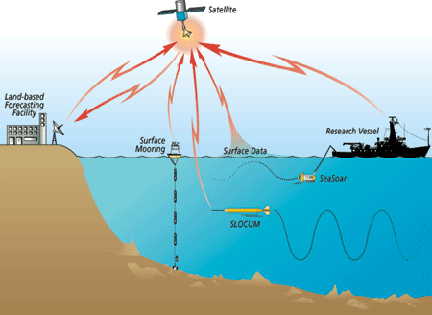
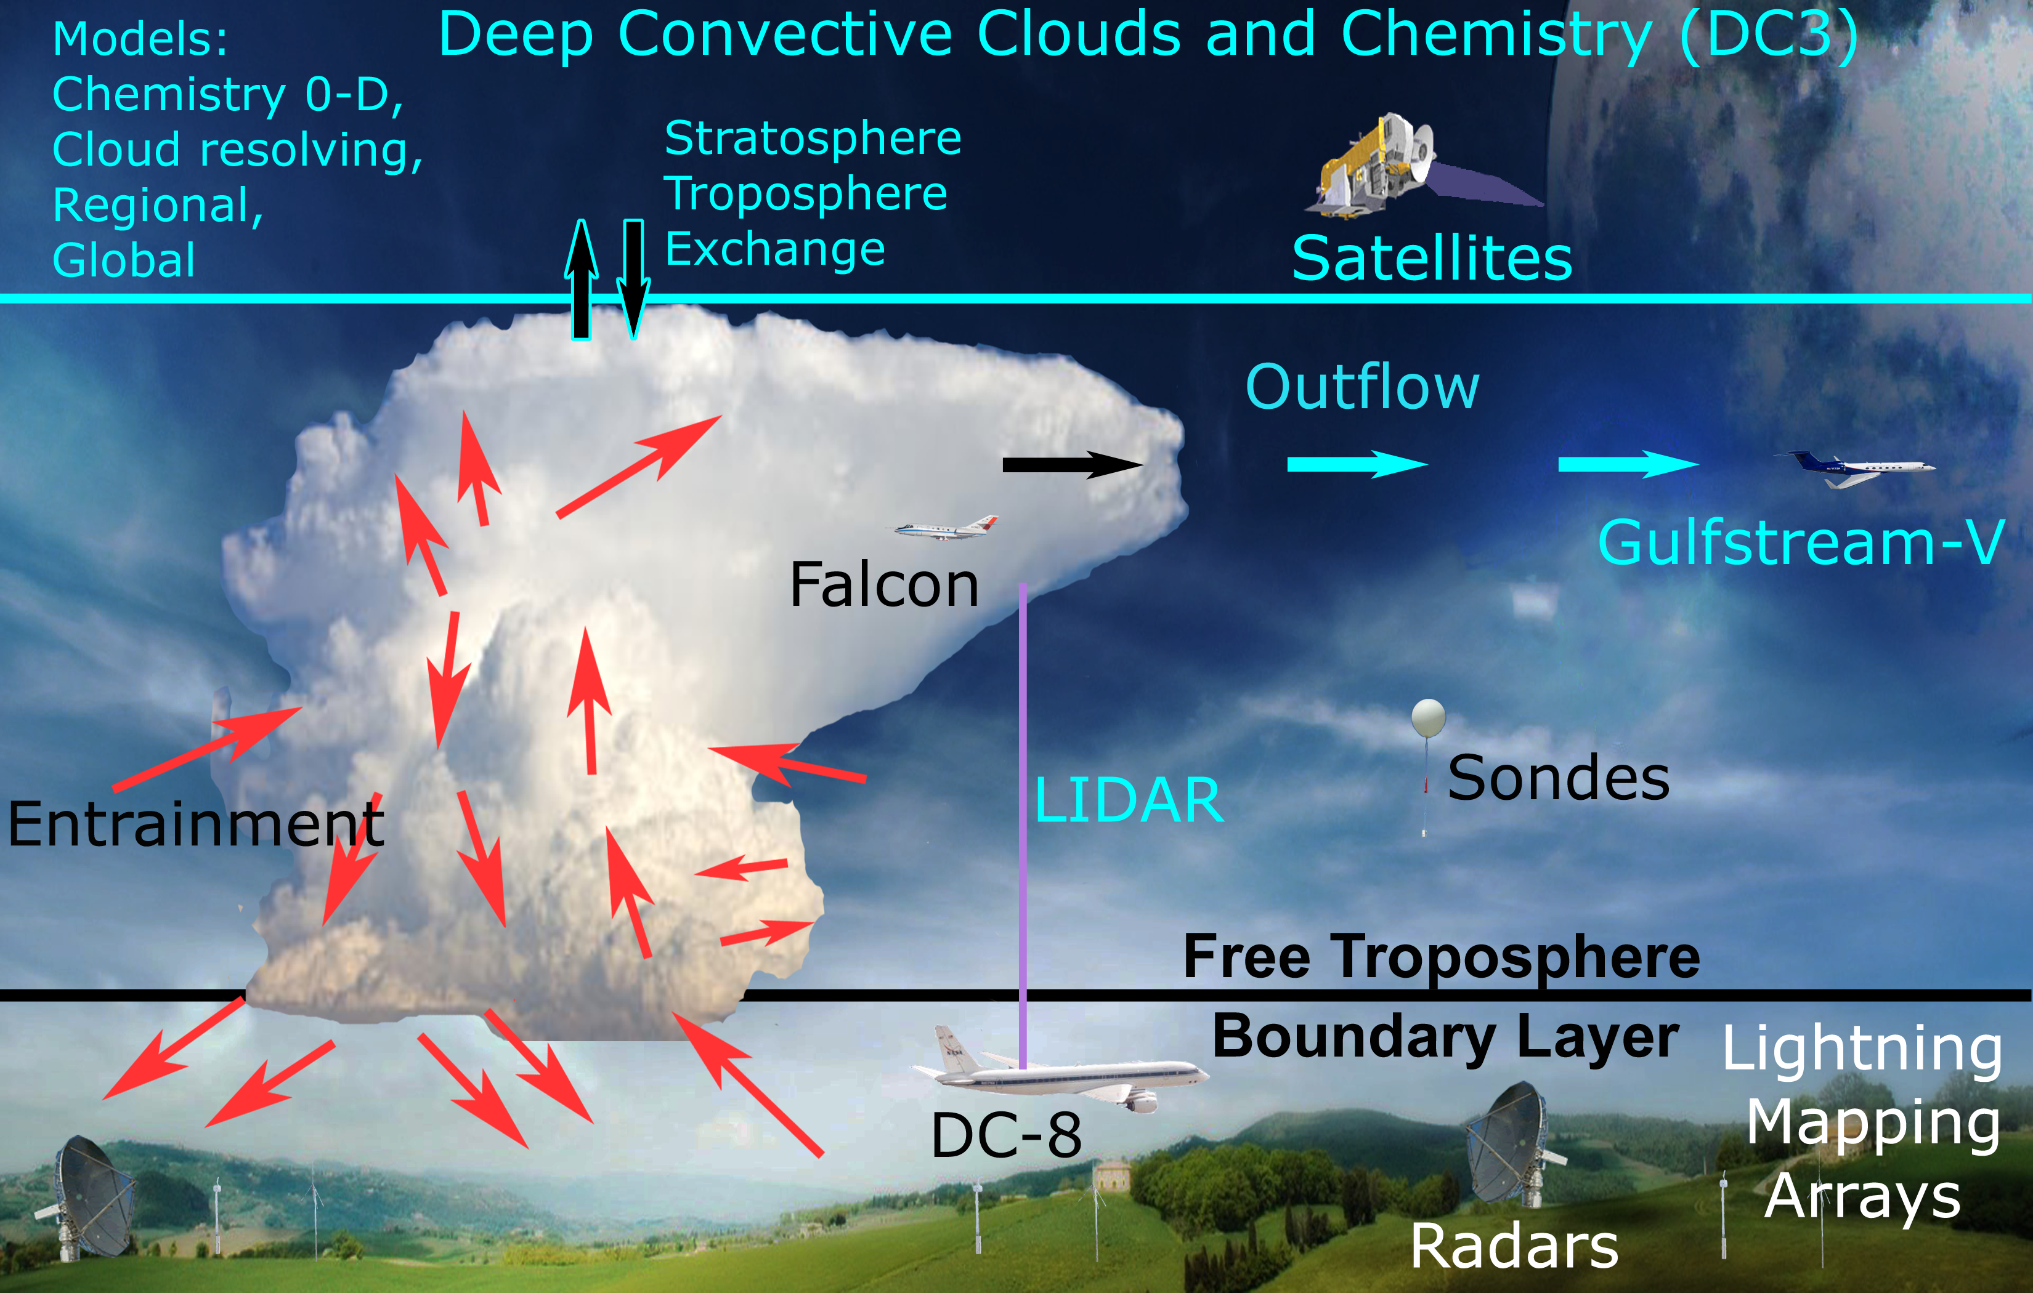
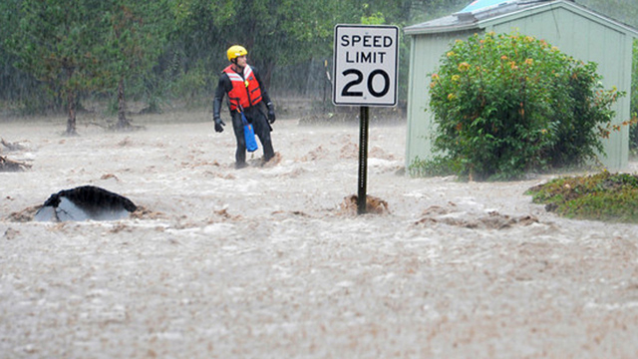
CHORDS is an EarthCube project focused on real-time data across the geosciences
Notes:
Real-time data is so important for tracking and predicting hazardous phenomenon. Real-time data is also critical when conducting a field experiment to analyze and sample e a moving storm. Platforms such as aircraft, mobile radars and other vehicles must be positioned around a storm in ways that optimize their sampling capabilities. To read more about the DC-3 project depicted above, see https://www.eol.ucar.edu/field_projects/dc3

Slide 4
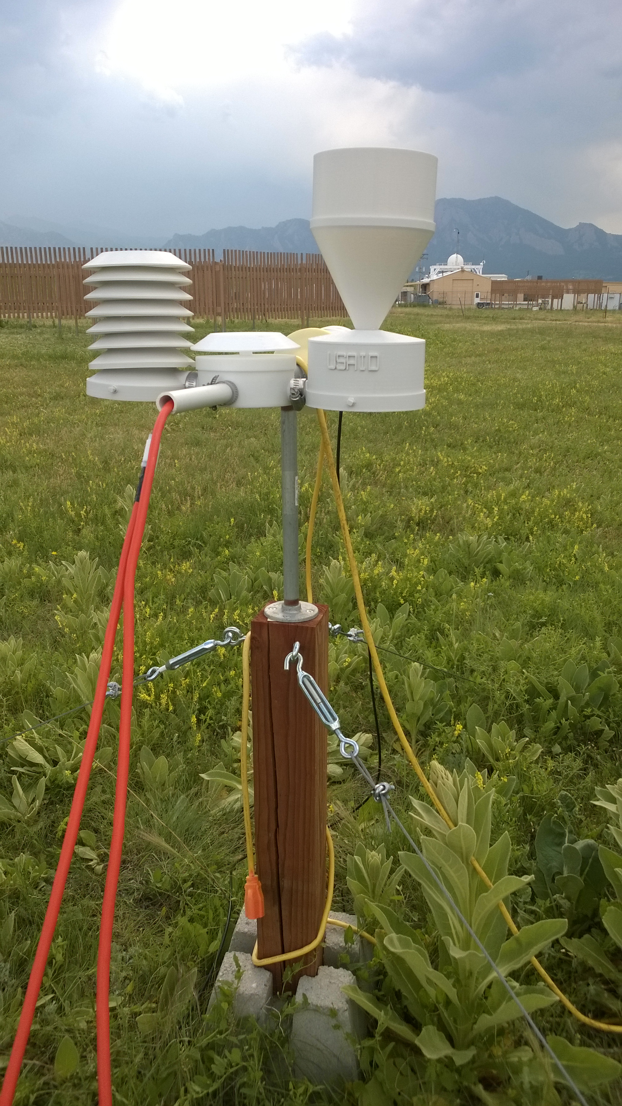
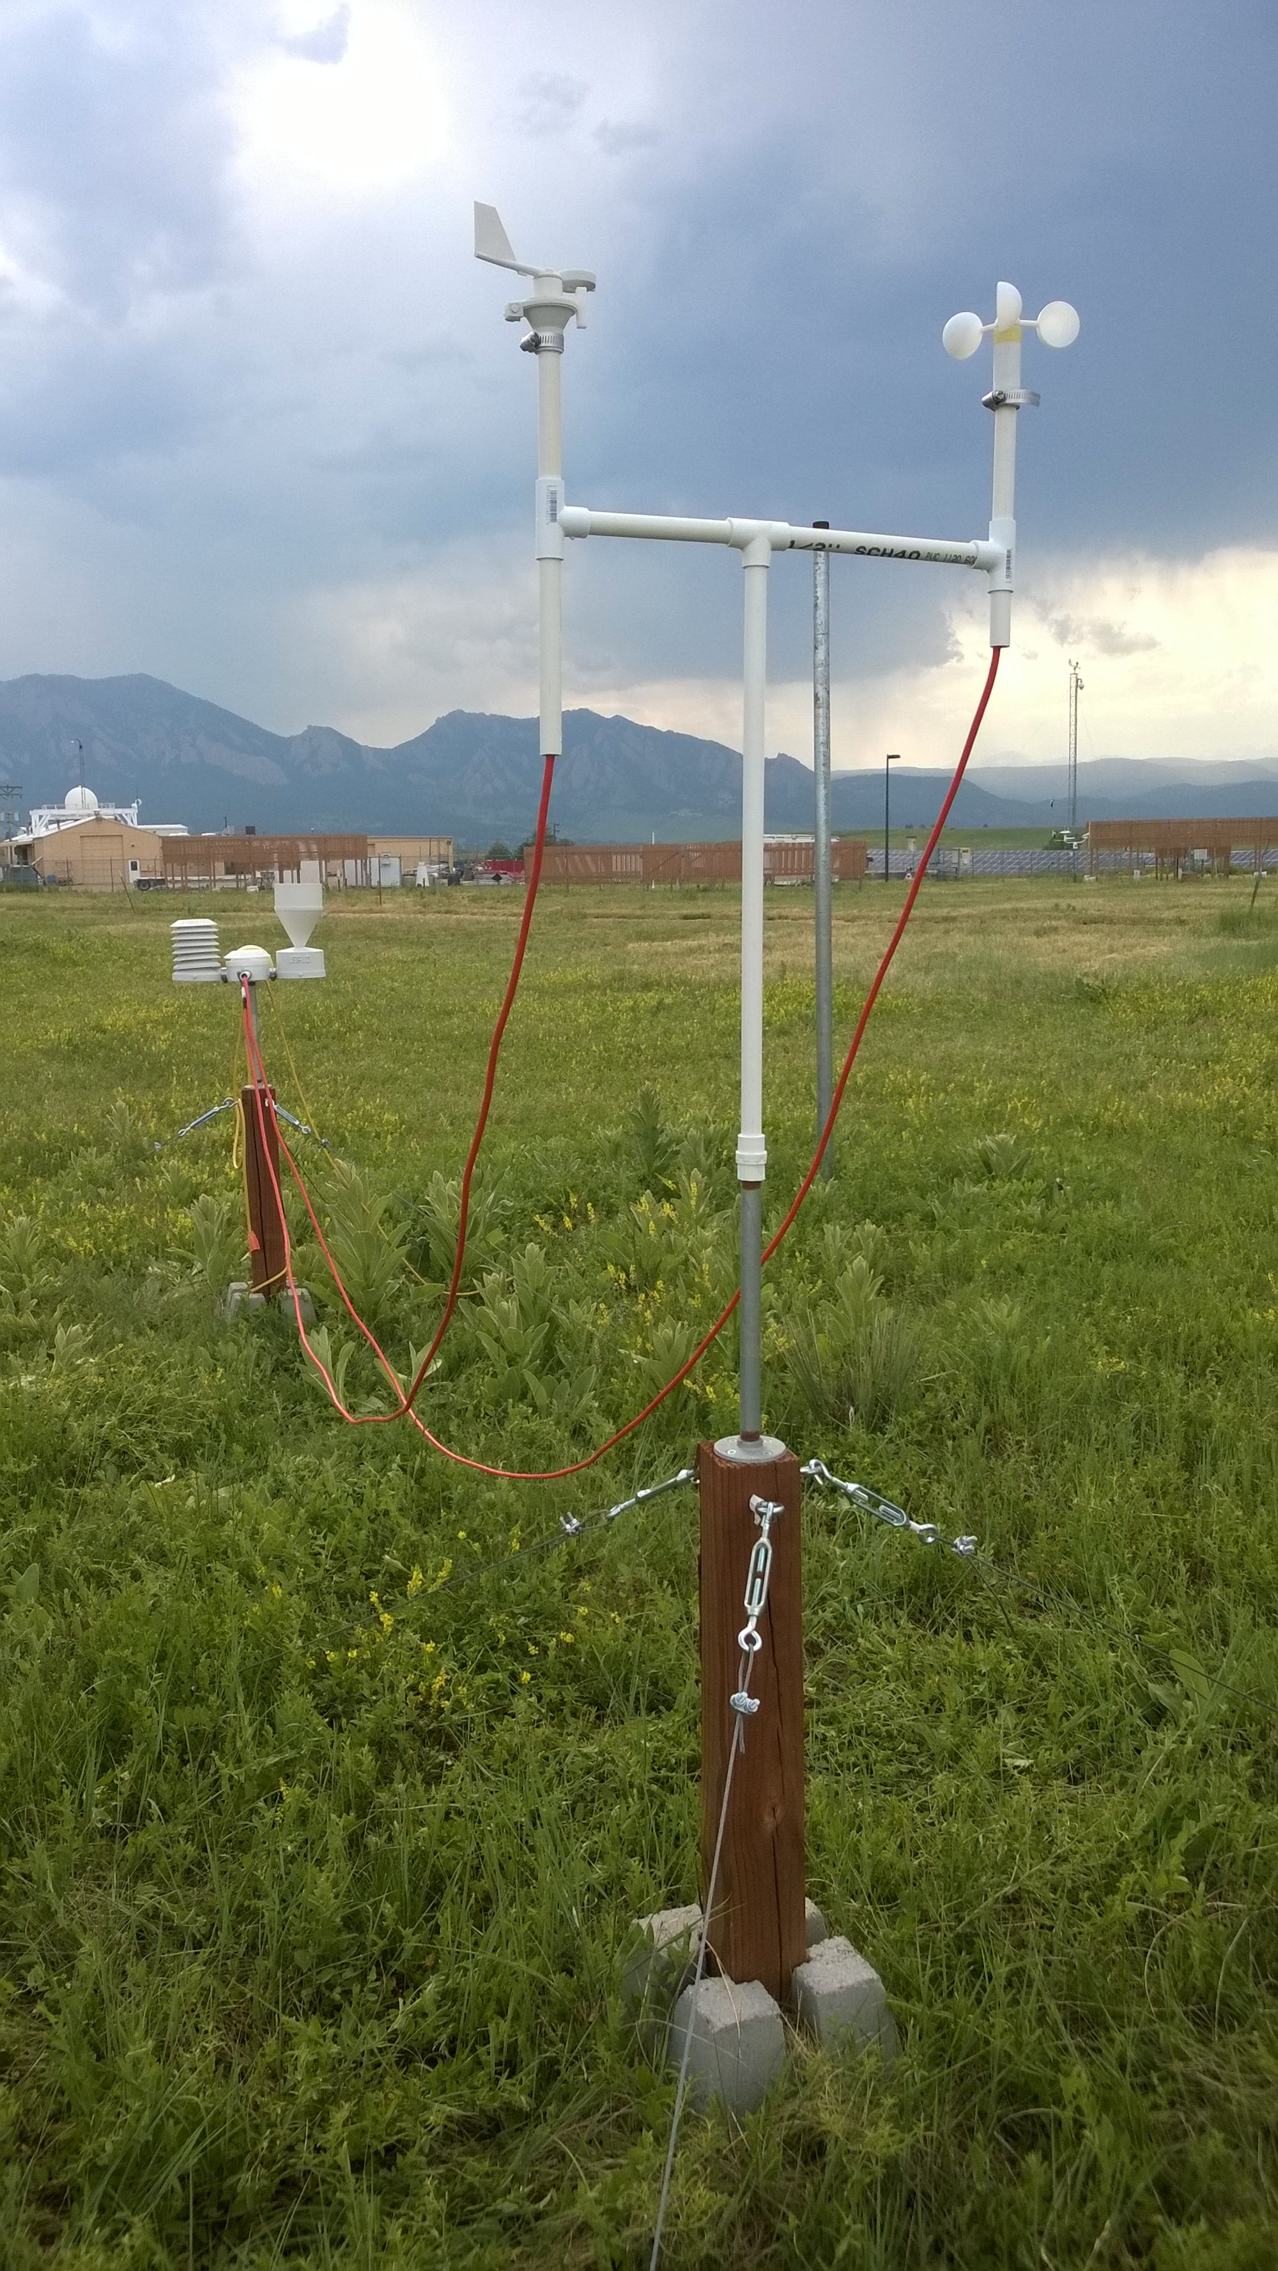
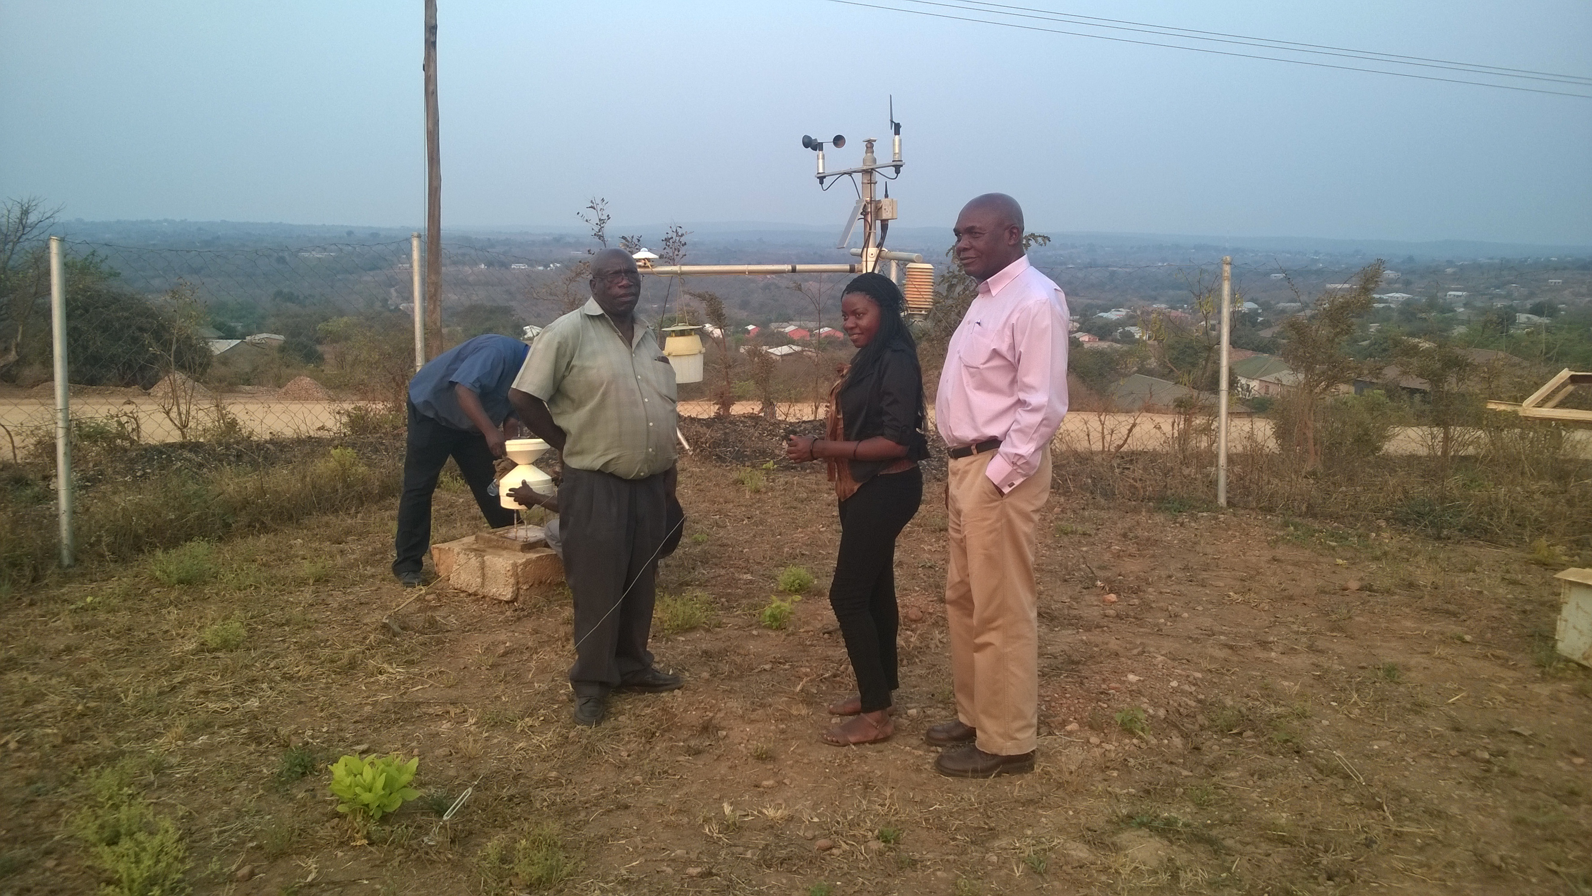
Real-time measurements from small research teams are filling gaps in observation, but could be more widely used
Notes:
Scientists could benefit from the measurements being taken by small groups, but their data is not accessible in standard formats or very often not even available on the Internet.

Slide 5
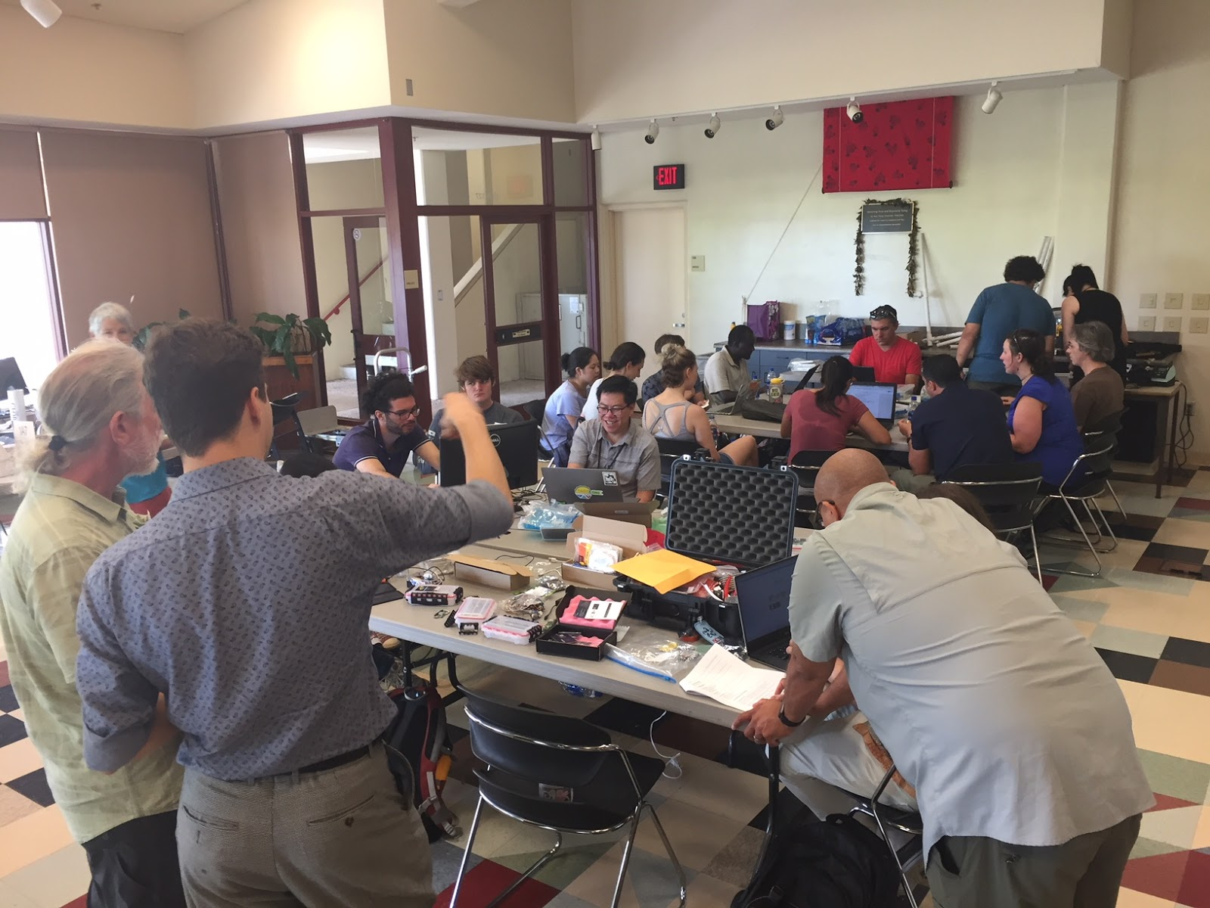
EarthCube Intelligent Systems Workshop Hilo, HI August 6-10, 2018
Inexpensive IoT sensors are allowing academic institutions to work with instrumentation in ways not possible before
Notes:
Many IoT platforms exist but they don’t provide geoscience metadata or services. This group was initially using ThingSpeak and we introduced them to CHORDS.

Slide 6
IoT and Webs of Sensor Data: A Big Data challenge of velocity and variety
Notes:
Standards need to be applied to the sensor data coming in so that it can be processed by computers. These standards can take a lot of time to implement, however. This is where CHORDS comes in.

Slide 7
CHORDS provides simple ingest and access to r/t data for geoscientists
Get an AWS account
2) Create and Configure your CHORDS portal
3) Start sending data and making it available on the net!
(see chordsrt.com)
Notes:
Through CHORDS, scientists can create their very own real-time data portal in the cloud and data can easily be sent to it with simple HTTP calls. The data coming from CHORDS will adhere to standards that will be used by sophisticated algorithms.

Slide 8
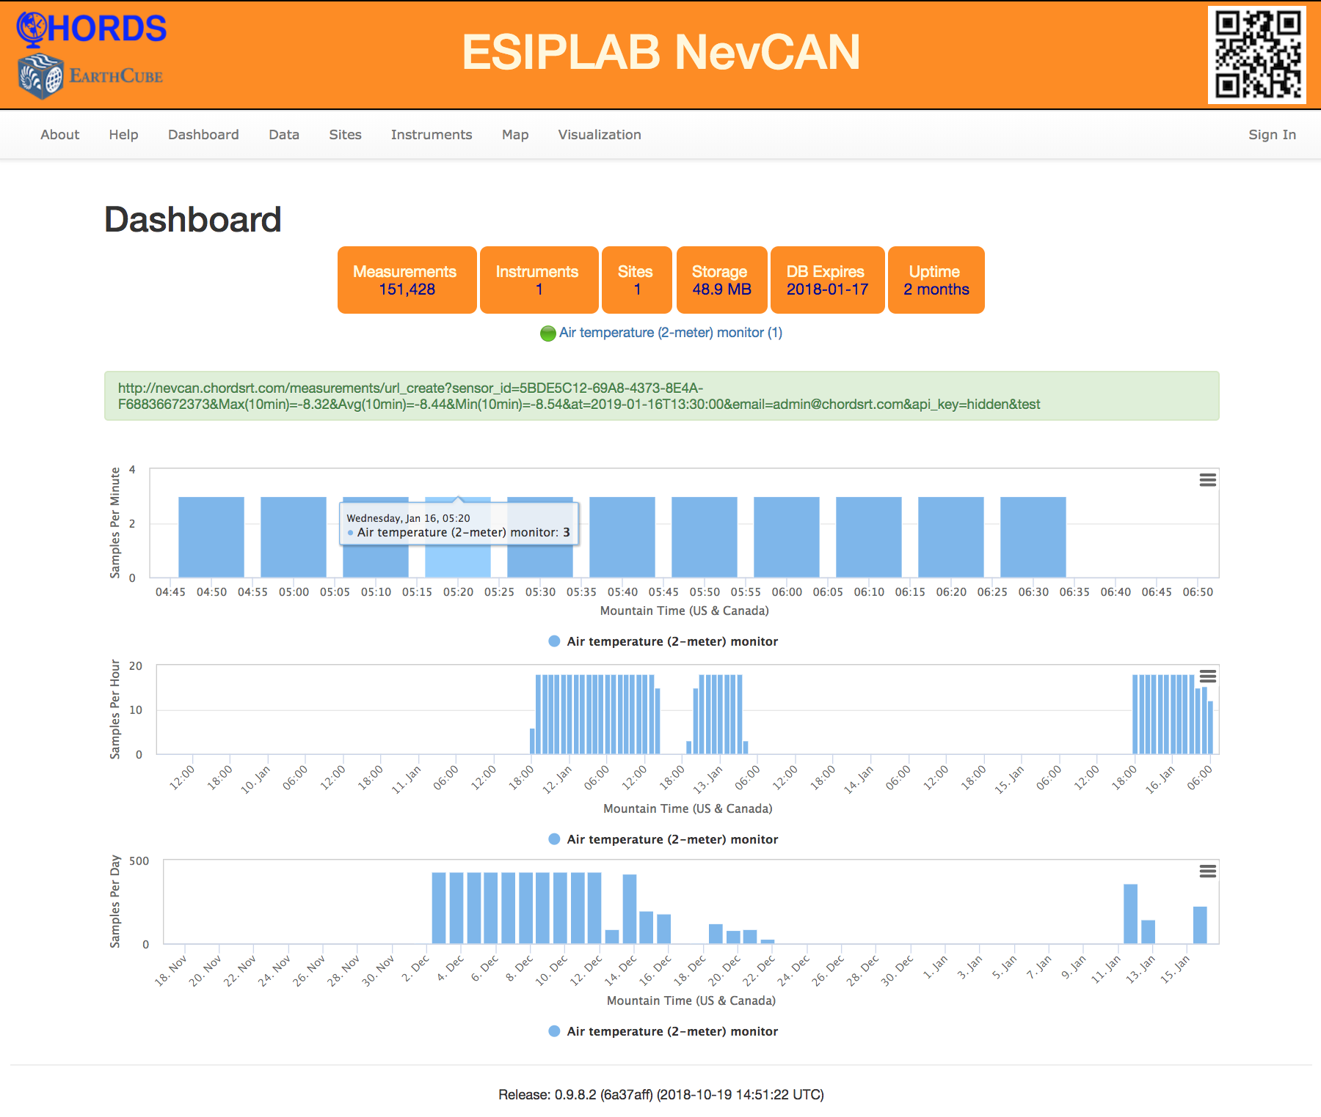
NevCan: Nevada Climate Change Portal

Slide 9
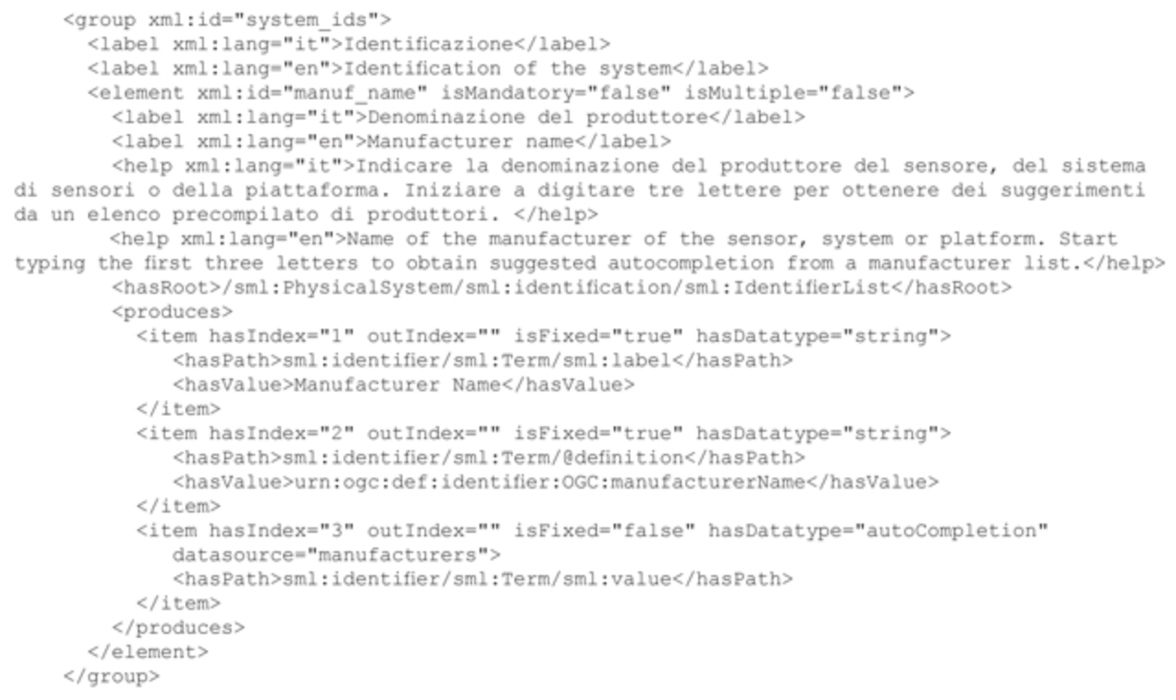
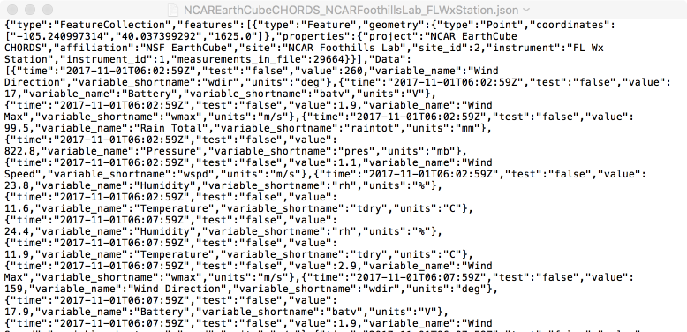
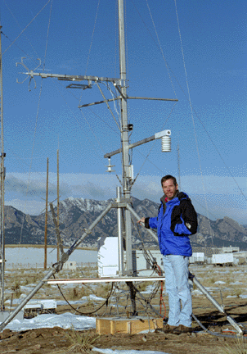
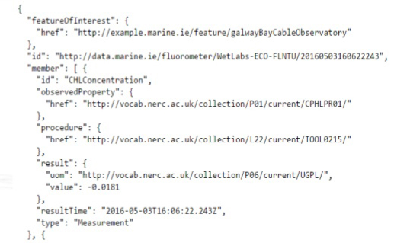
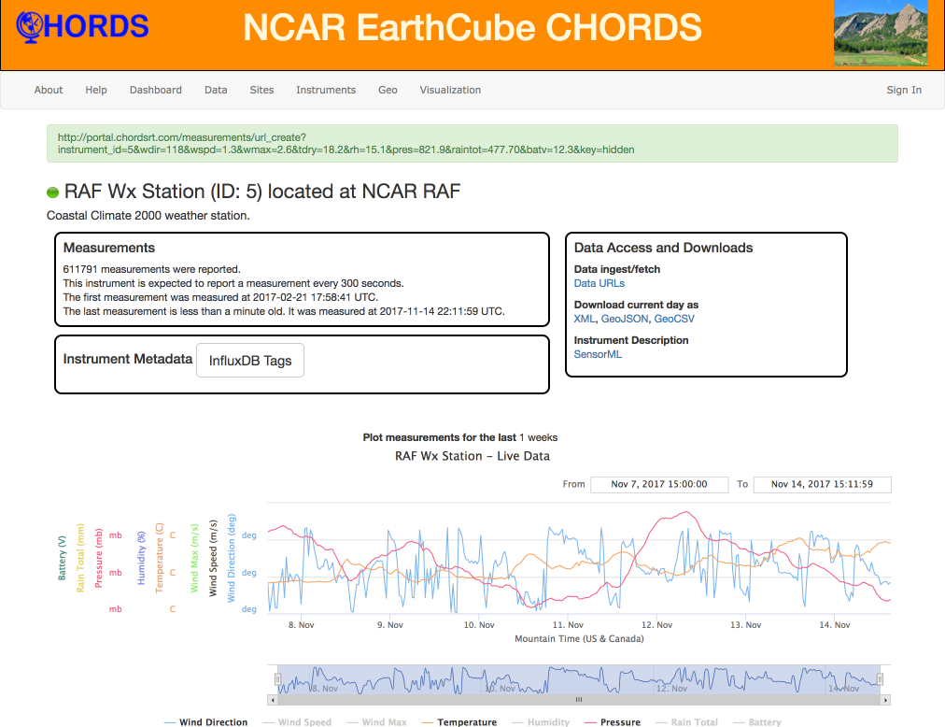
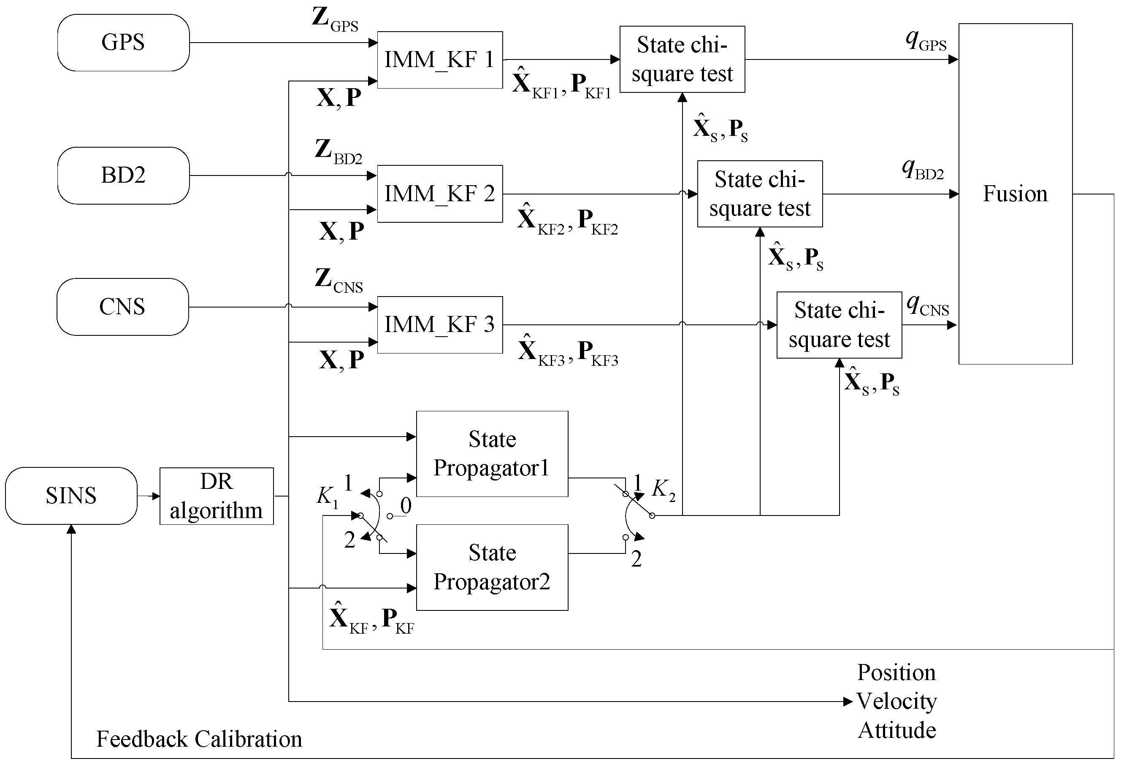
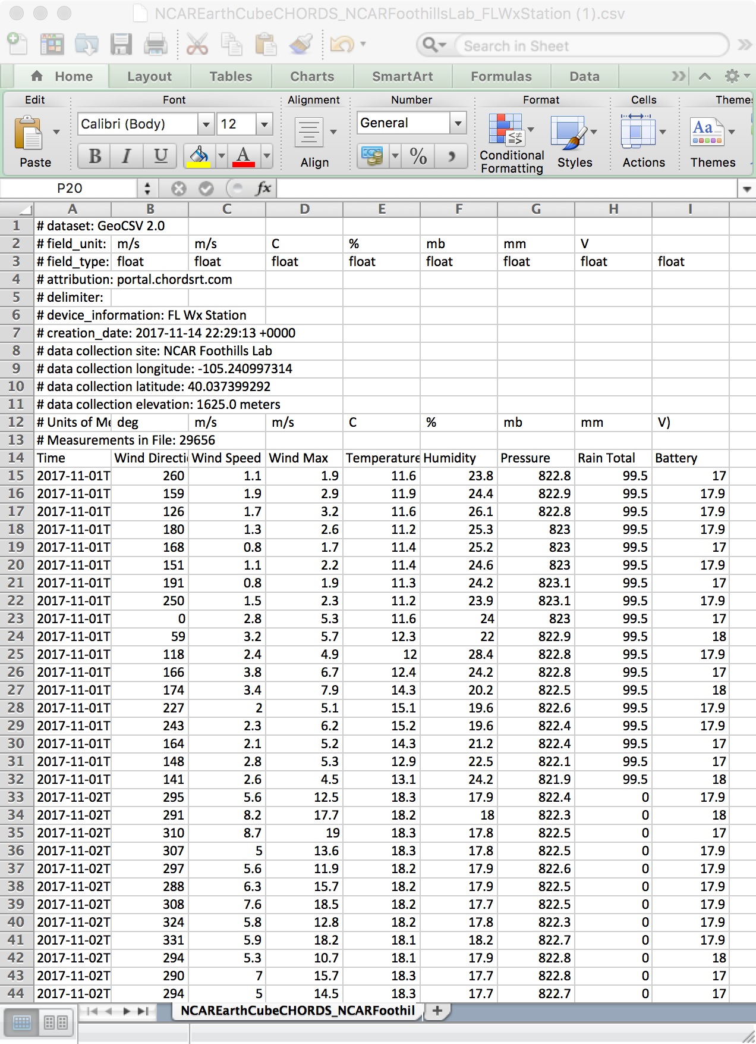
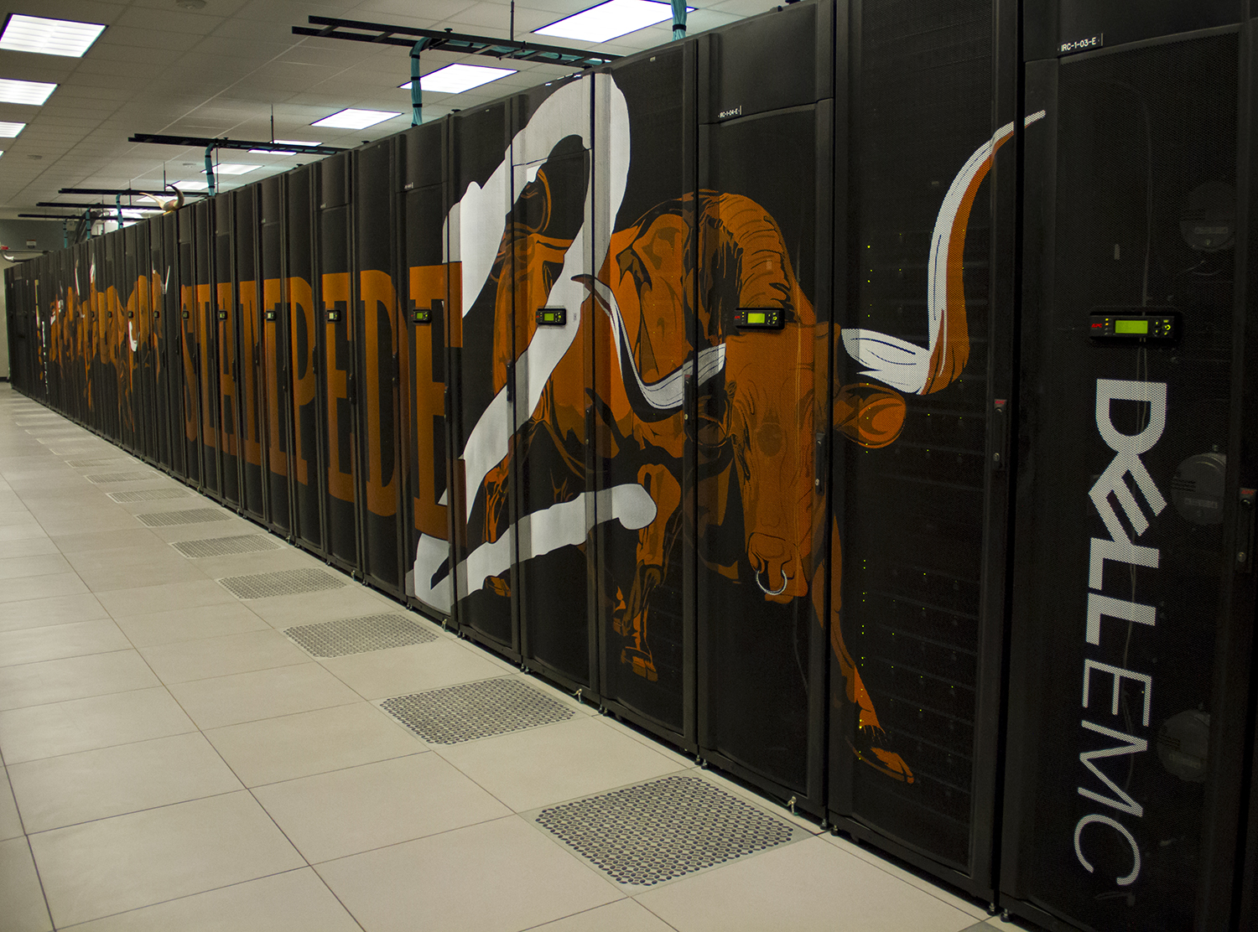
CHORDS creates real-time streams that are “Born Connected”¹
^{SensorML}
^{Instrument}
^{Description}
^{GeoJSON}
^{Archives}
^{JSON-LD and OM-JSON/SOS}
^{Sensor}
^{Data}
^{Algorithms}
^{CHORDS}
^{instance}
CHORDS uses standards and controlled vocabularies where they exist. Items in green are future developments.
^{GeoCSV}
^{Prediction Models}
¹Leadbetter, Adam & Smyth, Damian & Fuller, Robert & Shepherd, Adam & O'Grady, Eoin. (2016). Where Big Data meets Linked Data: Applying standard data models to environmental data streams. 10.1109/BigData.2016.7840943.

Slide 10
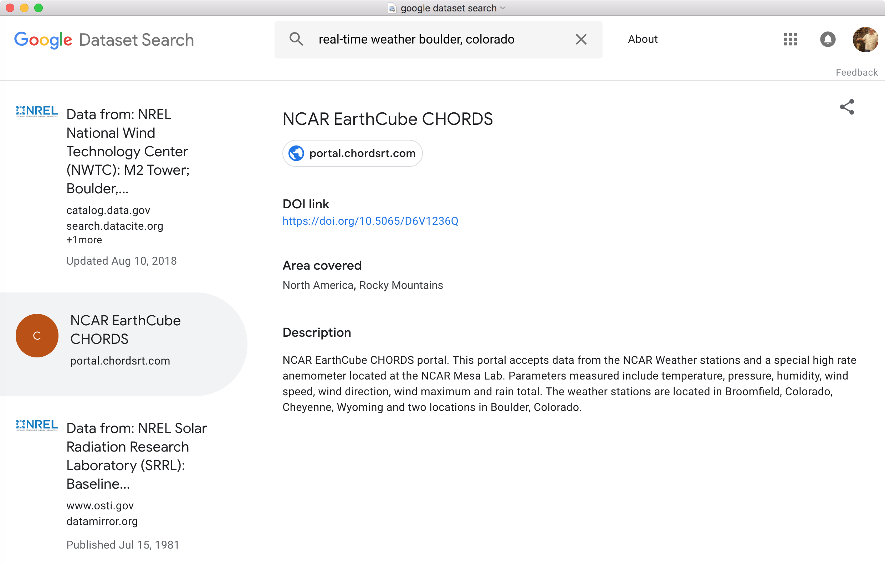

Slide 11
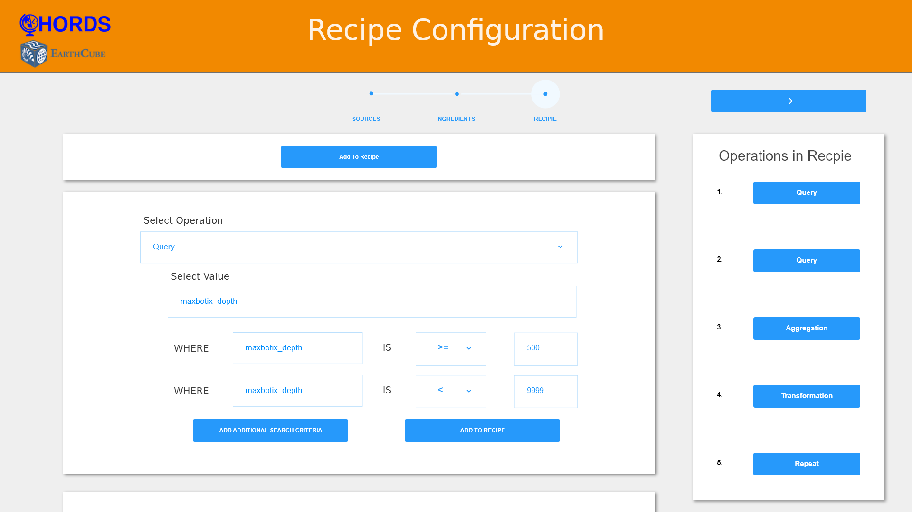
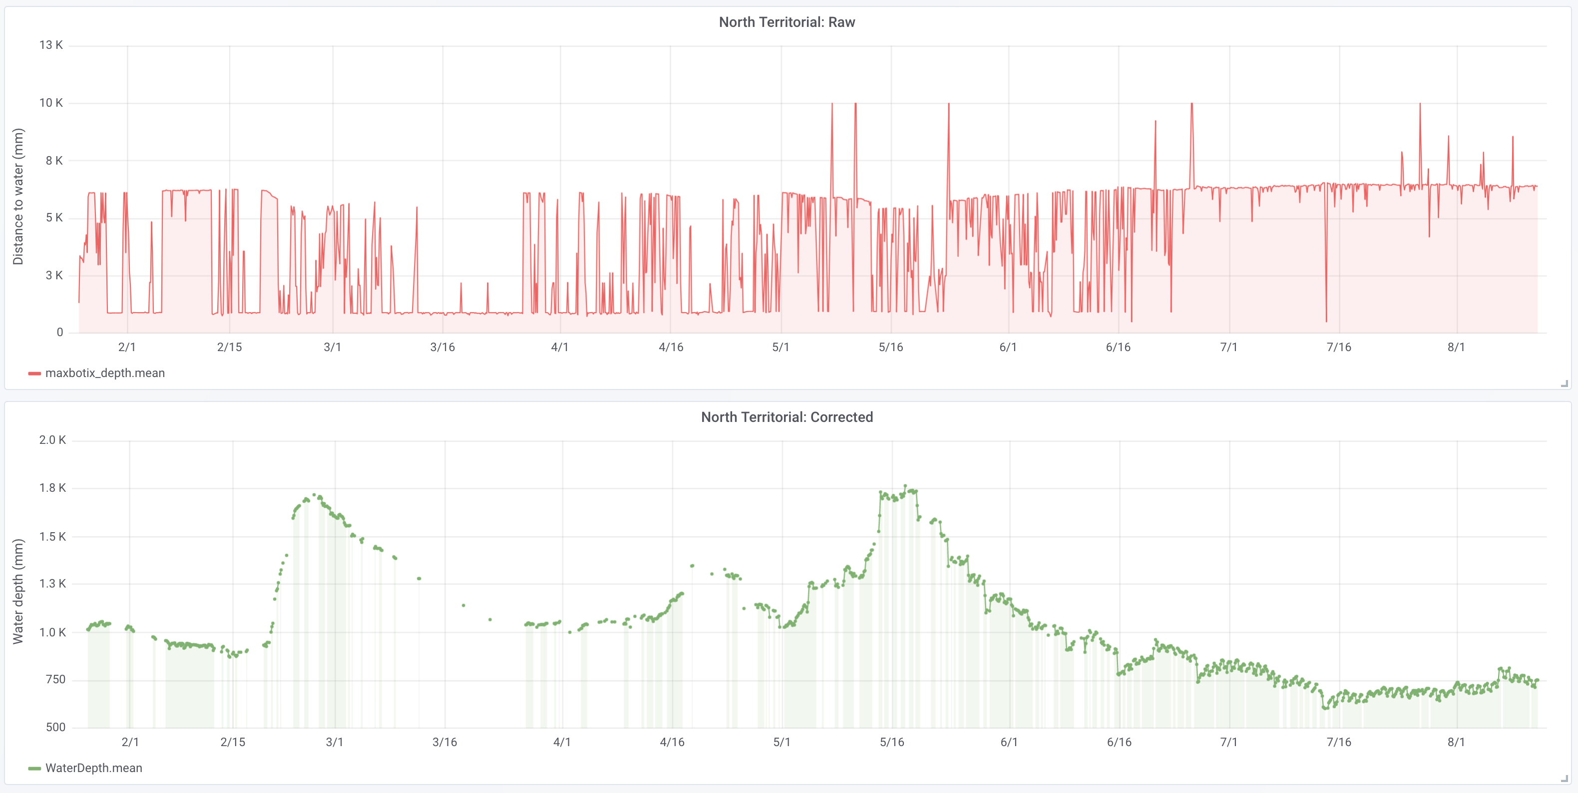
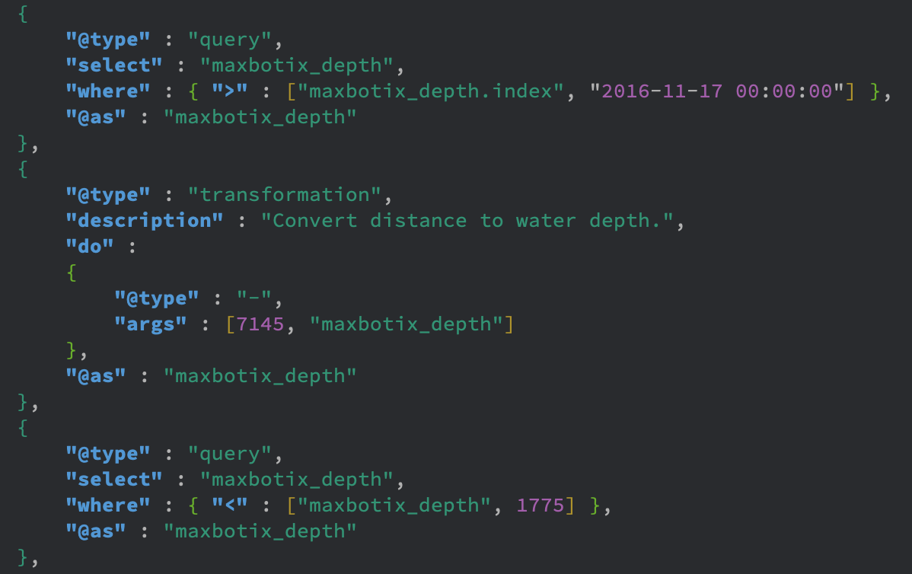
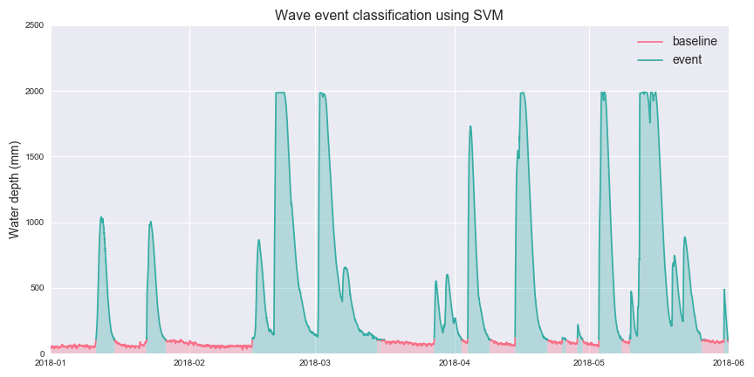
SensorDat data quality “recipes” applied to data streams
Quality Control recipe selector
Raw data (top) and corrected data (bottom) after the Quality Control recipe has been applied
JSON-LD description of Quality Control recipe
JSON-LD documents specify training and test data for machine learning classification

Slide 12
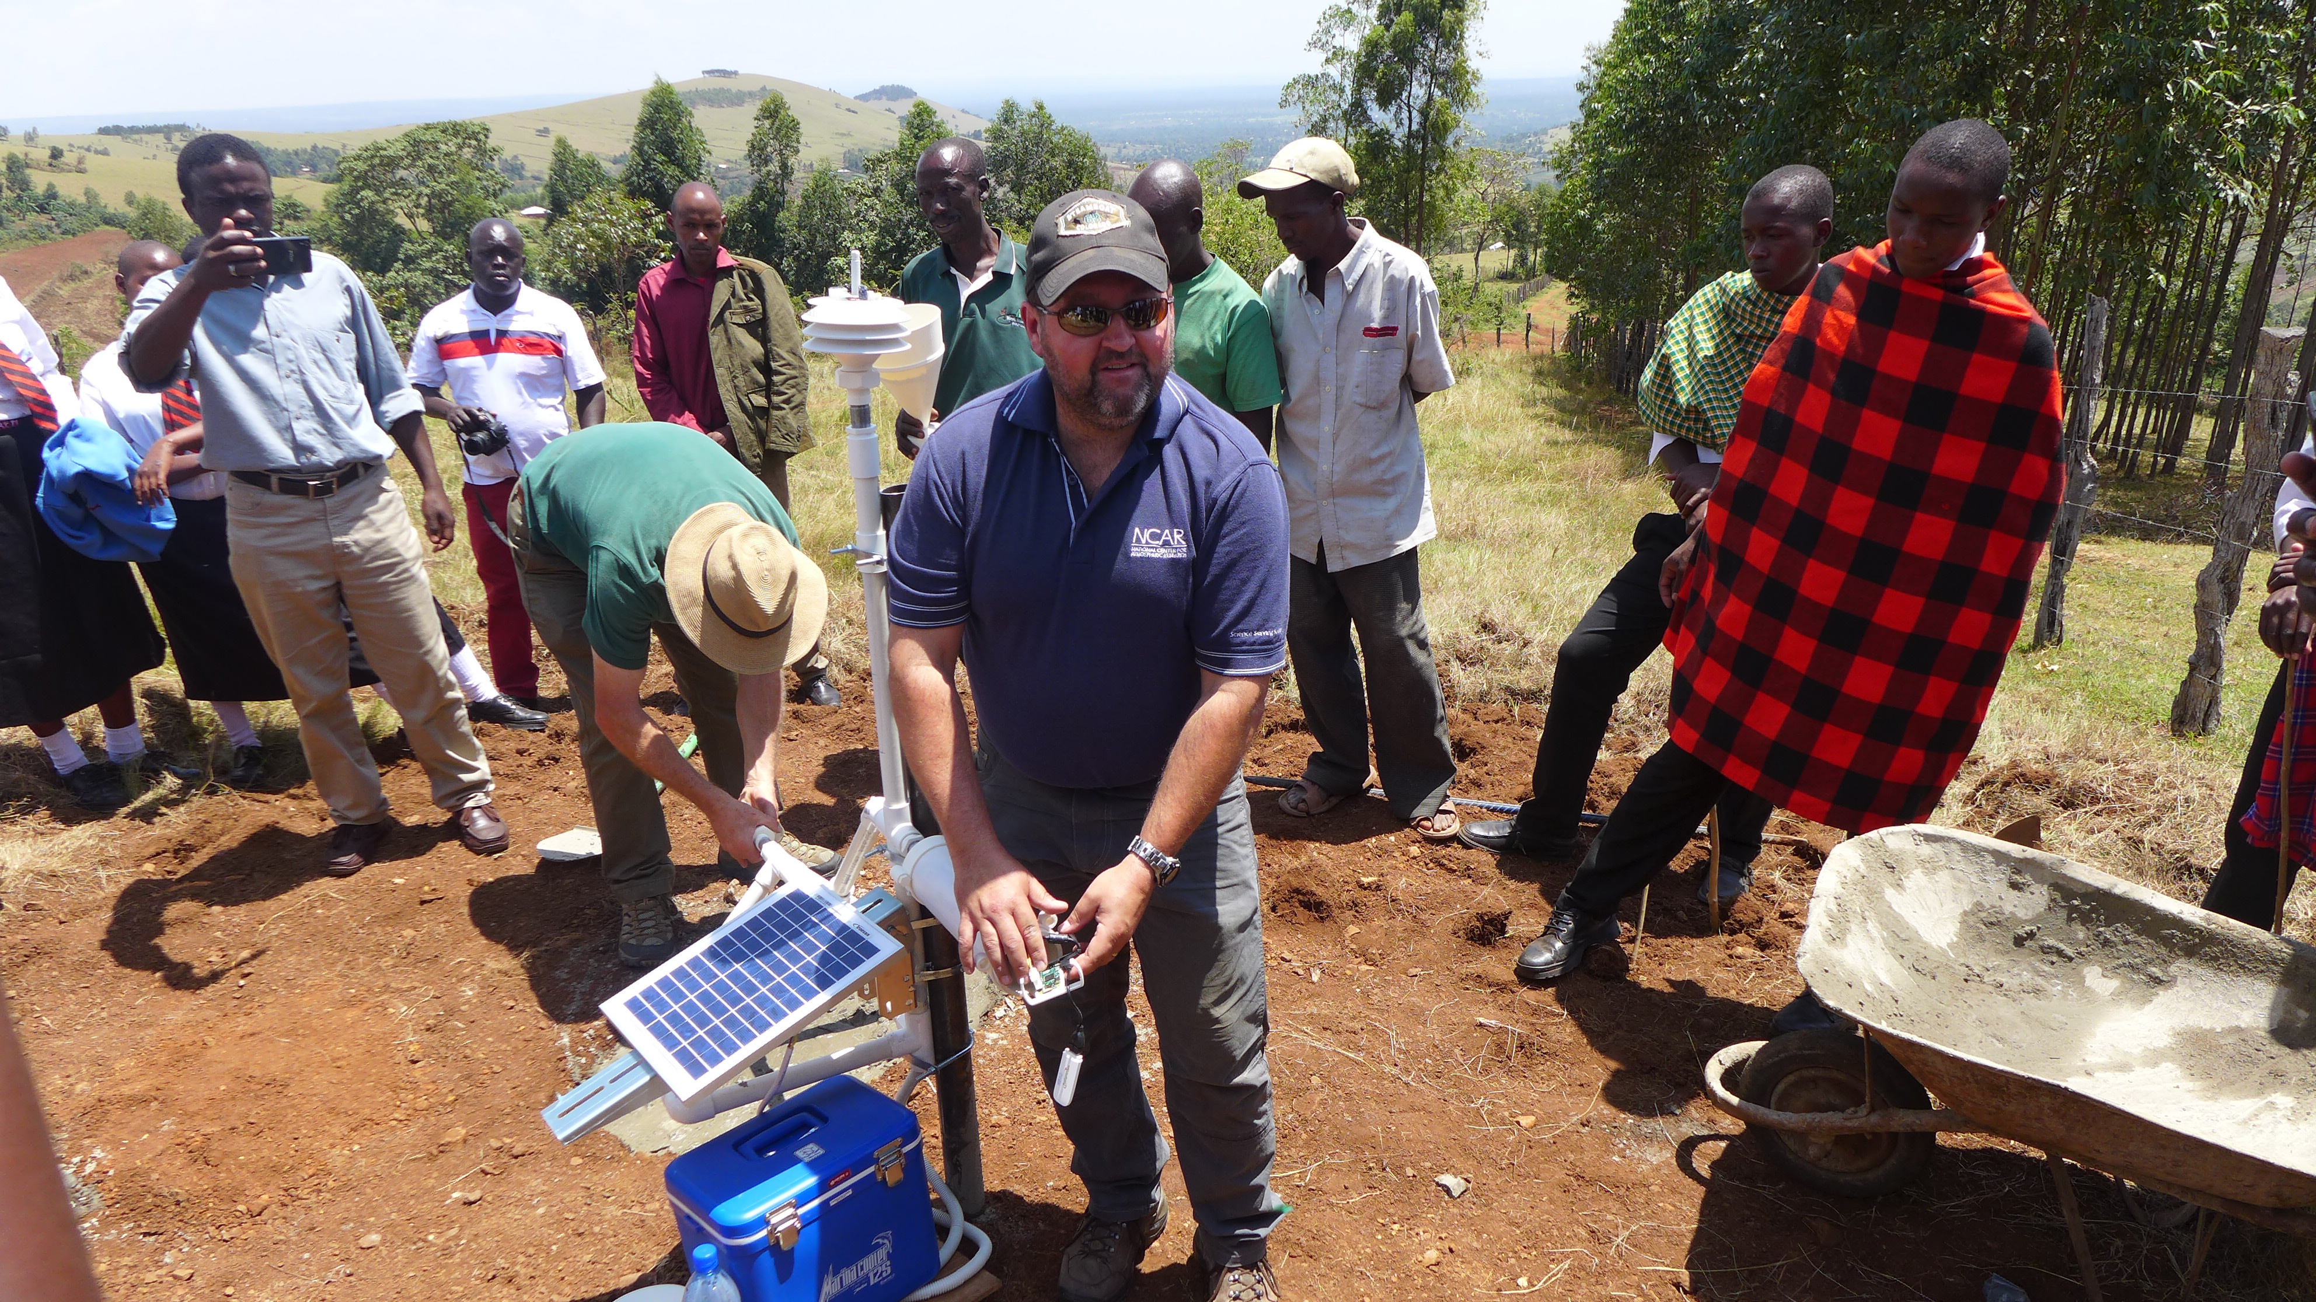
3D-printed weather stations using CHORDS
12 locations in the US
3 locations in Europe
6 locations in Zambia
11 locations in Kenya
Saudi Arabia, Curacao, Barbados
Used by local farmers in Africa to manage their crops
Local radio stations in Africa broadcast current conditions
Partnered with GLOBE schools (www.globe.gov) for E&O
3d.chordsrt.com
3d-kenya.chordsrt.com
3d-zambia.chordsrt.com
Notes:
These high-quality, 3-D printed weather stations are very inexpensive (less than $500) and so they can be purchased by science centers in third world countries. This means that, for the first time, these countries have access to local weather data on the Internet!

Slide 13
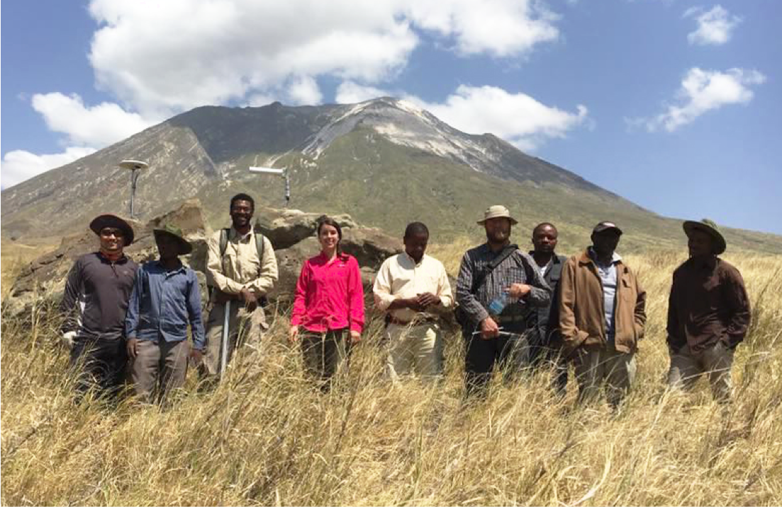
TZVOLCANO: Example case of hazards alert
1) Possible volcanic signal detected in real-time using CHORDS on January 17, 2017
2) Immediate notification to Tanzanian partners
3) Field deployment by Tanzanian partners to assess GNSS/GPS station stability
4) Reports of seismicity of volcanic crater geometry changes after signal detected
5) Rapid deployment of new stations with support from National Geographic Society
tzvolcano.chordsrt.com
Notes:
This is a photo of our Virginia Tech partners near the Ol Doinyo Lengau volcano in Tanzania. This volcano is right next to a small village and so the volcano position data they receive on their tablets and phones from CHORDS is very important to them.

Slide 14
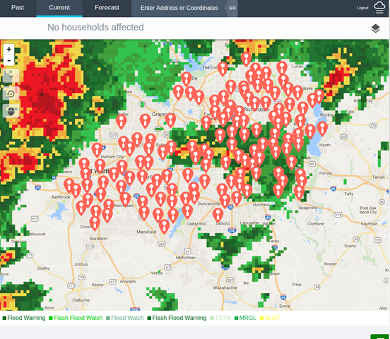
Verifying hail estimates from radar data using CHORDS & ground sensors
Validating the radar’s ability to identify & quantify hail in storms
Taking data from >130 hail sensors
Focused on the Dallas/Fort Worth area
csu-hail.chordsrt.com
Notes:
The CHORDS team works with lots of graduate students from universities across the US. This group at CSU is wanting to verify hail estimates from radars by actually measuring the hail that falls to the ground and comparing this to what the radars estimate.

Slide 15
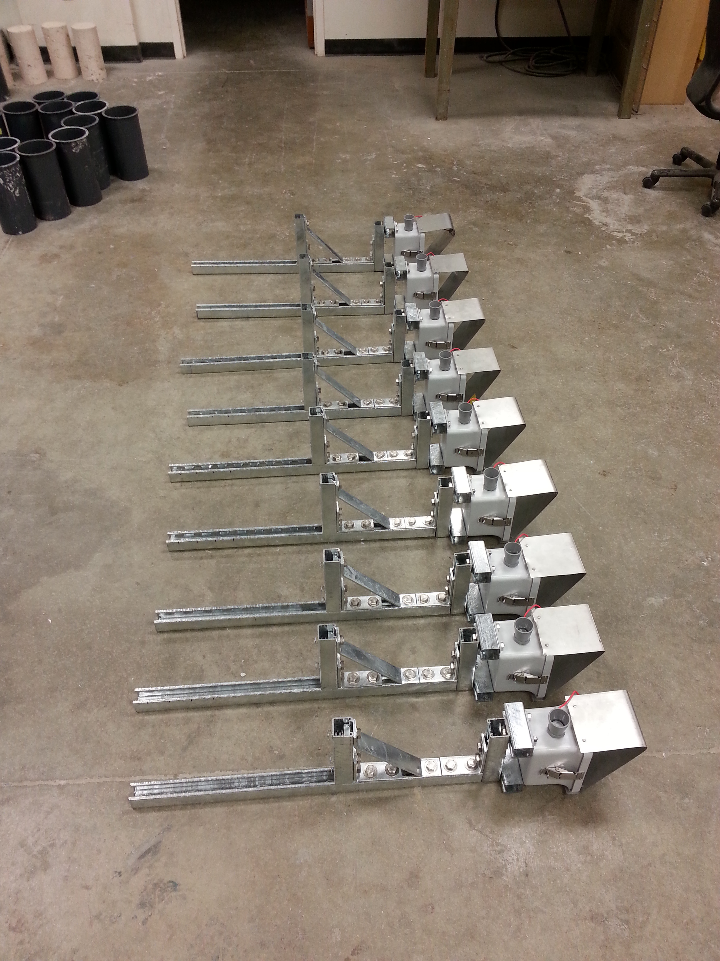
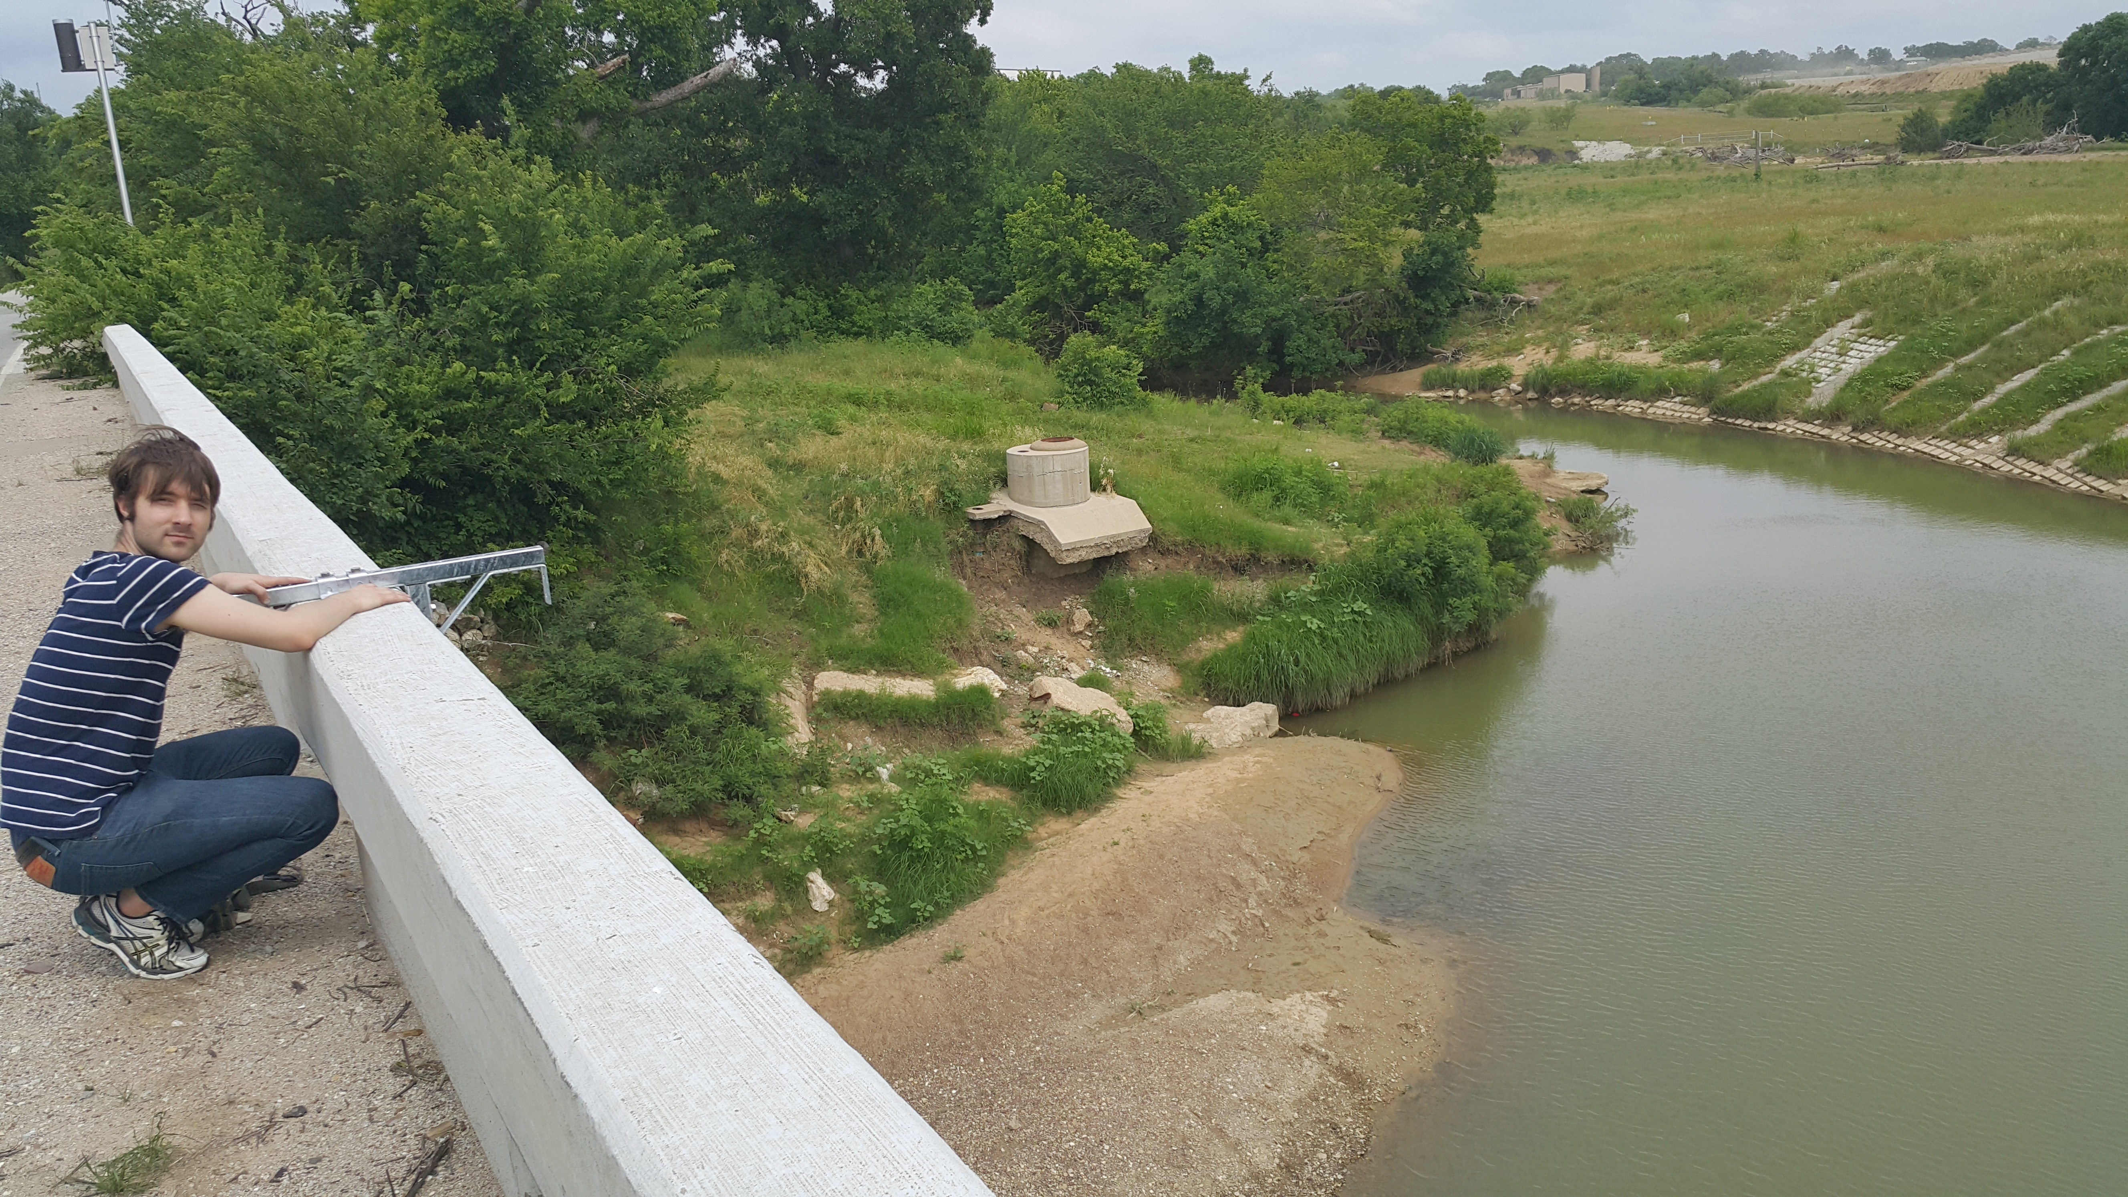
goo.gl/Xgicv6
Notes:
Our group from the University of Michigan is working in the field of urban hydrology. They build very inexpensive water depth devices that will be used by so-called “smart cities” to better manage drainage automatically using real-time data coming in during rain storms.

Slide 16
chordsrt.com
daniels@ucar.edu
http://dx.doi.org/10.5065/D6V1236Q
http://github.com/ESIPFed/SensorDat

