Slide 1
A deep-learning driven improved ensemble approach for hurricane forecasting
2019 ESIP Winter Meeting
UH AI team (Ebrahim E. and et al.)
PI: Yunsoo Choi
Department of Earth and Atmospheric Sciences
University of Houston
January 2019

Slide 3
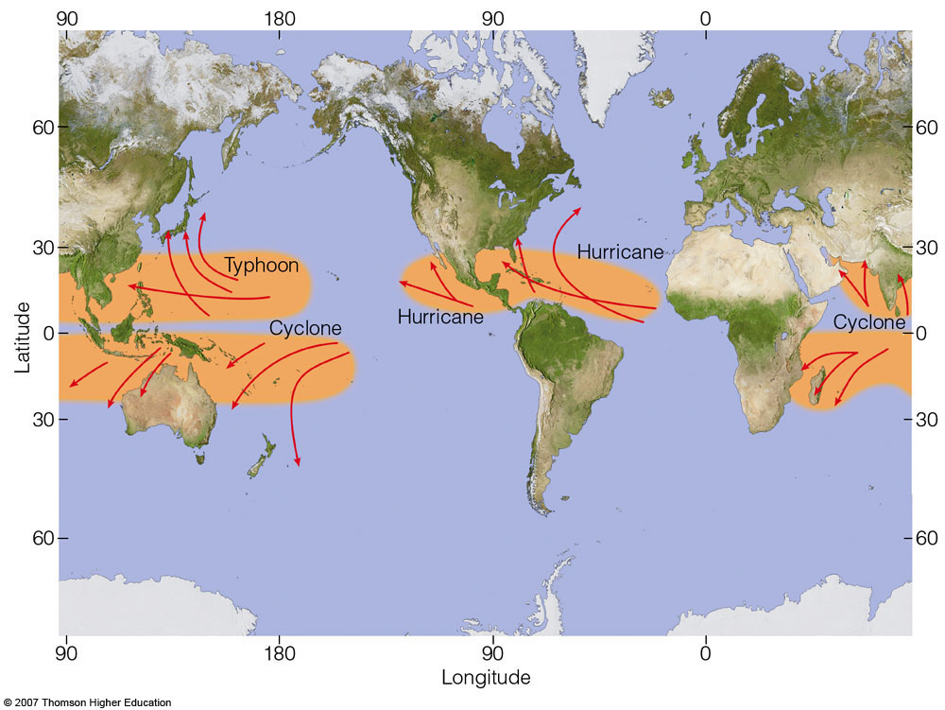
Overview
2007 Thomson Higher Education
1

Slide 4
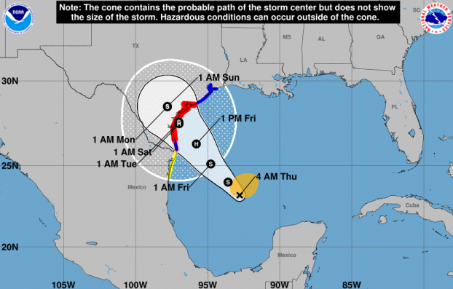
Overview
Tracking path and forecasting hurricane intensity are challenging:
Dynamical models, like HWRF, produce a significant model-measurement error.
Accurate forecasting hurricane is more difficult after its landfall.
Machine learning can be a supplementary approach for improving hurricane forecasting.
2

Slide 5
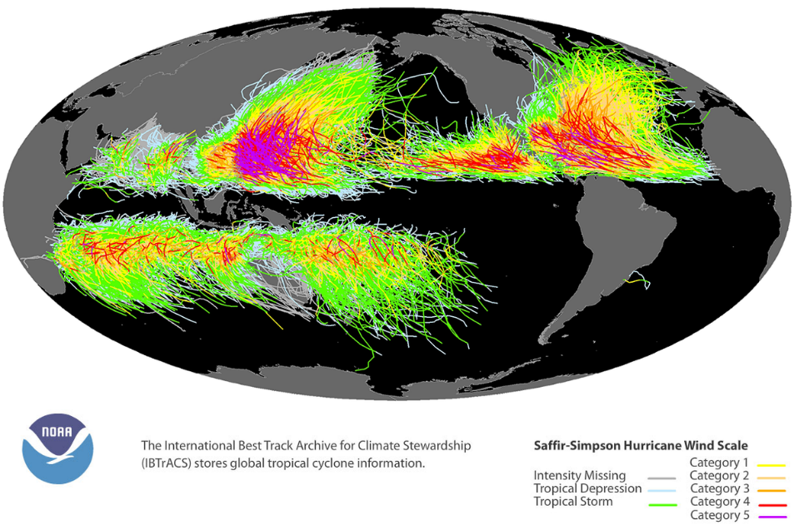
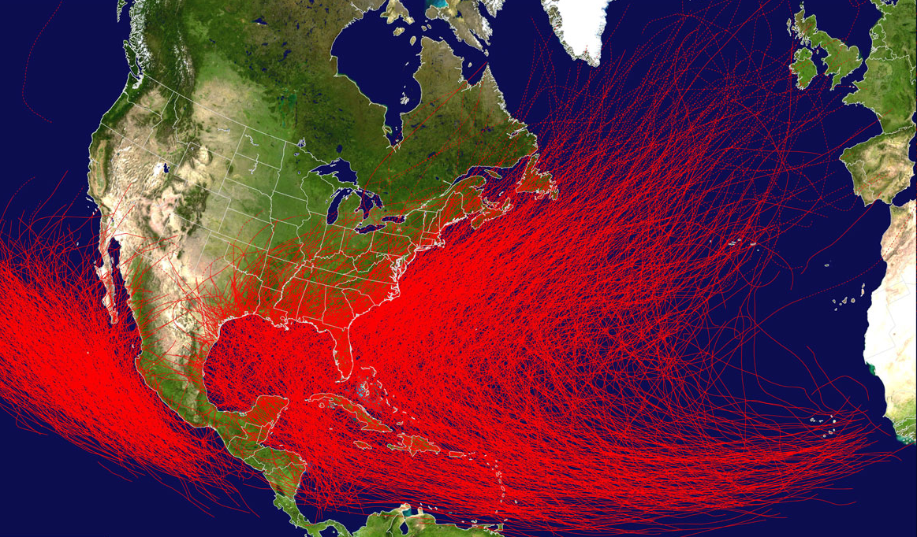
Overview
Tropical Cyclone History
Pacific: since 1949 , Atlantic: since 1851
3

Slide 6
Deep Learning
Introduction
Artificial Intelligence
Machine Learning
Neural Network
Deep Neural Network
Deep Convolutional Neural Network
Regressive 1-D
Deep Convolutional Neural Network
4

Slide 7
Deep Learning
Regressive 1-D Deep Convolutional Neural Network:
Hurricane model1
Hurricane model 2
…
Hurricane model n
Predicted hurricane path and intensity
…
…
…
…
Input variables
Input layer
Feature maps
Convolutional layer 1
…
Fully-connected layer
Output layer
Feature maps
Convolutional layer 2
5

Slide 8
Deep Learning application
Introduction
Application of deep learning in atmospheric sciences: (refer to our three posters from UH: (1) Hurricane forecasting; (2) Ozone forecasting; and (3) Pollen forecasting)
Prediction and model:
Weather forecasting (Salman et al., 2015; Hsieh et al., 2015; Zhang et al., 2016; Wang et al. 2017).
Air quality predictions (Li et al., 2016 & 2017; Pardo et al., 2017; Fan et al., 2017; Kök et al., 2017; Le 2017; Bui et al., 2018, Eslami et al., 2019, Sayeed et al., 2019, Lops, et al., 2019).
Approximation and analysis:
Identifying significant predictors in ozone forecasting (Eslami et al., 2017)
Classification and clustering:
Predicting extreme climate patterns (Iglesias et al., 2015).
Discovering spatial and temporal patterns in climate data (Anderson et al., 2015; Zhang et al., 2016).
6

Slide 9
Hurricane Forecasting
Introduction
Tropical cyclone forecasting is to predict several interrelated features:
Track, intensity, rainfall, storm surge, areas threatened, etc.
National Hurricane Center (NHC) forecasts Hurricane every 6 hours and up to 72 hours.
Official forecast is from a variety of subjective and objective models.
Ensemble approach is a mainstream approaches in hurricane forecasting.
Machine learning (e.g., deep learning) can be used as an efficient ensemble forecasting.
7

Slide 10
Hurricane Forecasting
Introduction
Why Ensemble model:
For track forecasting, dynamical models are generally the best.
For intensity forecasting, statistical models generally perform better.
We can combine the advantages of both models using an machine learning ensemble approach.
8

Slide 11
Input Models
Summary of global and regional dynamical models for track, intensity, and wind radii:
ATCF* ID | Model Name | Horizontal Resolution | Cycle/Run Period | NHC Forecast Parameters
NVGM/NVGI | Navy Global Environmental Model | Spectral (~31 km) | 6 hr (144 hr) | Track and intensity
AVNO/AVNI GFSO/GFSI | Global Forecast System | Spectral (~13 km) | 6 hr (180 hr) | Track and intensity
EMX/EMXI/EMX2 | European Centre for Medium-Range Weather Forecasts | Spectral (~9 km) | 12 hr (240 hr) | Track and intensity
EGRR/EGRI/EGR2 | U.K. Met Office Global Model | Grid point (~10 km) | 12 hr (144 hr) | Track and intensity
CMC/CMCI | Canadian Deterministic Prediction System | Grid point (~25 km) | 12 hr (240 hr) | Track and intensity
HWRF/HWFI | Hurricane Weather Research and Forecast system | Nested Grid point (18-6-2 km) | 6 hr (126 hr) | Track and intensity
CTCX/CTCI | NRL COAMPS-TC w/ GFS initial and boundary conditions | Nested Grid point (45-15-5 km) | 6 hr (126 hr) | Track and intensity
HMON/HMNI | Hurricane Multi-scale Ocean-coupled Non-hydrostatic model | Nested Grid point (18-6-2 km) | 6 hr (126 hr) | Track and intensity
* The Automated Tropical Cyclone Forecasting System (ATCF)
https://www.nhc.noaa.gov/modelsummary.shtml
9

Slide 12
Methodology
UH CNN Ensemble Hurricane Forecasting System:
Input
Output
Model 1
Model 2
.
.
.
Model n
Intensity
(all models)
Intensity
Hurricane Intensity and Track
DNN
Track
(all models)
Track
3 sub-
models
Global and Regional Dynamical Models
IBTrACS: Tropical Cyclone Best Track Data
DNNs modeling time period:
Training data: 2003 – 2016
Next step prediction: 2017 (e.g. Hurricane Harvey)
10

Slide 13
Methodology (3-sub models)
We used three sub-models in our ensemble model:
Intensity predictor
Direction predictor
Travel distance predictor
Regressive 1-D Deep Convolutional Neural Network was used for all DNN models.
Input
(Models)
Output
(Best Track)
Conv-1D
Hurricane Models
Intensity
DNN 1
Intensity
Model 1
Model 2
.
.
.
Model n
Forecasted Hurricane Path and Intensity
Direction
DNN 2
Direction
Travel Distance
DNN 3
Travel Distance
11

Slide 14
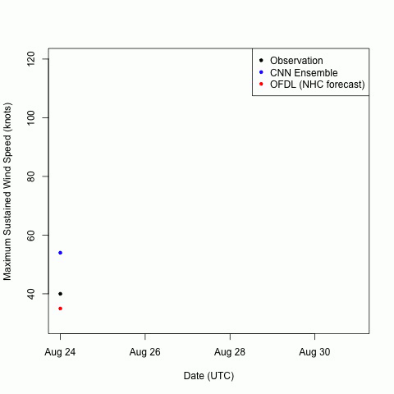
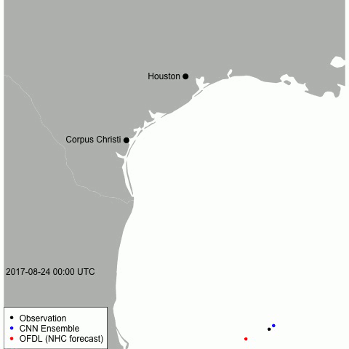
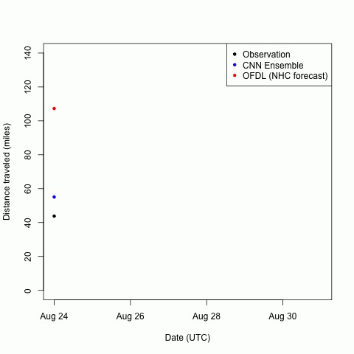
Methodology
12

Slide 15
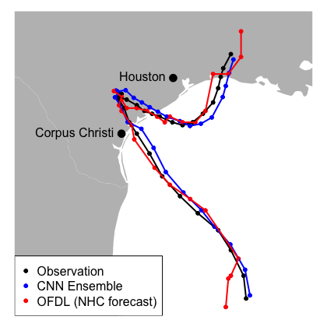
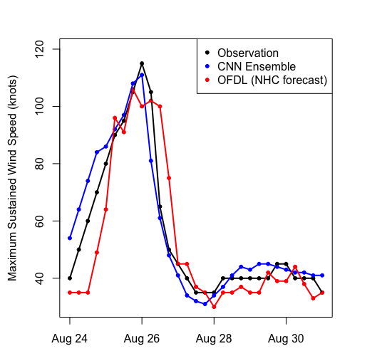
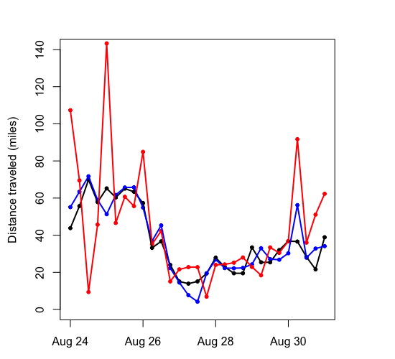
Methodology
13

Slide 16
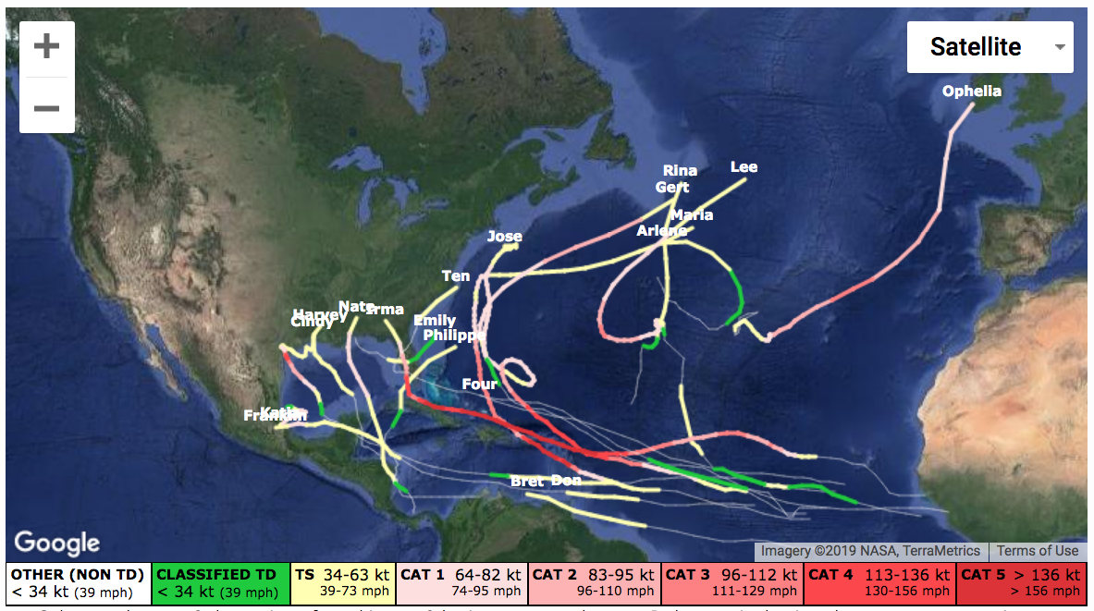
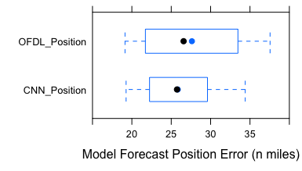
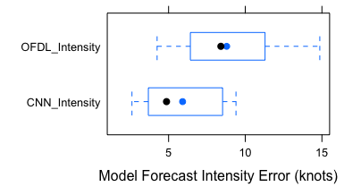
Results
19 Tropical cyclones (models & best track) for the North Atlantic in 2017:
RMSE for hurricane position and intensity:
UH Deep Learning Ensemble (UH DLE) Hurricane Modeling System vs. NHC official forecast (OFDL) (above) and other models (right).
14

Slide 17
Summary
We developed CNN-based ensemble hurricane forecasting model using eight dynamical hurricane model results.
We used all tropical cyclones in Atlantic Ocean from 2003-2016 and tested the model for 2017.
The preliminary results of CNN ensemble model show statistical benefit over NHC official forecasting.
15

Slide 18
Acknowledgements
Thanks to Earth Science Information Partner (ESIP)
Two high school students (Chan Kim & Lindsay Choi, James E. Taylor High School) have worked on smartphone app and website applications.
Thanks to helpful comments from Dr. Young-Joon Kim (NOAA/National Weather Service)
16

Slide 19
Thank
you
for
your
attention
"It only takes one storm to devastate a community”
– FEMA’s Daniel Kaniewski

