Slide 1
Increasing the use and value of Earth science data and information through standards
Ingo Simonis, Luis Bermudez: OGC Innovation Program Testbed-14 Results for Earth Science Community
Elena Pourmal, James Gallagher: OPeNDAP and HDF5 in the Cloud: Techniques and best practices for serving HDF5 data
Aleksandar Jelenak, Peter J. T. Leonard, Charlie Zender: NASA Dataset Interoperability Recommendations for Earth Science.

Slide 2
Summary
Ingo Simonis
@ESIP Winter
January 2019

Slide 3
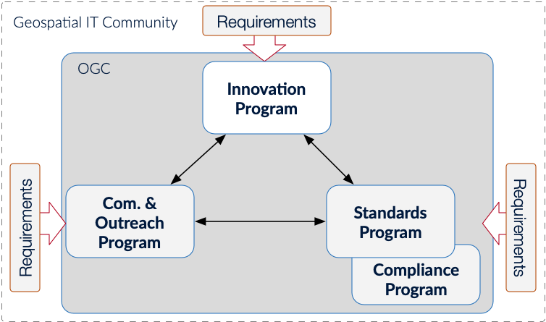

Slide 4
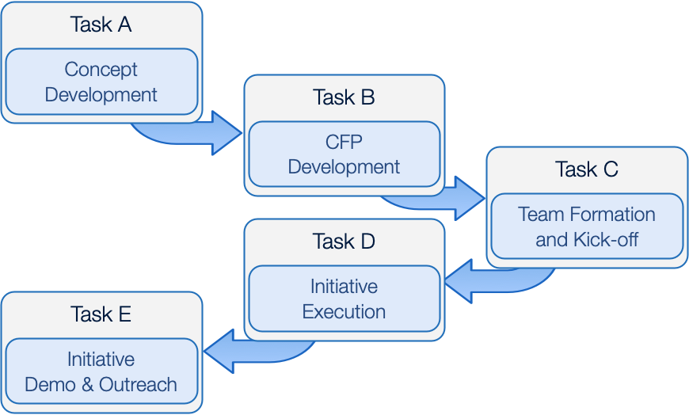

Slide 5
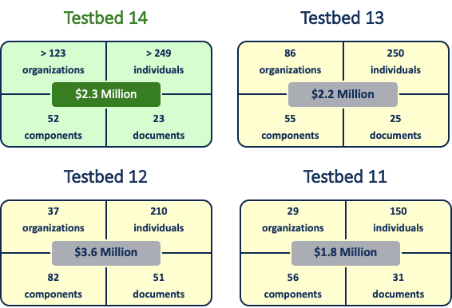
Notes:
75 observers in T14

Slide 6
Sponsors
Atos
European Space Agency (ESA) / CGI
Defence Science and Technology Laboratory (Dstl)
European Union Satellite Centre (SatCen)
Federal Aviation Administration (FAA) System Wide Information Management (SWIM) Program
Geonovum
Natural Resources Canada (NRCan)
Ordnance Survey Great Britain
US Geological Survey (USGS)
US National Aeronautics and Space Administration (NASA)
US National Geospatial-Intelligence Agency (NGA)
http://www.opengeospatial.org/projects/initiatives/testbed14

Slide 7
31 Participant Organizations
52°North GmbH
The Aerospace Corporation
Arizona State University
Army Geospatial Center / Carbon Project
Compusult
CREAF
CRIM
CubeWerx Inc.
Deimos Space S.L.U.
DigitalGlobe
e-Science Data Factory
Ecere Corporation
Envitia Ltd
EOX IT Services GmbH
George Mason University
Geoatys
GeoSolutions SAS
GIS.FCU
HEIG-VD // School of Business and Engineering Vaud
Helyx SIS
Hobu
Image Matters LLC
interactive instruments GmbH
keys
lat/lon GmbH
Meteorological and Environmental Earth Observation S.r.l.
Remote Sensing Solutions Inc
Solenix Deutschland GmbH
Spacebel
Steinbeis Transfer Center at HFT Stuttgart
University of Calgary

Slide 8
Threads and Deliverables
Earth Observation & Clouds (EOC)
4 ERs, 14 Components
Modeling, Portrayal, and Quality of Service (MoPoQ)
10 ERs, 19 Components
Next Generation Services (NextGen)
7 ERs, 15 Components
Compliance (CITE)
2 ERs, 4 Components
… 23 ERs + 52 components in total

Slide 9
Earth Observation & Clouds (EOC)

Slide 10
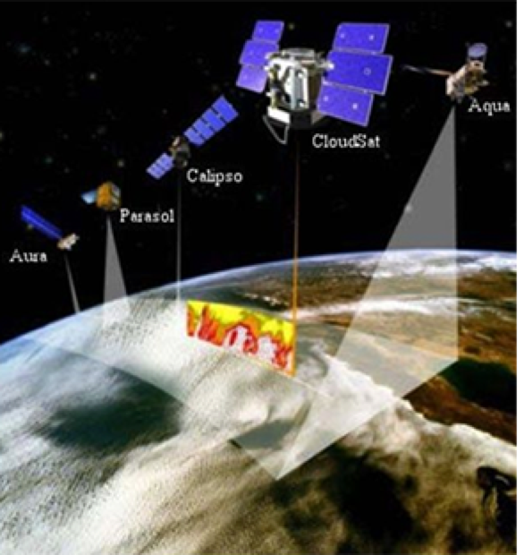
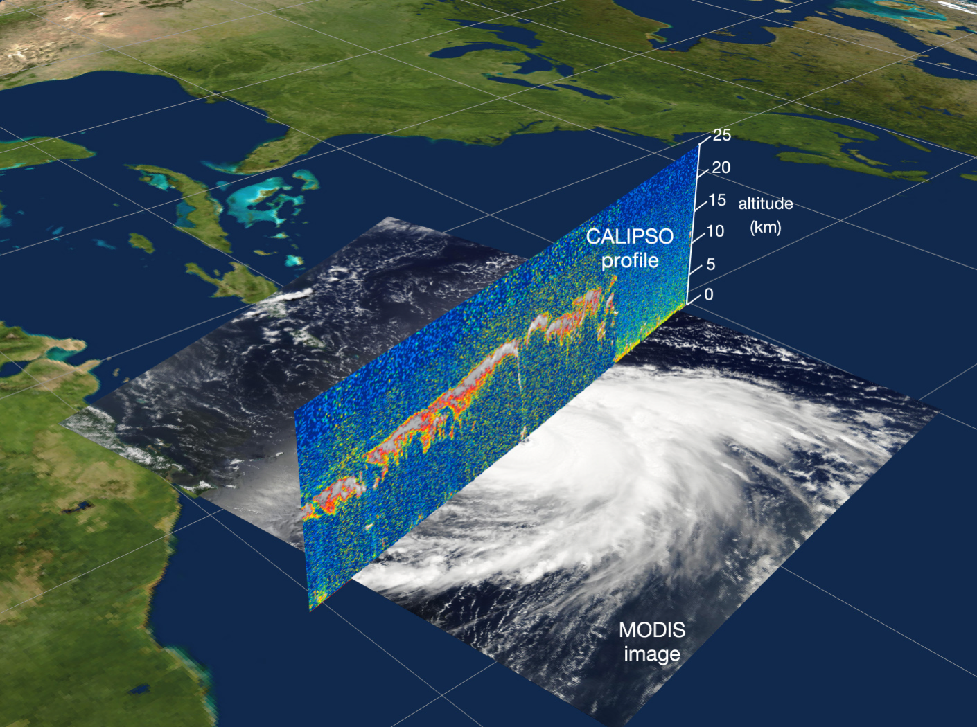
Swath Coverage Data
WCS
Notes:
NASA was interested in increasing the usage of low level satellite data, in particular level 1 and level 2, and offering this type of data with standardized interfaces. This would simplify the use of satellite data and could encourage the development of higher level products probably through Web Coverage Service. The difficulty is that the OGC coverage model (OGC Coverage Implementation Schema CIS v1.1) didn’t allow modelling of all types of swath data in an efficient way.
Cells are not rectangular and vary in size. If you see the figure the resulting swath data could have for example the shape of a vertical curtain. Here, cells are not rectangular and vary in size.
The traditional OGC CIS model separates the domain data (i.e. the spatio-temporal characteristics ) and range data (i.e. the property values of the various cell) and defines mapping rules. For vertical curtains, this approach has been proven to be sub-optimal in the way OGC CIS is handling it.

Slide 11
Swath Coverage Data: Approach
Analysed existing modeling approaches
Consulted the NetCDF-CF conventions for Swath Data editor
Explored Swath data modeling options in OGC
Developed
OGC Swath Coverage model
OGC Swatch Coverage encodings (GeoTiff-Swath, NetCDF-Swath, GeoPackage-Swath)
OGC Coverage Service
WCS Swath Coverage Profile
WCS Swath Coverage API
Explored standard interaction with WCS-Swath for data access and visualization
Notes:
After understanding that the current OGC WCS and CIS specifications resulted in enormous file sizes (factor 10 to 1000 greater than the original data file), we analysed the different Swath types. We did that in consultation of the NetCDF-CF conventions for Swath data editor, Aleksandar Jelenak, to find a common approach. We explored the various options and eventually developed an OGC Swath Coverage model, three different standard encodings, and a WCS profile for Swath. The WCS profile was complemented by a resource oriented approach, following the guidelines developed by OGC. Last, we explored data visualization and data access patterns for Swath data. For visualization purposes, it was recommended to only use low resolutions, where as data access should provide the full detail, including exact cell locations.

Slide 12
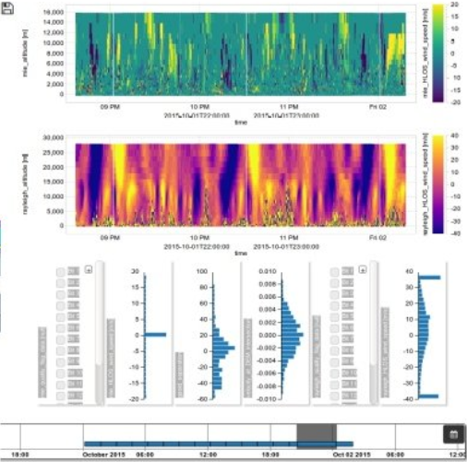
Swath Coverage Data: Way Forward
WCS-Swath profile including concrete Change Requests → WCS SWG
Resource oriented WCS → WCS SWG/Coverages DWG and OWS-Common SWG
Better support in GIS tools for un-gridded 4D Swath data required
Update the GDAL GPKG driver to support non-tiled data
Need to brainstorm how results from say a level-1 data set can be re-published at WCS after processing in a way that users understand what has happened
Notes:
The various WCS elements (Swath-profile, resource oriented version) need to be incorporated into the WCS specification or profiles/best practices thereof. Further on, it turned out that Swath data support is pretty limited in all GIS tools, in particular for complex data types such as vertical curtains. So far, most support is provided by dedicated clients like the one shown in the slide, but these lack other GIS capabilities. Thus, tool support needs to be improved. Once tools allow processing of lower level Swath data, mechanisms shall be explored that allow the re-publication of Swath Data at WCS, including all necessary metadata to understand the applied processing.

Slide 13
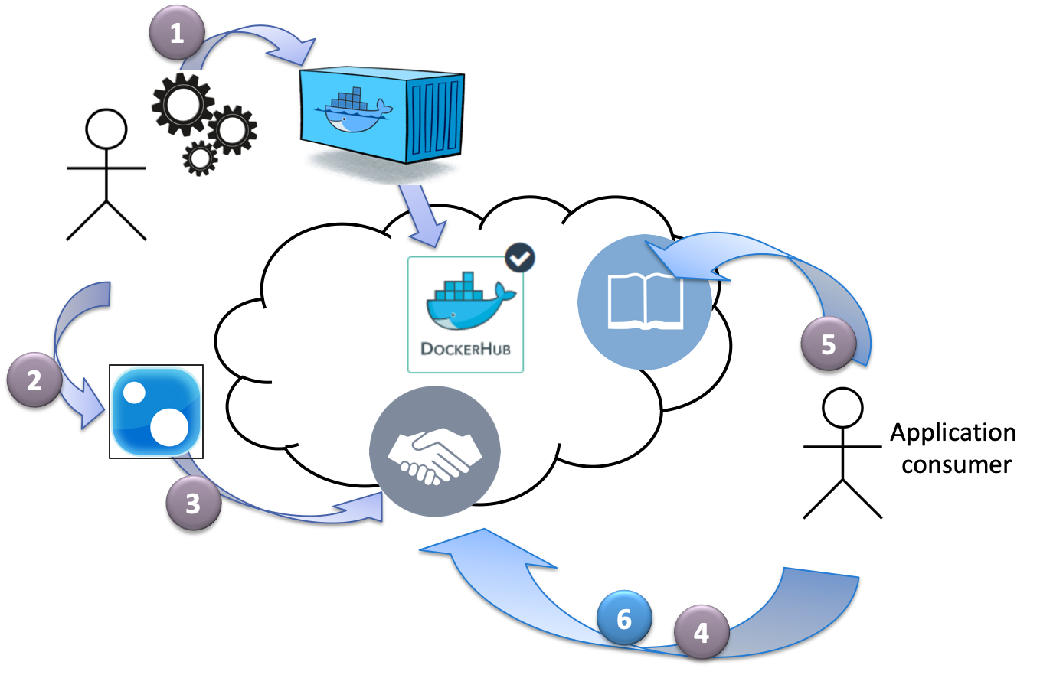
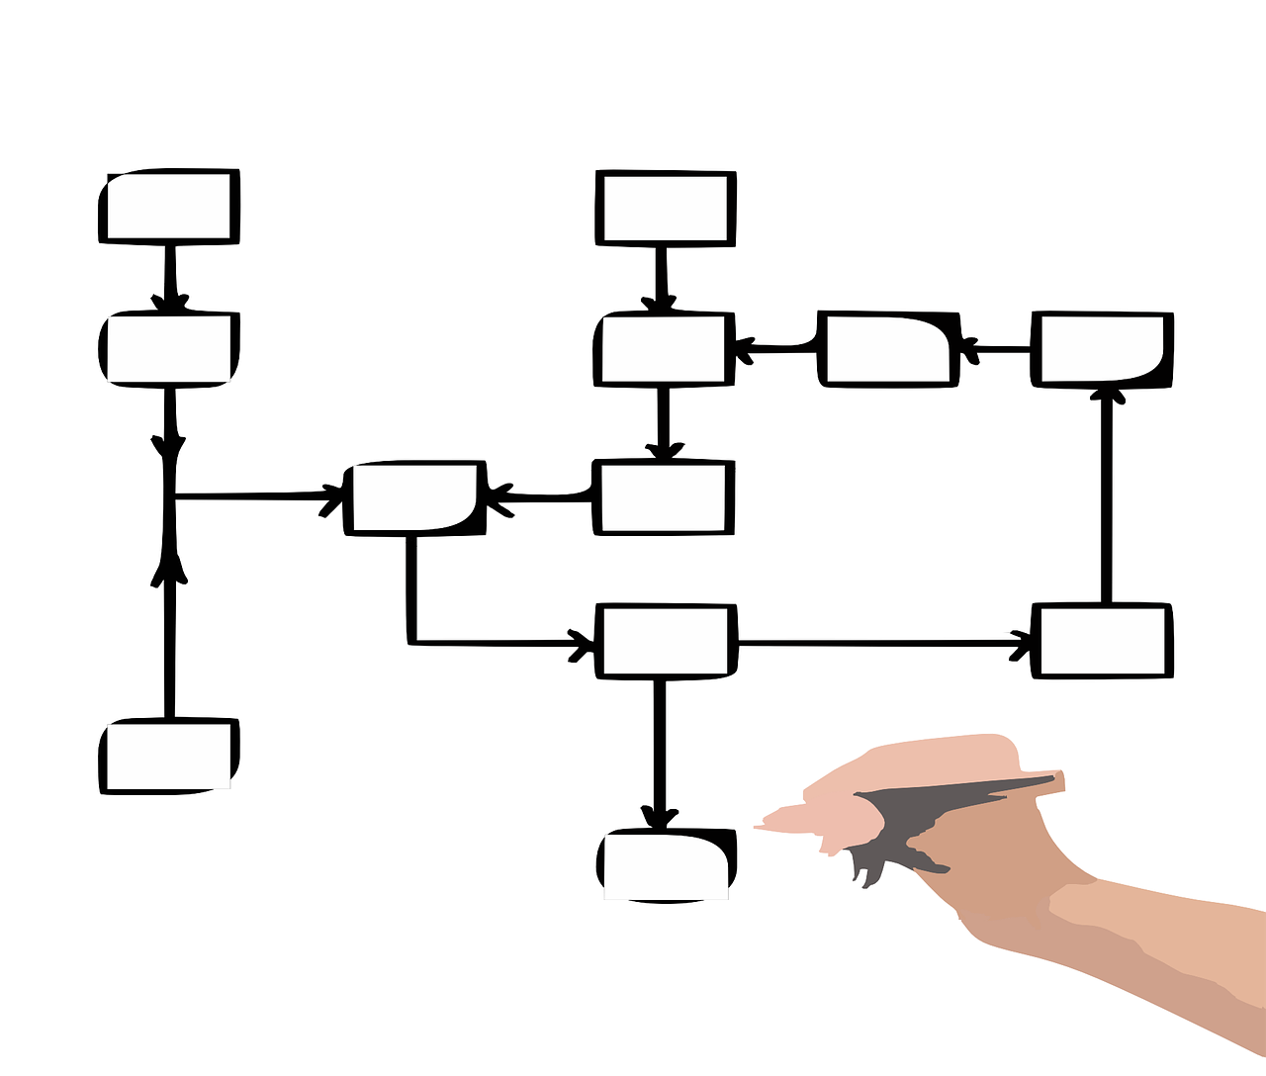
EO Applications in the Cloud: Challenge
Workflow registration composed of distributed applications
Notes:
More and more applications are cloud-enabled. They are being deployed and executed close to the physical location of the data. In Testbed-13, we developed an architecture that allows an application developer to develop an application that contained al the information to run in a wokrflow. This is, packing it into a Docker container, create metadata with all necessary information to run the container (e.g. inputs, parameters). The application package could be registered with a WPS service. Application consumers can find the application on that server and subsequently execute the workflow.
In Testbed-14, the challenge was how to register not one application but a workflow composed of various applications. In addition, moving away from the local machine into the cloud has the risk for the user that requested data processing causes enormous costs. Therefore, we needed a model that allows the application consumer to understand what a planned execution would cost.

Slide 14
EO Applications in the Cloud: Approach
We analyzed different workflow description languages
Common Workflow Language (CWL) vs. BPEL/BPMN
Simpler
Less error prone
Good range of tools available to execute in Docker environments
Follows the philosophy of Docker that execution commands should be expressible as command line instructions
Application Package format revised
Simpler
Execution unit changed from Docker container to workflow CWL script
Resource-oriented WPS developed
Brought everything across several clouds and including a quotation & billing model
Notes:
We had basically two major challenges: First, to describe workflows as a sequence of applications with each application possibly executed on a different cloud; second a quotation and billing model that allows commercialization of Earth observation apps. Initially, we evaluated different workflows expression languages and finally decided to use CWL (Common Workflow Language). Main rationale was simplicity and its command-line characteristics what included mounting of endpoints to serve and store and data, and its handling of parameter values for execution runs. Next, the Application Format was revised. The Testbed-13 approach of using OWS Context was dropped after long discussion in favor of pure WPS Process Description. This was a tough decision made after quite a number of iterations. Still, WPS Process Descriptions can be embedded in OWS Context files easily. WPS was updated to a resource oriented type with support for transactions, which are necessary to register new applications.

Slide 15
EO Applications in the Cloud: Way Forward
WPS 3.0 OpenAPI → WPS SWG group for API consolidation
CWL experiences → Workflow DWG
Quoting and billing model consolidation
Consolidation pilot in 2019 to mature the architecture
Notes:
Testbed-14 was a direct follow up of work started in Testbed-13. After two years, it is now time to run a pilot initiative to consolidate the work. Testbed-14 has demonstrated that all elements can be brought together successfully, but it isn’t smooth enough yet. The pilot initiative should further include processes that are already deployed and offered at WPS or WCPS interfaces. In terms of Standards Program Working Group activities, it is important to finalize the work on resource oriented WPS featuring OpenAPI.

Slide 16
Modeling, Portrayal, and Quality of Service (MoPoQ)

Slide 17
Application Schema Modeling and Conversion: Challenge
Explore the relationships between UML-based application schemas and OWL-based ontologies.
Determination of preliminary techniques for the development of subsets of ontologies to support different types of applications
Initial model for defining metadata about application profiles, so they can be searched and discovered by agents.
Increasing the understanding of state-of-the-art JSON technologies
Enhance ShapeChange to derive JSON Schema
How to map property name of JSON instance data to terms in JSON-LD
Notes:
Given the NGA’s NSG Application Schema:
This task endeavors to enhance the understanding of the relationships between UML-based application schemas and OWL-based ontologies.
Define the concept of application profiles (AP) for OWL-based ontologies used by Linked Data (LD) applications
Definition RDF application profiles for simple linked data application, and complex analytic linked data applications.
Increase OGC community’s understanding of state-of-the-art JSON, JSON Schema, and JSON for Linked Data (JSON-LD) technologies as applied to the encoding of an ISO 19109-conformant Unified Modeling Language (UML) application schema.

Slide 18
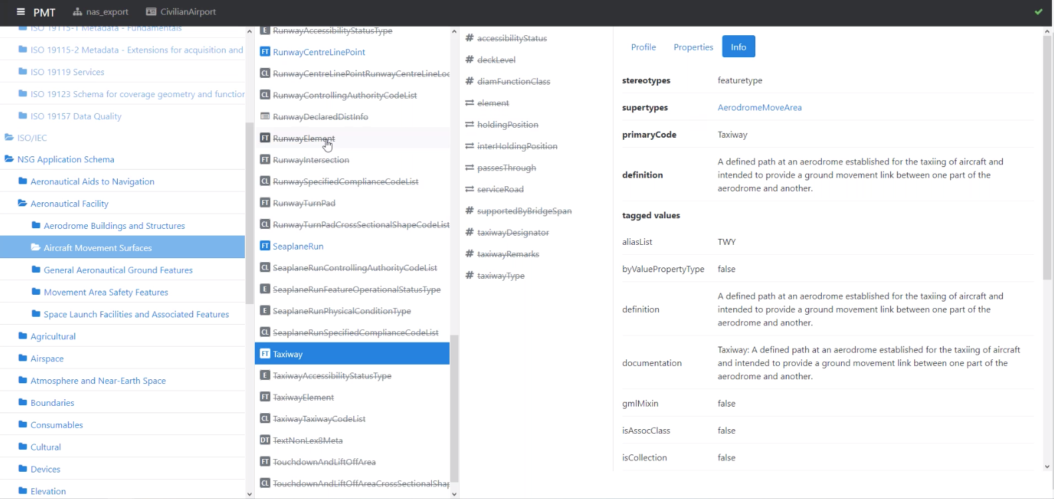
Application Schema Modeling and Conversion: Approach
Notes:
Unfortunately, the only thing to show in this task are UML diagrams, JSON encoding and RDF tuples. However, here is a screenshot of the ShapeChange Profile Management Tool (PMT) working to define an application profile of the NSG Application Schema.
This shows the properties of the definition of a Taxiway within the Aircraft Movement Surface inside the NSG Application Schema.
The participants conducted detailed and methodical dives into associated technologies for modeling, linked data and ontologies. This includes developing RDF application profiles for simple linked data application and complex analytic linked data applications.

Slide 19
Application Schema Modeling and Conversion: Way Forward
Continue working on challenges related to conversion of UML to GML
Develop SHACL services and build support in ShapeChange
Improve conversion of OCL constraints
Develop a new version of the ShapeChange JSON Schema target
Develop JSON Schemas for ISO schemas
Notes:
There is still need to extend the ShapeChange tool and investigate the best formats and languages to model with.
This includes determining the best use of SHACL as it relates to OCL constraints, and building services in SHACL.
Improving the conversion of OCL constraints to Schematron and OWL and extending the use of ShapeChange with regards to JSON Schemas.

Slide 20
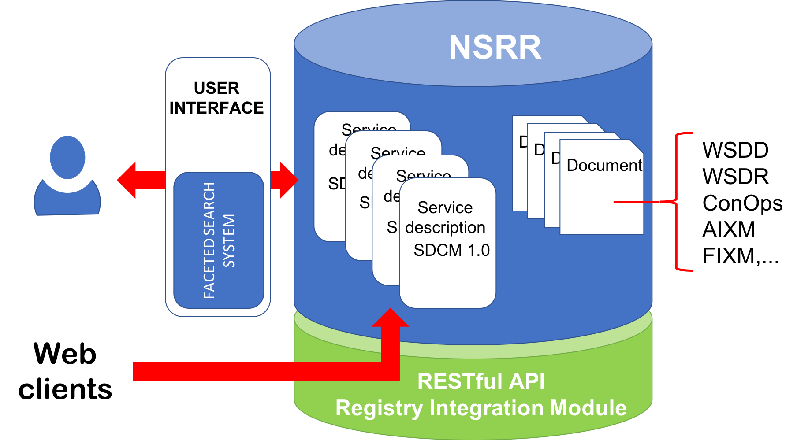
Information Registries & Semantic Enablement: Challenge
Notes:
The FAA’s National Airspace System (NAS) System-Wide Information Management (SWIM) network and Service Registry and Repository (known as the NSRR) were evaluated.
The Registry is an existing system that allows for the search and retrieval of service metadata; however it does not allow for the searching and retrieval of the data that is inside the services.
So I can currently find that a service provides flight plan data in FIXM, but I do not know the area it services.
How do we “semantically enable” existing data and metadata models, such as AIXM and FIXM, used in the aviation industry?

Slide 21
Information Registries & Semantic Enablement: Approach
FROM:
TO:
Notes:
Several methods were evaluated and discussed, such as, W3C’s Web Annotation Model, controlled vocabularies.
Also, Metadata level semantic enablement to support search and discovery of information, and Instance level semantic enablement to support data integration and reasoning.

Slide 22
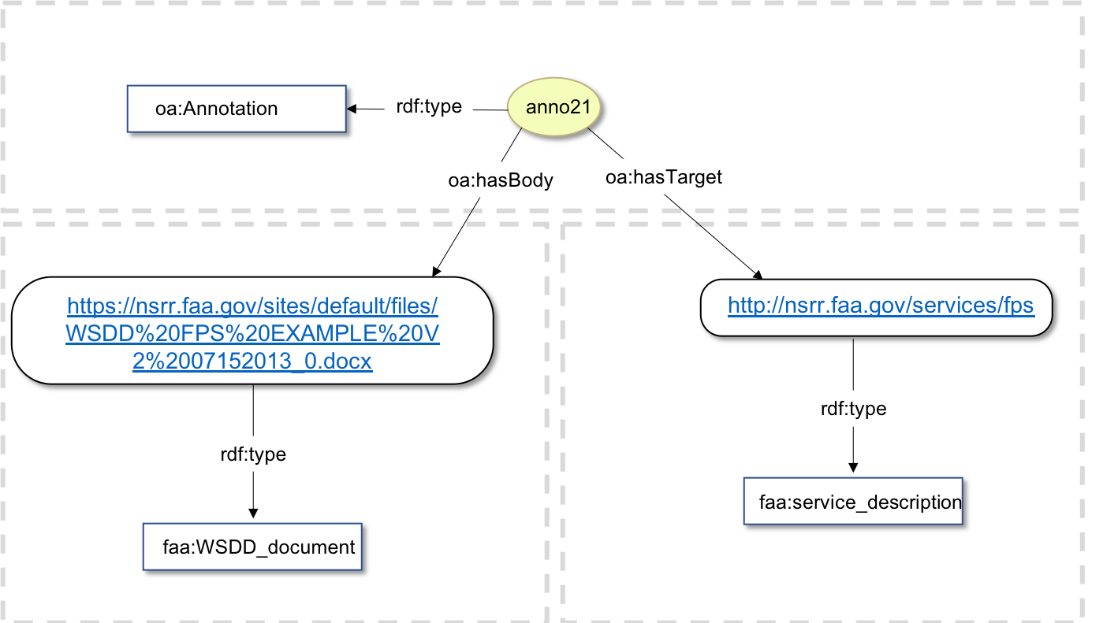
Information Registries & Semantic Enablement: Way Forward
Notes:
Number one: Use of W3C’s Web Annotation Model to tag information to service descriptions for underlying data sets they include.
How to use DCAT, GeoDCAT,Project Open Data, SRIM to semantically enable services and data.

Slide 23
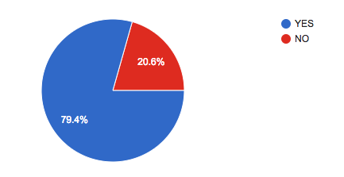
LiDAR Point Cloud Data Handling: Challenge
Do you experience software interoperability challenges when working with point cloud data?
Notes:
Surprising results: the number of people having no issues is surprisingly low

Slide 24
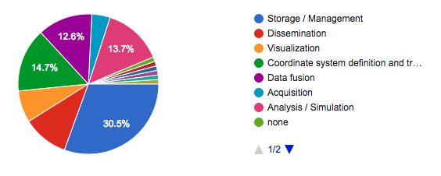
LiDAR Point Cloud Data Handling: Challenge
During what phase do you encounter the MOST software interoperability challenges?

Slide 25
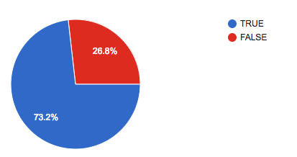
LiDAR Point Cloud Data Handling: Challenge
I regularly work on point clouds that exceed the processing, memory, or storage capacity of my workstation or laptop.

Slide 26
Research Questions
What is unique about point cloud data in relation to other geospatial data?
Why is a Web service for point clouds needed?
What is the expected data volume of point cloud data?
Do existing Web service standards within OGC already address the point cloud challenge?
Describe the challenges of point cloud Web services in relation to other kinds of web services such as those based on Web Map Service (WMS), Web Feature Service (WFS), and Web Coverage Service (WCS) standards

Slide 27
LiDAR Point Cloud Data Handling: Approach
Identify requirements for use, storage, and transmission of point cloud data
Investigate five current Web service software packages:
ESRI I3S [https://github.com/esri/ pointcloud],
Cesium 3D Tiles [https://github.com/AnalyticalGraphicsInc/3d-tiles]
Greyhound [https://greyhound.io],
PotreeConverter [https://github.com/potree/PotreeConverter],
Entwine [https://entwine.io])
Notes:
Given the current state of the Point Cloud community, we looked to define mandatory and optional requirements for the interoperable use, storage and transmission of point cloud data. Then, using those requirements, evaluate 5 of the current industy’s solutions. Each were evaluated using consistent criteria and market research.
The Point Cloud DWG is starting to evaluate the results of this study and should be recommending how OGC and the industry can move forward.
On big point of this study is to help an SDI to make their own decisions on a way forward with how they handle Point Cloud data.

Slide 28
Status Quo
Testbed-14 found out that the market is still missing an openly specified format with the following features:
Spatially accelerated access
Point cloud-appropriate compression with no intellectual property restrictions
Flexible data schema
Platform (JavaScript, Java, native) flexibility

Slide 29
LiDAR Point Cloud Data Handling: Way Forward
For Web service specifications coming from OGC, the following additional requirements must be considered:
Static tiling approach aligned with WMTS and GeoPackage
Suitability for archival data storage and transmission in addition to progressive access over HTTP network protocols
Downstream application performance sensitivity to data organization
Notes:
Tiling approaches need to be harmonized with WMTS and GeoPackage
Data storage and transmissions needs to be addressed in addition to progressive access over HTTP
Handling of downstream application performance depending on the data organization

Slide 30
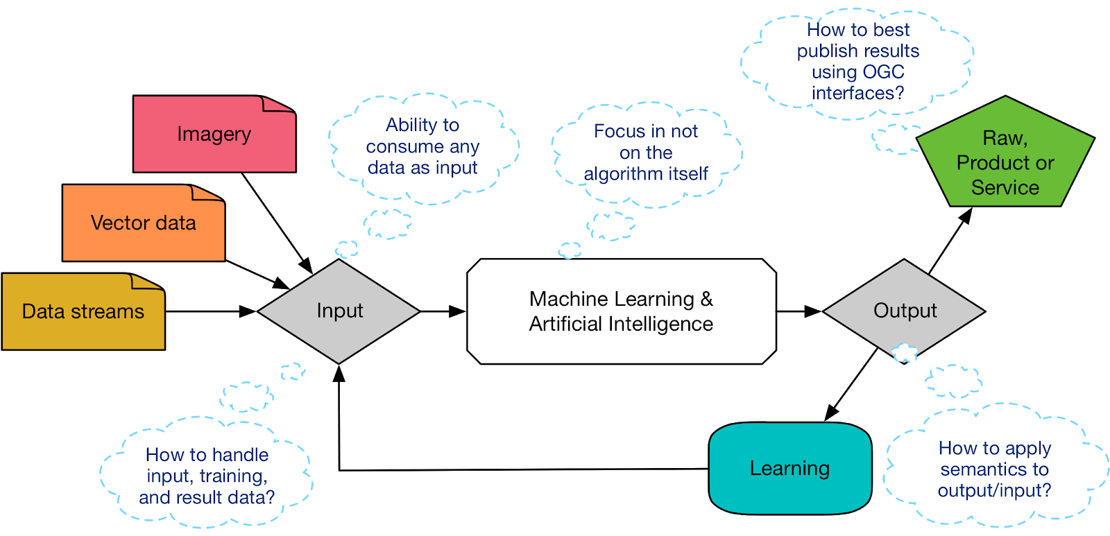
Machine Learning, Deep Learning & Artificial Intelligence: Challenge
Notes:
How is geospatial data use in systems that are running ML, AL and DL?
What is the best OGC interface standard to publish the results?
The goal of this work was to develop a holistic understanding of AI, ML, and DL in the geospatial context.
We expect to advance or derive best practices for integrating ML, DL, and AI tools and principles in the context of OGC Web Services.

Slide 31
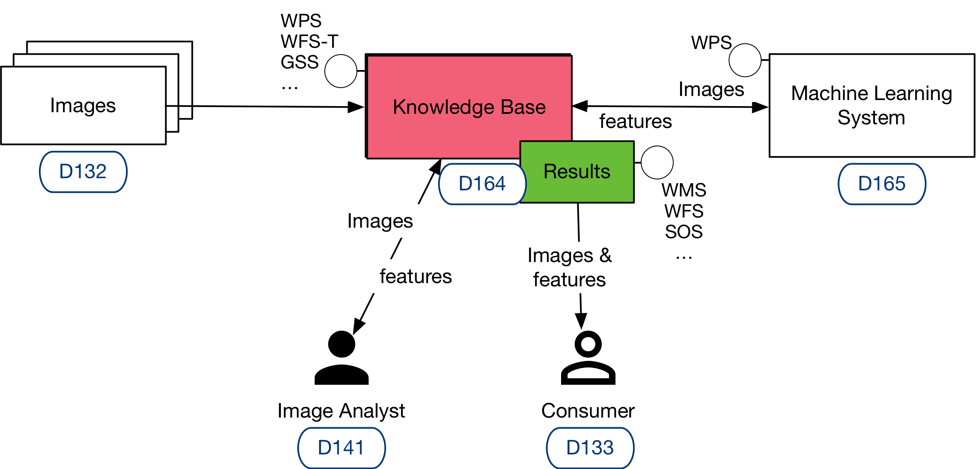
Machine Learning, Deep Learning & Artificial Intelligence: Approach
Notes:
This task worked to show how OGC Web Services and geospatial resources can be integrated into a Machine Learning system. We looked at what actors are involved and the APIs that needed to be developed.
OGC WFS and WCS are used to define an Image Repository and Feature Store with interactions with a Knowledge Base that provides access to the Machine Learning system and related models.

Slide 32
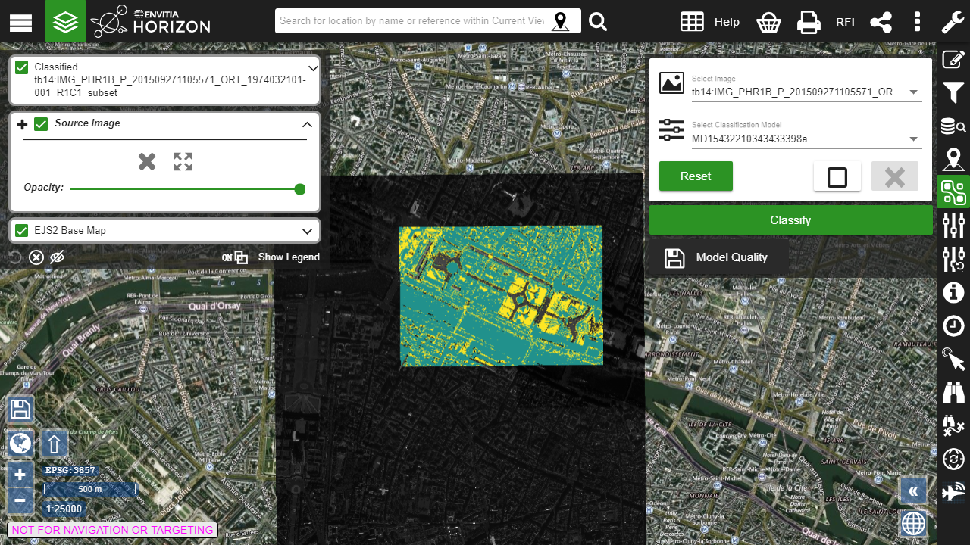
Machine Learning, Deep Learning & Artificial Intelligence: Way Forward
Notes:
Here is a classified image of Paris. The yellow areas are classified as “Park’ according to the land use classifier in the model run.
There are a lot of quality suggestions for future work in this domain. For example, additional study and documentation needs to include: Geospatial Machine Learning systems best practices, Artificial Intelligence for Earth Observation Application Packaging and Workflows best practices, and also Machine Learning for disaster interoperability.

Slide 33
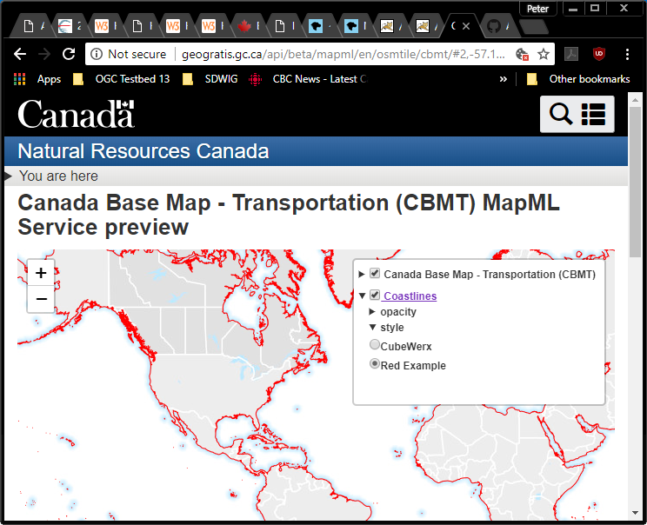
MapML: Challenge
How can we make maps truly accessible to everyone in a default web browser?
Notes:
Maps cannot be natively displayed on HTML web pages. Currently, a plugin, or library is required to be installed by the user to be able to interact with map information. How can we make maps truly accessible to everyone in a default web browser?

Slide 34
Image Maps vs. MapML

Slide 35
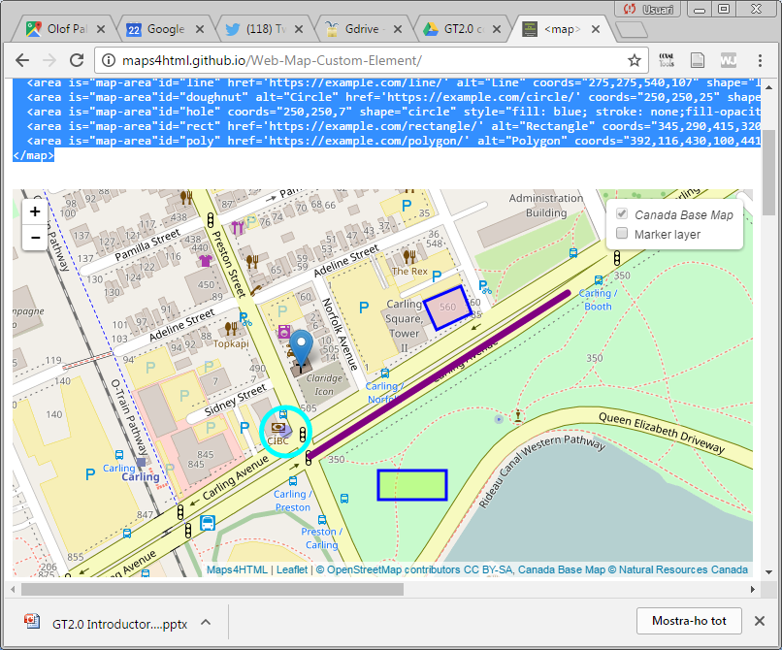
MapML

Slide 36
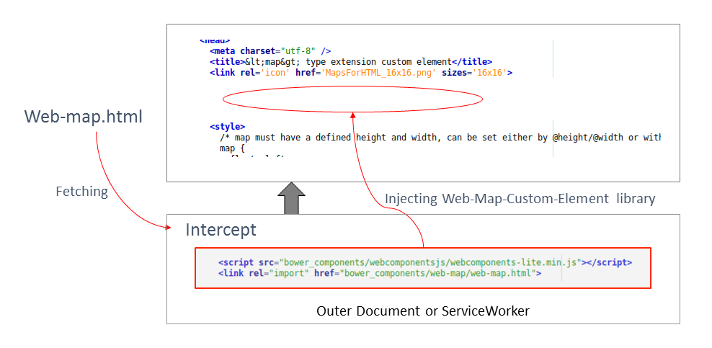
MapML: Approach
Notes:
Two implementations were developed in this testbed:
The first was to develop a ServerWorker proxy for MapML, using the Service Worker browser API. The application takes a MapML document and injects the web components library call and the web-map.html call in the MapML documents. This gives automatic support to MapML document for web browsers that does not support MapML natively.
The second implementation was a cloud-based MapML service to proxy (or cascade) existing OWS content services, including WMS, WFS, WMTS as MapML.

Slide 37
MapML: Way Forward
The next generation of OGC services can integrate MapML files more easily.
Potential use of MapML for social media.
Increase functionality of MapML with full integration with the OGC standards baseline and future generations of OGC standards for maps and tiles.
Notes:
Explanation well written - max 5 lines of text

Slide 38
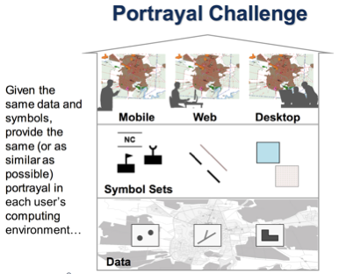
Notes:
According to many, the OGC Style Layer Description (SLD/SE) has run its course. As part of the Portrayal Concept Development Study (CDS), it became clear that a new conceptual model for Portrayal is necessary. So the question became: How do we develop a conceptual model for Portrayal that allows for what we called the “Portrayal Challenge”: Given the same data and symbols, provide the same (or as similar as possible) portrayal in each user’s computing environment.
The Key Point is to have “One Conceptual Model and Multiple Encodings”

Slide 39
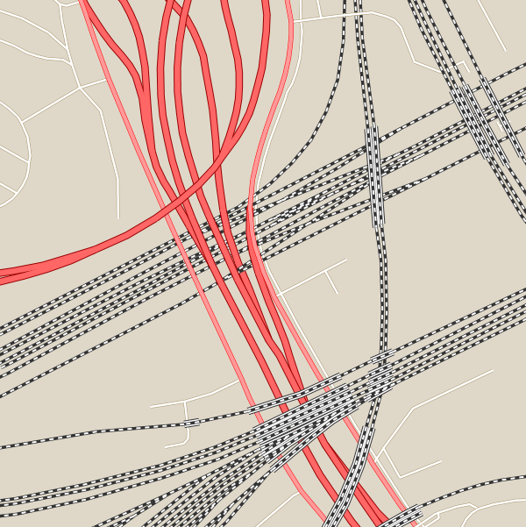
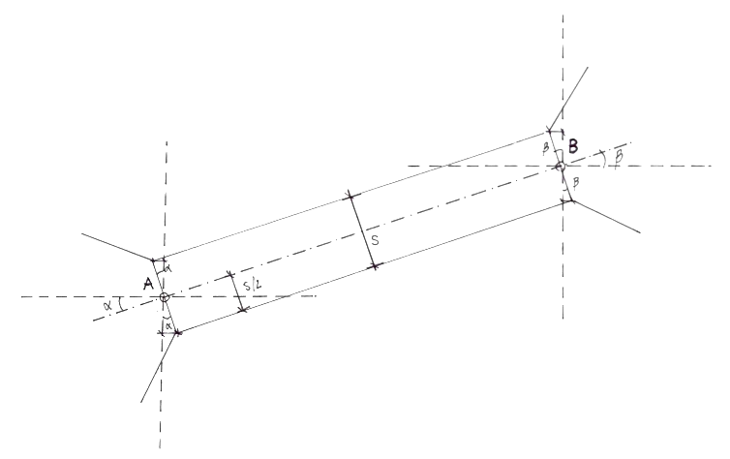
Portrayal: Approach
Notes:
The idea was to find some things that were easy and some a little harder to model:
Bridges, z-ordering (such as spaghetti junctions), and MIL Standard 2525 composite symbols were looked at, as well as simpler things like roads, boundaries and areas.
Encodings and environments evaluated were:
SLD and CSS for GeoServer (GeoCSS)
CartoCSS encoding and Carto rendering
JSON encoding and Mapbox Studio rendering
WMS with Portrayal Support using Mapnik
GeoPackage with Portrayal Support
We also produces an encoding of the conceptual model in GNOSIS Cartographic Map Style Sheets (CMSS) format.

Slide 40
Portrayal: Way Forward
Open Portrayal Framework
Notes:
What we found was that with a little work, almost all of the conceptual model could be encoded in most, if not all of the encodings tested. There is additional work that needs to be done, both on the conceptual model, and the individual encodings to ensure future interoperability of portrayal. 3D, raster and Augmented Reality portrayal are missing from the Conceptual Model. These need to be included in future work.

Slide 41
Quality of Service & Experience: Challenge
Quality of Service: Technical reliability and performance of a network service.
Quality of (User) Experience: A holistic, qualitative measure of the customers' experience of the application or service.
Notes:
Quality of Service and Experience
A discussion paper OGC 17-049, entitled "Ensuring Quality of User Experience with OGC Web Mapping Services" provides an assessment framework for identifying issues and measuring quality. It outlined fourteen criteria to measure QoSE, and recommendations are given for each of them. The goal of this task was to identify any changes needed to this discussion paper and determine an appropriate method for assessing active web map services according to these criteria.

Slide 42
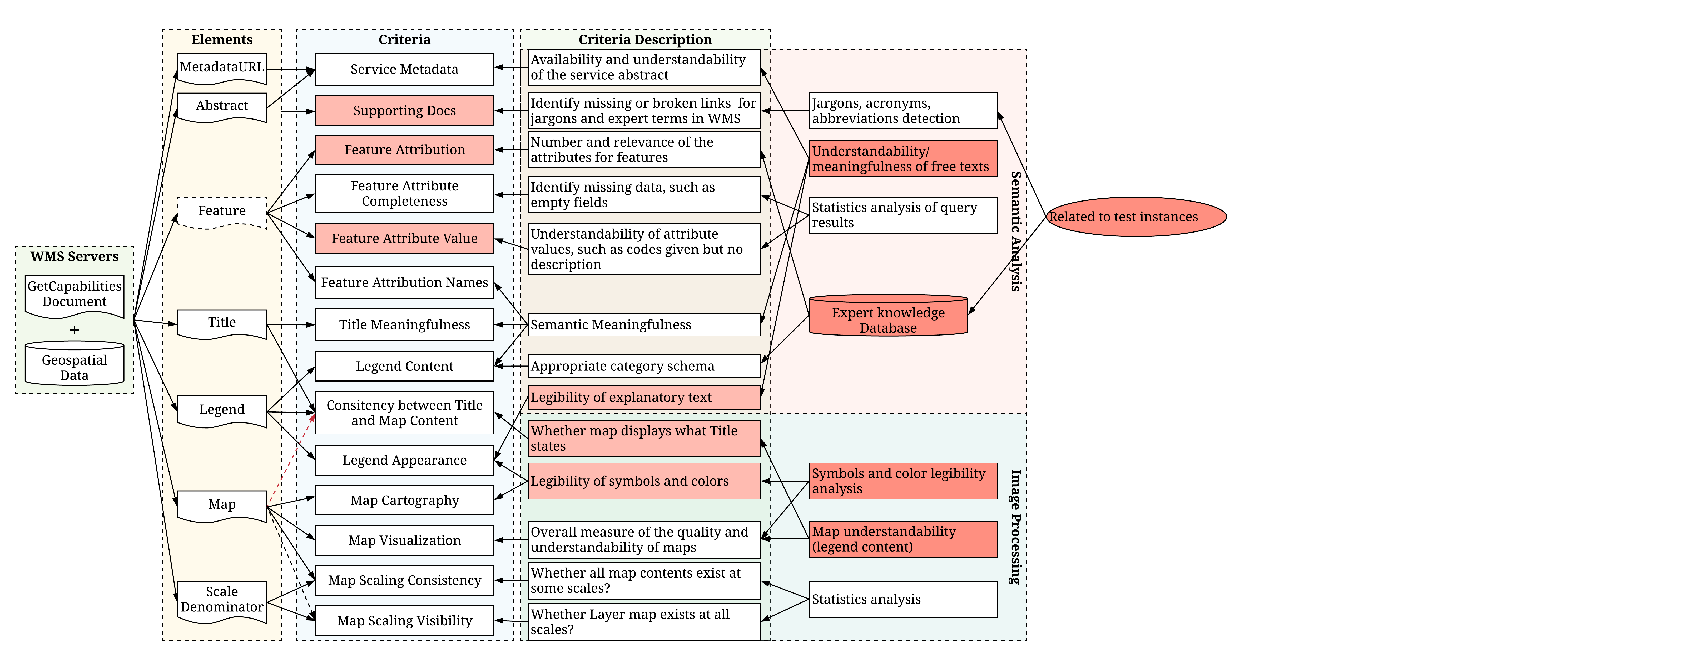
Quality of Service & Experience: Challenge
Notes:
Quality of Service and Experience
A discussion paper OGC 17-049, entitled "Ensuring Quality of User Experience with OGC Web Mapping Services" provides an assessment framework for identifying issues and measuring quality. It outlined fourteen criteria to measure QoSE, and recommendations are given for each of them. The goal of this task was to identify any changes needed to this discussion paper and determine an appropriate method for assessing active web map services according to these criteria.

Slide 43
Quality of Service & Experience: Challenge
Notes:
Quality of Service and Experience
A discussion paper OGC 17-049, entitled "Ensuring Quality of User Experience with OGC Web Mapping Services" provides an assessment framework for identifying issues and measuring quality. It outlined fourteen criteria to measure QoSE, and recommendations are given for each of them. The goal of this task was to identify any changes needed to this discussion paper and determine an appropriate method for assessing active web map services according to these criteria.

Slide 44
Quality of Service & Experience: Approach
Notes:
We developed a graphical user interface for manual assessing these criteria (a qualitative approach), an automated service, using JMeter to automate other criteria (a quantitative approach). We also looked at extending getCapabilities to include operating and performance information and even submitted several change requests for modifying WMS and other web services to have a human readable landing page instead of the prescribed XML style error page.

Slide 45
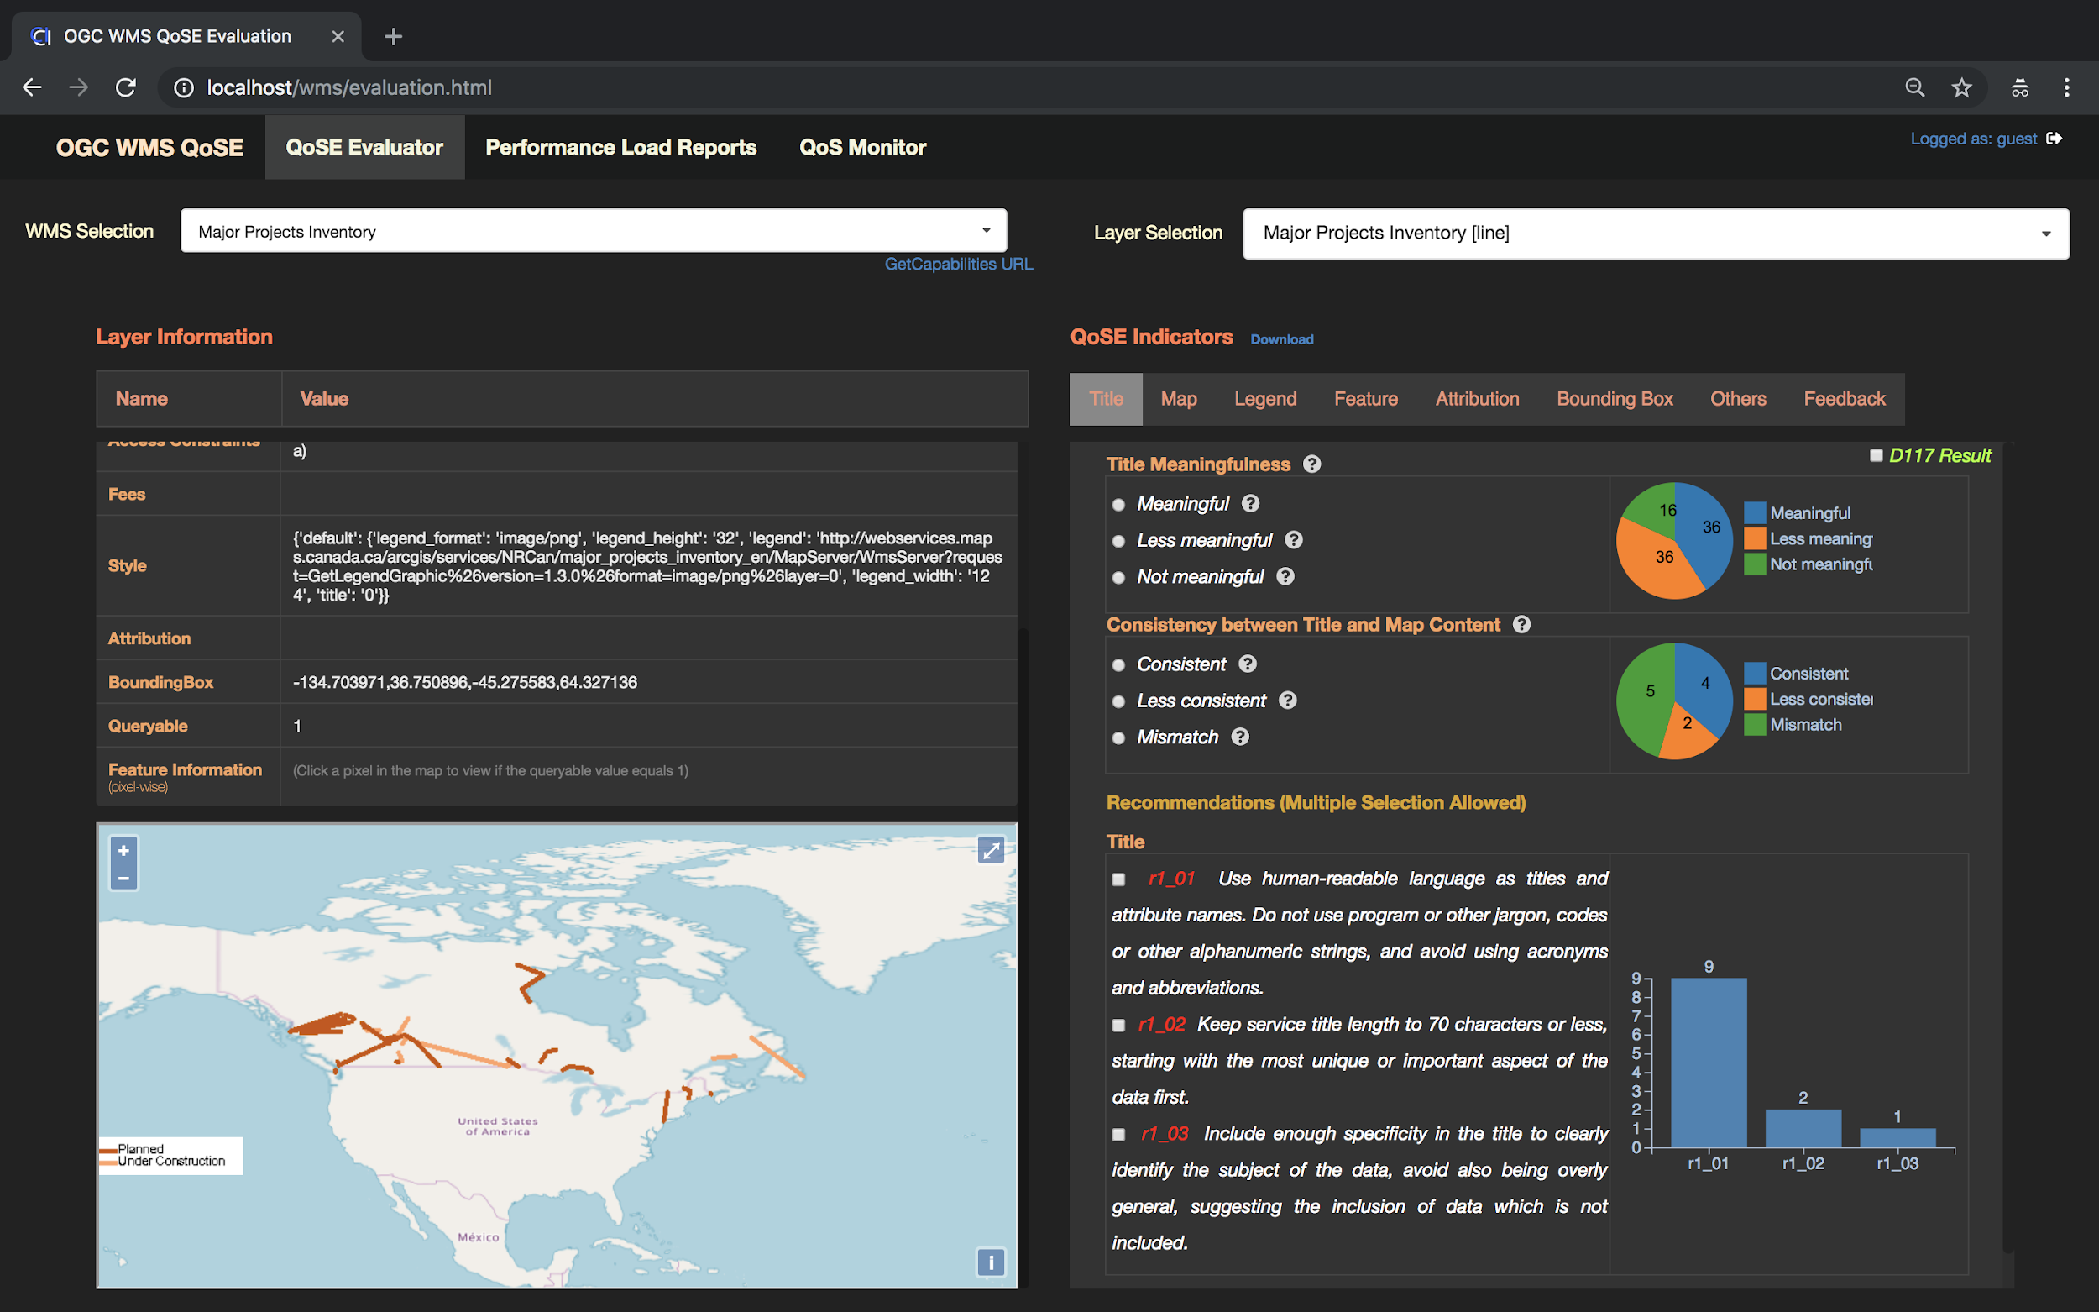
Quality of Service & Experience: Way Forward
Notes:
The assessment tools consists of three basic components, including WMS layer selector, metadata information viewer, and QoSE assessment panel. There are also linkages to the quantitative reports and performance geo-health checks. Organizations, such as a national SDI, can now use these tools to assess and provide feedback to service providers regarding their service instances, allowing them to improve the Quality of Service and Experience for consumers of the sites.

Slide 46
Next Generation Services (NextGen)

Slide 47
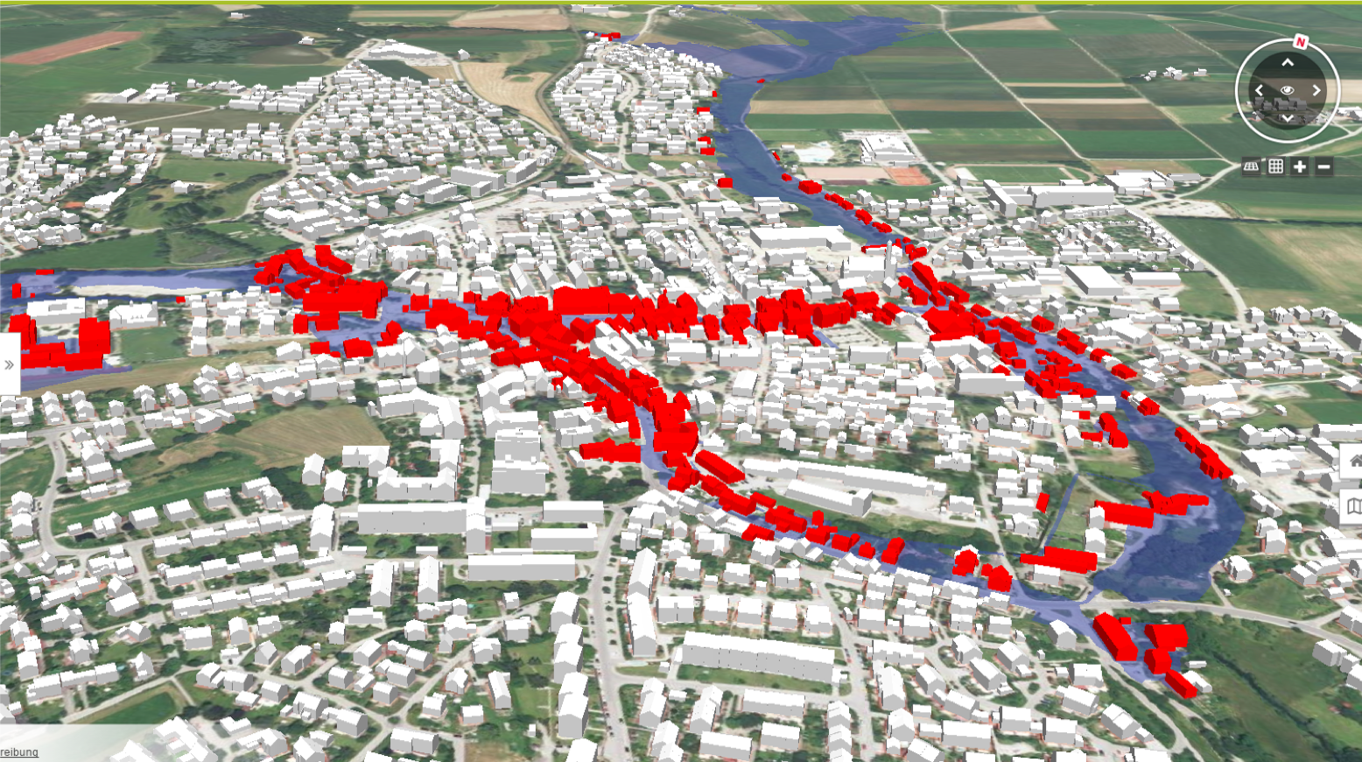
Next Gen OGC Web Services & APIs and Complex Feature Handling: Challenge
Develop a resource-oriented approach to service complex queries such as "Get all buildings having one or more ground surfaces whose CityGML LoD 2 geometry intersects with a given geometry.”
(note: Ground Surface is a nested feature in CityGML).
Notes:
Examine a next generation of OGC web services from the perspective of supporting complex 3D data or complex data schemas.
Ideally this work would lead to Web API building blocks rather than monolithic web services, so that the same API could address needs that currently require separate OGC web services, e.g. a WFS and a 3D Portrayal Service (3DPS).

Slide 48
Next Gen OGC Web Services & APIs: Approach
Notes:
For NextGen OGC Web Services & APIs, the approach was to extend the service architecture (using WFS 3.0 Part 1 as the starting point) with API building blocks for complex data, complex queries, and 3D portrayal. There were no general issues with migrating current WFS, 3DPS, WMTS, and WMS capabilities to the NextGen architecture. On the contrary, the NextGen approach improved interface consistency and removed redundancies.

Slide 49
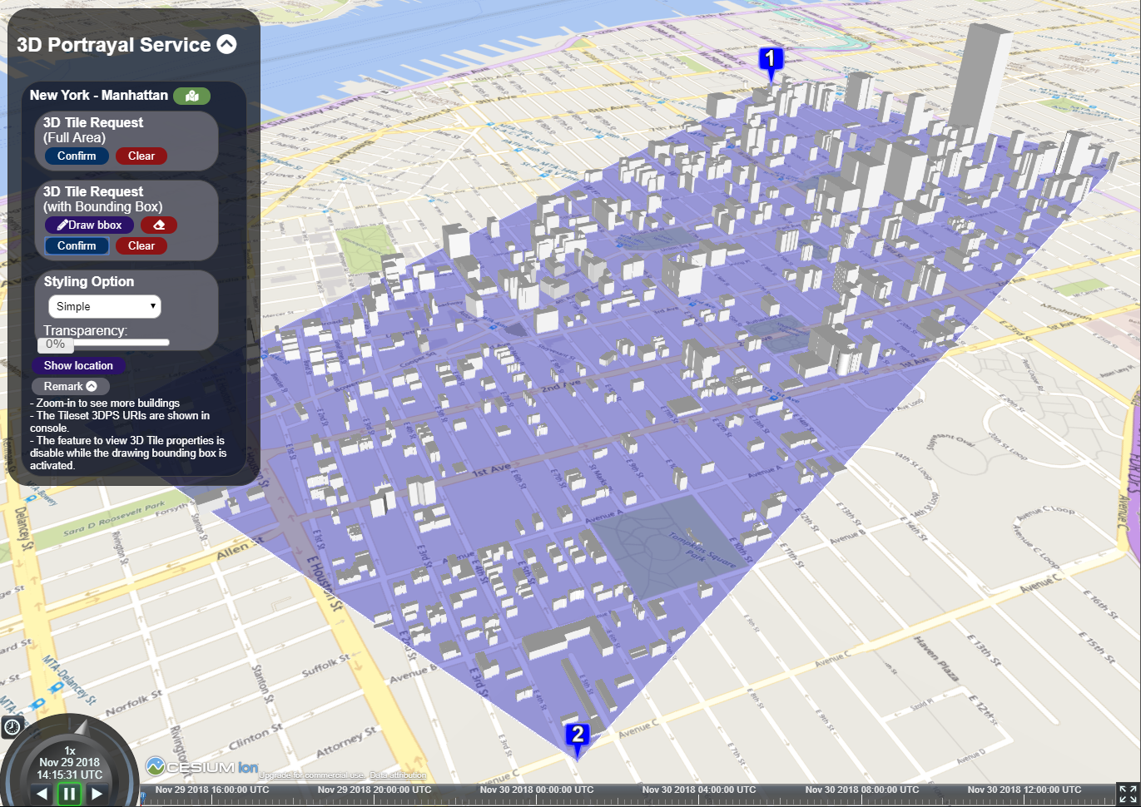
Complex Feature Handling: Approach
Query nested objects
Query that returns selected properties
Query solid geometries
Display in web browser
Notes:
For Complex Feature Handling, the approach was to examine real-world future requirements, including:
Querying / filtering features based on properties of related or nested objects or on expressions built from complex predicates;
Querying feature data and returning only parts of features (e.g., selected properties);
Access to and query of solid geometries and other geometries in a 3D CRS;
Use of responses for display in a web browser.

Slide 50
Next Gen OGC Web Services & APIs and Complex Feature Handling: Way Forward
Specify WFS 3.0 extensions for improved fetching
Migrate additional resource types used in current OGC web service standards to a Next Generation architecture
Investigate if/how GraphQL could be used to query a feature dataset
Consider the use of CityJSON as an additional WFS 3.0 encoding for 3D city models
Develop guidance for implementing advanced search capabilities in WFS 3.0 APIs.
Notes:
Explanation well written - max 5 lines of text

Slide 51
Federated Clouds: Challenge
Sharing data and computing resources in dynamic, collaborative environments that span different administrative domains with different security approaches (e.g., OpenID Connect and OAuth)
Notes:
Share data and compute resources in dynamic, collaborative environments that span different administrative domains, leading to the concept of “federation”.
Demonstrate a specific data-sharing scenario among two or more administrative domains using existing security tooling, e.g., OpenID Connect and OAuth.

Slide 52
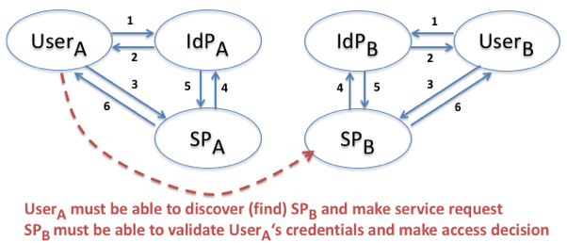
Federated Clouds: Approach
Notes:
Federated Clouds took the following approach:
Coordinate across all federation-related T-14 tasks, including EOC and Workflows,
Understand the overall federation design space, analyzing and critiquing the scope, trade-offs and limitations of T-14 federation capabilities,
Identify and prioritize future work, and
Liaise with external groups such as the NIST/IEEE Joint WG on Federated Cloud.
The primary result was that future work should identify and prototype different types of specific use cases where access decisions are being made by outside administrative domains.

Slide 53
Federated Clouds: Way Forward
Demonstrate how federated identity can be consistently managed and used, how the scope of attributes and authorizations can be used to consistently manage federated environments, and how resource discovery and access can be consistently managed across administrative domains.
Develop and use federation deployment models and evaluate implementation trade-offs.
Develop awareness and understanding of the purpose and need for Trust Federations.
Notes:
Explanation well written - max 5 lines of text

Slide 54
Security: Challenge
Extend prior testbeds to address Federated Identity Mgmt at a more detailed level.
Describe a general approach to security architectures that utilize the current state-of-the-art standards and takes into account Security Standard Candidates.
Include best practices to integrate security into Federated Clouds and Workflows.
Illustrate the implementation of initial steps toward realizing these practices.
Notes:
Explanation well written - max 5 lines of text

Slide 55
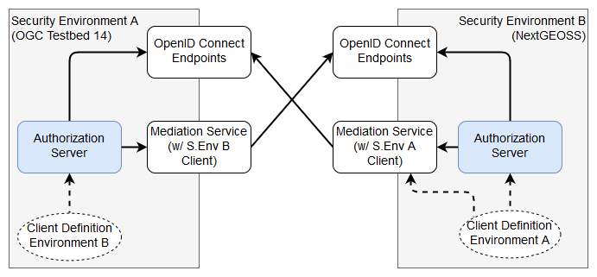
Security: Approach
Notes:
For Security, the approach was to:
Take initial steps toward a complete security architecture for Spatial Infrastructure.
Describe and test a solution covering Workflows and Federated Clouds concerns.
Enable future discussion and implementation of complex security architectures with components that any Security Environment (for Access Management) or Administrative Domain (for Federated Identity Management) should have.

Slide 56
Security: Way Forward
Further explore fine-grained authorization, Client Credentials and Resource Owner grants for Workflows, and use of JSON Web Tokens to efficiently store signed and encrypted user info.
Examine ways to use OpenAPI and capabilities documents to automate token acquisition.
Develop a Federation Manager capable of allowing management of resources on the owner side to facilitate the resolution of Federated Cloud governance issues.
Notes:
Explanation well written - max 5 lines of text

Slide 57
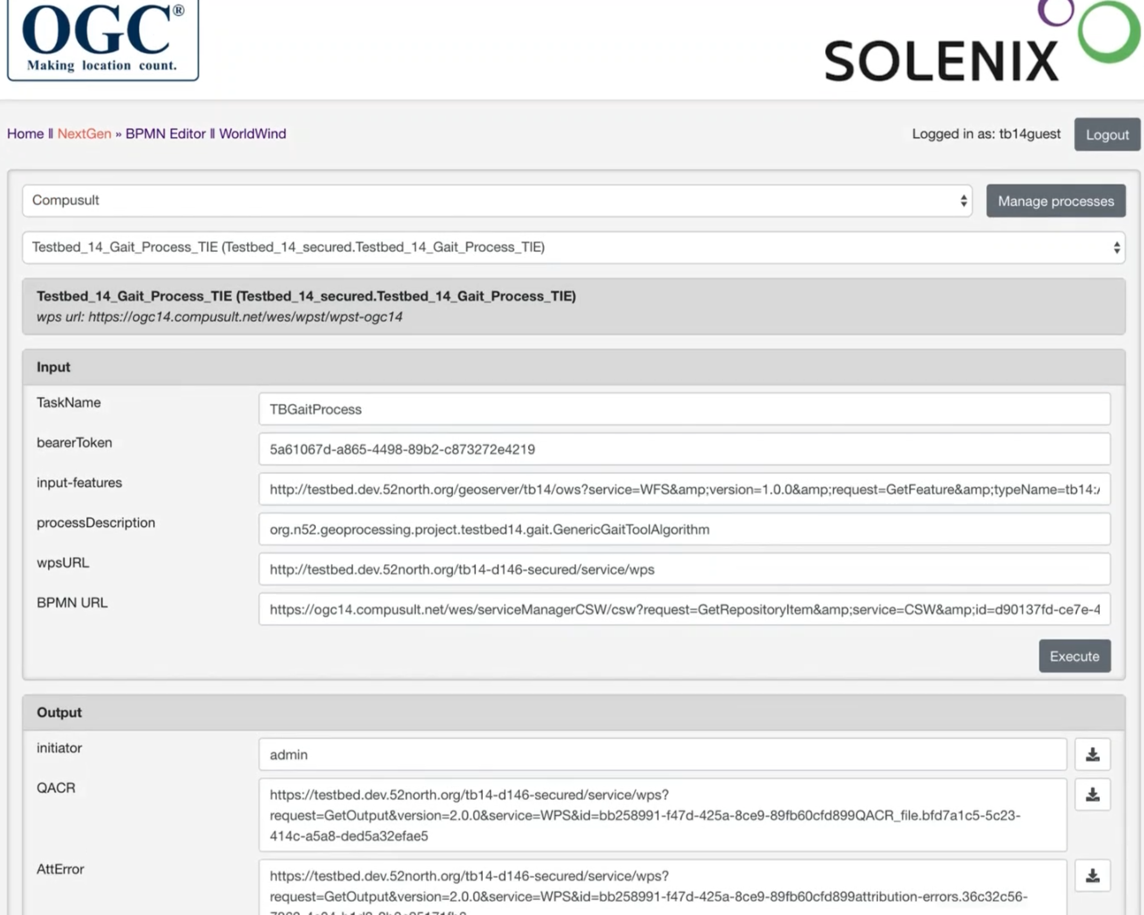
Secure Workflows: Challenge
Notes:
The need to dynamically add custom Workflow processing functionality to servers has been steadily growing, and the dynamic upload of workflows is an area of growing interest.
BPMN is an ISO standards that addresses many issues of other alternatives. Testbed-13 described a rudimentary implementation a BPMN engine to execute remotely authored documents via a transactional WPS. But there were no best practices for orchestration.

Slide 58
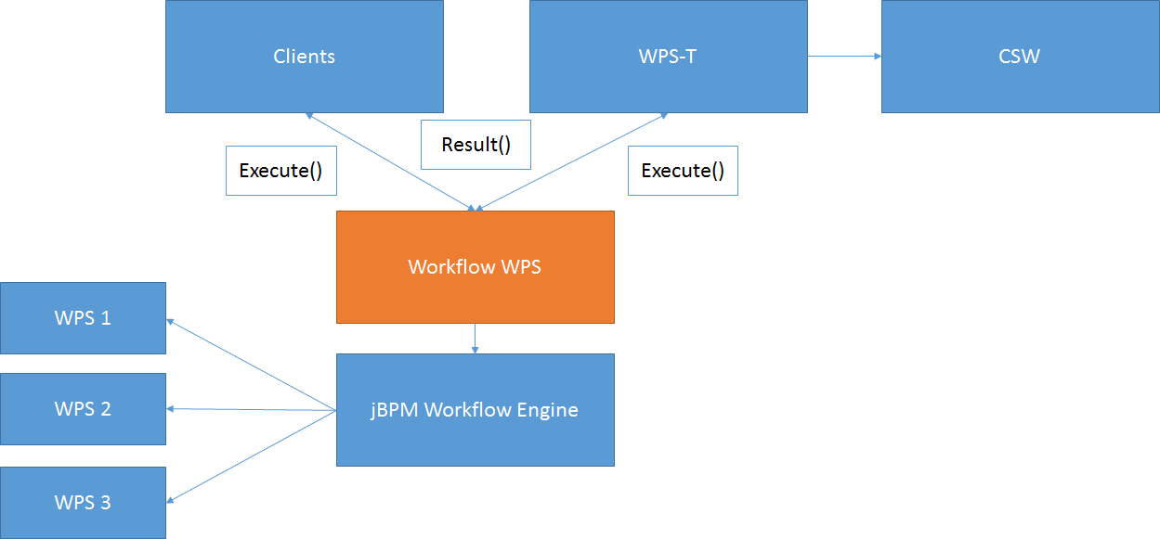
Secure Workflows: Challenge
Notes:
For Secure Workflows, the approach was to build on Testbed-13 by examining a transactional WPS 2.0 extension that included KVP and XML bindings, an abstract test suite, and a process deployment profile for BPMN. It provided best practices to assist orchestration of OGC services, utilizing a helper class implementation of the best practices.

Slide 59
Secure Workflows Execution
Notes:
This slide shows the sequence of messages among the various components during execution. D143 (upper left) is the client.

Slide 60
Secure Workflows: Way Forward
Security, discovery of deployment profiles, and a WPS-T REST binding,
Orchestration demonstration:
Checking for likelihood of workflow completion success prior to execution.
Managing the BPMN to WPS process transformation.
More sophisticated security encoding options and removal of access.
More complex use cases to take advantage of aspects such as parallel processing, swimlanes, decision gates and compensation events.
Notes:
Explanation well written - max 5 lines of text

Slide 61
CityGML and Augmented Reality: Challenge
Build on industrial capabilities to provide the highly detailed, fully integrated view of urban spaces required for the planning and execution of modern urban missions.
Evaluate the possible methods for integrating AR content into CityGML content, developing client side support for visualization.
Notes:
Explanation well written - max 5 lines of text

Slide 62
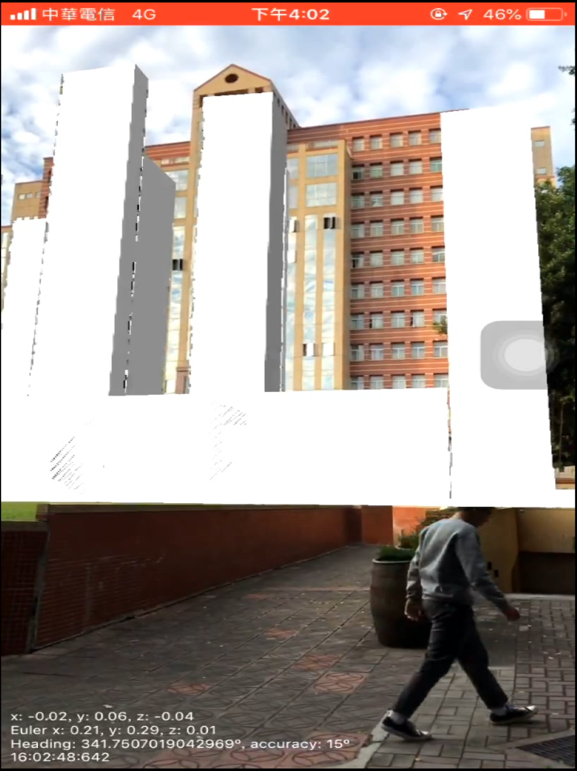
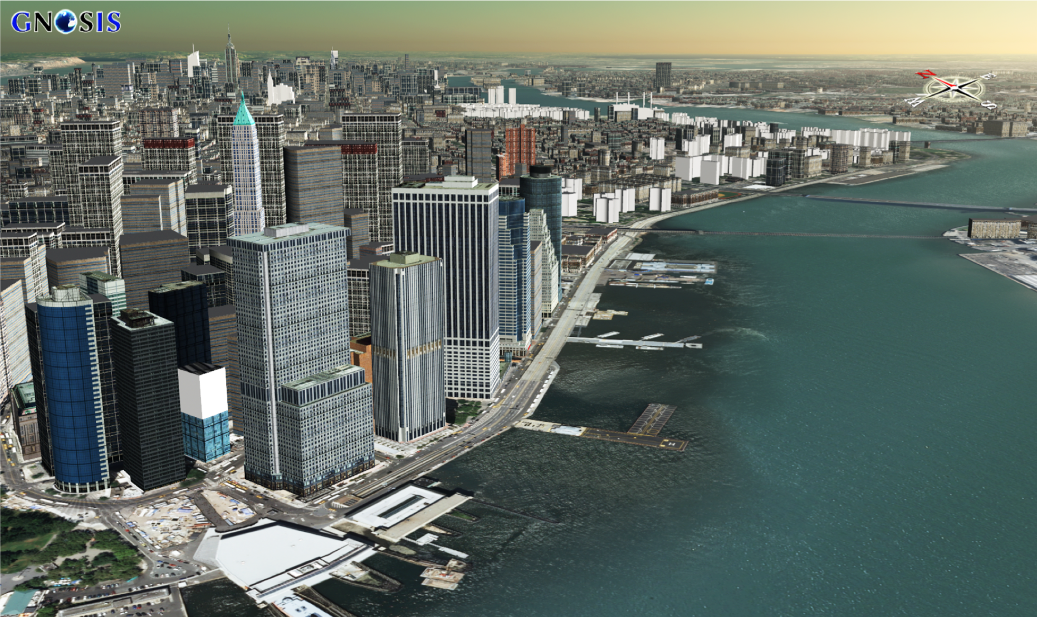
CityGML and Augmented Reality: Approach
Notes:
Explore various prototypes and performance constraints related to real-time camera view augmentation using 3D virtual objects derived from a CityGML dataset and anchored based on GPS (vs. device odometry). The work included prototyping of architectural elements such as back-end data, service interfaces, a compact binary 3D transmission format, and client AR applications. The graphic on the left shows the experimental 3D augmentations utilized in Testbed-14. The graphic on the right illustrates the level of detail and sophistication that might be possible in a future testbed.

Slide 63
CityGML and Augmented Reality: Way Forward
The scenario of augmenting real-time device location & camera views with heavy, precision-located 3D virtual objects creates a substantial performance burden.
Future work should consider precisely defined use cases to enable tradeoff analyses regarding which constraints can be relaxed.
For example, the requirements might allow for a high-capacity workstation client with 3D assets preloaded or for preplanning rather than an emergency response scenario.
Notes:
Explanation well written - max 5 lines of text

Slide 64
Compliance and Interoperability Testing (CITE)

Slide 65
Profiles Adoption: Challenge
Profiles with Extensions = Standard + Restrictions + Other stuff
CAT 2.0 + DGIWG Rules
Verify that the response indicates support for ‘English’ for queriables and returnables
Verify that the XML response indicates support for csw:Record and gmd:MD_Metadata
...
Not always straightforward to adopt by implementers
How can we verify this and encourage implementations?

Slide 66
Profiles Adoption: Approach
DGIWG Catalogue Service for the Web 2.0
Development of an Executable Test (ETS)
Provided feedback to the draft standard
Advanced Reference Implementation
Bi-product now we have also new reference implementation for CAT 2.0

Slide 67
Profiles Adoption: Way Forward
Parallelize the work of developing the standard, developing an executable test suite, and early implementations.
2018 TC-Discuss #1 Hot Topic

Slide 68
Testing Resource Oriented Services: Challenge
OGC is/will be developing more Representational State Transfer (REST) Application Program Interface (API) (e.g. WFS 3.0)
No REST tests existed before Testbed 14
No Capabilities, where to start?
You can navigate from one resources to other resources - and can create infinite loops
No XML, JSON - Schema?

Slide 69
Testing Resource Oriented Services: Approach
WFS 3.0 Executable Test Suite
Use OpenAPI as a starting point
Picked one output format to test responses (JSON)
Make sure the test is configure properly to select some features to test, not all of them (time)

Slide 70
Testing Resource Oriented Services: Way Forward
For new tests:
Create an OpenAPI conformance class or make it part of the core
Core must be the simplest minimum good to have rules
Mandate a default encoding (e.g. GeoJSON)

Slide 71
Testing Clients: Challenge
We had one test WMS 1.3
Need a better architecture
Add Security component
Use Case 1 is to verify that the secure client can anonymously connect to the secure server using HTTPS and issue valid requests.
Use Case 2 is similar to Case 1, but the secure client must provide authentication to the server.

Slide 72
Testing Resource Oriented Services: Approach
Secure Client Test
WMS 1.1.1, WMS 1.3.0, and OWS Common

Slide 73
Testing Resource Oriented Services: Way Forward
For new tests:
Consider – adding conformance classes for clients testing
Consider reusing the client security conformance classes in future tests

Slide 75
Testbed-15 Topics
Machine Learning
Delta Updates
Data Centric Security
Federated Cloud Analytics
Portrayal
Earth Observation Process and Application Discovery
bit.ly/Testbed-15
Notes:
Machine Learning: The task includes several models that need to be developed, thus focus is less on the integration of the models in general (which was T14), but more on details: How do these models pull data from services, how do they make results available etc. The models are real models, thus we are getting closer to real operations to explore all the nitty gritty details that need to be addressed to make systems work.
Data Centric Security: How does security on the feature level work in OGC? We have addressed service based security, the next step is authorization on the feature/layer level. Policy languages play a role again (e.g. XACML)
Delta Updates: In DDIL (denied, degraded, intermittent, and low bandwidth) environments, data exchange is a challenge. This task explores prioritization mechanisms to reduce data traffic to the necessary minimum.
Discovery of EO Processing Services and Applications: In T13 and T14, we developed an architecture to deploy and execute EO applications in the cloud. This task addresses the discovery aspect of these apps or apps that are already deployed as WPS instances. How to get to the EO app and service store?
Linked Data: How to link geospatial features with DBPedia, GeoNames, and other online geospatial data?

Slide 76
Thank you!
Testbed 14: https://www.opengeospatial.org/projects/initiatives/testbed14
Testbed 15: https://www.opengeospatial.org/projects/initiatives/testbed15

