Slide 1
Introduction
Arika Virapongse Principal, Middle Path EcoSolutions
Webinar series coordinator, ESIP
av@middlepatheco.com
The “pipeline” of Earth science data to climate resilience and its value for real-world decision making
October 2, 2018 | Webinar #4
www.esipfed.org
@ESIPfed | #ESIPfed
ESIP is supported by
and 110+ member organizations

Slide 2
Background
Fourth webinar in our series, “The Socioeconomic Value of Earth Science Data, Information, and Applications”
Summary of the webinar
ESIP Agriculture and Climate Cluster (ACC) has been developing a “pipeline” to transform agriculture / climate-related research and applications into case studies as part of the U.S. Climate Resilience Toolkit (CRT)
These CRT case studies document “how people are building resilience for their businesses and in their communities,” using relevant data and tools.
Structure for the webinar
Presentations
Audience discussion

Slide 3
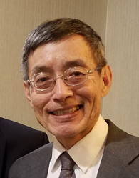
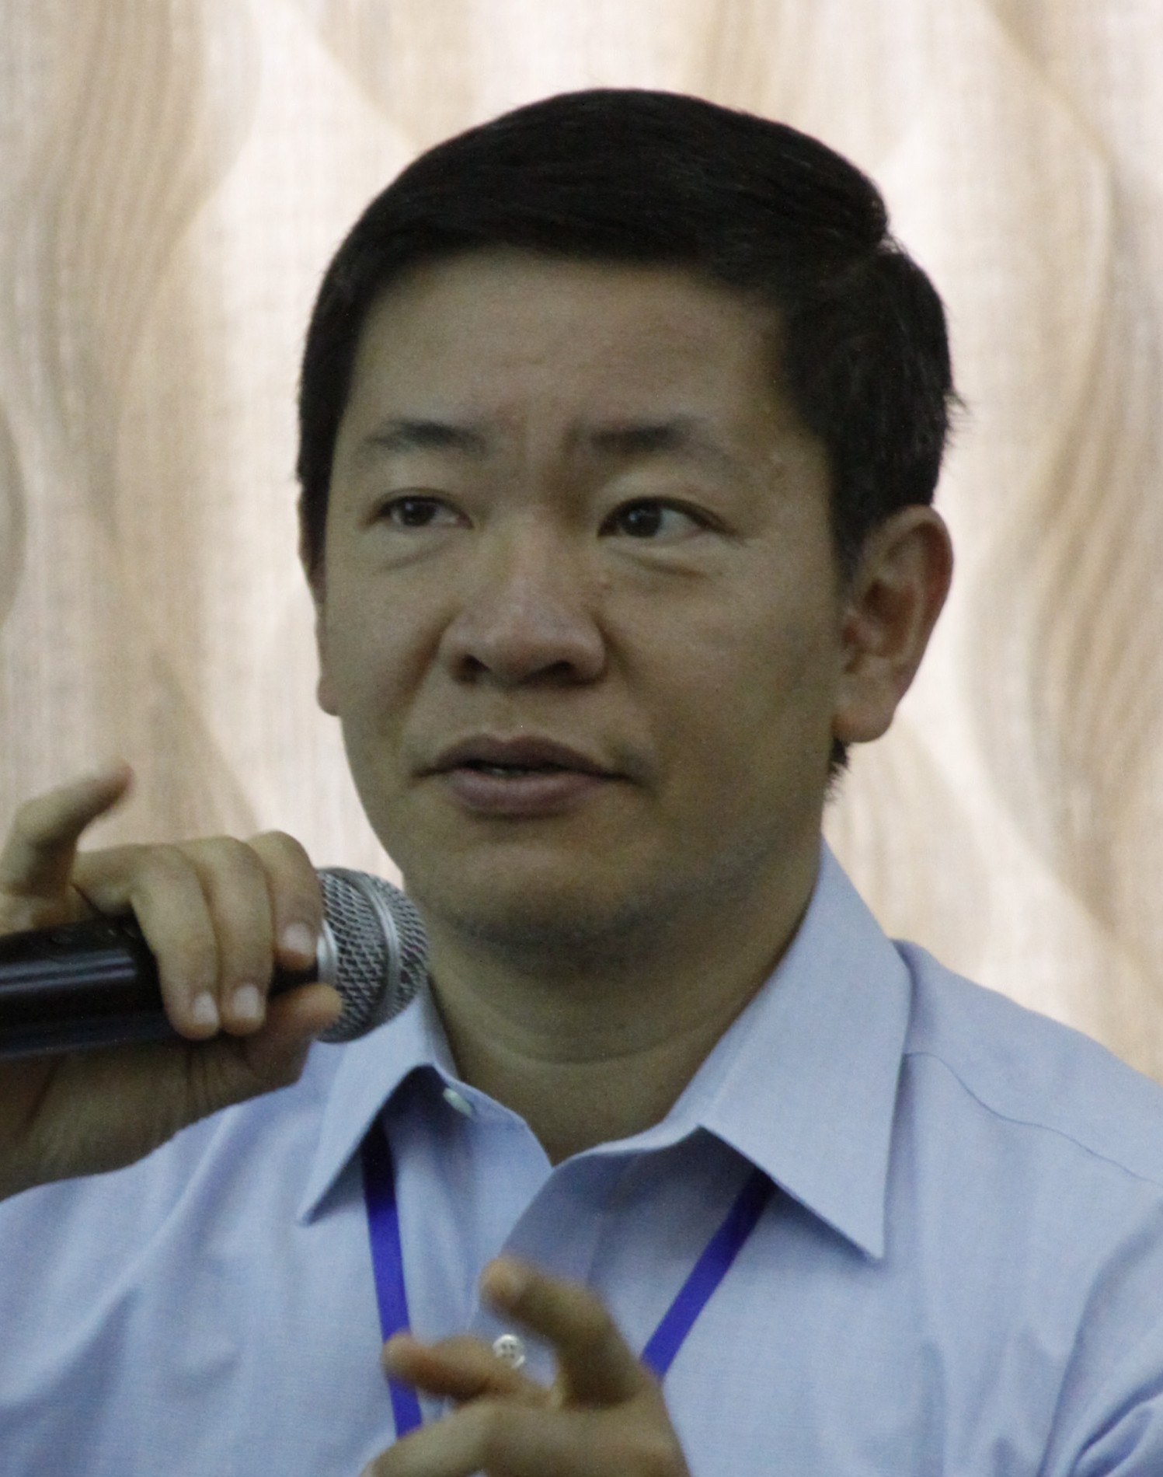
Presentations
Nancy Hoebelheinrich
Knowledge Motifs
“How can researchers promote the use of the data and/or their tools for climate resilience?”
Dr. Bill Teng
NASA
“ACC’s “Pipeline” approach for developing CRT case studies”
Dr. Richard Bernknopf
U. of New Mexico
“A Value of Information (VOI) study of the impact of Landsat on agricultural land management”
Dr. Brian Wee
Massive Connections
“Data to Decisions Provenance (d2dprovenance)”

Slide 5
ESIP Socioeconomic Value Workshop Featuring the Work of the Agriculture / Climate Cluster, October 2, 2018 How can researchers promote the use of their data and/or their tools for climate resilience?
Presented & adapted by Nancy Hoebelheinrich
from slides created by
LuAnn Dahlman | luann.dahlman@noaa.gov
NOAA Climate Program Office
Communications and Education Division
Co-managing Editor, U.S. Climate Resilience Toolkit

Slide 6
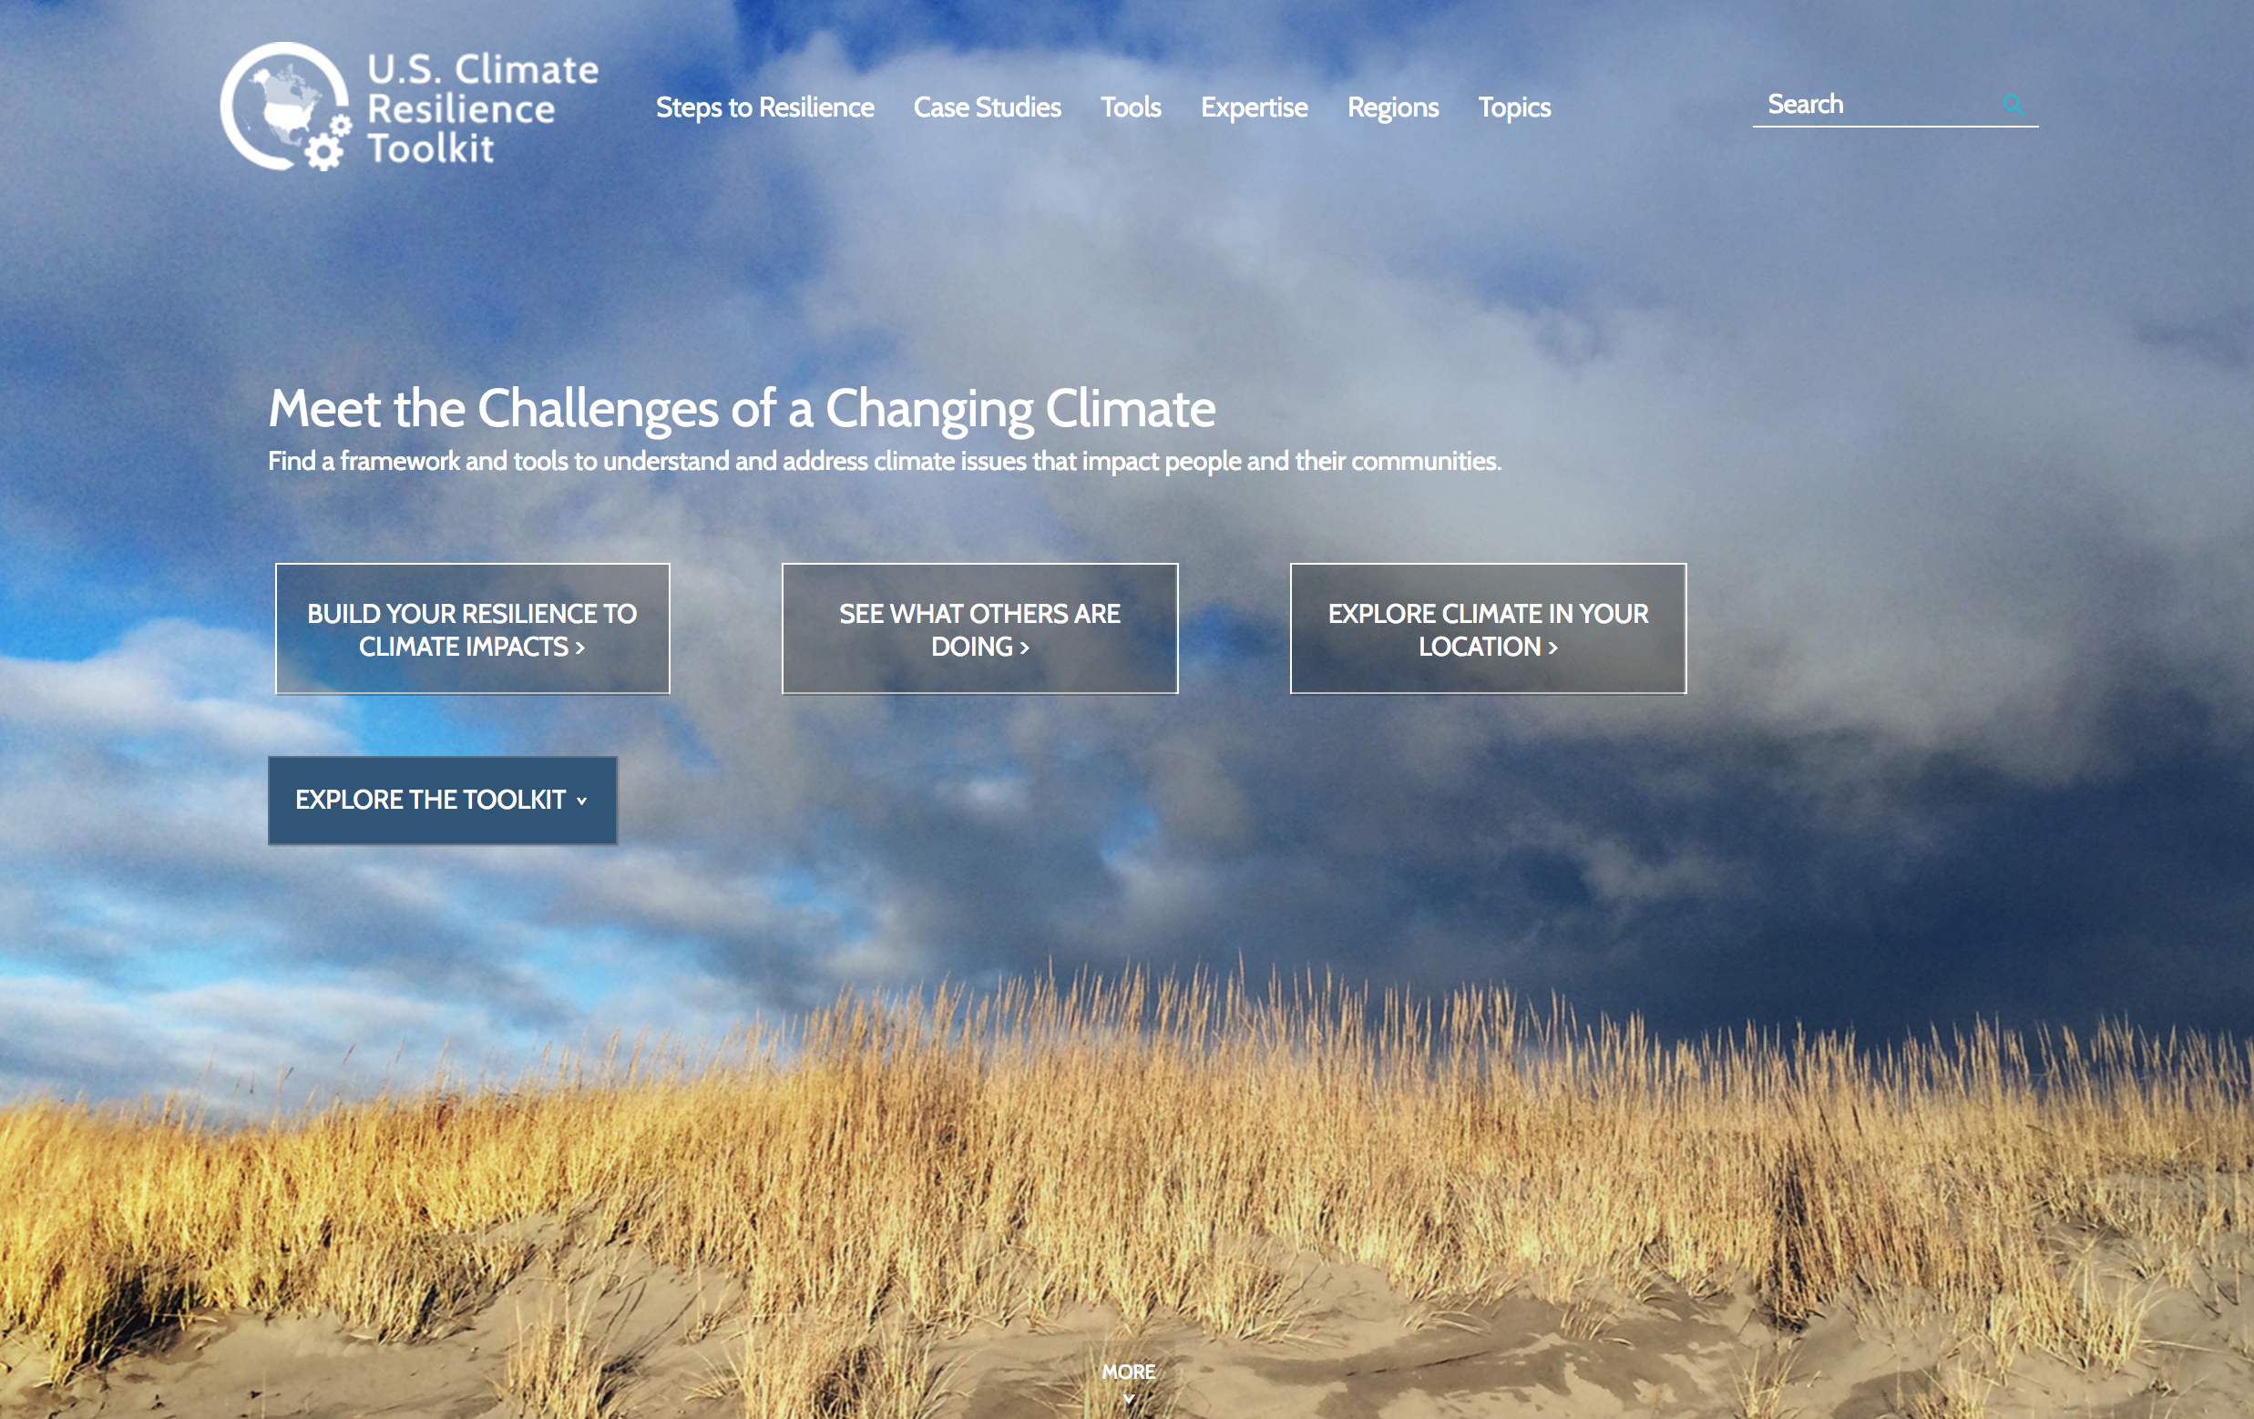
https://toolkit.climate.gov

Slide 7
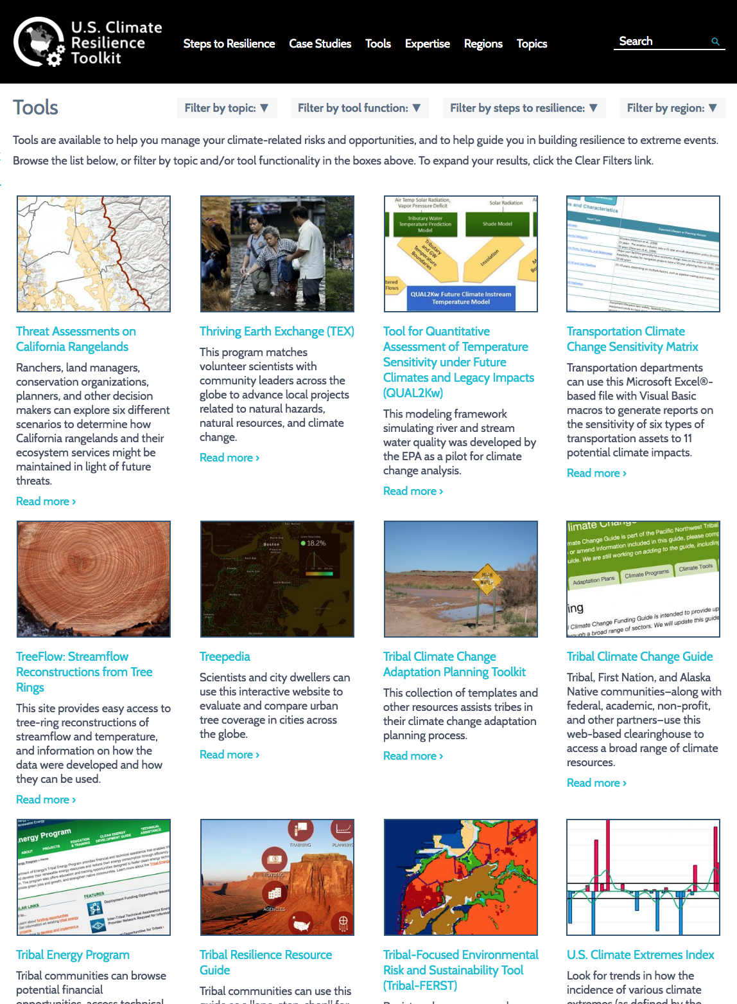
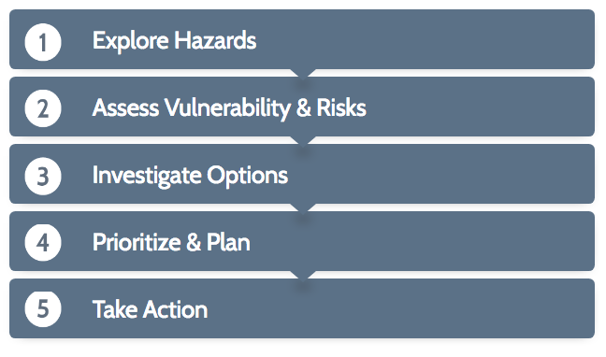
The toolkit offers a catalog of more than 300 resilience-building tools.
Tools are categorized broadly by the toolkit’s Steps to Resilience:
Other filters can help users zero in on tools that meet their needs.

Slide 8
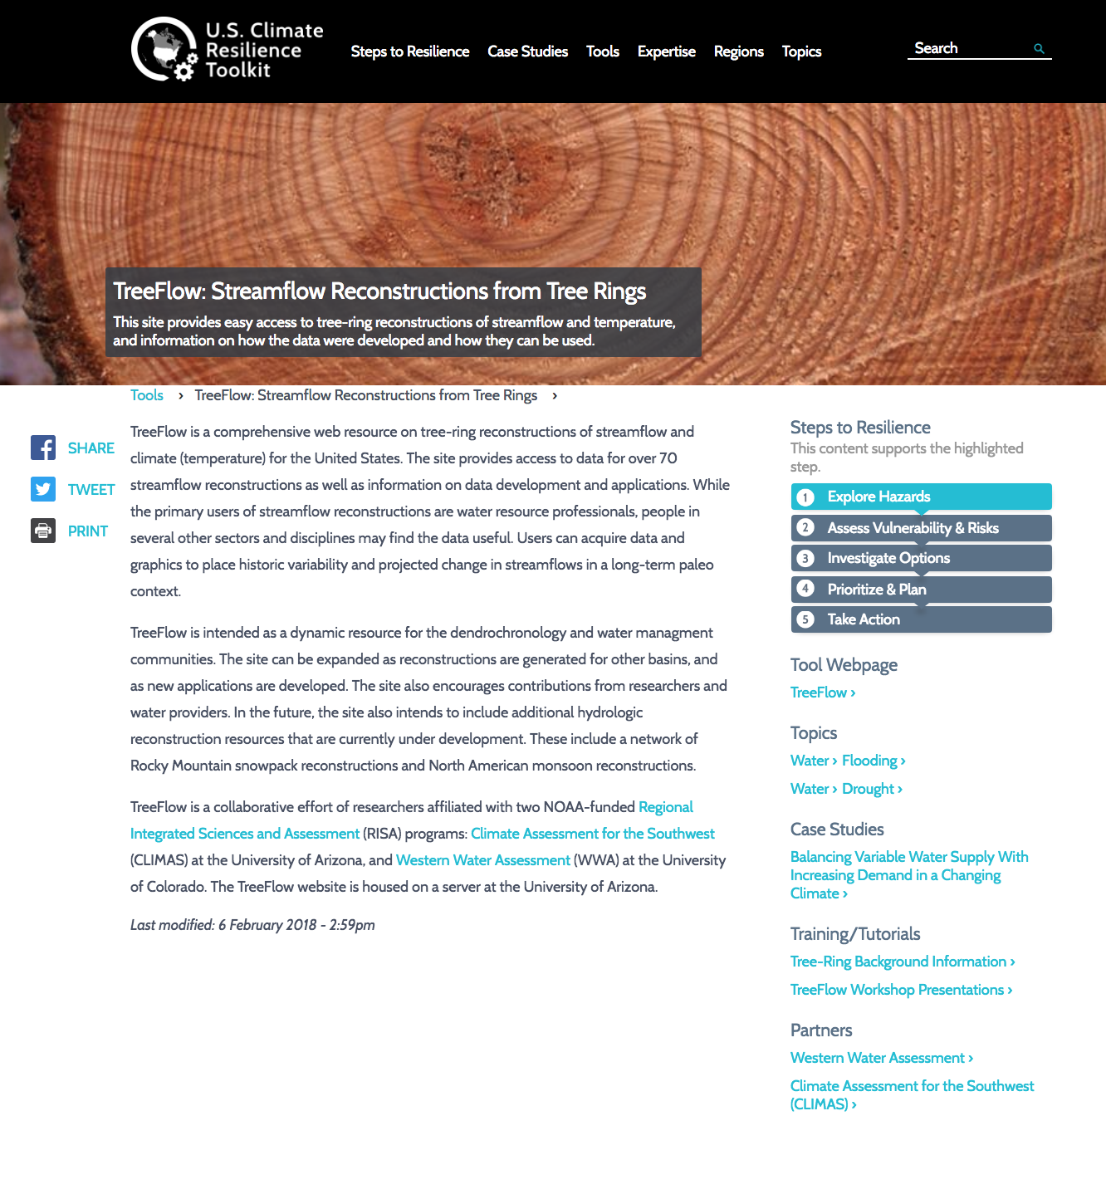
Each tool has a page describing how it might be used for building resilience, with links to the tool, related assets, and tool partners.

Slide 9
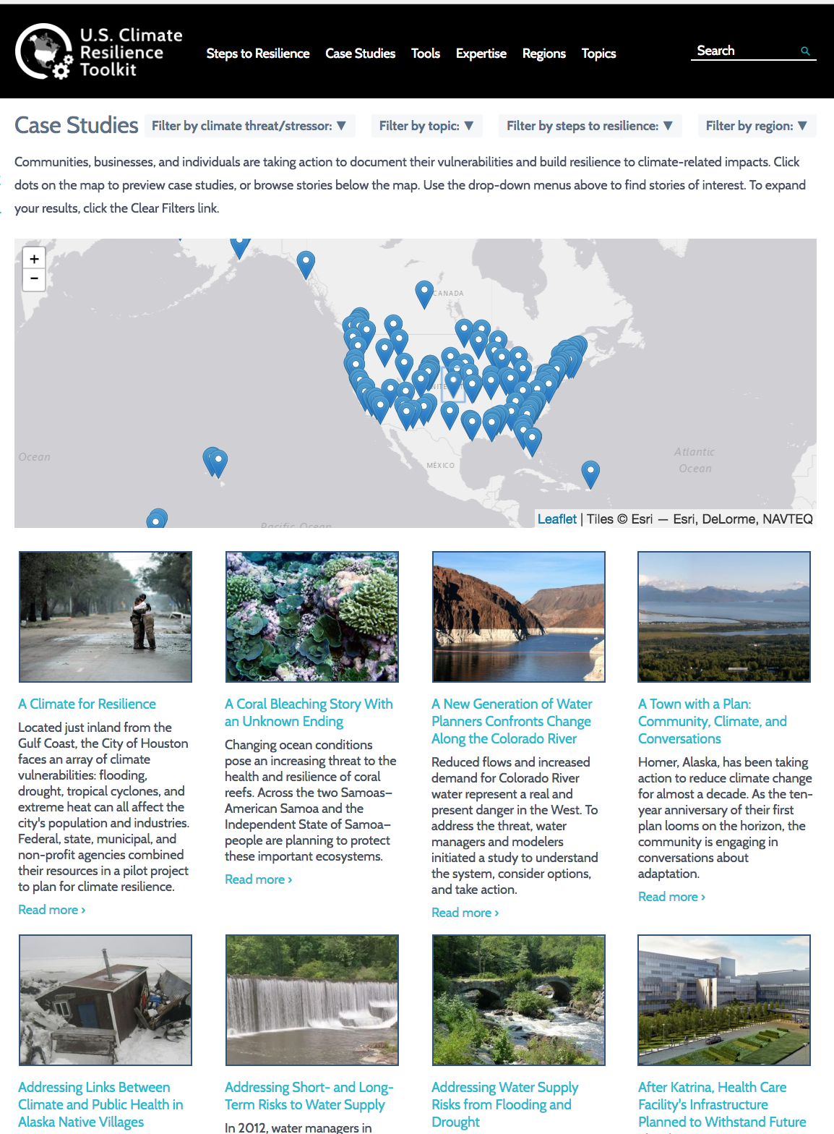
Case Studies are another feature of the Toolkit.
The goal of sharing these is to inspire others to build climate resilience.

Slide 10
What are CRT Case Studies?
Brief stories highlighting examples of real people or communities who recognize climate-related issues and take some action toward building resilience

Slide 11
What are CRT Case Studies?
Brief (400 – 800 words)
stories (ideally, with a struggling protagonist)
highlighting examples (that others can follow)
of real people or communities
who recognize climate-related issues and
take some action
toward building resilience

Slide 12
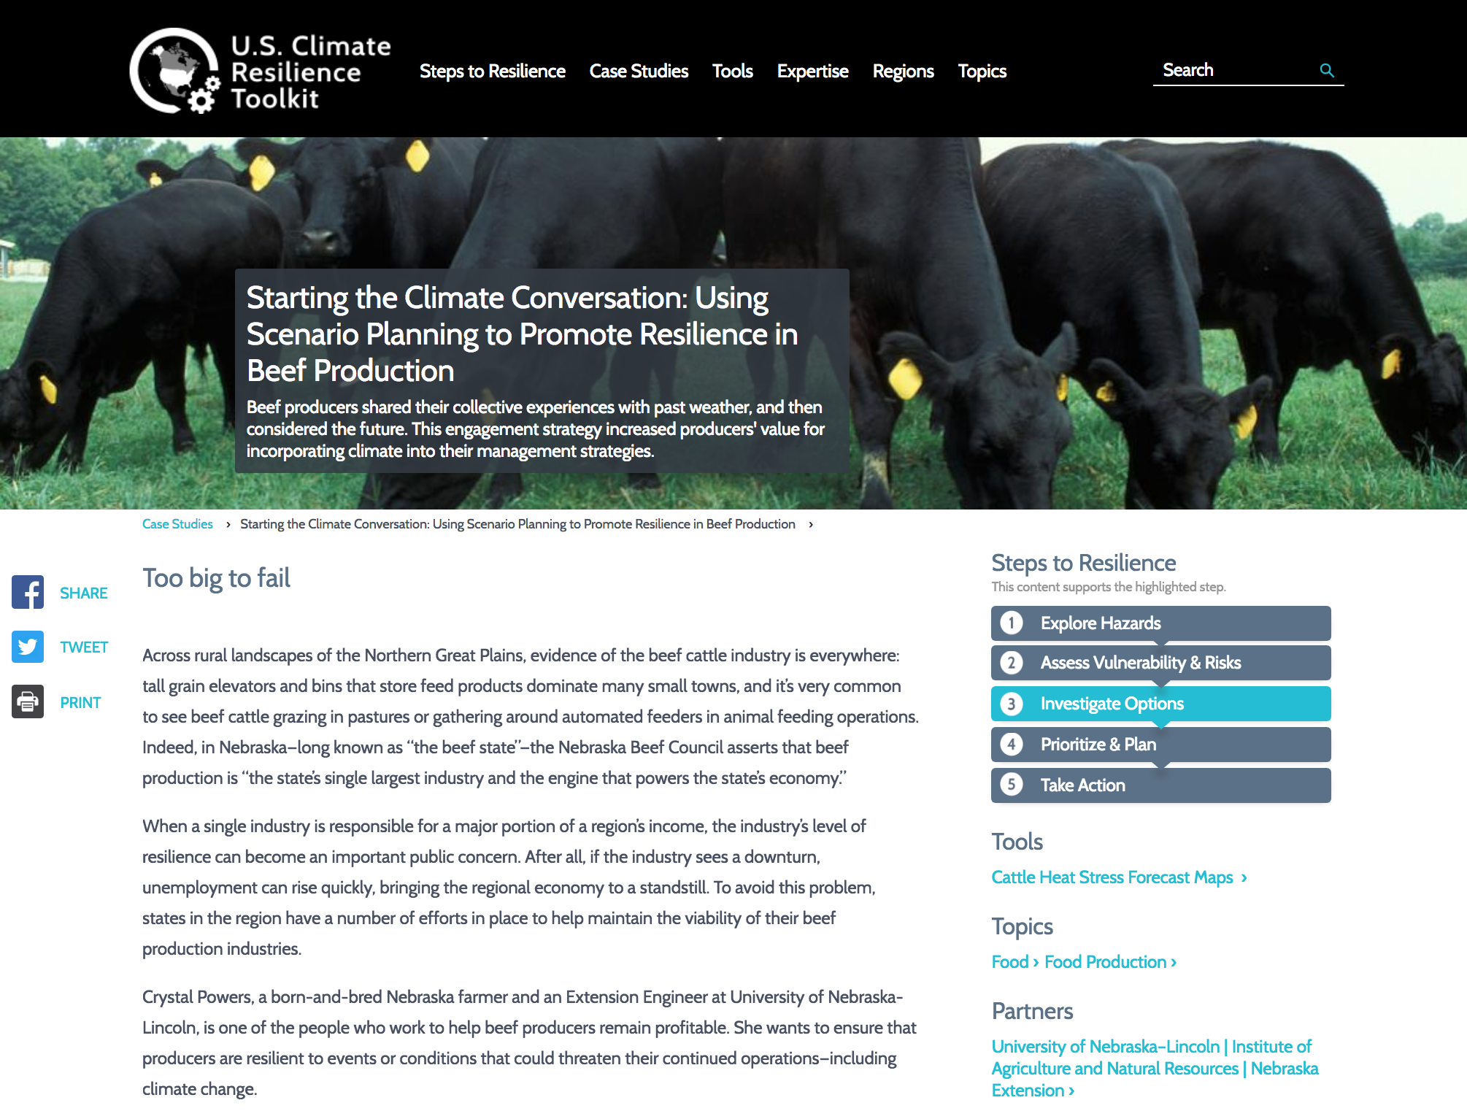
Notes:
An example case study

Slide 13
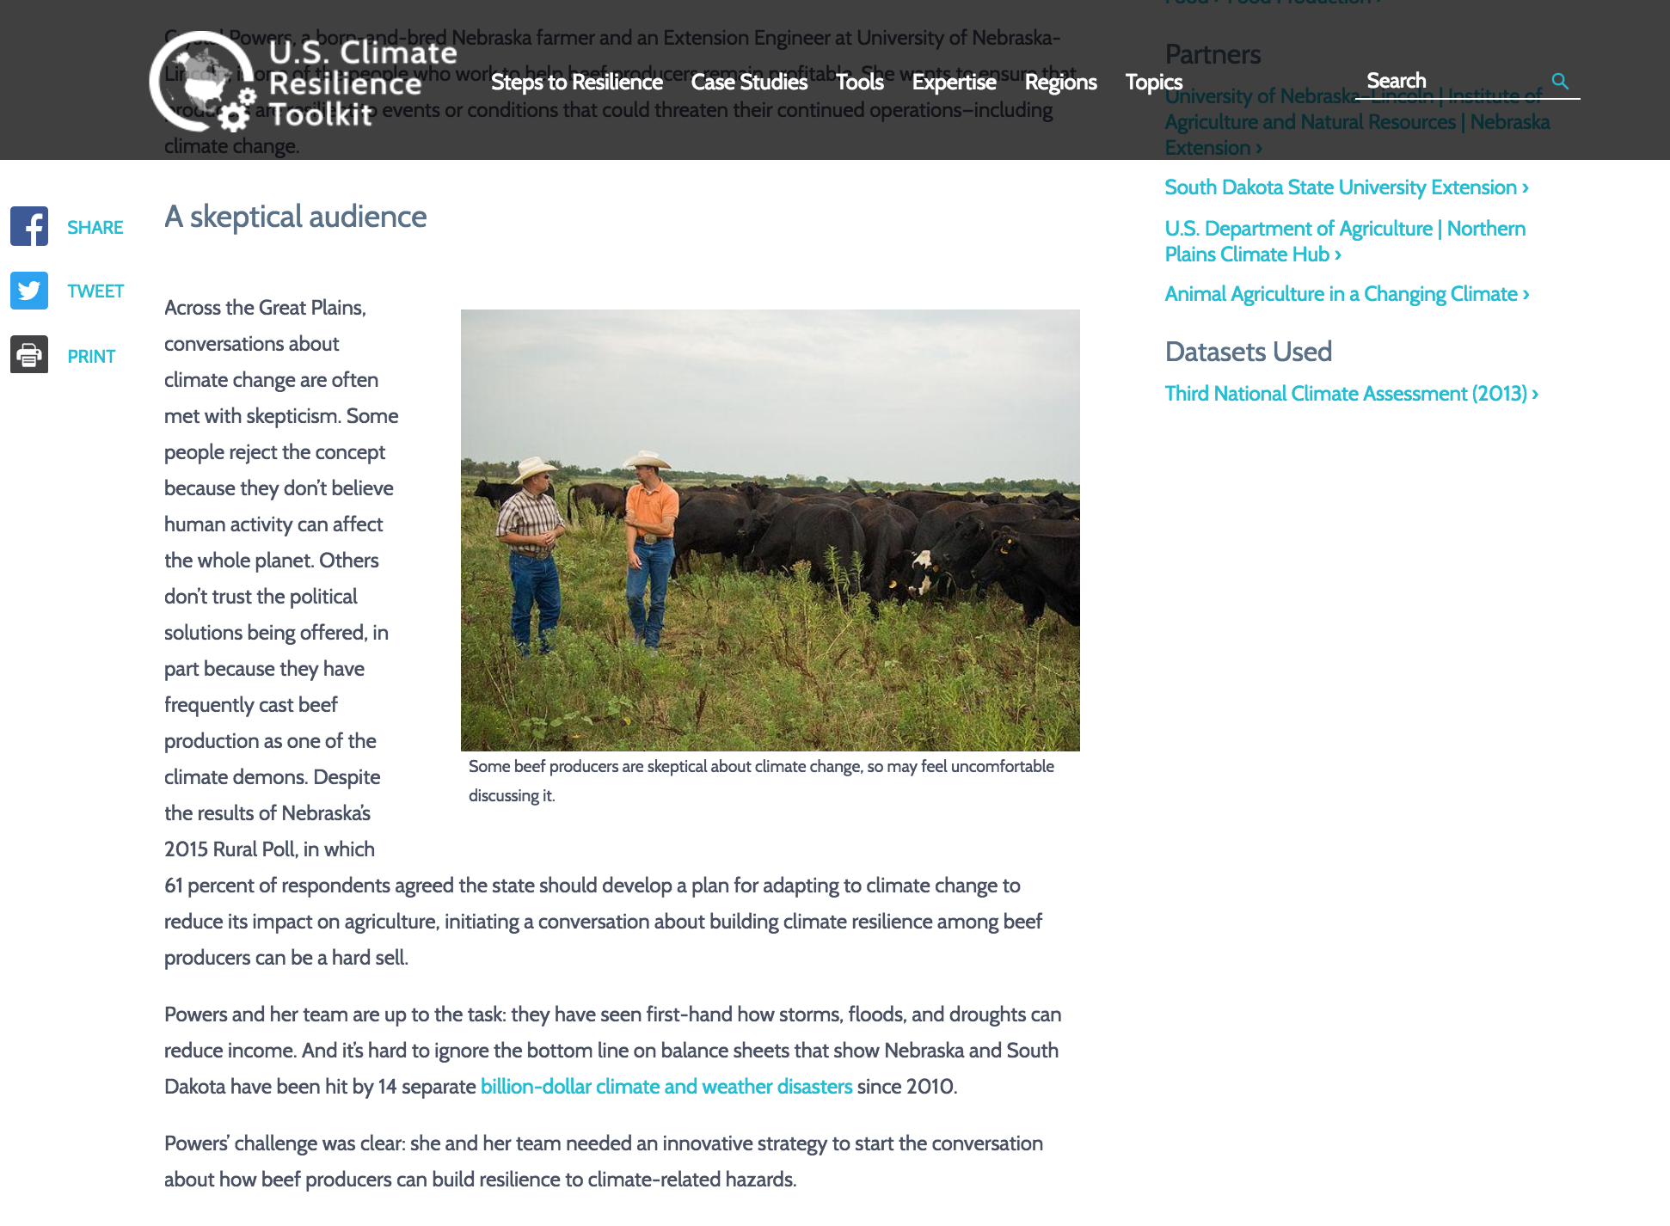
Notes:
An example case study

Slide 14
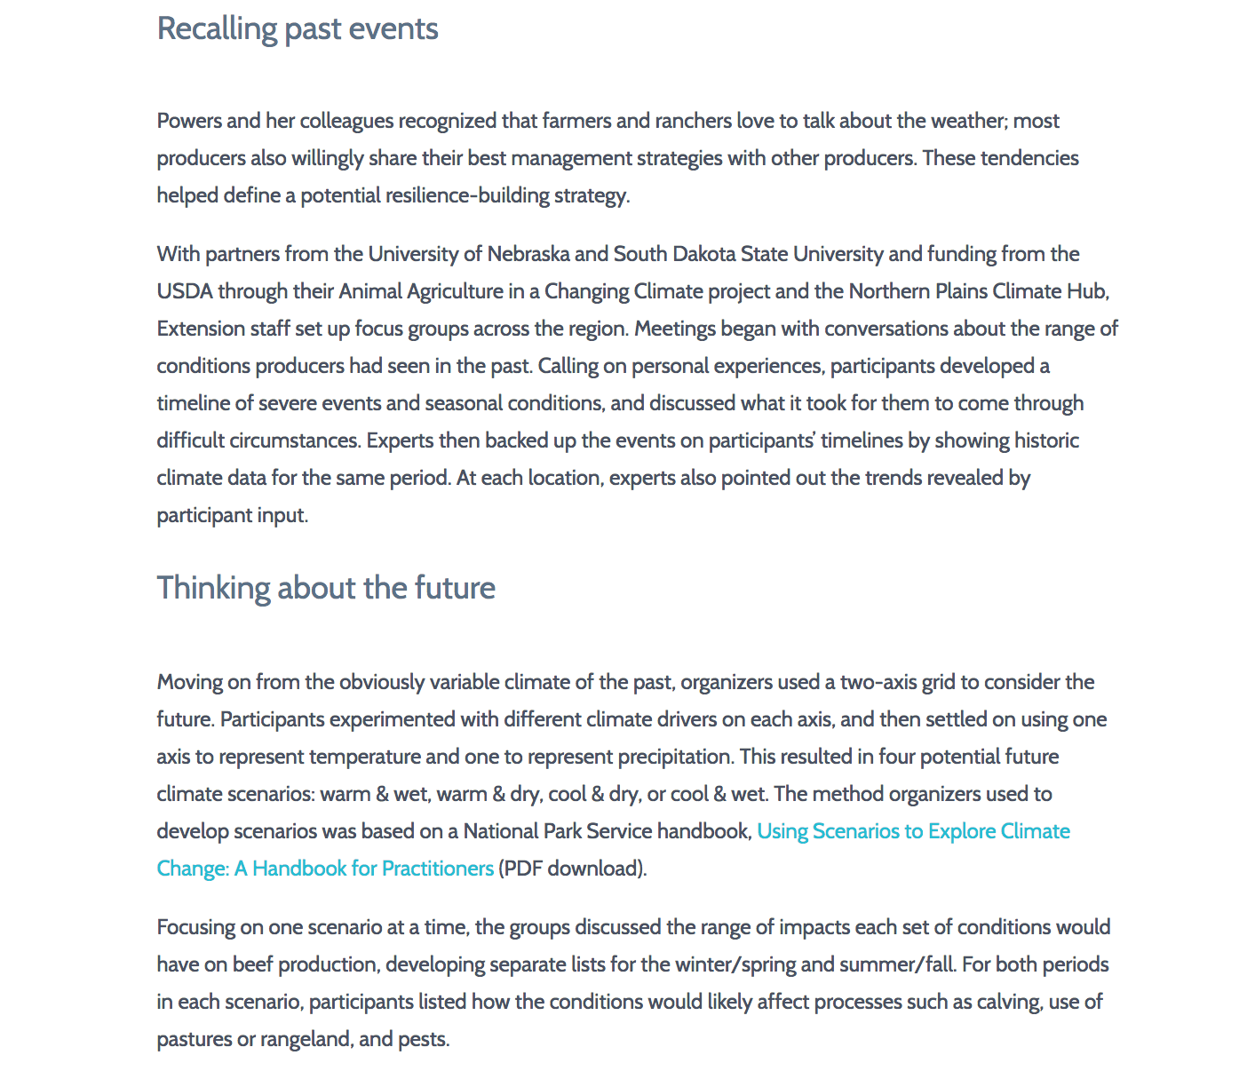
Notes:
An example case study

Slide 15
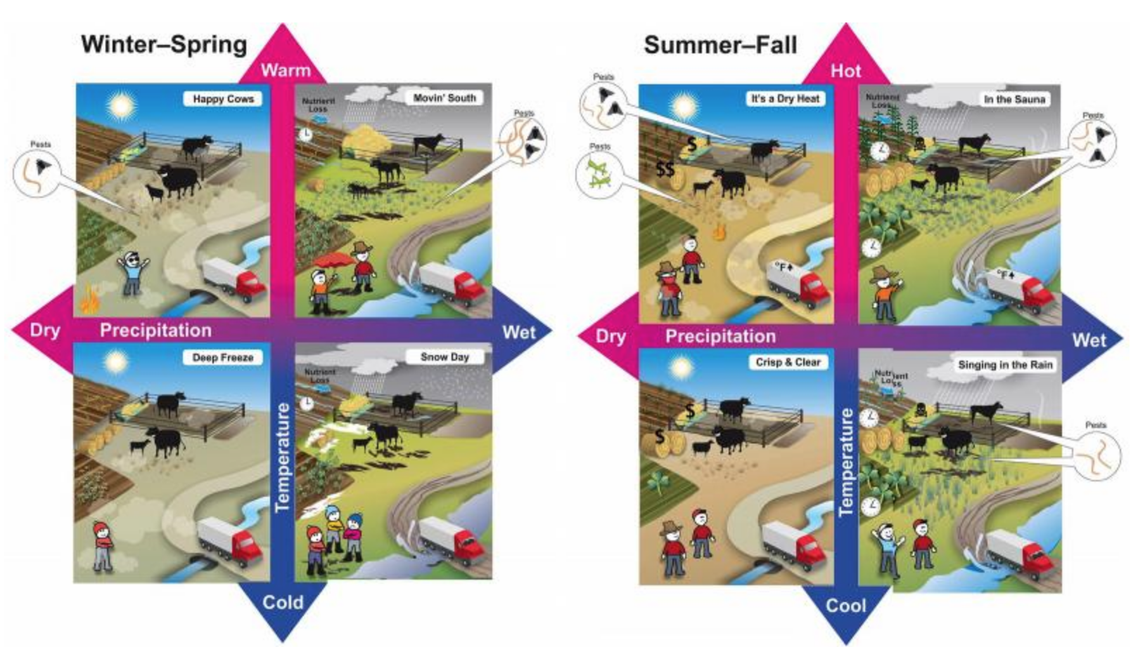
Notes:
An example case study

Slide 16
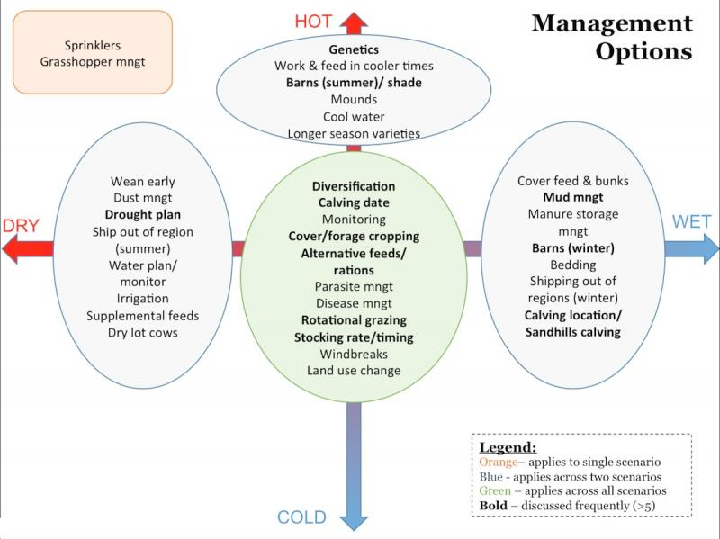
Notes:
An example case study

Slide 17
Elements of the Story
main character ________
goal ________
obstacle ________
solution ________
Notes:
Based on the previous case study, what are the elements of the story?

Slide 18
Paraphrasing Randy Olsen via Andy Revkin:
A simple one-sentence, fill-in-the-blanks template can help you identify a story structure:
__________ and _________,
(main character) (goal)
but ______, therefore ______.
(obstacle) (solution)
Notes:
http://dotearth.blogs.nytimes.com/2015/09/16/from-south-park-to-the-space-station-randy-olson-sees-an-and-but-therefore-story-solution/?_r=0
When we hear about research, think how we will fill in these four blanks before we flesh out the story.

Slide 19
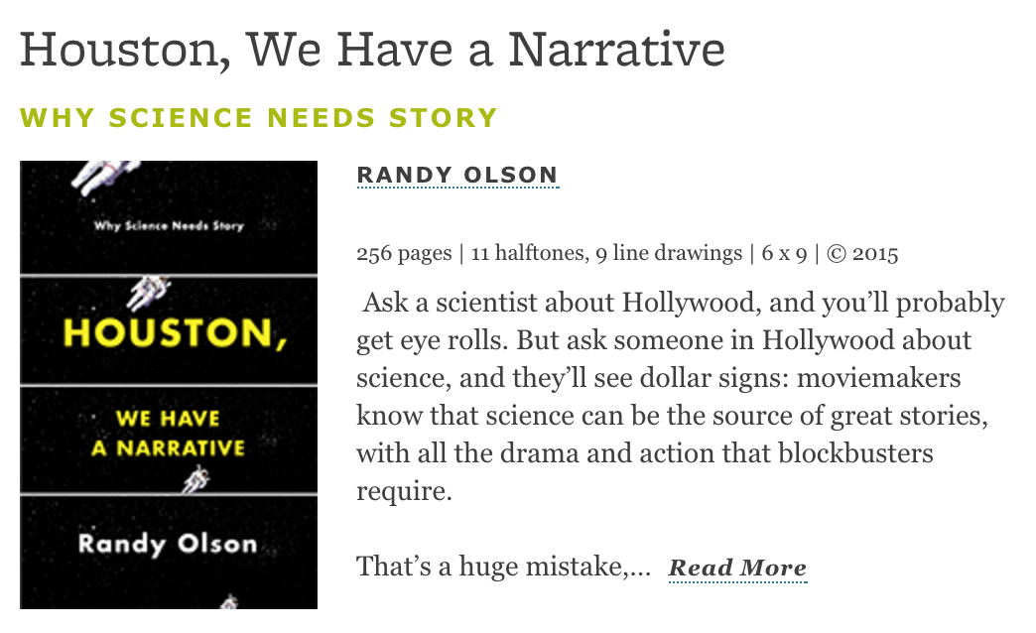
Notes:
Introduces the ABT template: tell stories using And, But, and Therefore.

Slide 20
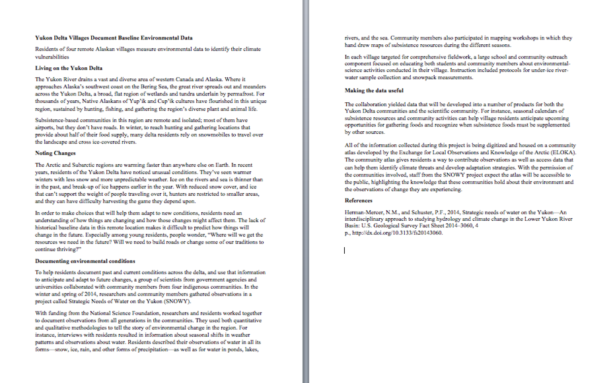
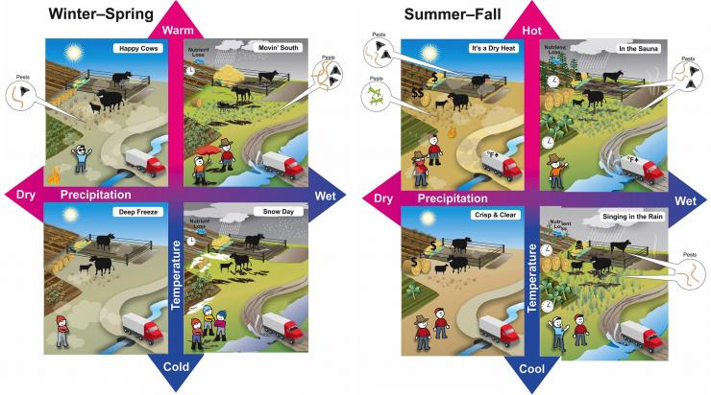
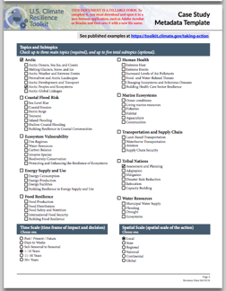
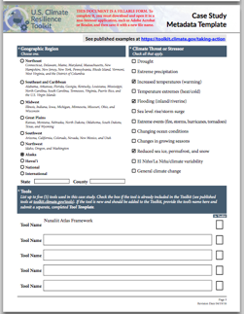
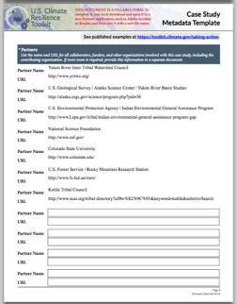
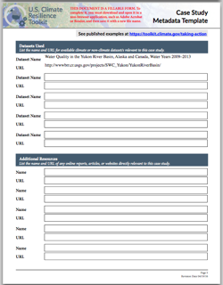
To get a case study in the CRT, you contribute 3 things:
1. Draft Text
2. Relevant Visuals
3. Completed Metadata Template

Slide 21
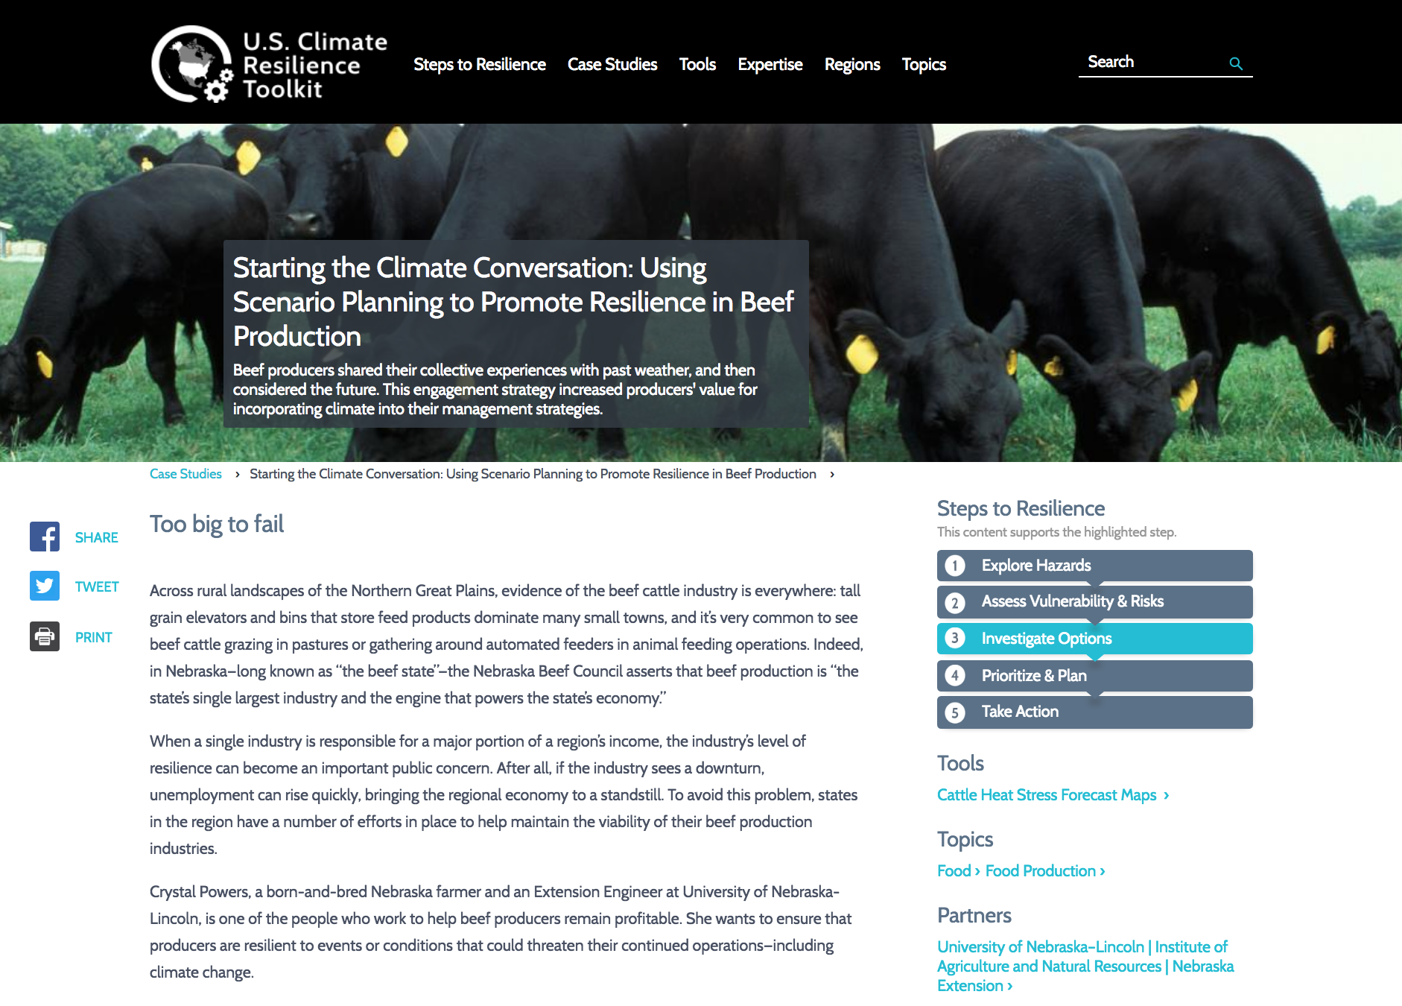
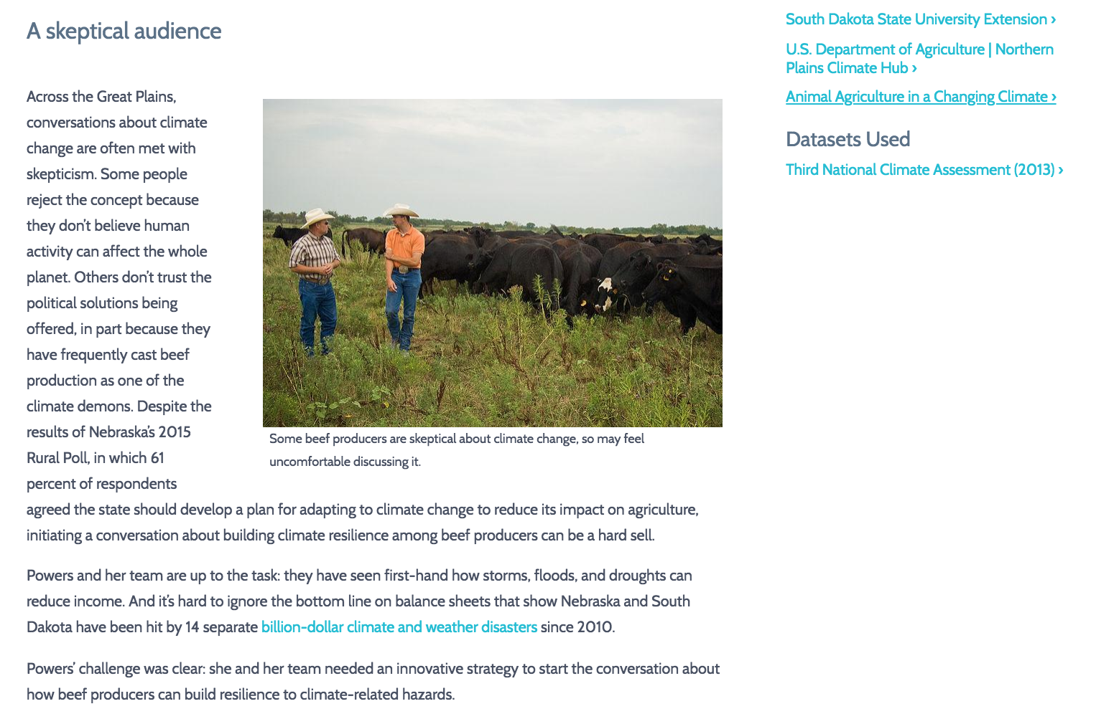
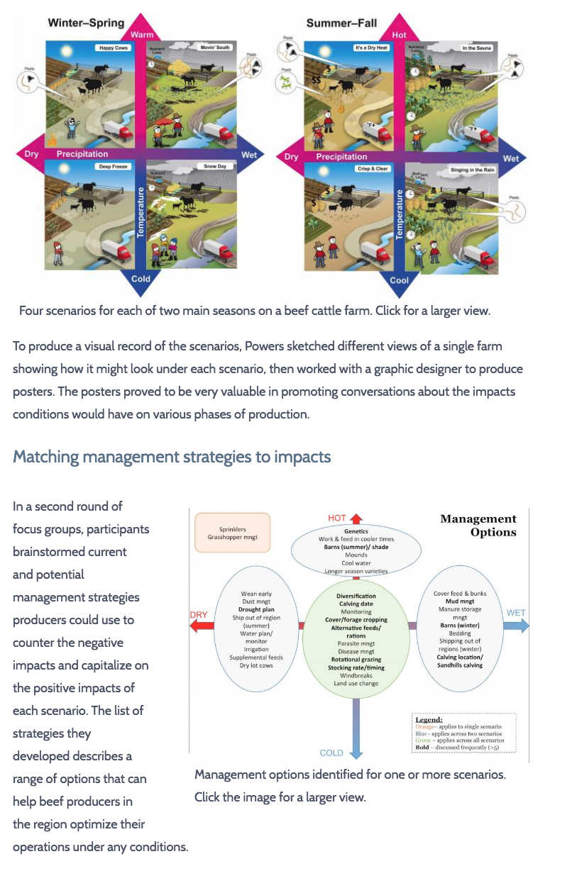
To get a case study in the CRT, you contribute 3 things:
Editors use your assets to build the story, get your approval, and publish
1. Draft Text
2. Relevant Visuals
3. Completed Metadata Template

Slide 22
<------------------------------------------------------->
Story Outline Draft Previously
Published Story
CRT editors accept content any place along the spectrum of story completeness.
We work with your text and add headings and visuals as needed.
Submitters review and approve the story before it is published.
Notes:
Once we have a draft, our writers/editors will help prepare it for publishing.

Slide 23
To submit a tool or case study to the CRT, see https://toolkit.climate.gov/contribute

Slide 24
The CRT website is really just a public face for federal efforts to build resilience.
Our real goal is to encourage communities to take steps toward resilience.
How can we help you promote the use of your tools for resilience?

Slide 25
Thank you!
LuAnn Dahlman
Co-Managing Editor, Climate Resilience Toolkit
luann.dahlman@noaa.gov

Slide 26
Presentations
Nancy Hoebelheinrich
Knowledge Motifs
“How can researchers promote the use of the data and/or their tools for climate resilience?”
Dr. Bill Teng
NASA
“ACC’s “Pipeline” approach for developing CRT case studies”
Dr. Richard Bernknopf
U. of New Mexico
“A Value of Information (VOI) study of the impact of Landsat on agricultural land management”
Dr. Brian Wee
Massive Connections
“Data to Decisions Provenance (d2dprovenance)”

Slide 28
CRT Workshop | Subject | Presenter
Winter 16 | - RETScreen, clean energy mgmt. - DSSAT, DSS for agrotechnology transfer | - P. Stackhouse, LaRC - J. Barnett, LaRC
Summer 16 | - Satellite mapping, drought, ag production - RainSphere, rainfall estimates | - F. Melton, NASA Ames - P. Nguyen, UC Irvine
Winter 17 | - Drought onset from SIF - USDA DSS, SMAP data | - Y. Sun, Cornell - J. Bolten, NASA ASP
Summer 17 | - Climate scenario planning, beef production | - C. Powers, UNB & USDA NPCH
Summer 18 | - RainSphere, updated - Crop insurance data, causes of loss | - H. Tran, UC Irvine - J. Reyes, USDA SWCH

Slide 29
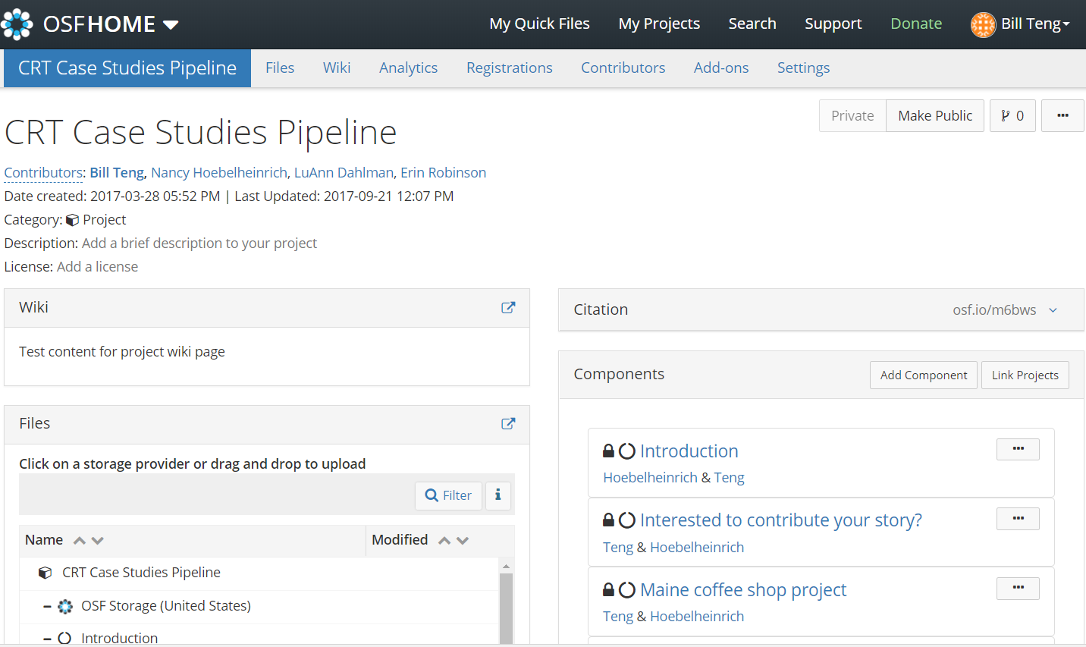
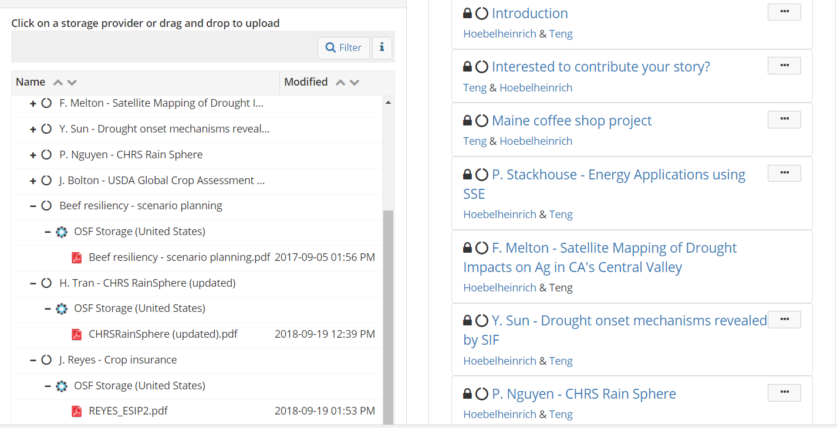
Open Science Framework (Center for Open Science)
Project
Components
Directory

Slide 30
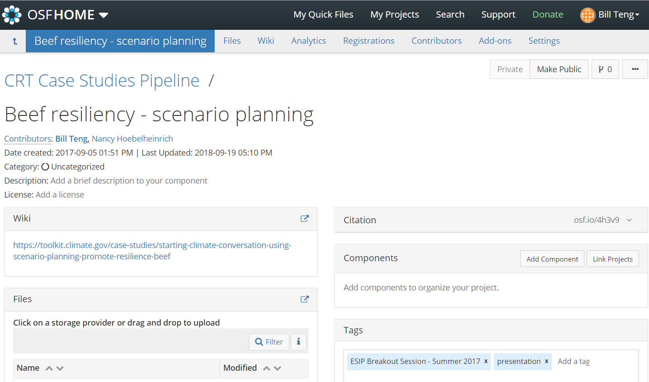
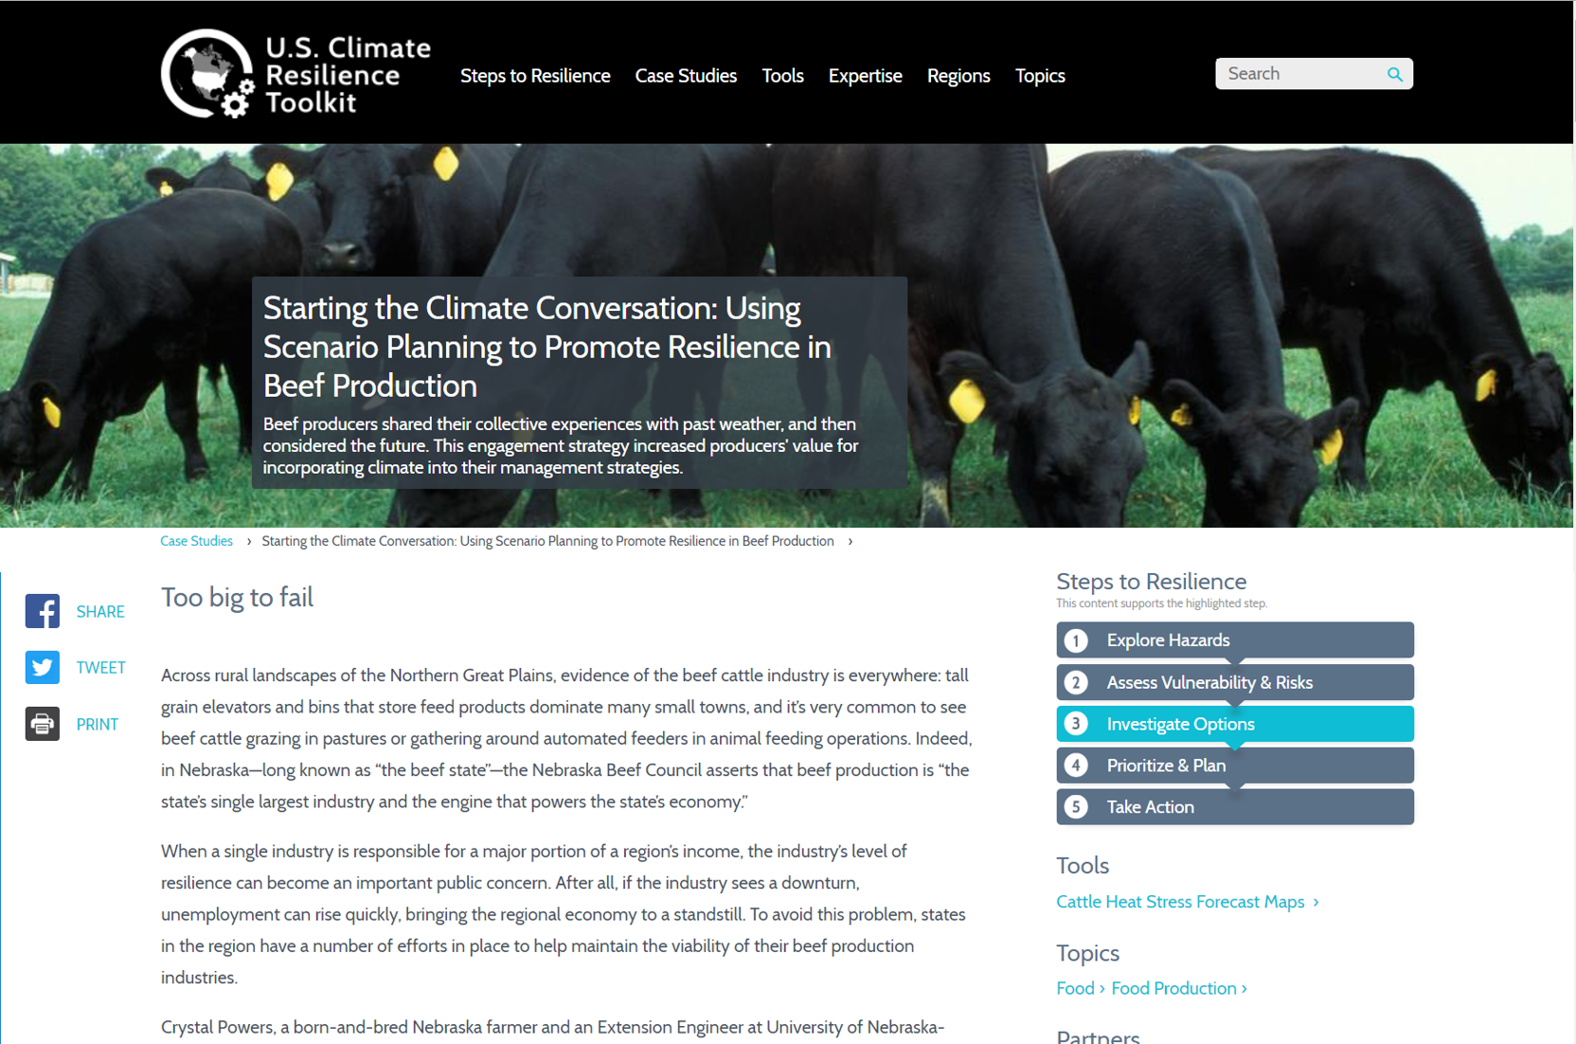
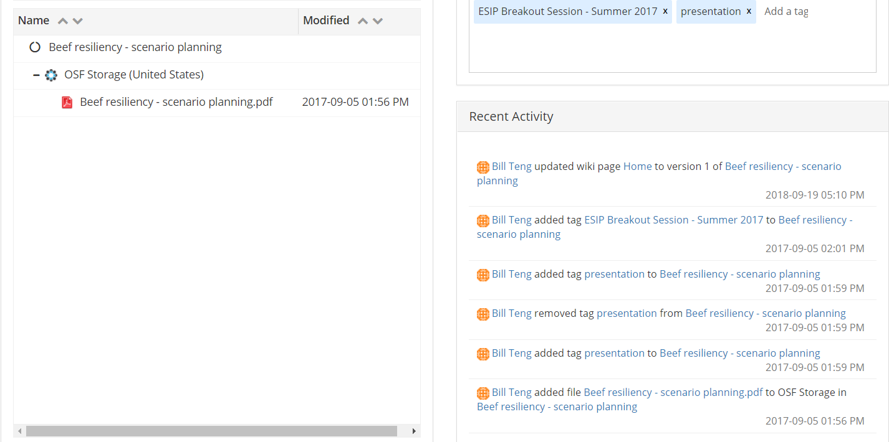
Other info
Files
Component page

Slide 31
Paraphrasing Randy Olsen via Andy Revkin:
A simple one-sentence, fill-in-the-blanks template can help you identify a story structure:
__________ and _________,
(main character) (goal)
but ______, therefore ______.
(obstacle) (solution)
Notes:
http://dotearth.blogs.nytimes.com/2015/09/16/from-south-park-to-the-space-station-randy-olson-sees-an-and-but-therefore-story-solution/?_r=0
When we hear about research, think how we will fill in these four blanks before we flesh out the story.

Slide 32
Presentations
Nancy Hoebelheinrich
Knowledge Motifs
“How can researchers promote the use of the data and/or their tools for climate resilience?”
Dr. Bill Teng
NASA
“ACC’s “Pipeline” approach for developing CRT case studies”
Dr. Richard Bernknopf
U. of New Mexico
“A Value of Information (VOI) study of the impact of Landsat on agricultural land management”
Dr. Brian Wee
Massive Connections
“Data to Decisions Provenance (d2dprovenance)”

Slide 33
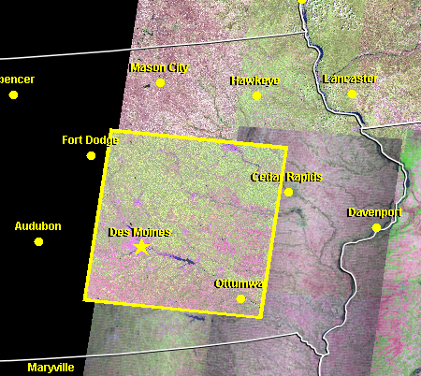
A Value of Information (VOI) study of the impact of Landsat on agricultural land management
Richard Bernknopf
email: rbern@unm.edu
Decision with EO:
Involves some level of uncertainty in scientific measurement
Value is dependent on whether the EO reduces the uncertainty in outcomes.
Decision: Regulating water pollution with Landsat.
Approach to VOI Impact Assessment:
Apply Landsat archive in a retrospective analysis to adapt agricultural production to reduce nutrient leaching into groundwater in a land use policy.

Slide 34
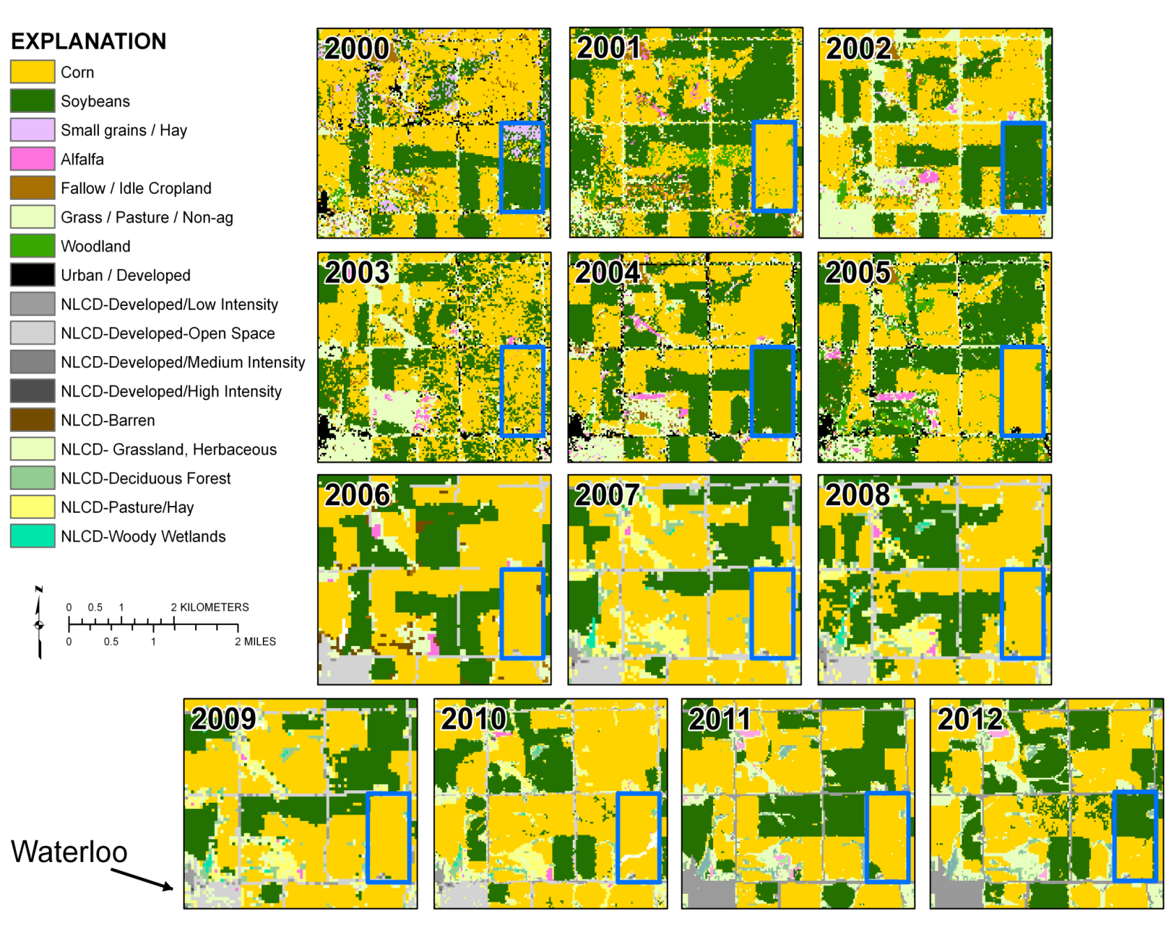
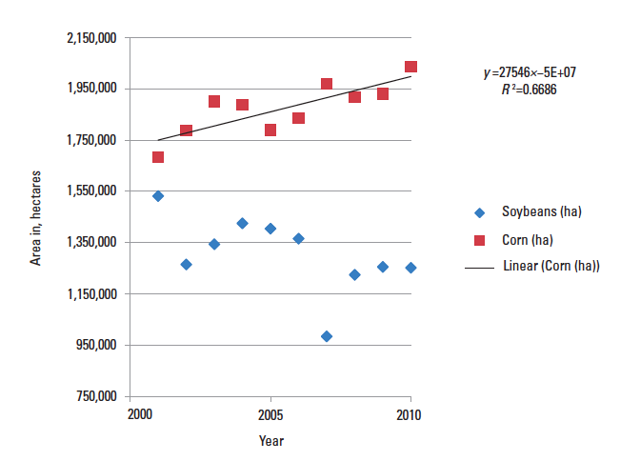
Project motivation: Unforeseen consequences that impact crop rotations and increased groundwater vulnerability
Waterloo
Iowa
Trends in corn and soybean acreage in 35-county northeastern Iowa study region, 2001-2010 (Source data: USDA NAS-CDL)
Impacts to crop rotation and groundwater quality
Notes:
Classification Standardization, changing techniques
Biofuel field

Slide 35
Objective: To measure the incremental value of EO for policy and financial decisions
VOI Impact Analysis – Expected benefits of a decision with and without Landsat for agricultural land management and regulation of groundwater contamination.
Drivers:
US Energy Policy Act 2005 and Energy Independence and Security Act 2007 – Biofuels supply requirement and subsidies.
USEPA Health Standard - Drinking water cannot exceed 10.0 mg/L for nitrate.
Nitrate reacts with other chemicals to form carcinogenic compounds.
Stakeholders:
Iowa farmers
Iowa Department of Natural Resources, EPA
Private and public drinking water providers
Cities, counties (deep wells)
Individuals (shallow wells)

Slide 36
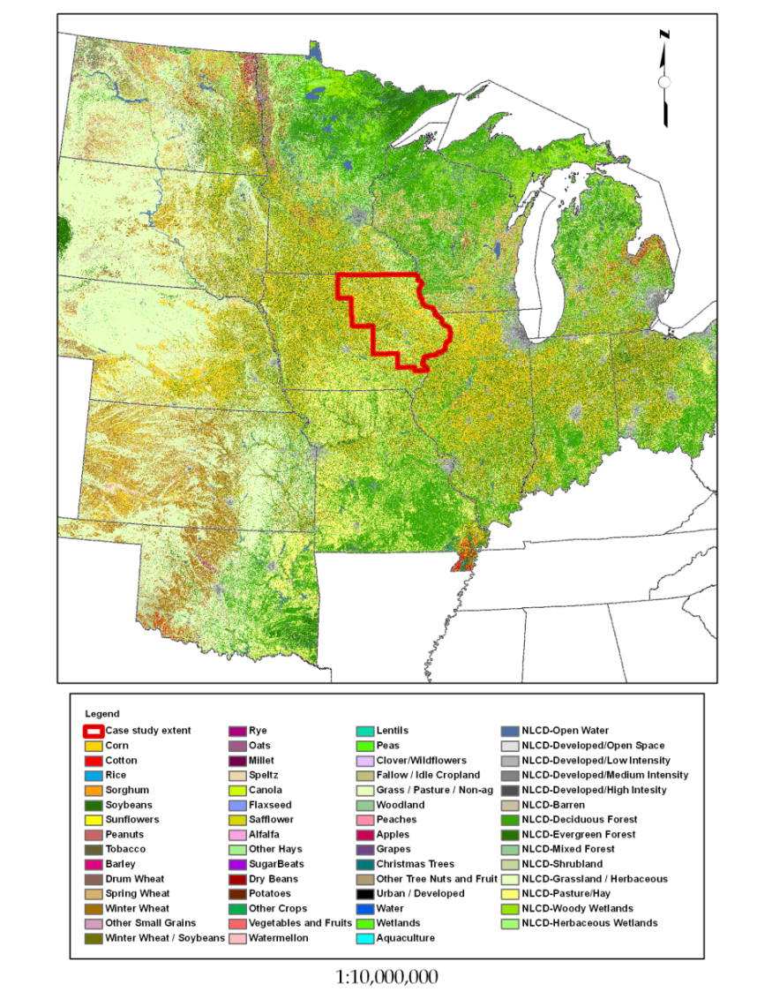
Iowa case study
5.4 million hectares in 35 counties
Corn (114 lb/acre of N) & soybean (3 lb/acre of N) are largest crops
USDA Cropland Data Layer based on MRLI provided corn & soybean production estimates for 2001 - 2010
80% of Iowa drinking water is from groundwater
32,000 wells ranging from just below the surface to 1,220 meters
603 watersheds (sub-basins) with a median of 7,910 Hydrologic Response Units (HRU). HRUs are areas within a watershed that respond similarly to given input

Slide 37
Objective: Measure the incremental economic value of Landsat in evaluating the impact of groundwater pollution based on farm activities in Iowa
Strategy:
Demonstrate how regional resource management can be improved and public health maintained by coupling EO with agricultural, geospatial, and hydrogeologic models.
Assess and target groundwater vulnerability from nitrogen application.
Couple producers and resource managers by using spatiotemporal information from markets and natural systems to aid in maximizing agricultural production and not decrease groundwater quality.
Implementation:
Use Landsat archive to link land use and groundwater pollution from nonpoint sources in a statistical survival model of nitrate accumulation.
Apply approach in a regulatory decision to evaluate the impacts of a regional land use adaptation program.

Slide 38
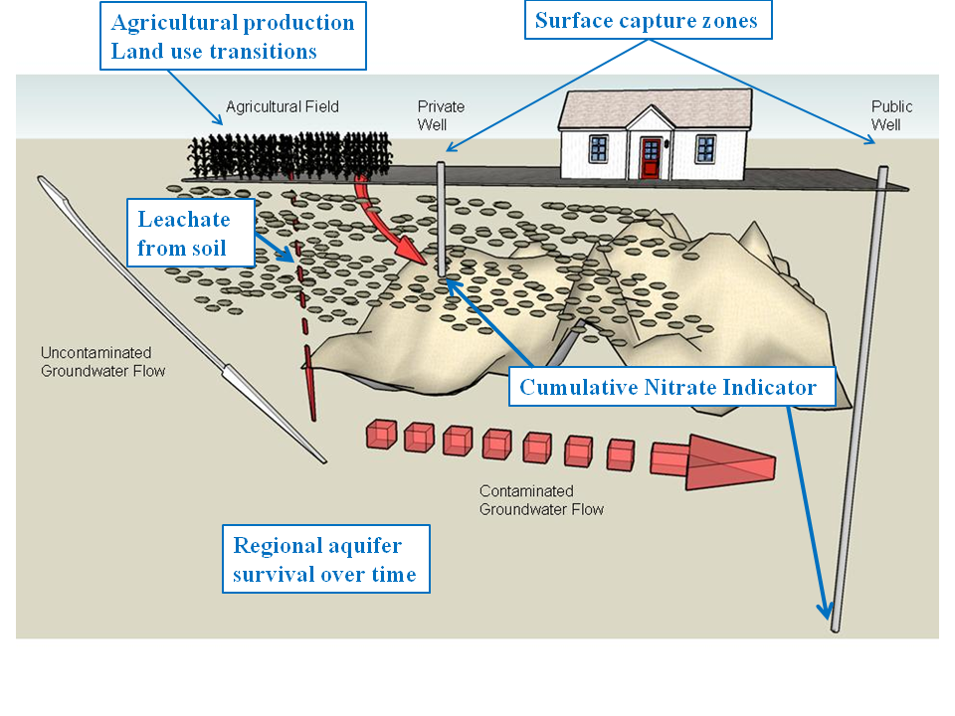
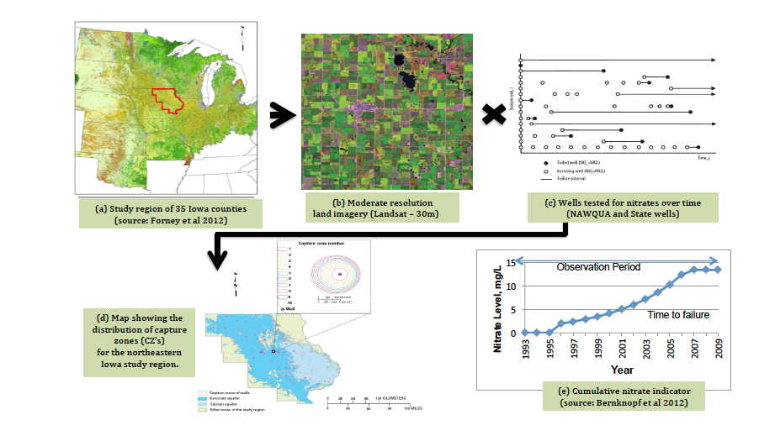
The steps to turn EO data and science into geospatial information for an environmental regulatory decision
Nitrate accumulation
Nitrate loading from fertilizer leaches through the vadose zone, is transported through stratigraphic layers, and can accumulate in and contaminate aquifers.
Transform EO into geospatial information

Slide 39
Results of retrospective case study
Estimated spatiotemporal nitrogen loading and agrochemical transport from fields to specific wells for 35 counties and 2 aquifers in Iowa.
For 2000 – 2010 - some groundwater wells are threatened by nitrate contamination and could fail to maintain drinking-water quality in the next 10 years.
Maximum estimated VOI for adaptation of land use with EO is an annualized $858M ± $197M / yr (in $2010) and net present value (NPV) of $38.1B ± $8.8B for Iowa case study; 1% of VOI achieved with EO is an annualized $43.0M / yr (in $2010) and NPV of $1.91B.

Slide 40
Audience discussion
Paraphrasing Randy Olsen via Andy Revkin:
A simple one-sentence, fill-in-the-blanks template can help you identify a story structure:
__________ and _________,
(main character) (goal)
but ______, therefore ______.
(obstacle) (solution)
Notes:
http://dotearth.blogs.nytimes.com/2015/09/16/from-south-park-to-the-space-station-randy-olson-sees-an-and-but-therefore-story-solution/?_r=0
When we hear about research, think how we will fill in these four blanks before we flesh out the story.

Slide 41
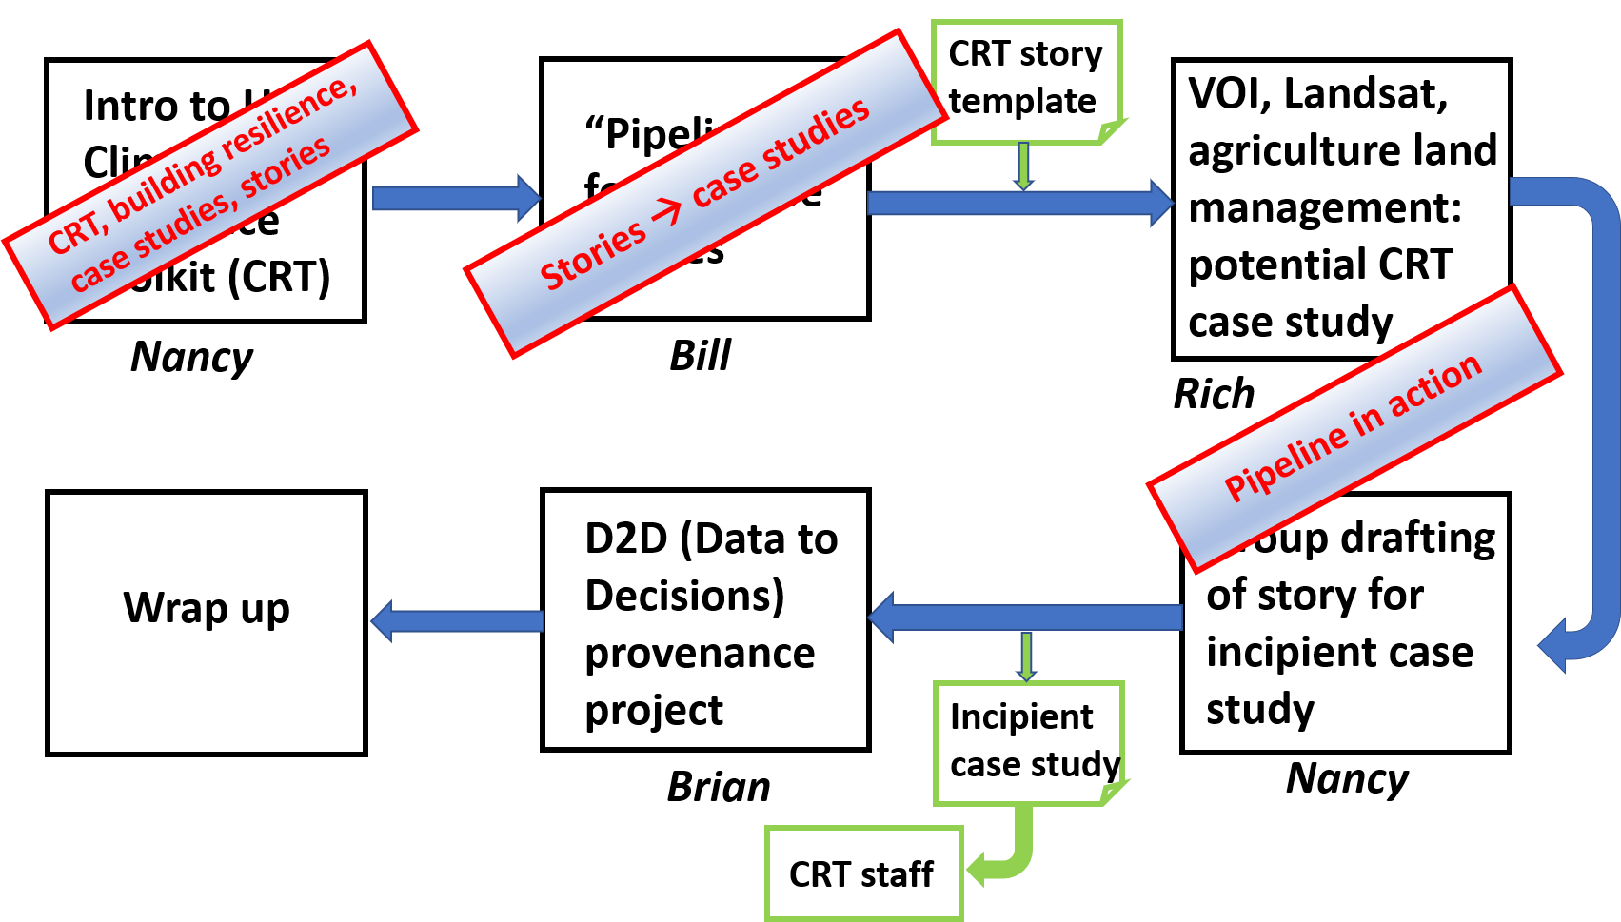
Summary

Slide 42
Presentations
Nancy Hoebelheinrich
Knowledge Motifs
“How can researchers promote the use of the data and/or their tools for climate resilience?”
Dr. Bill Teng
NASA
“ACC’s “Pipeline” approach for developing CRT case studies”
Dr. Richard Bernknopf
U. of New Mexico
“A Value of Information (VOI) study of the impact of Landsat on agricultural land management”
Dr. Brian Wee
Massive Connections
“Data to Decisions Provenance (d2dprovenance)”

Slide 43
Data to Decisions Provenance (d2dprovenance)
Brian Wee
Massive Connections
An ESIP Lab Project funded by the Federation of Earth Science Information Partners

Slide 44
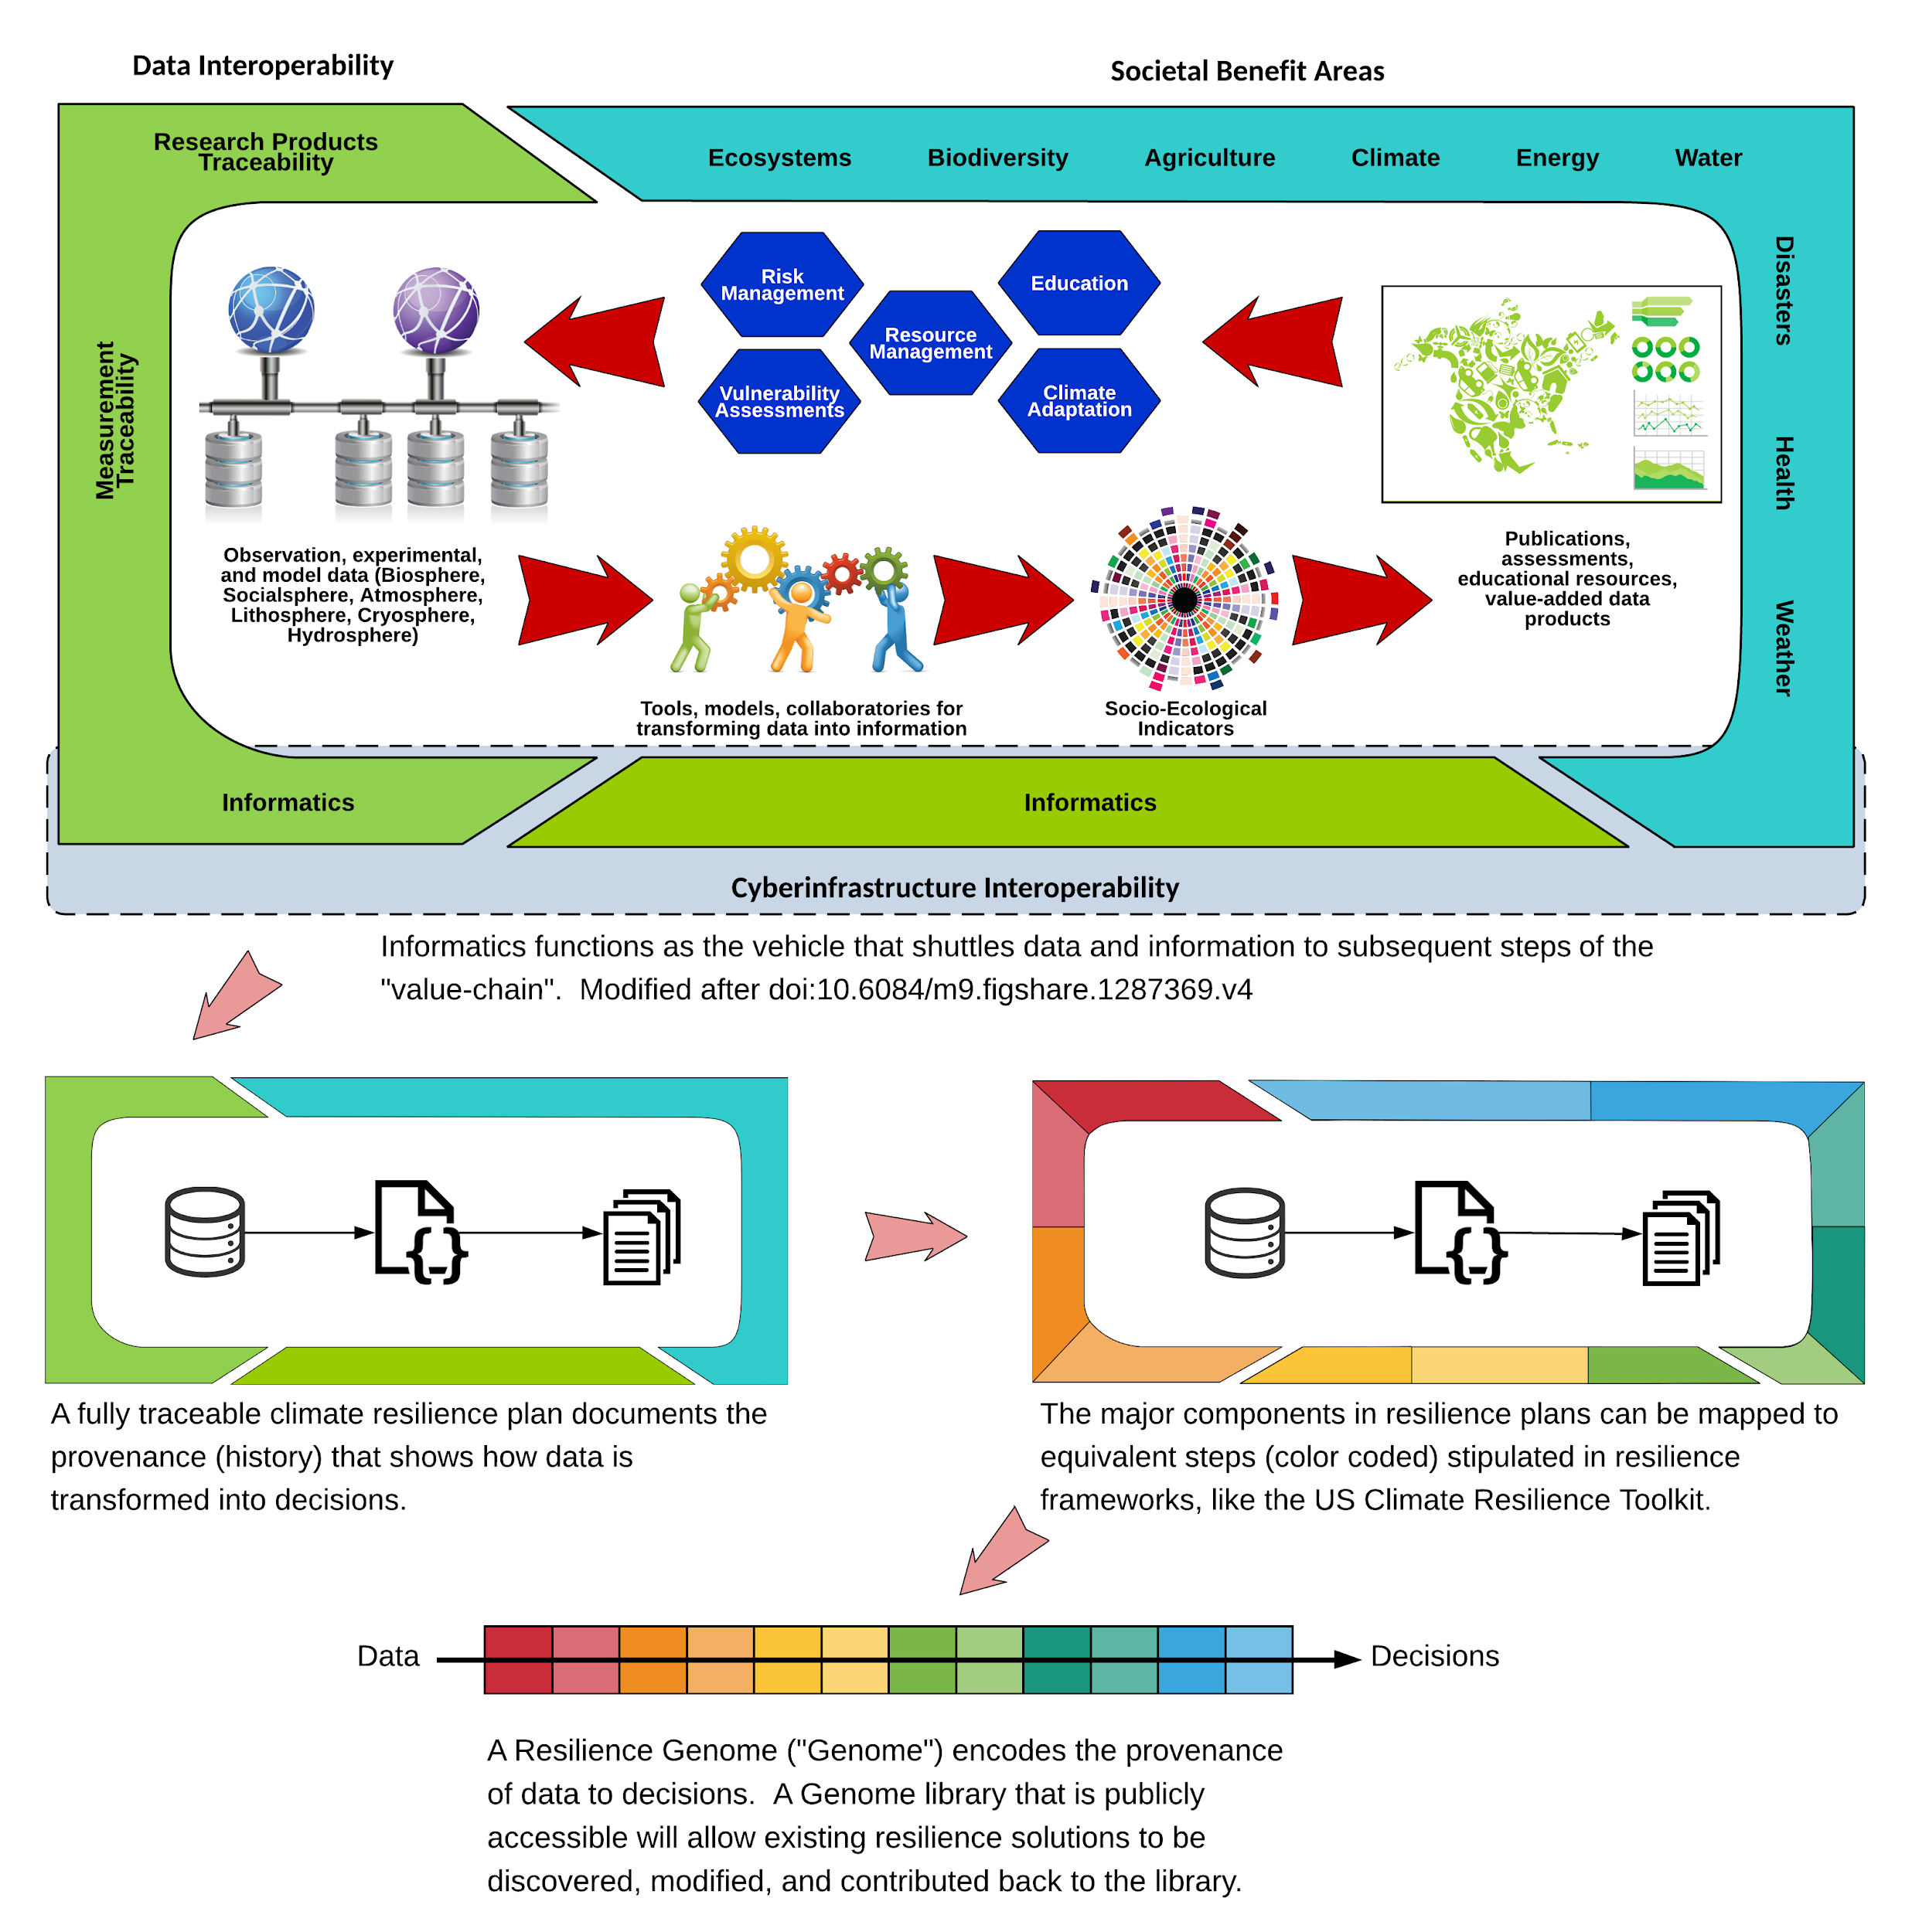
Scope of d2dprovenance

Slide 45
Contacts
Brian Wee, Massive Connections LLC, bwee@massiveconnections.com
Arif Albayrak, ADNET Systems, Inc. at NASA GES DISC, rustem.a.albayrak@nasa.gov
Nancy Hoebelheinrich, Knowledge Motifs LLC, nhoebel@kmotifs.com
Tom Narock, Assistant Professor at Notre Dame of Maryland University, tnarock@ndm.edu
William Teng, ADNET Systems, Inc. at NASA GES DISC, william.l.teng@nasa.gov

Slide 46
Final Remarks
Arika Virapongse Principal, Middle Path EcoSolutions
Webinar series coordinator, ESIP
av@middlepatheco.com
The “pipeline” of Earth science data to climate resilience and its value for real-world decision making
October 2, 2018 | Webinar #4
www.esipfed.org
@ESIPfed | #ESIPfed
ESIP is supported by
and 110+ member organizations

Slide 47
Socioeconomic Value of Data Webinar Series
Series is available on the ESIP YouTube Channel
Jun. 5
Does it Matter? The Socioeconomic Value of Earth Science Data, Information and Applications
Aug 7
The Information Pathway for Earth Science Data: Moving Between Supplier and User
Sep. 4
Measuring and assessing socioeconomic value
Oct. 2
The “pipeline” of Earth science data to climate resilience and its value for real-world decision making
Nov. 15
Managing disasters through improved data-driven decision-making
Dec. 4
TBD
Notes:
ESIP You Tube: https://www.youtube.com/channel/UCfQZ-8G7ptfbvbhii3T30OA?reload=9
Jun 5 webinar: https://docs.google.com/document/d/1BhyX-sj7FGvjI9NS2Qg_OaVxE3z1QFYcjfG-iA2mlK0/edit?usp=sharing
Aug 7 webinar: https://docs.google.com/document/d/1t8_jQvy-4vHCNSK1G2YCX5fNW1PlbslrOro3qWI6KEU/edit?usp=sharing
Sep 4 webinar: https://docs.google.com/document/d/1BByYfb-kek0tSzGyrpcdl3IHoH2MsGXm8fg5FoX6_1w/edit?usp=sharing
Oct 2 webinar: https://docs.google.com/document/d/149aeIIe06vJ4_Eh4ISEH2fnJa2AgJHzNr6lam47iQDc/edit?usp=sharing

Slide 48
Ways to stay involved
Webinar series:
Add your email to the sign-in sheet (goo.gl/YWoaXZ)
ESIP:
Join the Monday Update
Find active collaboration areas
ESIP Winter Meeting in Bethesda, MD in January, 2019
Join Agriculture & Climate Cluster calls:
Meetings (telecons) are on the first Tuesday of each month (ESIP calendar)
Meeting notes: goo.gl/9w5rua
GeoValue:
Join the GeoValue community! http://www.geovalue.org/
Kruse, J., J. Crompvoets, and F. Pearlman, editors (2017) GEOValue: The Socioeconomic Value of Geospatial Information. CRC Press/Taylor and Francis, Boca Raton, FL, USA.
Notes:
Sign in sheet: goo.gl/YWoaXZ
ESIP Monday update: http://esipfed.org/category/monday-updates
ESIP Collaboration areas: http://www.esipfed.org/get-involved/collaborate
Next ESIP meeting: http://www.esipfed.org/meetings/upcoming-meetings
Agriculture & Climate Cluster telecons: http://esipfed.org/get-involved/telecon-calendar
Agriculture & Climate Cluster telecon notes: goo.gl/9w5rua

Slide 49
Thank you!
For more information about the webinar and series, contact:
Arika Virapongse: av@middlepatheco.com

