Slide 1
NOAA/NCEI’s Approaches to
Informing Users on Uncertainty
July 20, 2018
Jeffrey L. Privette
Center for Weather and Climate
National Centers for Environmental Information
Revealing the Past, Interpreting the Present, and Informing the Future

Slide 3
Programmatic Considerations
Uncertainty provision is the right thing to do
Uncertainty analysis is typically complex and expensive
Uncertainty is often ignored by users. Very often.
Uncertainty is misunderstood by many users
Uncertainty is not an easy ‘sell’ for organizational funding
Uncertainty importance varies with data set. Use and User matters.

Slide 4
Explaining Uncertainty

Slide 5
Programmatic Considerations about Uncertainty
“Best” way to spend limited funds varies with users
Determine uncertainty, or
Improve resolution, latency, update frequency, validation, access interface, QA/QC, metadata and documentation…
Or add new features, extensions, or whole new products?
NCEI Goal: Inform trades by user community

Slide 6
NCEI’s Approach to Product Uncertainty
Target key data sets for uncertainty analyses
Importance, visibility, users and uses
Subjective decision-making
Document current uncertainty (Threshold requirement)
Document user-desired uncertainty (Objective requirement)
Be transparent about knowns and unknowns

Slide 7
Transparency and Targeted Upgrades
Documenting Uncertainty
Approach: Climate Algorithm Theoretical Basis Document
Performance and User Need: Product Requirements Sheet
Communicating to Users: Stewardship Maturity Matrix (G. Peng)

Slide 8
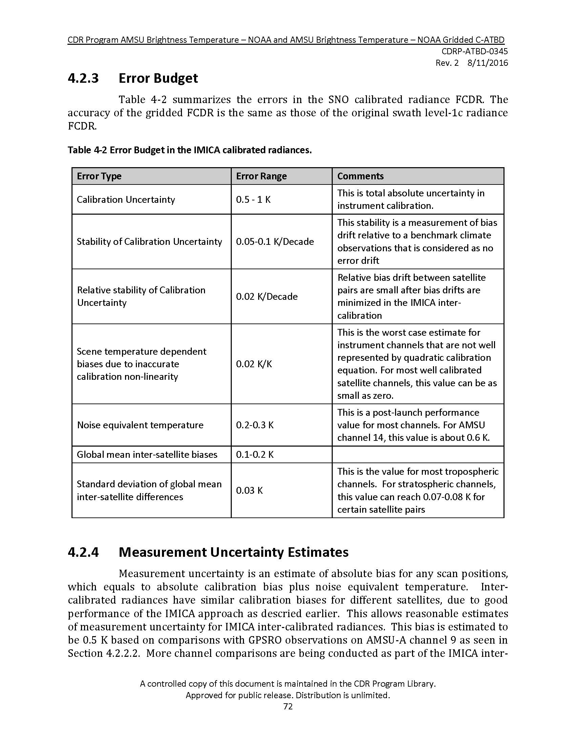
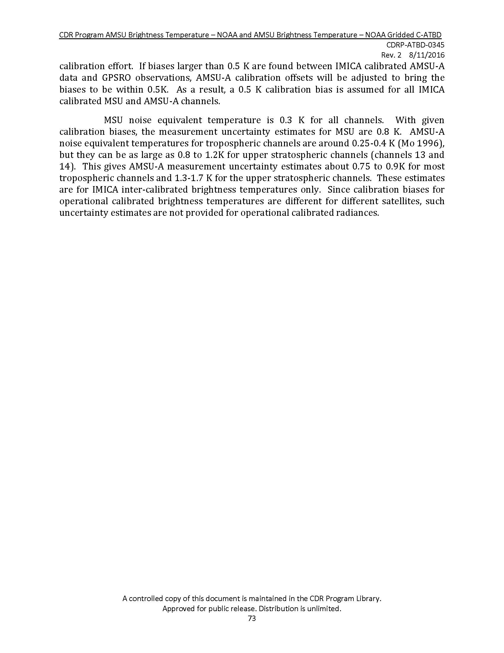
Climate Algorithm Theoretical Basis Document – Example

Slide 9
Product Requirements Sheet: Example
Notes:
NCDC Headquarters in Asheville, NC
Co-located with Air Force Weather Agency’s 14th Weather Squadron
NCDC’s Federal presence extends to:
Asheville, NC
Boulder, CO
Honolulu, HI
Silver Spring, MD and
WI, NY, TX, UT, MO, and AK
Our vision: to be the most comprehensive, accessible, and trusted source of state-of-the-art climate and historical weather data and information
Acquire and ingest data
Archive and scientific stewardship of the Nation’s meteorological data – national and international
Provide access to data, metadata (information about the data), and products
Monitor and describe the national and global climate

Slide 10
Transparency and Targeted Upgrades
Documenting Uncertainty
Approach: Climate Algorithm Theoretical Basis Document
Performance and User Need: Product Requirements Sheet
Communicating to Users: Stewardship Maturity Matrix (G. Peng)
Targeting data sets for uncertainty determination
Product Area Management (PAM) Plan
Annual product change recommendations driven by user requests

